Slide 1
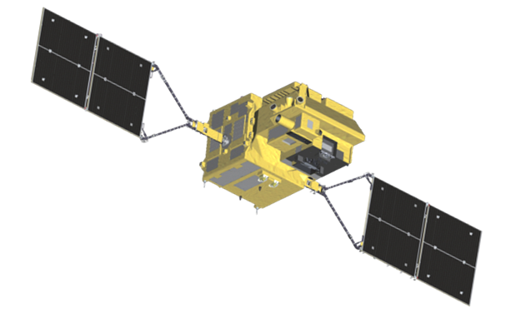
JAXA Calibration Activities of
GCOM-C/SGLI
Hiroshi Murakami and Masahiro Hori
JAXA/EORC
2016 GSICS Data & Research Working Groups Meeting
Mini Conference, 29 Feb. 2016

Slide 2
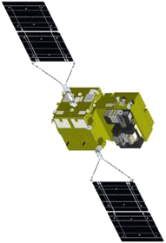
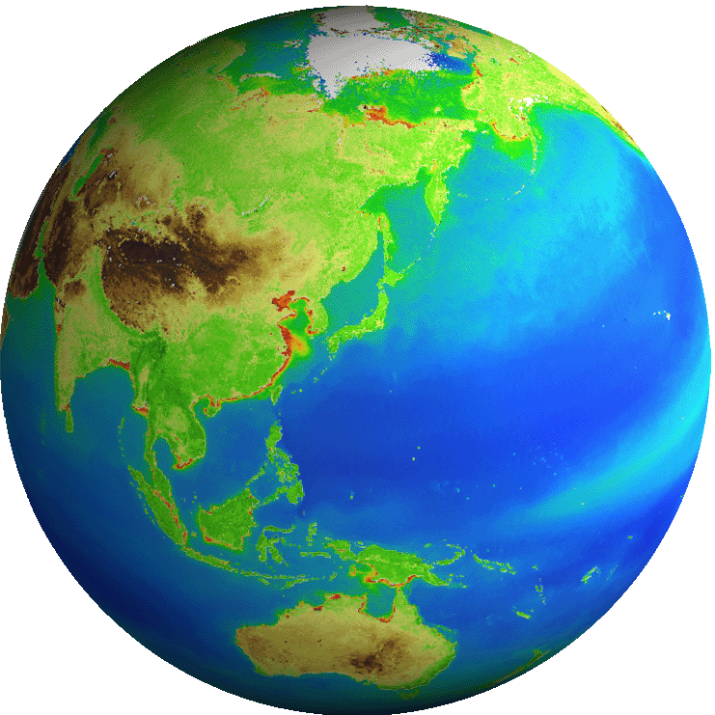

1. GCOM-C/SGLI: Mission targets
Long-term observation about radiation budget and carbon cycle
CO₂ increase and
Global warming
GCOM-C
Global/horizontal distribution of cloud and aerosol
Global environmental change
(irradiance, temperature,
CO₂, precipitation）
radiative forcing change
Global coverage
Many parameters
Long-term data
Photosynthesis production
Vegetation index
Leaf area index
Primary production
Above-ground biomass
Land cover/use
Soil respiration
Photosynthesis production
Phytoplankton chl-a
Sea surface temperature
PAR
Dissolved organic matter
CO₂ solution, pH
Sedimentation
Cloud
Land
Ocean
EarthCARE/CPR
3-D structure of
cloud and aerosol
Feedback
Aerosol
Monitoring and process knowledge of
cloud and aerosol by GCOM-C & EarthCARE
Ecosystem
CO₂ sink and pool
Evaluation of model outputs and process parameterization
Change of atmosphere CO₂
JFY 2016
GCOM-C
GCOM-C2
Launch
GCOM-C3
5 years
~13 years

Slide 3
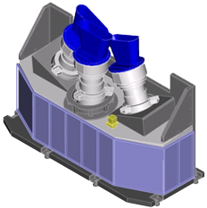
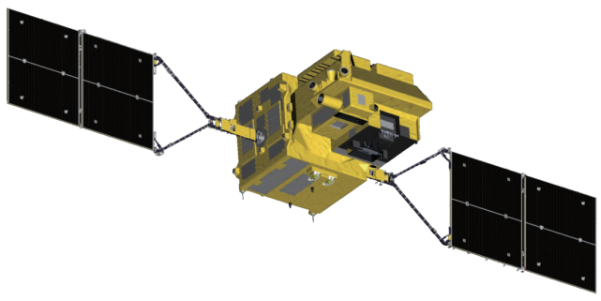
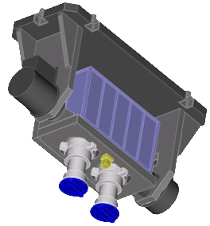
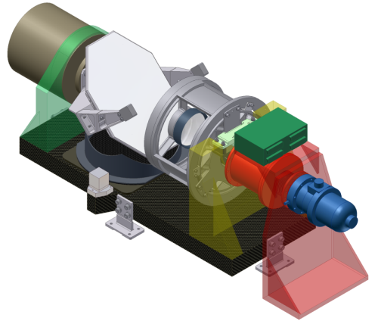
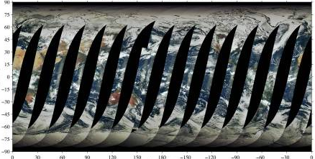
1. GCOM-C/SGLI: Satellite/Sensor system
Earth
Total FOV: 70deg
= 24deg × 3 telescopes
(~1150km@nadir)
Solar diffuser
VNR-NP
Non-polarization tree telescopes
Each has the same 11 channels
Orbit
Orbit
Earth direction
Visible and Near-infrared Radiometer
(SGLI-VNR)
GCOM-C
satellite
VNR-POL
Polarization two (670nm and 865nm) telescopes
Each has tree polarization-angle filters
FOV: 55deg
(~1150km@±45deg along-track slant)
approx. 1.3m
approx. 1.7m
InfraRed Scanner
(SGLI-IRS)
Solar calibration window
Internal lamp (PD)
±45deg
Earth
±45deg along-track slant observation
Earth view
window
FOV: 80-deg
Orbit
Earth
Orbit
SWIR detector
mechanical cooler
Scan mortar
Deep space
window
approx. 1.4m
Black body
approx. 0.6m
Optical bench
GCOM-C SGLI characteristics
Orbit | Sun-synchronous (descending local time: 10:30), Altitude: 798km, Inclination: 98.6deg
Launch Date | JFY 2016
Mission Life | 5 years (3 satellites; total 13 years)
Scan | Push-broom electric scan (VNR: VN & P) Wisk-broom mechanical scan (IRS: SW & T)
Scan width | 1150km cross track (VNR: VN & P) 1400km cross track (IRS: SW & T)
Spatial resolution | 250m, 500m, 1km
Polarization | 3 polarization angles for POL
Along track tilt | Nadir for VN, SW and TIR, & +/-45 deg for P
TIR detectors
SGLI/VNR daily coverage
Notes:
The Second-generation Global Imager (SGLI) on the Global Change Observation Mission -Climate (GCOM-C) is a multi-band optical imaging radiometer in the wavelength range from 380nm to 12000nm.
It consists of two main components, the Visible and Near Infrared Radiometer (SGLI VNR) and the Infrared Scanning Radiometer (SGLI IRS).

Slide 4
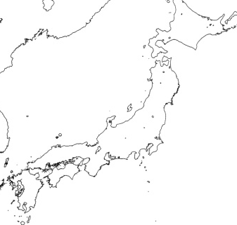
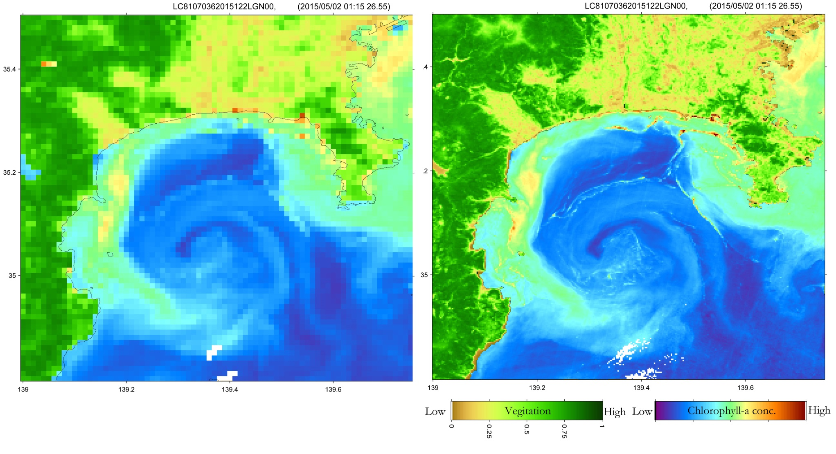
1. GCOM-C/SGLI:
SGLI 250m Visible-SWIR observation
250m resolution to detect finer structure in the coastal area such as river outflow, regional blooms, small current, and redtide
1-km resolution
250-m resolution
Redtide
1km
250m
(a) 250m Sagami-Bay (2 May 2015, CHL by LCI)
250m SGLI products simulated by Landsat image on 2 May 2015
(b) 1km Sagami-Bay (2 May 2015, CHL by LCI)

Slide 5

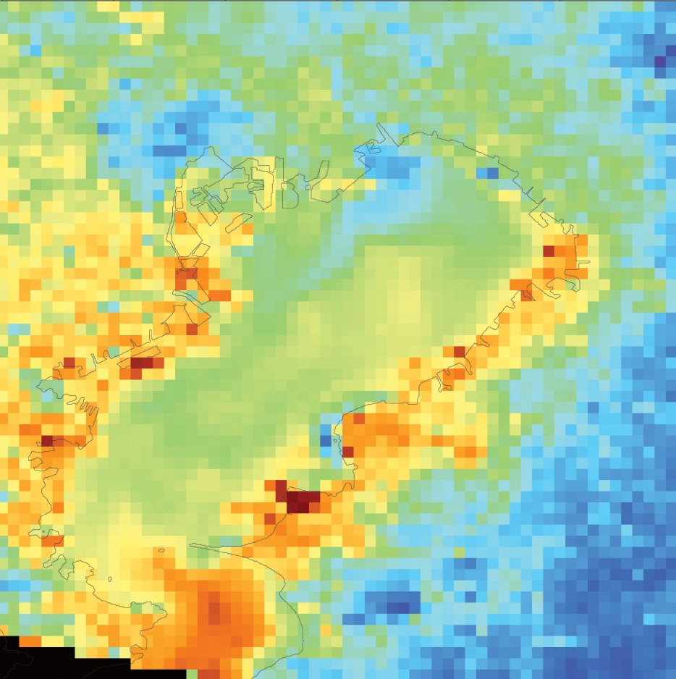
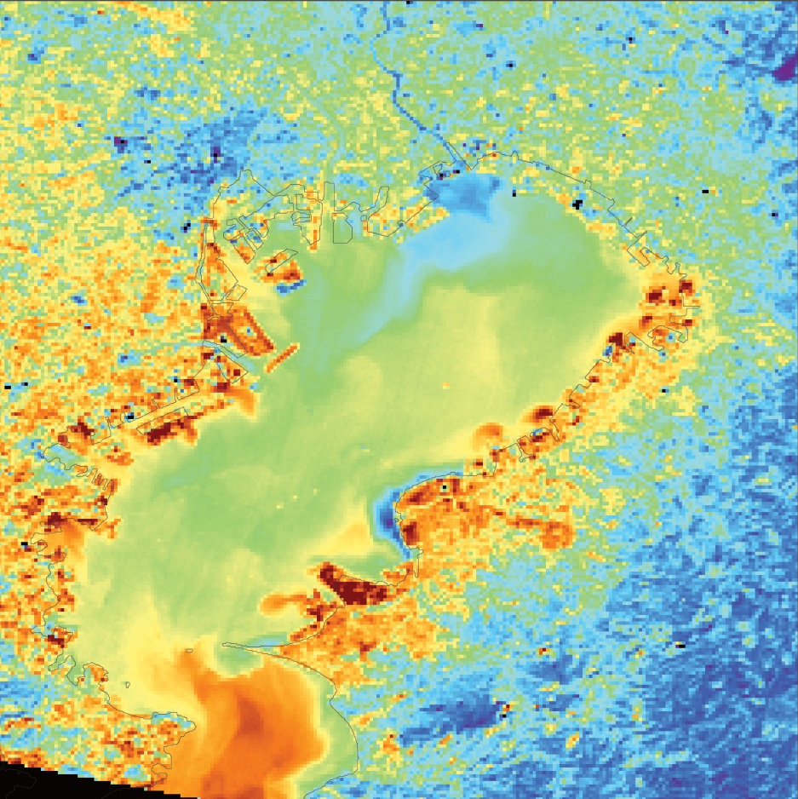
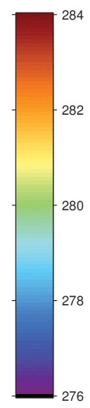
1. GCOM-C/SGLI:
SGLI 250m Thermal infrared observations
Simulated by LANDSAT-8/TIRS 11μm 100m data on 23 Jan. 2014
1-km resolution
250-m resolution
Arakawa Riv.
Edogawa Riv.
Tama Riv.
Obitsu Riv.
Kelvin

Slide 6
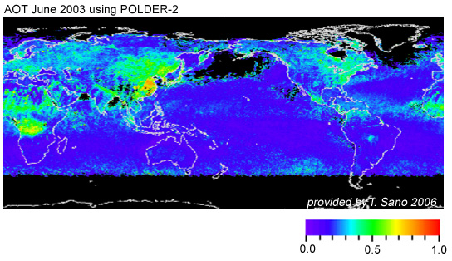





1. GCOM-C/SGLI:
SGLI slant-view polarization observation
Satellite direction
Polarization filter
0°/60°/120°
865nm
670nm
Along track slant obs
±45deg
Aerosol optical thickness
FOV=55deg(±27.5deg)
Global aerosol optical thickness in June 2003 using POLDER-2 polarization reflectance (provided by T. Sano, Kinki Univ.)
~1150km @ 45° slant view
Orbit direction
~2min
Along-track ±45deg modes will be planned for polarization observation of the atmospheric scattering
45deg
45deg

Slide 7

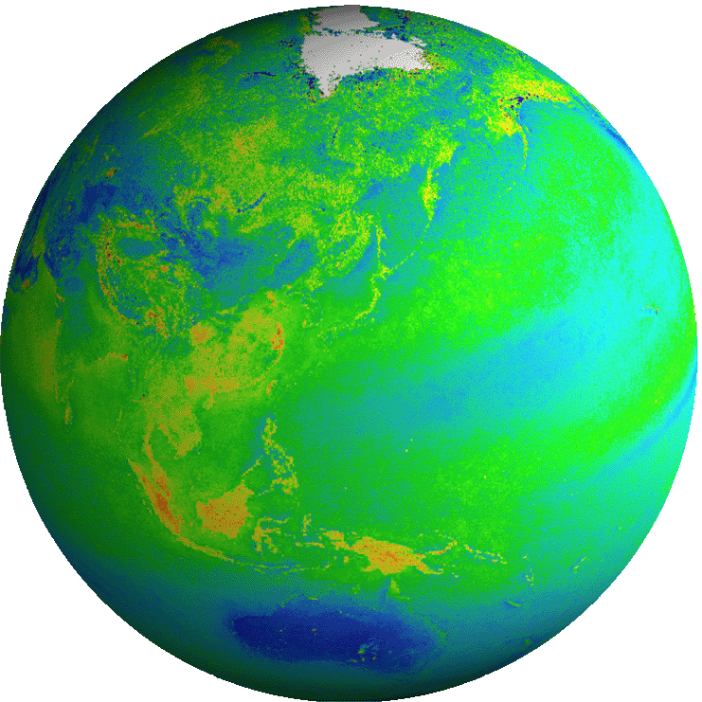
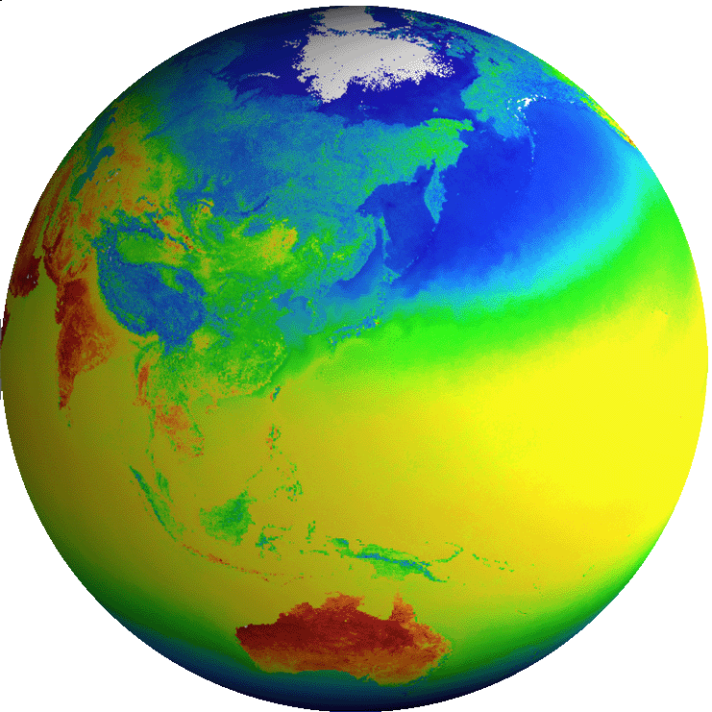

1. GCOM-C/SGLI: GCOM-C Observation Products
All standard products (L1, L2, L3) will be distributed by the internet (released to the public one year after the launch)
Free for both science and commercial purposes
Common
Radiance | TOA radiance (including system geometric correction)
Land
Surface reflectance | Precise geometric correction
 | Atmospheric corrected reflectance
Vegetation and carbon cycle | Vegetation index
 | Above-ground biomass
 | Vegetation roughness index
 | Shadow index
 | Fraction of Absorbed Photosynthetically available radiation
 | Leaf area index
Temp. | Surface temperature
Application | Land net primary production
 | Water stress trend
 | Fire detection index
 | Land cover type
 | Land surface albedo
Atmosphere
Cloud | Cloud flag/Classification
 | Classified cloud fraction
 | Cloud top temp/height
 | Water cloud optical thickness /effective radius
 | Ice cloud optical thickness
 | Water cloud geometrical thickness
Aerosol | Aerosol over the ocean
 | Land aerosol by near ultra violet
 | Aerosol by Polarization
Radiation budget | Long-wave radiation flux
 | Short-wave radiation flux
Ocean
Ocean color | Normalized water leaving radiance
 | Atmospheric correction parameter
 | Photosynthetically available radiation
 | Euphotic zone depth
In-water | Chlorophyll-a conc.
 | Suspended solid conc.
 | Colored dissolved organic matter
In-water | Inherent optical properties
Temp. | Sea surface temp.
Application | Ocean net primary productivity
 | Phytoplankton functional type
 | Redtide
 | multi sensor merged ocean color
 | multi sensor merged SST
Cryosphere
distribution | Snow and Ice covered area
 | Okhotsk sea-ice distribution
 | Snow and ice classification
 | Snow covered area in forest and mountain
Surface properties | Snow and ice surface Temperature
 | Snow grain size of shallow layer
 | Snow grain size of subsurface layer
 | Snow grain size of top layer
 | Snow and ice albedo
 | Snow impurity
 | Ice sheet surface roughness
Boundary | Ice sheet boundary monitoring
ECV
ECV
ECV
ECV
ECV
ECV
ECV
ECV
ECV
ECV
ECV
ECV
ECV
Blue: standard products
Red: research products
ECV

Slide 8
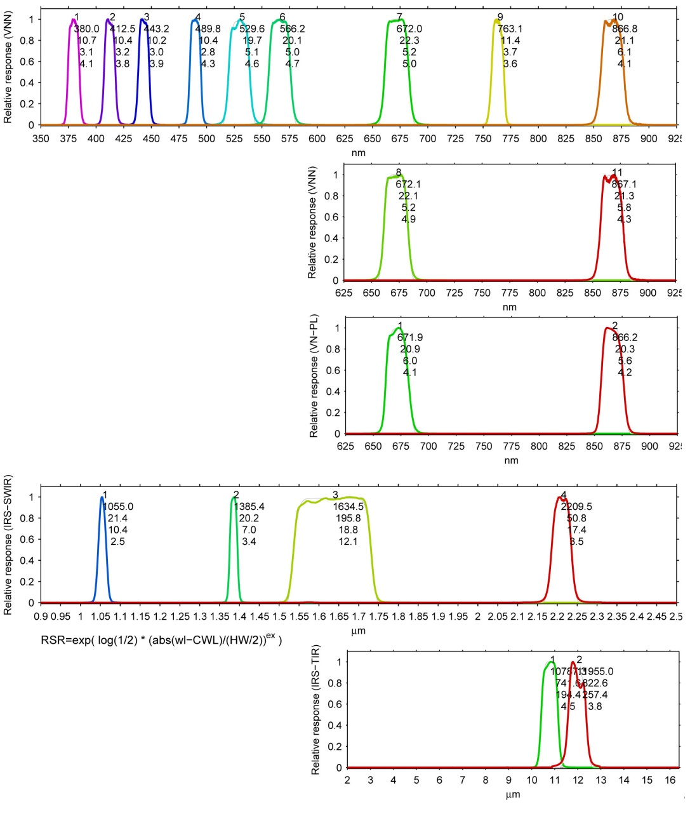
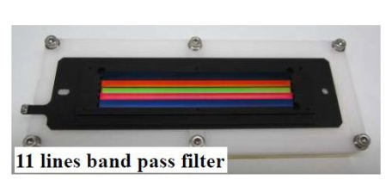
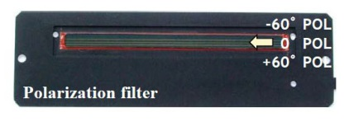
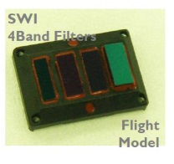
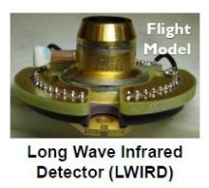
2. GCOM-C/SGLI development: Spectral bands
Characteristics of SGLI spectral bands
CH | λ | Δλ | L_{std} | L_{max} | SNR@L_{std} | IFOV
 | nm |  | W/m²/sr/μm K: Kelvin |  | - K: NEΔT | m
VN1 | 380 | 10 | 60 | 210 | 250 | 250 /1000
VN2 | 412 | 10 | 75 | 250 | 400 | 250 /1000
VN3 | 443 | 10 | 64 | 400 | 300 | 250 /1000
VN4 | 490 | 10 | 53 | 120 | 400 | 250 /1000
VN5 | 530 | 20 | 41 | 350 | 250 | 250 /1000
VN6 | 565 | 20 | 33 | 90 | 400 | 250 /1000
VN7 | 673.5 | 20 | 23 | 62 | 400 | 250 /1000
VN8 | 673.5 | 20 | 25 | 210 | 250 | 250 /1000
VN9 | 763 | 12 | 40 | 350 | 1200* | 250 /1000*
VN10 | 868.5 | 20 | 8 | 30 | 400 | 250 /1000
VN11 | 868.5 | 20 | 30 | 300 | 200 | 250 /1000
POL1 | 673.5 | 20 | 25 | 250 | 250 | 1000
POL2 | 868.5 | 20 | 30 | 300 | 250 | 1000
SW1 | 1050 | 20 | 57 | 248 | 500 | 1000
SW2 | 1380 | 20 | 8 | 103 | 150 | 1000
SW3 | 1630 | 200 | 3 | 50 | 57 | 250 /1000
SW4 | 2210 | 50 | 1.9 | 20 | 211 | 1000
TIR1 | 10800 | 700 | 300K | 340K | 0.2K | 250/500/1000
TIR2 | 12000 | 700 | 300K | 340K | 0.2K | 250/500/1000
VNR-NP
high-gain bands
VNR-POL
POL bands
Multi-angle obs. for 674nm and 869nm
SGLI-IRS
Uchikawa, T., K. Tanaka, Y. Okamura, S. Tsuida, and T. Amano, "Proto Flight Model (PFM) performance and development status of Cisible and Near Infrared Radiometer (VNR) on the Second-generation Global Imager (SGLI)", SPIE Asia-Pacific Remote sensing, Beijing, China, 9264-27, 2014.
Tanaka, K., Y. Okamura, T. Amano, T. Hosokawa, and T. Uchikita, "The development status of Second Generation Global Imager Infrared Scanning Radiometer (SGLI-IRS)", SPIE Asia-Pacific Remote sensing, Beijing, China, 9264-15, October, 2014.

Slide 9
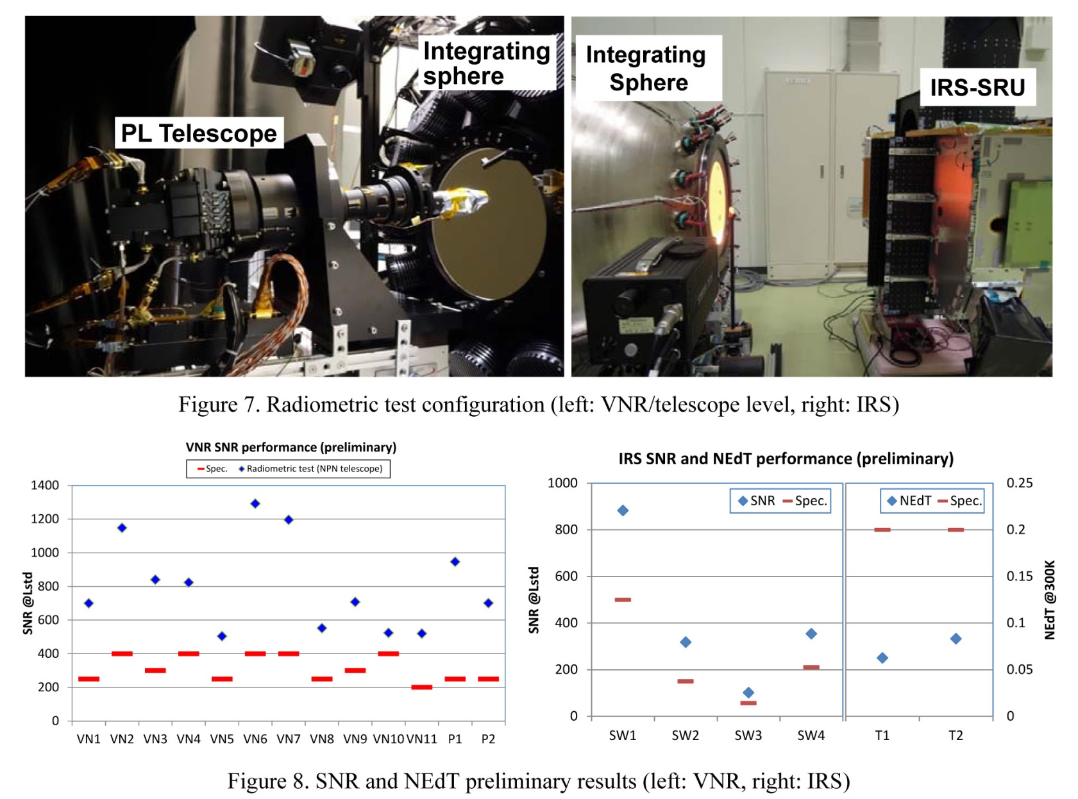
2. GCOM-C/SGLI development: Radiometric tests
Results
high SNR is better
specification
low NEdT is better
Yoshihiko Okamura ; Kazuhiro Tanaka ; Takahiro Amano ; Koichi Shiratama and Tamiki Hosokawa, " Development and pre-launch test status of Second Generation Global Imager (SGLI) ", Proc. SPIE 9639, Sensors, Systems, and Next-Generation Satellites XIX, 96390I (October 12, 2015); doi:10.1117/12.2193387

Slide 10
3. SGLI calibration: raiometric calibration system
Ground characterization
onboard
blackbody
SST
buoy SST
standard blackbody
radiometer
SGLI TIR
LST
in-situ radiometer
radiometer
internal lamp
NIST
AIST
launch shift
solar irradiance
2%
Solar spectrum
radiometer
diffuser BRDF
Onboard calibration
1%
<2%
longtime change
GIRO
(GSICS/ROLO)
fixed-point
blackbody furnace
integration
sphere
SGLI VN/SWR
Moon
Vicarious calibration
once/month
at the same phase angle
in-situ
radiometers
Ocean
Desert
Snow
Cloud
Cross calibration
Other satellite sensors
Post-launch Level-1 calibration will be based on the onboard calibration
Vicarious calibration will be used for
  confirmation of the onboard calibration,
  more accurate calibration (adjustment) required for the L2 algorithms

Slide 11

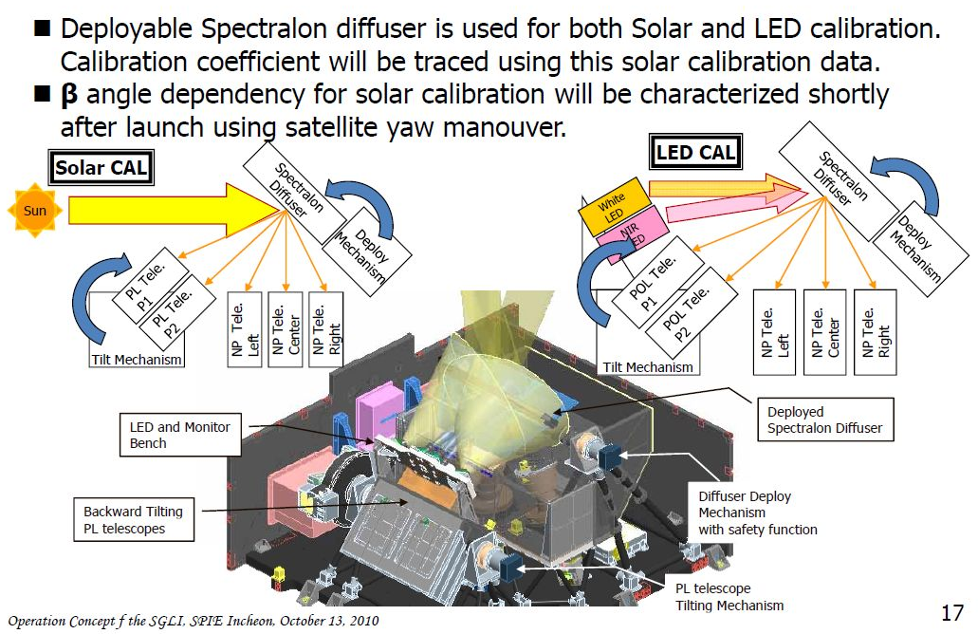
3. SGLI calibration: VNR onboard calibration
SGLI Operation Concept (SPIE, Incheon, Oct. 13, 2010)

Slide 12
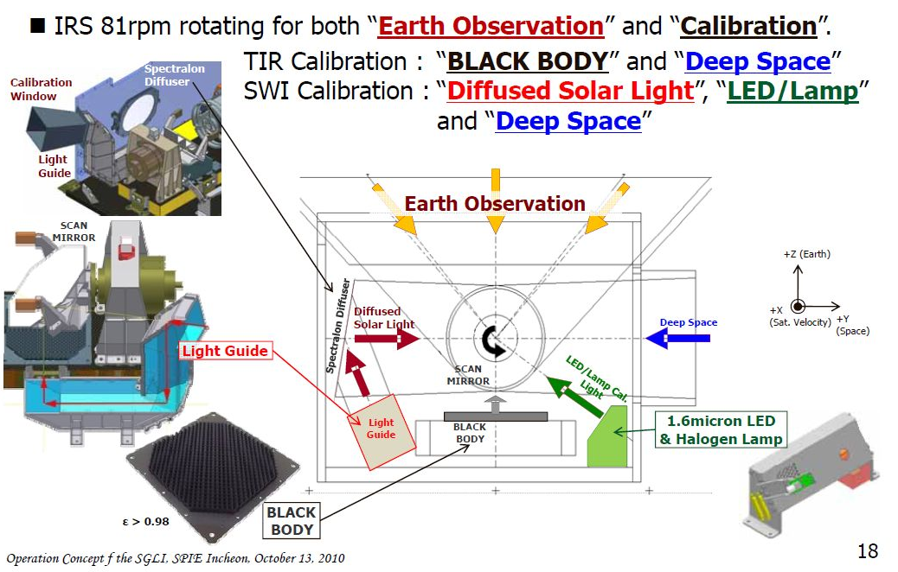
3. SGLI calibration: IRS onboard calibration
SGLI Operation Concept (SPIE, Incheon, Oct. 13, 2010)

Slide 13
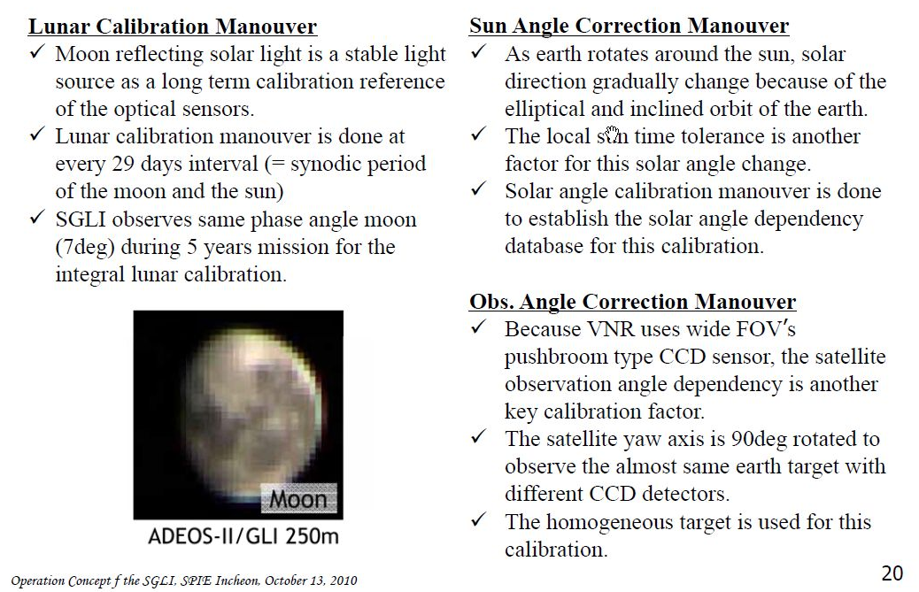
3. SGLI calibration: Calibration Maneuver
SGLI Operation Concept (SPIE, Incheon, Oct. 13, 2010)

Slide 14
4. Vicarious/cross calibration
Forward calculation from surface measurements by Radiative Transfer model: SST, land/snow surface reflectance, Ocean color..
Iteration from satellite radiance by modifying correction coefficients: Land surface temperature, Ocean Color..
In-situ aerosol or reference sensor/band ρ_{TOA}
SGLI ρ_{TOA}
Ancillary (Pres, O₃, H₂O, WS)
RT or LUT by RT with RSR
ρ_{r}, ρ_{g} , ρ_{a}(τ, Model), t_{g}, t₀, t₁, T₀, T₁, S_{a}
Corrected ρ_{TOA}
g_{vc}
Inversion algorithm
T₀T₁ × ρ_{s}^{BRF}
1 − S_{a} × ρ_{s}
ρ_{TOA} /t_{g} ≅ ρ_{r} + t₀t₁ ρ_{g} + ρ_{a} +
Product
Simulated ρ_{TOA}
In-situ or reference BRDF ρ _{s}^{BRF}
g_{vc}
In-situ or other satellite product
SGLI ρ_{TOA}
(A) Forward
(B) Iteration

Slide 15
4. Vicarious/cross calibration: products and methods
Target product | Vicarious calibration method
Ocean color and aerosol | (A & B) MOBY and BOUSSOLE (A & B) Aeronet-OC (confirmation) (A & B) Rrs ship measurements (confirmation)
Ocean color and aerosol (geometrical and FOV dependency) | (A) Other satellite Rrs
Sea surface temperature (SST) | NOAA iQuam data base +RT (A) AIRS, IASI + RT
Land-Surface Temperature (LST) | (B) LST measurements (desert sits) and iteration with LST algorithm
Snow properties | (A) Snow in-situ albedo (by PIs) + RT
Land vegetation products | (A) 500m-scale vegetation sites +RT
Ocean color, aerosol, and cloud (inter band) | (A) Sunglint in the offshore (+ multi-angle)
Ocean color and aerosol (Cross calibration, stability) | (A) Cross calibration over offshore ocean with Rayleigh scattering
land, snow, and cloud (Cross calibration, stability) | (A) Cross calibration over desert, snow sites, and high water cloud

Slide 16
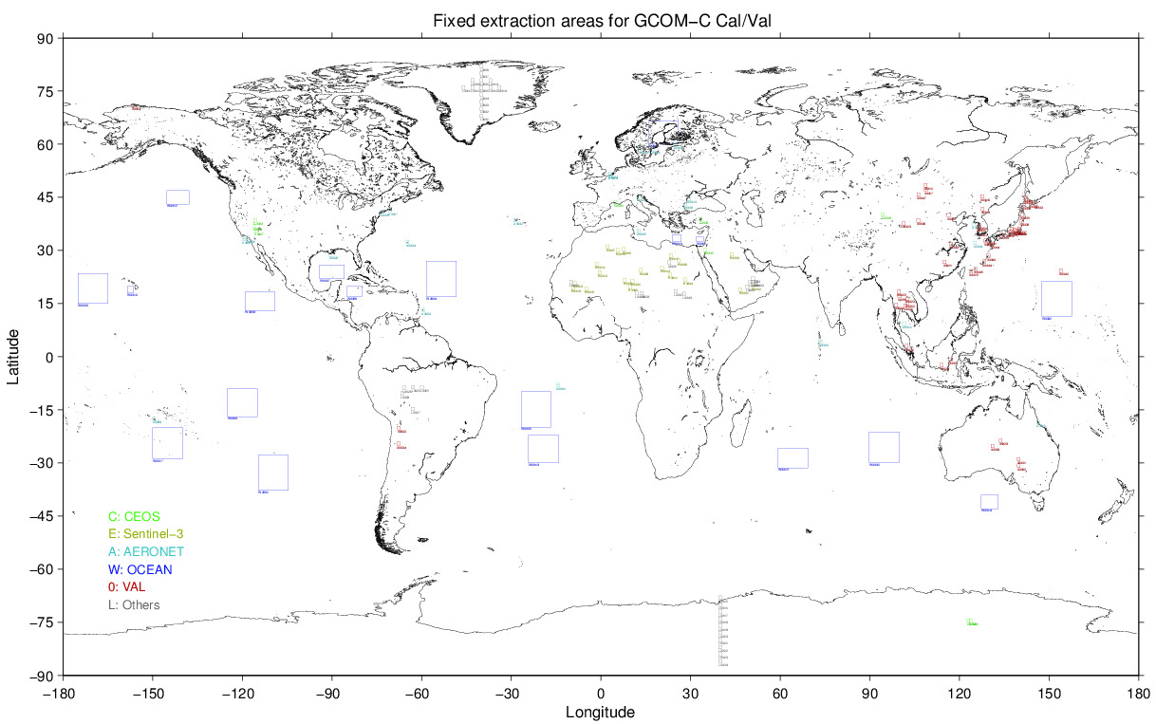
4. Vicarious/cross calibration: Fixed Area Extraction
Equal lat-lon grid from GCOM-C L_{TOA} tile data (250m and/or 1km resolution)
1deg x 1deg area (wide areas for the ocean stable areas)
Site locations (TBD): CEOS sites, other Sentinel-3 sites, and some val sites in the Asia-Pacific
Sites can be changed by modify list file: lut/cvsites.list
Format: HDF5 (TBD)

Slide 17
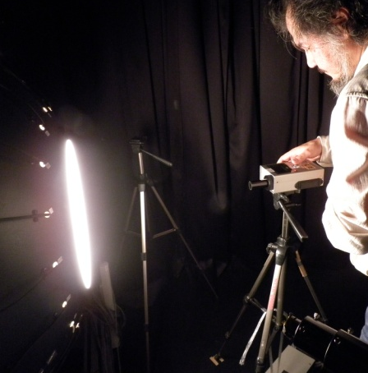
5. Calibration of in-situ instruments
JAXA/GCOM-C science team has prepared some in-situ observation instruments for the satellite algorithm development and validation
e.g., Skyradiometer (POM-02), MS700 spectroradiometer (irradiance), Microtops-II sunphotometer, FieldSpec spectroradiometer, TriOS spectroradiometer (ocean), multi-band profiling radiometer (PRR2600, C-OPS), ocean optical backscatter sensor (HydroScat-6P), etc.
Sensor vendor calibration
  Support and schedule yearly calibration
Radiance and wavelength of some sensors are calibrated by integration spheres and calibration lamps in JAXA (about twice per month)
  wide angle radiometers need special consideration
In-situ radiometer calibration by JAXA integration sphere (MS-720, Dr. Kajiwara, Chiba Univ.)

Slide 18
6. Summary
The mission targets of GCOM-C are contribution to the climate system researches, the carbon cycle and the radiative forcing.
  It has 250-m resolution and along-track slant-view polarization observation
  Stable calibration: on-board diffuser with monthly moon observation
GCOM-C/SGLI will be launched in Japanese Fiscal Year 2016.
Proto-flight tests of GCOM-C satellite-system are on-going in JAXA Tsukuba Space Center
  The radiometric tests (SNR, dynamic range, linearity, gain stability, etc.) are carried out using integrating spheres
  Preliminary results of SNR meet the specification with some margin
Post-launch calibration of SGLI will be conducted by using on-board diffusers supported by lamp, moon and vicarious/cross calibration (e.g., cross calibration with AHI and through AHI)
In-situ instrument calibration is comfirmed by JAXA integration spheres

