Slide 1



Calibration Activities of
GOSAT and GOSAT-2
GSICS Meeting 2016
TKSC, Tsukuba, Japan
February 29, 2016
Kei Shiomi
Japan Aerospace Exploration Agency
shiomi.kei@jaxa.jp

Slide 2
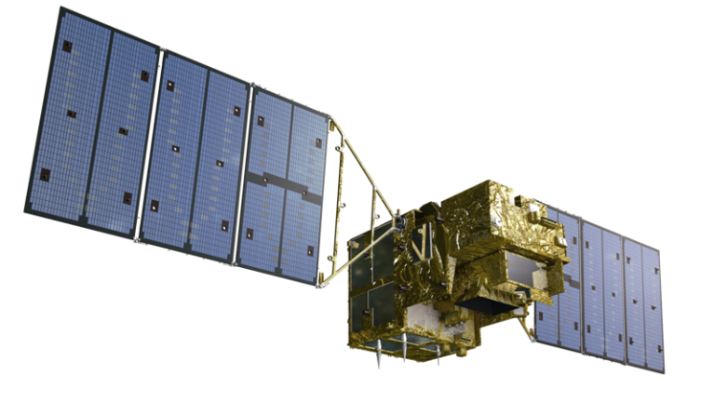
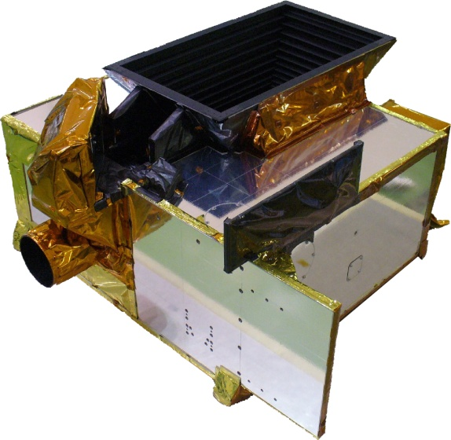
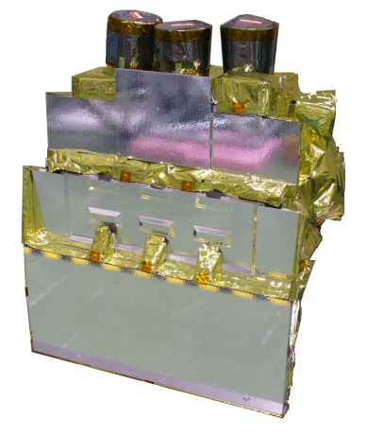
GOSAT TANSO-FTS and CAI
GOSAT on orbit since 2009
Fourier Transform Spectrometer (FTS)
Mission | GHGs measurements
Band | SWIR-0.76µm, 1.6µm, 2.0µm bands with P/S polarization (O₂-A, CO₂, CH₄, H₂O band)
 | TIR-5.5~14.3µm (CO₂, CH₄, O₃ band)
SPC Res. | 0.2cm⁻¹
Swath | 750km(3 points every 260km)
IFOV | 10.5km
666km altitude
3 days revisit
Thermal And Near infrared Sensor for carbon Observation (TANSO)
Cloud and Aerosol Imager (CAI)
Mission | Cloud detection and aerosol correction within FTS IFOV
Band | Nadir view 0.38, 0.67, 0.87, 1.60µm band
Swath | 750-1000km
Footprint | 0.5 and 1.5km
Fourier Transform Spectrometer (FTS)
Cloud and Aerosol Imager (CAI)

Slide 3
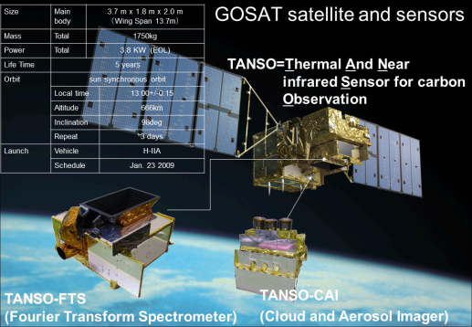
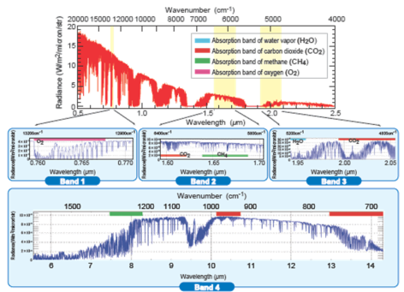
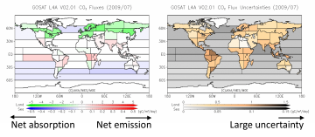


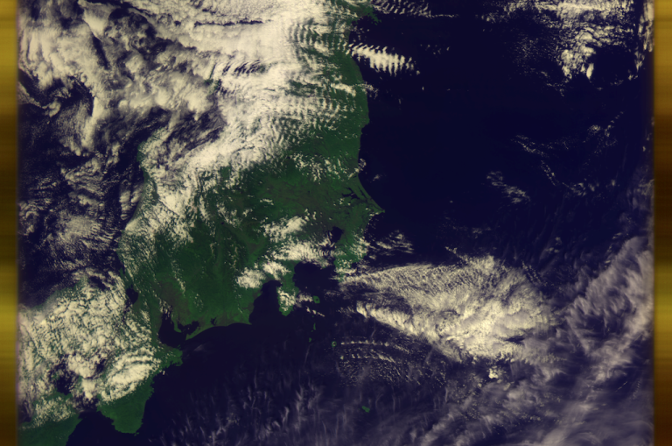
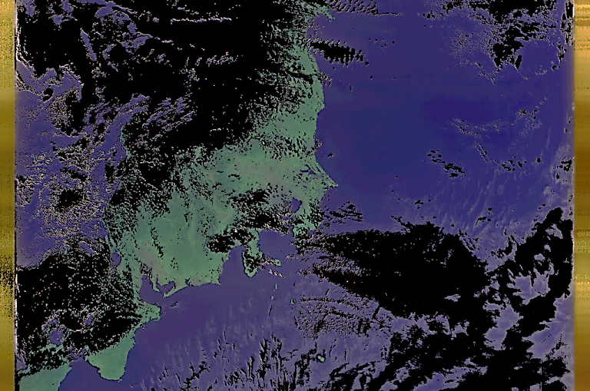
GOSAT on orbit since 2009
FTS L1B spectra
with high spectral resolution and SNR
L2 XCO₂ and XCH₄ distributions
with high precisions ~0.5% and 0.7%
L4 CO₂ and CH₄ flux inversion with uncertainty estimate
CAI L1B radiances
(0.38, 0.67, 0.87, 1.60 um)
and L2 cloud flag

Slide 4
GOSAT operation summary
 | 2009 | 2010 | 2011 | 2012 | 2013 | 2014 | 2015 -
Milestone | * launch |  |  |  |  | * * Solar paddle accident Unstable Pointing | * Switching Pointing mechanism
Nominal Pointing Pattern
Pointing system
FTS interferogram
V161.160
V201.201
5p-CT
3p-CT
1 &3 p-CT
3p-CT
The primary
Back up
No bias
800 fringes bias
Re-processing (no geometry correction)
Latest version
Latest version
Re-processing (pointing error, biased interferogram corrected)
Latest
GOSAT is operated with fully observations over 7 years since 2009, currently in extended operation phase.
GOSAT survived after overcoming two big events, satellite solar paddle accident (stop one of 2 paddles) and switching to redundancy pointing mechanism of FTS after unstable pointing of the primary one.
The latest 2 versions (currently v161.160 and v201.201) can be delivered to users.

Slide 5
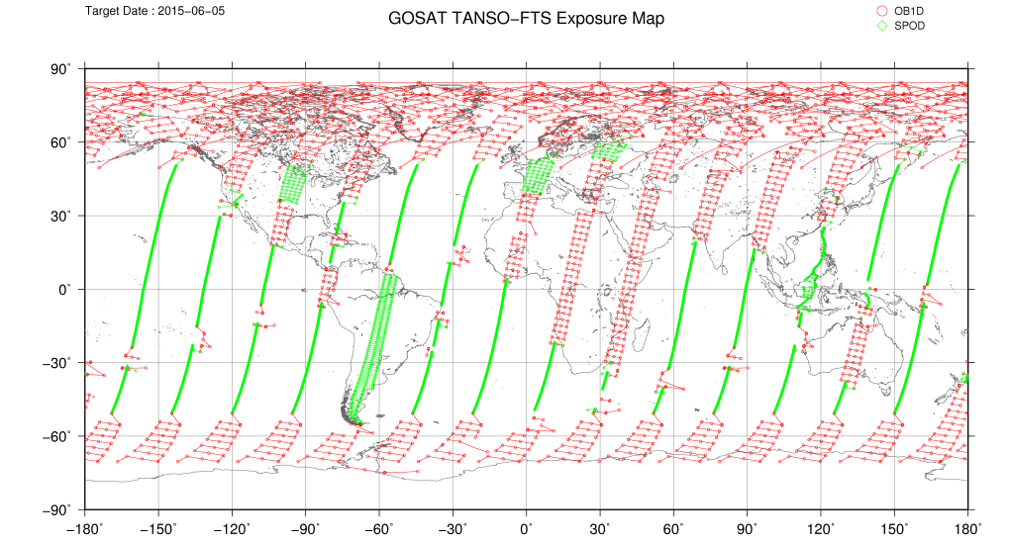
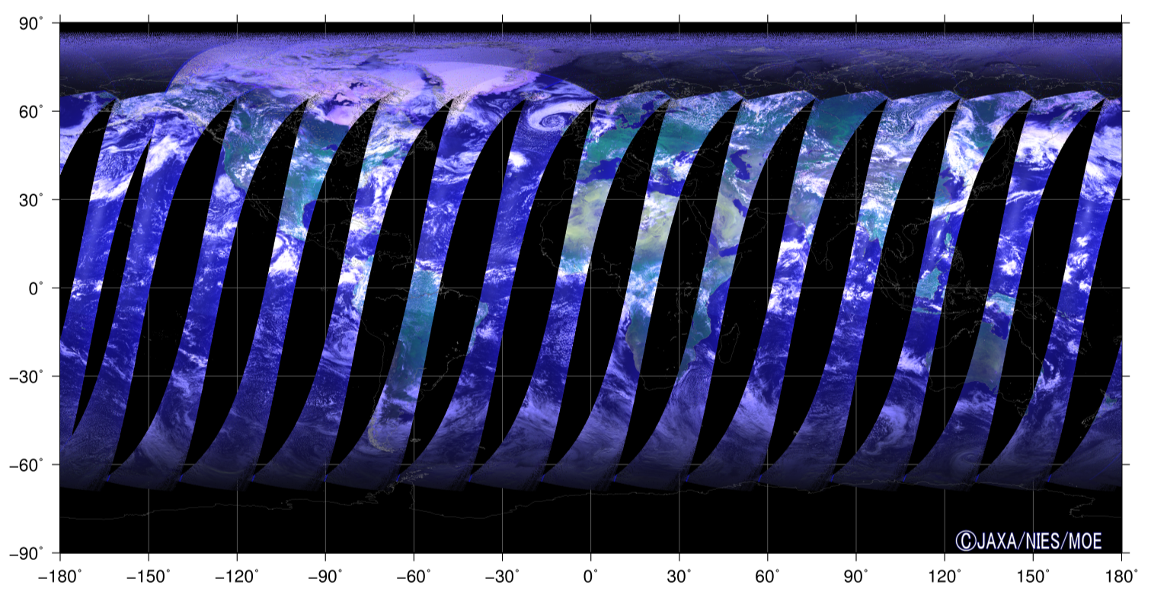
FTS and CAI observation on June 5 2015
3-point grid observation over land
Glint observation over ocean (extended high latitudes)
West US targeted
LA, Oil field, RRV
Island tracing
Amazon dithering
Challenging operation to get more effective observation points

Slide 6
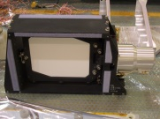

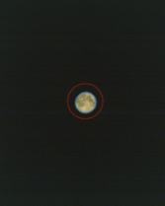

GOSAT calibrations
Solar diffuser plate onboard FTS
FTS-SWIR obs.
CAI obs.
Solar cal. (radiance, Fraunhofer)
FTS onboard-camera
Lunar cal.
CAI
FTS-TIR obs.
ILS cal.
Night obs.
 | FTS |  |  |  | CAI
 | B1P/S 0.76um | B2P/S 1.6um | B3P/S 2um | B4 5.5-14.3um | B1 0.38um | B2 0.67um | B3 0.87um | B4 1.6um
Radiance | Vicarious calibration (1/year) Solar calibration （backside: 1/month） Lunar calibration (2/year) |  |  | Vicarious calibration (1/year) Inter-comparison (AIRS) | Vicarious calibration（1/year） Lunar calibration (2/year) Dark (Night observation: 1/month)
Spectral features | Fraunhofer line (spectral shift) ILS calibration (B2P/S: 1/month) |  |  | - | -
Geometry | FTS onboard-camera image is validated by using AVNIR-2. |  |  |  | Validated by using GSHHS

Slide 7
Status of GOSAT calibration
(1) TIR radiometric calibration (The latest FTS L1B v201)
Blackbody (BB) and Deep Space (DS) views for onboard calibration (2-time in dayside, 4-time in nightside)
Polarization correction (mirrors, beamsplitter, dichroic filters)
BB emissivity (EM evaluated by heated halo method at UW-Madison)
Sensor background temperature estimation
Vicarious calibration field campaign (with UW-Madison), Inter-comparison with AIRS
(2) UV-SWIR radiometric calibration (Radiometirc degradation factor)
Onboard solar diffuser monitoring per month
Vicarious calibration field campaign (with NASA/OCO-2, Ames), Lunar calibration (2009-2015)
FTS L1B v201 is added the best-estimated radiance considered with degradation
(3) Geometric correction
Pointing location evaluated by onboard IFOV camera
Best-estimated geolocation data in FTS L1B v201
Pointing offset angle for FTS observation plan is affected after the accessment

Slide 8

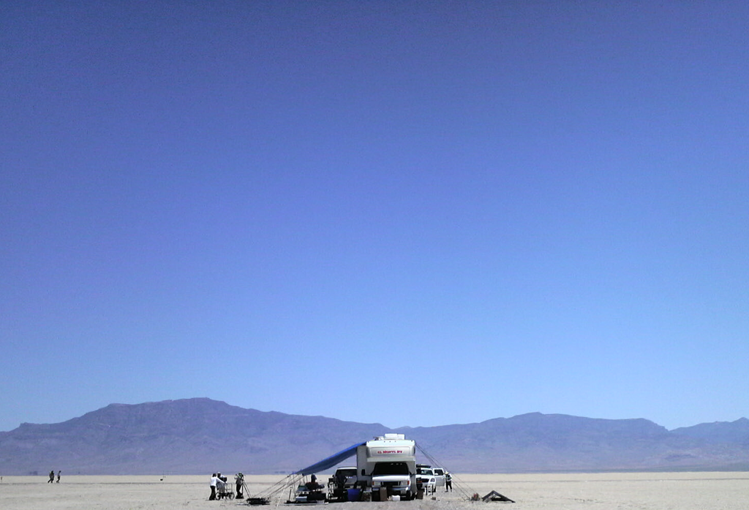

















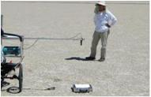



Vicarious calibration campaign at Railroad Valley
Path 37
from West
Path 36
from East
33.0deg
25deg
19deg
19.9deg
TOA Spectral radiance
High altitude
Horizontal
CO₂ CH₄
Vertical
CO₂ CH₄
Surface Thermal radiation
Surface and Profile
of Pressure, Temperature, Humidity
Aerosol Optical Thickens
Surface
CO₂ CH₄
Surface Spectral Reflectance
BRDF
Variability
8

Slide 9
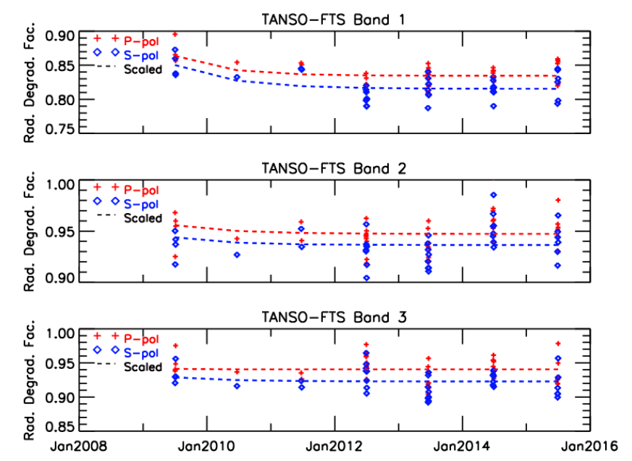
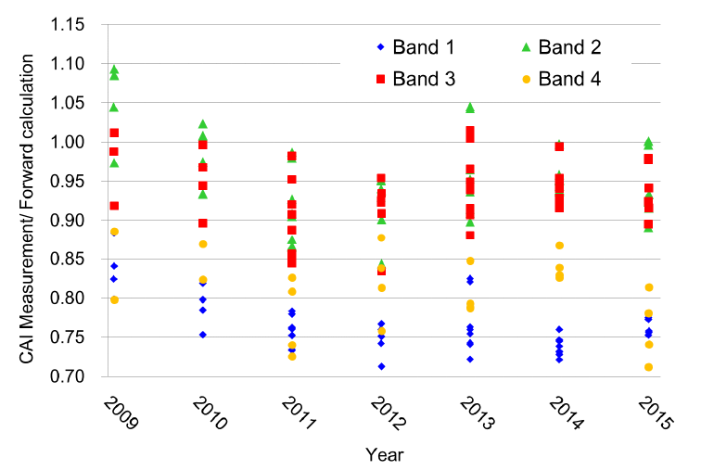
Radiometric evaluation of FTS SWIR and CAI at RRV
FTS radiance
CAI radiance
Kuze et al., AMTD, 2016

Slide 10
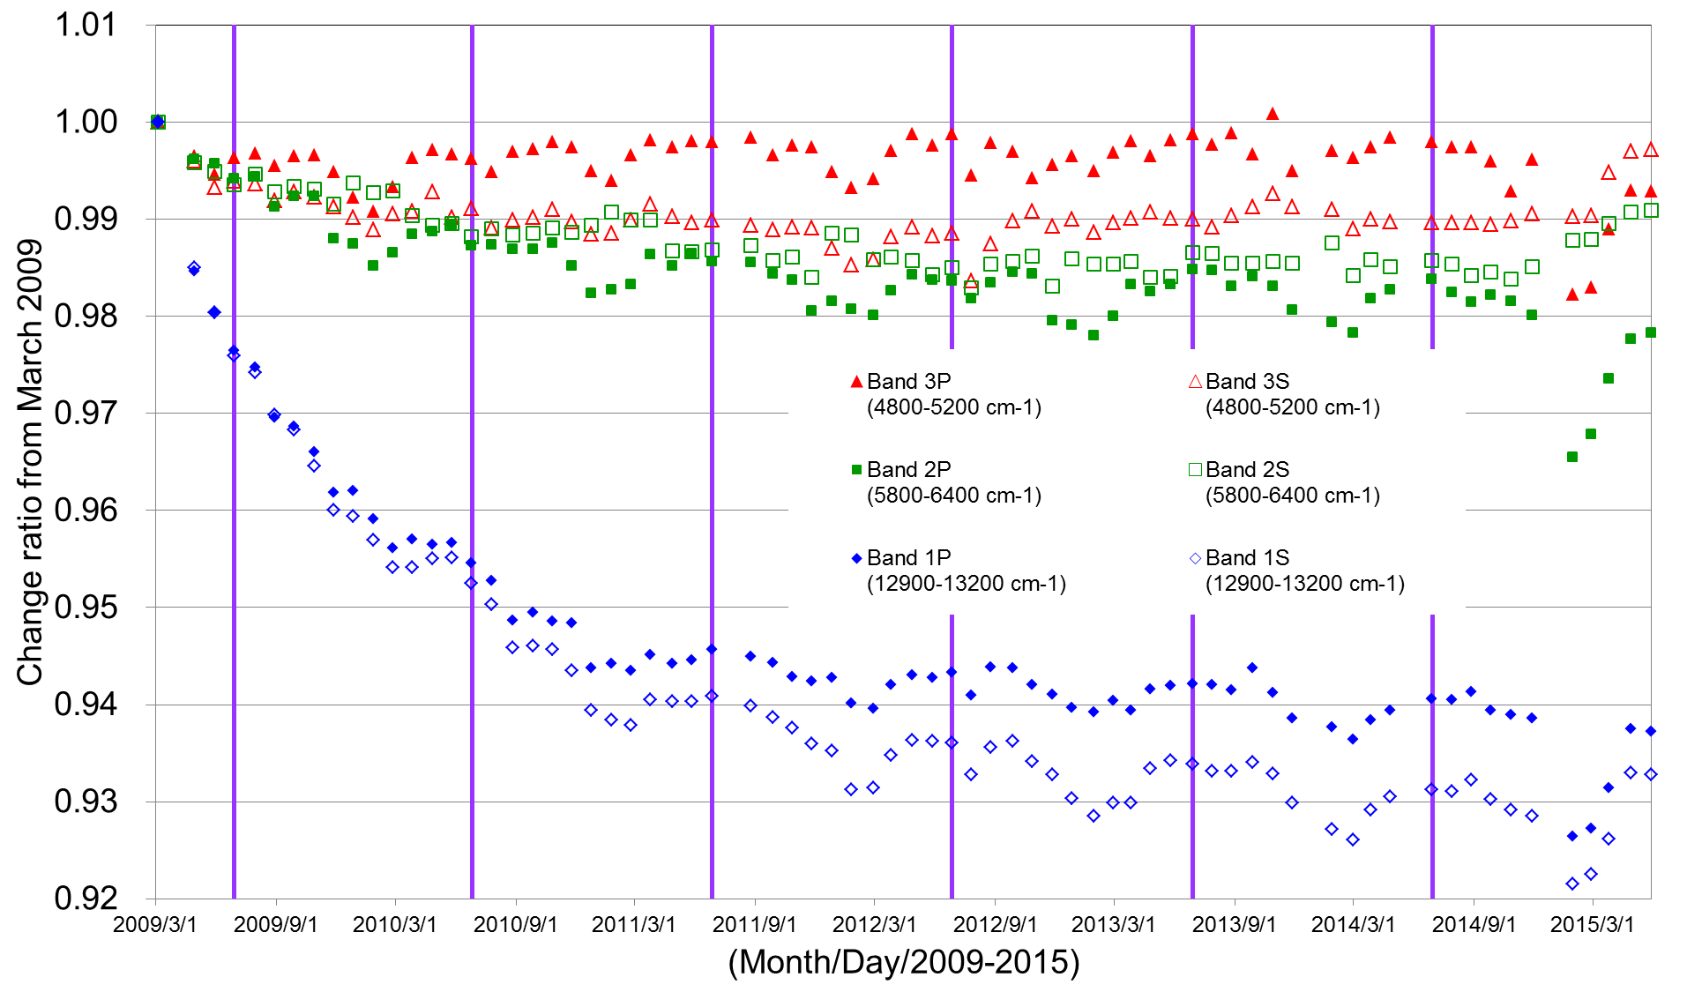
FTS SWIR solar diffuser monitoring
PM-B

Slide 11
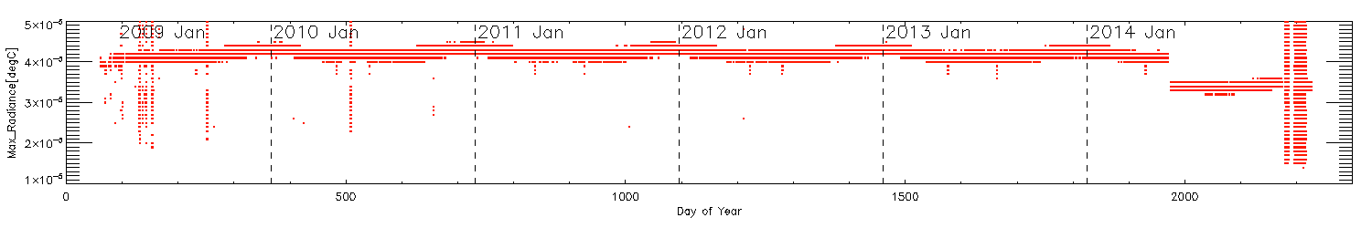
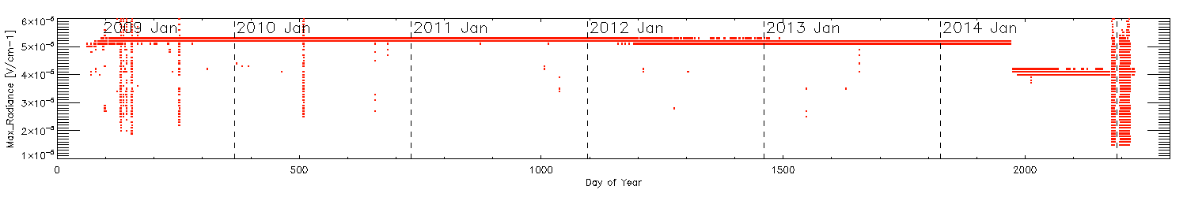
FTS TIR radiometric monitoring
One solar paddle stop
Blackbody calibration
PM-B
PM-B
Standby
Deep space view calibration
After stopping one solar paddle, TIR sensitivity decreased 80%.
After switching to PM-B, there was no significant change.

Slide 12
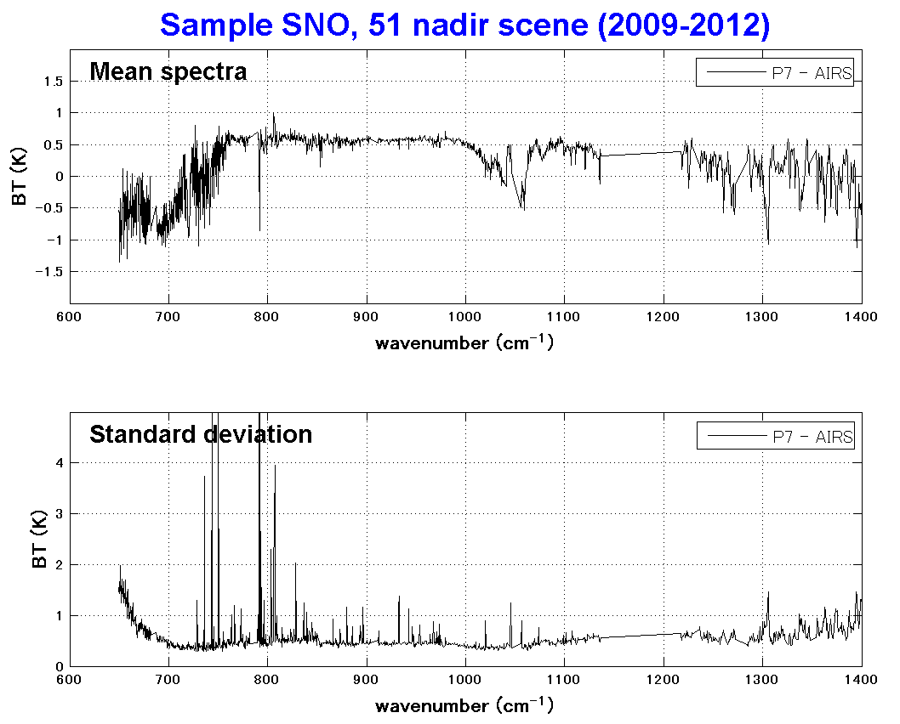
FTS TIR inter-comparison
The GOSAT TIR spectra are compared with Aqua/AIRS at Simultaneous Nadir Observations (SNOs).
- This work is collaborated with SSEC, Univ. Wisconsin-Madison.
The coincidences are located at mid-latitudes for AIRS. The spectral difference is evaluated in 0.5 K.

Slide 13
FTS TIR long-time inter-comparison with AIRS
GOSAT v161 -AIRS dT [K] at CO₂ 689.5 cm⁻¹
1
0
-1
-2
-3
-4
-5
-6
Solar paddle stop
Also TIR power down
2009 2010 2011 2012 2013 2014 2015 2016
Collaborated with SSEC, Univ. Wisconsin-Madison

Slide 14
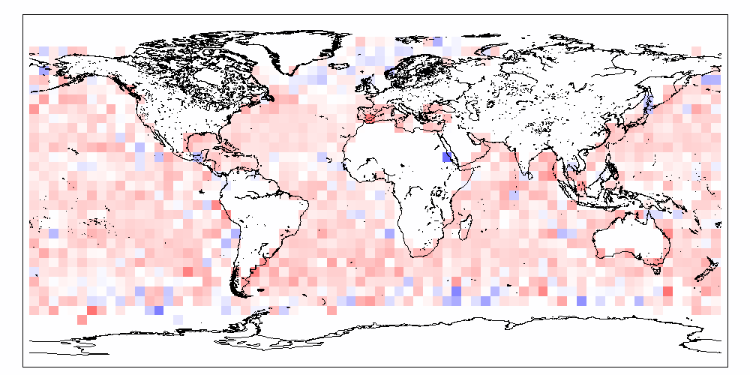
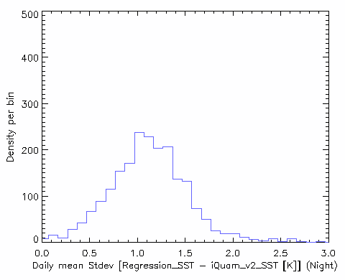
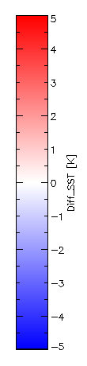
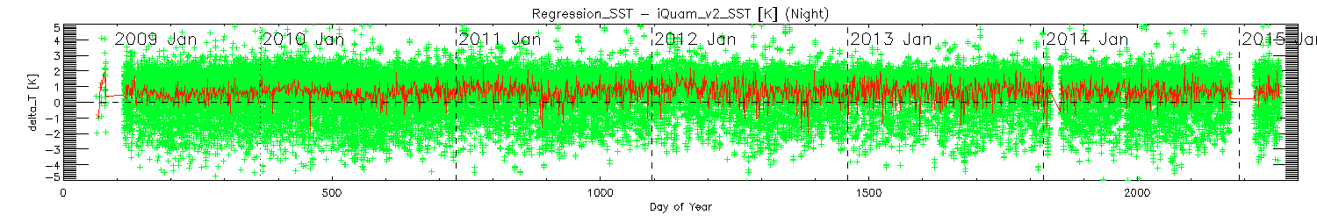
FS TIR long-time stability evaluated using SST
2009/03/03~2015/03/16
Nighttime
SST Residual (GOSAT SST- iQuamSST)
Daily mean stdev (GOSAT-SST-iQuam) [Night]
Night
stdev
Long-time stability

Slide 15
Lunar calibration for GOSAT
North
Radiometric onboard calibration for FTS SWIR and CAI
For FTS, gazing the moon by the satellite pointing with half IFOV
For CAI, scanning the moon by the satellite pitch motion
Once a year (also with backup, i.e. total twice)
Bright and stable target with observation phase angle of 7 degrees near full-moon
Phase ~7 deg near full-moon
CAI
FTS-SWIR band
(TIR off)
South

Slide 16
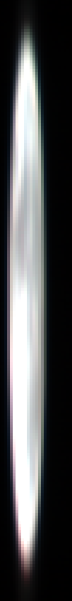
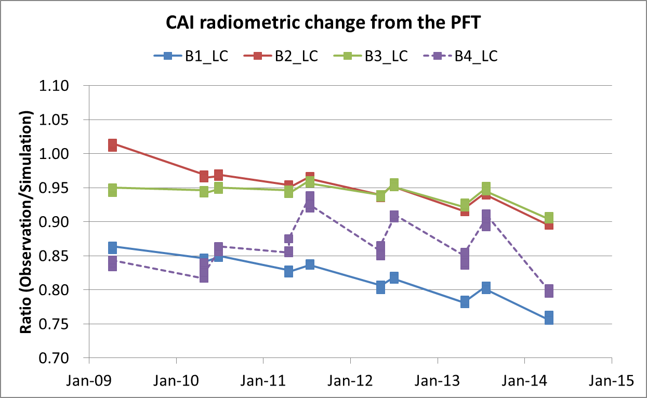


CAI lunar calibration result
Raw image
R:Band1
G:Band2
B:Band3
Band4
Resampled
12 pixels
4 pixels
Band4 IFOV is broader than the identical. It might not be well-evaluated.
Band1-3 radiometric trends are evaluated well.
CAI lunar observation on 28 April 2010. Images are oversampled in along-track direction.

Slide 17
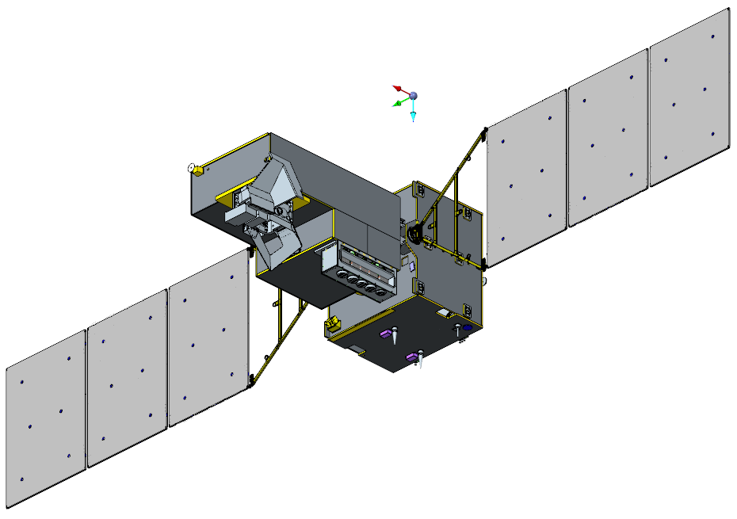
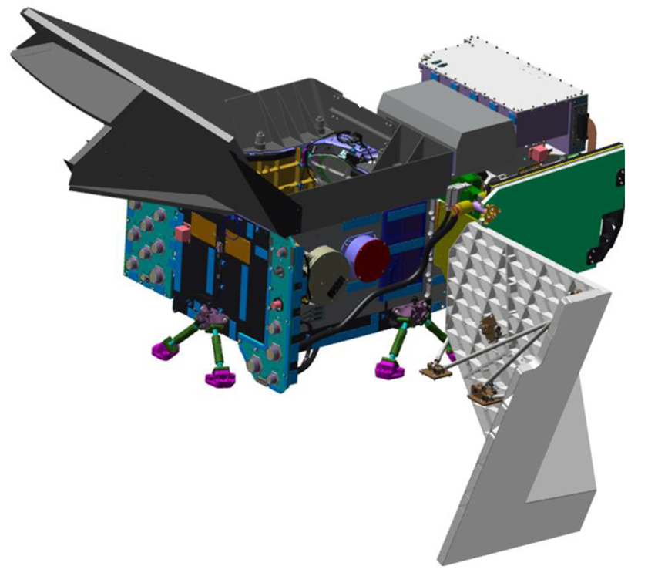
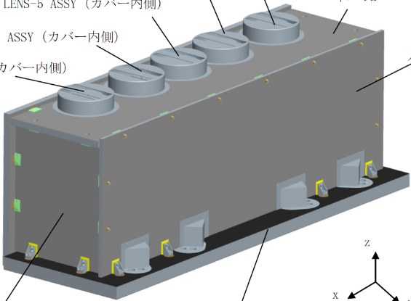
GOSAT-2 TANSO-2 FTS-2 and CAI-2
GOSAT-2 on orbit in early 2018
Fourier Transform Spectrometer -2 (FTS-2)
Mission | GHGs measurements
Band | SWIR-0.76µm, 1.6µm, 2.0-2.3µm bands with P/S polarization (O₂-A, CO₂, CH₄, H₂O, CO band)
 | TIR-5.5-8.4, 8.4-14.3µm (CO₂, CH₄, O₃ band)
SPC. Res. | 0.2cm⁻¹
Swath | 850km with all targeted observations every 4sec
IFOV | 9.7km
613km altitude
6 days revisit
Thermal And Near infrared Sensor for carbon Observation -2 (TANSO-2)
Cloud and Aerosol Imager -2 (CAI-2)
Mission | Cloud and aerosol properties
Band | 2 off-nadir sights (+20 and -20deg) 0.34/0.38, 0.44/0.55, 0.67/0.67, 0.87/0.87, 1.64/1.64µm band
Swath | 1000km
IFOV | 0.5 and 1.0km
Fourier Transform Spectrometer -2 (FTS-2)
Cloud and Aerosol Imager -2 (CAI-2)

Slide 18
GOSAT-2 calibrations
FTS-2 -SWIR obs.
CAI-2 obs.
GOSAT-2 lunar cal.
CAI-2
FTS-2
Lunar cal.
*AT scan for radiometry
*CT scan for PRNU correction (upgrade)
*SWIR for radiometry
*TIR signal output (upgrade)
FTS-2-TIR obs.
ILS cal.
Night obs.
Solar cal. (radiance, Fraunhofer)
 | FTS-2 |  |  |  | CAI-2
 | B1P/S 0.76um | B2P/S 1.6um | B3P/S 2-2.3um | B4 5.5-8.4, 8.4-14.3um | B1/B6 0.34/ 0.38um | B2/B7 0.44/ 0.55um | B3/B8 0.67um | B4/B9 0.87um | B5/B10 1.64um
Radiance | Vicarious calibration (1/year) Solar calibration （backside: 1-2/month） Lunar calibration (1 / 2month) |  |  | Vicarious calibration Inter-comparison Lunar calibration BB thermistor evaluation | Vicarious calibration（1/year） Lunar calibration (1 / 2month) - Radiance by AT, PRNU by CT scan Dark (Night observation: 1/month)
Spectral features | Fraunhofer line (spectral shift) ILS calibration (B1P/S,B2P/S: 1/month) |  |  | - | -
Geometry | FTS-2 onboard-camera image is validated |  |  |  | Validated by using GSHHG

Slide 19
Summary
GOSAT is operated with fully observations of FTS SWIR and TIR bands and CAI over 7 years.
Calibration activities in 7 years
  TIR inter-comparison by Simultaneous Nadir Observations (SNOs) with AIRS
  SWIR vicarious calibration field campaign with in-situ measurements and aircraft over-flight collaborated with NASA OCO-2 and Ames.
Ongoing work
  Simultaneous Off-Nadir Observations (SONOs) for scan angle dependency evaluation
  Simultaneous observation at Railroad Valley with GOSAT and OCO-2
  GOSAT-2 calibration plan is under preparation based on GOSAT.

Slide 21
GOSAT-2 specification
GOSAT-2
TANSO-2 FTS-2
 |  |  | GOSAT-2 | GOSAT
Main body Size(m) X*Y*Z |  |  | 5.8 x 2.0 x 2.1 （Wing Span 16.5m） | 3.7 x 1.8 x 2.0 （Wing Span 13.7m）
Total Mass |  |  | 1800kg | 1750kg
Total Power |  |  | 5.0 kW(EOL) | 3.8 kW (EOL)
Life Time |  |  | 5 years | 5 years
Orbit |  |  | sun synchronous | sun synchronous
 | Local time |  | 13:00+/-0:15 | 13:00+/-0:15
 | Altitude |  | 613km | 666km
 | Inclination |  | 98deg | 98deg
 | Repeat |  | 6 days (89 revol.) | 3 days (44 revol.)
Launch |  | Vehicle | H-IIA | H-IIA
 |  | Schedule | JFY2017 | 23 Jan., 2009
TANSO-2 CAI-2
GOSAT
TANSO-CAI
TANSO-FTS

Slide 22
Items | GOSAT-2 TANSO-2 FTS-2 | GOSAT TANSO FTS
Measurement Gases | CO2，CH4，O3，H2O，CO | CO2，CH4，O3，H2O
Footprint size (FOV) | 9.7 kmφ (15.8mrad) | 10.5 kmφ (15.8mrad)
Spectral Ranges (μm)(cm-1) | band 1 : 0.75-0.77 (12,950-13,250) band 2: 1.56-1.69 (5,900-6,400) band 3: 1.92-2.33 (4,200-5,200) band 4: 5.5-8.4 (1,188-1,800) band 5: 8.4-14.3 (700-1,188) | band 1: 0.75-0.77 (12,900-13,200) band 2: 1.56-1.72 (5,800-6,400) band 3: 1.92-2.08 (4,800-5,200) band 4: 5.5-14.3 (700-1,800)
SNR | band 1: >400 (S@13,050cm⁻¹) band 2: >300 (S@6,200cm⁻¹) band 3: >300 (S@5,000cm⁻¹) >250 (S@4,250cm⁻¹) band 4: >300 (@1,300cm⁻¹) band 5: >300 (@700cm⁻¹) | band 1: >300 (345) band 2: >300 (322) band 3: >300 (412) band 4: >300 (304)
Observation Mesh | 160km (5 points in the CT direction) | 160km (5 points in the CT direction)
Scan duration | 4 seconds / interferogram | 4, 2, 1.1 seconds / interferogram
Sampling resolution | 0.2cm⁻¹ | 0.2cm⁻¹
Effective Aperture size | Φ73mm | Φ64mm
Gain steps | 16 | 2
Avoidance of the cloud | Intelligent pointing | -------
TANSO-FTS-2 Specifications

Slide 23

Items | GOSAT-2 TANSO-2 CAI-2 |  | GOSAT TANSO-CAI
Spectral Ranges (nm) | Forward Viewing (+20 deg) b 1 : 333-353 b 2 : 433-453 b 3 : 664-684 b 4 : 859-879 b 5 : 1585-1675 | Backward Viewing (-20deg) b 6 : 370-390 b 7 : 540-560 b 8 : 664-684 b 9 : 859-879 b 10: 1585-1675 | Nadir Viewing band 1 : 370-390 band 2 : 664-684 band 3 : 860-880 band 4 : 1555-1645
Spatial Resolution nadir | except band 5, 10 band 5, 10 460m (700μrad) 920m(1,400μrad) |  | Band 1-3 Band 4 500m(750μrad) 1,500m(2,250μrad)
swath/FOV | every points on the earth to be observed at least twice a recurrent cycle |  | Band 1-3 Band 4 1,002 km / 72 deg 786km / 60 deg
SNR (@spectral-radiance/albedo) (W/m²/sr/μm) | b 1 : >200 (45/0.158) b 6 : >200 (48/0.152) b 2 : >200 (79/0.144) b 7 : >200 (65/0.125) b 3 : >200 (46/0.106) b 8 : >200 (46/0.106) b 4 : >200 (30/0.112) b 9 : >200 (30/0.112) b 5 : >200 (7/0.101) b 10 : >200 (7/0.101) |  | b 1 : >200 (47/0.149) b 2 : >200 (45/0.104) b 3 : >200 (29/0.108) b 4 : >200 (7/0.101)
TANSO-CAI-2 Specifications

Slide 24
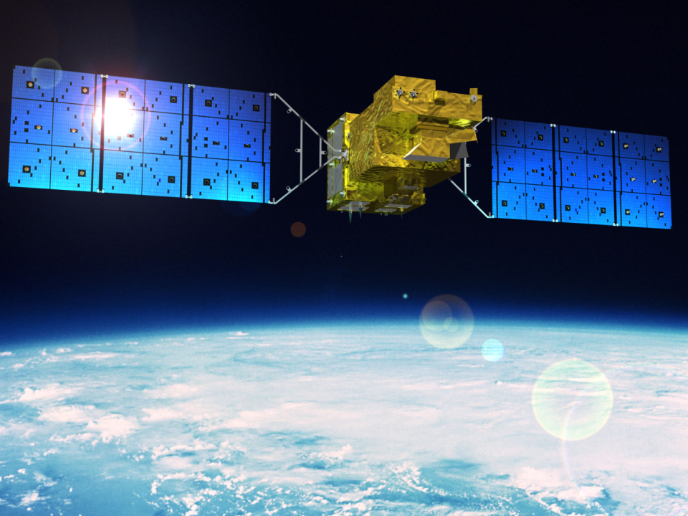
GOSAT-2 lunar calibration plan
GOSAT-2 lunar cal
On orbit in early 2018
TANSO-FTS-2
CAI-2
*AT scan for radiometry
*CT scan for PRNU correction (upgrade)
TANSO-CAI-2
FTS-2
Upgrade specifications from GOSAT
FTS-2 | Adding CO channel (2.3 μm)
CAI-2 | 2 off-nadir sights (+ 20deg and – 20deg) Adding 3 bands (0.34, 0.44, 0.55 μm) 0.5 and 1.0 km spatial resolutions
*SWIR for radiometry
*TIR signal output (upgrade)

Slide 25
Solar diffuser plate onboard FTS
FTS-SWIR obs.
CAI obs.
Solar cal. (radiance, Fraunhofer)
Lunar cal.
FTS-TIR obs.
ILS cal.
Night obs.
FTS-2 -SWIR obs.
CAI-2 obs.
Lunar cal.
FTS-2-TIR obs.
ILS cal.
Night obs.
Solar cal. (radiance, Fraunhofer)

Slide 26
Summary
GOSAT has operated lunar calibration around April and July every year since 2009 for radiometric calibration.
GOSAT targets the moon with observation phase angle around 7 deg.
CAI observes the moon with a linear array sensor of 0.38-1.6 microns by pitch (along-track) scan operation.
FTS observes the moon with a half size of the IFOV of 0.78-2.0 microns in high resolution. (not shown here)
GOSAT-2 will be upgraded in FTS-2 by adding 2.3micron channel, while CAI-2 by extending to 0.34 micron.
CAI-2 will also examine the photo response non-uniformity (PRNU) by yaw (cross-track) scan operation.

