Slide 1
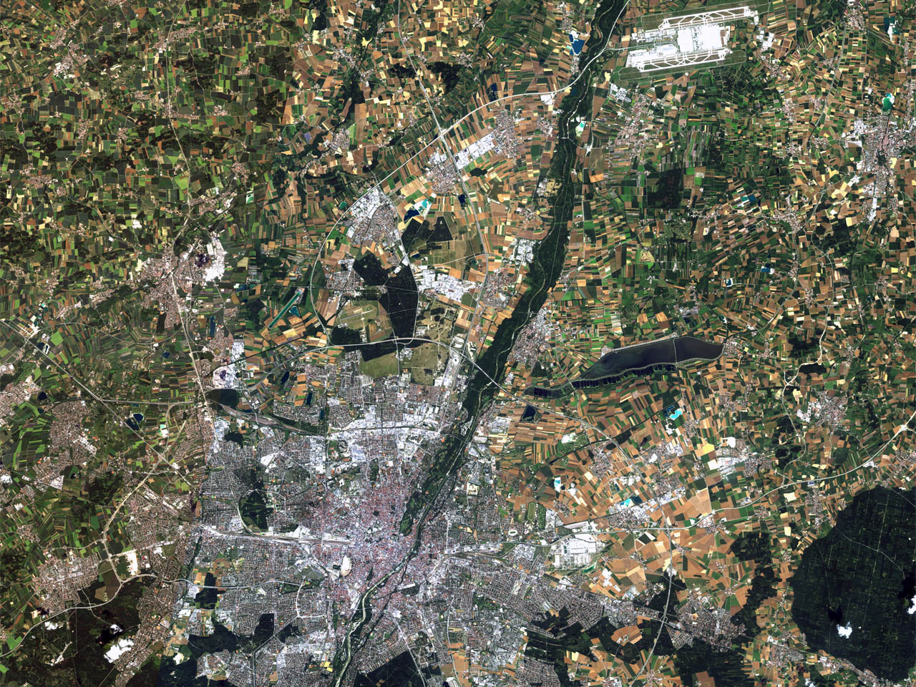
GSICS Mini Conference #TKSC, JAXA, Japan
February 29, 2016
Calibration Activities of PRISM and AVNIR-2 Onboard ALOS ‘Daichi’
Takeo Tadono and Hiroshi Murakami
Earth Observation Research Center (EORC)
Japan Aerospace Exploration Agency (JAXA)
tadono.takeo@jaxa.jp
AVNIR-2 image in Munich, Germany on 21 July 2010

Slide 2
Outline
Background
  ‘Daichi’ (ALOS) and instruments
  Calibration Work Flow
Calibration Results and Time Trends
  Geometric Calibration
    Ground Control Points (GCPs) collection
    PRISM: CCD alignment as relative cal.
    PRISM: Absolute calibration
    AVNIR-2: Band-to-band ratio as relative cal.
    AVNIR-2: Absolute calibration
  Radiometric Calibration
    AVNIR-2: Relative and absolute cal.
    PRISM: Relative and absolute cal.
Conclusions
1

Slide 3
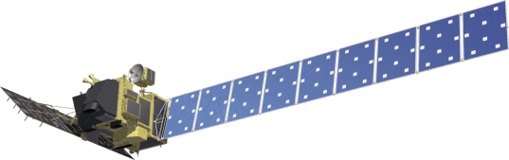
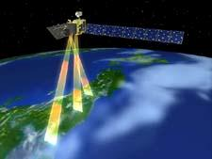
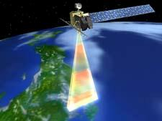
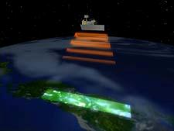
Advanced Land Observing Satellite
(ALOS, ‘DAICHI’)
Operation:
24 Jan. 2006 by H-2A Rocket #8
12 May 2011 Mission ended
~22 Apr. 2011: Low Load Mode (LLM)
> 1,934 days=5.3 years
Objectives:
  Cartography (1/25,000 scale)
  Regional environmental monitoring
  Disaster monitoring, etc.
PRISM
AVNIR-2
PALSAR
PRISM
Panchromatic Remote sensing
Instrument for Stereo Mapping
AVNIR-2
Advanced Visible and Near-Infrared
Radiometer type 2
PALSAR
Phased Array type L-band
Synthetic Aperture Radar
PRISM can acquire triplet stereo imageries by nadir-, forward-, and backward-radiometers with 2.5m spatial resolution in 35km swath.
AVNIR-2 can observe with 10m resolution in 70km swath, and it can be changed the observation area by pointing capability within +/-44 deg. in across track.
PALSAR can acquire the data in not only daytime but also nighttime as well as cloudy and rainy whether conditions.
2

Slide 4
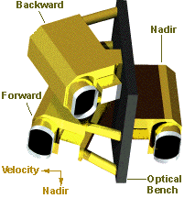
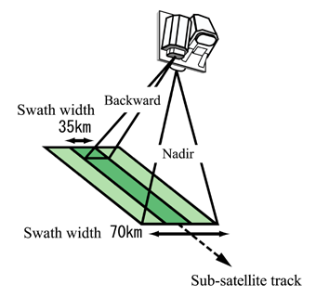
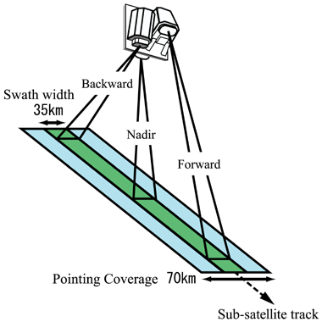
PRISM
Panchromatic Remote-sensing Instrument for Stereo Mapping
パンクロマティック立体視センサ
0.52-0.77μm
Number of Optics : 3, AT +/- 23.8 deg
(Nadir / Forward / Backward)
Base/Height ratio : 1.0 (F / B)
Spatial resolution : 2.5m at Nadir
Swath width : 35km at Triplet mode
70km at Nadir only
Pointing angle : +/- 1.5 deg.
S/N : >70, MTF : >0.20
Scanning method : Push broom
Quantization : 8 bits
Data compression : JPEG extension
Compression rate: 1/4.5 or 1/9
Nadir alone or
nadir + backward modes.
Observing geometry of triplet mode.
Two observation (+/-1.20deg. pointing angle) per orbit are necessary for observing whole coverage by triplet mode except in high latitude areas.
3

Slide 5
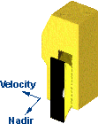
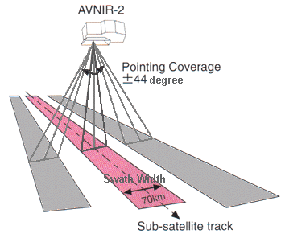
AVNIR-2
Advanced Visible and Near Infrared Radiometer type 2
高性能可視近赤外放射計2型
Band 1 : 0.42-0.50μm
Band 2 : 0.52-0.60μm
Band 3 : 0.61-0.69μm
Band 4 : 0.76-0.89μm
Field of view : 5.8 deg.
Swath width : 70km at Nadir
Instantaneous FOV : 14.28 μrad
Spatial resolution : 10m at Nadir
Number of detectors : 7000 /band
Pointing angle : +/- 44 deg.
S/N : >200, MTF : >0.25 (1-3), >0.20 (4)
Scanning method : Push broom
Quantization : 8 bits
1,500 km
Improvements in AVNIR-2 from AVNIR
Resolution : 10m < 16m
Pointing angle : +/-44 deg < +/-40 deg
Calibration system : lamp 2 < lamp 1, Solar 1
4

Slide 6
PRISM Cal/Val Plan
Data flow
Level 1
1A (Raw data)
1B1 (Radiometric correction)
1B2 (Geometric correction)
Work flow
PPDS (attitude/pointing determination)
Geometric Calibration
Relative alignment between CCD
Pointing/attitude
  Determination accuracy
  Stability
  Control accuracy
Geometric correction accuracy
Establishing ground
control point (GCP)
Geometric model
Aim to geometric accuracy of 1B2
Rational Polynomial
Camera (RPC) model
Stereo pair
Validation
Absolute orientation
Absolute DSM
Matching
Relative orientation
Relative DSM
Radiometric model
Image Quality Evaluation
MTF, S/N
Lossy, JPEG extension
Matching accuracy
Co-registration with AVNIR-2
Radiometric Calibration #1
Evaluation of cal. mode data
Stripe
Linearity
Offset and slope
Relative accuracy between optics
Ortho Image
Radiometric Cal. #2
Absolute calibration
Aim to radiometric accuracy of 1B2
PRISM Cal/Val plan and evaluation items.
AVNIR-2 : Similar evaluation flow > relative and absolute
Precision Pointing and Geolocation Determination System (PPDS) for
satellite position and attitude evaluations : GPSR, STT, IRU, and ADS
5

Slide 7
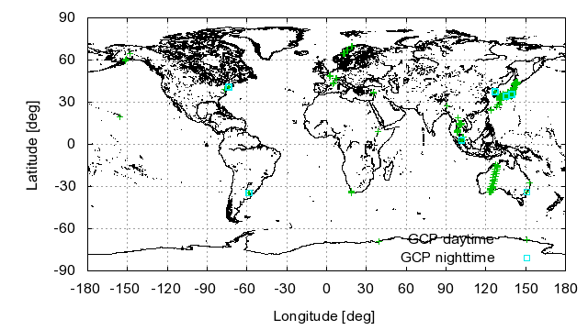
Geo Cal: Establishment of Global GCPs
Distribution of GCPs for calibration and validation of PRISM and AVNIR-2 (5,532 daytime, 181 nighttime)
Geometric calibration of PRISM (similar for AVNIR-2)
Relative cal: CCD-units alignment parameters (now Version 3)
  - Standard deviation (STDEV) within a scene is defined as relative accuracy
Absolute cal: Pointing alignment parameter (AP) updated in each two months for L1 product; Sensor alignment model maintained for research products
    Ground control points (GCPs) were used in the modeling during operation (include prediction)
    GCPs were used as the check points (CPs) in accuracy evaluation
    The root mean square error (RMSE) at CPs is defined as absolute accuracy (CE 90)
6

Slide 8
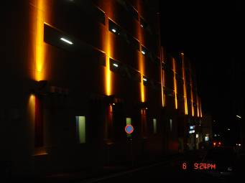
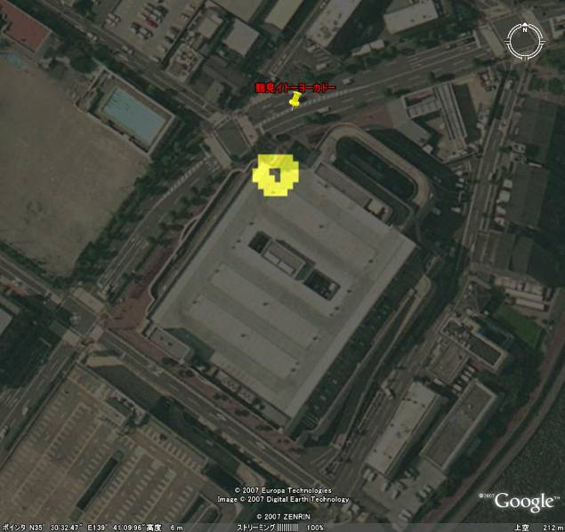
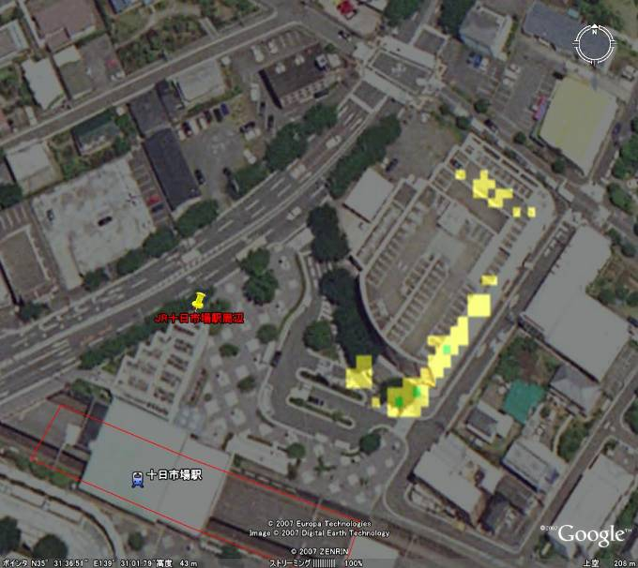
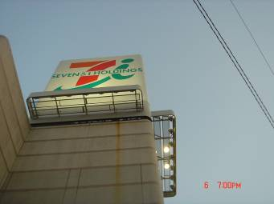
Geo Cal: Nighttime GCP Collection
Nighttime GCP collection: Tokyo and Yokohama measured on June 6, 2007
PRISM image acquired in ascending node on April 26 2007 were overlaid to Google-Earth.
PRISM image were colored by yellow and green that corresponds less then 200 DN. We have been measured there location by VRS-GPS.
These GCPs can be operationally used when images acquired without cloud covers; Mar, Apr, and Jun. 2007 were already obtained.
7

Slide 9
Geo Cal Methods using GCPs
External Orientation
GCP(X, Y, Z) → (L, P) coordinate transfer
where,
: Initial value,
: residual,
: satellite position,
: attitude (roll, pitch, yaw), and
: orientation parameters.
Method 1 : Absolute (Exterior) Orientation using GCPs
Calculation of orientation parameters (position (<3D) and attitude (<3D)) from equation of colinearity condition
GCP coordinate (X, Y, Z) → Image coordinate (L, P) transfer
AVNIR-2: Evaluation of each pointing angle → Sensor alignment
PRISM: Evaluation for each CCD → Relative CCD alignments
  Densely GCPs
PRISM: Evaluation as functions of each time frequencies → Pointing alignment
  0.37msec = line, 5sec = scene, 46sec = dual radiometers, 91sec = triplet radiometers,
  49min = half recurrent, 100min = recurrent, 3months = seasonal variability, and
  1year = annual variability
  Results will be compared with PPDS (precise attitude and pointing)
Method 2 : Image Matching
Least square matching / Image correlation matching
8

Slide 10
Geo Cal: PRISM Relative Calibration
CCD alignment model
  6 CCD units for NDR / 8 CCD units for FWD& BWD
  Approx. 5,000 detectors on each CCD
  The accuracy of the CCD alignment model with GCP residuals of an image orientation process has been monitored.
PRISM CCD units configuration
A sample of GCP residuals on a PRISM image
9

Slide 11
Geo Cal: PRISM CCD Alignments
CCD alignments evaluation of PRISM Backward radiometer (Pink: CCD#1-3, Yellow: CCD#3-5, Blue: CCD#4-6).
After correction of relative CCD alignments (orientation residual in X direction).
PRISM Relative CCD alignments estimation:
External orientation technique with 943GCPs and 15 stereo pair images
Almost of residuals of orientation are within +/-5m after correction
Unevaluated CCDs have been observed on Sep. 20 and 23, 2006
10

Slide 12
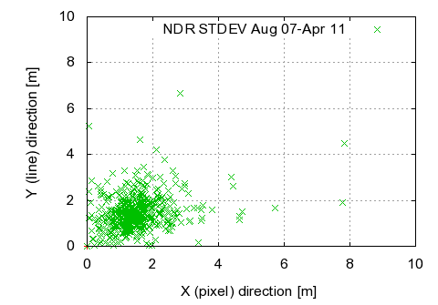
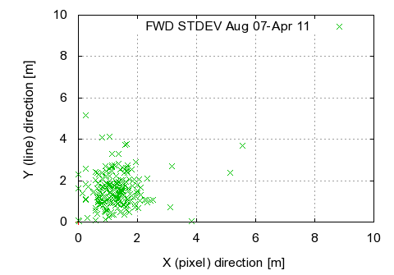
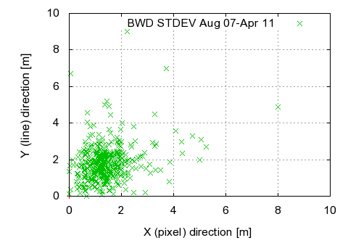
Geo Cal: PRISM Relative Calibration Result
a) Nadir (5,154 CPs, 584 scenes) b) Forward (1,572 CPs, 216 scenes) c) Backward (4,077 CPs, 475 scenes)
The latest result of relative geometric accuracy of PRISM (27 Aug 2007-18 Apr 2011)
 | Latest result: 07/8/27-11/4/18 obs
 | Scene # | # of CPs | X (pixel) STDEV (m) | Y (line) STDEV (m) | Distance (m)
Nadir | 584 | 5,154 | 1.5 | 1.5 | 2.2
Forward | 216 | 1,572 | 1.3 | 1.6 | 2.2
Backward | 475 | 4,077 | 1.5 | 1.8 | 2.4
Related to interior orientation parameter:
CCD alignment (version 3) is used since June 2007 and keeping within 1 pixel accuracy.
11

Slide 13
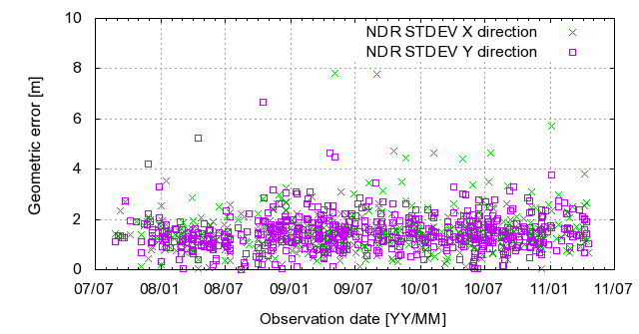
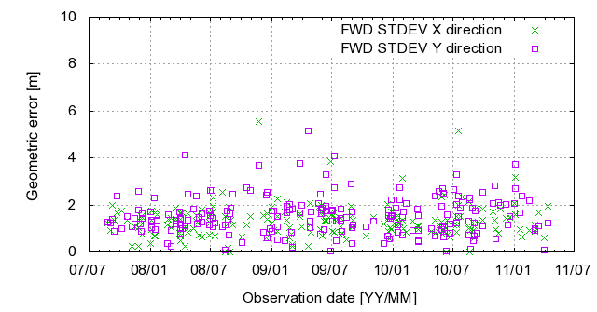
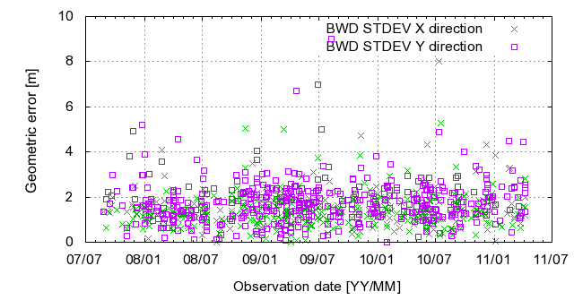
Geo Cal: PRISM Relative Calibration Result
a) Nadir (5,154 CPs, 584 scenes) b) Forward (1,572 CPs, 216 scenes)
No dependency with observation date
Sometime large error happened;
Error in (line, pixel) to (long, lat) transform coefficients
c) Backward (4,077 CPs, 475 scenes)
Time trend of relative geometric accuracy of PRISM (27 Aug 2007-18 Apr 2011)
12

Slide 14
Geo Cal: PRISM Absolute Calibration
PRISM sensor alignment model updates (Cont.)
  Model Ver.6 released on Feb. 2009 (FWD)
Fitting model
Fitting scenes of GCP sites
Independent scenes of GCP sites
Roll
Pitch
sunny side
dark side
sunny side
dark side
north hemi.
south hemi.
north hemi.
south hemi.
Repeating trend with orbit cycles
Roll
Pitch
Long-term trend with operational dates (3 years)
(as of Sep. 2009)
13

Slide 15
Geo Cal: PRISM Alignment Parameter (AP)
PRISM sensor alignment model updates (Cont.)
  Model Ver.7 released on Oct. 2009 (FWD)
Fitting model
Fitting scenes of GCP sites
Independent scenes of GCP sites
Fitting scenes of GCP sites (New)
Roll
Pitch
sunny side
dark side
sunny side
dark side
north hemi.
south hemi.
north hemi.
south hemi.
Repeating trend with orbit cycles
Roll
Pitch
Long-term trend with operational dates (3 years)
(as of Sep. 2009)
14

Slide 16
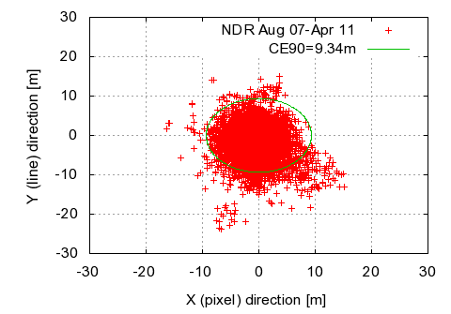
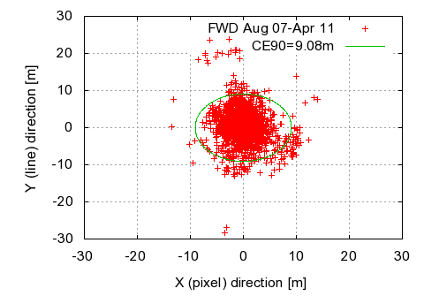
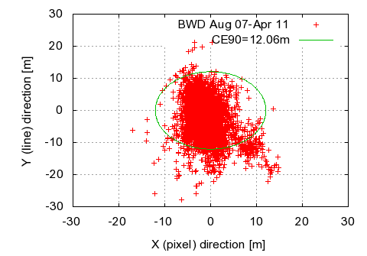
Geo Cal: PRISM Absolute Calibration Results
a) Nadir (5,154 CPs, CE90 = 9.4 m) b) Forward (1,572 CPs, CE90 = 9.1 m) c) Backward (4,077 CPs, CE90 = 12.1 m)
The latest result of absolute geometric accuracy of PRISM (27 Aug 2007-18 Apr 2011)
 | Latest result: 07/8/27-11/4/18 obs (#11-32 Pointing AP) |  |  |  | Announced：07/6/22-09/6/4 obs (#10-20 Pointing AP)
 | Scene # | # of CPs | RMSE (m) | CE90 (m) | Scene # | # of CPs | RMSE (m) | CE90 (m)
Nadir | 584 | 5,154 | 6.1 | 9.4 | 586 | 5,499 | 7.8 | 11.8
Forward | 216 | 1,572 | 5.9 | 9.1 | 225 | 1,771 | 7.8 | 12.4
Backward | 475 | 4,077 | 7.6 | 12.1 | 525 | 4,839 | 8.7 | 13.4
Pointing Alignment Parameter (AP) was updated in each two months.
15

Slide 17
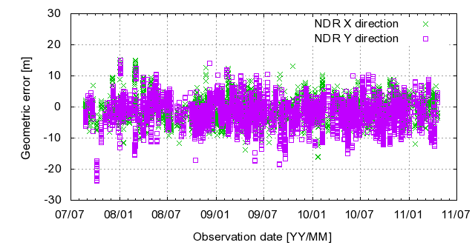
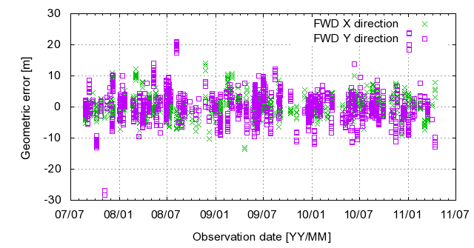
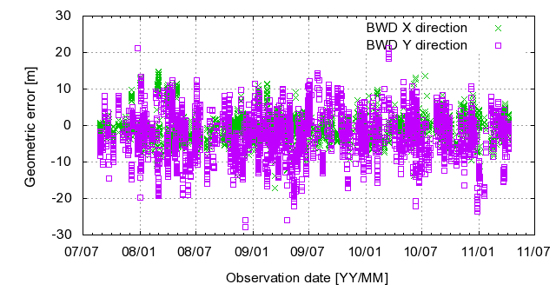
Geo Cal: PRISM Absolute Calibration Results
a) Nadir (5,154 CPs, CE90 = 9.4 m) b) Forward (1,572 CPs, CE90 = 9.1 m)
No dependency with observation date
Sometime large error happened;
Error in (line, pixel) to (long, lat) transform coefficients
c) Backward (4,077 CPs, CE90 = 12.1 m)
Time trend of absolute geometric accuracy of PRISM (27 Aug 2007-18 Apr 2011)
16

Slide 18
Geo Cal: AVNIR-2 Relative Calibration
Evaluation of AVNIR-2 band-to-band registration (0deg. pointing angle, Sky blue: Band1, Blue: Band2, Pink: Band4).
After correction of the registration (as of Sep. 26).
AVNIR-2 Band-to-Band registration estimation and correction:
19 scenes, various pointing angles (-41.5 to +41.5deg.), Band 3 is base image
Automatic image matching technique (least square matching)
Parameters were modified in geometric sensor model
17

Slide 19
Geo Cal: AVNIR-2 Absolute Calibration
History of alignment parameter updates
- October 20, 2008
- April 26, 2010
Absolute geometric error of AVNIR-2 (Typical 7 pointing angles, all data)
Geometric accuracy evaluation for typical seven pointing (0, ±21.5, ±34.3, ±41.5 deg)
X direction: Limitation of quantization for pointing angle setting encoder (260m)
Error trends (repeatability) in each pointing angle > Correction of bias component
18

Slide 20
Geo Cal: AVNIR-2 Absolute Calibration
History of alignment parameter updates
- October 20, 2008
- April 26, 2010
- February 17, 2011
◆：Correction values estimated from error trends
◆：Test results
Alignment correction for seven pointing angles (Blue: correction values, Pink: Test results)
Geometric accuracy evaluation for typical seven pointing (0, ±21.5, ±34.3, ±41.5 deg)
Correction values: Bias component in 0 deg then bias component of each angle
Test processing data before release: better than previous one
19

Slide 21
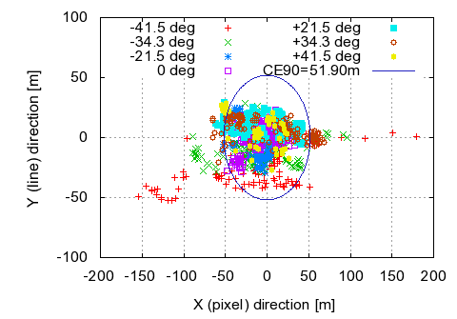
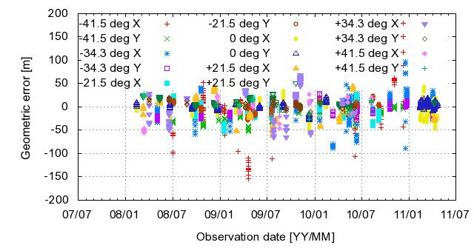
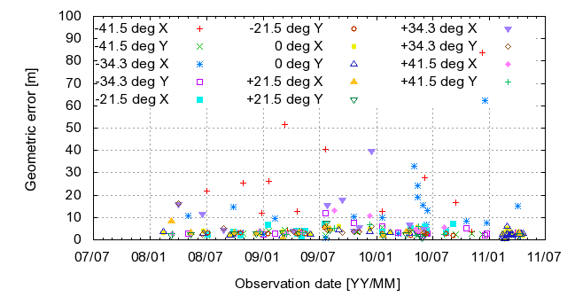
Geo Cal: AVNIR-2 Absolute Calibration Results
The latest result of geometric accuracy of AVNIR-2
(11 Feb 2008-18 Apr 2011)
Pointing angle(deg) | Latest result: 08/2/11-11/4/18 obs (Alignment parameter ver. 3)
 | Scene # | # of CPs | RMSE (m) | CE90 (m) | STDEV (m)
All | 118 | 1,329 | 34.3 | 51.9 | 9.9
-41.5 | 14 | 128 | 66.8 | 129.4 | 25.0
-34.3 | 21 | 231 | 34.9 | 55.2 | 14.5
-21.5 | 17 | 215 | 18.8 | 28.1 | 5.2
0 | 30 | 382 | 21.9 | 37.7 | 4.2
+21.5 | 14 | 208 | 30.8 | 42.9 | 5.0
+34.3 | 11 | 117 | 41.6 | 60.2 | 13.3
+41.5 | 9 | 48 | 32.4 | 57.1 | 7.0
Time trend of geometric accuracy of AVNIR-2
(Upper: absolute accuracy, lower: relative accuracy)
Selected seven pointing angles were calibrated
- X direction: limitation of quantization of angle setting encoder (~260m)
Alignment parameter Ver.3 were released on 17 Feb 2011
20

Slide 22
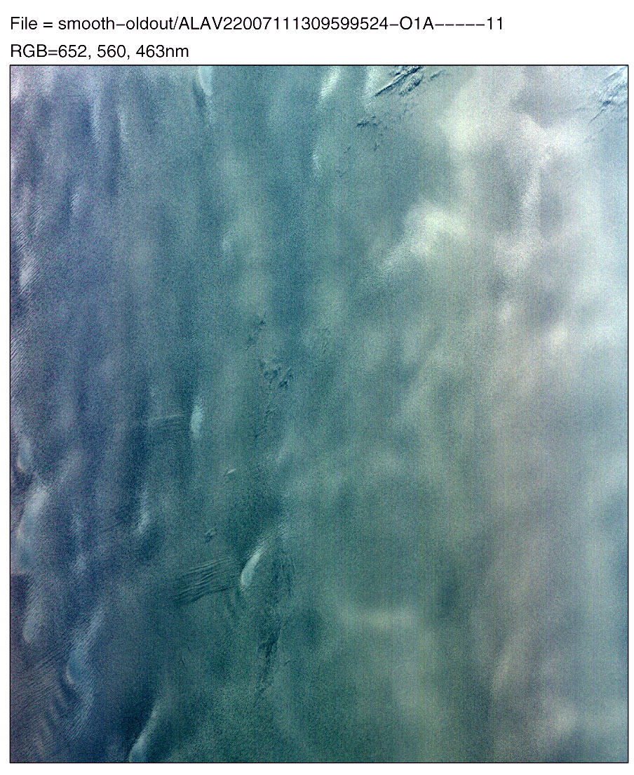
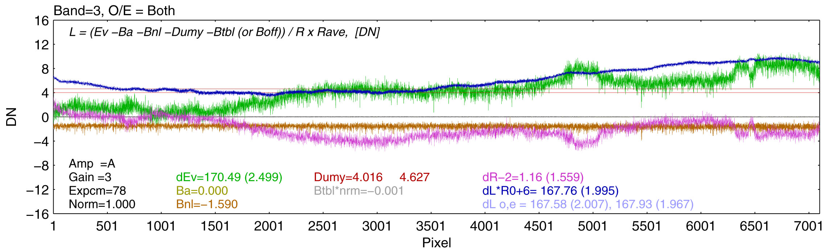
Radio Cal: AVNIR-2 FOV Calibration
Unrealistic inter-channel difference
Released on May 9, 2008
RGB
Image
2007/
11/13
L1B radiance = Real data + FOV noise + small-scale noise
(e.g., o/e, cal table error..)
Radiance (or DN)
Real data + FOV anomaly
Real TOA radiance
Pixel (FOV; ~70km)
Pixel (FOV; ~70km)
1. FOV noise
  Corrected by cross-calibration with MODIS (using a directional function of MODIS TOA reflectance)
  Temporal change is described using the internal lamp of AVNIR-2
2. Gain-mode difference
  Gain-modes 2 and 3 are corrected using the lamp data
3. Small-scale noise (<~0.5DN)
  Corrected by small scale average of smooth & bright area (polar snow fields)
Line average plot of Band 3 on 2007/11/13
L1A
L1B
Corr. tables
Pixels
21
Notes:
Next, I am describing relative geometric accuracy of PRISM, which is shows the relative alignments between CCD unit. Each CCD unit has about 5,000 pixels. The nadir looking radiometer consists of 6 CCD units, and forward- and backward radiometer consists of 8 units. If each CCD units has miss alignment, the image has also distortion within a scene. These figures shows the evaluation results of relative CCD alignments. X-axis show pixel number depends on CCD unit, and Y-axis show geometric errors, left are in X direction and right are Y direction. Currently we are operating using version 3 parameters. As the results, it still work very well within 0.7 pixels for all radiometers and directions.

Slide 23
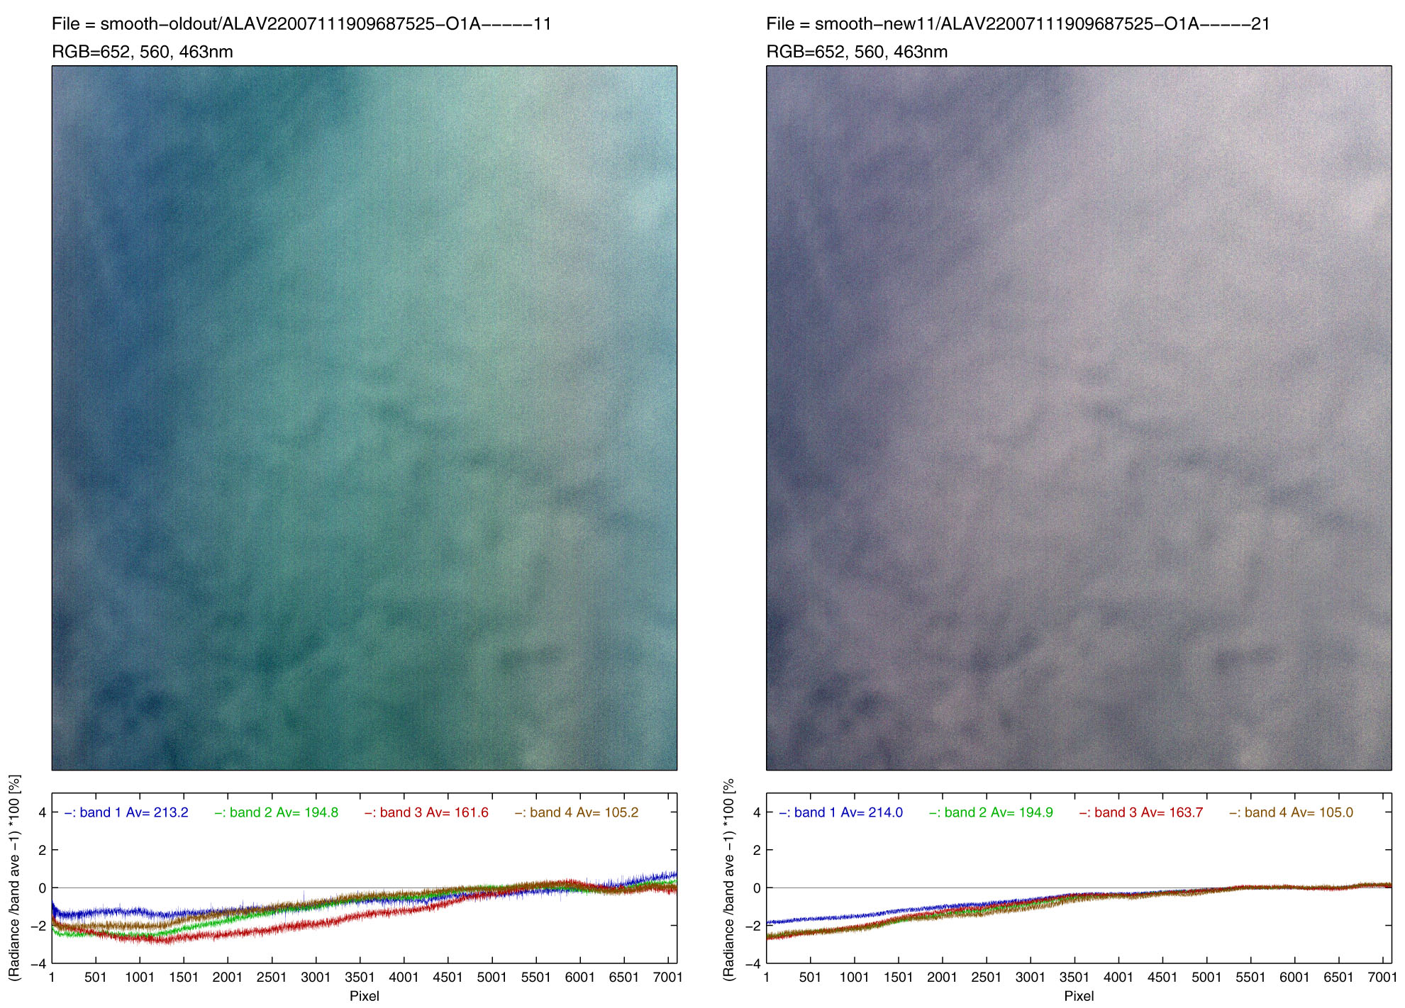
Radio Cal: AVNIR-2 FOV Calibration
Antarctic
2007/11/19
old
new
Band 3,2,1
RGB image
Band-1~4
line plot
Differences between old and new are +/- 2%
22
Notes:
Next, I am describing relative geometric accuracy of PRISM, which is shows the relative alignments between CCD unit. Each CCD unit has about 5,000 pixels. The nadir looking radiometer consists of 6 CCD units, and forward- and backward radiometer consists of 8 units. If each CCD units has miss alignment, the image has also distortion within a scene. These figures shows the evaluation results of relative CCD alignments. X-axis show pixel number depends on CCD unit, and Y-axis show geometric errors, left are in X direction and right are Y direction. Currently we are operating using version 3 parameters. As the results, it still work very well within 0.7 pixels for all radiometers and directions.

Slide 24
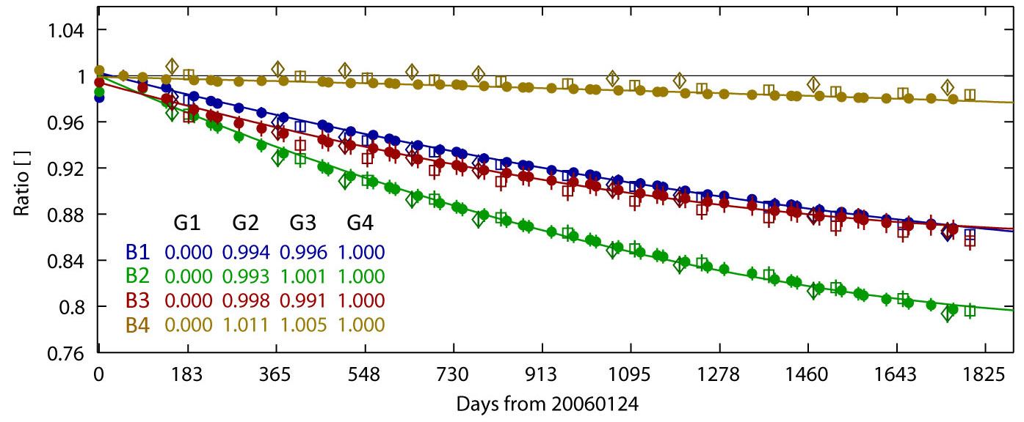
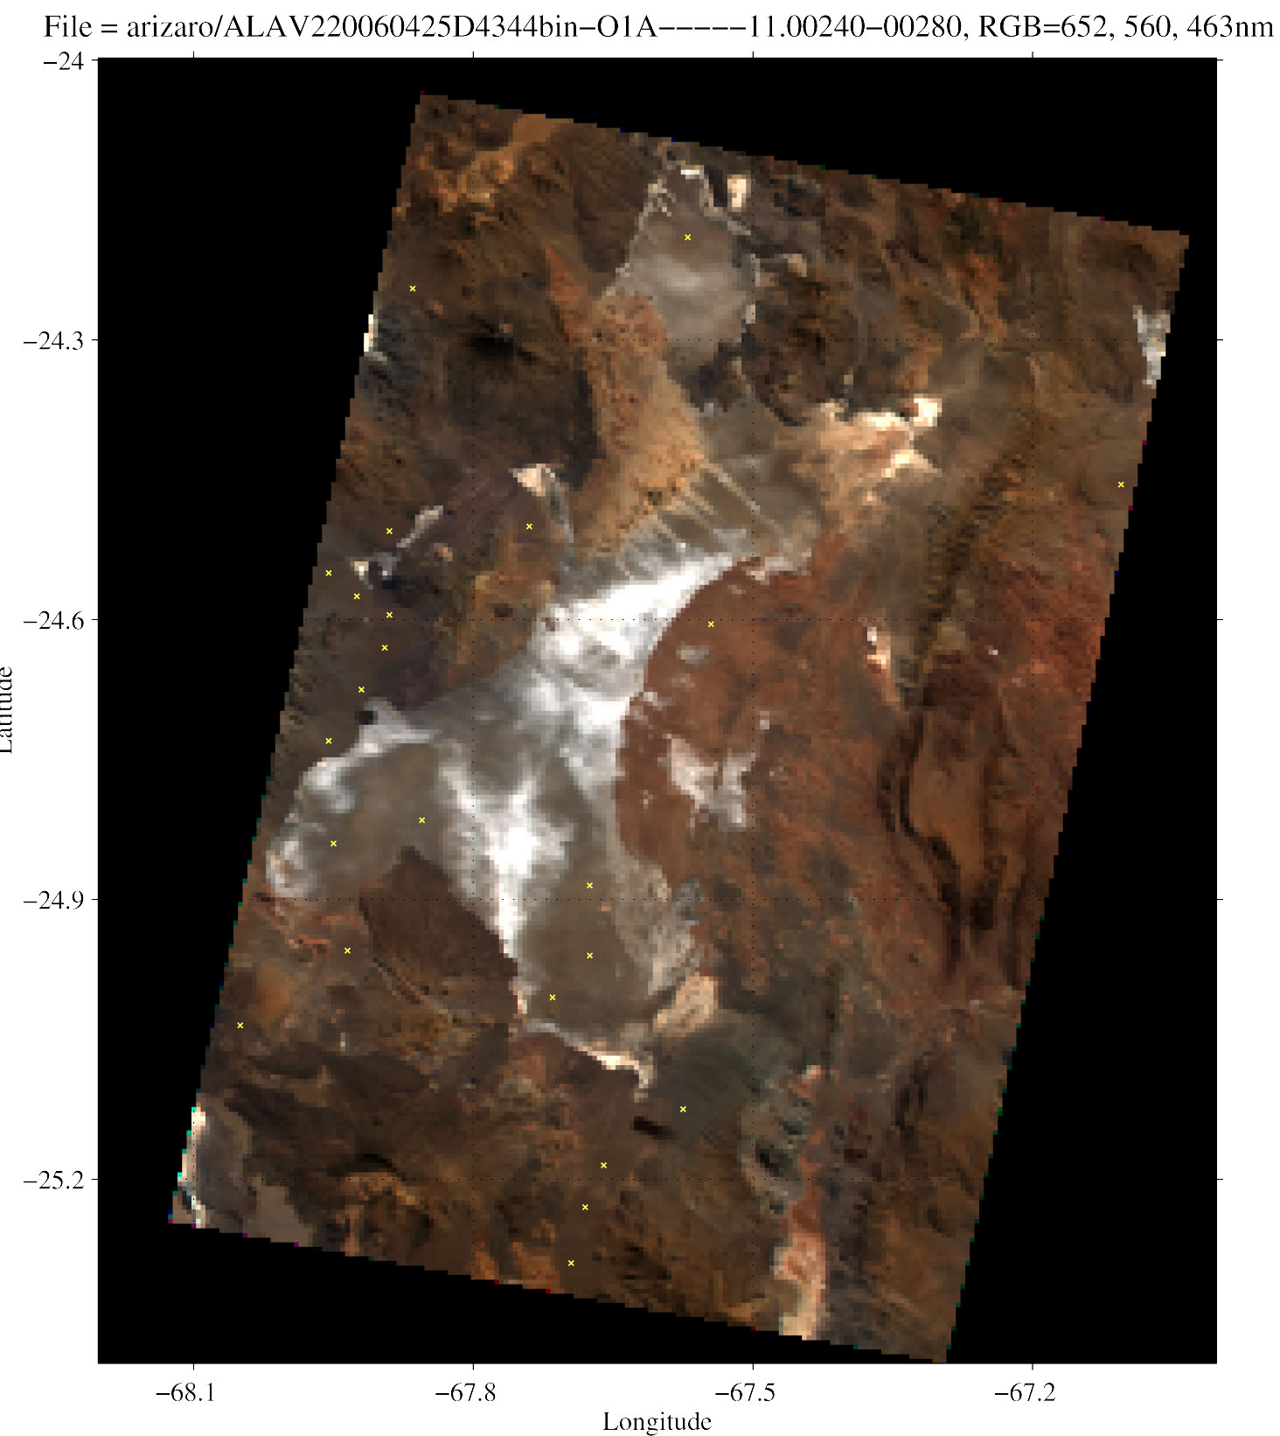
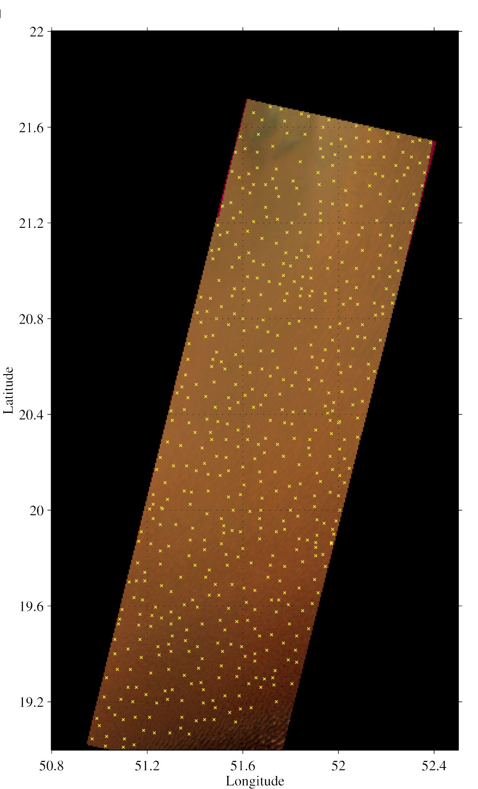
Radio Cal: AVNIR-2 Absolute Calibration
Radiometric calibration strategy
AVNIR-2 has internal calibrators i.e. two internal lumps
A problem is difficult to separate actual sensitivity degradation of the detectors and degradation of lump itself or lump monitor.
The internal calibration was used to monitor relative degradation.
Cross calibration conducted with MODIS onboard Aqua and Terra satellites as reference over homogeneous targets for absolute calibration.
MODIS are calibrating well
Numbers of evaluation scene and point can be increased
Comparison of simulated AVNIR-2 surface reflectance by MODIS and actual one at TOA over stable surfaces
Aqua/Terra MODIS 500m resolution
AVNIR-2: 500m average, variation <3%
The relative sensitivity change monitoring for AVNIR-2 during five years
06/04/25 Arizaro, Argentine. 06/05/23 Rab Khali desert.
Yellow dots shows evaluation points (variation<3%).
23

Slide 25


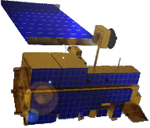
Radio Cal – TOA Reflectance Function Scheme
The scheme is a cross calibration using the similar geometric condition; solar zenith (θ₀), and relative azimuth (ϕ) angles which depend on local time and inclination angle of the orbit (ALOS ≅ Terra ≅ Aqua (N-S line symmetry) ≅ ENVISAT).
We use top-of-atmosphere (TOA) reflectance function of satellite zenith angle (θ) at target points using MODIS observations for the reference.
Merits: we can get many samples, not only nadir, and don’t need in-situ data
ALOS pointing θ^{AVNIR2}
ALOS and EOS observations
AVNIR-2 and MODIS channels
MODIS scanning in 16 days
 | ALOS AVNIR-2 | Terra MODIS | Aqua MODIS
Orbit | Sun-Synchronous Descending 10:30 | Sun-Synchronous Descending 10:30 | Sun-Synchronous Ascending 13:30
Repeat Cycle | 46 days Sub Cycle: 2 days | Repeat Cycle: 16 days Sub Cycle: 2 days
Altitude | 691.65 km | 705 km
Inclination | 98.16 deg | 98.2 deg
Satellite zenith | −44~+44 deg (pointing) | −65~+65 deg (scanning)
FOV (swath) | 70 km | 2330 km
IFOV | 10 m | 250~1000 m
-θ
AVNIR2 | MODIS
1 (463nm) | 3 (466nm)
 | 4 (554nm)
2 (560nm)
 | 1 (646nm)
3 (652nm)
4 (821nm) | 2 (856nm)
-
+θ
θ₀
E
ϕ
N
S
W
geometric condition
Geometric condition of AVNIR-2 and PRISM (Nadir) are similar to geometries in 16 days MODIS observations.
24

Slide 26
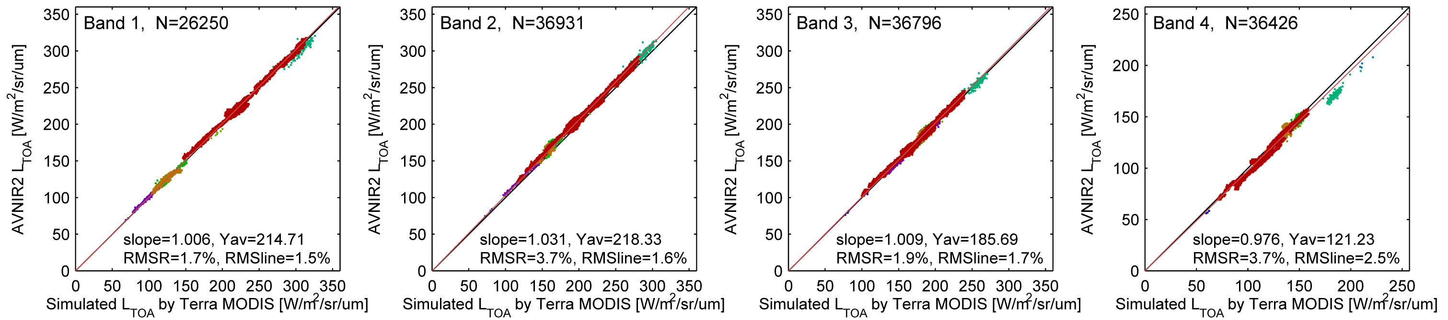
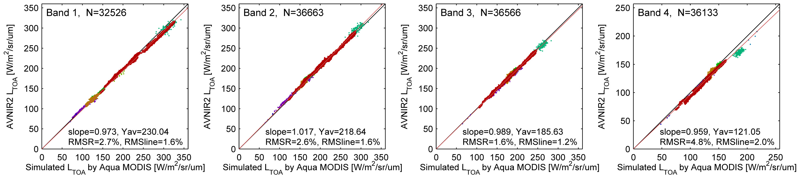
Radio Cal: AVNIR-2 Absolute Calibration Results
X axis: Simulated AVNIR-2 by Terra/MODIS
X axis: Simulated AVNIR-2 by Aqua/MODIS
AVNIR-2 | Terra/MODIS |  |  | Aqua/MODIS
Band | Number | Slope | RMSE (%) | Number | Slope | RMSE (%)
1 | 26,250 | 1.008 | 1.7 | 32,526 | 0.973 | 2.7
2 | 36,931 | 1.031 | 3.7 | 36,663 | 1.017 | 2.6
3 | 36,796 | 1.009 | 1.9 | 36,566 | 0.989 | 1.6
4 | 36,426 | 0.976 | 3.7 | 36,133 | 0.959 | 4.8
25

Slide 27
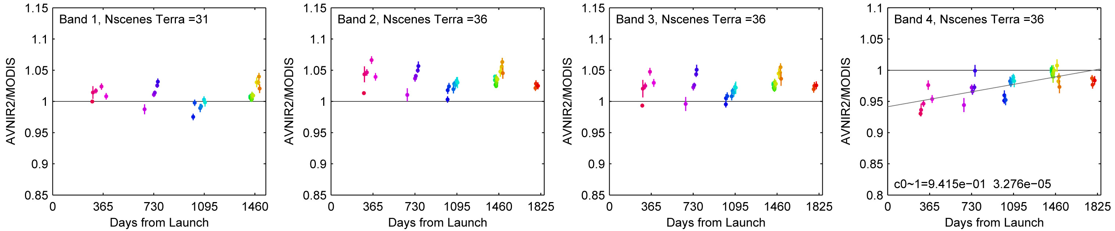
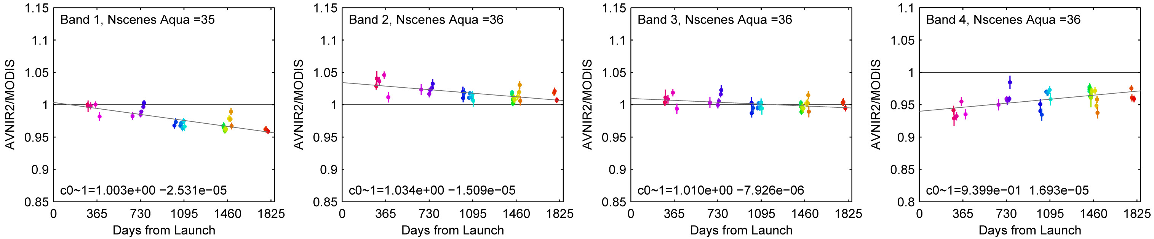
Radio Cal: AVNIR-2 Absolute Calibration Results
X axis: Simulated AVNIR-2 by Terra/MODIS
X axis: Simulated AVNIR-2 by Aqua/MODIS
Time trend of absolute radiometric accuracy of AVNIR-2 since 24 Jan. 2006
No significant time dependency
Around 5% / 5 years
Reflect to calibration factors
26

Slide 28
Radio Cal: PRISM Relative Calibration
Odd-Even pixel and inter-CCD unit difference were large sometimes in PRISM images
We assume PRISM sensor itself is stable and the error is caused by insufficient frequency of the dark-current downlink (optical black i.e. offset error)
We estimate the dark current statistically using each scenes
Released on October 19, 2007
PRISM image
Block 1
CCD
1
CCD
2
CCD
3
CCD
4
Block 2
Block 3
Block 4
Inter-CCD unit difference (offset) is corrected by overlap samples (32 pixels) after the default radiometric correction
  The correction coefficients are tuned to keep mean radiance of all CCD unit
Odd-Even pixel difference (offset) is corrected by statistics of the Even minus neighboring two Odd samples in each CCD
Above statistics are processed in each one of five line-blocks, and correction offsets are linearly interpolated by the line number
  Irregular and high-contrast samples are excluded in the statistics
Block 5
CCD overlap
Statistics in each segment
A) Odd
N-1
B) Even
N
C) Odd
N+1
Dif = B – (A + C)/2
27
Notes:
Next, I am describing relative geometric accuracy of PRISM, which is shows the relative alignments between CCD unit. Each CCD unit has about 5,000 pixels. The nadir looking radiometer consists of 6 CCD units, and forward- and backward radiometer consists of 8 units. If each CCD units has miss alignment, the image has also distortion within a scene. These figures shows the evaluation results of relative CCD alignments. X-axis show pixel number depends on CCD unit, and Y-axis show geometric errors, left are in X direction and right are Y direction. Currently we are operating using version 3 parameters. As the results, it still work very well within 0.7 pixels for all radiometers and directions.

Slide 29
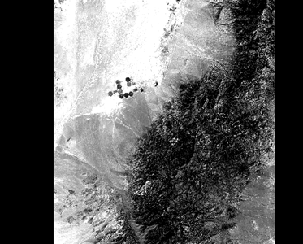
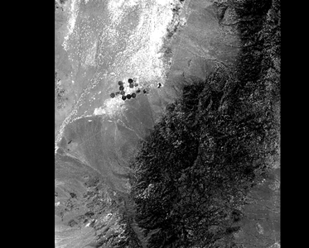
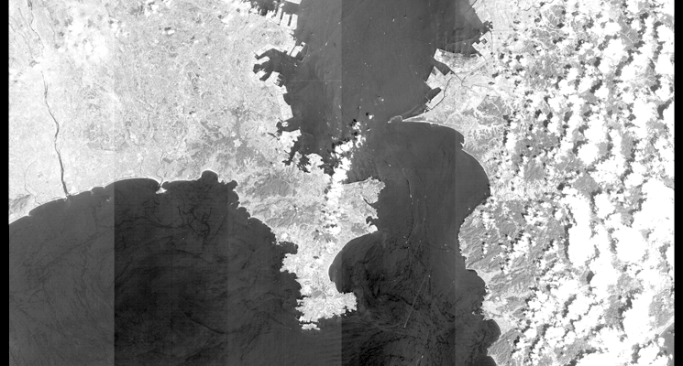
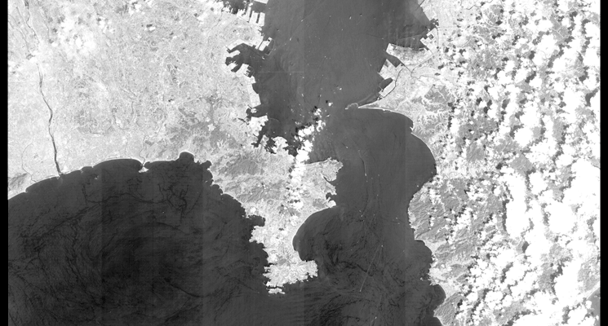
Radio Cal: PRISM CCD Sensitivity Collection
There are radiometric variations between CCDs in L1B2
→ Radiometric correction is not sufficient
→ Relative sensitivity variation between CCD
Characteristic evaluation using overlap pixel (32 pixels)
Corrected values estimation for each CCD, each gain and all radiometers.
  Separate to pixel-to-pixel variation
Correction of sensitivity variation between CCDs.
1B1, ALPSMN029422830-O1B1, left: before correction, right: after correction
Correction of sensitivity variation between CCDs.
1B1, ALPSMW031652890-O1B1___W, left: before correction, right: after correction
28

Slide 30
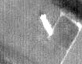
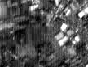
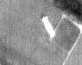
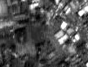
Radio Cal: PRISM Stripe Noise Reduction
ALPSM20070803081102820 Forward
Before
After
29
Notes:
Next, I am describing relative geometric accuracy of PRISM, which is shows the relative alignments between CCD unit. Each CCD unit has about 5,000 pixels. The nadir looking radiometer consists of 6 CCD units, and forward- and backward radiometer consists of 8 units. If each CCD units has miss alignment, the image has also distortion within a scene. These figures shows the evaluation results of relative CCD alignments. X-axis show pixel number depends on CCD unit, and Y-axis show geometric errors, left are in X direction and right are Y direction. Currently we are operating using version 3 parameters. As the results, it still work very well within 0.7 pixels for all radiometers and directions.

Slide 31
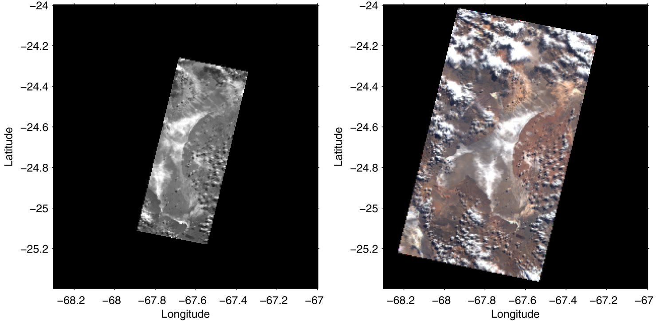


Radio Cal: PRISM Cross-Cal with AVNIR-2
Comparison of TOA radiances between simulated PRISM by AVNIR-2 (x axis) and actual PRISM (y axis).
Example of images observed simultaneously with PRISM nadir (left) and AVNIR-2
over Arizaro Salt Lake, Argentina on May 2, 2006.
Absolute radiometric calibration of PRISM is achieved by cross-cal with simultaneously acquired AVNIR-2
  The nadir image can observe under same geometry and same atmospheric condition at the same time
Comparison is done by top-of-atmosphere (TOA) radiances calculated from simulated PRISM reflectance by AVNIR-2 and actual PRISM radiance
The radiances agree well with 3.6% (RMSE)
Response functions comparison
30
Notes:
Next, I am describing relative geometric accuracy of PRISM, which is shows the relative alignments between CCD unit. Each CCD unit has about 5,000 pixels. The nadir looking radiometer consists of 6 CCD units, and forward- and backward radiometer consists of 8 units. If each CCD units has miss alignment, the image has also distortion within a scene. These figures shows the evaluation results of relative CCD alignments. X-axis show pixel number depends on CCD unit, and Y-axis show geometric errors, left are in X direction and right are Y direction. Currently we are operating using version 3 parameters. As the results, it still work very well within 0.7 pixels for all radiometers and directions.

Slide 32

Calibration Results of PRISM/AVNIR-2
Standard Product | Previous results as of July 1, 2009 | Results as of Sep. 6, 2011 (Public*)
PRISM 1B2 | Geometry (Jun. 22, 2007-Jun. 4, 2009) Absolute Accuracy (RMS) Pixel (X) Line (Y) Distance Nadir 5.6m 5.3m 7.8m using 5,499 GCPs, 586 scenes Forward 4.9m 6.1m 7.8m using 1,771 GCPs, 225 scenes Backward 5.0m 7.1m 8.7m using 4,839 GCPs, 525 scenes Relative Accuracy (1σ) 3 radiometers 1.4m 1.8m 2.4m CE90 Nadir 11.8m, Forward 12.4m, Backward 13.4m Radiometry Absolute accuracy: similar to that of AVNIR-2 | Geometry (Aug. 27, 2007-Apr. 18, 2011) Absolute Accuracy (RMS) Pixel (X) Line (Y) Distance Nadir 3.5m 5.0m 6.1m using 5,154 GCPs, 584 scenes Forward 3.3m 5.0m 5.9m using 1,572 GCPs, 216 scenes Backward 3.5m 6.8m 7.6m using 4,077 GCPs, 475 scenes Relative Accuracy (1σ) 3 radiometers 1.5m 1.8m 2.4m CE90 Nadir 9.4m, Forward 9.1m, Backward 12.1m Radiometry Absolute accuracy: similar to that of AVNIR-2
AVNIR-2 1B2 | Geometry (all period) Absolute Accuracy (RMS) Pixel (X) Line (Y) Distance 0 deg. pointing 71.1m 7.5m 71.9m +/-41.5 deg. 60.9m 96.6m 114.2m Relative Accuracy (1σ) 3.4m 7.7m 8.5m using 1,035 GCPs, 54 scenes Radiometry (all period) Absolute accuracy Band 1-3: 3.2%, Band4: 7.3% | Geometry (all period) Absolute Accuracy (RMS) Pixel (X) Line (Y) Distance 0 deg. pointing 19.8m 9.4m 21.9m +/-41.5 deg. 31.3m 14.1m 34.3m Relative Accuracy (1σ) 8.8m 3.3m 9.9m using 1,329 GCPs, 118 scenes Radiometry (all period) Absolute accuracy Band 1-3: 3.2%, Band4: 7.3%
* Latest ALOS calibration result can be find at
http://www.eorc.jaxa.jp/hatoyama/satellite/data_tekyo_setsumei/alos_hyouka_e.html in English
31

Slide 33

Conclusions
This presentation described summary of calibration results of PRISM and AVNIR-2 onboard ALOS, which was unfortunately terminated on May 2011 however global archive data are available. Therefore calibration information is still important not only for data users but also for sensor developer in the feature mission.
1) Archived data are still available for users. These may be helpful for any
applications as a base-information in 2006-2011,
2) Geometric accuracy evaluation results of PRISM and AVNIR-2,
- Relative geometric accuracies within 1 pixel,
- Absolute accuracy of PRISM/N is 6.1 m (RMSE) and 9.4 m (CE90),
- 21.9 m (RMSE) and 37.7 m (CE90) achieved for AVNIR-2/0deg.,
3) Radiometric accuracy evaluation result of AVNIR-2,
- 4.8 % (RMSE) absolute accuracy and 5 % stability.
These knowledge and experiences will be reflected in the feature mission i.e. ALOS-3.
32

Slide 34

Cal/Val Test Sites for PRISM and AVNIR-2
Except for Japan area, As of December 28, 2006
Location of Cal/Val Test Sites for PRISM and AVNIR-2 in the world.
Notes:
These figures show time trend of geometric accuracy of PRISM nadir-looking radiometer. Upper figures show the average error that corresponds to absolute accuracy, and lower show the standard deviation of errors that relative accuracy. The color indicate updating pointing alignment parameters. We are using GCPs as check points.

Slide 35

Cal/Val Test Sites for PRISM and AVNIR-2
As of December 28, 2006
Location of Cal/Val Test Sites for PRISM and AVNIR-2 in Japan.
Notes:
These figures show time trend of geometric accuracy of PRISM nadir-looking radiometer. Upper figures show the average error that corresponds to absolute accuracy, and lower show the standard deviation of errors that relative accuracy. The color indicate updating pointing alignment parameters. We are using GCPs as check points.

Slide 36
























Acquisition Results of PRISM
May 16, 2006 – April 22, 2011
PRISM OB1 (35km) (Cloud cover: 0~2% / scene)
PRISM OB1 (35km) (Cloud cover: 0~20% / scene)
PRISM OB2 (70km) (Cloud cover: 0~2% / scene)
PRISM OB2 (70km) (Cloud cover: 0~20% / scene)
PRISM coverage based on the basic observation scenario
Total: 8,737,329 scenes for all directions
3,118,518 scenes for nadir radiometer
1
4
7
More than 10
2
5
8
3
6
9
Notes:
These figures show the acquisition status of PRISM and AVNIR-2. The upper figures show the acquired areas based on the Scenario. It seems to be already covered almost of entire global areas. However, these images are affected by clouds. Therefore, lower figures show the area only selected less than two percents cloud cover in a scene. Even so, PRISM is already covered about 50 percents, and AVNIR-2 is covered 64 percents, respectively.

Slide 37












Acquisition Results of AVNIR-2
May 16, 2006 – April 22, 2011
AVNIR-2 (Cloud cover: 0~2% / scene)
AVNIR-2 (Cloud cover: 0~20% / scene)
1
4
7
More than 10
2
5
8
3
6
9
AVNIR-2 coverage based on the basic observation scenario
Total: 1,325,411 scenes
Notes:
These figures show the acquisition status of PRISM and AVNIR-2. The upper figures show the acquired areas based on the Scenario. It seems to be already covered almost of entire global areas. However, these images are affected by clouds. Therefore, lower figures show the area only selected less than two percents cloud cover in a scene. Even so, PRISM is already covered about 50 percents, and AVNIR-2 is covered 64 percents, respectively.

Slide 38
























Acquisition Results of PALSAR
May 16, 2006 – April 22, 2011
PALSAR FBS 34.3 HH (Asc.)
PALSAR FBD 34.3 HH+HV (Asc.)
PALSAR PLR 21.5 (Asc., Selected areas)
PALSAR WB1/WB2 27.1 (Desc.)
PALSAR coverage based on the basic observation scenario
Total: 2,096,793 scenes
All three total: 6.54 million (nadir only) or 12.16 million scenes
1
4
7
More than 10
2
5
8
3
6
9
Notes:
These figures show the acquisition status of PRISM and AVNIR-2. The upper figures show the acquired areas based on the Scenario. It seems to be already covered almost of entire global areas. However, these images are affected by clouds. Therefore, lower figures show the area only selected less than two percents cloud cover in a scene. Even so, PRISM is already covered about 50 percents, and AVNIR-2 is covered 64 percents, respectively.

Slide 39



Concept of Geometric Calibration for PRISM
Accuracy evaluation
Calibration
Reference i.e. GCPs
Parameters and algorithms update
PRISM Data
EOC
System correction
Sensor model < Relative cal.
Pointing Alignment Parameter (AP)
< Absolute cal.
Position and attitude data
Level 1
EORC
EORC Alignment Variation Model
< Absolute cal.
Research Products
http://www.eorc.jaxa.jp/ALOS/en/calval/calval_index.htm
Digital surface model (DSM)
Ortho rectified image (ORI)
Rational polynomial coefficient (RPC)
Other applications

Slide 40


ALOS Happened Anomaly
ALOS was put into the Low Load Mode (LLM) of operation at 6:41:10am on 22 April 2011 (JST) due to a reduction in on-board power generation capacity.
The electric parts might happened anomaly, and finally depleted the battery power.
Power generation
Day time
Time (JST)
LLM over Belgium
Normal operation
before LLM

Slide 41
Calibration Results of PALSAR
Radiometric calibration accuracy (common for all the off-nadir angles)¹
Absolute accuracy |  | 0.76dB （1σ） : Corner reflector 0.22dB （1σ）: Amazon Forest *
Noise equivalent sigma-naught |  | -34dB (FBD-HV) -32dB (FBD-HH) -29dB (FBS-HH)
Amplitude ratio of VV/HH for PLR |  | 1.013 （0.062：1σ）
Phase difference of VV and HH for PLR |  | 0.612deg (2.66deg：1σ)
Cross talk (PLR) |  | 31.7dB
Resolution | Single look in azimuth | 4.49m
 | Range | 9.6m (FBD, PLR, DSN)
 | Range | 4.8m (FBS)
Side lobes | In azimuth | -16.6dB
 | In range | -12.6dB
 | Two-dimensional | -8.6dB
Ambiguity | Azimuth | －
 | Range | 23dB
Geometric accuracy (common for all the incidence angles) ²
FBS, FBD, PLR, DSN |  | 9.7m (RMS)
WB1, WB2 |  | 70m (RMS)
as of July 1, 2009
¹ Measurements of radiometric accuracy: Statistical analysis of the impulse response of the corner reflectors (CRs) at the calibration site and the responses from the Amazon rainforest. * Standard deviation of the incidence angle dependence of the gamma-naught** measured for five off-nadirs (e.g. 9.9, 21.5, 34.3, 41.5, and 50.8 degrees). ** Gamma-naught: normalized radar cross section (NRCS or sigma-naught) divided by the cosine of incidence angle.
² Measurements of geometric accuracy: Statistical evaluation of the worldwide CRs in total 572 and calculation of the root sum square of the distance between the position of the CRs, that is identified in the PALSAR image and obtained from the PALSAR geometric conversion formula, and its true location on the GRS80 that is calculated from the CR true measurement and the SAR observation geometry.

Slide 42




ALOS Last Shots
PRISM (RSP538): 21 April 2011 20:21 (UTC)
AVNIR-2 (RSP538): 21 April 2011 20:21 (UTC)

Slide 43



ALOS Last Shots
PALSAR: 21 April 2011 21:15 (UTC)
Lake Chad, Africa

