Slide 1


Calibration activities of ALOS-2 PALSAR-2
○Takeshi Motohka
Masanobu Shimada, Yukihiro Kankaku, Shinichi Suzuki
Japan Aerospace Exploration Agency (JAXA)
ALOS-2 Project Team / Earth Observation Research Center

Slide 2
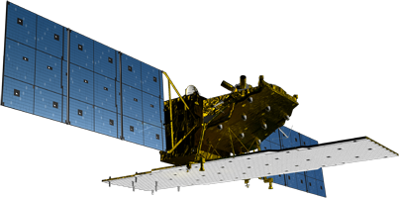
ALOS-2 satellite
L-band SAR (PALSAR-2) | Stripmap: 3 to 10m res., 50 to 70 km swath ScanSAR: 100m res., 350km/490km swath Spotlight: 1×3m res., 25km swath
Orbit | Sun-synchronous orbit Altitude: 628km Local sun time : 12:00 +/- 15min Revisit: 14days Orbit control: ≦+/-500m
Life time | 5 years (target: 7 years)
Launch | May 24, 2014 H-IIA launch vehicle
Downlink | X-band: 800Mbps(16QAM) 400/200Mbps(QPSK) Ka-band: 278Mbps (Data Relay)
Y
X
Z
Antenna of L-band Synthetic Aperture Radar (SAR) [PALSAR-2]
Experimental equipments
Compact InfraRed Camera (CIRC)
SPace based Automatic Identification System Experiment (SPAISE2)
Notes:
ALOS-2 carries L-band Synthetic Aperture Radar called PALSAR-2.
The local sun time is at noon in order to complement other SAR satellites which are in dawn-dusk orbits. The revisit time is shortened from that of ALOS and the orbit is controlled within 500m tube for interferometry.
The observation data is transmitted either directly to a ground station via X-band at 800Mbps or through inter-satellite communication via Ka-band at 278Mbps.

Slide 3
ALOS-2 Mission Objectives
Disaster Monitoring
Environmental monitoring for Biosphere, Geosphere, Cryosphere, and Hydrosphere
Agriculture, Ocean monitoring, and Natural Resources
Technology Development for the Future Earth Remote sensing (satellite and sensor)

Slide 4
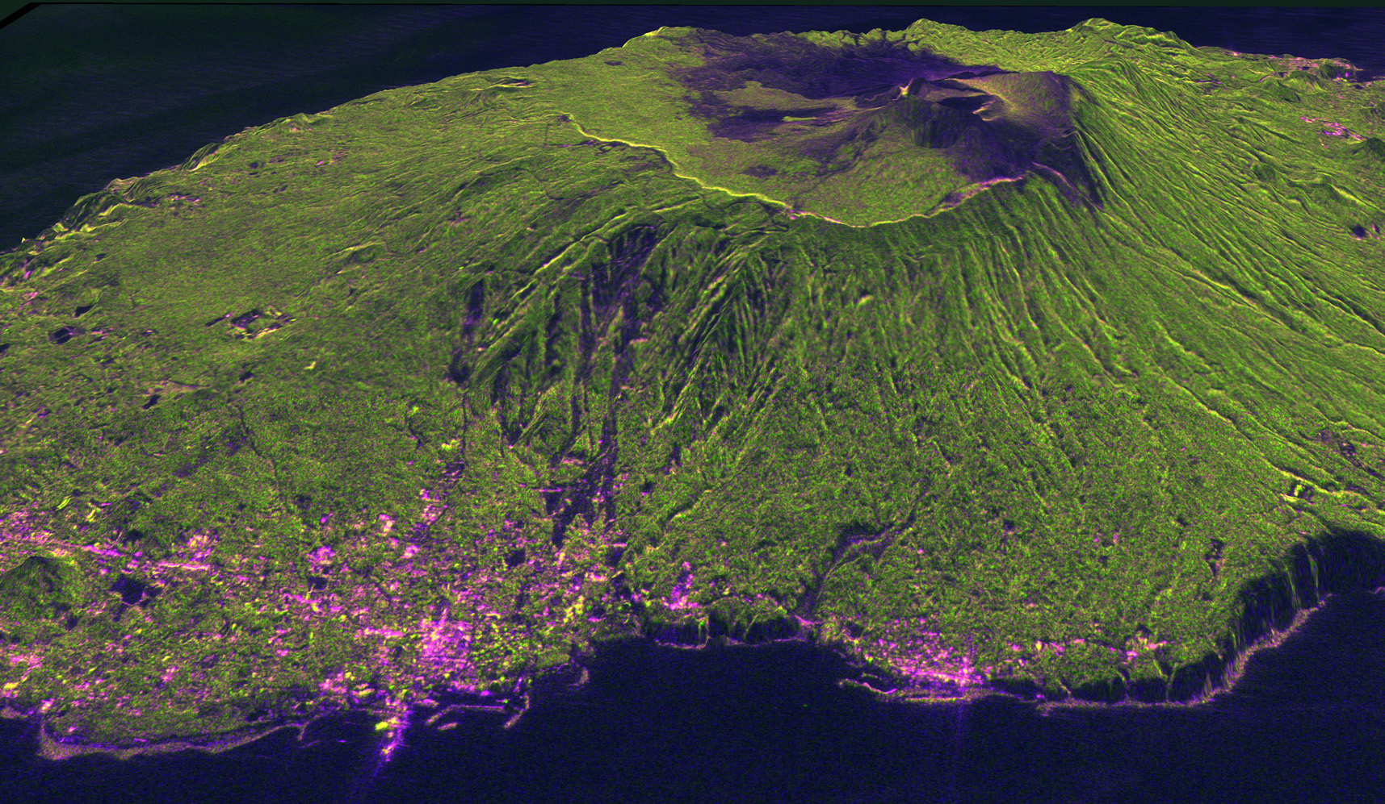
Izu-Oshima Island
PALSAR-2の機能確認の一環として初画像を取得

Slide 5
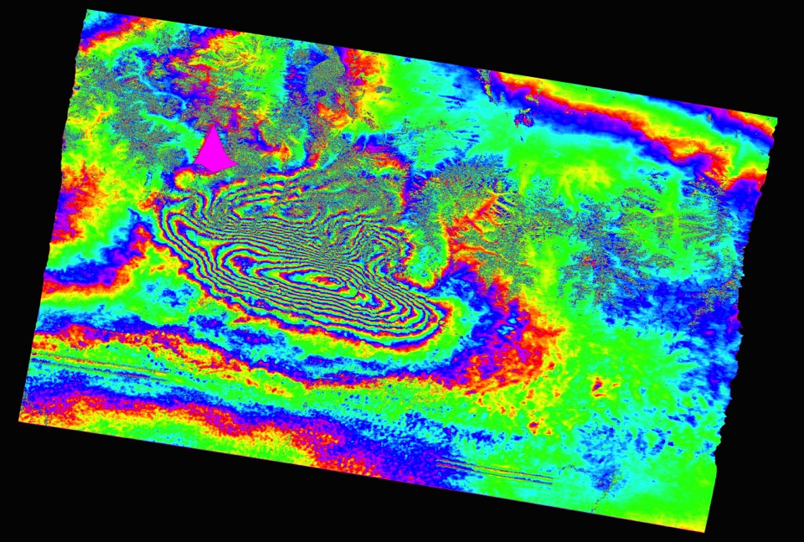

Nepal Earthquake (Apr. 2015)
SAR Interferometry for detection of crustal deformation
-5.9cm 5.9cm

Slide 6
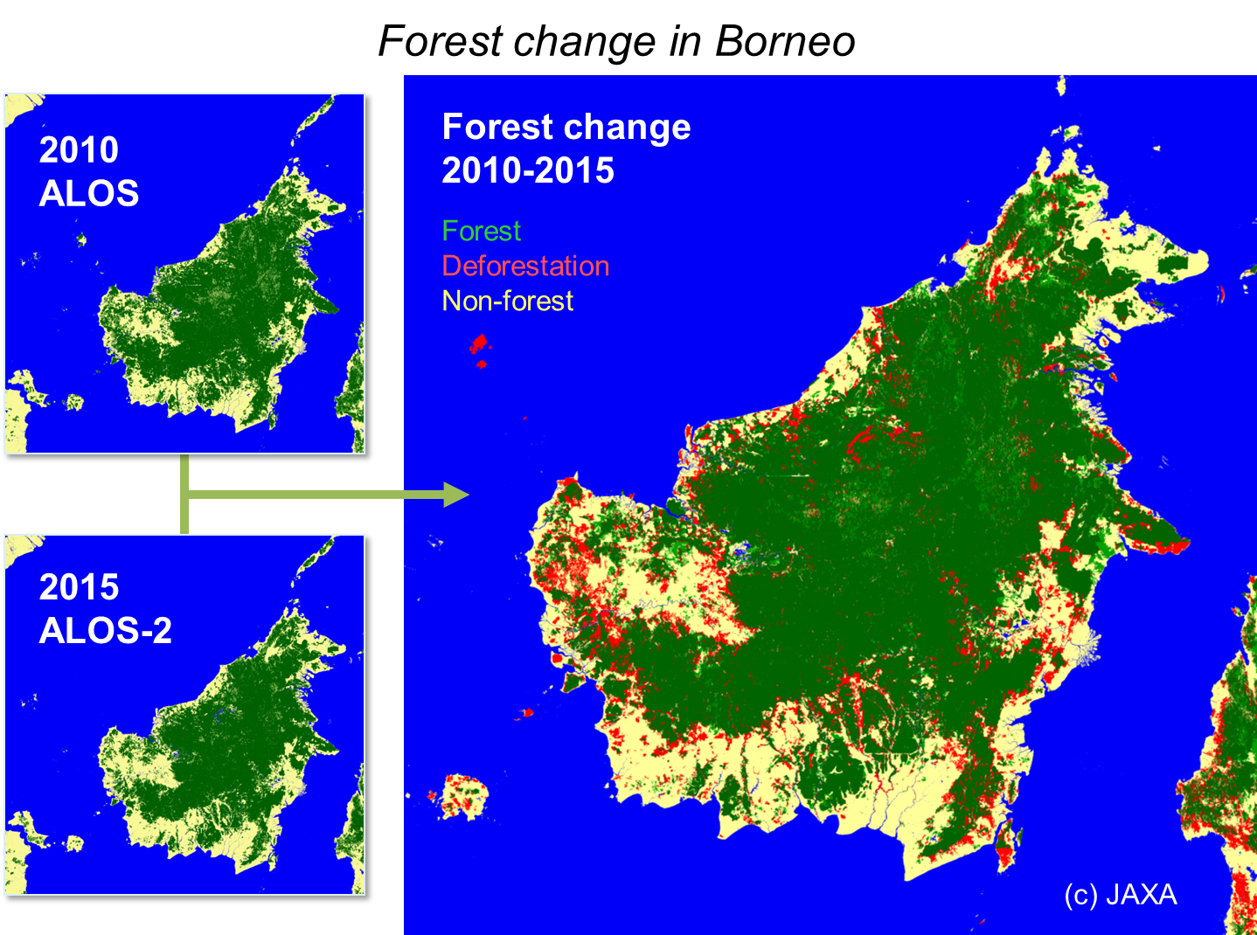
Global forest monitoring

Slide 7
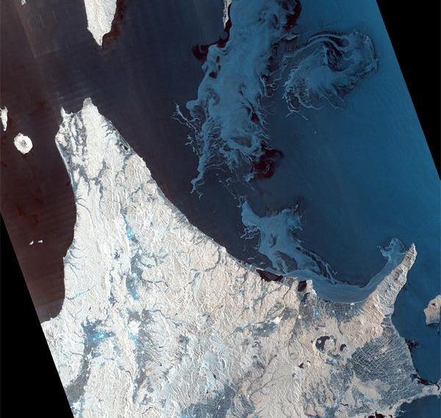
Drift Ice in Okhotsk Sea

Slide 8
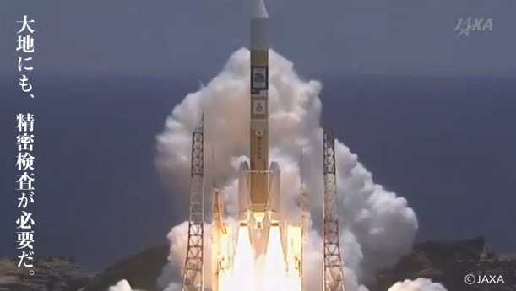
ALOS-2 Schedule and status
2014
May 24-26 launched and PALSAR-2 antenna deployed.
June 19-21 PALSAR-2 first images were acquired.
Aug. 4 Initial Calibration started
Aug. 20 Move to the operational observation phase
Nov. 25 starts the product distribution
2015〜
Ongoing global observation and the emergency observation
Initial Cal.
(3.5 months)
Routine Cal.

Slide 9
PALSAR-2 Calibration
Raw data evaluation
SAR imaging evaluation
Calibration
  Radiometry (backscattering coefficient)
  Geometry
  Polarimetry
Image quality
  Noise equivalent sigma zero (NESZ)
  Signal to ambiguity ratio (range and azimuth)
  Polarimetry
  RFI, Ionospheric effects
Raw Signal
SAR Imaging
Image product

Slide 10
Observation modes of PALSAR-2
Mode |  | Stripmap mode |  |  |  | ScanSAR mode
 |  | Spotlight | Ultra Fine | High Sensitive | Fine | Nominal |  | Wide
Center frequency |  | 1257.5 MHz |  |  | 1236.5/1257.5/1278.5 MHz
Bandwidth |  | 84 MHz | 84 MHz | 42 MHz | 28 MHz | 14 MHz | 28 MHz | 14 MHz
Resolution |  | 3m×1m | 3m | 6m | 10m | 100m (3 looks) |  | 60m (1.5 looks)
Swath |  | 25×25km | 50km | 50km | 70km | 350km |  | 490km
Polarization |  | S | S/D | S/D/F/C |  | S/D
NESZ |  | -24dB | -24dB | -28dB | -26dB | -26dB | -23dB | -23dB
S/A | Range | 25dB | 25dB | 23dB | 25dB | 25dB |  | 20dB
 | Azimuth | 20dB | 25dB | 20dB | 23dB | 20dB |  | 20dB
Polarization: S=Single, D=Dual, F=Full, C=Compact-pol.
NESZ: Noise equivalent sigma zero
S/A: Signal to ambiguity ratio
Notes:
Each image mode is expected to be used by different applications.
The more modes combined with polarization, left/right looking, the more conflicts among user requests.

Slide 11
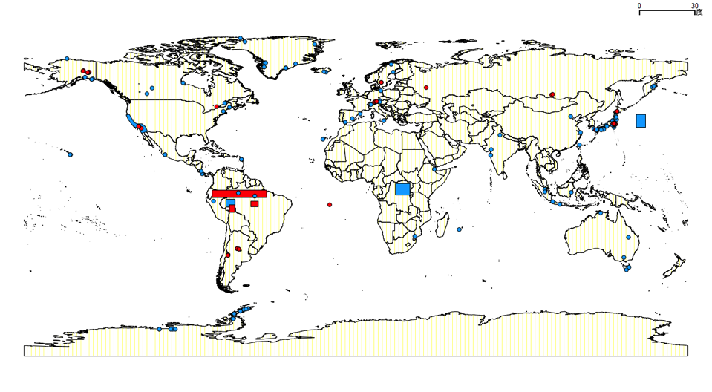
Global calibration sites
Circle: Corner reflector sites (JAXA and CVST team)
Box: Target regions for calibration of antenna pattern and image quality

Slide 12
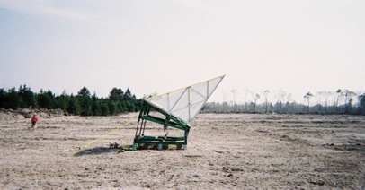
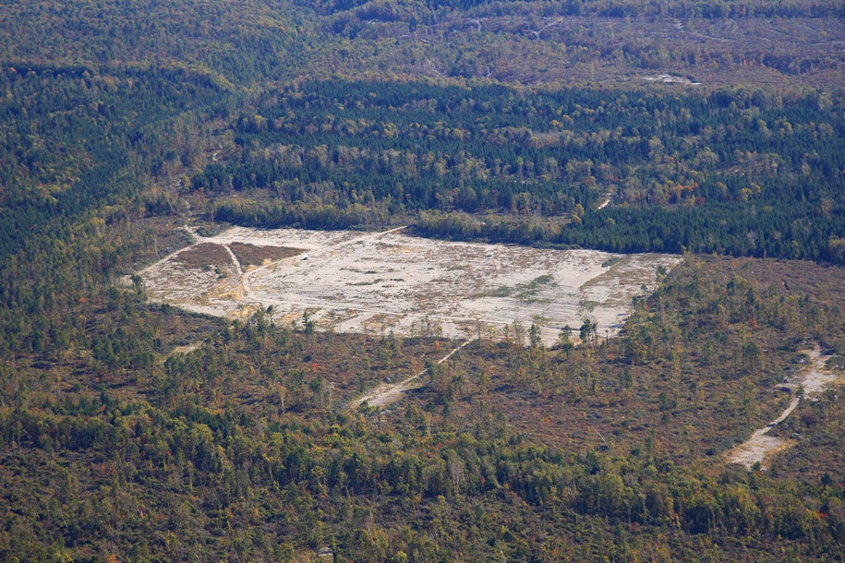
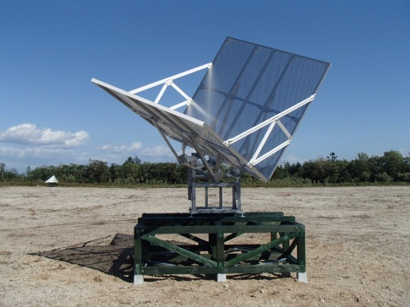
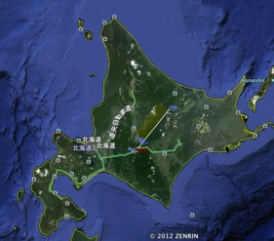
Tomakomai calibration site
3m Corner reflectors

Slide 13
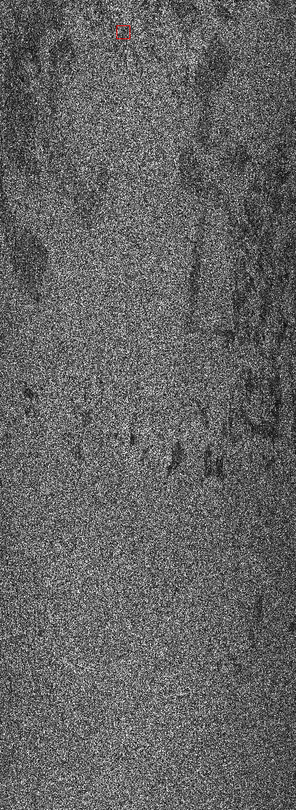
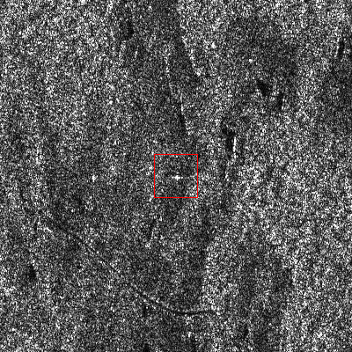
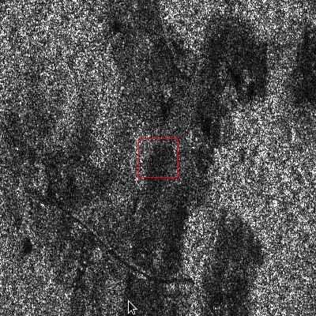
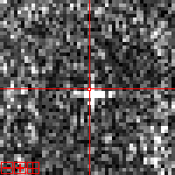
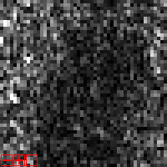
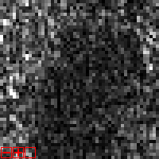
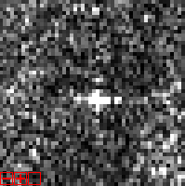
HBQ250/RSP028/2014.8.4/Rio Branco J02(CR3.0m)
HH
HV
VH
VV
HH
HV
VH
VV

Slide 14
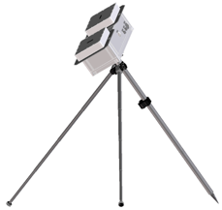
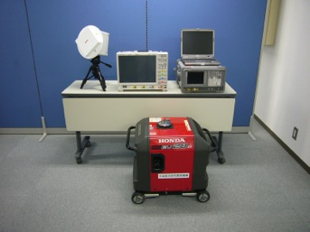
Active Radar Calibrator and SAR signal receiver
SAR
Tx/Rx antenna
Geometric calibrator with location uncertainty of 1 cm
45 (0, 90 deg) degree rotational ARC.
Manually controlled for off nadir angle.
High RCS stability using thermally insulated units
Wide resistance for temperature and humidity
ARC mode prepares the H and V phase difference
ARC
三脚
 | GCx2 | Receiver
Frequency band | 1215-1300MHz | 1215-1300MHz
Off nadir angle | 9.9～50.8° | 9.9～50.8°
RCS or receiving capability | 25dBm2:Spotlight 30dBm2:3m strip 35dBm2:6m strip 40dBm2:10mstrip | 100Mhz AD conversion
ALOS tracking | No | No
temperature range | -10～＋50℃ | -10～＋50℃
Humidity range | 35～100%RH | 35～100%RH
Receiver

Slide 15
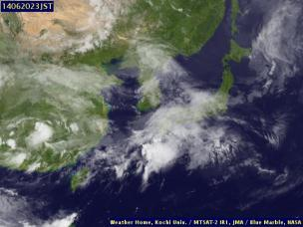
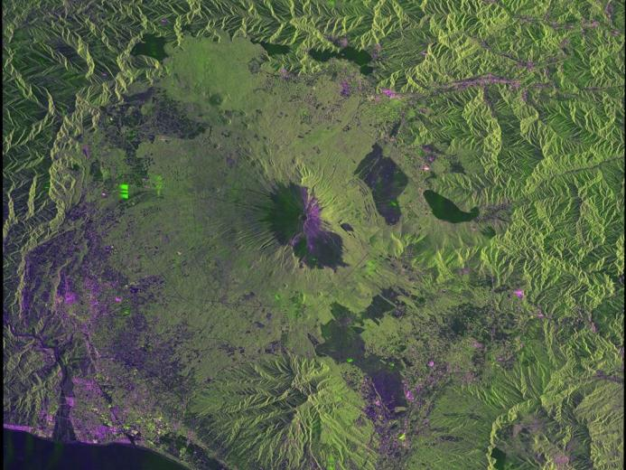
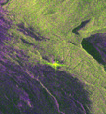
First image of PALSAR-2
Weather: cloudy
Ultra-Fine mode (3m dual-pol.) image over Mt. Fuji at night
Signal of an active rader calibrator

Slide 16
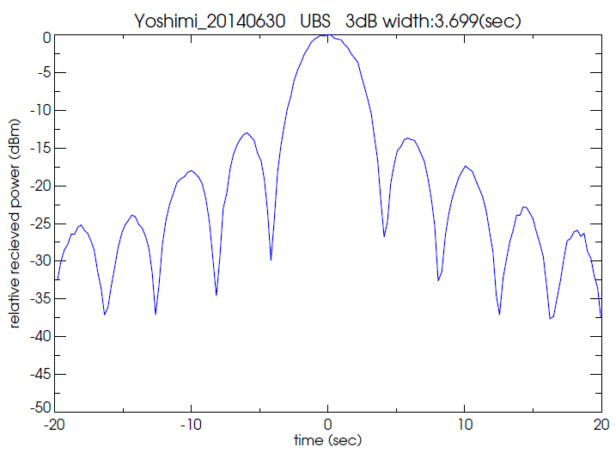
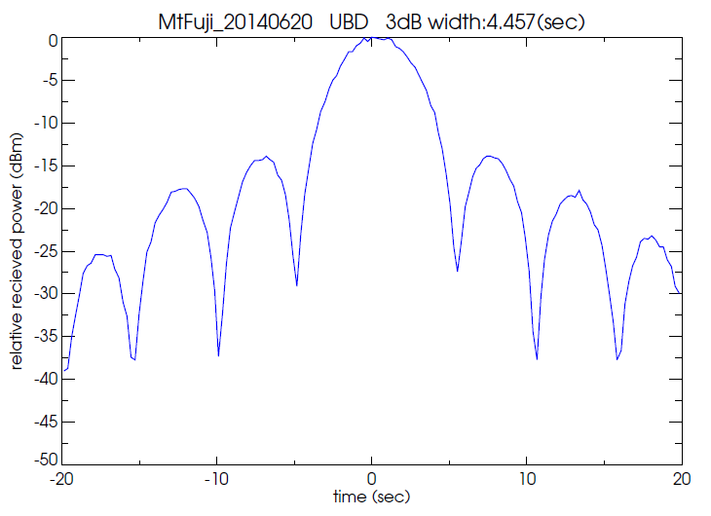
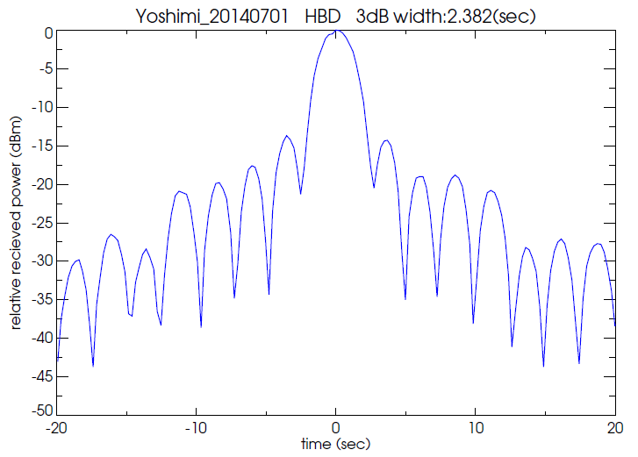
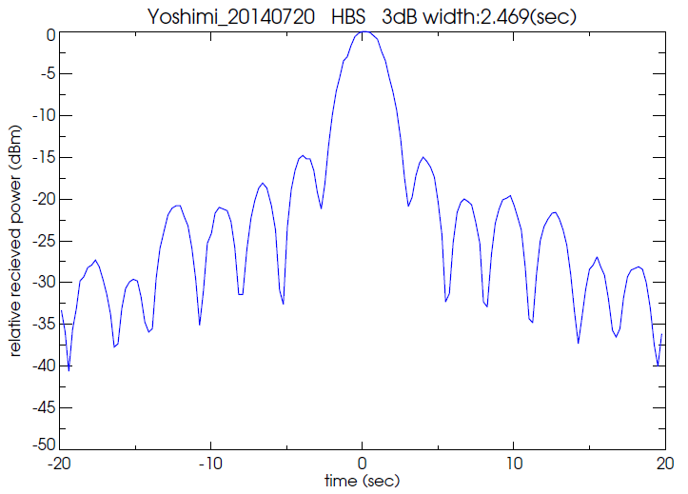
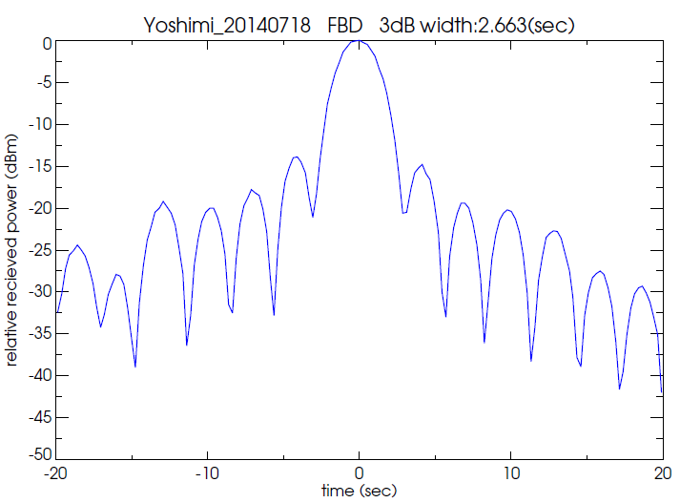
Transmit antenna patterns measured by in-situ receiver
3m res.
(Single-pol.)
3m res.
(Dual-pol.)
6m res.
(Single-pol.)
HBD
10m res.
(dual-pol.)

Slide 17
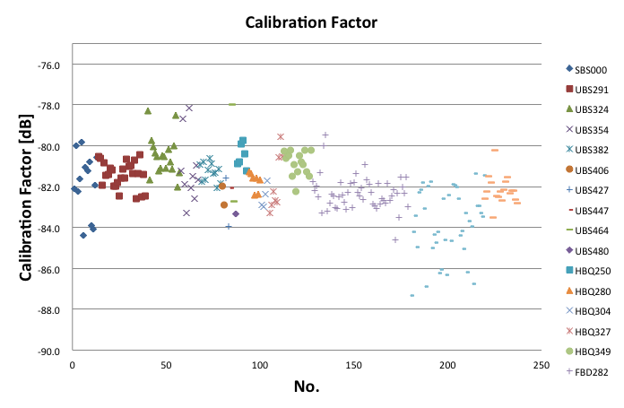
  Radiometric calibration
Calibration factor for conversion from digital number to backscattering coefficient (sigma zero) is determined by using point target observations
There are no big changes from initial calibration phase
Year 2014-2015
Mean=-82.0dB(±1.47dB)

Slide 18
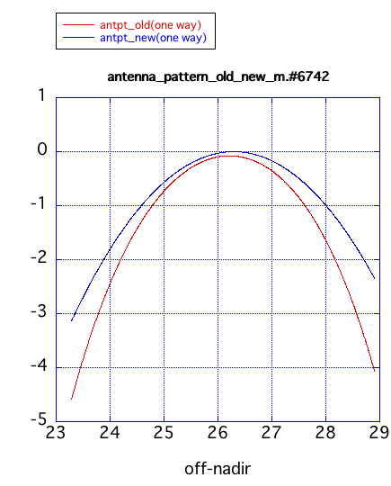
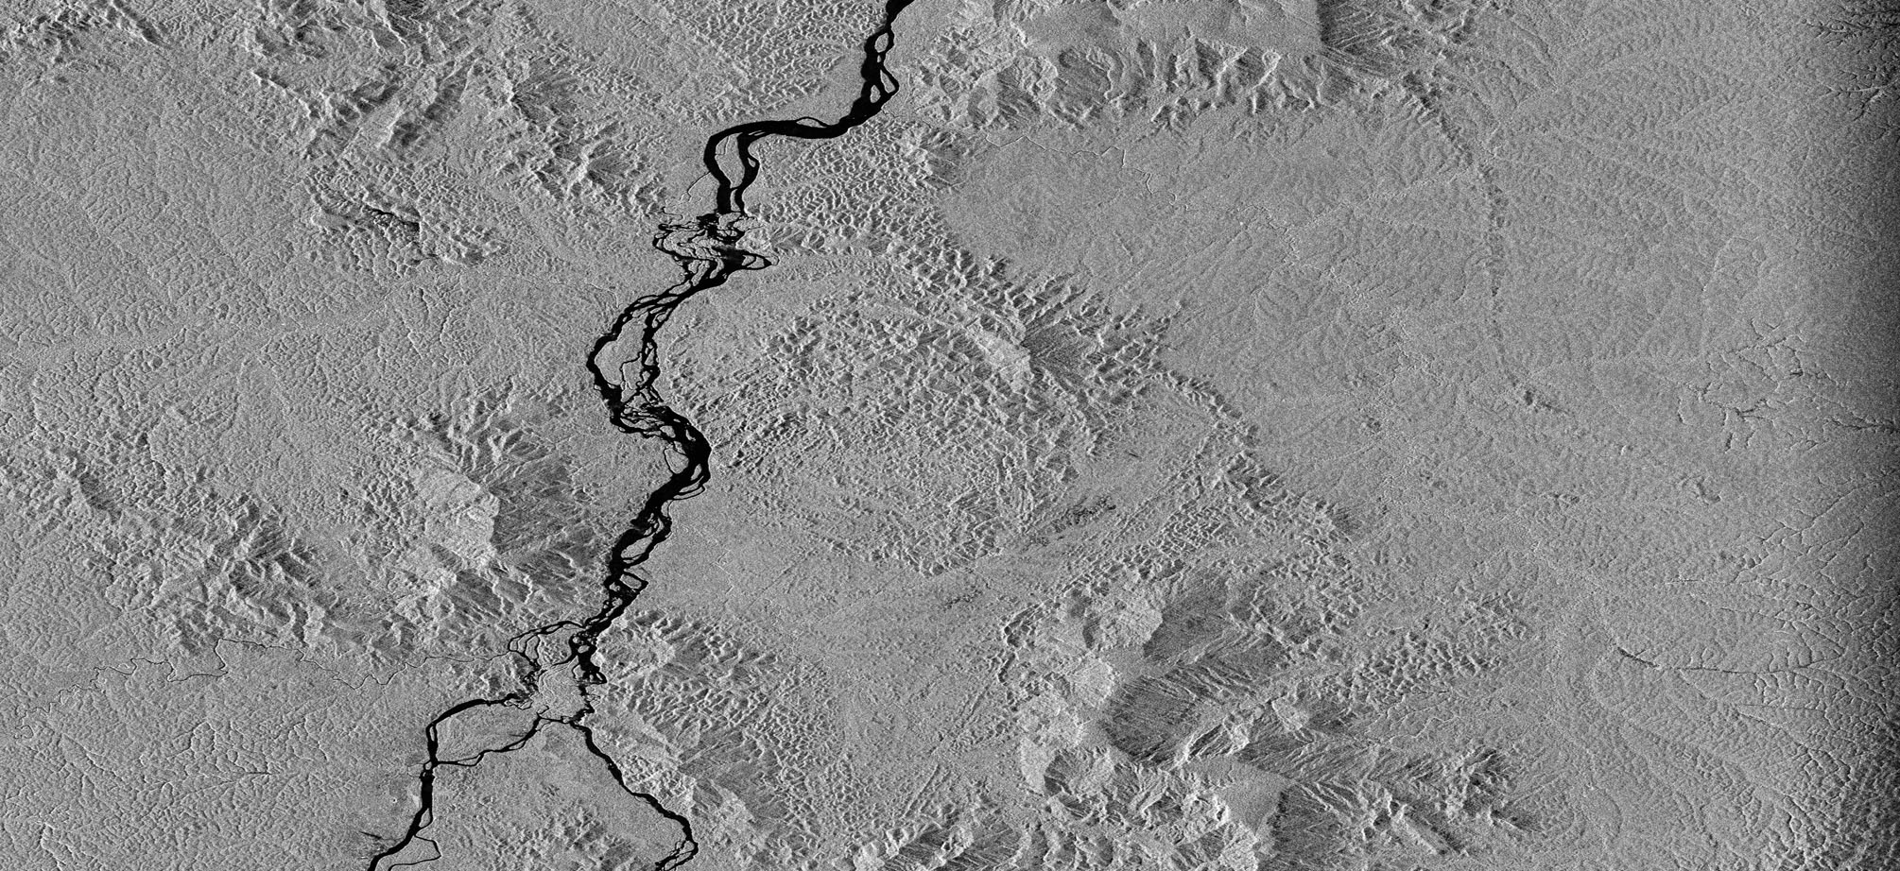

Antenna pattern calibration
Use data over Amazonian forest as homogeneous target.
Main nominal beams (3m: 9, 6m: 5, 10m: 3, Scan: 2) were calibrated in the Initial calibration phase (Aug.-Nov. 2014).
The other beams have been calibrated end of Nov. 2015.
Before
After

Slide 19
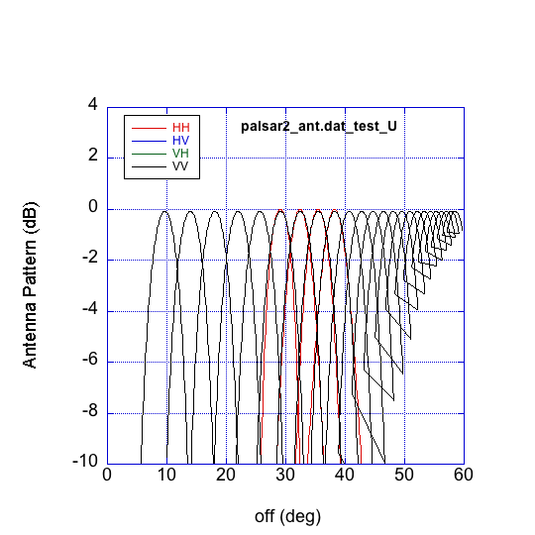
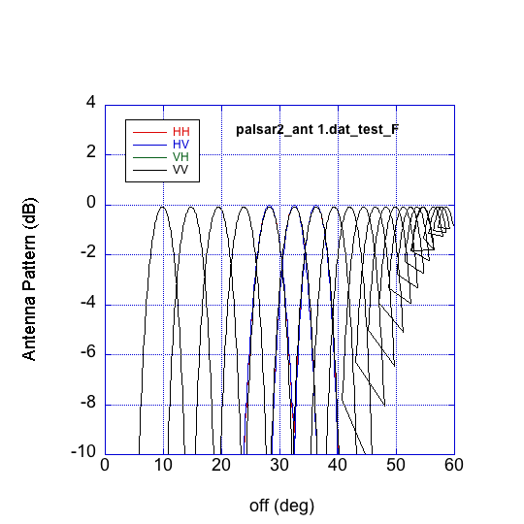
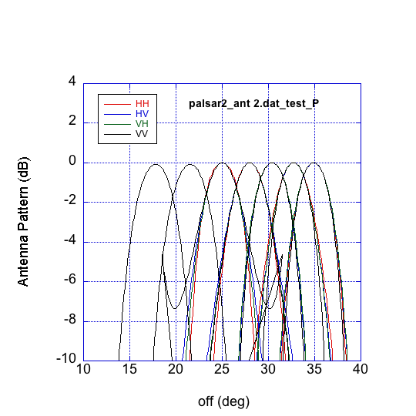
Antenna pattern calibration
UBS antenna pattern
FB antenna pattern
HBQ antenna pattern
Notes:
Each image mode is expected to be used by different applications.
The more modes combined with polarization, left/right looking, the more conflicts among user requests.

Slide 20
  Geometric calibration
Offset parameter for start time of range-gate is determined by using point target observations
Geometric accuracy is within 10m, and there are no big changes from initial calibration phase.
【Initial calibration result】
mode | dx ave. [m] | dx stddev. | dy ave.[m] | dy stddev. | #points
A/L | 0.839 | 2.563 | 2.574 | 2.08 | 7
A/R | -2.874 | 2.035 | 2.808 | 1.735 | 58
D/L | 3.836 | 5.598 | -5.899 | 3.284 | 14
D/R | -1.152 | 1.988 | -3.186 | 1.654 | 48
【After Initial calibration (~Dec. 2015)】
mode | dx ave. [m] | dx stddev. | dy ave.[m] | dy stddev. | #points
A/L | 1.170 | 4.002 | 0.582 | 2.365 | 16
A/R | -5.435 | 6.068 | 0.853 | 2.388 | 109
D/L | 6.562 | 8.218 | -3.870 | 4.273 | 19
D/R | 2.021 | 5.834 | -2.357 | 2.227 | 93

Slide 21
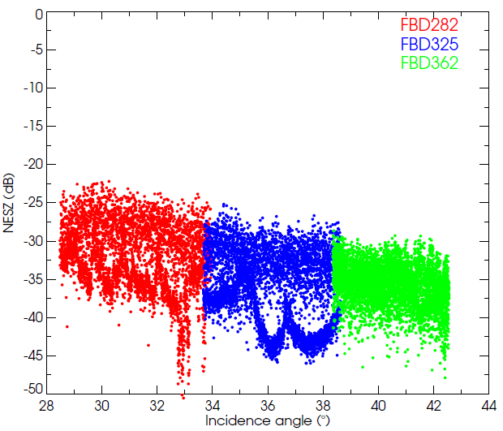
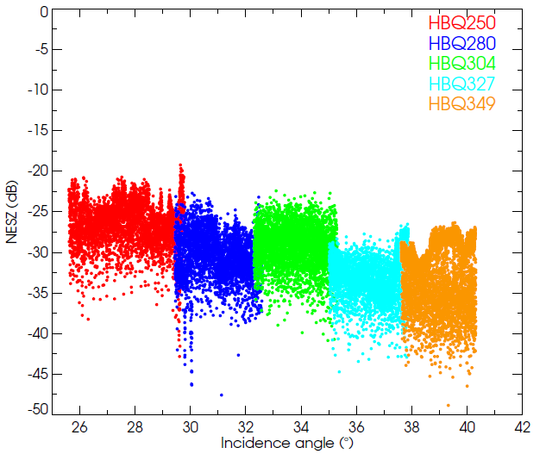
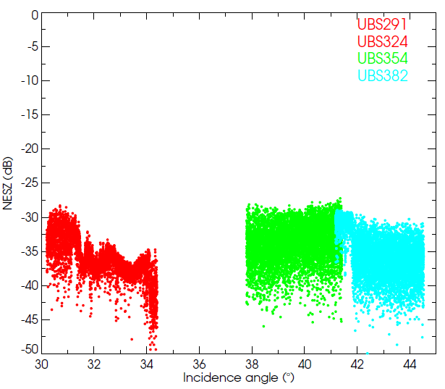
  Image quality (Noise equivalent sigma zero: NESZ)
Min.
ファイル名 | 最低値 | 平均値 | 中央値
FBD282_ALOS2017377150-140918 | -50.53501 | -35.11314 | -34.83520
FBD325_ALOS2020930210-141012 | -45.97483 | -40.21743 | -41.06180
FBD362_ALOS2016050160-140909 | -47.88250 | -36.53103 | -36.55561
HBQ250_ALOS2016630850-140913 | -42.82800 | -27.89674 | -27.58296
HBQ280_ALOS2024177180-141103 | -47.58296 | -31.23381 | -31.00234
HBQ304_ALOS2022257190-141021 | -40.85580 | -29.47732 | -29.24942
HBQ327_ALOS2014717190-140831 | -44.72372 | -33.82870 | -33.57417
HBQ349_ALOS2013230840-140821 | -48.84860 | -36.17019 | -35.95635
UBS291_ALOS2023513470-141030 | -49.37518 | -36.36374 | -36.59707
UBS354_ALOS2024470670-141105 | -45.97483 | -33.81170 | -33.60356
UBS382_ALOS2023290600-141028 | -49.93575 | -35.40385 | -35.57864
-41.1
-36.0
-36.6
FBD
HBQ
UBD
Notes:
Each image mode is expected to be used by different applications.
The more modes combined with polarization, left/right looking, the more conflicts among user requests.

Slide 22
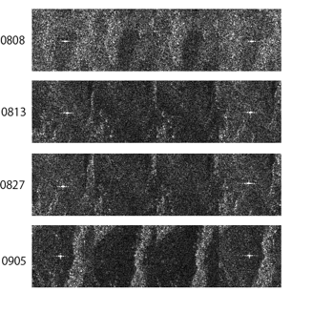

Polarimetric Calibration
Even the uncalibrated PolSAR data in the Amazon (Rio Branco) shows that the cross talks look very small.
HH HV VH VV
PolCal Equation
Determine unknown parameters (Amazon data+CR, reflection symmetry and Model-based analysis)
1) Cross-talk is smaller than -40 dB
2) Channel imbalannce can be well corrected as shown in the polarimetric signature images
Example（２３°）
Trans Distorsion
=
( 1.0000e+00 0.0000e+00) ( 2.9780e-03 2.6764e-03)
( 2.7118e-03 1.6514e-03) ( 9.1212e-01 -4.8408e-01)
Receiver Distorsion
=
( 1.0000e+00 0.0000e+00) (-3.2790e-03 2.6533e-03)
( 4.7041e-03 7.2861e-03) ( 1.0681e+00 -1.9712e-02)
Before
After

Slide 23
  Summary of calibration result
Items | Results |  | Data | Requirement
Geometry (RMSE) | High resolution/ Spotlight mode | 5.34m(L 1.1) / 6.73m(L 2.1) | 127/129 | 20m
 | ScanSAR mode | 60.77m(L1.1)/29.93m(L2.1) | 7/8 | 100m
Radiometry | Corner reflector Amazon（forest） NESZ（F/H/U） HH HV | 1.31 （CF：-81.60） 0.406（CF:-82.34） -41.1(F)/-36.0(H)/-36.6(U) -49.2(F)/-46.0(H) | 120 30 scenes | 1.0 dB 1.0 dB:-6.84dB@Amazon -26.0(F)/-28.0(H)/-24.0(U)
Polarimetry | VV/HH VV-HH phase(deg) Cross talk (dB) | 1.0143(σ：0.06) 0.350(σ：0.286) -43.7(σ：6.65) hv/hh -44.0(σ：7.10) vh/vv -48.2(σ：6.05) corr | 6 | 1.047 5 deg -30dB -30dB -30dB
Resolution(m) Azimuth/range | Spotlight High resolution[3m] High resolution[6m] High resolution[10m] | 0.79(σ：0.028)/1.66(σ：0.04) 2.81(σ：0.034)/1.70(σ：0.022) 4.06(σ：0.108)/3.53(σ：0.317) 5.05(σ：0.110)/5.36(σ：0.126) | 3 35 28 61 | 1.00x1.1/1.78 2.75x1.1/1.78 3.75x1.1/3.57 5.00x1.1/5.36
Sidelobes | PSLR（azimuth） PSLR（range） ISLR | -16.20(σ：2.53) -12.59(σ：1.84) -8.80(σ：3.23) | 124 | -13.26dB+2dB -13.26dB+2dB -10.16dB+2dB
Ambiguity | Azimuth Range | 23~14(mean:20) Invisible | 7 scenes | 20~25dB以上 25dB以上
Note:PSLR:Peak to Sidelobe Ratio, ISLR: Integrated Sidelobe Ratio, U is high resolution[3m], H for [6m], F for [10m].
Standard dev. of CF is 1.31 will be tuned under 1.0 synchronized with Amazon calibration data.
Notes:
Each image mode is expected to be used by different applications.
The more modes combined with polarization, left/right looking, the more conflicts among user requests.

Slide 24
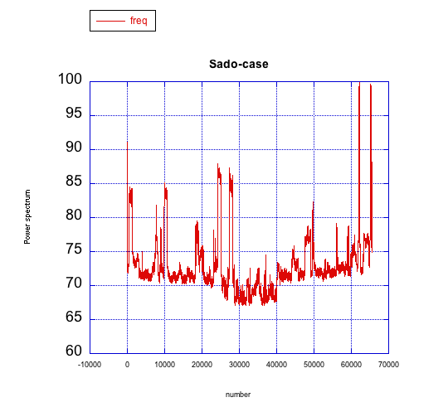
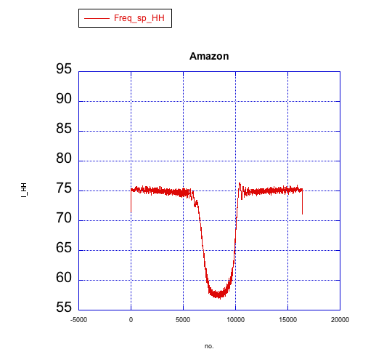
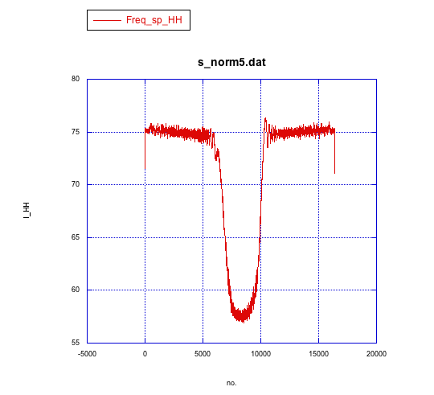
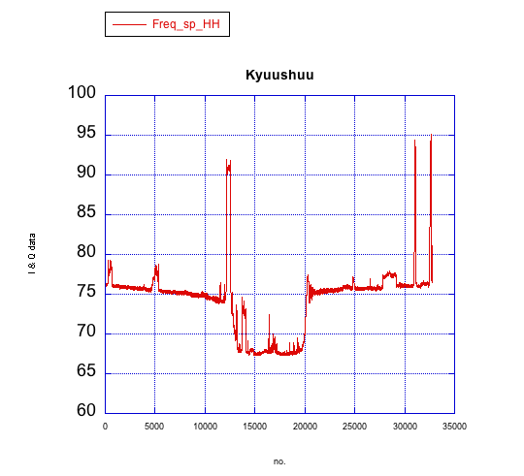
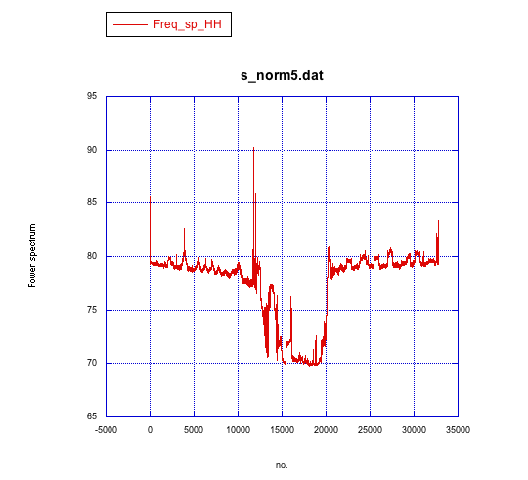
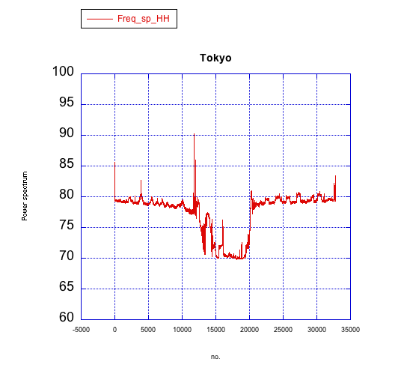
RFI (Radio Frequency Interference)
RFI has been an issue for degrading the SAR images with the contaminated external signal sources. Bw ~ 3~5MHz, RFI power exceeding less than 25dB.
Sado
(84MHz)
Amazon
(28MHz)
Kyushu
(84MHz)
Tokyo(84MHz)

Slide 25
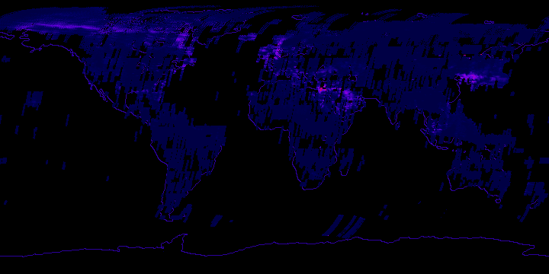
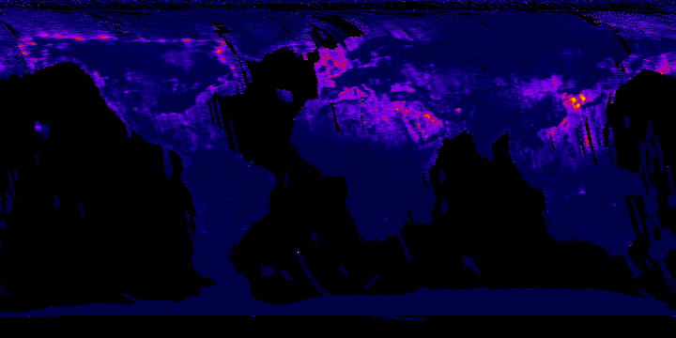

RFI monitoring by JERS-1 SAR (1992-1998)
BW=15MHz
HH
RFI monitoring by PALSAR (2010/4~2011/4)
BW=14MHz
HV
0 100
Normalized zero padded bandwidth (%)

Slide 26
RFI monitoring by PALSAR (2010/4-2011/4)
BW=14MHz
HV
RFI monitoring by PALSAR2 (2014/8~2014/12)
Corresponding
BW=14MHz
HV
FBD is used.
Japan is not observed by FB
0 100
Normalized zero padded bandwidth (%)

Slide 27
Summary
ALOS-2 PALSAR-2 was calibrated on Nov. 20 2014 initially and the data were distributed since then.
JAXA and ALOS-2 CVST team are routinely monitoring the data. PALSAR-2 data is stable and there are no changes in calibration factors and image quality from Nov. 2014 (the end of initial calibration phase).
RFI increases compared to PALSAR data.

Slide 29
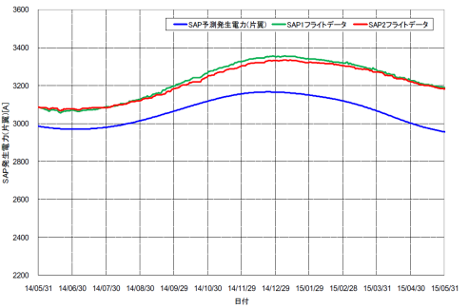
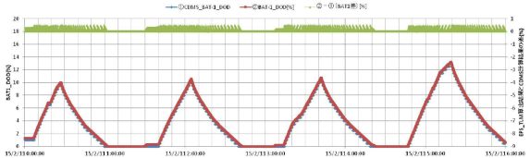
Bus system operation results
(Power generation)
estimation
SAP1
SAP2
generation power (one paddle) [W]
Solar array paddle
generation power profile
date
Battery DOD profile
The generatad power is
normal for operation.

Slide 30
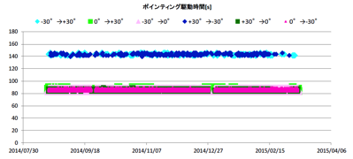
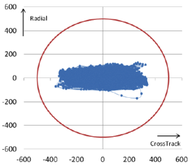
Bus system operation results
(Attitude control)
Pointing time [s]
Flight direction
-30 to 30 deg or 30 to -30 deg
0 to ±30 deg
30deg
30deg
Nadir
PALSAR-2 antenna
Nadir
120 s
120 s
Right looking
Non obs.
Left looking
180 s
orbit control
100%!
Stability

Slide 31

Technical overview of PALSAR-2
Command and Telemetry
from / to satellite
SC
IF
UNIT
EX
TX
TRM
Mission data
to satellite
DP
RX
TRM
ELU
EX: Exciter
RX: Receiver
SC: Signal Processor
TX: Transmitter
DP: Data Processor
ANT
60 % aperture
Mode | Transmit | receive
42-84MHz | 60% aperture | full
14-28 MHz | Full aperture | full
Full Aperture

Slide 32
RFI ratio
Nw
Pt
If 2.0dB<Pt-Pn
Pn
Bw
Bw
Notch filter with NBI (Narrow band interference)
Before RFI removal
RFI removal

Slide 33

Image quality assessment using point target data

