Slide 1
Calibration activities of
TRMM & GPM Radars
Takeshi Masaki, Kinji Furukawa, Takuji Kubota, Kaya Kanemaru,
Riko Oki*1,Toshio Iguchi ,Hiroshi Hanado, *2
Naofumi Yoshida *3
*1: Japan Aerospace Exploration Agency
*2: National Institute of Information and Communications Technology
*3:Remote Sensing Technology Center of Japan
February 29th, 2016 Annual Meeting of GRWG+GDWG at JAXA/TKSC

Slide 2
Outline
1. Introduction
2. DPR Algorithm status
3. Calibration status
4. Summary

Slide 3
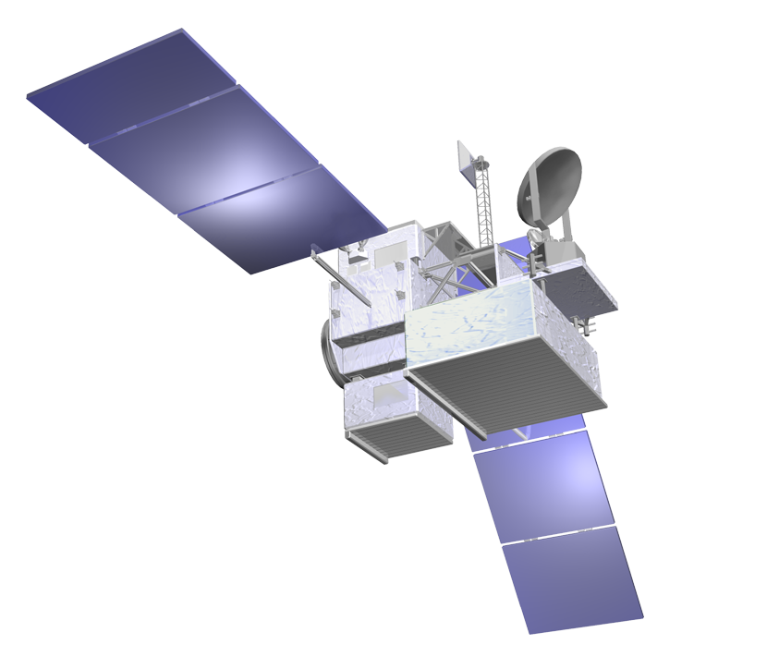
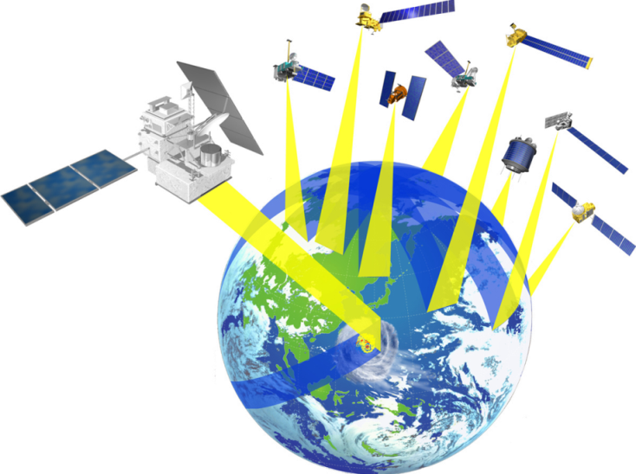
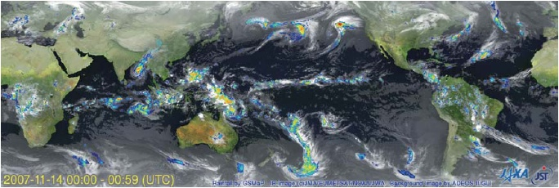
Global Precipitation Measurement (GPM) mission status
1. Introduction
GPM is an international mission consisting of the GPM Core Observatory and Constellation Satellites for high accurate and frequent global precipitation observation.
Dual-frequency Precipitation Radar (DPR)
  It was developed by JAXA and NICT
  The DPR is composed of two radars: KuPR & KaPR
GPM Core Observatory was successfully launched on 28 Feb. 2014 (JST).
The DPR has observed steadily.
All GPM standard products were released on September 2014.
New version products will be released in March 2016.
GPM Core Observatory
GMI (Microwave Imager)
KuPR: 13.6GHz radar (phased array)
KaPR: 35.5GHz radar (phased array)
Constellation
Satellites by international partners
Core
Observatory
by NASA-JAXA
Notes:
GPM is an international mission consisting of the GPM Core Observatory and Constellation Satellites for high accurate and frequent global rainfall observation.
- Core Observatory: developed under NASA and JAXA equal partnership.
- Constellation satellites: provided by international partners (includes GCOM-W1)
Dual-frequency Precipitation Radar (DPR)
- developed by JAXA and NICT
- the most sophisticated precipitation radar
- 3D structure of rainfall
- simultaneous dual-frequency observation to detect even weak rainfall and snowfall.
GPM Core Observatory will be launched in early 2014.

Slide 4

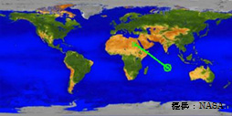
1. Introduction
Tropical Rainfall Measuring Mission (TRMM)
US-Japan joint mission
Japan: PR, launch
US: satellite, TMI, VIRS, CERES, LIS, operation
Completion of Precipitation Radar (PR) Normal Mission Operation on 7th October 2014, due to lack of fuel. Completion of PR extra operation on 1st April 2015.
Completion of TRMM Microwave Imager (TMI) on 8th April 2015.
The TRMM spacecraft re-entered the Earth’s atmosphere on June 15, 2015 over the South Indian Ocean
Launch | 28 Nov. 1997 (JST)
Altitude | About 350km (since 2001, boosted to 402km to extend mission operation）
Inc. angle | About 35 degree, non-sun-synchronous orbit
Design life | 3-year and 2month (completed on April 2015)
Instruments | Precipitation Radar (PR) TRMM Microwave Imager (TMI) Visible Infrared Scanner (VIRS) Lightning Imaging Sensor (LIS) CERES (not in operation)

Slide 5
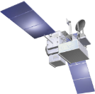
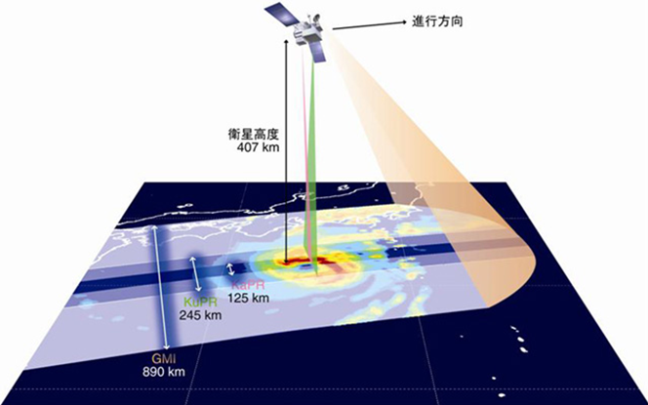
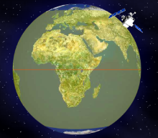
1. Introduction
DPR specification
GPM/DPR
Inclination
65 degrees
Fight
direction
Swath
KuPR：245km
KaPR：125km
Altitude
about 407km
Range resolution
KuPR：250m
KaPR：250/500m
Frequency
KuPR: 13.6 GHz
KaPR: 35.5 GHz
DPR (and PR) can observe three dimensional structure of precipitation.
Foot print size about 5km

Slide 6
1. Introduction
Photograph of the DPR
At JAXA
KaPR
330kg
1.4m
1.0m
0.6m
2.4m
2.4m
KuPR
450kg
0.6m

Slide 7
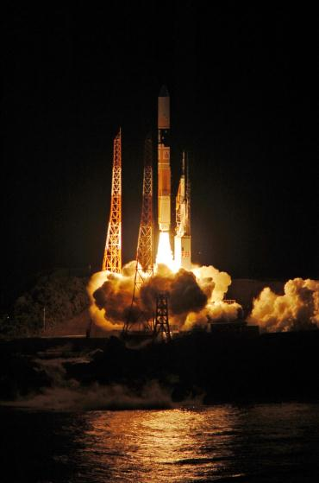
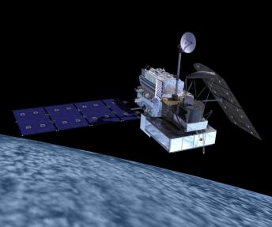
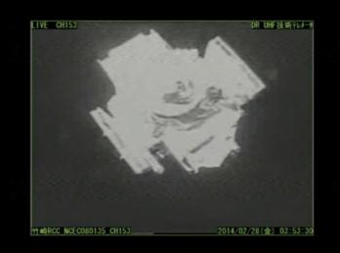
GPM Core Observatory was successfully launched on 28 Feb. 2014 (JST).
1. Introduction
GPM core observatory launch
CG image
NASA
JAXA
Launch from the JAXA Tanegashima Space Center by the H-IIA F23 rocket
Separation of the spacecraft
JAXA

Slide 8
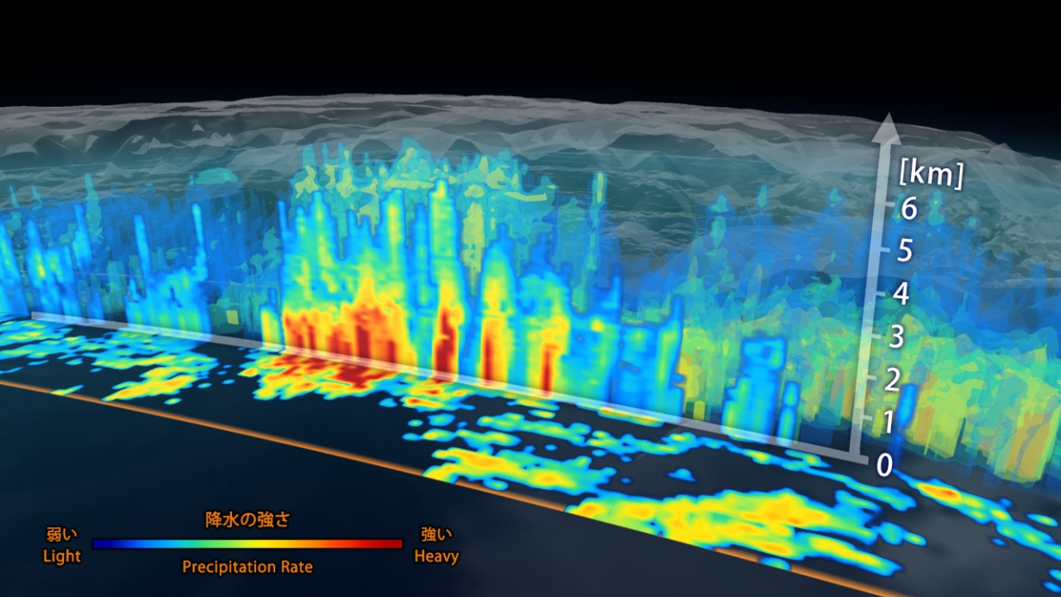
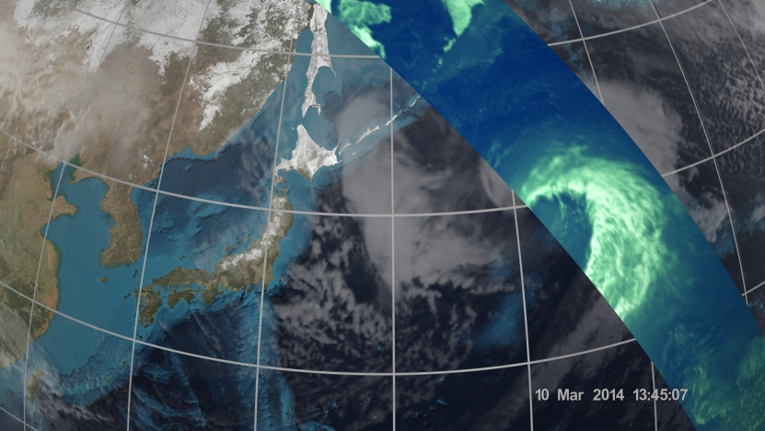
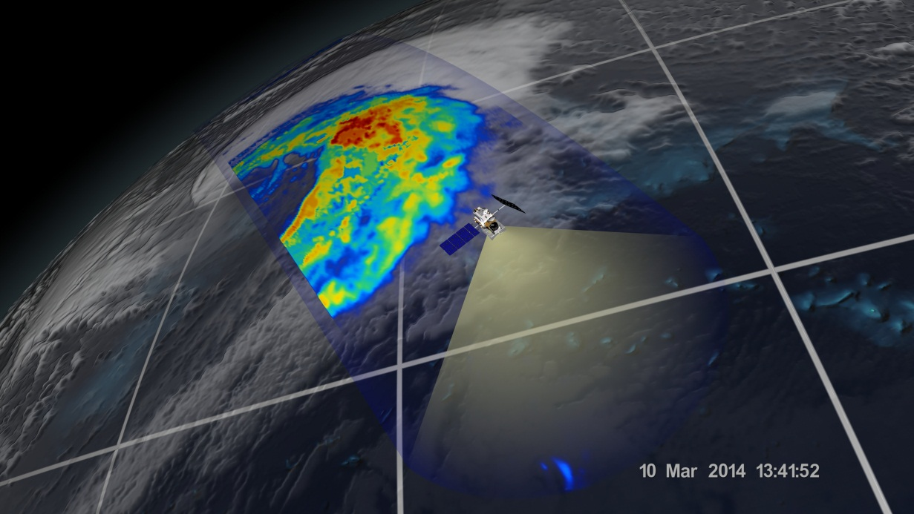
NASA-JAXA Joint First Images from the GPM Core Observatory
1. Introduction
JAXA/NASA
NASA/JAXA
↑ GMI 36-GHz H TB is overlaying to the Geostationary IR provided by JMA and NOAA.
↑ Three dimensional structure of precipitation captured by DPR.
Extratropical Cyclone over the northwest Pacific Ocean (around 40N, 167E) around 1330Z on 10 Mar. 2014.
→Surface precipitation captured by GMI.
NASA/JAXA

Slide 9



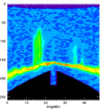
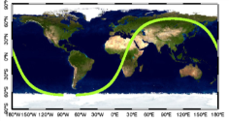

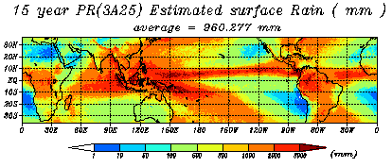
2. DPR Algorithm status
DPR data processing flow
HK / Science Telemetry
＜APID sorted Data＞
L0 product
Observation data
Satellite altitude
Sensor Temperature
Sensor Status etc
power
＜Swath Data＞
L1 algorithm
Transformation and Calibration
Transmitted/Received Power
Scan Time
Geolocation etc
geolocation
L1 product
New version products will be released in March 2016.
Please access ‘ G-portal ’ to get the data.
https://www.gportal.jaxa.jp/gp/top.html
L2 algorithm
Calculate Physical value
＜Swath Data＞
Rain Rate
Rain Rate
Rain Type
DSD (Drop Size Distribution)
Radar Reflectivity factor etc
L2 product
L3 algorithm
Calculate Statistic value
＜Global Grid Data＞
Grided Precip Rate
Daily Mean
Monthly Mean
Grided data
L3 product

Slide 10
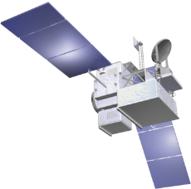
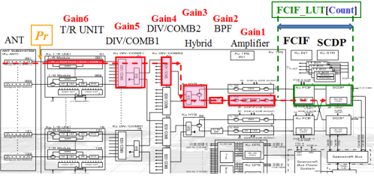
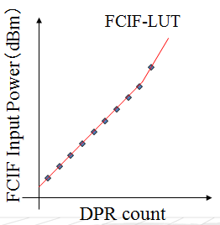
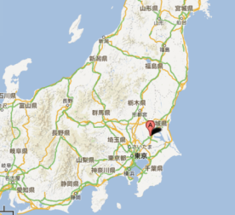
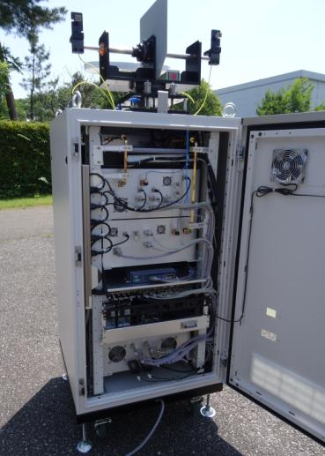
3. Calibration status
Concept of DPR calibration(1/2)
FCIF: Frequency Converter & IF
The calibration of DPR is composed of ‘Internal calibration’ and ‘External calibration’
Internal Calibration
Radio Frequency is not tramsmited to out of DPR
【Purpose】
To calibrate the FCIF-LUT which converts digital count to power.
【Frequency】
Per a week on board.
External Calibration
【Frequency】
It is planed 10 times in a year at the JAXA tsukuba space center in Japan.
【Purpose】
To calibrate the absolute value of the DPR transmitted / received powers.
★
Notes:
.

Slide 11
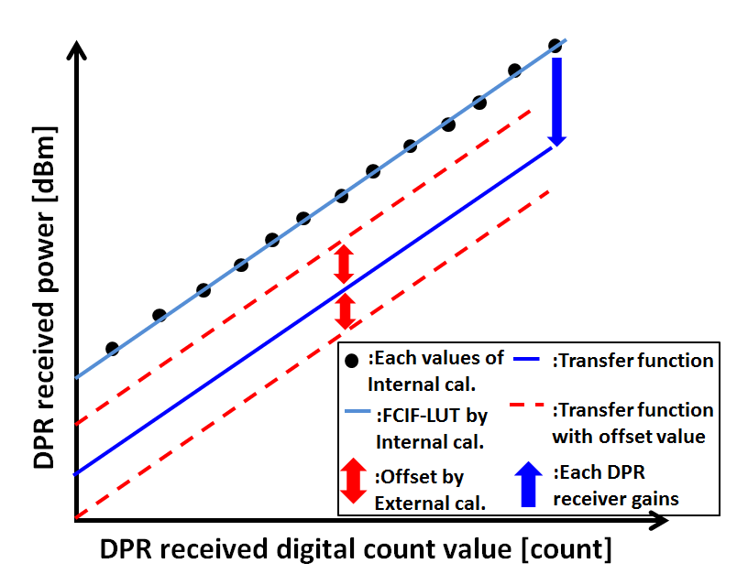
3. Calibration status
Concept of DPR calibration(2/2)
Relationship between internal calibration
and external calibration
FCIF-LUT by
Internal calibration
Calibration
coefficients
Transfer function
with offset by external calibration

Slide 12
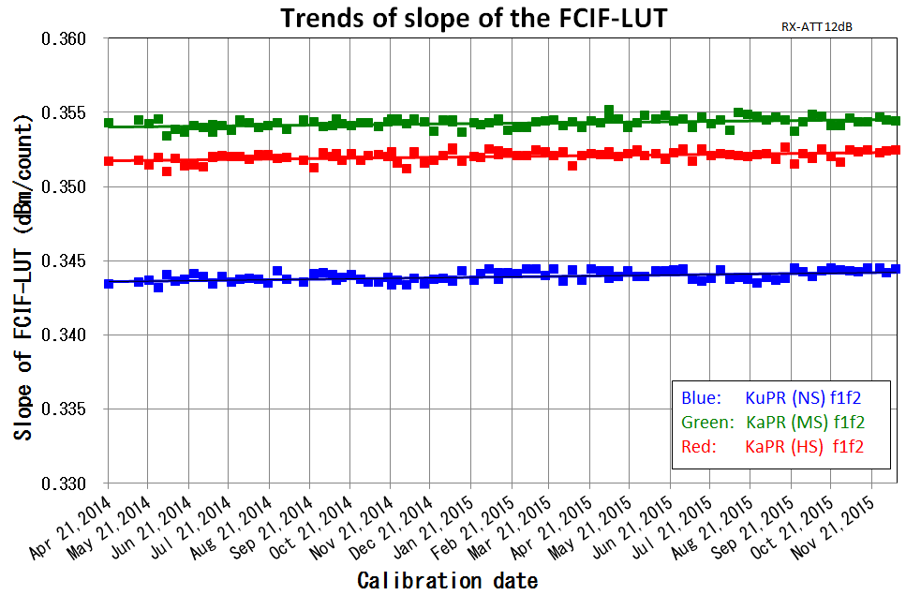
3. Calibration status
Result of the internal calibration
The results of the internal calibration have been stable.

Slide 13
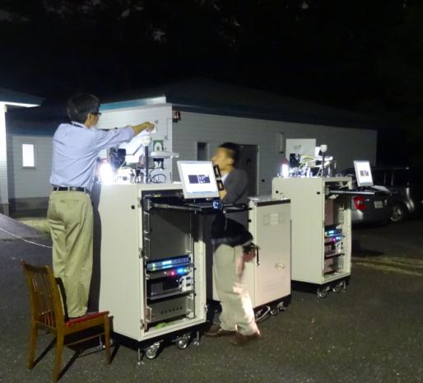
3. Calibration status
Concept of the external calibration(1/2)
Active Radar Calibrator (ARC)
The situation of external calibration
KaARC
KuARC
W:717mm x D:700mm x H:2167mm
Weight: 130kg
Transmit power level : 1.2W
Transmit wave type : CW or Pulse
Two people treat two ARCs for KuPR and KaPR in once calibration.
The people need to carry out the calibration night and day, since the DPR has sun-asynchronous orbit.

Slide 14
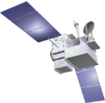
3. Calibration status
Concept of the external calibration(2/2)
DPR receiver system
DPR transmitter system
DPR
DPR
Received power
measured by DPR
Compare
Received power
estimated by calculation
Transmitted power
estimated by calculation
Compare
Transmitted power
measured by ARC
KaARC
KuARC
KaARC
KuARC
JAXA aims that accuracy of the calibration becomes within ±1dB.

Slide 15
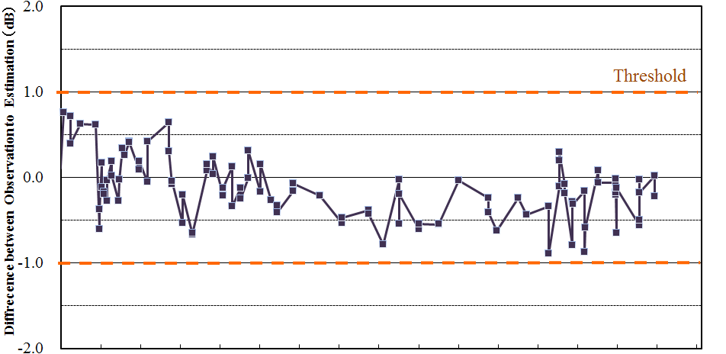
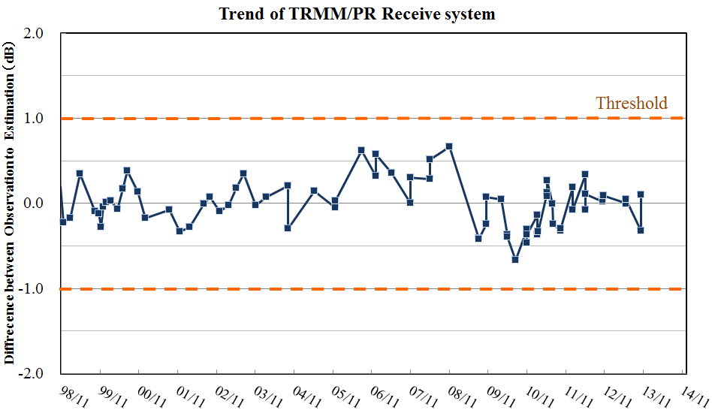
3. Calibration status
Trend of TRMM/PR calibration accuracies
PR Transmitter System
【TRMM/PR calibration】
The PR’s calibration is almost same as the DPR calibration method.
Calibration accuracies were satisfied within ±1dB in both transmitter and receiver system.
It means that both PR transmit system and PR receive system had worked well.
PR Receiver System

Slide 16
3. Calibration status
Current status of the DPR calibration
Continuity
We need to conduct absolute calibration for DPR and PR while maintaining the continuity of σ₀ of both.
The new version product which will be released in March 2016 satisfies the continuity of the σ₀.
A slight offset bias seemed to exist in the results of the DPR external calibration.
The bias correction will not be applied in the new version product, since the DPR external calibration may have some error.
After a re-examination for the error, the bias correction may be applied in future algorithm.
DPR σ0
PR σ0
DPR
PR
Absolute
Calibration
Absolute
Calibration
DPR/
ARC2
PR/
ARC
* σ₀ is the good index for an inter-comparison between different sensors.
It is very difficult to calibrate while keeping continuity of different sensors.

Slide 17
4. Summary
GPM Core Observatory was successfully launched on 28 Feb. 2014 (JST).
DPR has observed stably after the launch.
The new version product which will be released in March 2016 satisfies the continuity of σ0 between PR and DPR.
Some slight bias were found in DPR external calibration.
To increase the accuracy of calibration, JAXA is evaluating all calibration data in more detail.

Slide 18

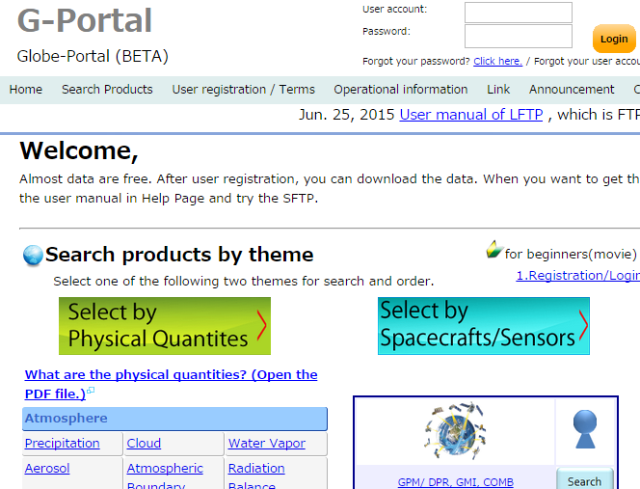
Information for DPR product
To get dataformat, news and so on.
To get DPR product.
http://www.eorc.jaxa.jp/GPM/index_e.htm
https://www.gportal.jaxa.jp/gp/top.html
Please access !!

Slide 19
backup

Slide 20
GPM / DPR calibration status and plan
GPM/DPR calibration is going well.
The internal calibration
  The DPR’s internal system is calibrated by this calibration.
  It has been conducted once per a week from the launch.
  It will be conducted same frequency in future.
The external calibration
  The absolute value of the DPR’s received and transmitted powers are calibrated by this calibration.
  It has been conducted 10 time in a year.
  It will be conducted same frequency in future.
To increase the accuracy of calibration, JAXA is evaluating these calibration data in more detail.

Slide 21
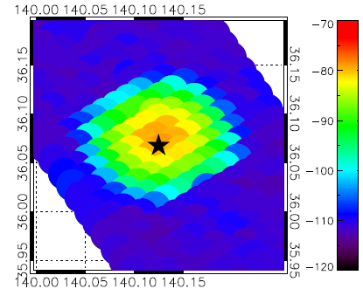
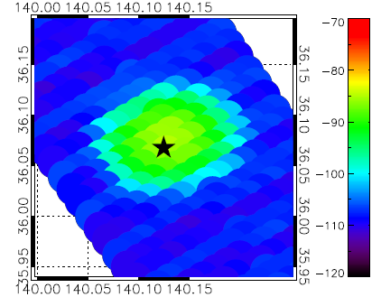
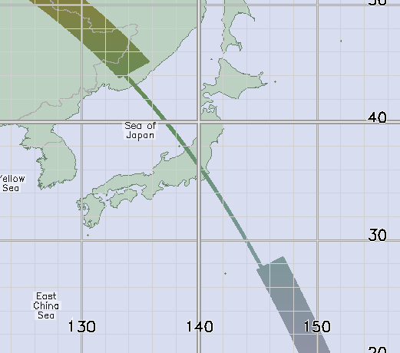
3. DPR calibration status
Example of external calibration
*The power is not calibrated in this figure.
＜External Calibration on Jun 14, 2015＞
★：ARC setting point
Received power of KuPR
Received power of KaPR
nominal observation swath
These figures show that received power of the DPR during external calibration on Jun 14th 2015.
The footprint where the received powers are high level shows that the DPR received the transmit power of ARC.
During the external calibration, the DPR observes 4 times density for cross track and 3 times density for along track corresponding to nominal observation.
external calibration swath

Slide 22
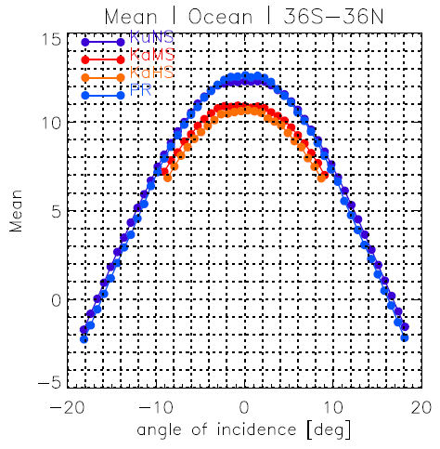
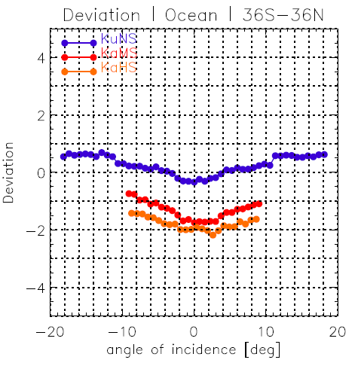
3. Calibration status
Results of calibration for the DPR
DPR：V04
PR：V7
sigma Zero (σ0) Measured
Monthly mean
sigma Zero (σ0) Measured
Deviation from PR
Over
ocean
15
4
Difference of the σ0 at incidence angle where SD is minimum.
KuPR – PR (dB)：
11.2 – 11.1 = +0.1
KuPR – KaMS (dB) ：
11.2 – 9.7 = +1.5
10
2
(dB)
5
(dB)
0
-2
KuNS
0
KuNS
KaMS
KaMS
-4
KaHS
KaHS
PR
-5
A slight offset bias seemed to exist in the results of the DPR external calibration (not shown) because of remaining issues for the DPR external calibration’s error.
After the re-examination of the error, the bias correction will be applied in future algorithm (it is not applied to new version products released in March 2016).
As for the new version products released in March 2016, the σ0 which is one of the calibration index satisfies continuity well between DPR and PR.

Slide 23
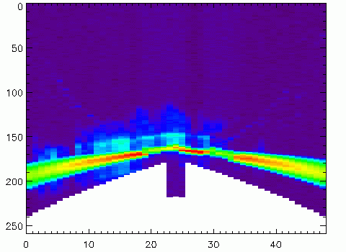
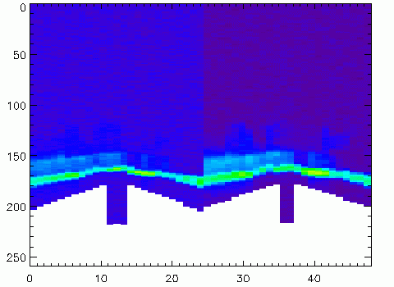
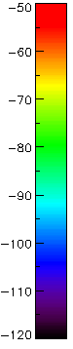
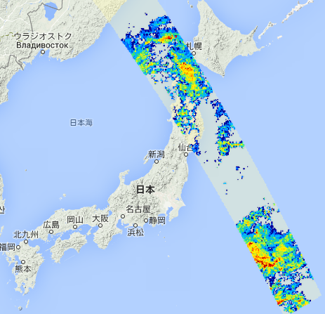
2. Algorithm status
Example of DPR L1 product
*The power is not calibrated in this figure.
Received power of KuPR
Received power of KaPR
dBm
KuPR
KaMS
KaHS
Vertical range
(RangeBin number)
Ground echo
Ground echo
Horizontal range
(AngleBin number)
Horizontal range
(AngleBin number)
Nov 9th 2014
Scan pattern
Flight
direction
KuPR
26
49
KaMS (Matched-beam with KuPR)
1
13
37
49
1
25
KaHS (High-sensitivity beam)
New version products will be released in March 2016.

