Slide 1
Intercalibration of
SAPHIR and ATMS
Isaac Moradi and Ralph Ferraro
Univ. of Maryland
NOAA/NESDIS

Slide 2
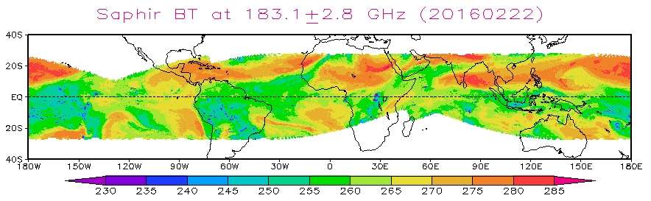
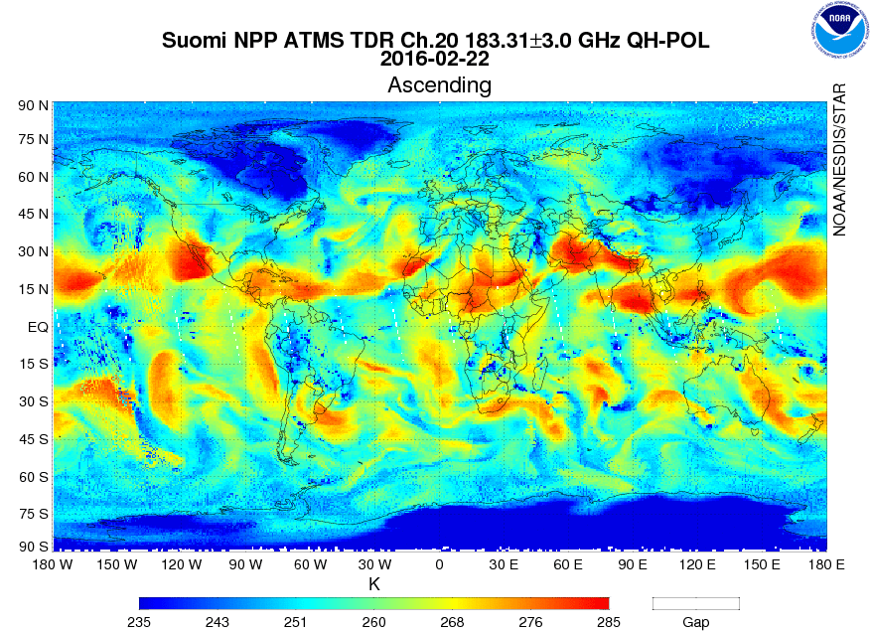
Motivation
The M-T SAPHIR humidity sounder provides an opportunity to cross-calibrate (in tropics) with other similar sensors
  Here we focus on comparisons with S-NPP ATMS
Launch dates
  S-NPP 10/2011
  M-T 11/2011

Slide 3

SAPHIR vs. ATMS
ATMS | SAPHIR
183.31+1.0 | 183.31+0.20
183.31+1.8 | 183.31+1.10
183.31+3.0 | 183.31+2.80
183.31+4.5 | 183.31+4.20
183.31+7.0 | 183.31+6.80
 | 183.31+11.0
Notes:
Bandwidths vary, SAPHIR tends to be smaller
NEDT varies, ATMS tends to be smaller

Slide 4
Methodology
Co-locations (Jan 2012 – Dec 2015)
  Close to nadir (geometry critical – cross scan sensors)
  Within 1 hour and 50 km (satellite and radiosonde)
  (Also included GPS-RO, not showing here, however)
Data filtering
  Ice water path criteria (TB₁₈₃₊₁ – TB₁₈₃₊₇) < -15 K
  Additional threshold on TB₁₈₃₊₁ > 240 K

Slide 5
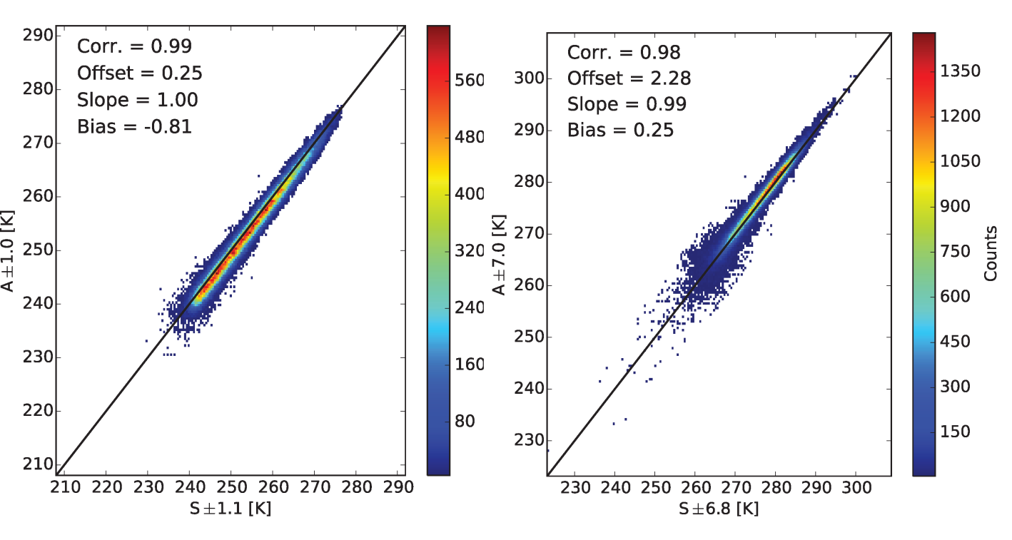
Results – Direct comparisons

Slide 6
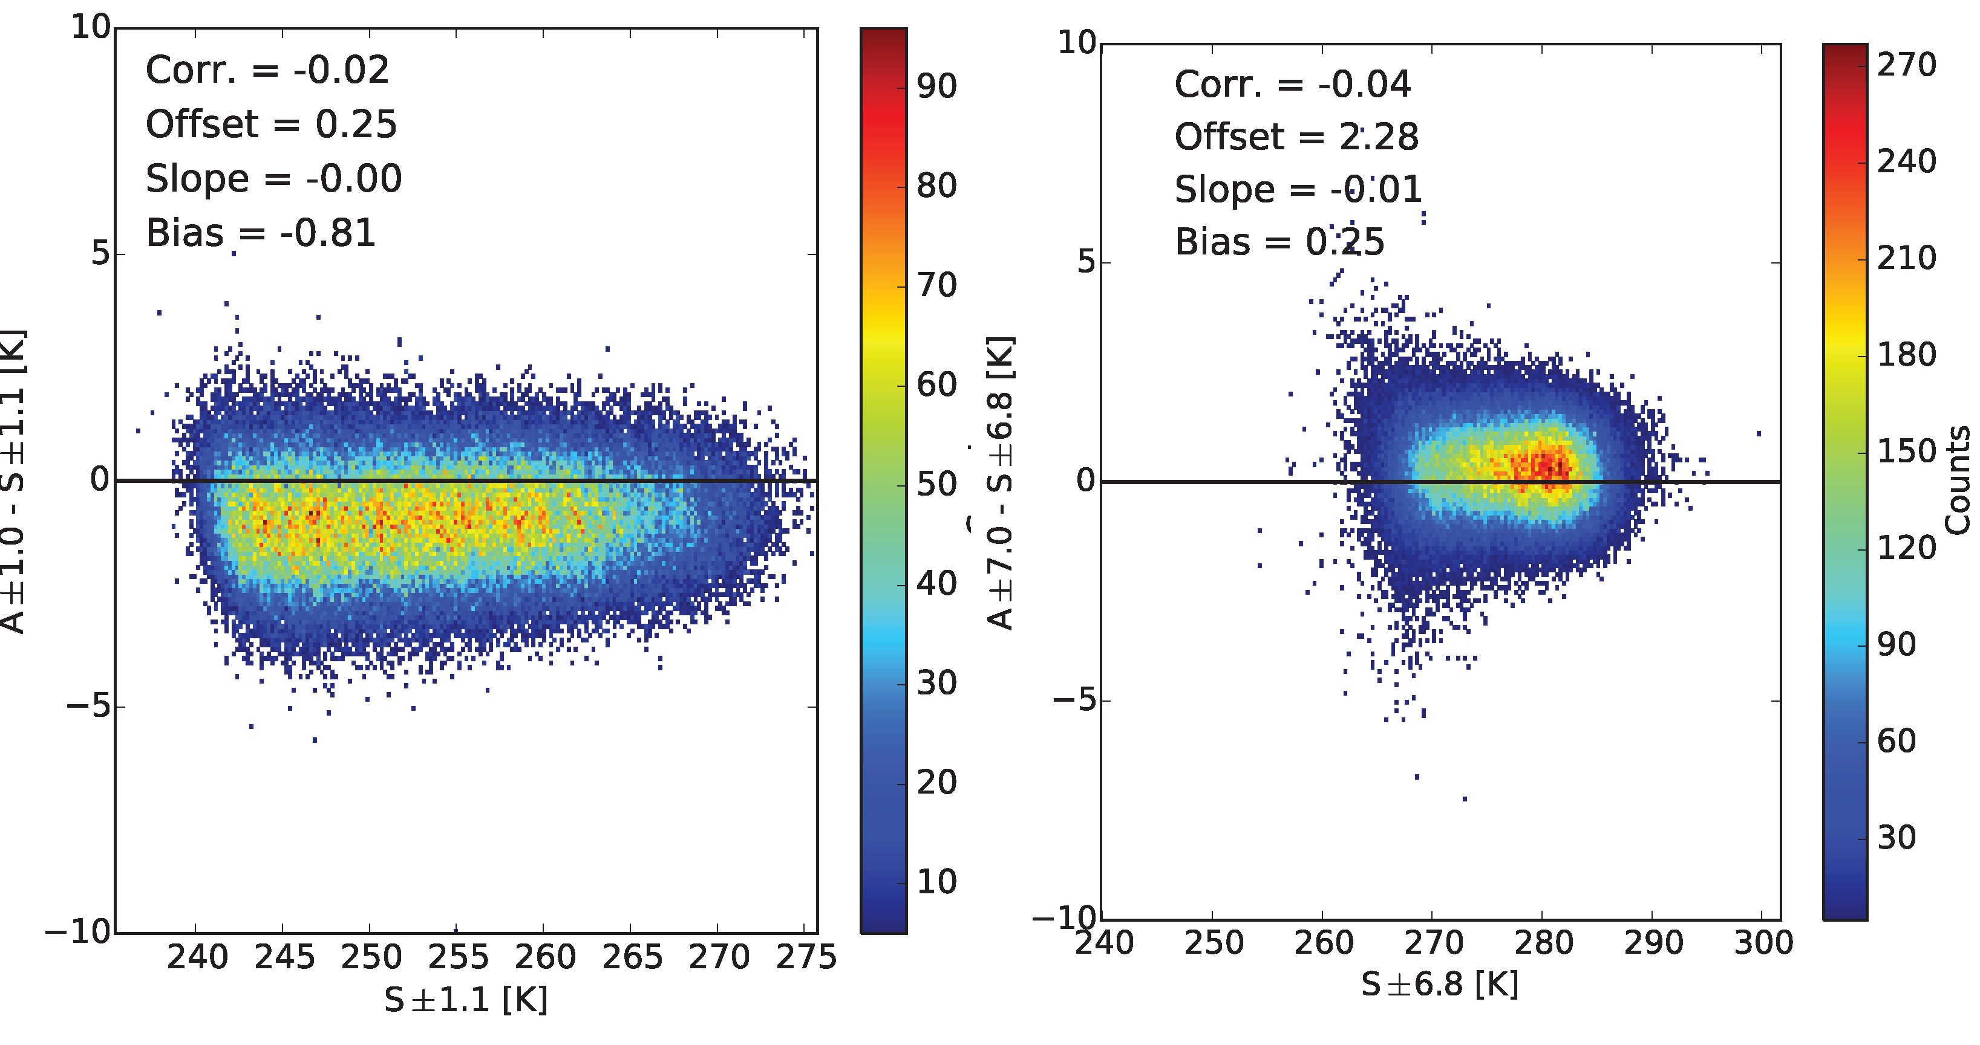
Results – Conditional Differences

Slide 7
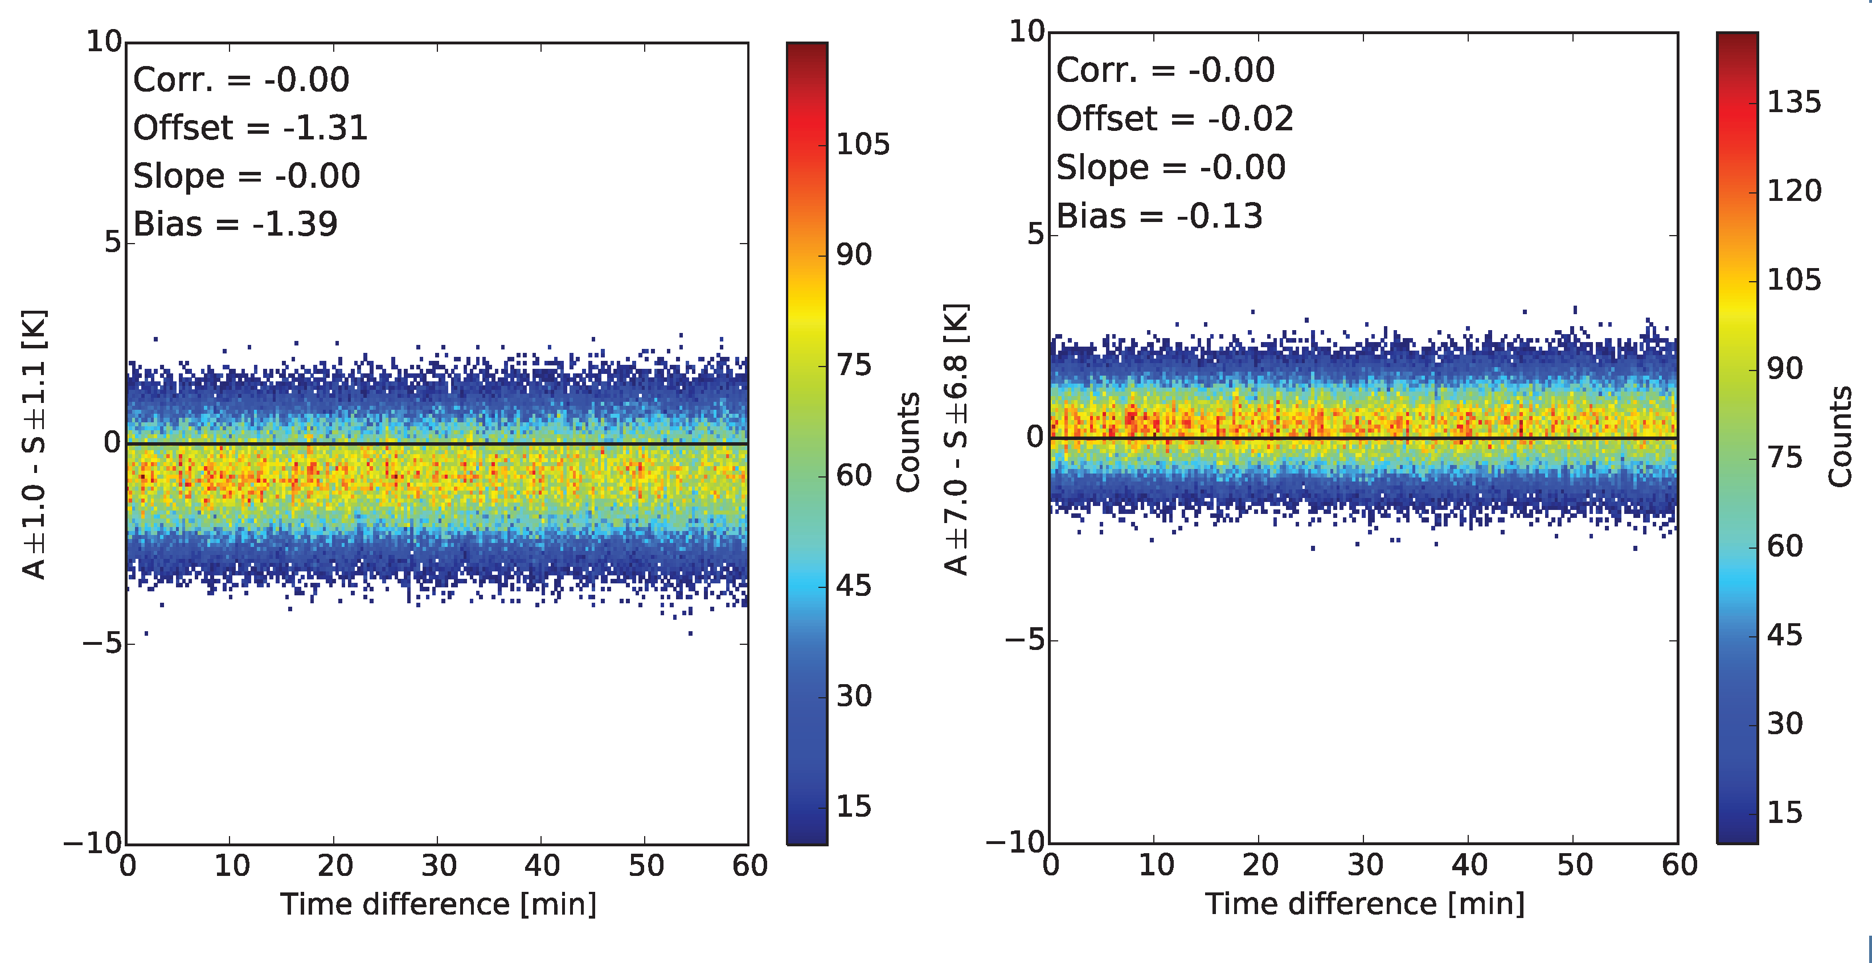
Sensitivity to Colocation Time

Slide 8
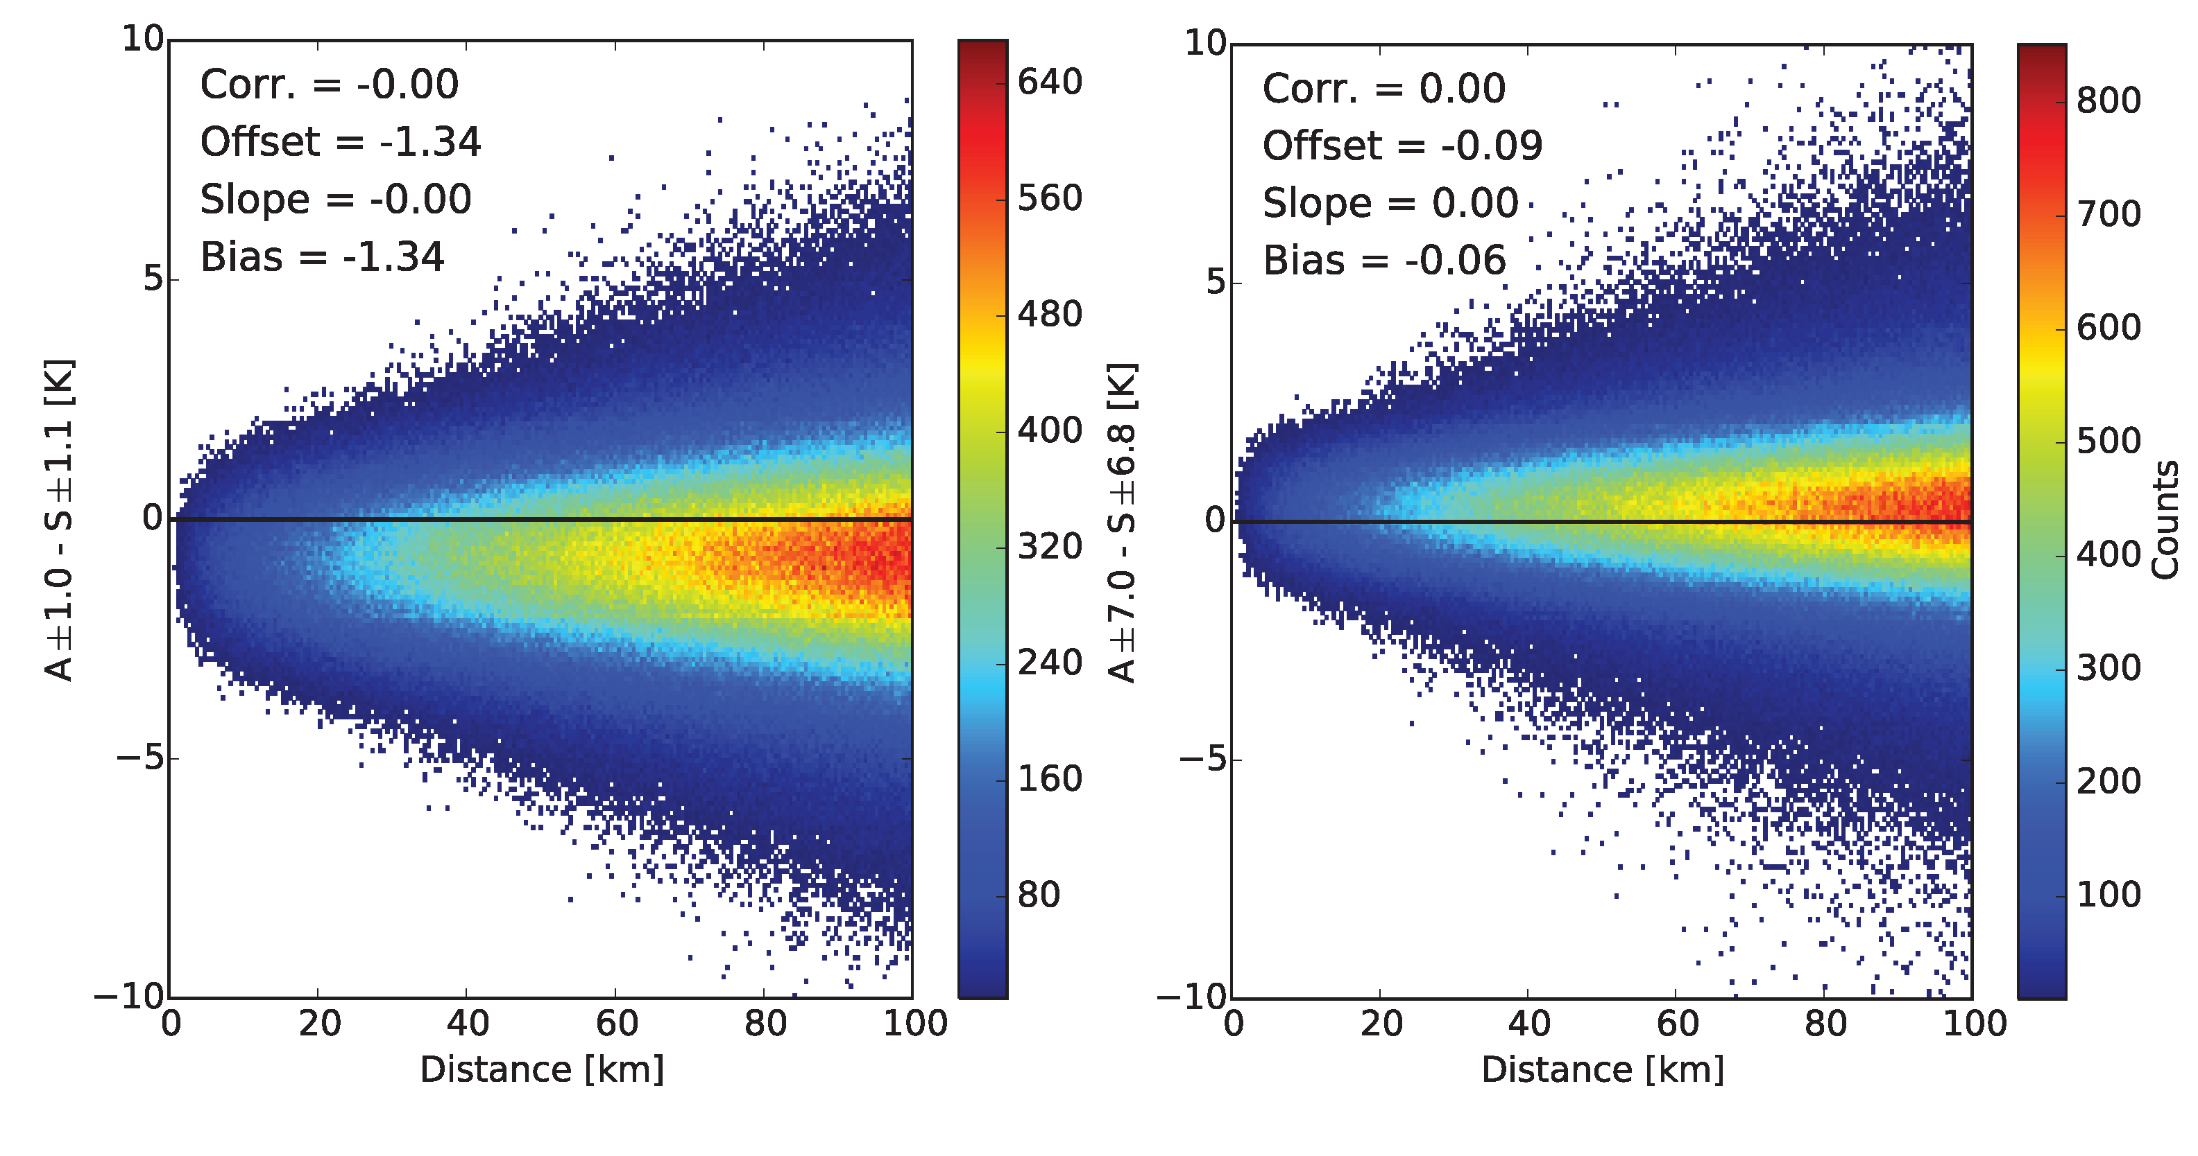
Sensitivity to Colocation Distance

Slide 9
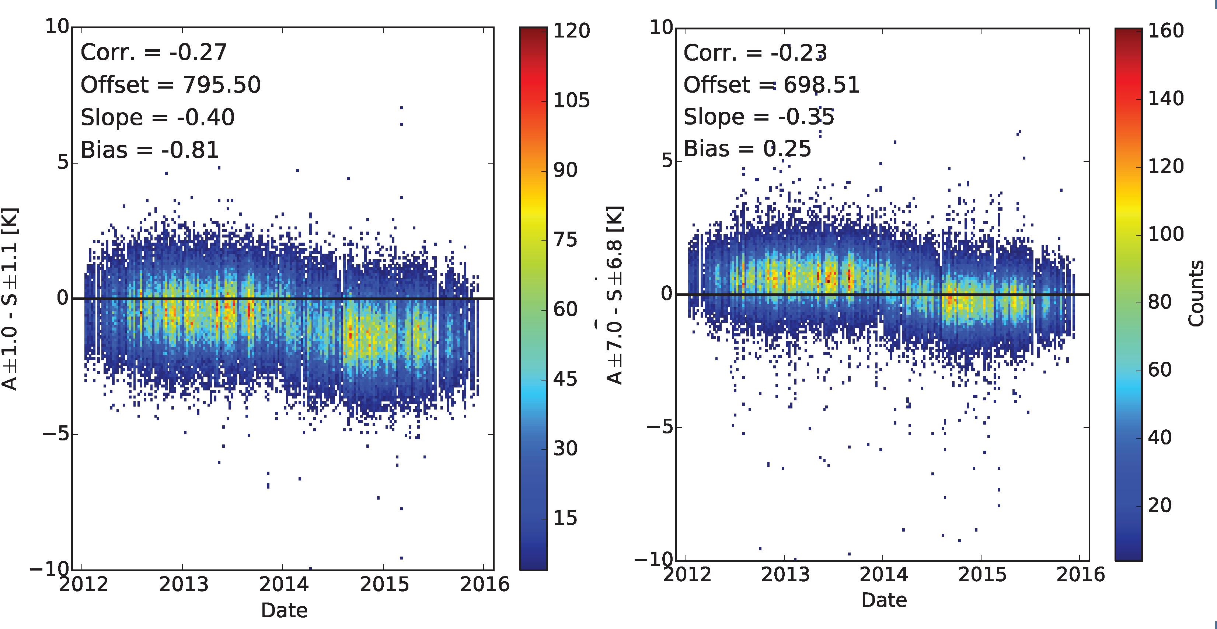
Trends over Time

Slide 10
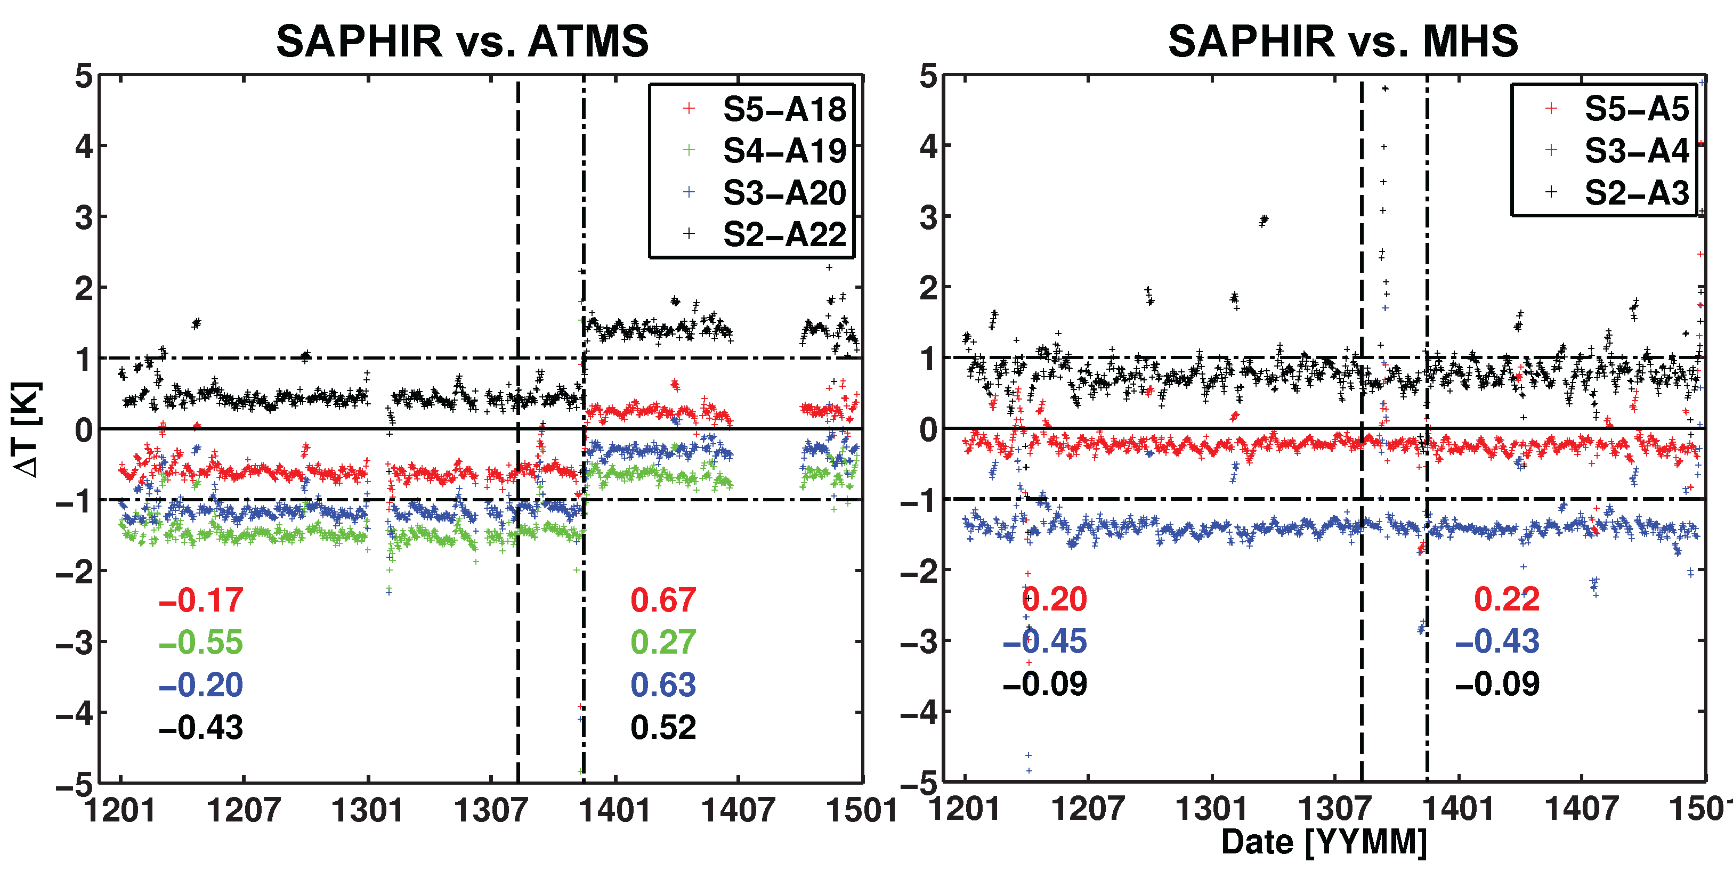
More trends, including MHS

Slide 11
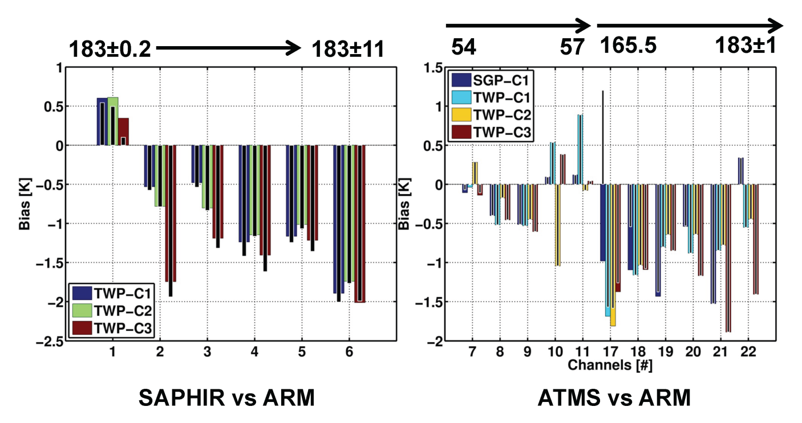
ARM Radiosondes

Slide 12
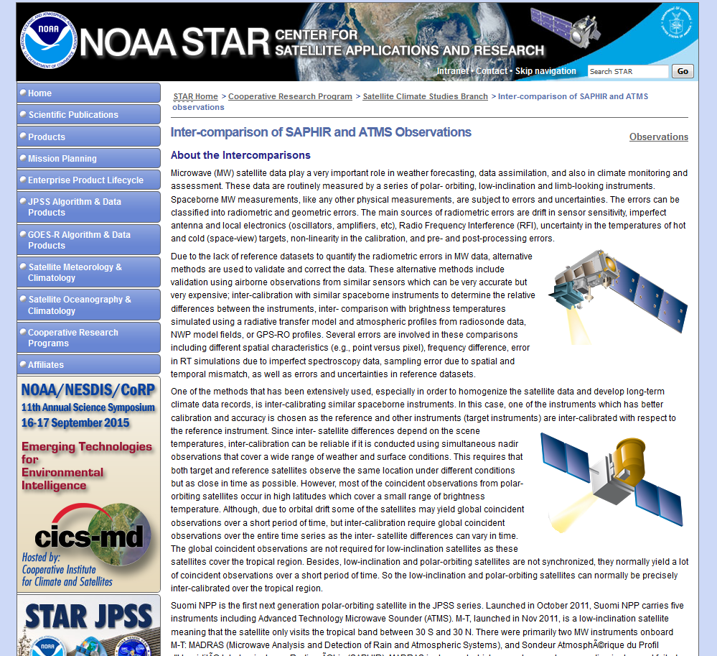
Routine Monitoring - http://www.star.nesdis.noaa.gov/star/mw-calval.php

Slide 13
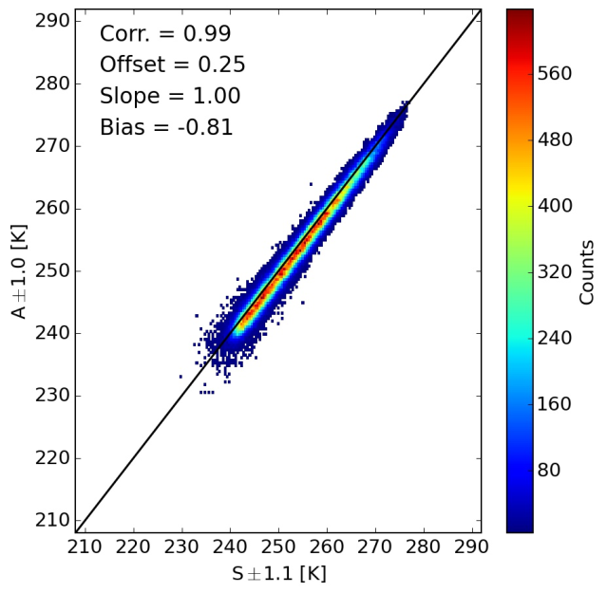
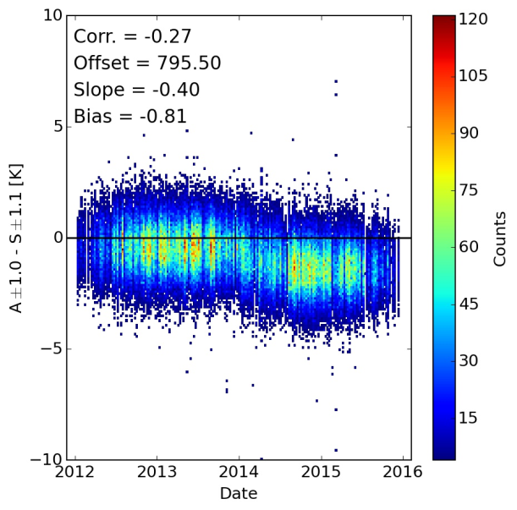
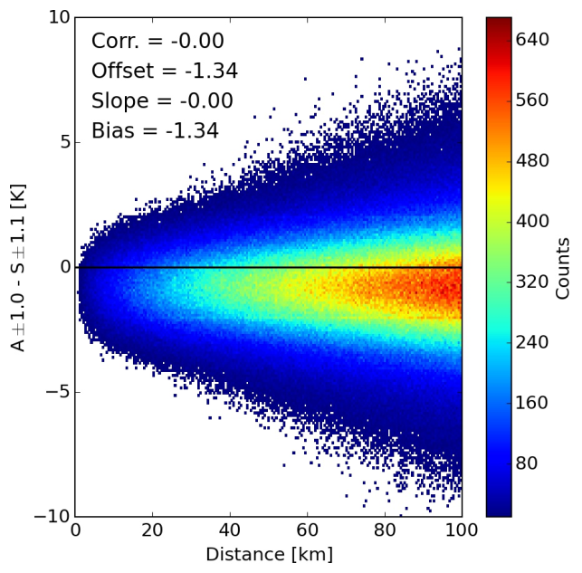
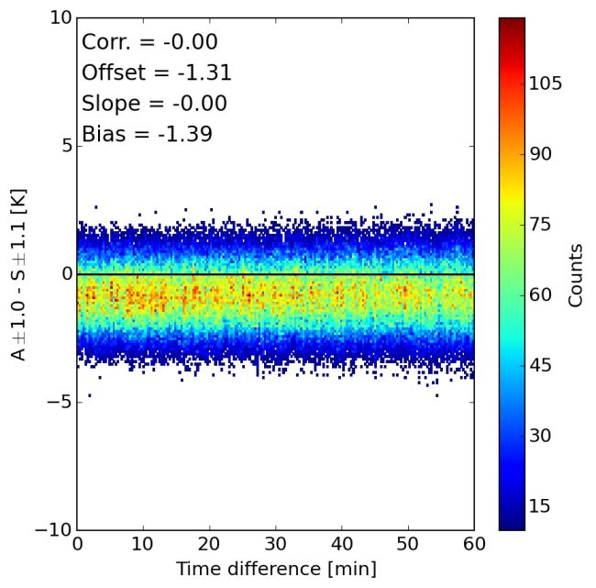
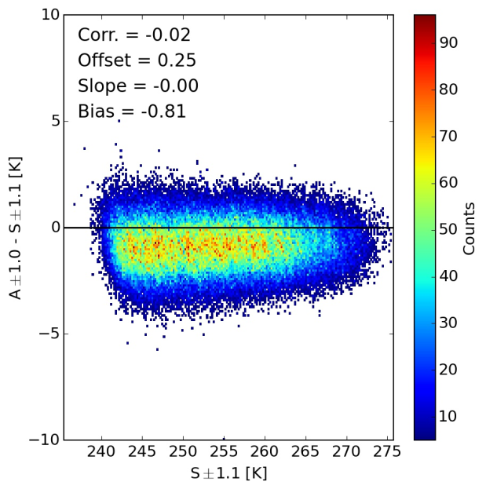
What’s on that page…
Plots for all 4 similar
channel pairs are
available

Slide 14
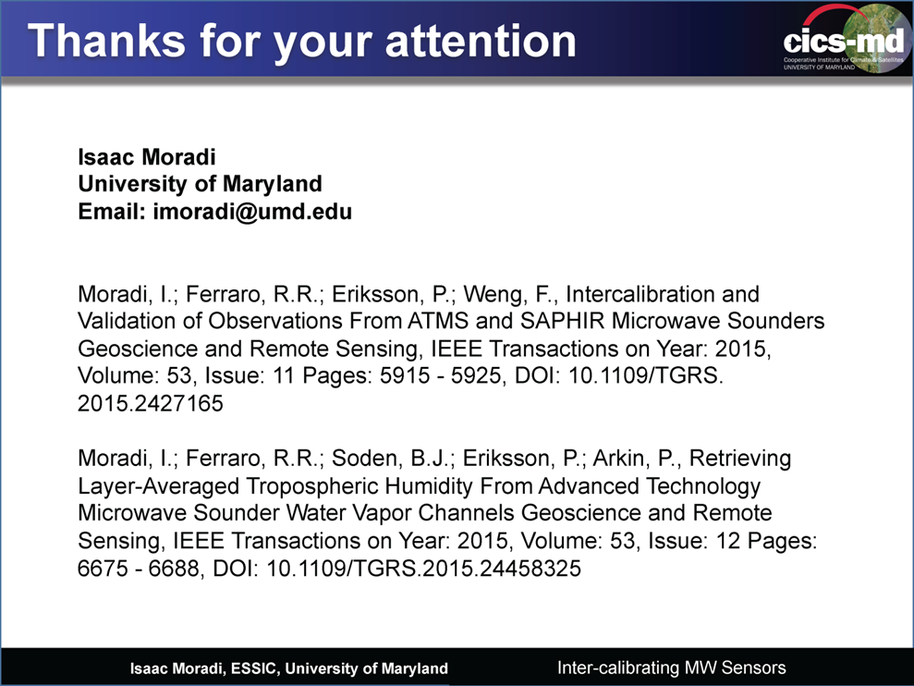
Summary
SAPHIR and ATMS observations show very good consistency!
Despite being tropical focus, SAPHIR provides excellent cross-calibration with POES satellites
  More chances for co-locations than amongst POES themselves
  Minimal surface effects in tropical environment
  Potential limitations on cold target values
Useful references:

