Slide 1
Intercalibration of
AMSR2 and PMW radiometers
Takashi Maeda(JAXA/EORC), Arata Okuyama (JMA),
Kazufumi Kobayashi (RESTEC), Mieko Seki (RESTEC),
Keiji Imaoka (Yamaguchi Univ.), Misako Kachi (JAXA/EORC)

Slide 2
Introduction
The GCOM-W research project team in JAXA/EORC has dealed with intercalibration between AMSR2 and other PMW radiometers to increase the availability of retrieval algorithms for AMSR2.
Mr. Okuyama promoted this work when he belonged to JAXA/EORC.

Slide 3
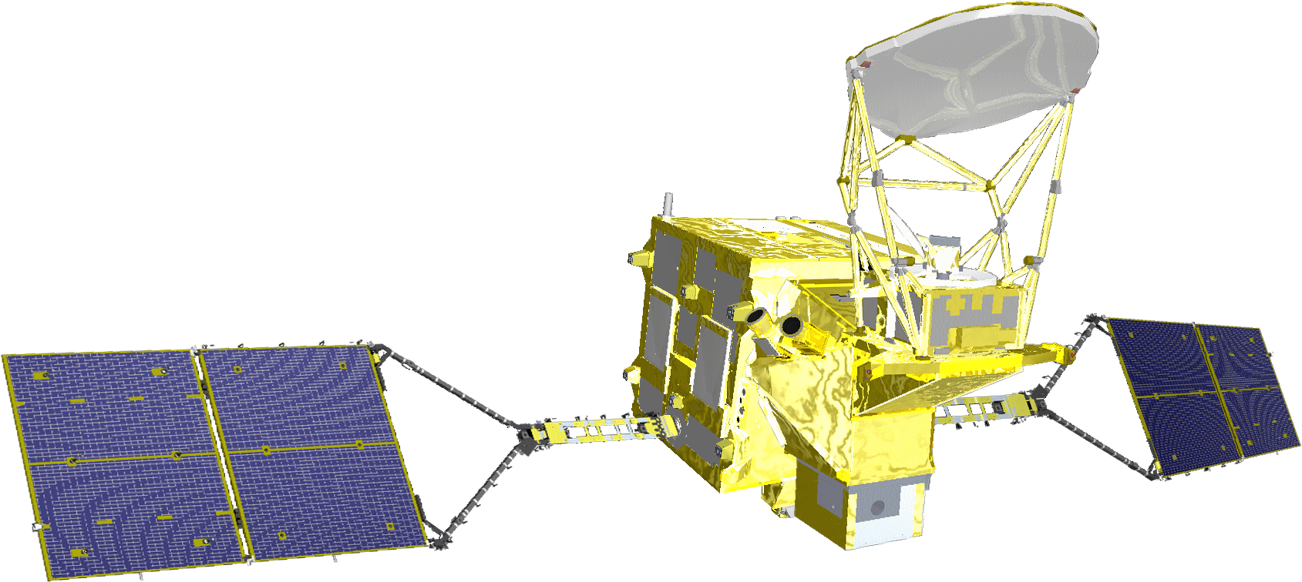
AMSR2 onboard GCOM-W satellite
The main mission of the GCOM-W satellite is to monitor the global water cycle, for which it has onboard the Advanced Microwave Scanning Radiometer-2 (AMSR2).
AMSR2 is a multifrequency total-power microwave radiometer that rotates in 40 rpm and detects vertically and horizontally polarized microwave energy emitted from the Earth’s surface and the atmosphere as a brightness temperature (TB).
AMSR2
Orbit | Sun synchronous orbit Altitude: 699.6km (on Equator) Inclination: 98.186° Local sun time: 13:30±15min
Life | 5 years
Launch | May 17, 2011 by H-IIA Rocket
Satellite scale | 5.1m (X) * 17.5m (Y) * 3.4m (Z)
Satellite mass | Total 1,911kg

Slide 4
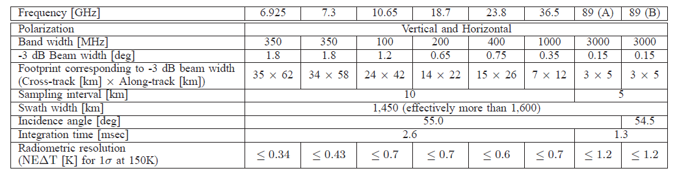
AMSR2

Slide 5
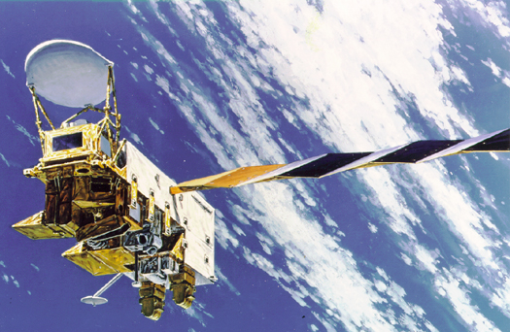
Target PMW radiometers
D
i
re
ct
co
mp
a
ri
so
n
(2
rp
m)
AMSR
-E
AMSR
2
Pa
st
d
a
t
a
co
mp
a
ri
so
n
Po
l
a
r
Po
l
a
r
MW
R
D
D
-D
D
MW
R
Double
Double
Double
D
i
f
f
e
re
n
ce
D
i
f
f
D
e
re
n
ce
i
f
f
e
re
n
ce
Double
Double
D
i
f
f
D
e
re
n
ce
i
f
f
e
re
n
ce
T
MI
G
MI
Double
D
i
f
f
e
re
n
ce
N
o
n
-su
n
syn
ch
ro
n
o
u
s
Notes:
We have the slow rotation AMSR-E data in AMSR2 operation period.
We first compared the slow rotation AMSR-E data and the AMSR2 data.
Then, we compared the past AMSR-E data in the nominal rotation mode and the AMSR2 data.
Finally, we tried to compare the AMSR2 data and the TMI or GMI data in double difference method.

Slide 6
Intercalibration results
AMSR2 vs AMSR-E in slow rotation mode (`Current' AMSR-E)
AMSR2 vs AMSR-E in operational mode (`Past' AMSR-E)
AMSR2 vs TMI or GMI

Slide 7
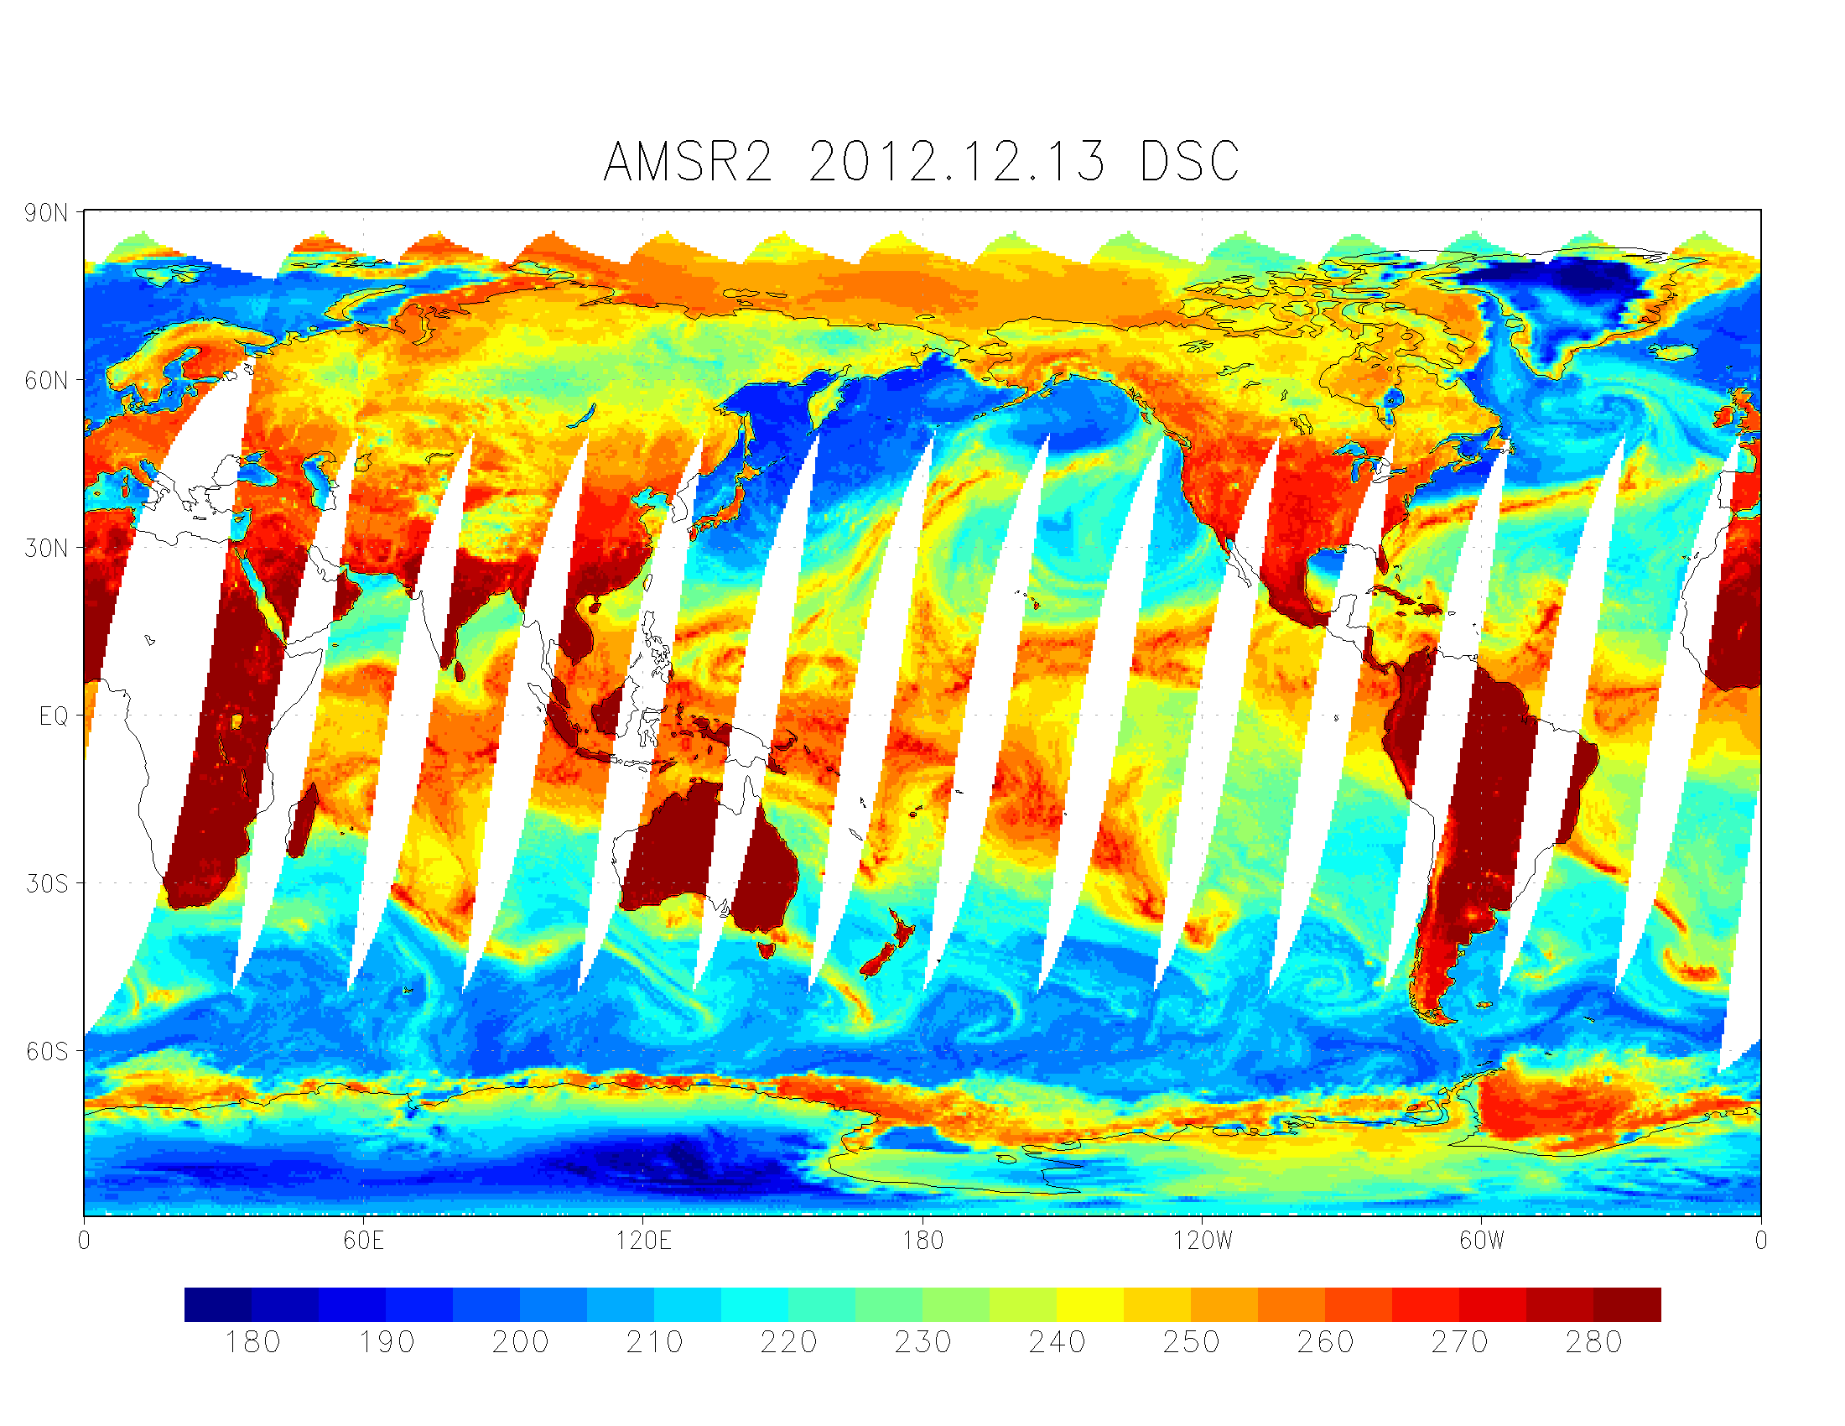
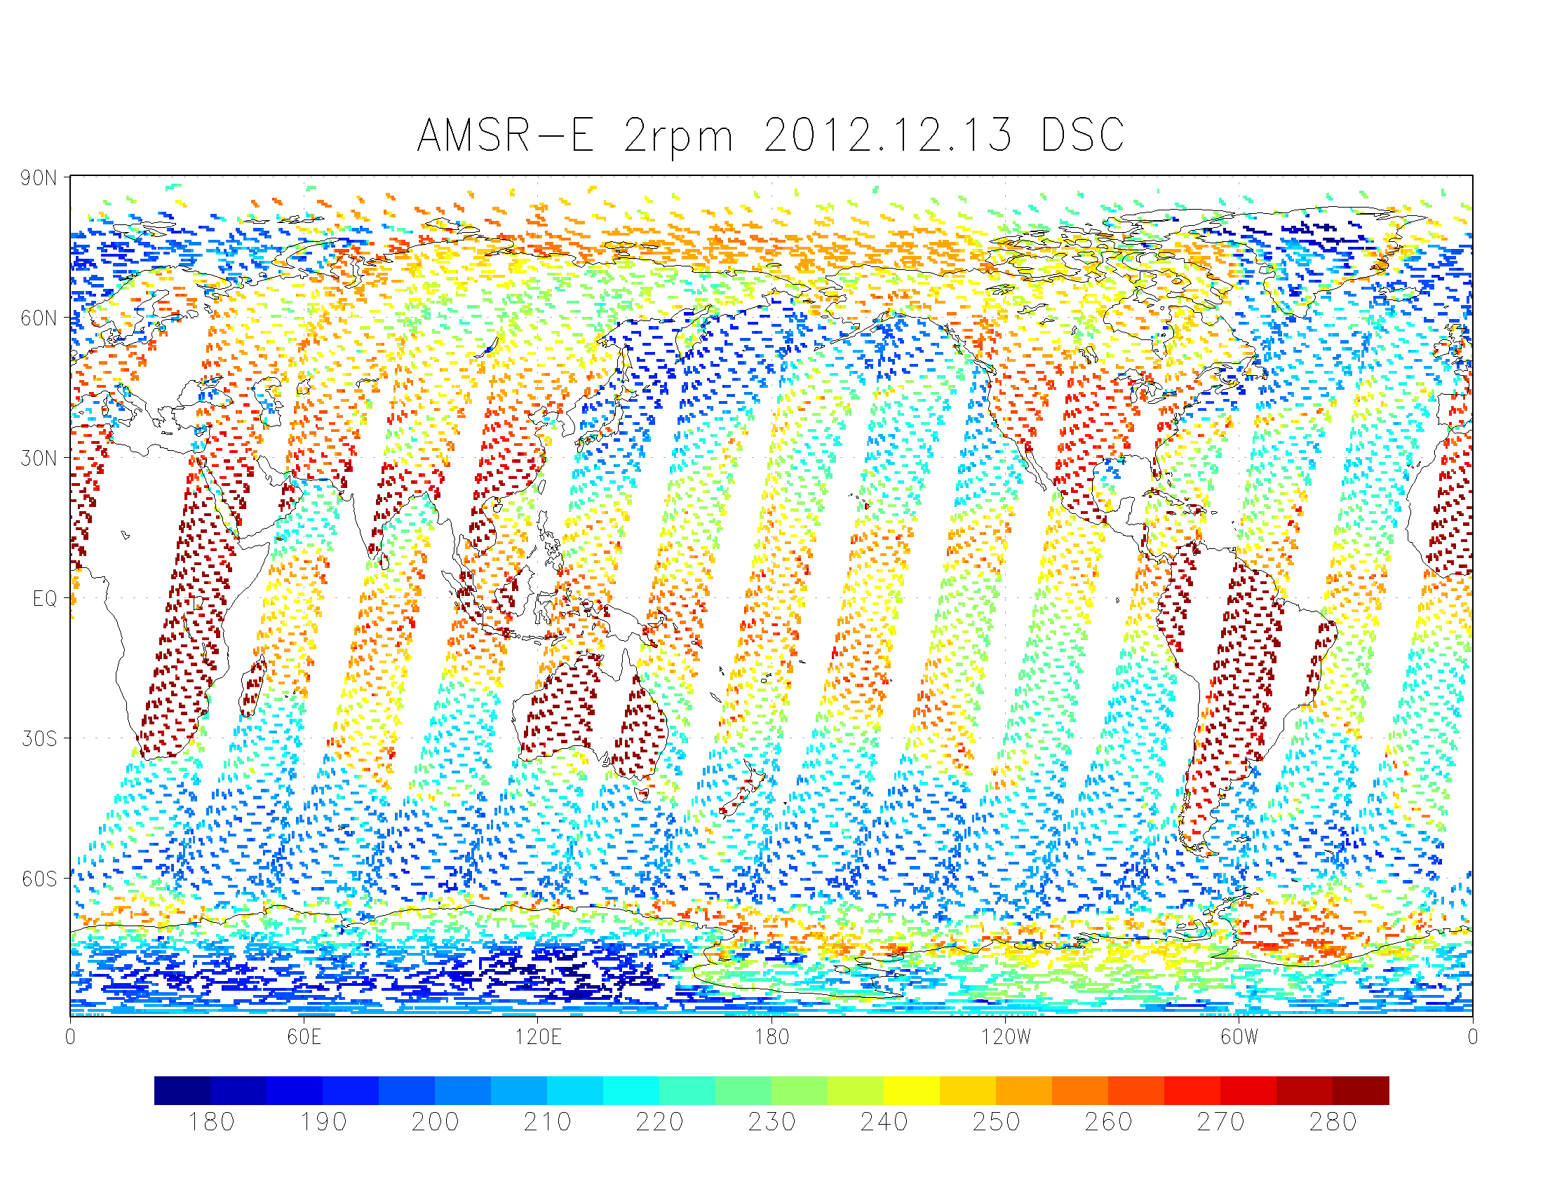
Direct comparison with the `Current' AMSR-E
Observation frequencies and incidence angles of AMSR2 and AMSR-E are identical though AMSR2 does not have a 7.3-GHz channel.
  We don't have to consider frequency and angle correction to compare the AMSR2 data with the AMSR-E data.
  We can compare Tb in a wide range over land, ice, and ocean.
AMSR-E resumed observation in Dec 2012 in slow rotation speed.
Observation data was sparse but the data amount was sufficient for global-scale analysis.
AMSR2 23V Dsc
AMSR-E 2rpm 23V Dsc
Notes:
The first comparison is a direct comparison with AMSR-E.
Observation frequencies and incidence angles of AMSR2 and AMSR-E are identical except for 7.3GHz channel.
It means that Frequency and angle correction is not required to compare AMSR2 with AMSR-E measurement.
AMSR-E is a good reference to evaluate AMSR2 data.
AMSR-E resumed observation in Dec 2012 with slow rotation speed.
Modification of geolocation and radiometric correction software was necessary.
Now we have 3 month data.
Observation data is sparse, like this, but amount is reasonable for global-scale analysis.
The next slide shows difference of Tb, this AMSR2 minus AMSR-E.

Slide 8
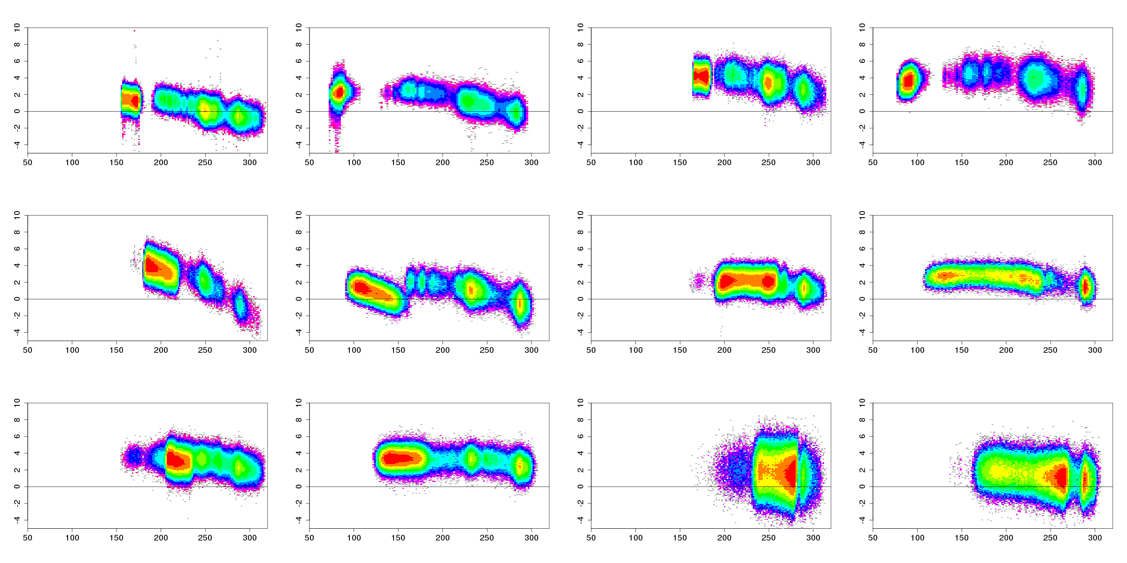
Tb difference (Ascending)
Dec. 2012 – Feb. 2013
6.9V
6.9H
10.6V
10.6H
18.7V
18.7H
23.8V
23.8H
36.5V
36.5H
89.0V
89.0H
x-axis: AMSR2(obs Tb)
y-axis: AMSR2(obs) – AMSR-E(obs)
Notes:
We can see the parabolic shape other than 18.7 H.
The vertical-axis is the Tb difference, AMSR2 – AMSR-E, for each channels.
The horizontal-axis is AMSR2 measured Tb.
Data period is 3 month, ascending orbit.

Slide 9
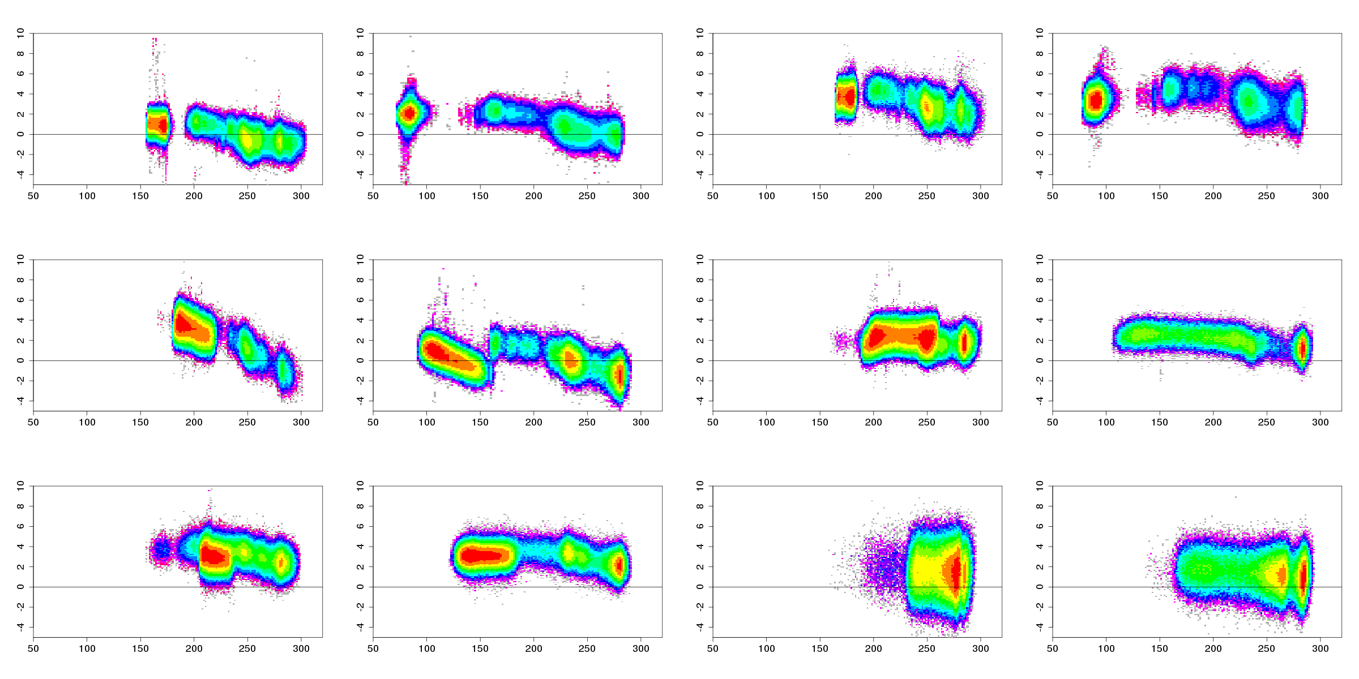
Tb difference (Descending)
Dec. 2012 – Feb. 2013
6.9V
6.9H
10.6V
10.6H
18.7V
18.7H
23.8V
23.8H
36.5V
36.5H
89.0V
89.0H
AMSR2 Tb has a positive bias up to 5K comparing with AMSR-E Tb in many channels.
The bias varies depending on measured Tb.
x-axis: AMSR2(obs Tb)
y-axis: AMSR2(obs) – AMSR-E(obs)
Notes:
This slide is for descending orbit.
We can find that AMSR2 Tb tend to show positive bias up to 4 or 5K comparing with AMSR-E in many channels.
And The bias varies depending on measured Tb.
For example, in this 18GHz H-pol channel, left group of plots is by ocean, and this right group is by rainforest area.
The bias by ocean area is 4 K or so, and the bias by rainforest area is 0 K or less.
The next slide is a summary of these charts…

Slide 10
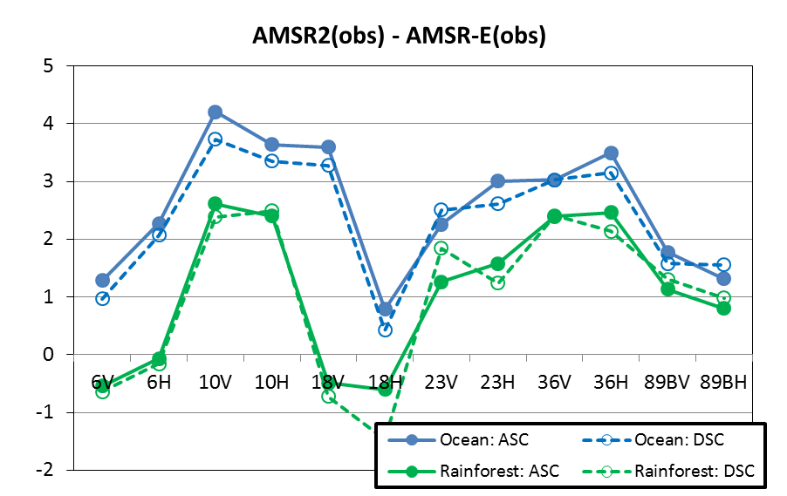
AMSR2 - Current AMSR-E over the ocean and rainforest areas
The AMSR2 Tb was higher than the AMSR-E Tb.
  0 to +4 K over the ocean
  -1 to +3 K over rainforest areas
The differences (AMSR2 - AMSR-E) over the ocean were higher than those over rainforest areas.
The difference between ascending and descending tracks was less than 0.5 K.
over the ocean
over rainforest areas
Dec. 2012 – Feb. 2013
Notes:
Horizontal axis is each channel, 6GHz-V, 6GHz-H, … and so forth.
Blue line is the bias over ocean, and Green line is the one over rainforest area. Cold end and Warm end.
Solid and dash lines are biased for ascending and descending orbit.
The Points are:
1. AMSR2 Tb tend to be higher than AMSR-E Tb
2. The differences, AMSR2 – AMSR-E, over ocean are higher than the ones over rainforest area.
3. Difference between ascending and descending orbits is small.
I said AMSR-E is a good reference to check AMSR2 data quality, but …

Slide 11
Intercalibration results
AMSR2 vs AMSR-E in slow rotation mode (`Current' AMSR-E)
AMSR2 vs AMSR-E in operational mode (`Past' AMSR-E)
AMSR2 vs TMI or GMI

Slide 12
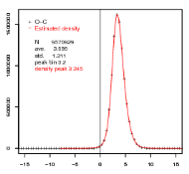
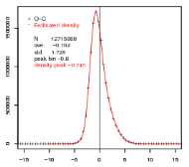
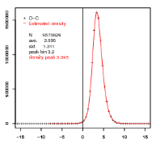
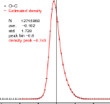
Comparison with the `Past' AMSR-E
12
AMSR2 is compared with the operational `past' AMSR-E L1B data statistically:
  Methodology (Double Difference Technique)
  Step 1: calculate AMSR2 SD (Single Difference: obs. Tb – simulated Tb) over the cloud-free ocean and rainforest areas, and obtain a typical SD from a histogram.
  Step 2: obtain a typical SD for AMSR-E L1B in 2011, in a similar way.
  Step 3: calculate SD(AMSR2) – SD(AMSR-E) (≡DD; Double Difference) representing Tb difference trend between AMSR2 and AMSR-E.
  Radiative transfer model was RTTOV. NWP dataset to input to RTM was JMA objective analysis.
  Data period
  AMSR-E: Oct 2010 - Sep 2011 / AMSR2: Jul 2012 - Jun 2013
Diff
minus
AMSR2 (2012)
O(obs) – C(RTTOV)
AMSR-E (2011)
O(obs) – C(RTTOV)
Notes:
Geometric and radiometric correction methods for the L1S are not identical to the past operational ones.
So, just in case, Current AMSR2 is compared with past but operational AMSR-E L1B data statistically.
Approach is:
Firstly, compute AMSR2 single difference. Single difference is observed Tb – simulated, simulated Tb. over cloud free ocean and rainforest.
Next, obtain a typical SD, mode or mean, from its histogram like this.
And, obtain a typical SD for AMSR-E L1B in 2011, in a similar way.
SD(AMSR2) – SD(AMSR-E) seems to show calibration difference between both satellites.
なぜ観測値のヒストグラム同士の比較ではなく、ＲＴＭをはさむのか？
→ 大気場が去年と今年で同じとは限らないから。

Slide 13
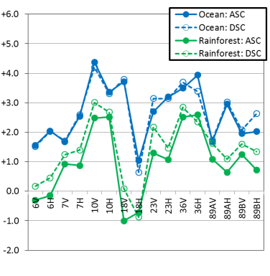
Indirect comparison with the `Past' AMSR-E
SD(AMSR2:2012)–SD(AMSR-E:2011)
over ocean
over rainforest
Similarly, the AMSR2 Tb was higher than the AMSR-E Tb:
  0 to +4 K over the ocean
  -1 to +3 K over rainforest areas
Notes:
This is result for each channels.
The result of this indirect comparison and that of direct comparison show good agreement.

Slide 14
Intercalibration results
AMSR2 vs AMSR-E in slow rotation mode (`Current' AMSR-E)
AMSR2 vs AMSR-E in operational mode (`Past' AMSR-E)
AMSR2 vs TMI or GMI

Slide 15
Comparison with TMI or GMI
Because the TMI and GMI were not in a sun synchronous orbit, it is convenient to make collocation data with the AMSR2, but observation frequency and incidence angle were not identical.
Double Difference Technique is suitable to cancel out Tb biases caused by differences such as observation frequency and incidence angle.
  Methodology
  step 1: make collocation dataset from AMSR2 and TMI. (within 15minutes and ±0.1 degrees)
  step 2: calculate SD (single difference) for both of AMSR2 and TMI.
  SD = (Observed Tb) – (Simulated Tb)
  step 3: calculate DD (double difference)
  DD = SD(AMSR2) – SD(TMI or GMI)
  Radiative transfer model was RTTOV. NWP dataset to input to RTM was JMA objective analysis.
Notes:
The third reference is the TMI.
TRMM is Non-sun synchronous orbit, it is convenient to make collocation data with AMSR2.
To cancels out Tb biases brought by differences such as observation frequency and incidence angle, we adopted double difference approach.
The approach is:
compute the Single Difference for both of AMSR2 and TMI, observed Tb – simulated Tb.
The Double Difference is SD of AMSR2 – SD of TMI.
It means calibration difference between AMSR2 and TMI.

Slide 16
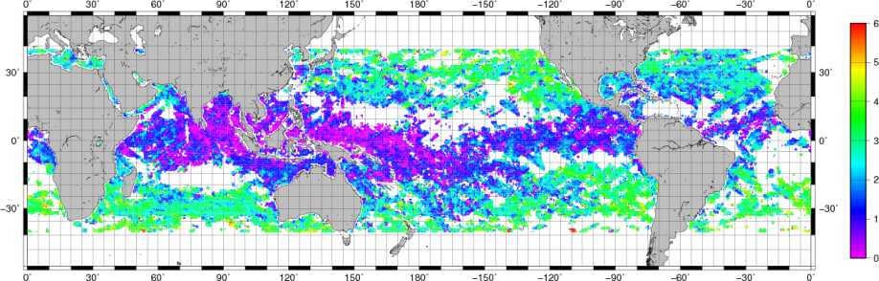
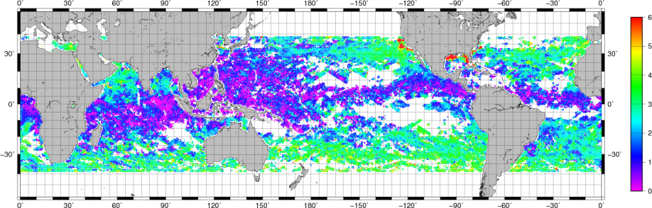
DD of AMSR2 and TMI
AMSR2(O-C: 18.7GHz H) – TMI(O-C: 19.35GHz H)
Ascending
Descending
Notes:
This is an example of the Double difference value, by AMSR2 18GHz H-pol and TMI 19GHz H-pol.
Orbital inclination angle of TRMM is around 35 degrees, so, the collocation data is spread from equator to mid latitude area, like this.
Colors mean the DD values. Purple area means 0 K, green area is around 3 or 4 K.
We can find relatively large calibration difference around US coastal area. It is too localized and large to be of natural origin. It seems to be RFI signature.
In this case, This figures show that :
the calibration difference is almost positive value, and
tend to be small in equator region, and relatively larger in mid-latitude area.
This pattern implies that the calibration difference correlate with measured Tb.

Slide 17
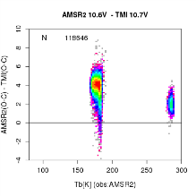
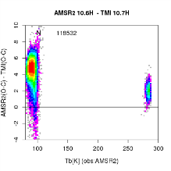
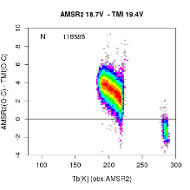
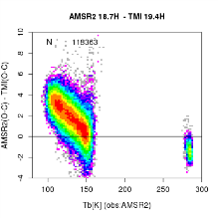
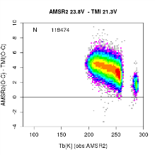
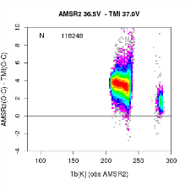
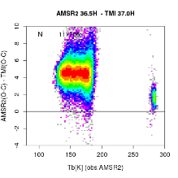
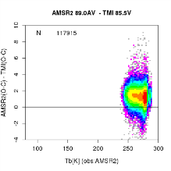
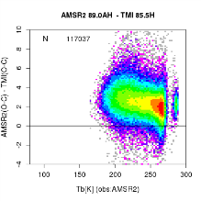
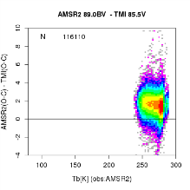
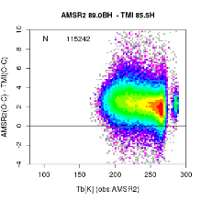
DD of AMSR2 and TMI (Ascending)
10.6(AMSR2) – 10.7(TMI)
18.7(AMSR2) – 19.4(TMI)
10
V
H
V
H
AMSR2 – TMI
0
-4
obs. Tb
23.8(AMSR2) – 19.4(TMI)
36.5(AMSR2) – 37.0(TMI)
V
July 2012 to June 2013 Ascending orbit
V
H
the double difference varies depending on measured Tb.
89.0A(AMSR2) – 85.5(TMI)
89.0B(AMSR2) – 85.5(TMI)
V
H
V
H
Notes:
So, this slide is the double difference values and measured Tb, for each channels.
2 groups of plots are for ocean and rainforest area.
Positive trend and dependency on measured Tb seen in AMSR-E are applicable also to this chart.

Slide 18
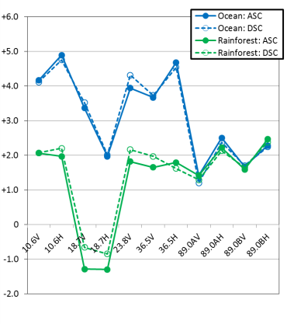
DD of AMSR2 and TMI
Cloud-free ocean and rainforest areas
Jul. 2012 to June 2013
AMSR2 Tbs are 0 to 5 K higher than TMI Tbs
Tb differences over the ocean and over rainforest areas are different from each other.
The double differences based on ERA-Interim is almost same.
AMSR2(SD) – TMI(SD)
over ocean
over rainforest
Notes:
This is a summary of the comparison with TMI.
This figure looks similar to the one for AMSR-E. It is reasonable because AMSR-E Tb was calibrated based on TMI and SSMI.

Slide 19
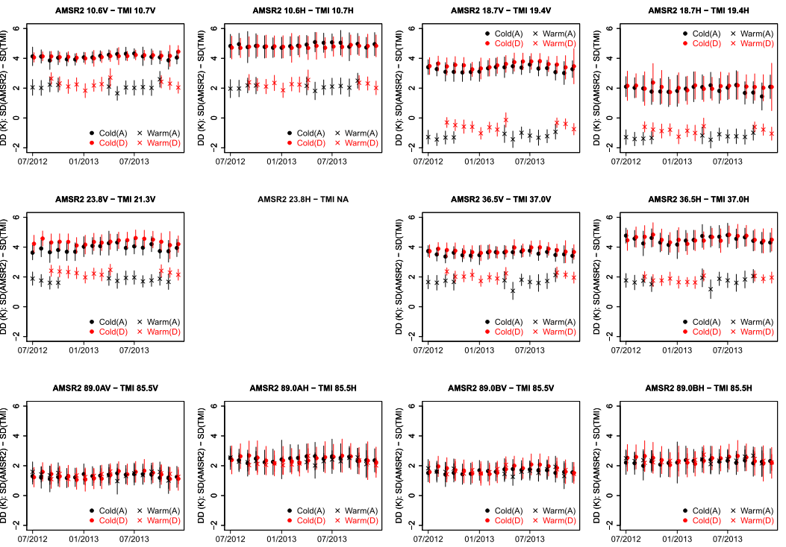
DD of AMSR2 and TMI (Seasonal trend)
Seasonal variation of the bias is smaller than that of AMSR-E.
over ocean
over rainforest
Notes:
The next slide is a trend of the calibration differences, AMSR2 –TMI, from July 2012 to the last month, one and a half year.
Red and black are for ascending and descending orbits, respectively.
And circles and cross marks are for ocean and rainforest, respectively.
In 89Ghz channels, the plots for ocean and rainforest are overlapped.
We made same chart for the AMSR-E, and confirmed that seasonal variation is smaller than that of AMSR-E.

Slide 20
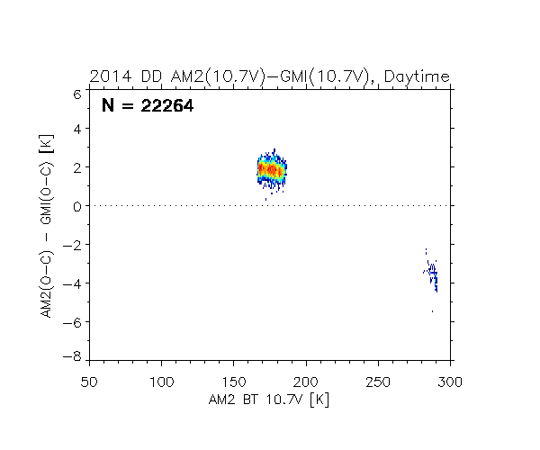
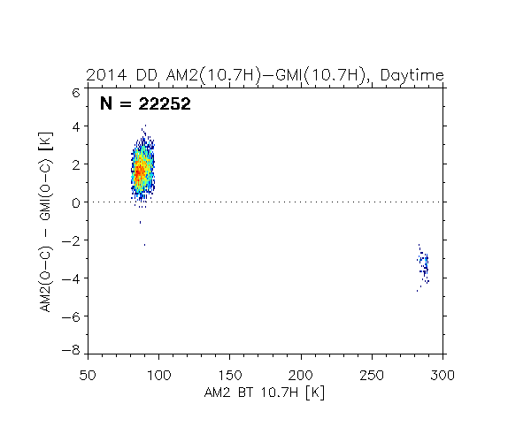
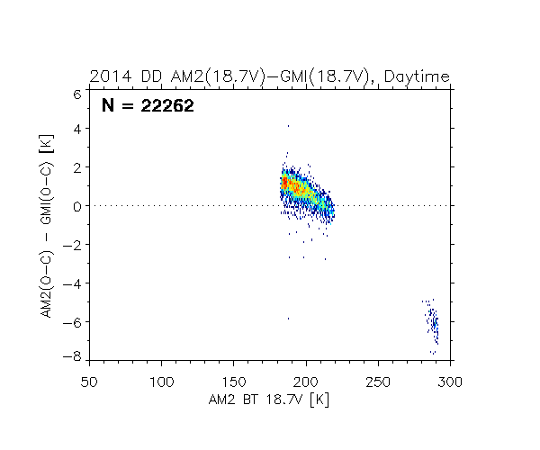
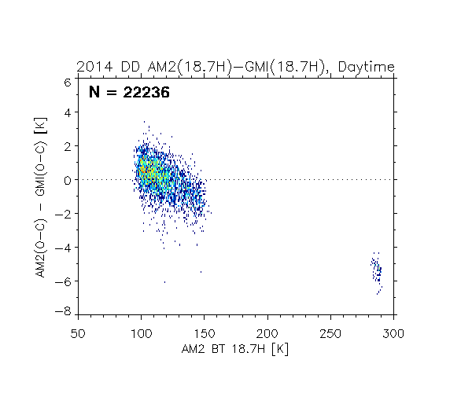
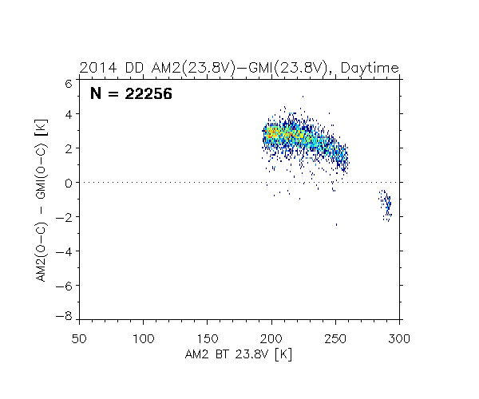
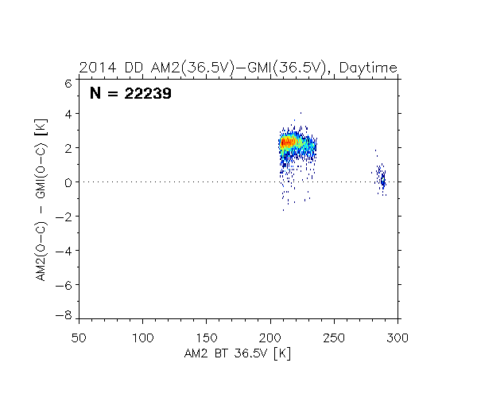
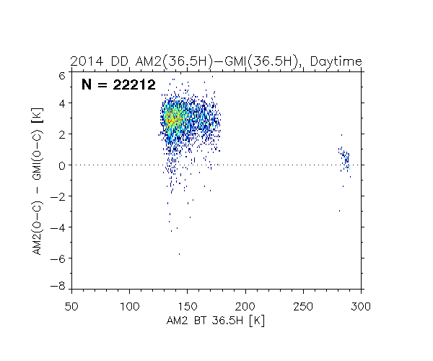
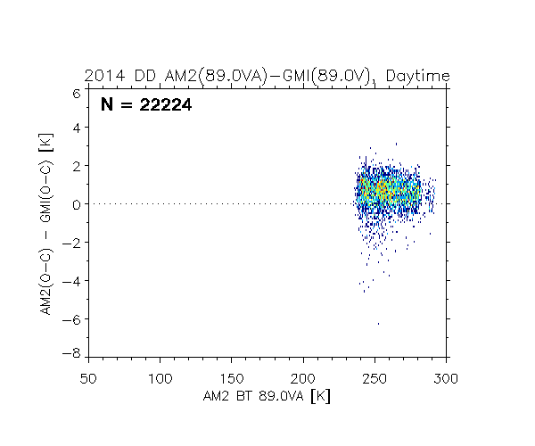
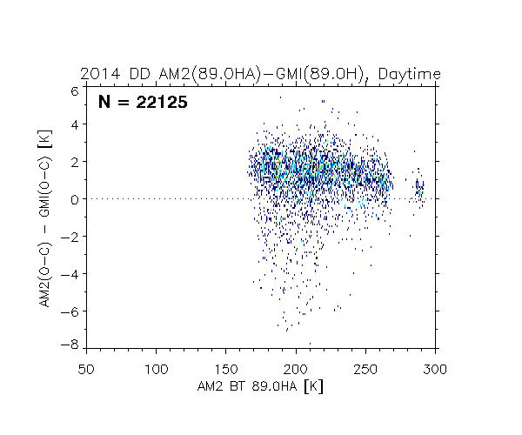
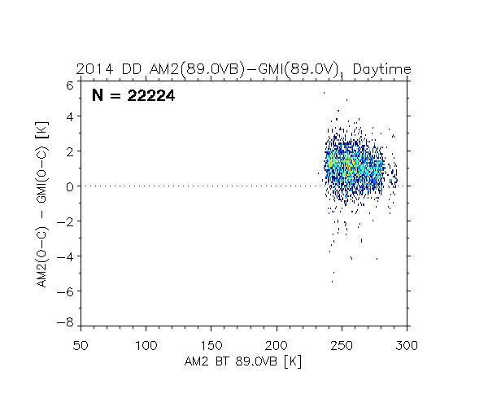
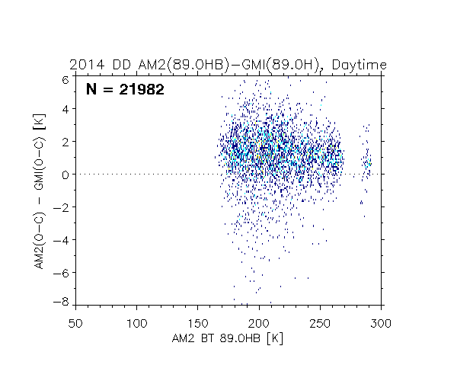
DD of AMSR2 and GMI (Ascending)
10V
10H
19V
19H
6
0
AMSR2 –GMI
-8
24V
37V
37H
89VA
89HA
89VB
89HB

Slide 21
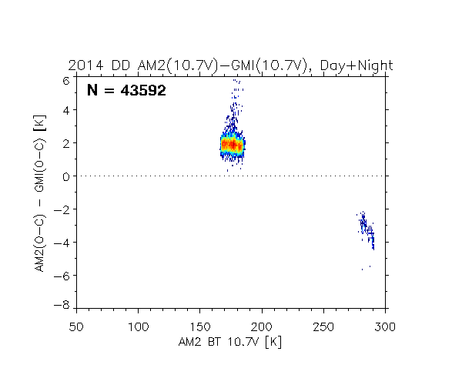
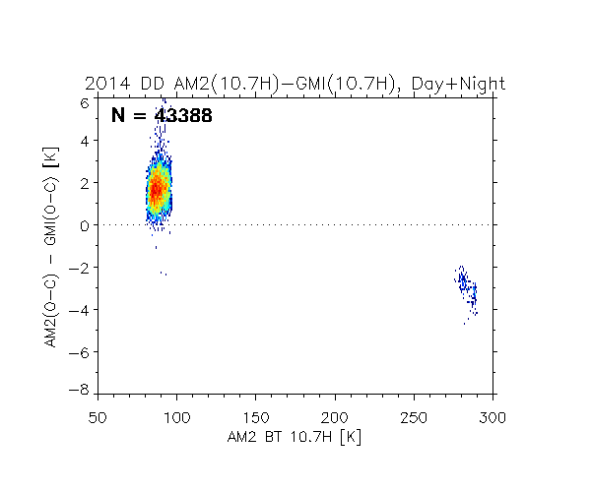
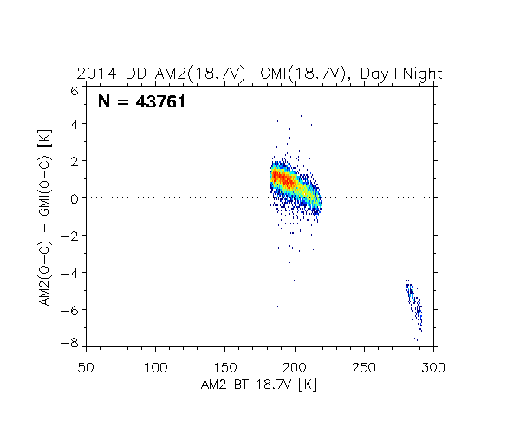
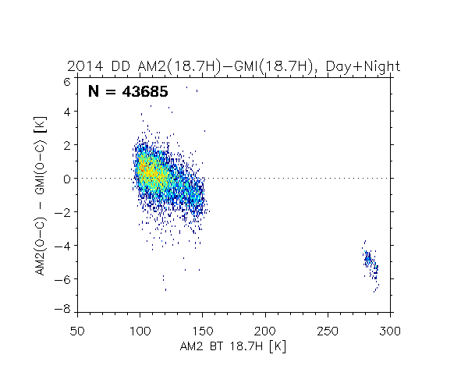
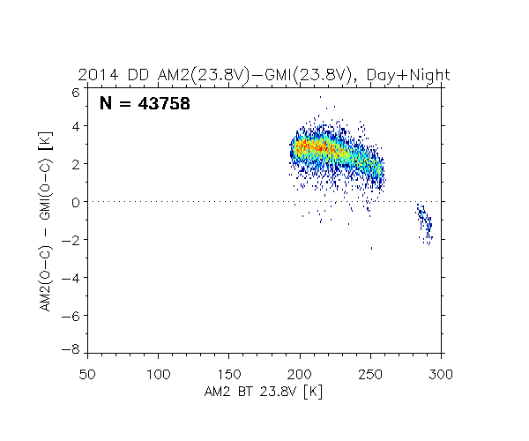
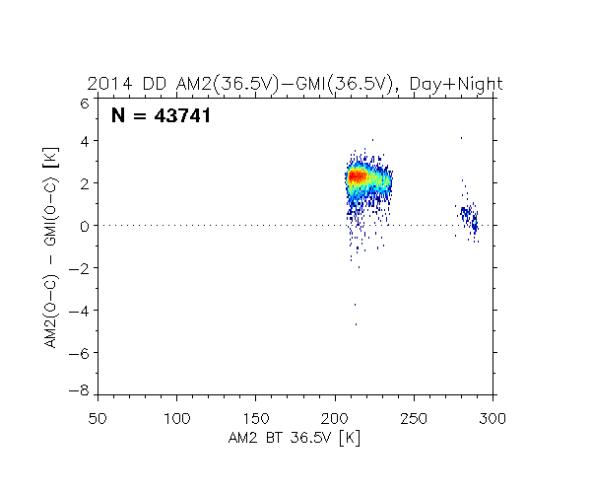
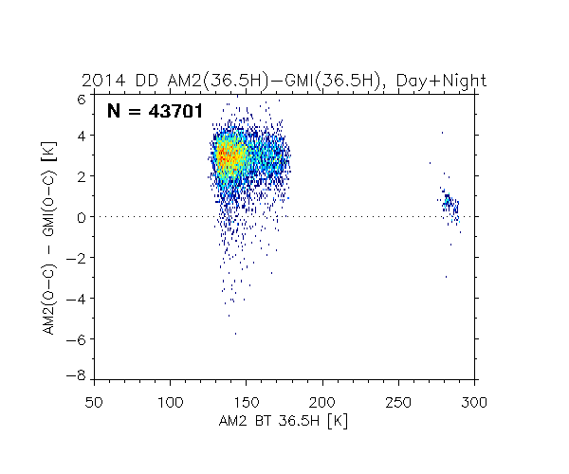
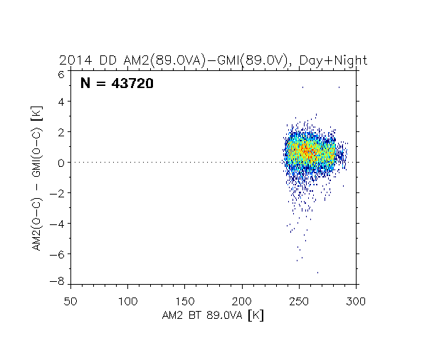
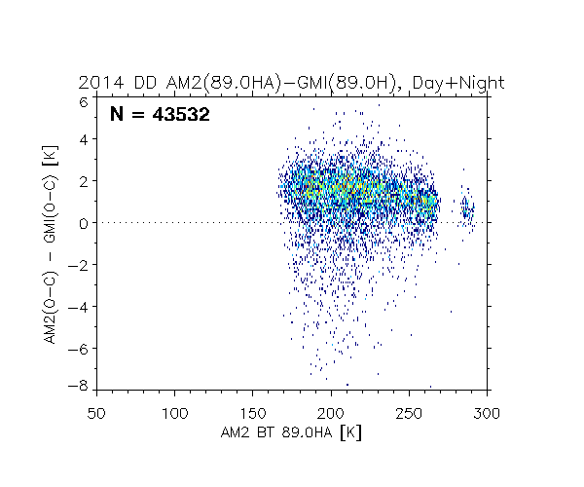

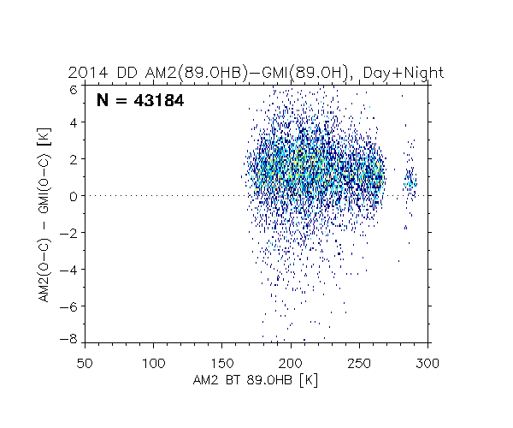
DD of AMSR2 and GMI (A+D)
10V
10H
19V
19H
24V
37V
37H
89VA
89HA
89VB
89HB

Slide 22
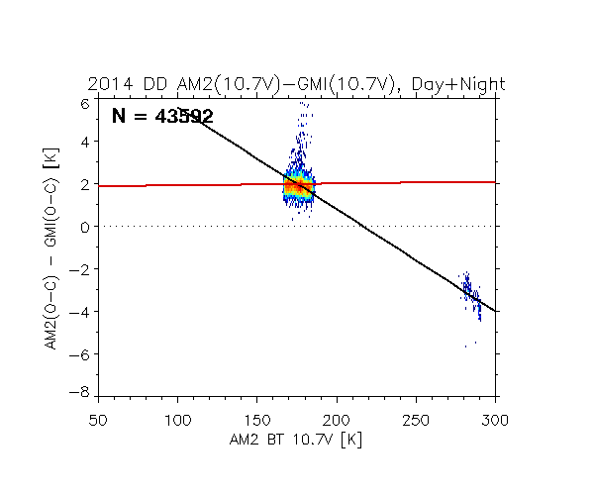










DD of AMSR2 and GMI (A+D)
10V
10H
19V
19H
24V
37V
37H
89VA
89HA
89VB
89HB

Slide 23
Summary
AMSR2 Tb has a positive bias for AMSR-E, TMI and GMI Tb.
However, AMSR2 Tb's positive bias for GMI Tb was relatively small.
From a parabolic-shape approximate curve, we suspect the validity of the AMSR2 receiver's non-linearity parameters.
We are now ongoing to validate the AMSR2 algorithms for geophysical values using various PMW radiometers' Tb converted to the quasi-AMSR2 Tb by intercalibration results.

