Slide 1
2b. GSICS Coordination Centre (GCC) 2015-2016
Larry Flynn and Manik Bali
2016 GSICS Annual Meeting
Tsukuba, Japan
Feb 29-4 Mar, 2016

Slide 2
Outline
Introduction
GCC Activities
Registrations in GUMS
GSICS Quarterly Newsletter
Meeting Support
GPPA and Product Acceptance.
SRF Kiosk
Product Versioning
GSICS Product Status
GSICS Instrument performance Summary
GSICS Users Feedback
Near Term goals
Summary

Slide 3
GCC Activities - Registrations in GUMS
Interest in GSICS activities growing

Slide 4
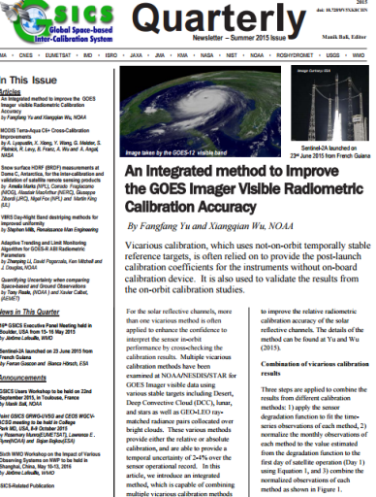
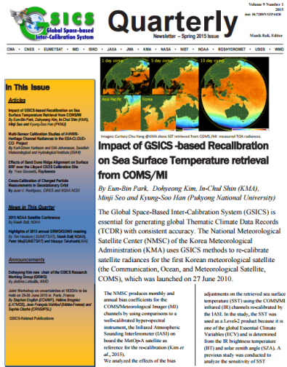
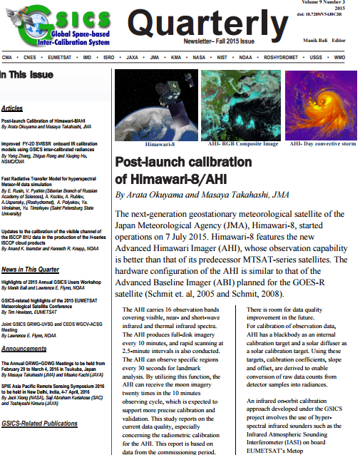
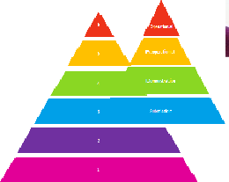
GSICS Activities (1)
Newsletter four new Issues of GSICS Newsletter published
Over 25 Research Articles , 15 Topics of News to which
Over 70 Scientists contributed as Authors + Co-Authors.
Reviewed contemporary journal policy on content sharing
Meeting Support
10 Web-meetings + GSICS Users Workshop
Supported CEOS WGCV-ACSG and GSICS UV Meeting at NCWCP
GPPA → Fine Tuned the GPPA and proposed review paths to producers ( Prime and DCC products).
MSG 2/3 –IASI review completed in six months
More discussion in agenda under 7.u.

Slide 5
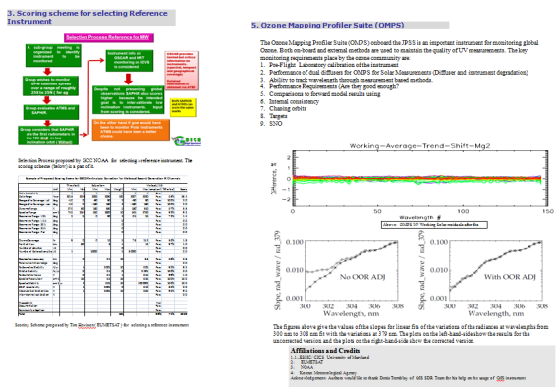
GSICS Activities (2)
Review the GSICS versioning paradigm.
Agencies encouraged to pick the versioning best suited for their needs provided the versioning is well documented and visible to the users.
Updated the Instrument Info Kiosk with the SRF netCDF files and Hyperlinks to the SRF data
Updated Instrument kiosk and SRF information available here .
Selection of Reference Instrument (discussion in 3e)
GCC evaluated the criterion to select reference suggested
by Tim Hewison and proposed a process of selection.
Presented the work in JPSS Science meeting.
(With contributions from JMA, KMA, EUMETSAT and NOAA)

Slide 6
GSICS Activities (3)
GCC to review FCDR inter-calibration requirements, in the framework of the GSICS User Product Guidance, to identify common inter-calibration types, which are not specialized to specific applications, and report to GRWG. These could be considered as potential future GSICS products.
IR – Reviewed FIDUCEO project report.
MW – User feedback from MW FCDR taken.

Slide 7
Proposed Entity Categorization (Talk 2s)
Core products
Subject to GPPA
Models and data sets
These should be reviewed by GSICS and recommended for use (or not).
Tools
These are made available because GRWG members find them useful.
GSICS Documents
GPRC and OSCAR Documents and Resources
Discussion of proposed acceptance processes for each Category in Talk 2u

Slide 8
GSICS-Product status
Operational 4 product [4 EUMETSAT]
Preoperational 4 products [4 NOAA]
Demonstration 27 products [4 EUMETSAT, 13 NOAA, 6 JMA]
EUMETSAT, ISRO and KMA
Submitted their cross calibration products to GCC for review
GCC initiated the GPPA review process for these new products
Review Process Status
ISRO INSAT IASI Product
KMA COMS- IASI Product
EUMETSAT DCC Product
EUMETSAT Prime Product
→ Initial GPAT review sent to producer for implementation
→ Initial GPAT review sent to producer for implementation
Proposed GPPA tuning,
GCC Connected with Users
Proposed GPPA tuning,
received one review
Notes:
Four demonstration products (NOAA) have ended production.
There are two prototype products.

Slide 9
GSICS Instrument Performance Summary
The aim is to provide a summary of in-orbit performance of monitored instrument, e.g., recent statistics compiled from GSICS products showing how well the products are doing.
We are extracting statistical performance metrics and will present them to characterize the measurements.

Slide 10
User Feedback
Ep-16 assigned actions on GCC that were aimed at collecting Requirements and Expectations from Potential Users of GSICS Products → We want to make our products more useful to community.
GCC collected questions from each subgroup (IR, MW, UV and VIS, GRWG ,GDWG) which were put to potential users to understand their expectations (See here ).
GCC put an-online version of the questionnaire and opened it to the scientific community.
Add in your expectations from GSICS by filling out the Questionnaire and participating in discussions during 7c User Feedback.

Slide 11
Near-term Goals for 2016-2017
GSICS Procedure for Product Acceptance
Support inclusion of New Products
Coordination
Continue to coordinate efforts to establish the GSICS baseline algorithms, especially those for the GEO solar reflective channels,
Continue to provide communication between the developing group and users
GSICS Quarterly
Continue to create and distribute this important link to the GSICS community.
Support Reviews of GSICS Products, Deliverables and Resources
Meeting Support
Joint Meeting, GSICS Web Meetings and QA4EO telcons.
Organization of GSICS 7rd Users Workshop at NCWCP, USA
Gather more user Requirements
Facilitate WMO Appreciation nominations.

Slide 12
2016 Users’ Workshop
Welcome to the GSICS Users’ WORKSHOP 2016 at
NOAA NCWCP, College Park, MD USA
as part of the JPSS Annual Science Team Meeting 8-12 Aug 2016
환영합니다
Bienvenue
Willkommen
Web site for last year’s meeting including the agenda and presentations
http://www.star.nesdis.noaa.gov/star/meeting_2015JPSSAnnual.php

Slide 13
Summary
GSICS Coordination Center continues to support and coordinate exchanges of ideas within GSICS.
Review of MSG2/3- IASI product completed and Product in Operational Status.
Newsletter, GPPA fine tuning, Meeting Support, Entity Categorization.
List of GCC talks at this meeting
2b GCC Annual Report
2s Defining GSICS Products
2u GPPA growing pains
3e Selecting References
7b/c Strawman User Requirements Document and User Survey
7g GSICS Quarterly Special Issues/Editors
7h User Interaction & 2016 Users’ Workshop

Slide 14
Thank You

