Slide 1
GDWG Report 2015 / 2016
Peter Miu / Masaya Takahashi
CMA, CNES, EUMETSAT, ISRO, IMD, JAXA, JMA, KMA, NASA, NIST, NOAA, ROSHYDROMET, USGS, WMO

Slide 2
Overview
GDWG Actions and Membership
GDWG Notable Activities Summary
GDWG Work Plan 2016 / 2017
GDWG Challenges
Questions

Slide 3
GDWG Actions and Membership
Actions Summary 2016
40 actions proposed in 2015 joint meeting – a new Record!
24 actions have been completed.
12 actions have feedback provided, they are in progress.
4 actions where no feedback has been received; this is a problem that needs addressing.
Membership Updates 2016
New NOAA Member – Jordan Yao.
New KMA Members – Hyunjong Oh
, Jin Woo.
Notes:
Collaboration Server service improvements; GSICS product mirror and new product notification and distribution.

Slide 4
GSICS Data Preservation Strategy
(Reported at the EP-16 meeting in May 2015)
Data Archiving vs Data Preservation
“Data archiving” not only implies storage but additional services such as data discovery/identification/search/migration
“Data preservation” only implies reliable access to the data
For GSICS products, a data preservation strategy shall apply
The GSICS EP endorsed this Strategy
Objective should be the preservation of the “Re-analysis Corrections”, rather than the “Near Real-Time Corrections”
Additional Recommendation from the GSICS EP
Collocation data shall be preserved.
GSICS products generation software shall be able to regenerate all versions of their GSICS products.

Slide 5
Collaboration Servers Network Status
EUMETSAT Server is in operation.
CMA Server is available; EUMETSAT to support CMA on its operation.
NOAA Server has been available for some time; EUMETSAT to work with new NOAA GDWG member to further its operations into the collaboration network.
EUMETSAT Server offers source data sets, examples of the intermediate data sets, and the first GSICS operational product (GEOLEOIR). Several demonstration and pre-operation GSICS products also exist on this server.
Collaboration servers operations and tools is a major agenda item to be discussed between the members in the GDWG breakout session.
Notes:
Collaboration Server service improvements; GSICS product mirror and new product notification and distribution.

Slide 6
Version controlling software for GSICS software development (lead by J. Kim, KMA)
Use of GitHub (online version controlling) will be discussed at 5g, lead by H. Oh (KMA)
Agency | Version controlling software | Comments by GDWG member
CMA | Subversion on a local server controlled by software engineers | GitHub will be possible
EUMETSAT | Subversion | Use of GitHub has been investigated
JMA | Subversion + Git (some developers) | GitHub is good for us.
KMA | Git on systems for real time operation/data processing, radiometric/geometric performance evaluation, space weather monitoring Subversion on systems for real time operation support and meteorological analysis | Like CMA status: the controlling established on a local server at each contract company. GitHub will be possible.
NOAA | Subversion | Git can give better performance. F. Yu has authored the GSICS product at NOAA.
Notes:
Members of the GDWG have produced some developments that are currently residing in their own software version controlling systems. While subversion fulfil our software version control needs at EUMETSAT, it cannot be used for collaboration developments. For example, the GSICS Calibration Products Plotting Tool. EUMETSAT has developed this tools for visualising the contents of the GEOLEOIR Calibration product. This tool needs to be updated for each new GSICS product types, and at present, only EUMETSAT can update this tool. We need a mechanism to provide all GDWG members with the ability to update this tool, and any other GSICS software. GitHub is a software version control system that supports collaboration developments across the internet. Not sure if Asia has access to GutHub and/or similar systems, and this is what we would like KMA to investigate and propose a way forward such that the GDWG can perform collaboration developments.

Slide 7
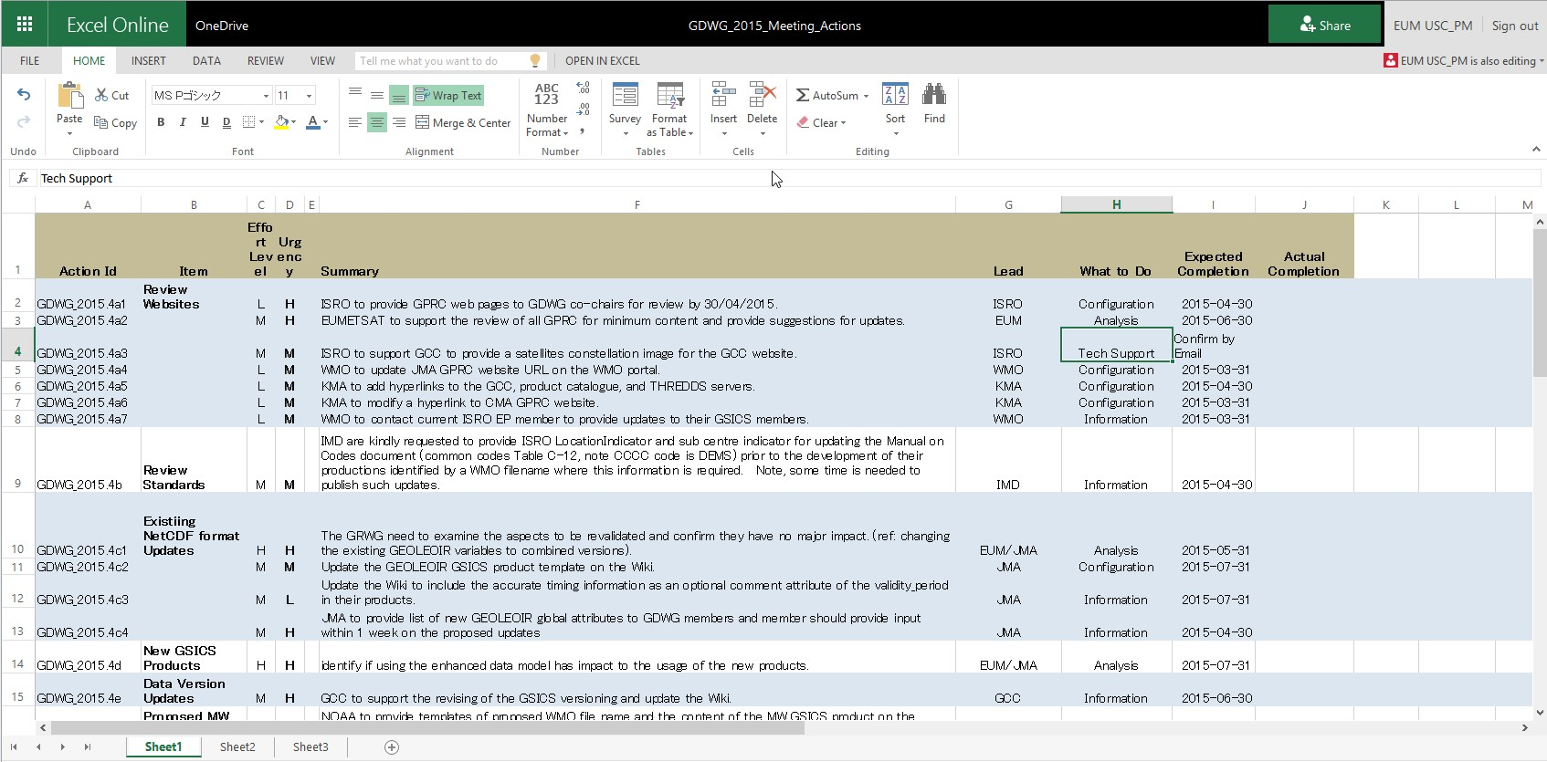
Action Tracking
2015 GDWG actions are recorded in an online spreadsheet with new categorisations. This is available to all members to view.
Improving the action tracking way will be discussed in GDWG session.

Slide 8
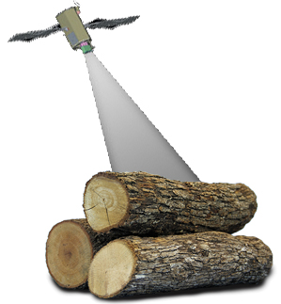
Instrument Event Logging
(lead by Rob Roebeling, EUMETSAT)
Goal: to develop a uniform approach for presenting, logging, and monitoring calibration information across satellite operators
A white paper for CGMS-44 in 2016 is in preparation
First step: to create/maintain stable landing pages
The pages are linked from the WMO-OSCAR
EUMETSAT/JMA have already created, other agencies are also in progress
Second step: to adopt nomenclature and standards for instrument events
To identify a common set of parameters across space agencies. E.g.,
- Irregular Events
Radiometric Calibration Events
Geometric Calibration Events
- Processing Events
Processing Updates
Reprocessing Events

Slide 9
Supporting GRWG activities – Lunar calibration
Infrastructure to distribute the GIRO (executable + source codes) + GLOD (lunar observation dataset) is in progress
THREDDS: no mechanism to limit access. This does not stop google finding the link and provide anyone with access to the data sets.
For GIRO, if restricted access is still required, then another mechanism needs to be found to support this requirement.
GIRO product checker, which was required from GRWG, would be realized by GSICS product generation framework
international collaboration amongst CMA/EUMETSAT/IMD/JMA/KMA

Slide 10
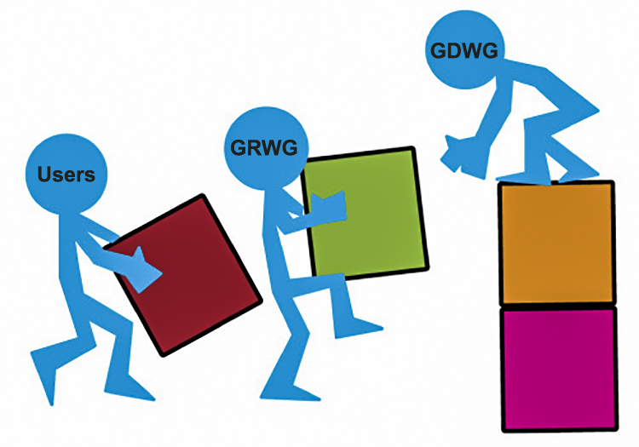
GDWG Work Plan 2016 / 2017
Specification of GSICS Data Management Guidelines, Conventions and Standards to address the users’ needs for new GSICS products.
GSICS Collaboration Servers - collaboration network realisation and operations.
Version controlling software for GSICS activities
Investigate how to collaborate the development of the GSICS Tools and Utilities.
GSICS product generation framework
The use of Digital Object Identifiers (DOIs) for GSICS deliverables; ATBD and products.
Notes:
Guidelines, conventions and standards; using the netCDF as the format for data exchange, use of the WMO file naming convention for data and product identification, using CF conventions where possible to organise the netCDF array structures, and specifying meta-data.
GSICS collaboration servers are the platforms for data exchange and GSICS product distribution.
GSICS tools and utilities; GSICS products plotting tool, automate the GSICS products netCDF ncml validation, provide framework for the development of GSICS products in netCDF (in progress).
GSICS products generation framework simplifies and speeds up GSICS product development. This is needed as our partners are not all aware of how to develop the netCDF format. Framework provide a structure to create netCDF files through configuration, a ncml file defining the netCDF, and the implementation of mapping classes to populate the netCDF file from the native data.

Slide 11
GDWG Challenges
Use of the netCDF Enhance Data Model for future GSICS products.
Satellite events integration into the GSICS universe.
Operations aspects; getting GSICS products to the users in timely fashion; automated dissemination.
Collaboration automation; using tools for actions tracking, reminders, progress updates.
GDWG membership; long term commitment and effective collaboration.
Notes:
netCDF is currently using the classic data model; simply and works with all netCDF tools. Limitations with data types, lack of data structures and file size, enhance data mode provides these new features.
We need a easy way to do work together; documents and software developments – look for free tools to do this.
As part of data preservation for the GSICS products, we need to replicate all operational GSICS products across the GSICS servers.
Automated distribution of GSICS products would be very useful for users who are regularly using them for their operational systems.

Slide 12
Actions Identifier Format
GDWG Chairs were asked to provide a Format, the format is:
GsicsId.yyyy[ mmdd. | .agendaItemId. ]actionCount:
Valid GsicsId (update when needed):
[ GDWG | GRWG | GWG | GEP | GCC | GIR | GVNIR | GMW | GUV ]
agendaItemId is for annual meeting agenda item identification. 1a
mmdd is all other meetings indicates the month and day e.g. 0118
Examples:
GDWG.2016.5d.1 - GDWG annual joint meeting action 1
GIR.2016.2c.5 - GRWG IR sub group annual joint meeting action 5
GWG.20160118.3 - First GRWG & GDWG webex meeting in 2016, action 3
GEP.2016.1a.2 - GSICS EP annual meeting action 2
GCC.20161102.12 - GCC webex meeting in 2016 action 12
Please use this format for the actions in your group.

Slide 13
End of Presentation: Thank you for your attention
Notes:
Questions?

Slide 14
Backup slides…maybe useful but not to be presented in their current form.

Slide 15
GDWG Achievements (2)
Calibration Event Logs
CGMS has tasked its participating agencies to provide working papers on current and future capabilities for calibration monitoring and event logs.
EUMETSAT has taken the lead in specifying a standard vocabulary for calibration events. This in progress and is a GDWG agenda item to discuss and worked on in this joint meeting such that a paper can be presented to CGMS calibration events team for further development.
Support to the development of New GSICS Products
Input and output file format for Lunar calibration products
KMA GEOLEOIR products
CMA GEOLEOIR products
GSICS products generation framework; EUMETSAT leads an initiative to simplify and speed up the development of GSICS products by offering a SDE (prototype will be demonstrated in the breakout session).
Terms of Reference (ToR) Updates
Clarification of scope of responsibility for the roles; this is needed as GSICS is becoming bigger.
Clarification of the task responsibility for the roles.

Slide 16
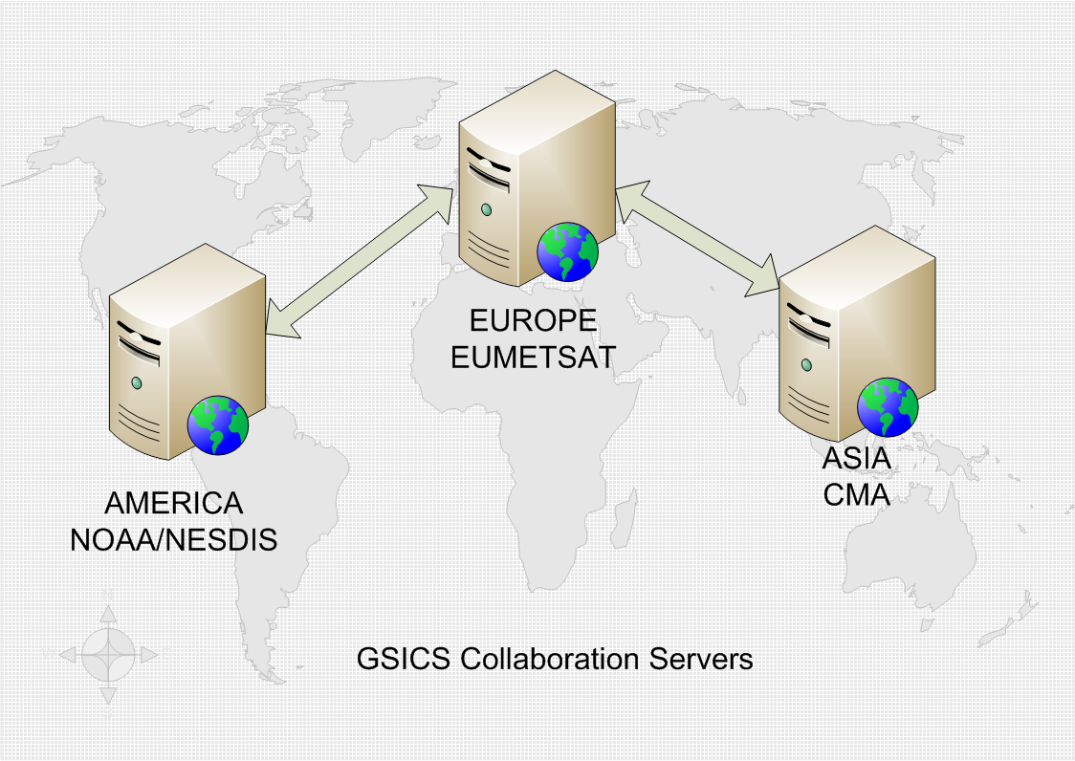
GSICS Collaboration Servers Network Status

Slide 17
What do these Servers do?
Provides the platforms offering a set of Data Management Services for the GSICS community to exchange data for the creation and then the access of GSICS products.
Note: all data and products following agreed Data Management guidelines, conventions and standards.
The proposed GSICS Collaboration Servers are now in place. Each server should exchange on request satellite data most applicable for their region as well as provide redundancy for other servers in the network in terms of serving GSICS products to the user community.
The servers can also act as data sources for web tools that can work with the agreed GSICS formats. Also, dedicated GSICS tools such as the GSICS Product Plotting tools can exploit the data sets offered by these servers.

Slide 18
Planned Activities for the Collaboration Server Network: 2015
Revision of the directory structures to improve the usability of searching for data and products on these servers.
The automated transfer of GSICS products between servers requires implementation.
The GSICS Product Plotting Tools is expected to be enhanced with new user requirements (to be discussed in the GDWG breakout session).
User service improvements; technical solutions for notification and distribution of operational products. This is to be coordinated with the GCC.

Slide 19
GDWG Work Plan 2015 / 2016 (1)
Specify an Archiving Strategy for operational products
Discuss the evolutions of product format, conventions, guideline, and standards.
Propose a technical solution for online collaboration access to source code, source data sets for ATBDs and documents such as ATBDs.
Support developments in Events logging; events catalogue, landing pages, and brainstorm concepts for investigation by the CGMS calibration events team
GSICS tools to support product developer and users.
Notes:
Product developers – framework, Users – notification and download tools.

Slide 20
GDWG Work Plan 2015 / 2016 (2)
GSICS specific document templates, logos, branding, etc.
Address the Human Resource Challenges to support GDWG activities
Management of GDWG task expectations
Momentum / Motivation building through short term expert visits to work on collaboration activities.

