Slide 1
Update from the GRWG/Microwave Subgroup
Ralph Ferraro
NOAA/NESDIS

Slide 2
Members
Signed up as of January 2016
Representation from ~10 space institutions and their related affiliates
NOAA (and affiliates) - Ralph Ferraro (Chair), Huan Meng, Cheng-Zhi Zou, Manik Bali (Univ. Maryland), Isaac Moradi (Univ. Maryland), Hu (“Tiger) Yang (Univ. Maryland), Wenze Yang (Univ. Maryland), Jun Park (Univ. of Maryland)
EUMETSAT (and affiliates) – Tim Hewison, Karsten Fennig, Viju John, Jörg Ackermann, Sabatino DiMichele, Sante Laviola, Vinia Mattoli, Sreerekha Thonipparambil, Christophe Accadia
NASA (and affiliates) – Ed Kim, Linwood Jones (Univ. of Central Florida), Rachael Kroodsma (Univ. of Maryland), Wes Berg (Colorado State Univ.)
NIST - David Walker
CMA (and affiliates) - Songyan Gu, Qifeng Lu, Lin Chen, Hu Yang, Xiaolong Dong
KMA (and affiliates) – Jun Park, Dong-Bin Shin (Yonsei University, South Korea)
JAXA (and affiliates) - Misako Kachi
IISC – Ram Ratan
OTHERS I may have missed….

Slide 3
Scope of Microwave Sub-Group
Understanding the users’ requirements for inter-calibration products for microwave instruments
  Imagers + sounders – passive only (initially, but eventually consider active if there is a need…)
  Retrospective calibration (CDR’s and their components like geolocation, scan biases, inter-satellite)
  Forward looking calibration (near-real time uses)
Identifying existing products that could meet those requirements, but first….
  Need to define criteria…Reference standards (sensor(s), models, calibration methodologies….)
  And then a process that adheres to GSICS principles
We should also focus on tools/algorithms like SNO, Double Difference, RTM, etc.
  Might be something more feasible in near term?
Define data standards (jointly with GDWG)
Encourage the creators of those products to submit them to the GSICS Procedure for Product Acceptance (GPPA), once its defined for MW
  Candidates include Cheng-Zhi Zou (MSU-AMSU), Karsten Fennig (SSMI), GPM X-Cal LUT’s
GSICS Products could be developed within the Microwave Sub-Group
Coordination with other groups (e.g., CEOS WGCV MW, GPM X-Cal) would also be required to generate standards and best practices

Slide 4
Recent Meetings of Microwave Sub-Group
Mostly web meetings (some side bars in USA…)
  Max 2.5hr:
    11:00-13:30 UTC in summer
    11:30-14:00 UTC in winter
13 January 2015
13 May 2015
16 September 2016
6 January 2016
Also participation at the GSICS User’s Workshop
Summary articles drafted for next GSICS Newsletter
Can always be found on the Wiki

Slide 5
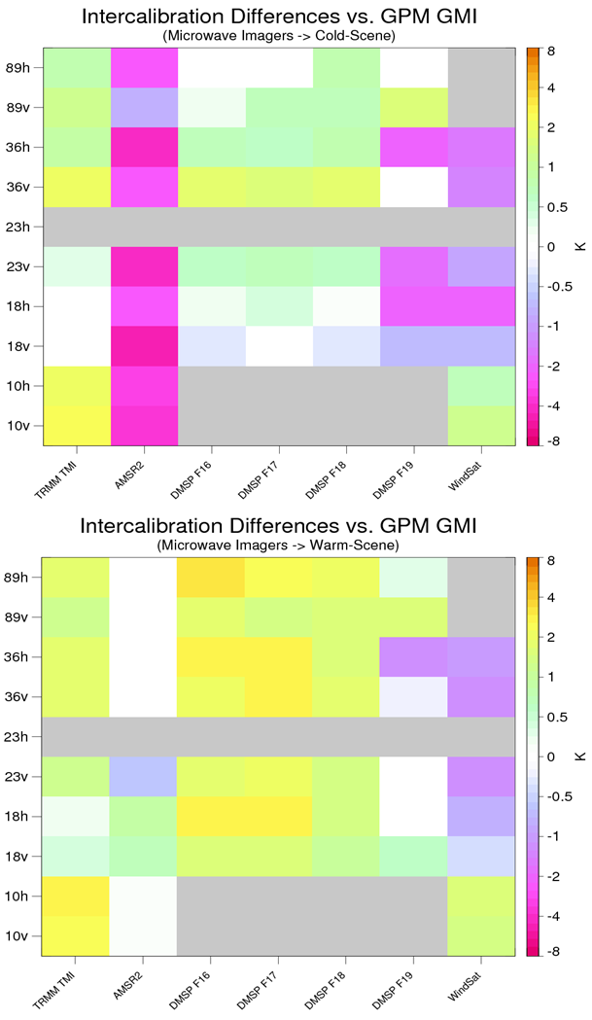
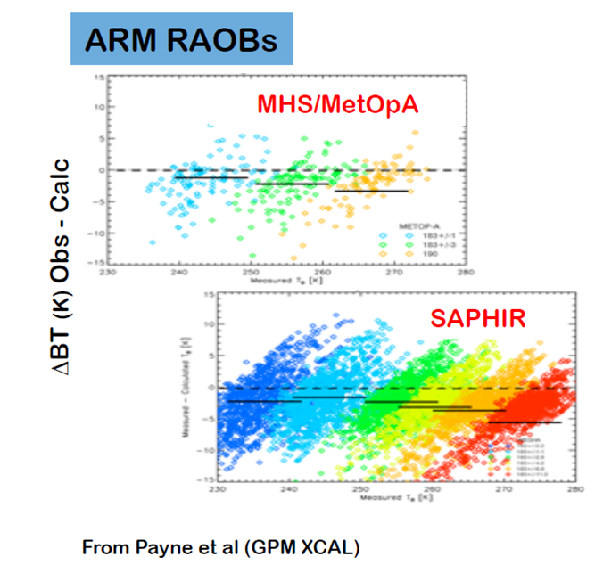
Some items of interest…
GPM X-CAL - W. Berg
NIST Calibration Reference – D. Walker
Workshop on Uncertainties @183 GHz
– V. Mattoli

Slide 6
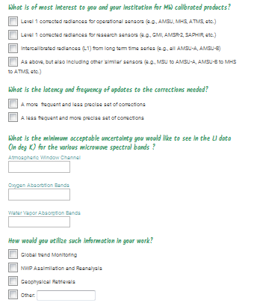
GSICS Microwave Survey
(discussed at GSICS Users Workshop)
Real time use and/or climate use?
Latency vs. precision?
Different spectrum has different use and requirements
Potential application areas

Slide 7
Survey Summary
With only a small number of responses, difficult to draw any conclusions from full community…however…
  Mapping time series of similar sensors but from vastly different heritage (e.g., SSMT2 to AMSU-B) together is of low priority (Q1)
  More precise, longer latency correction are preferred (Q2)
  It does appear most users would look at time series for global trends (most likely the O₂ & H₂O bands) and use to derive geophysical parameters (most likely window & H₂O bands) (Q3)
  The average desired accuracy of the corrections was on the order of 0.4 K (slightly less for the O₂ bands) (Q4)

Slide 8
Focus Topics for 2016
Defining CLEAR PATH for GSICS MW products and algorithms
  Methodologies (TBD)
    SNO, Double difference, etc.
  Reference Standards (TBD)
    A particular sensor? Likely to be wavelength dependent (e.g., window, O₂, H₂0); A RTM?
  LUT/Correction Tables (TBD)
    Near real-time and climate; they will be different
Tying together other groups/opportunities
  Engaging more closely GPM X-Cal (Wes, Rachel)
  Formalizing linkages to CEOS MW subgroup (Cheng-Zhi, Xiaolong Dong)
    CEOS-GSICS Microwave Coordination Meeting – 2016 July 5-6, Beijing, China (at time of IGARSS 2016)
      Can there be a common definition of standards?
      Define some concrete collaborations
  Expanding active participation – India, others? (Manik, Ralph)
Participation by subgroup at upcoming meetings of relevance:
  GSICS; CEOS;CALCON, Microrad 2016, AMS Sat. Met, EUMESAT Satellite, etc.

