Slide 1
JAXA Agency Report
Misako Kachi
Earth Observation Research Center (EORC)
Japan Aerospace Exploration Agency (JAXA)
GSICS/GRWG Meeting
Tsukuba, Japan
March 1, 2016

Slide 2
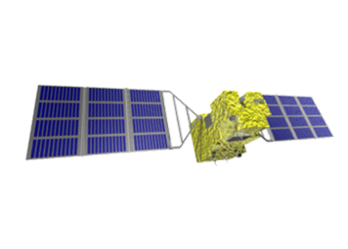
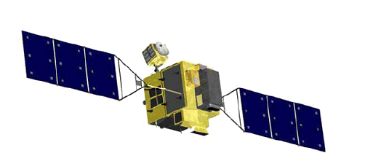
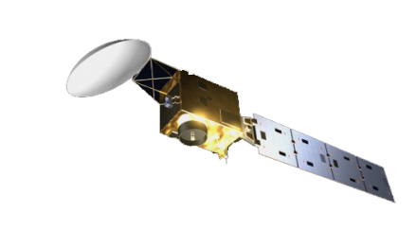
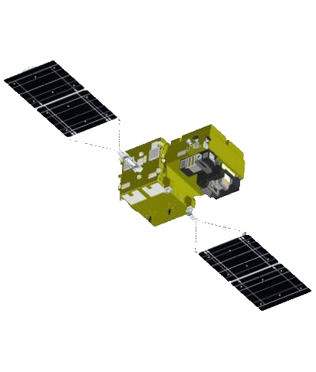


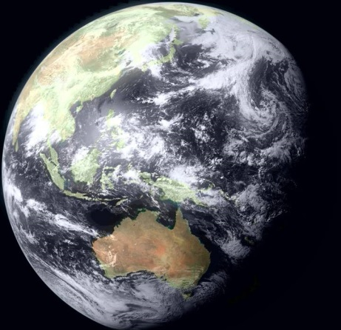
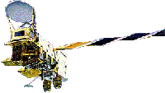
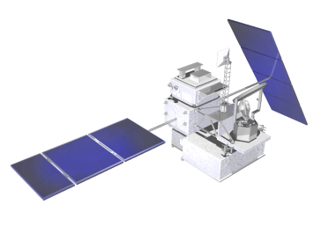
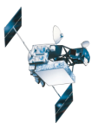
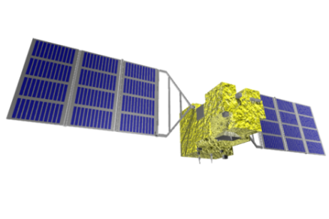
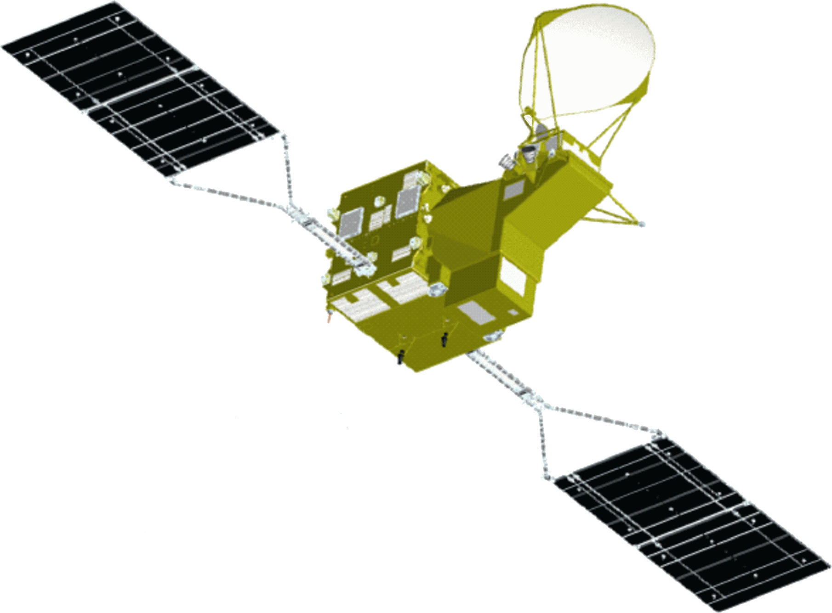
JAXA’s Current and Future Satellite/Sensor Activities
GOSAT-2
High Resolution Wide Swath (Optical)
(JFY2017)
Earth CARE/CPR
(JFY2019 (TBD))
GCOM-C
(JFY2017)
(JFY2016)
ALOS-2 SAR
(2014)
DAICHI (ALOS)
(JFY2005)
GPM/DPR
(2014)
Aqua/AMSR-E
(JFY2002)
ADEOS-Ⅱ
(JFY2002)
TRMM/PR
SHIZUKU
(GCOM-W)
JERS-1
(JFY1997)
(JFY1991)
MOS
(2012)
IBUKI (GOSAT)
(JFY1986)
(2009)
Notes:
結果、これまで２０機近くの地球観測衛星を開発、運用しています。
現在運用している地球観測衛星は、この絵で衛星名が緑色となっているもので、計４機あります。
そして、今後もGCOM-Cなど新たな衛星を開発しています。

Slide 3
Agency update
Recent launches, commissioning status
    GPM: Launched in 2014. Data release in September, and version up is scheduled on March 3, 2016
    GCOM-W: Launched in 2012. Latest version 2 was released in March 2015
    ALOS-2: Launched in 2014. Data release in November, 2014
    GOSAT: Launched in 2009. Latest version 201.201 was released in 2015.
  Forthcoming launches
    GCOM-C (JFY 2016)
    GOSAT-2 (JFY 2017)
    EarthCARE (JFY 2017)
  Major satellite events
    End of TRMM science operation (April 2015, NASA and JAXA)
    End of AMSR-E operation (December 2015)
Other major events
  JMA and JAXA are collaborating in exchanging information, calibration, and geophysical products generation, by taking advantage of GEO/LEO complementarity especially in Himawari-8.
  JAXA Himawari Monitor to distribute images and data of Himawari-8 (L1 & L2) has opened since August 2015.

Slide 4
AMSR-E operation completed on Dec.4, 2015
The AMSR-E on EOS-Aqua had been operated in slow rotation mode (2 rotations per minute) since December 4, 2012 for cross-calibration with the AMSR2 in order to produce and provide a consistent and long-term dataset between the AMSR-E and AMSR2 by correcting their differences in sensor properties.
However, the AMSR-E automatically halted its observation and rotation at around 2:30 p.m. on December 4, 2015 (JST). As December marks just three years of simultaneous AMSR-E and AMSR2 operation, and because we obtained sufficient data necessary for cross-calibration, we decided to complete operation of the AMSR-E at this time.
AMSR-E slow rotation observation data is distributed at JAXA GCOM-W web site, and used cross-calibration activities between AMSR-E and AMSR2.
AMSR-E products applying AMSR2 algorithms and formats will be produced in JFY2016.

Slide 5
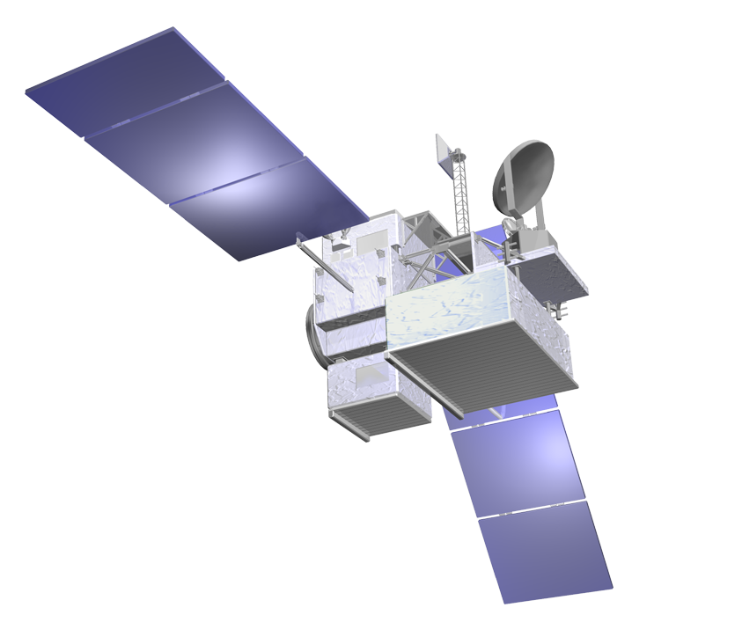
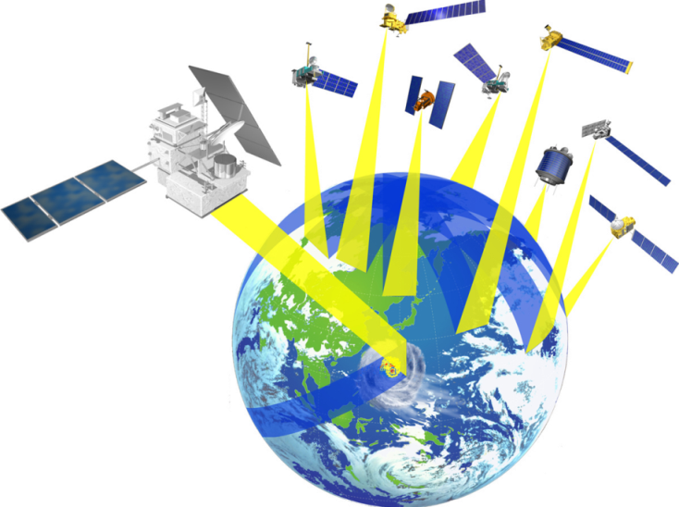
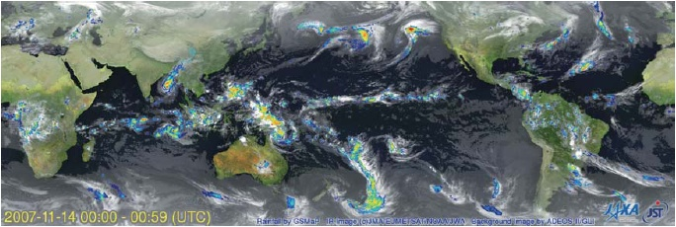
Global Precipitation Measurement (GPM)
GPM is an international mission consisting of the GPM Core Observatory and Constellation Satellites for high accurate and frequent global precipitation observation.
GPM Core Observatory was successfully launched on 28 Feb. 2014 (JST).
The DPR has observed steadily.
All GPM standard products (V03) were released on September 2014.
New version products (V04) will be released in March 2016.
  Major changes in GMI L1 & small changes in DPR L1.
  New latent heating products.
  Release of GMI L2 & global rainfall map will be delayed.
GPM Core Observatory
GMI (Microwave Imager)
KuPR: 13.6GHz radar (phased array)
KaPR: 35.5GHz radar (phased array)
Constellation
Satellites by international partners
Core
Observatory
by NASA-JAXA
Notes:
GPM is an international mission consisting of the GPM Core Observatory and Constellation Satellites for high accurate and frequent global rainfall observation.
- Core Observatory: developed under NASA and JAXA equal partnership.
- Constellation satellites: provided by international partners (includes GCOM-W1)
Dual-frequency Precipitation Radar (DPR)
- developed by JAXA and NICT
- the most sophisticated precipitation radar
- 3D structure of rainfall
- simultaneous dual-frequency observation to detect even weak rainfall and snowfall.
GPM Core Observatory will be launched in early 2014.

Slide 6
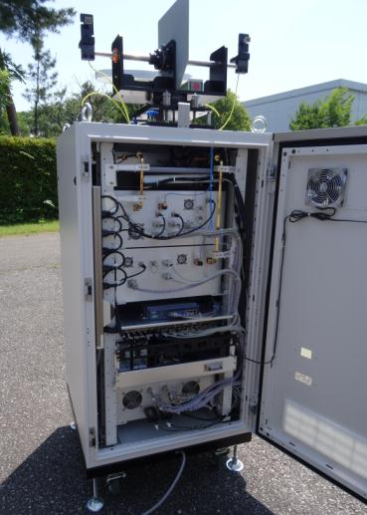
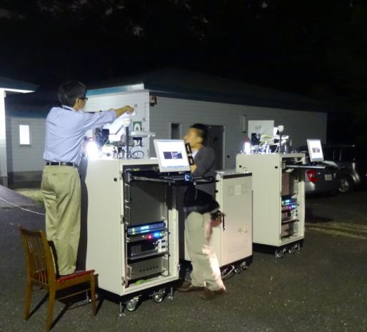
GPM / DPR calibration status and plan
GPM/DPR calibration is going well.
The internal calibration
  The DPR’s internal system is calibrated by this calibration.
  It has been conducted once per a week from the launch.
  It will be conducted same frequency in future.
The external calibration
  The absolute value of the DPR’s received and transmitted powers are calibrated by this calibration.
  It has been conducted 10 time in a year.
  It will be conducted same frequency in future.
To increase the accuracy of calibration, JAXA is evaluating these calibration data in more detail.

Slide 7
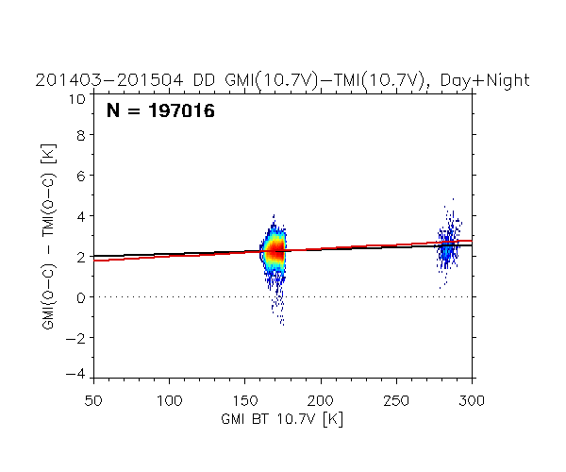
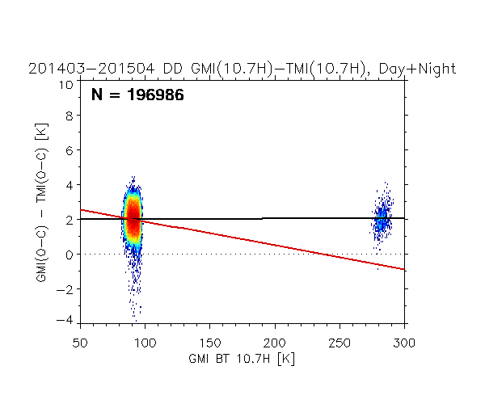
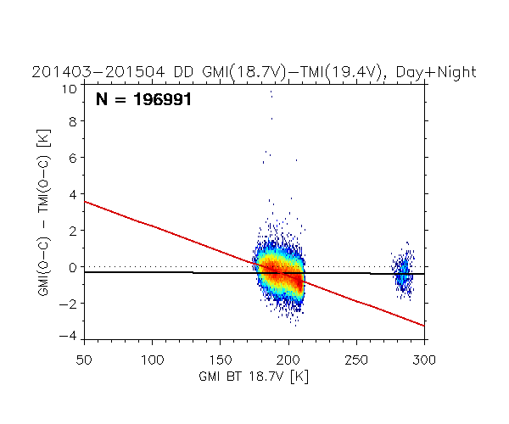
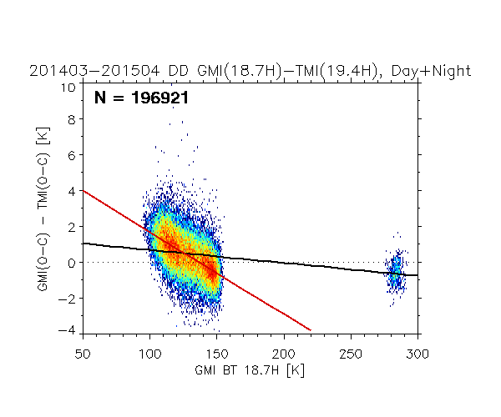
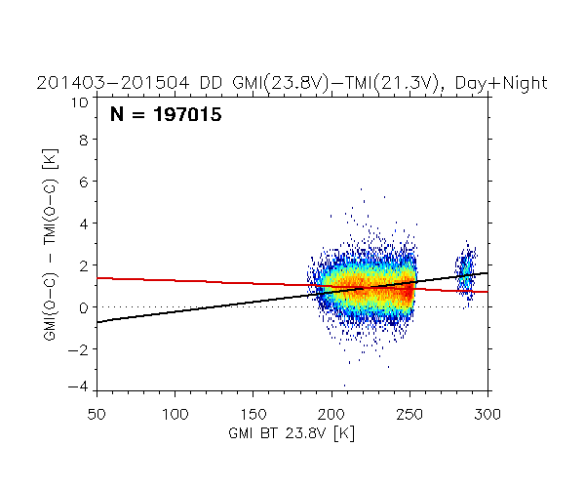
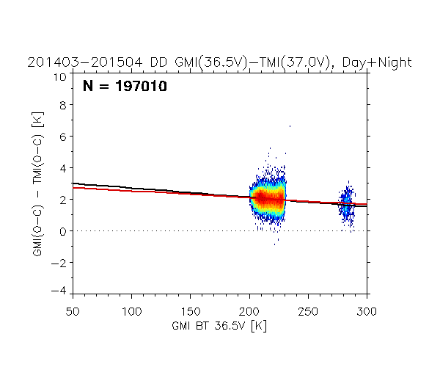
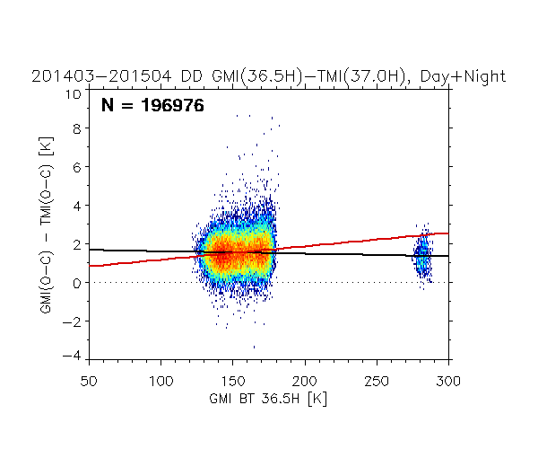
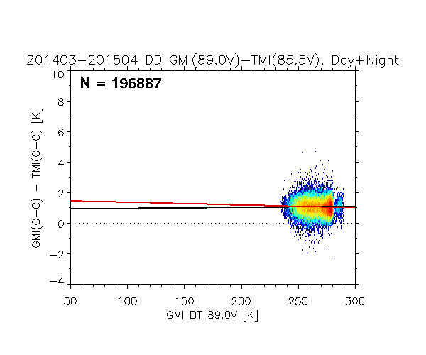
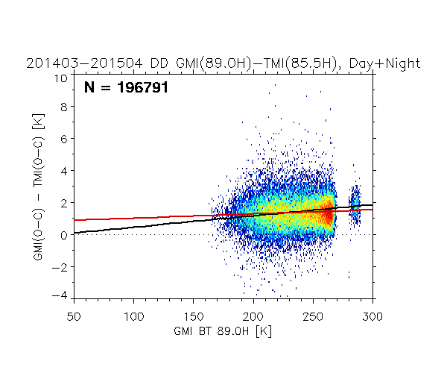
Intercomparison of GMI ITE043 and TMI V7：TB dependency on DD
* ITE043 (equivalent to V04)
10V
10H
18V
18H
23V
36V
36H
Day & Night
ー：Ocean & Land
ー：Ocean only
89V
89H

Slide 8
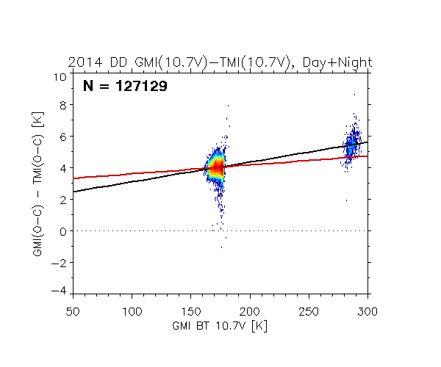
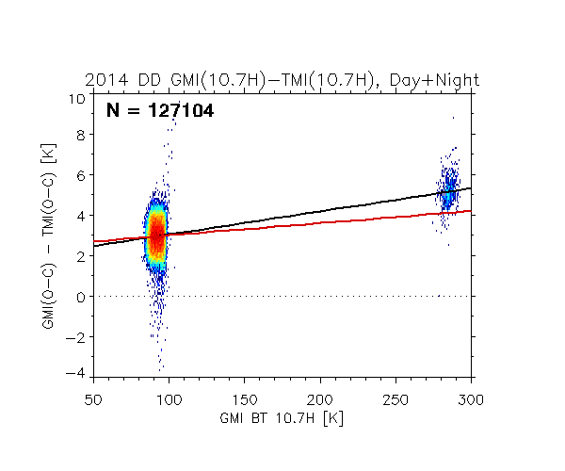
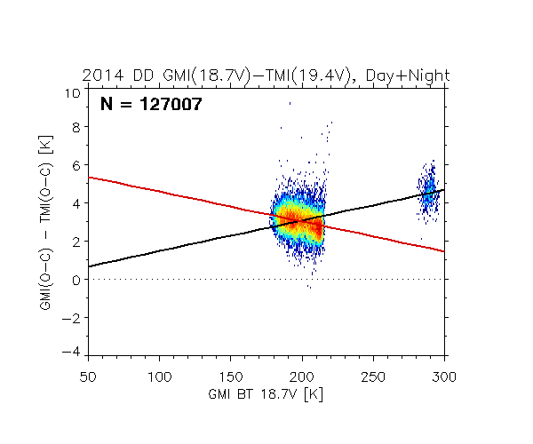
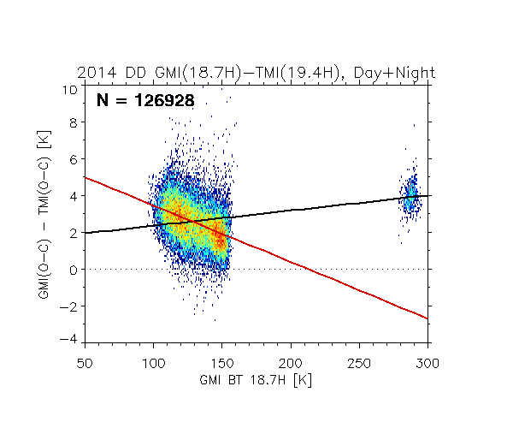
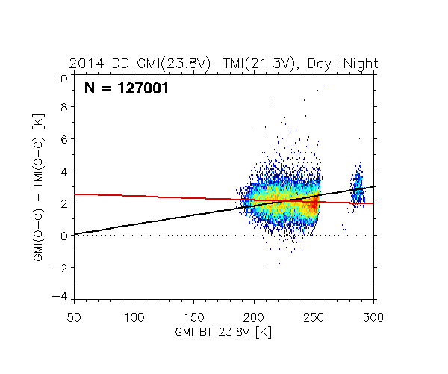
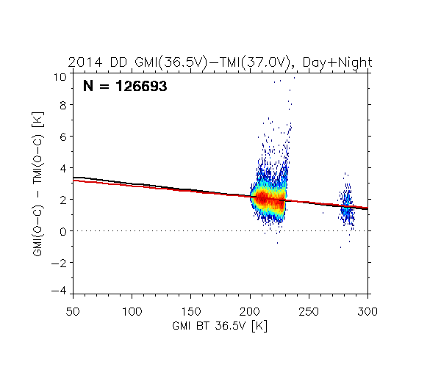
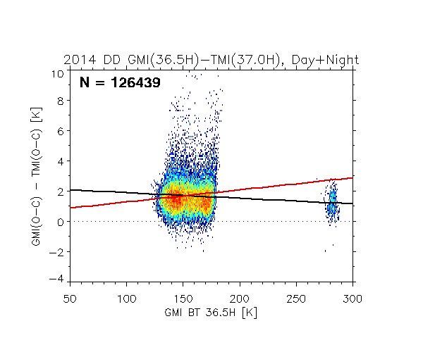
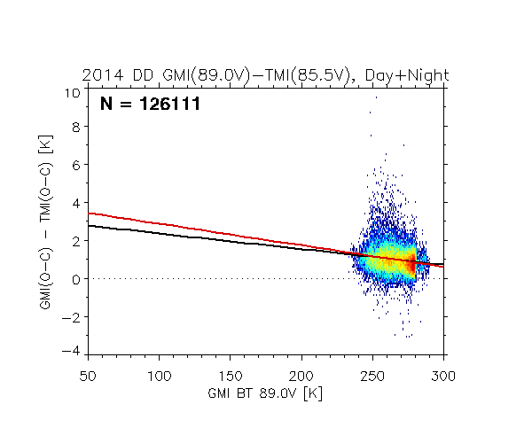
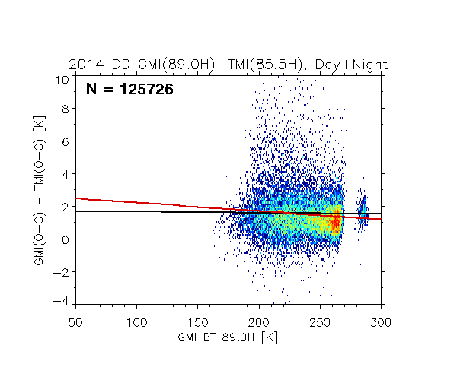
[Reference] Same for GMI V03 – TMI V7
10V
10H
18V
18H
23V
36V
36H
Day & Night
ー：Ocean & Land
ー：Ocean only
89V
89H
Values of DD and TB dependency are largely differ between 03B and ITE043 (equivalent to V04)
GMI TB of new version tends to show lower TB in low frequency channels and higher TB in high-frequency channels compared to current version.

Slide 9
GMI-TMI Correction table (Feb. 22, 2016)
Day & Night | ①Ocean only |  | ②Ocean & Land |  | TB Average |  | ①Ocean only |  | ②Ocean & Land
 | slope | intercept | slope | intercept | TB@Ocean | TB@Land | ΔT@Ocean | ΔT@Land | ΔT@Ocean | ΔT@Land
10V | 0.00393 | 1.58953 | 0.00217 | 1.88466 | 170.46 | 283.83 | 2.26 | 2.70 | 2.25 | 2.50
10H | -0.01377 | 3.25549 | 0.00014 | 1.99748 | 90.28 | 282.38 | 2.01 | -0.63 | 2.01 | 2.04
18V | -0.02731 | 4.94333 | -0.00036 | -0.30006 | 195.44 | 284.47 | -0.39 | -2.83 | -0.37 | -0.40
18H | -0.04590 | 6.27480 | -0.00724 | 1.40903 | 127.05 | 283.47 | 0.44 | -6.74 | 0.49 | -0.64
23V | -0.00268 | 1.51054 | 0.00946 | -1.19568 | 227.49 | 285.83 | 0.90 | 0.75 | 0.96 | 1.51
36V | -0.00437 | 2.96817 | -0.00594 | 3.30752 | 216.45 | 282.61 | 2.02 | 1.73 | 2.02 | 1.63
36H | 0.00695 | 0.48128 | -0.00130 | 1.73286 | 153.30 | 282.07 | 1.55 | 2.44 | 1.53 | 1.37
89V | -0.00180 | 1.54235 | 0.00076 | 0.87162 | 265.93 | 285.54 | 1.06 | 1.03 | 1.07 | 1.09
89H | 0.00262 | 0.75715 | 0.00707 | -0.24468 | 235.10 | 285.29 | 1.37 | 1.50 | 1.42 | 1.77
TB biases over the land largely differ between ① and ②.

Slide 10
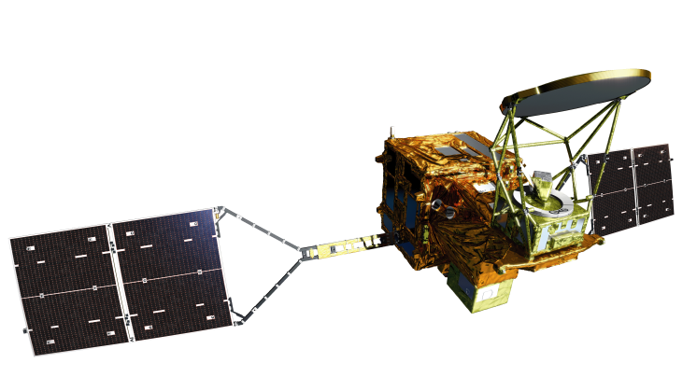
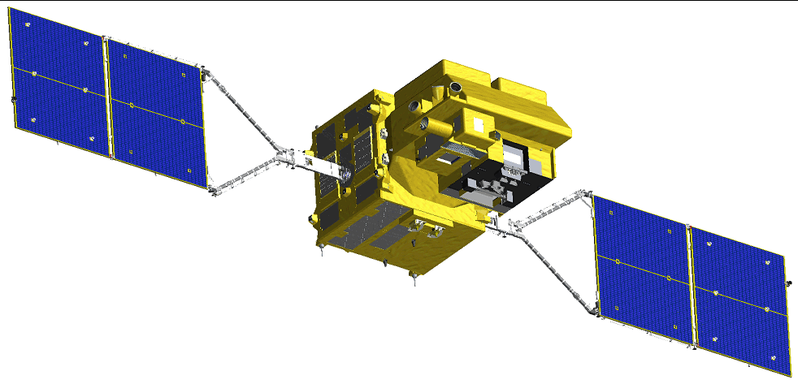
GCOM 1st Generation Satellites
“SHIZUKU”
May 18, 2002 –
(in operation)
late JFY 2016
(to be launched)
GCOM-W (Water)
GCOM-C (Climate)
Instrument | Advanced Microwave Scanning Radiometer-2
Orbit | Sun Synchronous orbit Altitude：699.6km (on Equator) Inclination: 98.2 degrees Local sun time: 13:30+/-15 min
Size | 5.1m (X) * 17.5m (Y) * 3.4m (Z) (on-orbit)
Mass | 1991kg
Power gen. | More than 3880W (EOL)
Launch | May 18, 2012
Design Life | 5-years
Instrument | Second-generation Global Imager
Orbit | Sun Synchronous orbit Altitude：798km (on Equator) Inclination: 98.6 deg. Local sun time: 10:30+/- 15min
Size | 4.6m (X) * 16.3m (Y) * 2.8m (Z) (on orbit)
Mass | 2093kg
Power gen. | More than 4000W (EOL)
Launch | JFY 2016
Design Life | 5-years
10

Slide 11
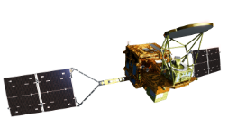
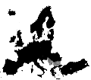

GCOM-W1 Status
Data Distribution
Recorded Global Data
every 100 minutes
14～15 times per day
Real-time Data
around Japan
4 times per day
Real-time Data
around USA
4 times per day
Near Real time data
（99% Success)
[End users]
[ Users]
Weather
forecast
JMA
Svalbard
Near Real time data
Fishery
JAFIC
JAXA
USA
Climate change
Agriculture
Sea ice
Water resource
Ship routing
Others
Other
Institutes
Laboratory
・EUMETSAT
・ECMWF
GSMaP
GCOM-W1 Web site to users
NOAA
US government organizations
Universities
Precipitation products
to Asian users
Users from more than 80 countries
（GSMaP:Global Satellite
Mapping of Precipitation)

Slide 12
AMSR2 Standard Products
Ver.2 has been released in March 2015
Product |  | Release Accuracy | Standard Accuracy | Target Accuracy | Version 1 Accuracy | Version 2 Accuracy
GEO | Total Precipitable Water | ±3.5 kg/m² | ±3.5 kg/m² | ±2.0 kg/m² | ROB:2.7 kg/m² GPS:1.5 kg/m² | ROB:2.5 kg/m² GPS:1.5 kg/m²
 | Cloud Liquid Water | ±0.10 kg/m² | ±0.05 kg/m² | ±0.02 kg/m² | 0.04 kg/m² | 0.04 kg/m²
 | Precipitation | Ocean ±50 % Land ±120 % | Ocean ±50 % Land ±120 % | Ocean ±20 % Land ±80 % | Ocean 49% Land 86% | Ocean 48% Land 84%
 | Sea Surface Temperature | ±0.8 ºC | ±0.5 ºC | ±0.2 ºC (zonal mean) | 0.59 ºC | 0.58 ºC
 | Sea Surface Wind Speed | ±1.5 m/s | ±1.0 m/s | ±1.0 m/s | 1.8 m/s | 1.1 m/s
 | Sea Ice Concentration | ±10 % | ±10 % | ±5% | 9 % | 8 %
 | Snow Depth | ±20 cm | ±20 cm | ±10 cm | 16 cm | 16 cm
 | Soil Moisture | ±10 % | ±10 % | ±5 % | 4 % | 4 %
Achieved Release Accuracy
Achieved Standard Accuracy
Achieved Target Accuracy

Slide 13
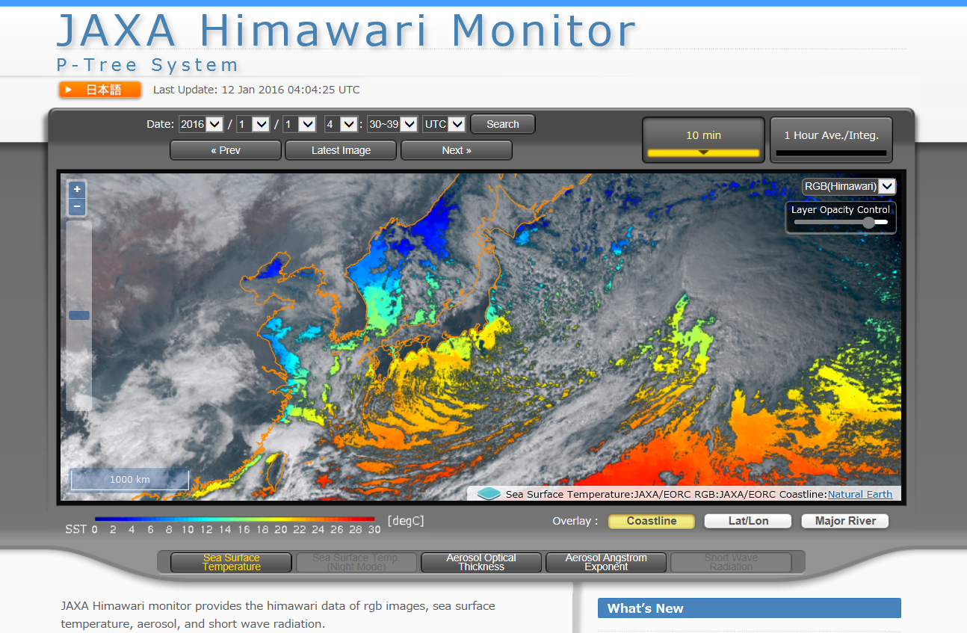
JAXA’s Himawari-8 Activities
Using Himawari-8 AHI data in processing of Global Satellite Mapping of Precipitation (GSMaP) realtime version product
Producing Himawari-8 L2 products, which are consistent with the JAXA’s Earth observing missions, and distributing them through the JAXA Himawari Monitor (http://www.eorc.jaxa.jp/ptree)
JAXA Himawari Monitor
Available Data
L1 (JMA):
HSD format
L2 (JAXA):
NetCDF format
- Aerosols
- SST
- Solar Radiation
- PAR
- Chla

