Slide 1
JMA Agency Report
Arata Okuyama, Masaya Takahashi,
Hidehiko Murata
Meteorological Satellite Center,
Japan Meteorological Agency

Slide 2
Contents
Update of JMA GSICS members
Summary of JMA related action status
GEOLEOIR GSICS product template was updated. [GDWG]
Templates of landing page submitted to GDWG. [GDWG]
NetCDF template for SRF data and list of existing SRF data sets [had been submitted]. [GDWG]
The uncertainty analysis to support progress to Pre-Operational mode is ongoing. [GRWG]
Calibration event database design is ongoing. [GRWG]
Himawari8/AHI data quality
2015 achievements / 2016 work plan
AHI GEO-LEO-IR to Pre-operational phase
...

Slide 3
JMA GSICS members
EP
Kotaro Bessho
GRWG
Arata Okuyama
Masaya Takahashi
Hidehiko Murata
GDWG
Masaya Takahashi
Co-chair Feb 2015~
Point of operational contact: Arata
Member | GRWG | GDWG | GEO-LEO-IR | DCC | Moon | Vicarious method (RTM) | Ray matching | GEO-GEO
Masaya Takahashi (Mr.) | Y | Y | Y | Y | Y |  | Y
Arata Okuyama (Mr.) | Y |  |  | (Y) | (Y) | Y
Hidehiko Murata (Mr.) | Y |  |  |  |  |  |  | Y

Slide 4
Status of actions assigned to JMA (GRWG)
Action Ref | Description | Assigned to | Due Date | State
GRWG_14.8 | CMA and JMA to present their analysis on GEO-GEO IR products at the next meeting. | CMA/JMA | 1-May-15 | Reported in New Delhi (2015)
GRWG_14.23 | All GPRCs to provide satellite instrument specific links to calibration events to WMO-OSCAR. | Main.ALL, Main.GPRC | 1-May-15 | Reported in New Delhi (2015)
 | - Work in progress. Almost all agencies now nominated someone for the calibration tasks team, these nominees are providing Rob with the links.
GRWG_14.24 | All GPRC to seek consensus on common naming conventions for calibration events at the level of Main-Categories/Sub-Categories/Event Types. | Main.ALL, Main.GPRC | 1-May-15 | Open
 | - Only progress on this is that we have now a calibrations task team. Within the GDWG Rob would like to discuss the way forward on this, i.e., in cooperation work on a white paper defining common naming conventions
GRWG_14.25 | EUMETSAT/NOAA/NASA/JMA to define a calibration events database design, and if needed, discuss this in a future webex meeting. | Main.EUMETSAT, Main.NOAA, Main.NASA, Main.JMA | 1-May-15 | Open
 | - To be discussed at the 2015 GDWG meeting. This was our plan, but may be too ambitious. At least now. First issue is to agree on nomenclature, and report this is a white paper. Second issue is to adopt the common nomenclature within existing calibration events data bases. Third issue could be to work towards a common database design, and a centralized database, however, Rob foresees that this will take long and that it requires extra resources.
GRWG_14.27 | All GPRCs to review their GSICS websites to take into account of the new developments in GSICS as these websites will be reviewed in the next joint meeting. | Main.ALL, Main.GPRC | 1-May-15 | Open can be closed??
GRWG_14.29 | Masaya Takahashi to check for a document regarding minimum content for GPRC GSICS webpage. If this document does not exist, then he shall author one and upload it to the Wiki. | Masaya Takahashi | 1-May-15 | Reported in New Delhi (2015)
GRWG_14.35 | EUMETSAT/NOAA/NASA/JMA to perform analysis to evaluate the optimal temporal resolution for a DCC product. GPRCs are invited to report at the next web-meeting on the DCC method. | Main.EUMETSAT, Main.NOAA, Main.NASA, Main.JMA | 1-May-15 | DCC approach was discussed in Webex meeting in 4 Feb. 2016
GRWG_15.47 | JMA to investigate and provide a report on the uncertainty analysis to support progress to Pre-Operational mode. | MasayaTakahashi | 29-Feb-16 | Open
Can be closed item

Slide 5
Status of actions assigned to JMA (Lunar calibration WS )
Action Ref | Description | Assigned to | Due Date | State
GLCWS_14.5 | All participants to provide lunar irradiances from the missing instruments to the common lunar calibration data set. | AllGroups? | 1-Dec-15 | Moon data of MT2 and H8 was provided.
GLCWS_14.7 | GSICS Data Working Group to identify a suitable mechanism for sharing the lunar calibration dataset. | MasayaTakahashi | 1-Dec-15 | Discussed in New Delhi (2015)
GLCWS_14.10 | The GSICS Data Working Group is asked to develop a procedure for verifying users’ implementation of GIRO. | MasayaTakahashi | 1-Dec-15 | Discussed in New Delhi (2015)
GLCWS_14.5 : Lunar data already provided need to be revised. Updated version will be provided.
Can be closed item

Slide 6
Status of actions assigned to JMA (GDWG)
Action Ref | Description | Assigned to | Due Date | State
GDWG_14.2 | GDWG to investigate methods to structure the order the global attributes within the netCDF file - e.g. between attributes related to the method and the application. | Main.Masaya | 1-May-15 | Discussed in Webex 5 June 2014
GDWG_14.3 | GDWG to investigate how to include algorithm type in filename. | Main.Masaya | 1-May-15 | Will be discussed in GDWG
GDWG_14.10 | All GPRCs to provide satellite instrument specific links to calibration events to WMO-OSCAR. (cf. GRWG_14.23) | Main.All | 1-May-15 | Reported in New Delhi (2015)
GDWG_14.11 | All GPRC to seek consensus on common naming conventions for calibration events at the level of Main-Categories/Sub-Categories/Event Types. (cf. GRWG_14.24) | Main.All | 1-May-15 | Open
GDWG_14.12 | EUMETSAT/NOAA/NASA/JMA to define a calibration events database design, and if needed, discuss this in a future web meeting. (cf. GRWG_14.25) | Main/EUM/NOAA /NASA/JMA | 1-May-15 | Open
Can be closed item

Slide 7
Status of actions assigned to JMA (GDWG)
Action Ref | Description | Assigned to | Due Date | State
GDWG_2015.4c1 | The GRWG need to examine the aspects to be revalidated and confirm they have no major impact. (ref: changing the existing GEOLEOIR variables to combined versions).- | Main/EUM.JMA | 31-May-15 | Discussed by email
GDWG_2015.4c2 | Update the GEOLEOIR GSICS product template on the Wiki. | Main.JMA | 31-Jul-15 | Discussed in [gsics-dev]
GDWG_2015.4c3 | Update the Wiki to include the accurate timing information as an optional comment attribute of the validity period in their products. | Main.JMA | 31-Jul-15 | Open
GDWG_2015.4c4 | JMA to provide list of new GEOLEOIR global attributes to GDWG members and member should provide input within 1 week on the proposed updates | Main.JMA | 31-May-15 | Discussed in [gsics-dev]
GDWG_2015.4d | Identify if using the enhanced data model has impact to the usage of the new products. | Main/EUM.JMA | 31-Jul-15 | Will be discussed in GDWG
GDWG_2015.4l2 | EUMETSAT and JMA to provide templates of landing page to GDWG (or GSICS wiki). | Main/EUM.JMA | 30-Apr-15 | Closed
GDWG_2015.6a1 | JMA GRWG to provide the list of existing SRF data sets to be stored. GPRC responsible for these data sets shall provide them to GDWG co-chair as soon as possible. | Main.JMA | 31-Jul-15 | Will be closed soon
GDWG_2015.6a2 | JMA to provide the netCDF template to GDWG co-chair for these SRF files. | Main.JMA | 30-Apr-15 | Closed
GDWG_2015.6a5 | The GEOLEOVISNIR or LEOLEOVISNIR shall include an optional global attribute referencing the location of the associated SRF netCDF file. | Main/EUM.JMA | 1-Mar-16 | Will be discussed in GDWG
GDWG_2015.6b1 | GDWG co-chair to support GRWG to implement the recommendations for sharing work in a Data Managed way. | Main/EUM.JMA | 30-Apr-15 | Closed
GDWG_2015.6b3 | CMA, IMD, JMA and KMA to collaborate in the implementation of the netCDF GSICS product checker. | Main/CM/IMD/JMA.KMA | 31-Dec-15 | Open
GDWG_2015.6f | WMO and GPRCs to provide the GCC with examples of document management procedures including templates to support the creation of GSICS branding documentation templates. | Main.All | 31-Dec-15 | Open
GDWG_2015.9b2 | GDWG will come with a proposal on how to number the actions. The action tracking tool should include the actions coming from the web meetings. | Main/EUM.JMA | 31-May-15 | Open
GDWG_2015.9b3 | Alternatives to the current action tracking tool should be discussed at further stage (web meeting). | Main/EUM.JMA | 31-May-15 | Open

Slide 8
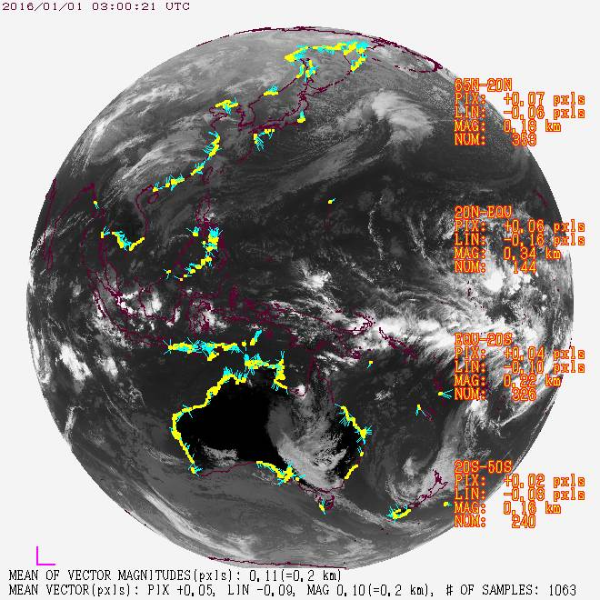
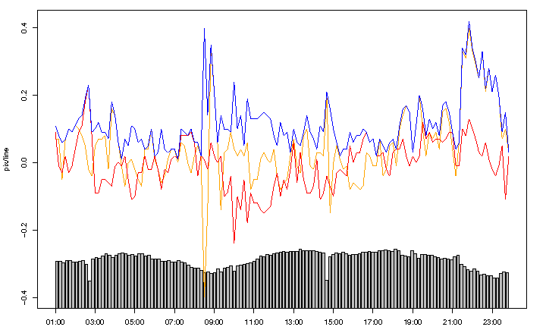
AHI data quality (INR)
Navigation error of Himawari Standard Data (L1B equivalent) is less than around 0.3 pixel (1 pixel = 2 km). It is estimated by landmark analysis.
Residual navigation error
10.4um band (2 km), every 10 minutes
1200
1 pix
(~2km)
Referenced landmark
Direction and magnitude of error
1 Jan., 2016 01:00 (UTC)
East-West direction [pix] North-South direction [pix] Magnitude [pix] Number of landmark points
2 Jan., 2016
00:00 (UTC)

Slide 9
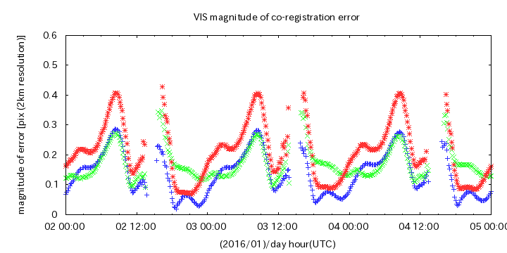
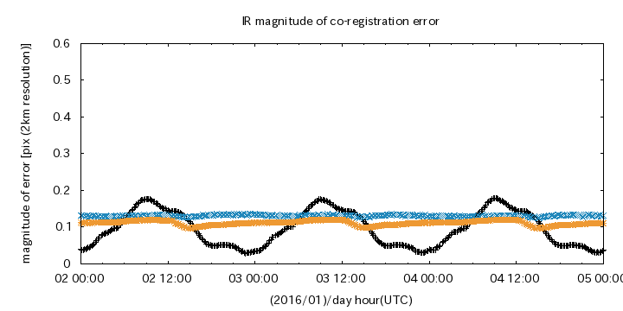
AHI data quality (Band to band registration)
Band to band registration error is less than 0.1 – 0.2 pixels (1 pixel = 2 km).
The error is:
estimated by correlation analysis between Band 13 (10.4 um) and each band.
large in midnight in VIS-3.9um bands.
stable in IR bands.
The registration process will be updated soon.
B01(0.47)
Band [μm] | Average in the daytime
B01 (0.47) | 0.127
B02 (0.51) | 0.157
B03 (0.64) | 0.189
B04 (0.86) | 0.150
B05 (1.6) | 0.462
B06 (2.3) | 0.138
Band [μm] | Average
B07 (3.9) | 0.096
B08 (6.2) | 0.132
B09 (6.9) | 0.216
B10 (7.3) | 0.229
B11 (8.6) | 0.280
B12 (9.6) | 0.178
B14 (11.2) | 0.116
B15 (12.4) | 0.111
B16 (13.3) | 0.015
B02(0.51)
B03(0.64)
B07(3.9)
B08(6.2)
B15(12.4)
1 pixel = 2km (All band)
Averaged error magnitude from 2-4 January, 2016

Slide 10
will be reported in [4m]
AHI data quality (VIS-NIR calibration)
There is no significant bias in Band 1-4 (0.47-0.86 um)
+/- 5% bias in Band 5 and 6 (1.6 and 2.3 um).
Time series of DCC from ray-matched data, Ray-matching and RT simulation results
Band 1 (0.47μm) Band 2 (0.51μm) Band 3 (0.64μm)
Band 4 (0.86μm) Band 5 (1.6μm) Band 6 (2.3μm)

Slide 11
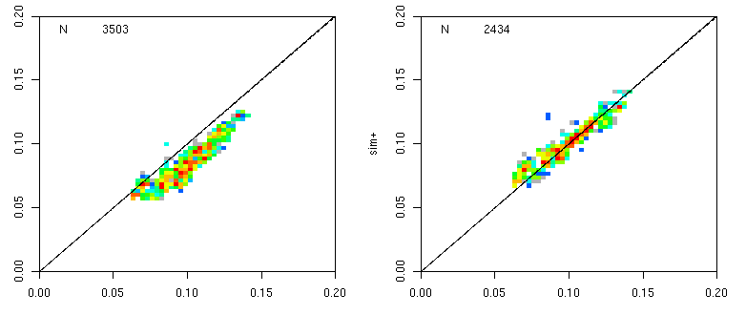
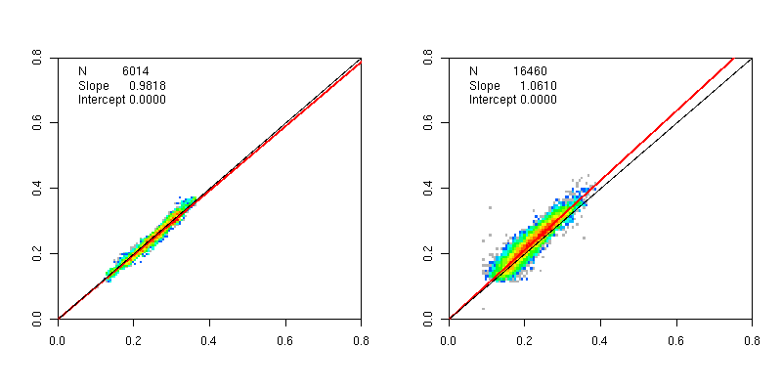
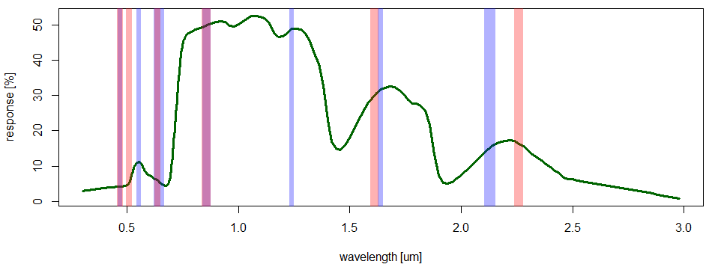
Vicarious calibration for AHI
Clear sky ocean
Clear sky ocean
Clear sky ocean
Ocean color needs to be considered in shorter wavelength band ( < 0.6um)
Possibly also polarization
It is dark for NIR bands
Land surface
It can provide low uncertainty.
Precise ground surface reflectivity is necessary, because AHI’s band width is narrower than the one of MTSAT-2.
VIIRS BRDF product is awaited, because its bands are close to AHI’s.
Liquid water cloud
Looks good.
DCC
Kernel file is under development in JMA/MRI.
simulation
B01 (0.47um)
B01 (0.47um)
observation
observation
MODIS ocean color (NASA) is applied.
Land
Water cloud
Slope 0.98
Slope 1.06
simulation
simulation
B06 (2.3um)
B06 (2.3um)
observation
observation
MODIS
AHI
Grass

Slide 12
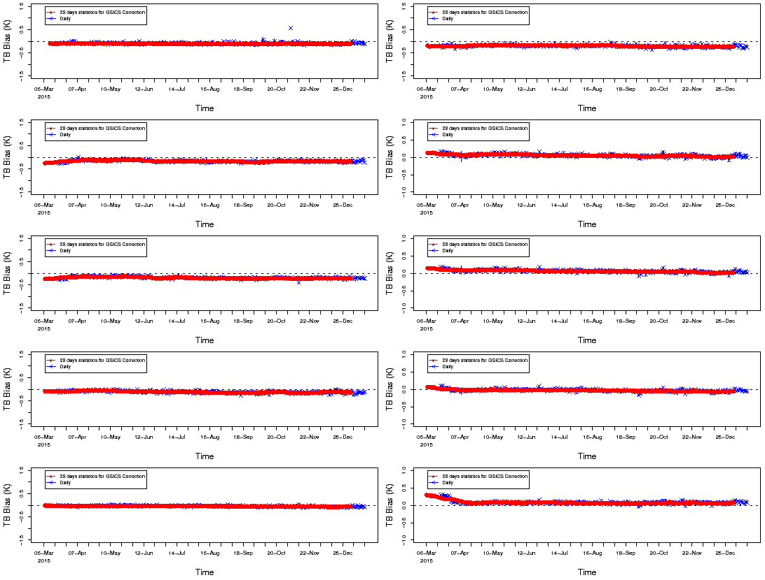
will be reported in [3k]
AHI data quality (IR calibration)
The Tb bias is less than 0.2 K in all band at standard radiances.
Band 7
Band 12
Band 8
Band 13
Band 9
Band 14
Band 10
Band 15
Band 11
Band 16

Slide 13
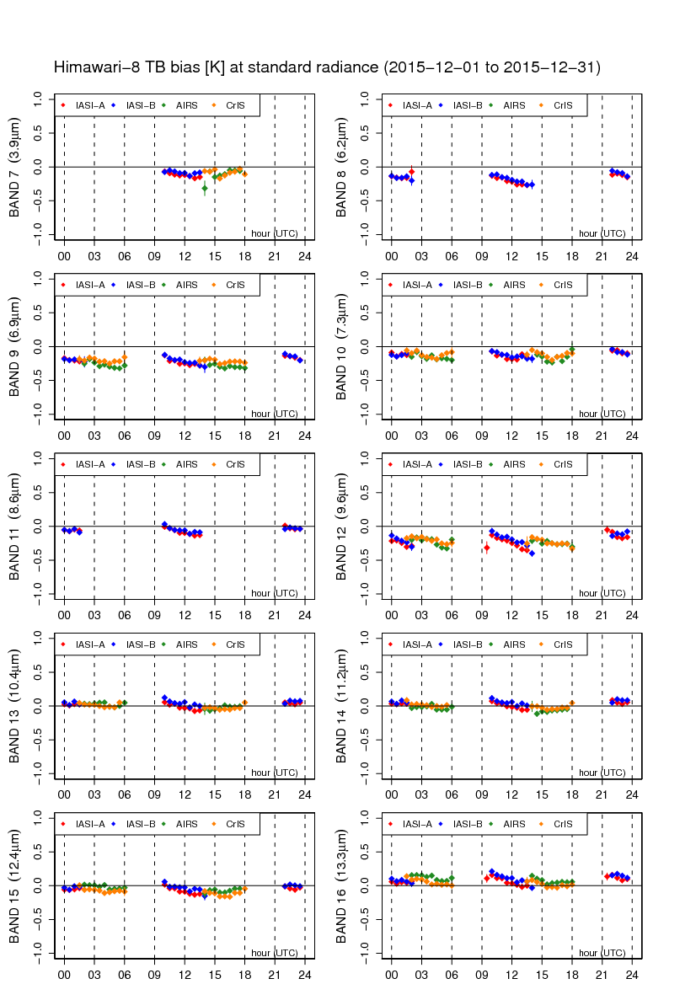
AHI data quality (Diurnal variation in IR)
will be reported in [3k]
Himawari-8/AHI
There is no significant diurnal variation seen in MTSAT-2
The biases at the standard radiance are shown.
Data period is December 2015.
Reference sensors are:
Metop-A/IASI
Metop-B/IASI
Aqua/AIRS
S-NPP/CrIS
MTSAT-2/Imager

Slide 14
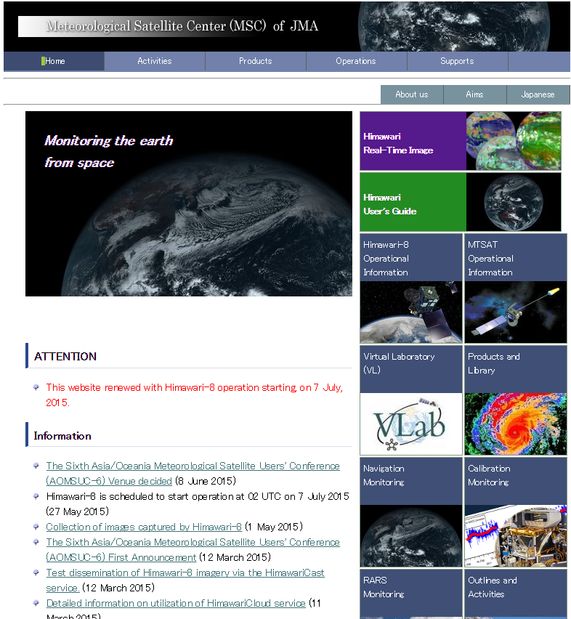
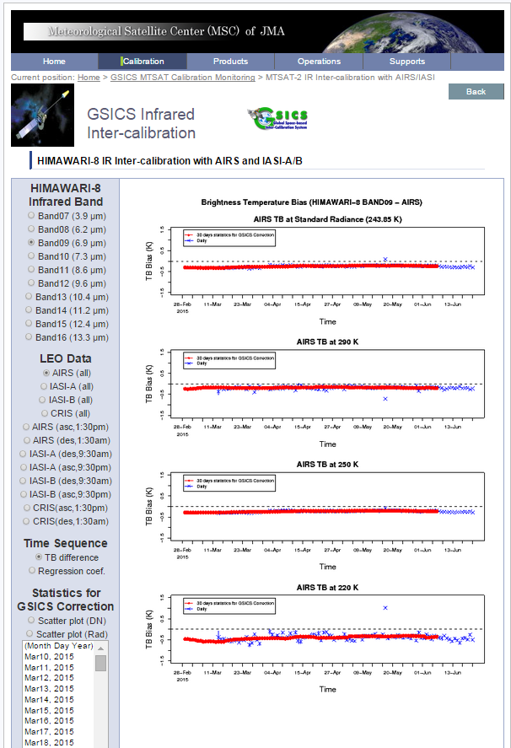
Monitoring web page
AHI calibration and navigation monitoring is available on JMA/MSC Web page.
http://www.jma-net.go.jp/msc/en/index.html

Slide 15
Improvements of the Ground Segment
Himawari Standard Data will be update from 05:00UTC, 9 March 2016 05:00UTC
Implementation of coherent noise reduction processing
Band 7 (3.9 um): already applied
Band 1, 2, 4, 5, 6, 10, 11, 12, 13, 14 and 15: will be applied
Improvement of band-to-band co-registration algorithm for IR bands
Implementation of granular noise reduction in resampling processing and Bug fix
Before
After
Coherent noises
Swath boundary
Band 4 (low-radiance emphasized Image) @ clear sky sea surface
Notes:
HSD is L1B equivalent data.

Slide 16
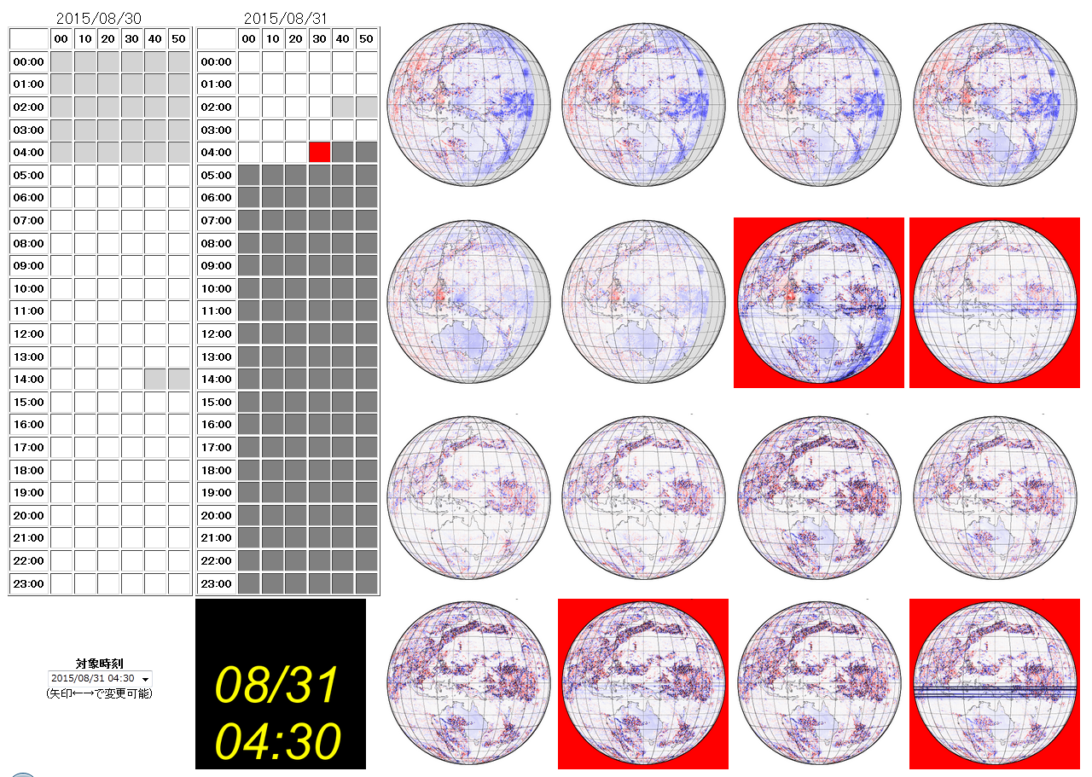
Application of GEO-GEO AHI-AHI comparison as a monitoring support tool
To support operational quality check
e.g. After operational configuration change
e.g. Stray-light in eclipse season midnight
For quick and qualitative check
No collocation, no RT computation
GSICS approach is necessary for quantitative analysis.
Sometime false alarm appears.
Threshold tuning is based on trial and error.
For internal use.

Slide 17
2015 achievements / 2016 work plan
2015 achievement
Feasibility study for DCC inter-calibration for all VIS/NIR bands
AHI lunar calibration using GIRO (ongoing)
AHI-CrIS inter-calibration
(AHI calibration monitoring environment)
2016 work plan
Submission of AHI GEO-LEO-IR product to Pre-operation phase
Prime Correction
Extend inter-comparison of MTSAT-2 VIS approaches (Lunar, DCC, RTM) to entire MTSAT-2 operation period
Collaboration with GDWG members (e.g. generating GSICS netCDF checker, use of gitHub for sharing codes)
SCOPE-CM calibration-related activities
Re-processing of surface albedo retrieval (LAGS)
Inter-calibration of GMS WV/IR channels using HIRS (IOGEO)

