Slide 1
EUMETSAT Agency Report
2015/16 GSICS activities
J. Ackermann, S. Elliott, T. Hewison, K. Holmlund, V. John, R. Munro, P. Miu, A. O’Carroll, R. Roebeling, H. Rothfuss, B. Viticchiè, S. Wagner

Slide 2
Overview
EUMETSAT involvement
Status of the actions on EUMETSAT
EUMETSAT achievements for 2015/2016 and plans
IR sub-group
VIS/NIR sub-group
UV sub-group
Climate activities
Instrument Information and Event Logs
GSICS Data Working Group activities

Slide 3
EUMETSAT Personnel involved in GSICS
Executive Panel
Ken Holmlund | EUMETSAT representative
Data Working Group
Peter Miu | Co-chair + Data management expert
Simon Elliott | Formats Expert
Research Working Group
Tim Hewison | Co-chair GRWG + chair Infrared sub-group
Sébastien Wagner | VIS/NIR + Lunar calibration
Rob Roebeling | Archive re-calibration
Rosemary Munro | Chair UV sub-group
Joerg Ackermann | Microwave
Supported by
Bartolomeo Viticchiè | VIS/NIR + Lunar calibration
Viju John | Infrared (Meteosat - HIRS) + MW
Anne O’ Carroll | Infrared (SLSTR & AVHRR - IASI)
Point of Contact for Operational Matters
Harald Rothfuss

Slide 4
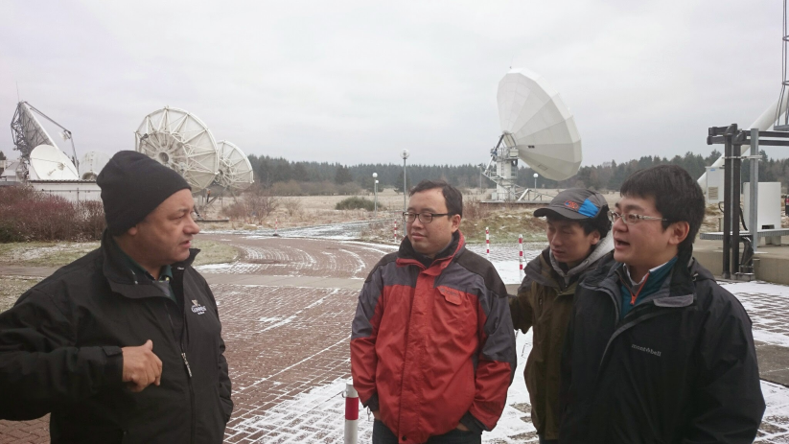
EUMETSAT Visitors involved in GSICS
Masaya Takahashi
JMA Visitor 12 months to Feb 2015 Funded by JMA | Lunar Calibration, Deep Convective Cloud, Application to Himawari-8/AHI, GEO-LEO IR uncertainty analysis, Data Management Now co-chair Data Working Group
Lin Chen
CMA Visitor 5 months to May 2015 Funded by EUMETSAT | Lunar Calibration Deep Convective Cloud Application to FY-2 and FY-3 imagers
Xu Zhe
CMA Visitor 3 months to Feb 2015 Funded by EUMETSAT | GSICS Data and Products Server Product formatting
Tom Stone (USGS)
Several visits Funded by EUMETSAT | Validation EUMETSAT implementation of ROLO lunar irradiance model (GIRO)
3 EUMETSAT Visiting Scientists visit EUMETSAT ground station at Usingen,
Jan 2015

Slide 5
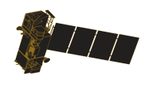
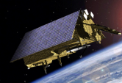
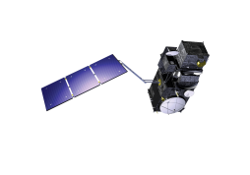
EUMETSAT commitment to long term continuity...
YEAR...
03
04
05
06
07
08
09
10
11
12
13
14
15
16
17
18
19
20
21
22
23
24
25
26
27
28
29
30
31
32
33
34
35
36
37
38
39
40
METEOSAT FIRST GENERATION
METEOSAT-7
METEOSAT SECOND GENERATION
METEOSAT-8
METEOSAT-9
MSG-3/METEOSAT-10
MSG-4/METEOSAT-11*
METEOSAT THIRD GENERATION
MTG-I-1 : IMAGERY
Mandatory Programmes
MTG-S-1: SOUNDING
MTG-I-2: IMAGERY
MTG-I-3: IMAGERY
EUMETSAT POLAR SYSTEM (EPS)
MTG-S-2: SOUNDING
METOP-A
MTG-I-4: IMAGERY
METOP-B
METOP-C
EPS-SECOND GENERATION (EPS-SG)
METOP-SG: SOUNDING AND IMAGERY
METOP-SG: MICROWAVE IMAGERY
Optional Programmes
JASON
JASON-2
JASON-3
SENTINEL 6 (JASON-CS)
Third Party Programmes
COPERNICUS
SENTINEL-3
SENTINEL-4 ON MTG-S
SENTINEL-5 ON EPS-SG
YEAR...
03
04
05
06
07
08
09
10
11
12
13
14
15
16
17
18
19
20
21
22
23
24
25
26
27
28
29
30
31
32
33
34
35
36
37
38
39
40

Slide 6
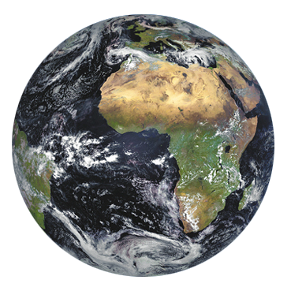
Current EUMETSAT satellites + third party programmes
Sentinel-3A (third party prog.)
(LOW-EARTH, SUN – SYNCHRONOUS ORBIT)
COPERNICUS PROGRAMME
Metop -A -B
(LOW-EARTH, SUN – SYNCHRONOUS ORBIT)
EUMETSAT POLAR SYSTEM/INITIAL JOINT POLAR SYSTEM
JASON-2, -3
(LOW-EARTH, 66° INCL. NON SYNCHRONOUS ORBIT)
OCEAN SURFACE TOPOGRAPHY MISSION
Meteosat 8-9-10-11 (2nd GENERATION)
(GEOSTATIONARY ORBIT)
TWO-SATELLITE SYSTEM:
Meteosat - 10: FULL DISK IMAGERY MISSION AT 0° (15 MN)
Meteosat - 9: RAPID SCAN SERVICE OVER EUROPE AT 9.5°E (5 MN)
Meteosat - 8: BACK UP AT 3.5°E
Meteosat - 11: STORAGE
Meteosat – 7 (1st GENERATION)
(GEOSTATIONARY ORBIT)
INDIAN OCEAN DATA COVERAGE MISSION AT 57°5 E
(UNTIL beginning 2017)
➔ Upon approval by council (June 2016), Meteosat-8 relocated at 41.5°E, with OPE early 2017.

Slide 7
Overview
EUMETSAT involvement
Status of the actions on EUMETSAT
EUMETSAT achievements for 2015/2016 and plans
IR sub-group
VIS/NIR sub-group
UV sub-group
Climate activities
Instrument Information and Event Logs
GSICS Data Working Group activities

Slide 8
Actions on EUMETSAT Closed during 2015/16
Action Ref | Description | Assigned to | Due Date | State
GRWG_14.10 | EUMETSAT to provide support to CMA on navigation of the MSG satellites as requested. | EUMETSAT | 1 May 2015 | Closed (visiting scientist)
GRWG_14.17 | EUMETSAT to report the AVHRR-IASI inter-calibration work in next meeting. | EUMETSAT | 1 May 2015 | Closed (present meeting)
GRWG_14.21 | EUMETSAT shall provide a method to formalise the process of archiving new data sets in an automated way (if possible). | EUMETSAT | 1 May 2015 | Closed (pres. at exec panel)
GDWG_14.13 | EUMETSAT to keep in contact with WMO on adopting OSCAR to include links to instrument events web-pages. | EUMETSAT | 1 May 2015 | Closed
GRWG_15.8 | Tim to put Pradeep in touch with 3G activity to assess uncertainties in RAOB-Sat | T. Hewison | 29 Feb 2016 | Closed (by email)
GRWG_15.11 | EUMETSAT to circulate report on investigation of the impact of the GSICS correction on atmospheric motion vector winds and other products. | T. Hewison | 29 Feb 2016 | Closed (email)
GRWG_15.23 | Delivery of the Wehrli solar spectrum used in the GIRO to the GSICS wiki | S. Wagner | 29 Feb 2016 | Closed
GRWG_15.29 | Proposal for an approach of issuing frequent GSICS corrections to the Exec Panel and Users Workshop. | T. Hewison | 29 Feb 2016 | Closed (User WS)

Slide 9
Actions on EUMETSAT Closed during 2015/16
Action Ref | Description | Assigned to | Due Date | State
GRWG_15.31 | Circulate the revised proposed policies for the GIRO and the GLOD for approval by Lunar Calibration Community. | S. Wagner | 1 June 2015 | Closed
GRWG_15.32 | Organise a web meeting to close the discussion on the GIRO + GLOD policy, seeking attendees' agreement | S. Wagner | 1 June 2015 | Closed (no need)
GRWG_15.48 | Ask ECMWF for feedback on double differencing of geostationary ring. | T. Hewison | 29 Feb 2016 | Closed (email)
GRWG_15.50 | Survey to identify a date among GPRC so that they produce the GSICS corrections for that date and provide them to Dave | T. Hewison | 29 Feb 2016 | Closed (present meeting)
GDWG_2015.4c | Changing the existing GEOLEOIR variables to combined versions: GRWG to examine the aspects to be revalidated and confirm they have no major impact. | EUMETSAT | 31 May 2015 | Closed (email)
GDWG_2015.9b1 | Define what to put in place to share the GIRO code and the GLOD (GSICS Lunar Observation Dataset). | S. Wagner/P. Miu | 31 May 2015 | Closed
GRWG_15.41 | EUMETSAT to update the GEO-LEO IR ATBD and operational implementation to inflate the coefficient uncertainties to obtain consistency with time series estimates of the random component. | T. Hewison | 29 Feb 2016 | Closed
GRWG_15.64 | Tim to cooperate with the GDWG to develop a version control document. - Completed by email in Feb 2016: Implemented in User Guide by EUMETSAT. GDWG chair will add clarifications to explain case of bug fixes. | T. Hewison | 29 Feb 2016 | Closed (email)

Slide 10
Status of Outstanding Actions on EUMETSAT
CGMS: 3 actions due for 29/02/2016 (Actionee = T. Hewison but as a co-chair of GSICS Research Working Group)
GSICS 2015:
Data Working Group: 17 actions (4 closed + 13 open)
Research Working Group: 25 actions (12 closed + 13 open)
Executive panel: 3 actions due for 29/02/2016 (Actionee = T. Hewison but as a co-chair of GSICS Research Working Group)
GSICS 2014 (including Actionee = “All”):
Data Working Group: 5 actions
Research Working Group: 9 actions
GSICS 2013 (including Actionee = “All”):
Data Working Group: 3 actions (2 derive from the annual meeting)
Instrument dev/ope – Calibration best practice: 3 actions ➔ superseded by recent actions Joint07_10 + Joint07_11 + EP-12.22 ➔ GRWG_14.25, GRWG_14.26, GDWG_2015.4l3
Notes:
GWG_13.14
Propose a solution based on modification of plotting tool and server structure and content to allow daily results to be displayed
T. Hewison / 01 Sep 2013
GWG_13.37
EUMETSAT (lead) + GDWG members to work with EUMETSAT to use their bias plotting tool for GPRC product monitoring plots.
T. Hewison / 01 Mar 2014

Slide 11
Status of Outstanding Actions on EUMETSAT
Two long standing actions on GPRC: GWG_13.14 + GWG_13.37 (related to the plotting tool + product monitoring)
➔ No sufficient resources at EUMETSAT to implement the required changes. Expected to change in 2016
Notes:
GWG_13.14
Propose a solution based on modification of plotting tool and server structure and content to allow daily results to be displayed
T. Hewison / 01 Sep 2013
GWG_13.37
EUMETSAT (lead) + GDWG members to work with EUMETSAT to use their bias plotting tool for GPRC product monitoring plots.
T. Hewison / 01 Mar 2014

Slide 12
Overview
EUMETSAT involvement
Status of the actions on EUMETSAT
EUMETSAT achievements for 2015/2016 and plans
IR sub-group
VIS/NIR sub-group
UV sub-group
Climate activities
Instrument Information and Event Logs
GSICS Data Working Group activities

Slide 13
EUMETSAT achievements – IR subgroup
GEO-LEO IR and hyperspectral SNOs:
GSICS Corrections for Near Real-Time ➔ alternative cal coefficients in L1.5 headers for all MSG
GSICS Corrections for SEVIRI-IASI ➔ Now Operational GSICS Products for all MSGs (Meteosat-8 to 10).
GSICS Product Acceptance Team review
Accessible via Server: http://gsics.eumetsat.int
Prime GSICS corrections ➔ GPPA started (since 09/2015) ➔ still on hold (one reviewer still missing)
See presentations 3f + 3g for further discussions
Received feedback on impact of GSICS Corrections for MVIRI on L2 products (including winds) ➔ Circulated report

Slide 14
Overview
EUMETSAT involvement
Status of the actions on EUMETSAT
EUMETSAT achievements for 2015/2016 and plans
IR sub-group
VIS/NIR sub-group
UV sub-group
Climate activities
Instrument Information and Event Logs
GSICS Data Working Group activities

Slide 15
Towards a GSICS VIS/NIR product
GSICS VIS/NIR sub-group’s current focus:
Deep Convective Clouds Method
Lunar calibration + inter-calibration using the Moon as transfer (through the GIRO)
➔ Those targets are common to all GEOs
Motivation: definition of a GSICS VIS/NIR product as a blend of the DCC and Lunar methods
➔ Possibility to close the GEO ring with a VIS/NIR product as currently discussed in the IR sub-group

Slide 16
EUMETSAT achievements and plans for DCCs
Deployment of the GSICS DCC software
GSICS VIS/NIR products for Meteosat-10 SEVIRI VIS0.6:
Accessible via Server: http://gsics.eumetsat.int
Submitted GSICS Procedure for Product Acceptance in September 2015 to enter the demonstration phase ➔ still on hold (one reviewer still missing)
Collecting user requirements ➔ beta tester = marine application group (study on deriving water turbidity using SEVIRI data) (provided with a dataset for Meteosat-9)
Achievements
Extending the method to other reflective solar bands to cover the current and future needs (SEVIRI warm channels and MTG/FCI)
Use of a new reference such as Suomi NPP VIIRS
Reprocess the MSG archive to consolidate the current monitoring capabilities
Support EUMETSAT activities on climate to apply DCC algorithm to support re-calibration of Meteosat First Generation archive
Plans
See presentation 4l

Slide 17
EUMETSAT achievements and plans for Lunar Cal
Since the First Lunar Calibration Workshop in December 2014:
GIRO Version 1.0.0 released
GIRO usage and GSICS Lunar Observation Dataset policy terms agreed within Lunar Calibration Community and presented at the GSICS Executive Panel
Tighten links and interactions with CEOS WGCV IVOS, who support GSICS initiative on lunar calibration
Licensing arrangement to release software
Set-up of the infrastructure to distribute GIRO (sources) + GLOD
Developing inter-calibration using the Moon as a transfer target (part of EUMETSAT’s organisational objectives for 2016) and add the method to the GSICS blend
Continuing collaboration between agencies (e.g. visit to CMA in March 2016)
Study on validation of SBAFs using hyperspectral measurements
Achievements
See presentation 4f
Plans

Slide 18
Overview
EUMETSAT involvement
Status of the actions on EUMETSAT
EUMETSAT achievements for 2015/2016 and plans
IR sub-group
VIS/NIR sub-group
UV sub-group
Climate activities
Instrument Information and Event Logs
GSICS Data Working Group activities

Slide 19
EUMETSAT achievements – UV subgroup
Joint GSICS Research Working Group UV Sub-Group (GRWG-UVSG) and CEOS Working Group on Calibration and Validation - Atmospheric Composition Sub-Group (CEOS WGCV-ACSG) meeting NOAA/NCWCP, College Park, MD, on the 8th and 9th October 2015
User survey designed to assess the most appropriate focus for the GSICS sub-group activities.
White Paper on Ground-based Characterisation of UV/Vis/NIR/SWIR spectrometers
Aim: to prepare a white paper documenting best-practise for the on-ground calibration of UV/Vis/NIR/SWIR spectrometers based on in-orbit experience from relevant missions. Lead – R. Lang (EUMETSAT)
See presentation 2f

Slide 20
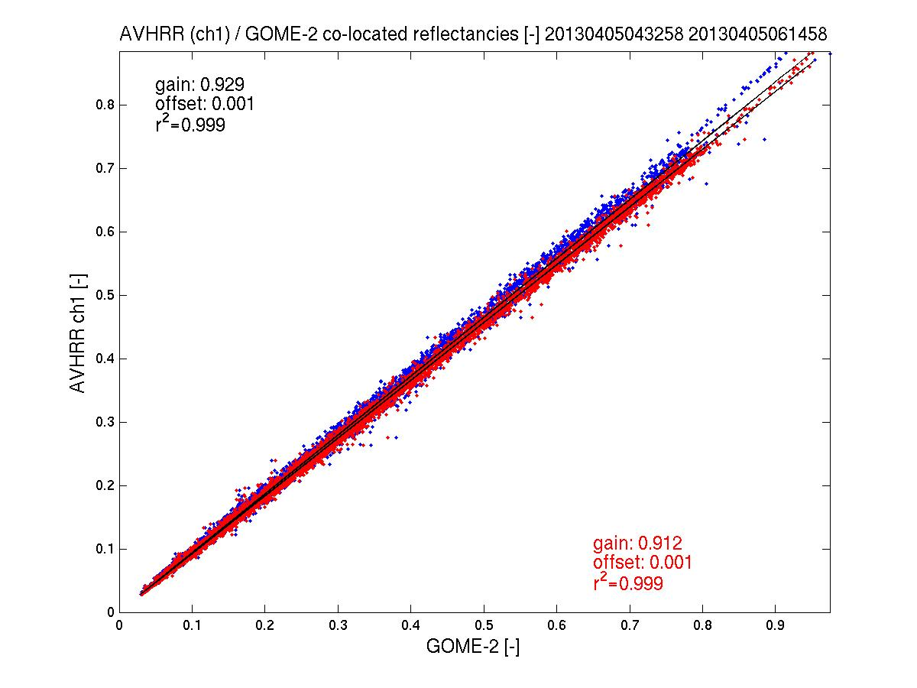
EUMETSAT achievements – UV subgroup
GOME-2/AVHRR reflectance inter-calibration: AVHRR Channel 1 (Metop-A)
EUMETSAT also providing support to VIS/NIR activities by developing a GOME-2 / AVHRR Channel 1 inter-calibration algorithm
AVHRR Ch 1 to GOME-2/Metop-A gain in reflectance < 8% (AVHRR < GOME-2)
2013
Corrected /
Uncorrected
Comparison of Collocated Reflectances
(spatial aliasing accounted for)

Slide 21
EUMETSAT plans – UV sub-group
GOME-2 - AVHRR (channel 1) cross-calibration methodology developed in the context of the Metop PMAp (Polar Multi-mission Aerosol product) development
To be implemented in the operational PMAp processor
Cross-calibration coefficient can be extracted during the operational PMAp processing.
Stand-alone software to be developed for integration into the operational product monitoring environment
Methodology can be adapted to other imager data (e.g. SEVIRI)

Slide 22
Overview
EUMETSAT involvement
Status of the actions on EUMETSAT
EUMETSAT achievements for 2015/2016 and plans
IR sub-group
VIS/NIR sub-group
UV sub-group
Climate activities
Instrument Information and Event Logs
GSICS Data Working Group activities

Slide 23
Climate Activities at EUMETSAT – Reprocessing + FIDUCEO
Time Series of Brightness Temperatures over Libya#4 in IR (top) and WV (bottom) after MVIRI Recalibration 1983-2006
Met-2
Met-3
Met-4
Met-5
Met-6
Met-7
2016: Will work on the MSG IR6.8 and IR10.8 for time period before IASI to extend time series
Activities of immediate relevance for GSICS:
European project FIDUCEO (Fidelity and Uncertainty in Climate Data Records from Earth Observation) ➔ Objective = to develop and apply a rigorous metrology of Earth observation for climate data records
Topics addressed by the project (➔ see 1e):
Terminology
Traceability and Key Comparison Reference Values ➔ see 3f
SRFs changing in time + reprocessing with SSCC (vicarious calibration system)
Analysis of HIRS: understanding its calibration + SRF by inter-comparison with IASI

Slide 24
Climate Activities at EUMETSAT – SCOPE-CM
SCOPE CM - Inter-calibration of passive imager observations from time-series of geostationary satellites (IOGEO) (SCM-06)
Objective = re-calibrate and inter-calibrate Meteosat First Generation (MFG) and Meteosat Second Generation (MSG) IR, WV, and VIS radiances from 1982 to present.
Achievements in 2015:
Completed recalibration of MVIRI infrared and water vapor radiances for full METEOSAT time-series (1982- date)
Release of the recalibrated FCDR (netCDF format) planned for 2016.
Generated re-calibration coefficients for the MVIRI time-series of IR and WV radiances;
Received feedback from CM SAF on the quality of the MVIRI re-calibration coefficients;
Prepared standard netCDF HIRS data record for use as calibration reference in IOGEO;
Set-up a collaborative study to compare re-calibrated IR and WV observations from IOGEO and GSICS for a common test month including all geostationary satellites;
Set-up an FTP site to exchange data between IOGEO project partners (see 3b).

Slide 25
Overview
EUMETSAT involvement
Status of the actions on EUMETSAT
EUMETSAT achievements for 2015/2016 and plans
IR sub-group
VIS/NIR sub-group
UV sub-group
Climate activities
Instrument Information and Event Logs
GSICS Data Working Group activities

Slide 26
Instrument Event Logging
GSICS GRWG/GDWG 2014 Action 33:
All GPRCs to provide satellite instrument specific links to calibration events to WMO-OSCAR.
Following the update of WMO-OSCAR (= one landing page link per Satellite per Instrument ), EUMETSAT together with JMA published standardized landing pages for their instruments
EUMETSAT coordinates the inter-agencies efforts to provide the requested information to the user community
CGMS-43: WGII/3 Action 43.01:
Calibration events logging task team to prepare a white paper outlining the set of parameters, the nomenclature, and the standards to be used for reporting on instrument calibration across space agencies.
Set-up of a Task Team with representatives from all Satellite Operators
Draft of a White Paper for common nomenclature and standards for calibration events (under review): breakdown of Instrument Events + recommendations for WMO-OSCAR Landing Pages + recommendations for Common Nomenclature and Standards.
See 6c + 7a

Slide 27
Overview
EUMETSAT involvement
Status of the actions on EUMETSAT
EUMETSAT achievements for 2015/2016 and plans
IR sub-group
VIS/NIR sub-group
UV sub-group
Climate activities
Instrument Information and Event Logs
GSICS Data Working Group activities

Slide 28
EUMETSAT achievements – Data working group
Completion of an operational GSICS collaboration server with operational GSICS products (GEOLEOIR) currently being used by the MSG15 data sets ➔ see 5e
The EUMETSAT Data Centre now supports the minting of Digital Object Identifiers (DOIs) for GSICS deliverable and EUMETSAT Climate Data Records (CDRs) ➔ see 6h
Support to development of several new GSICS products from the Data Management context, and offer them from the EUMETSAT GSICS collaboration server.
Improving the collaboration process with our JMA and CMA partners through the visiting scientists programme sponsored by EUMETSAT ➔ see 5i
Notes:
Guidelines, conventions and standards; using the netCDF as the format for data exchange, use of the WMO file naming convention for data and product identification, using CF conventions where possible to organise the netCDF array structures, and specifying meta-data.
GSICS collaboration servers are the platforms for data exchange and GSICS product distribution.
GSICS tools and utilities; GSICS products plotting tool, automate the GSICS products netCDF ncml validation, provide framework for the development of GSICS products in netCDF (in progress).
GSICS products generation framework simplifies and speeds up GSICS product development. This is needed as our partners are not all aware of how to develop the netCDF format. Framework provide a structure to create netCDF files through configuration, a ncml file defining the netCDF, and the implementation of mapping classes to populate the netCDF file from the native data.

Slide 29
EUMETSAT plans – Data working group
For 2016:
Enhancing the GSICS product plotting tool to support new products ➔ see 6f
Realisation of the Data Preservation approach to ensure the availability of all GSICS products ➔ see 5e
Bringing the GIRO + GLOD service into operations ➔ see 5f
Propose an approach for specifying netCDF meta-data conventions across data sets (EUMETSAT / European Met Service profiles)
Propose an approach for using the netCDF Enhanced Data Model ➔ see 5b
See also 6f + 7a
Notes:
Guidelines, conventions and standards; using the netCDF as the format for data exchange, use of the WMO file naming convention for data and product identification, using CF conventions where possible to organise the netCDF array structures, and specifying meta-data.
GSICS collaboration servers are the platforms for data exchange and GSICS product distribution.
GSICS tools and utilities; GSICS products plotting tool, automate the GSICS products netCDF ncml validation, provide framework for the development of GSICS products in netCDF (in progress).
GSICS products generation framework simplifies and speeds up GSICS product development. This is needed as our partners are not all aware of how to develop the netCDF format. Framework provide a structure to create netCDF files through configuration, a ncml file defining the netCDF, and the implementation of mapping classes to populate the netCDF file from the native data.

