Slide 1
NOAA GPRC Report
Fangfang Yu and Xiangqian Wu
With contributions from Changyong Cao, Taeyong “Jason” Choi, Ralph Ferraro, Lawrence Flynn, Yong Han, Ninghai Sun, Likun Wang, Fuzhong Weng, Yuanzheng “Jordan” Yao, Mitch Goldberg etc.
2016 GSICS Annual Meeting
29 Feb. – 4 March 2016
Tsukuba, Japan

Slide 2
Outlines
NOAA GPRC Annual Meeting Action Review
6 actions completed or closed
NOAA Instrument Performance Summary and GSICS activities
UV Subgroup + OMPS
VIIRS
CrIS
ATMS
Microwave subgroup
GOES GEO-LEO IR operation
GSICS GEO-LEO Inter-calibration Research
Collocated DCC
Geospatial inter-calibration
Lunar radiance calibration

Slide 3
Past Annual Meeting Action Review -1
Action: Implement Sebastien’s Deseasonalisation method and compare with Fangfang’s and report back
Closed. Reported to the GRWG VIS/NIR Sub-group Web meeting on 2016-02-04.
For long term time series, there is no significant difference between deseasonalizations by variogram and FTT in trending accuracy and precision. None improved GOES results significantly.
Performance for shorter term time series is unknown.
Unlike METEOSAT, GOES observations of DCC does not have sinusoidal variations.
Other agencies are encouraged to continue if interested.
Action: Provide NASA the Metop/AVHRR instrument information
Closed

Slide 4
Past Annual Meeting Action Review -2
Action: Investigate inter-channel calibration with IASI
Pearlman, A., R. Dalta, C. Cao, and X. Wu, “Multichannel IR Sensor Advanced Baseline Imager Calibration Validation Using Planck’s Law”, Calcon, August 2015.
Did not find dependence of bias that depends on channel or radiance.
Invite Pagano and Yong Han to review scoring scheme for reference instruments
Completed
Action: Provide NOAA’ GEO-LEO IR algorithm code to IMD
GEO-LEO IR algorithm codes has already provided to GCC
Report on plans to incorporate GOES-R/ABI in ICVS
Completed

Slide 5
UV Sub-group and UV Instruments
Joint GRWG-UVSG and CEOS WGCV ACSG meeting on Oct. 8-9, 2015 at NOAA NCWCP, College Park MD USA
Four baseline projects were identified
Reference Solar Spectrum (NOAA Lead) (4t)
White Papers on Group-based characterization of UV/Vis/NIR/SWIR spectrometers
Match-Ups and Target Sites
Cross-Calibration below 300nm (NOAA Lead)
Monitoring figures for the NOAA BUV instruments are regularly updated at the NOAA ICVS
The OMPS instrument is very stable, extremely flexible, and has good SNRs.
A summary of the four projects was provided at a NASA EOS Aura OMI meeting in Feb 2016.
L. Flynn

Slide 6
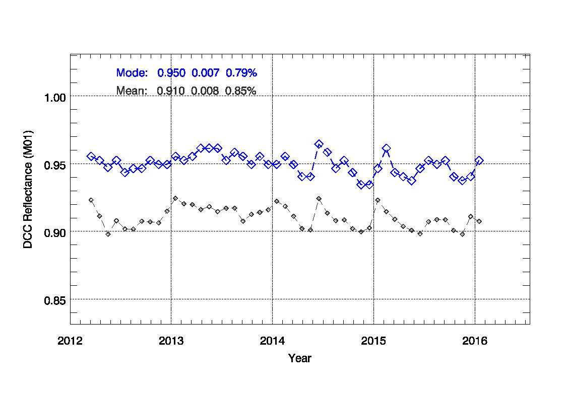
NOAA SNPP VIIRS SDR Highlights and Cal/Val Updates
The VIIRS reflective solar bands have performed well.
The Rotating Telescope Assembly (RTA) tungsten oxide degradation has leveled off since mid 2013.
VIIRS reprocessing will correct the RTA degradation effects.
VIIRS calibration is closely monitored at 30+ cal/val sites worldwide.
Time series results show the calibration is very stable and accurate.
There are more than 19+ Remote Sensing Journal papers of the special issue on S-NPP VIIRS Cal/Val.
http://www.mdpi.com/journal/remotesensing/special_issues/VIIRS
J. Choi and C. Cao

Slide 7
S-NPP CrIS SDR
Full Spectral Resolution Mode on 10/15/2014
The over-all agreement between CrIS and AIRS/IASI is good with some differences between sensors around 0.1-0.2K dependent on spectral regions. (3q)
Inter-comparison will be carried out with re-processed CrIS data
The IDL version of line-of-sight based CrIS collocation tool has been developed and the Python version will be released soon(1v).
04/02/2012
First SDR product
04/19/2012
Beta status
10/15/2014
Full spectral resolution mode
01/13/2013
Provisional status
02/20/2014
Validation status;
Calibration algorithm and
coefficient updates (Mx8.1)
L. Wang

Slide 8
M. Goldberg

Slide 9
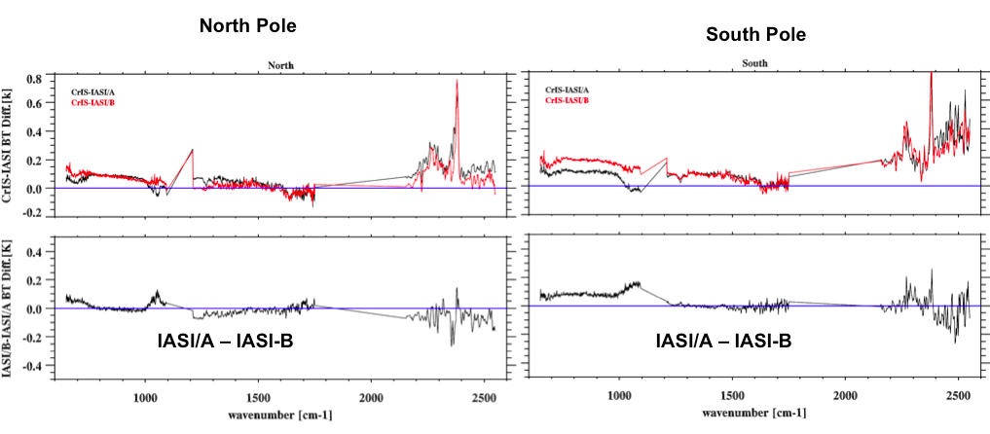
March 2015 Greenland SNPP campaign
M. Goldberg

Slide 10
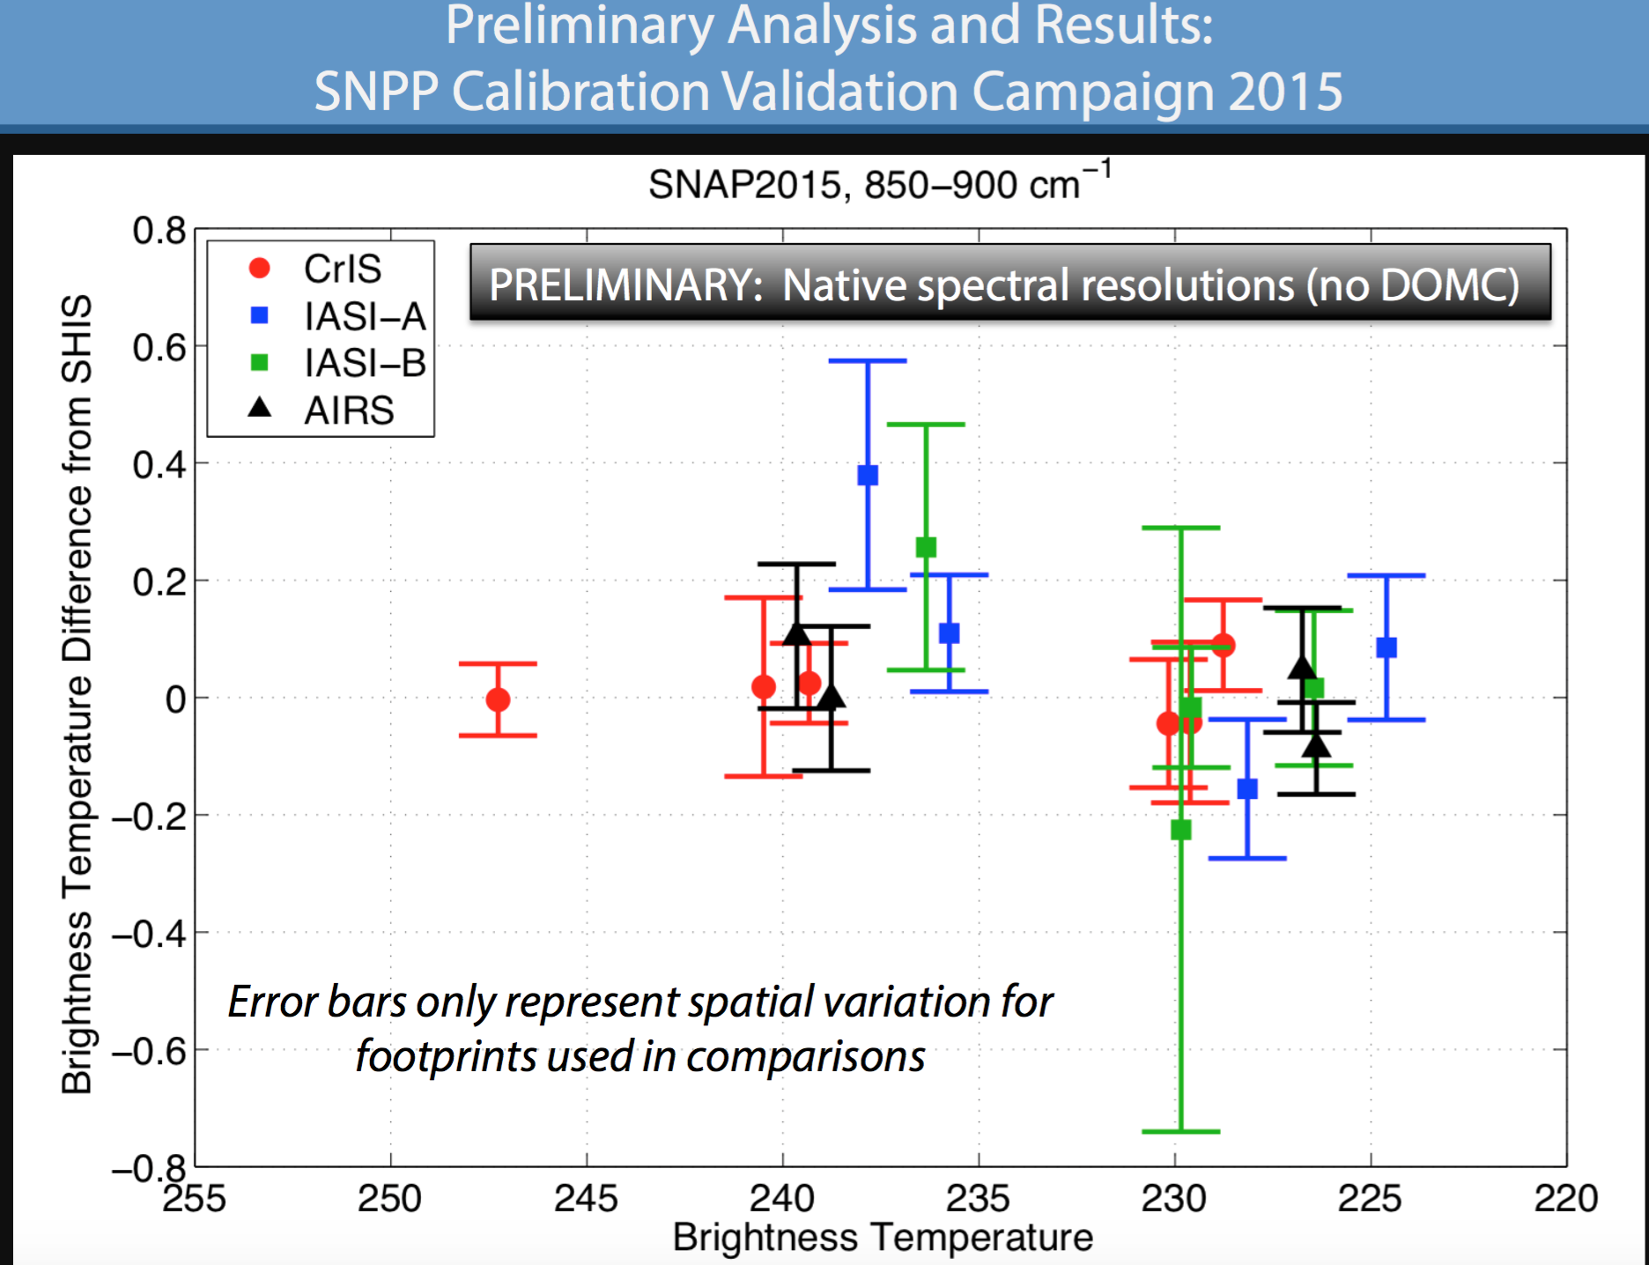
Credit: Tobin
M. Goldberg

Slide 11
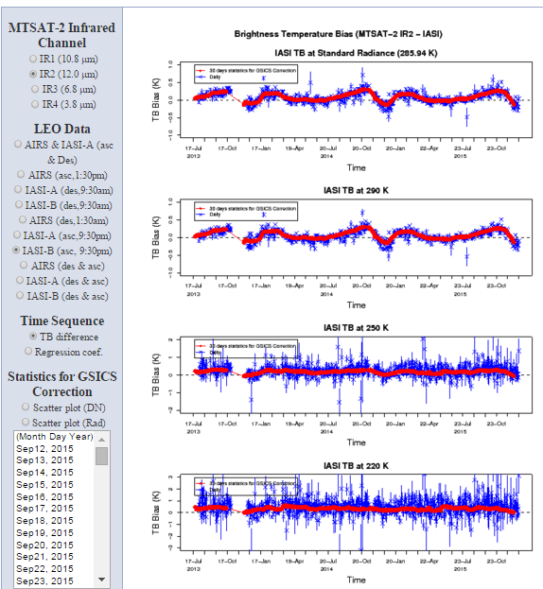
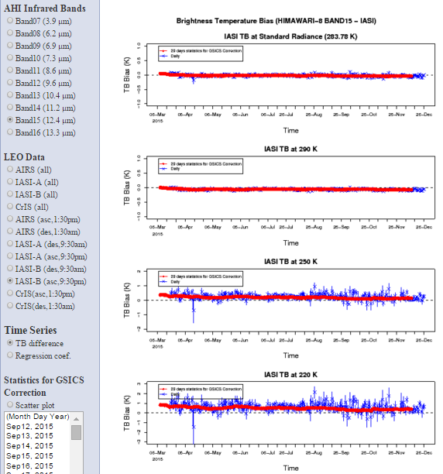
GSICS correction is negligible for AHI
M. Goldberg

Slide 12
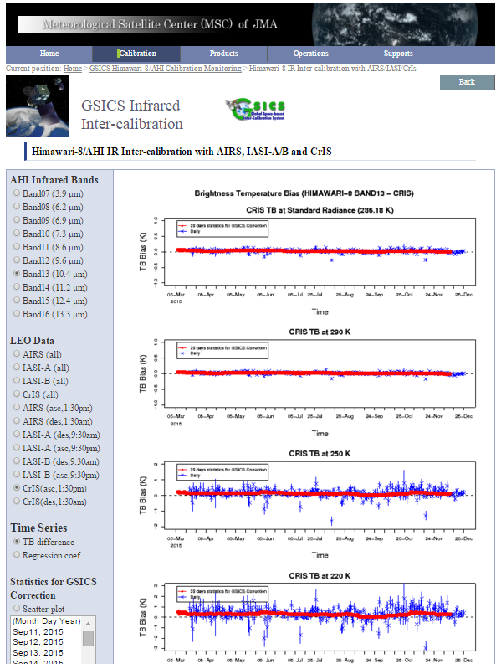
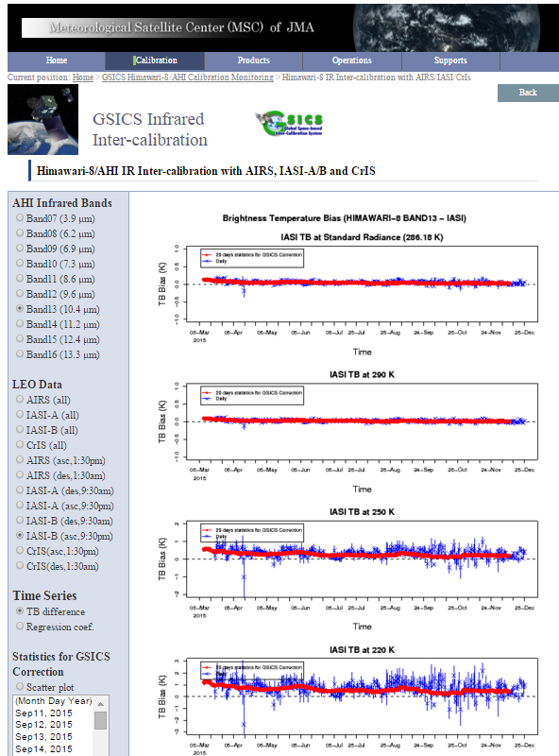
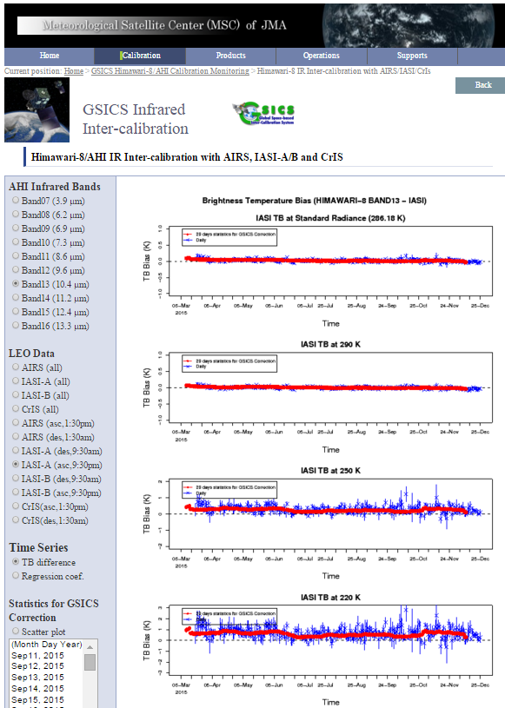
M. Goldberg

Slide 13
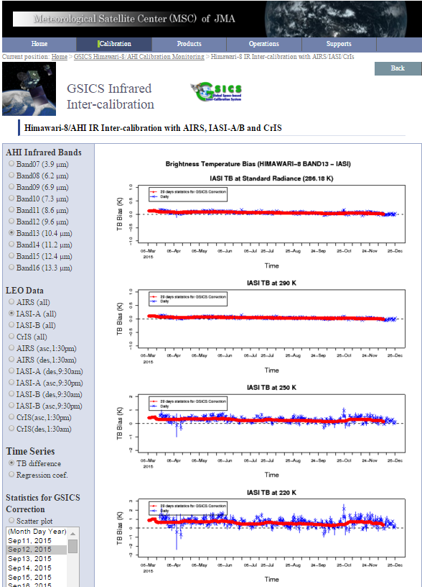
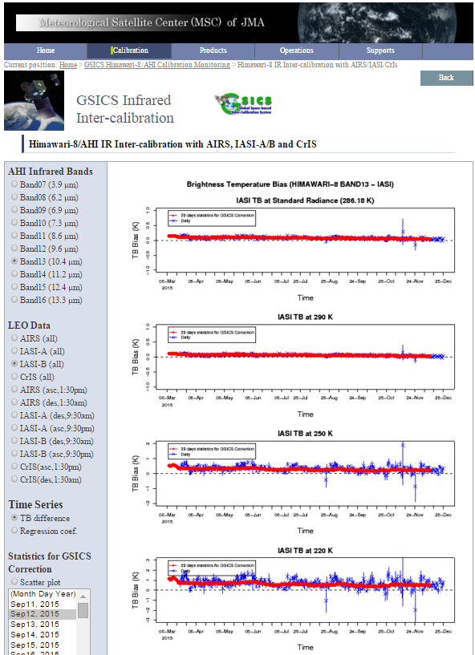
M. Goldberg

Slide 14
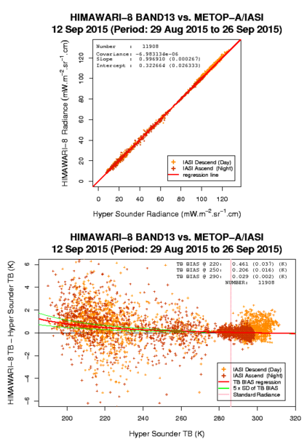
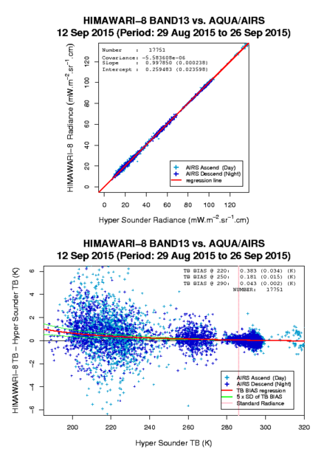
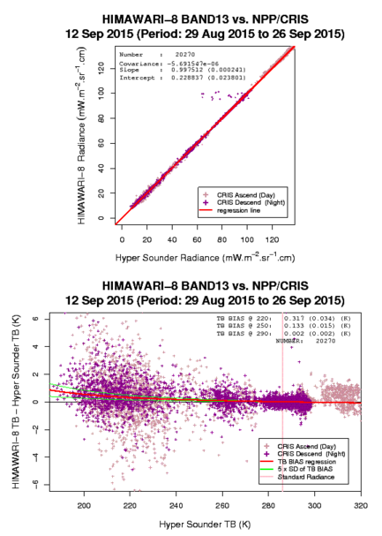
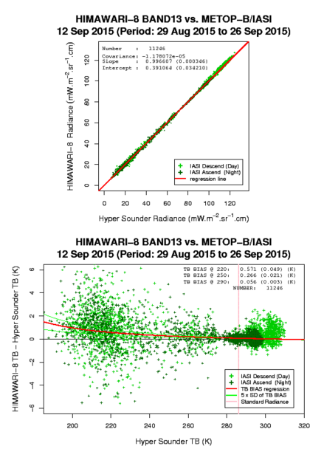
M. Goldberg

Slide 15
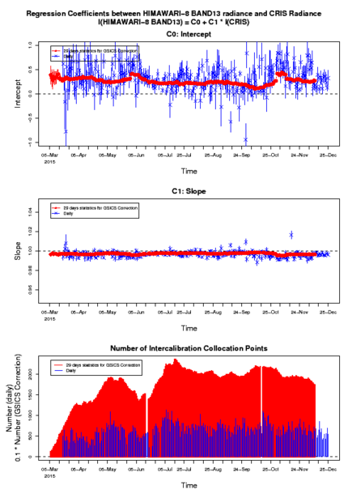
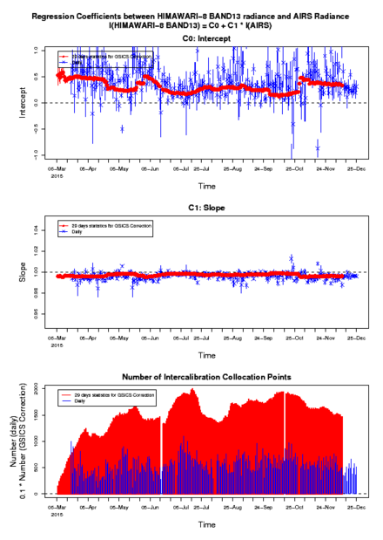
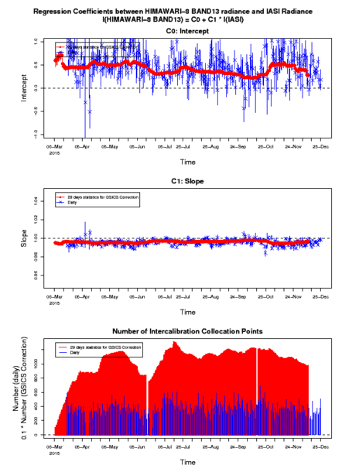
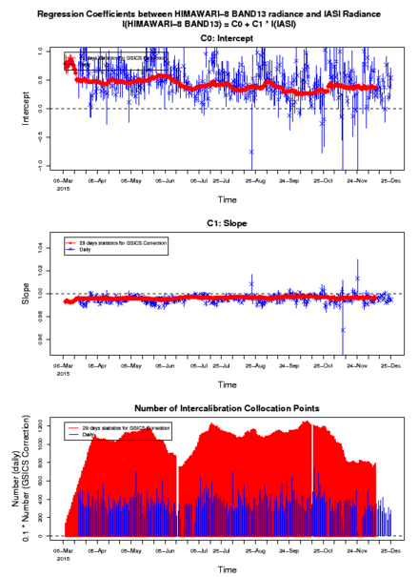
M. Goldberg

Slide 16
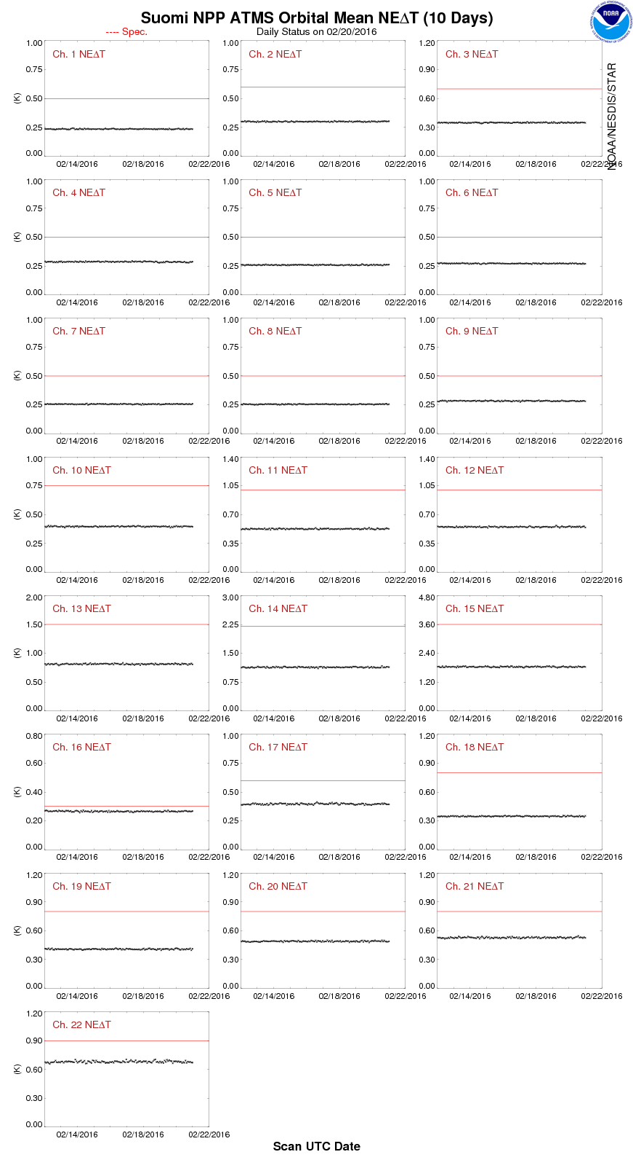
SNPP ATMS Performance
Suomi NPP ATMS All Channel Sensitivities (NE∆Ts) are stable and well below the specification since launch. Shown here is a 10-day all channel NE∆T chart as reference.
N. Sun and F. Weng

Slide 17
NOAA GSICS MW Subgroup (2g)
Convened 4 telecons over the past year
Participated at GSICS User’s Group meeting
Survey and analysis
Expanded/Enhanced membership
Other agencies, closer collaboration with CEOS, GPM
Making (slow, but steady) headway on products
Definition, standards, potential tools, etc.
Forthcoming articles for newsletter
R. Ferraro

Slide 18
GOES GEO-LEO IR Operation
GOES Imager GEO-LEO IR correction product promoted to pre-operational stage in Dec. 2013
GOES-13/15 Imager IR
Server broke down in July 2015
Revived the GEO-LEO collocation in Dec. 2015, and the correction products in Feb 2015 (Jordan: 3m)

Slide 19
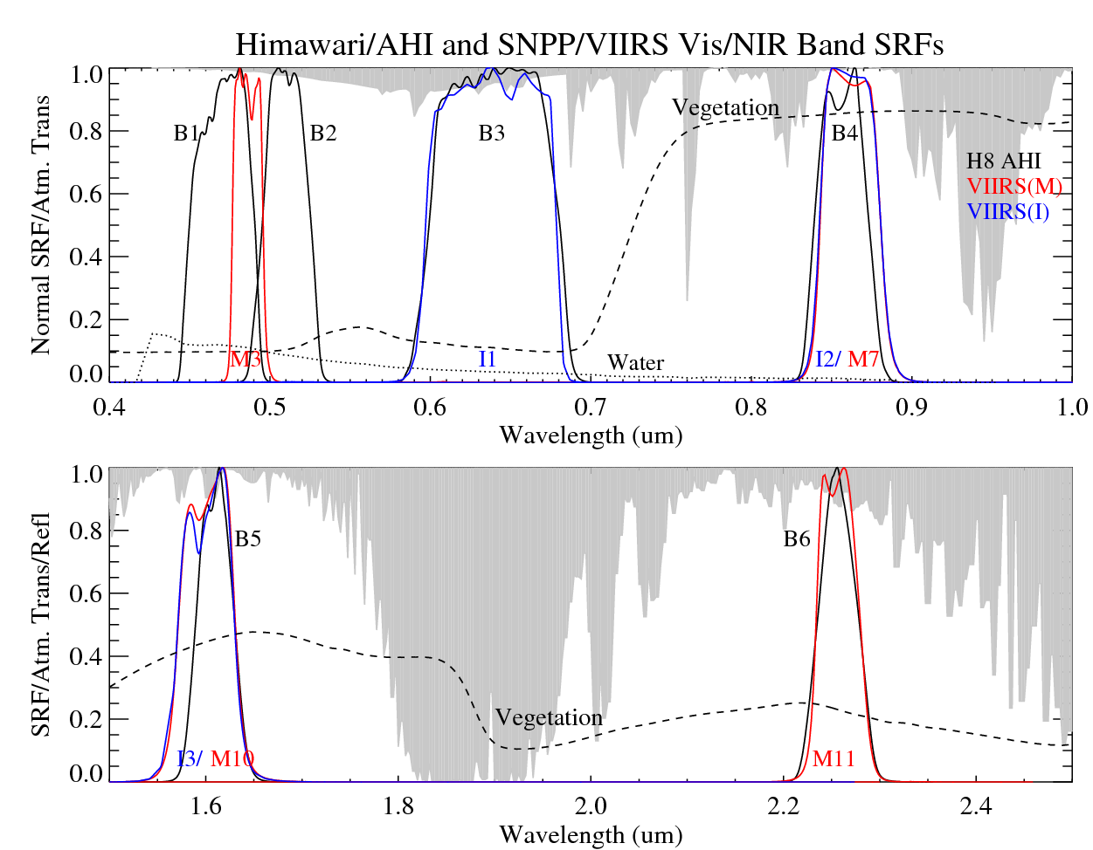
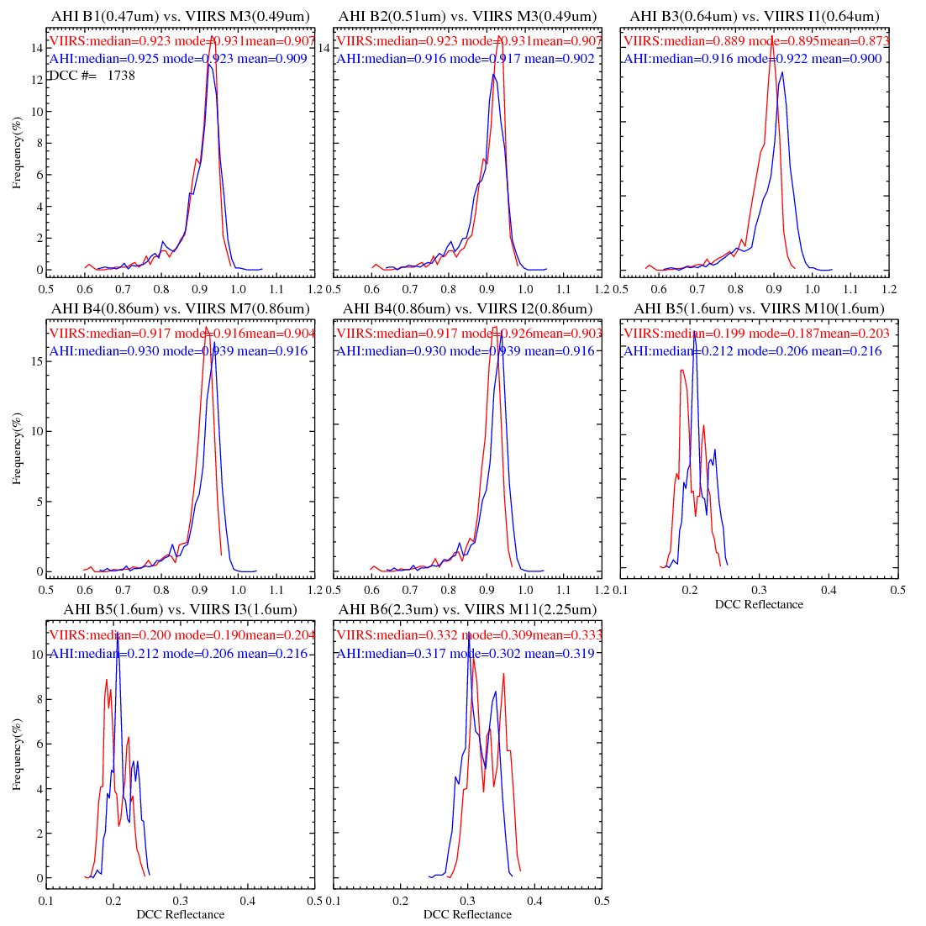
GSICS GEO-LEO Calibration Research Activities
Collocated DCC
Compared to the legacy GEO instruments, higher temporal and spatial resolutions of new generation GEO instruments result in much more DCC pixels, making it possible to use collocated DCC method for more robust inter-calibration results for median/high albedo scenes
Compared to the Ray-matching method, the collocated DCC method has less uncertainty at NIR bands
Higher spectral resolution of new generation GEO instruments should be explored for better understanding of the DCC microphysics and thus improve the DCC calibration uncertainty
AHI |  | B1 (0.47um) | B2 (0.51um) | B3 (0.64um) | B4 (0.86um) |  | B5 (1.6um) |  | B6 (2.3um)
VIIRS |  | M3 |  | I1 | M7 | I2 | M10 | I3 | M11
Ray-matching |  | 1.010 (±0.026) | 0.999 (±0.028) | 1.037 (±0.030) | 1.021 (±0.029) | 1.022 (±0.032) | 1.079 (±0.058) | 1.073 (±0.065) | 0.963 (±0.045)
DCC | Median | 1.002 | 0.992 | 1.031 | 1.014 | 1.015 | 1.067 | 1.061 | 0.955
 | Mode | 0.992 | 0.985 | 1.030 | 1.024 | 1.014 | 1.102 | 1.084 | 0.977
 | Mean | 1.003 | 0.994 | 1.031 | 1.014 | 1.015 | 1.064 | 1.058 | 0.958
 | Statistics* | 1.003 (±0.024) | 0.995 (±0.026) | 1.032 (±0.028) | 1.015 (±0.024) | 1.015 (±0.025) | 1.065 (±0.030) | 1.059 (±0.032) | 0.959 (±0.026)
Reduced Uncertainty compared to Ray-matching method
Yu, F. and X. Wu, 2016, Remote Sensing, in press

Slide 20
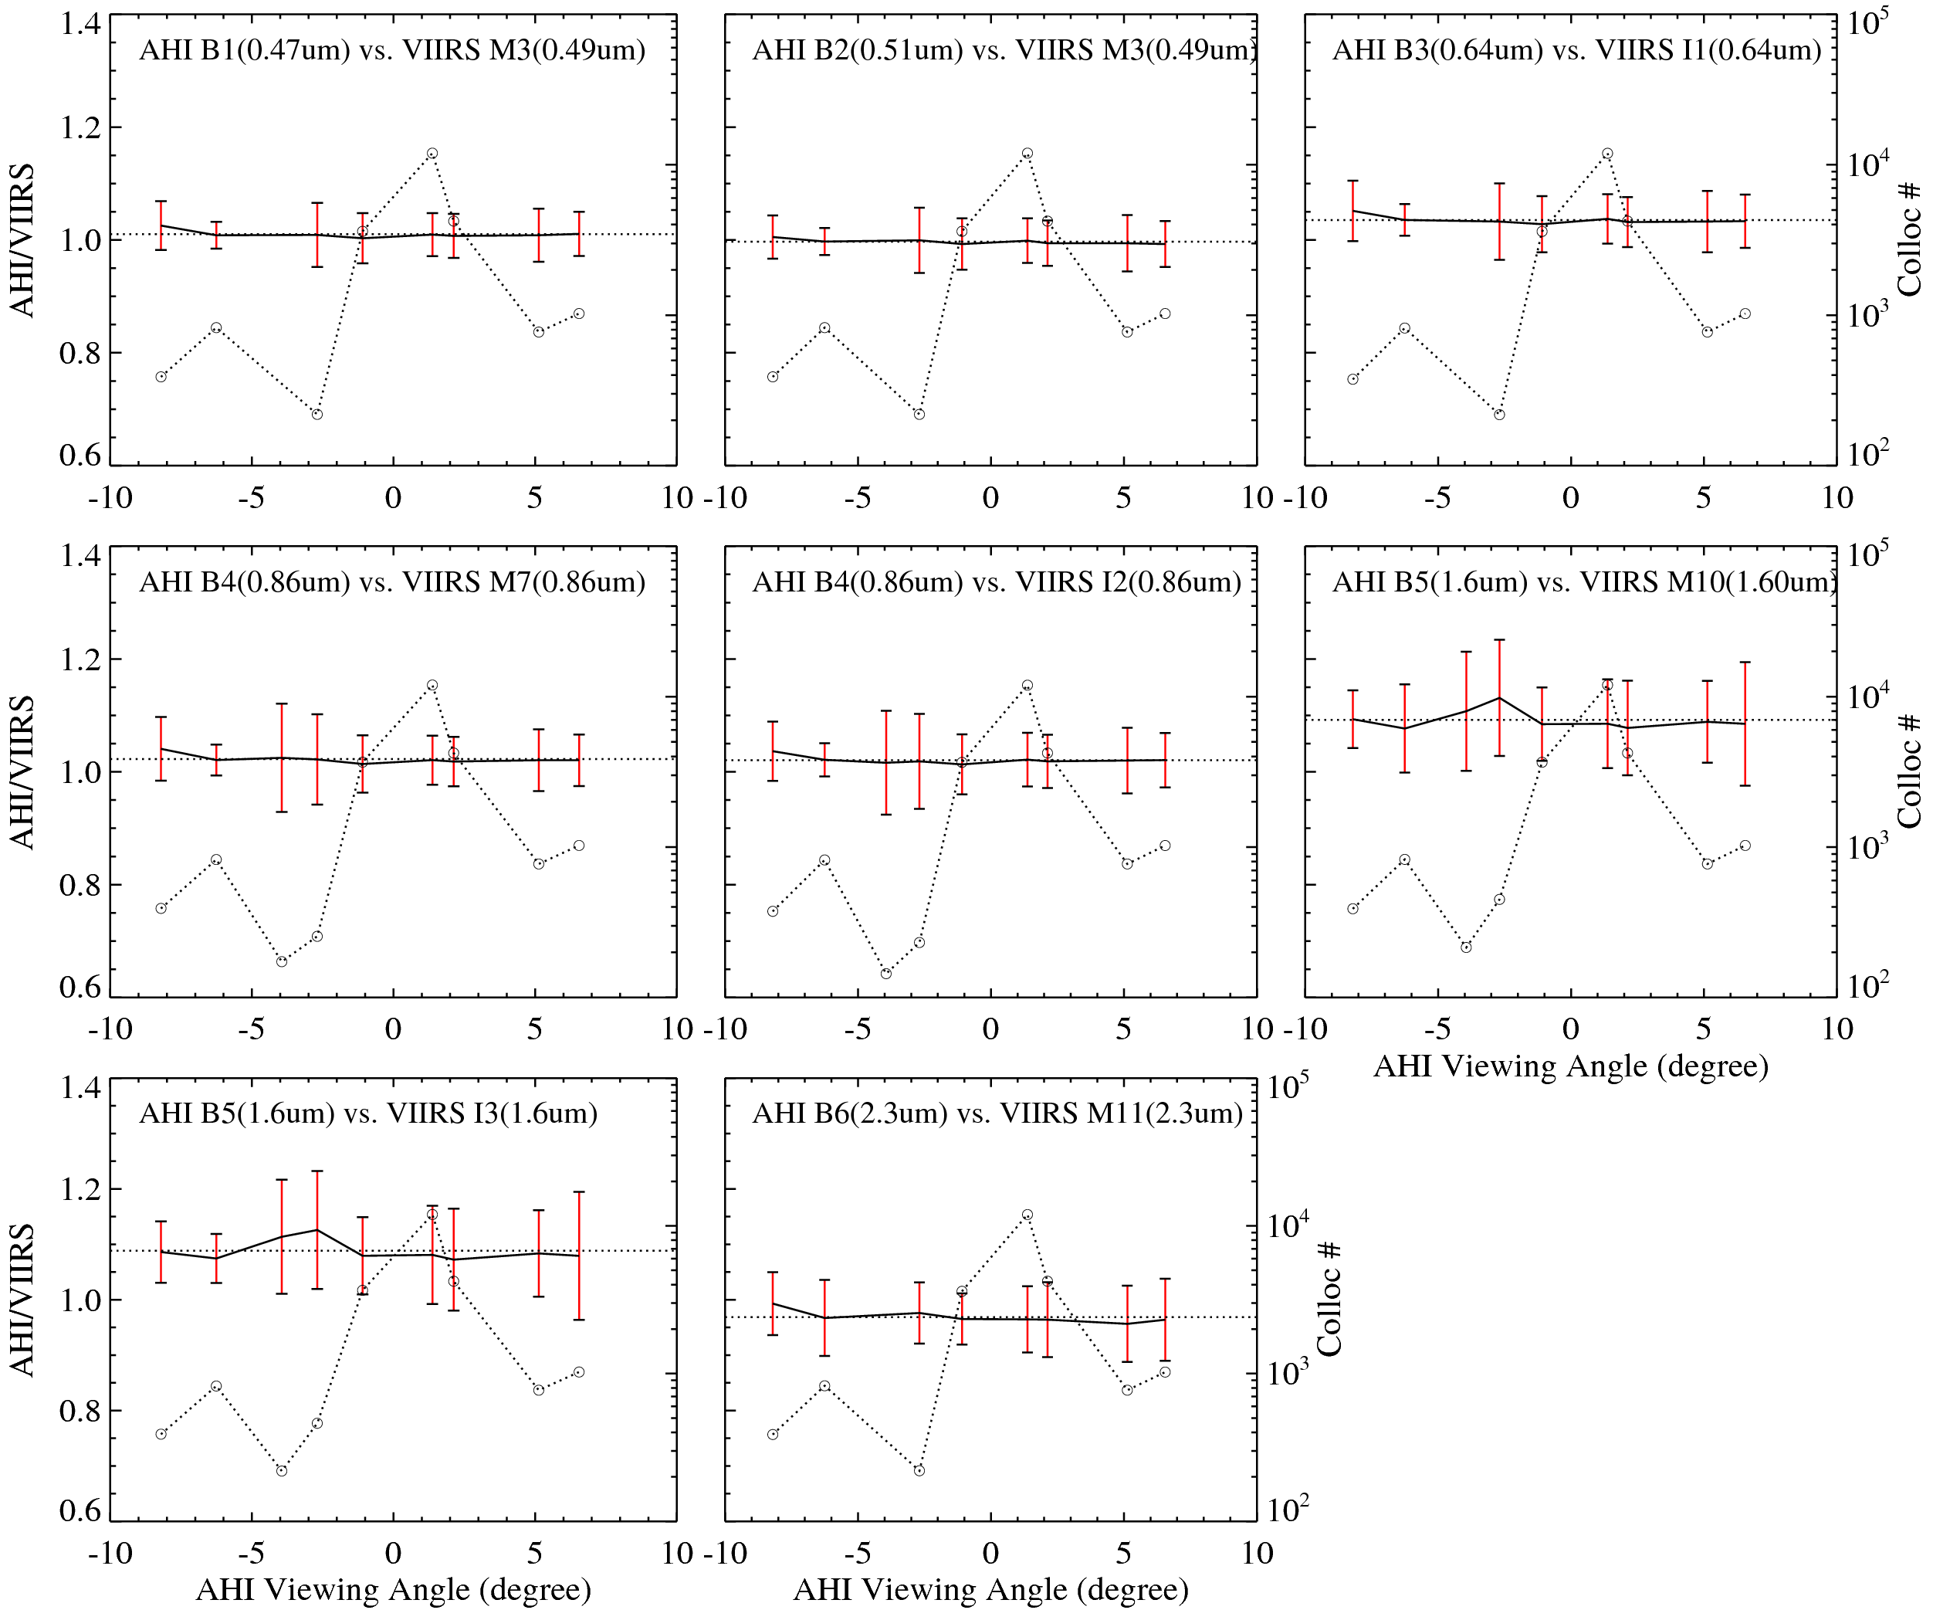
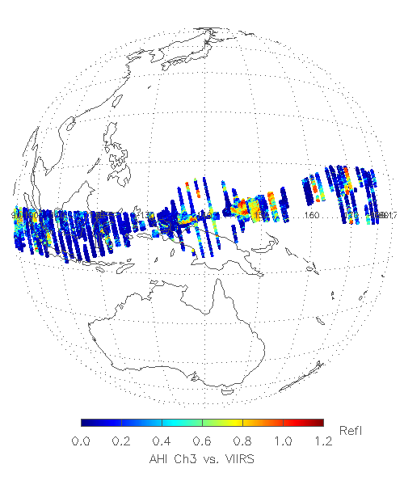
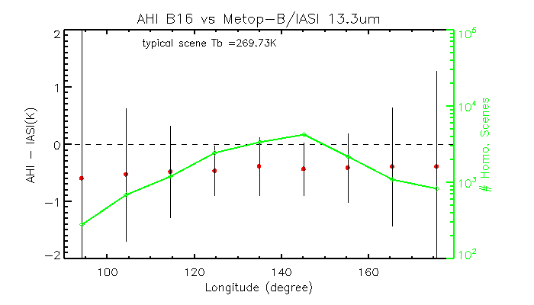
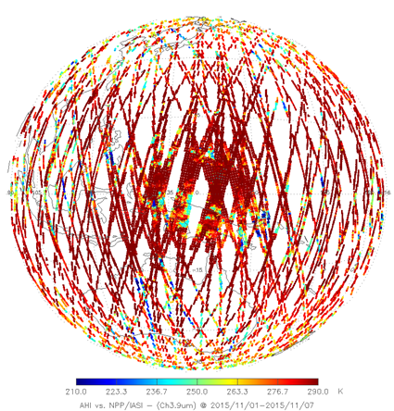
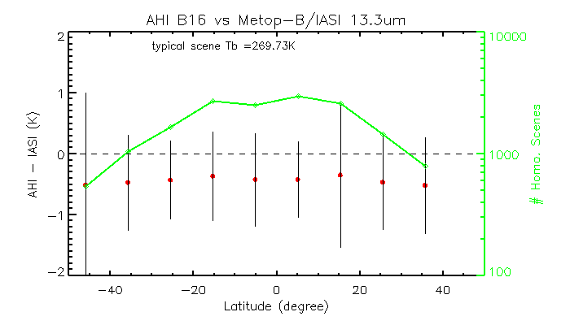
GEO-LEO Inter-calibration – Viewing angular calibration difference
Higher temporal and spatial resolutions results in much more collocation scenes
Robust incident angular dependent calibration difference can be generated with collocations from much less durations
AHI vs. VIIRS Ray-matching Collocations
Yu, F. and X. Wu, 2016, Remote Sensing, in press
2 months
AHI vs. IASI GEO-LEO Collocations
E-W Scan-Mirror, AHI B16 (13.3um)
N-S Scan-Mirror, AHI B16 (13.3um)
One week

Slide 21
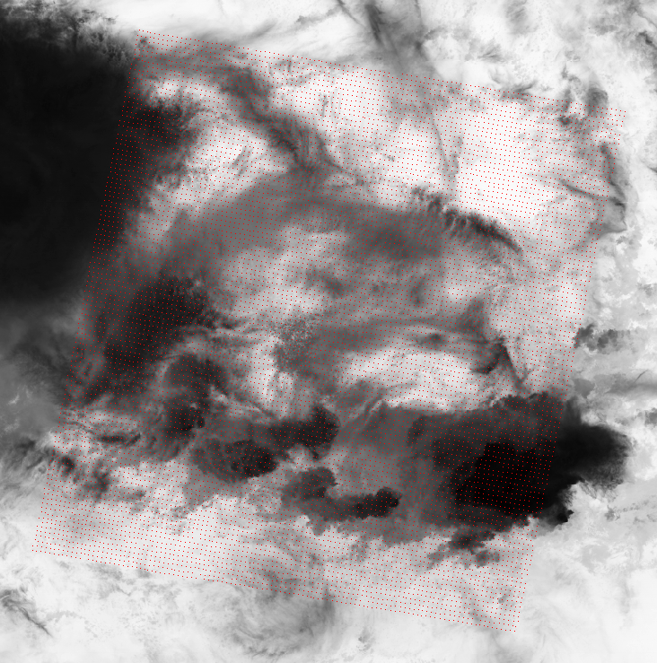
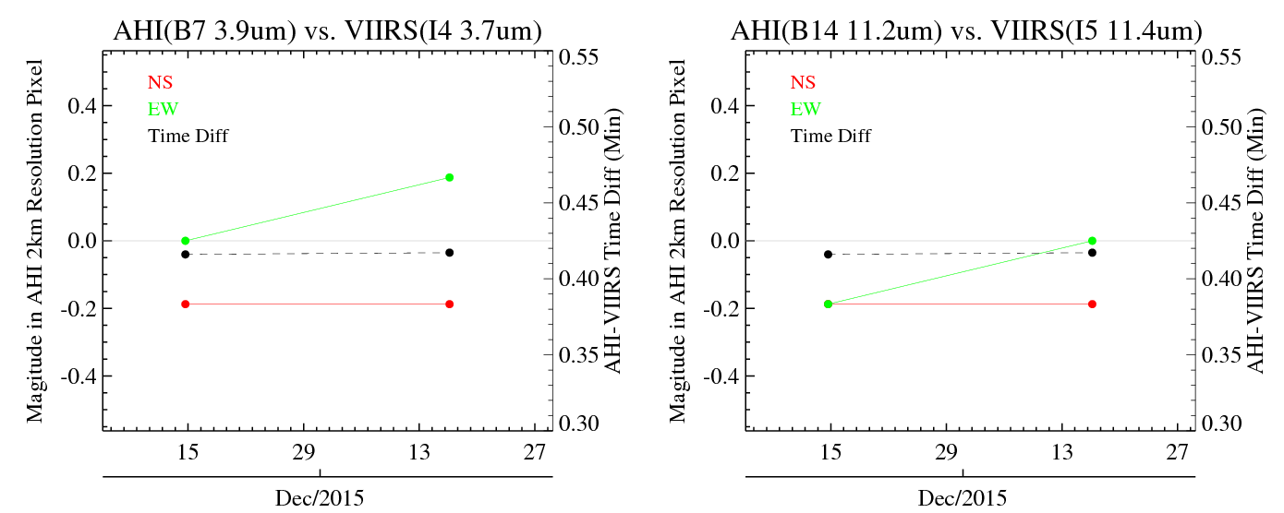
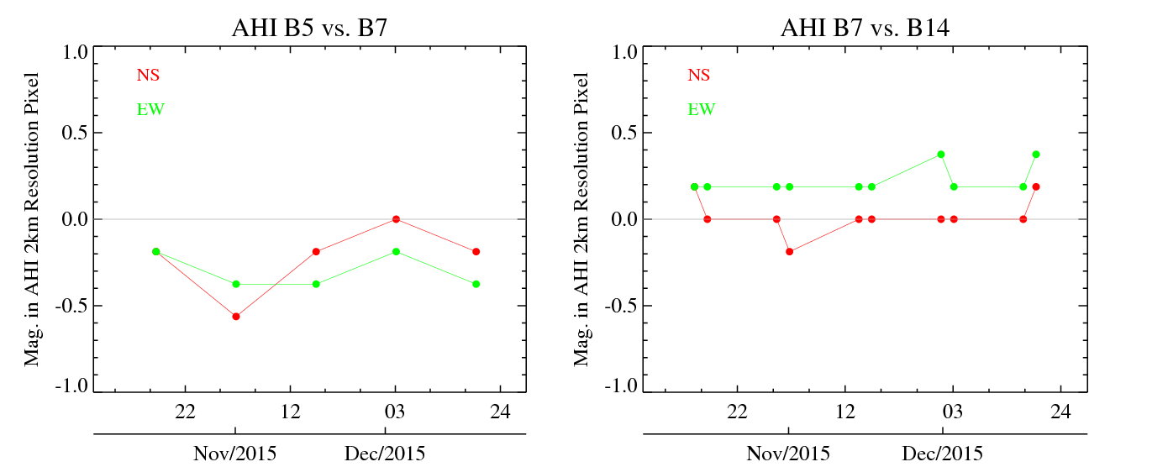
Geo-spatial calibration accuracy validation using SNO/Ray-matching data
AHI |  |  | VIIRS
Band name | Central wav. (µm) | Spatial res. (km) | Band name | Central wav. (µm) | Spatial res. (km)
B5 | 1.6 | 2 | I3 | 1.6 | 0.375
B7 | 3.9 | 2 | I4 | 3.9 | 0.375
B14 | 11.2 | 2 | I5 | 11.4 | 0.375
Navigation difference between AHI and VIIRS
A complementary method to independently validate the IPATS NAV results
Applicable for cloudy images which dominate over the Earth surface
Results agree very well with the IPATS method
Can be also used to validate the band-to-band registration (BBR) calibration accuracy
Time-series of AHI BBR difference between October 13 and December 19, 2015.
Yu, F. et al. 2016 IGARSS, submitted

Slide 22
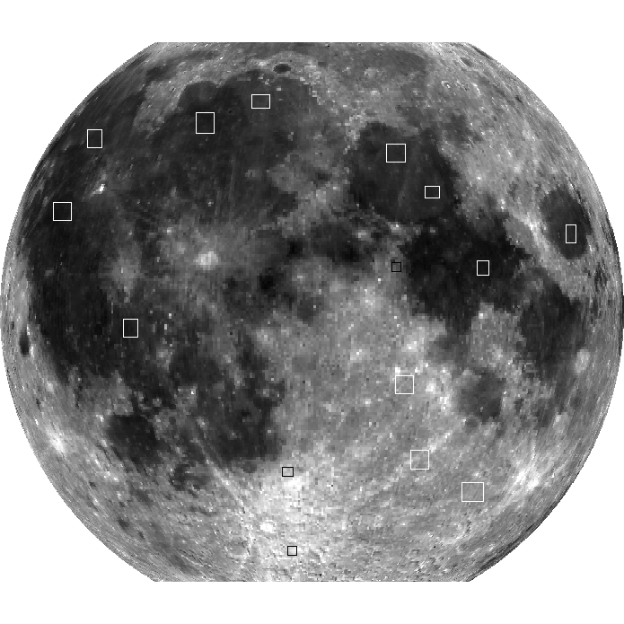
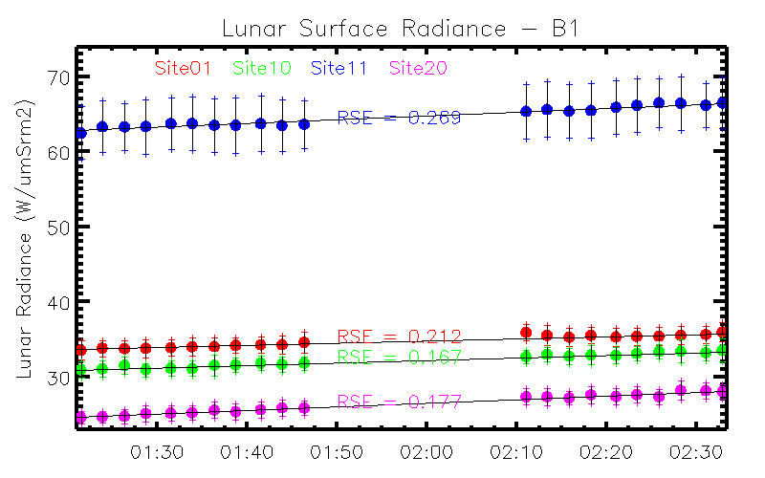
Lunar Radiance Calibration for H8 AHI and GOES-R ABI
Lunar target selections with SELENE/LALT and SELENE/SP data
Spectral characterization of the targets with SELENE/SP
Data extraction technique development
Current on-going collaboration with JMA to develop the lunar radiance model for the AHI/ABI calibration
Detail reports at 1g and 4h
10
9
13
3
14
1
AHI lunar radiance
4
Apollo Site #16
12
2
15
5
6
7
8
11

Slide 23
Summary
Completed most NOAA GPRC actions from the past annual meeting, if not all
NOAA SNPP instruments perform stable and healthy in-orbit
Candidates of reference instruments from UV to MW spectra
NOAA fully participate the GPRC activities and leading several subgroups
Potential new GSICS MW products
C. Zou (MSU-AMSU), J. Fenning (SSMI), GPM X-Cal LUT’s
Actively explore and improve GSICS inter-calibration algorithms
LoS collocation
Collocated DCC
GEO-LEO INR validation
Lunar radiance calibration

