Slide 1
USGS Report to GSICS March 01, 2016
Tom Stone, USGS Flagstaff, (on-site)
Greg Stensaas and Ron Morfitt, USGS EROS, (telecon)

Slide 2
Overview
Landsat Mission Status
Observatory statuses
Instrument performance and anomalies
Lunar calibration
Additional Activities Relating to Cal/Val
Non-Landsat imagery assessments
Land Product Characterization System (LPCS)
Requirements Capabilities and Analysis for Earth Observations (RCA-EO)
National Earth Observation Assessment (EOA)
Future Collaborative Efforts

Slide 3
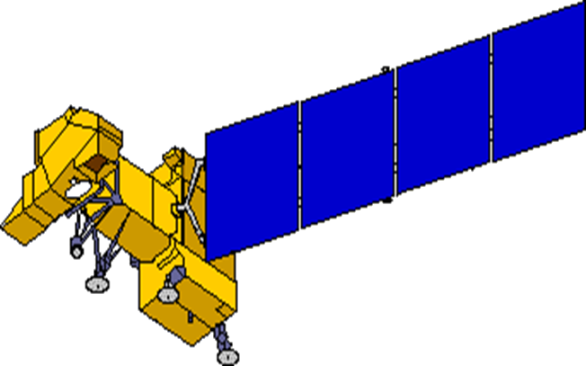
Landsat 7 Spacecraft Status
Power Subsystem
≈ 16 years of on-orbit operations
Batteries
Solar Array
Performance nominal
5/14/2002 Circuit #14 Failure
5/16/2005 Circuit # 6 Failure
8/13/2008 Circuit #14 partial recovery
14 circuits remain operating
no impact to ops
Attitude Control System
Power Control Unit
•05/05/2004 Gyro 3 Shut Off
•1-gyro control system in development
10/18/2014 BVR failover
Enhanced Thematic Mapper +
•5/31/2003 SLC Failure
•4/01/2007 Bumper mode
Reaction Control System
1/07/04 Fuel line #4 thermostat #1a failure
2/24/05 Fuel line #4 thermostat failure; Primary
heater circuit disabled
4/25/13 Fuel line #2 thermostat failure; Redundant
heater circuit disabled
Remote Tlm Cmd (RTC) Box
•09/27/2014 RTC A Failover
Solid State Recorder
11/15/1999 SSR PWA #23 Loss
02/11/2001 SSR PWA #12 Loss
12/07/2005 SSR PWA #02 Loss
08/02/2006 SSR PWA #13 Loss
03/28/2008 SSR PWA #22 Loss
09/03/2008 SSR PWA #23 Recovered
10/12/2013 SSR PWA #11 Loss
Each PWA is 4% loss of launch capacity
Boards are likely recoverable
X-band System
S-band System
Performance nominal
Performance nominal

Slide 4
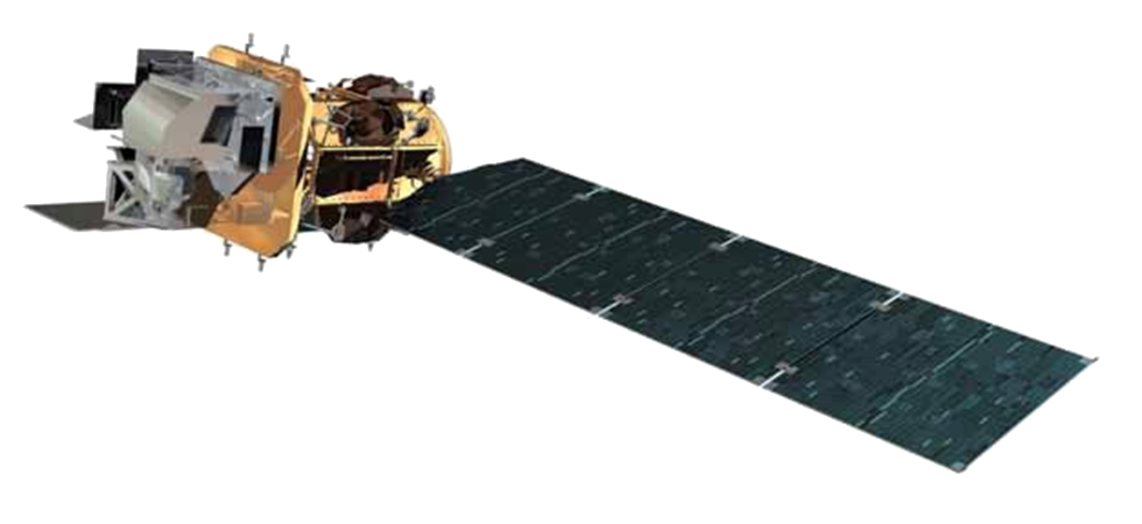
Landsat 8 Spacecraft Status
≈ 3 years of on-orbit operations
Operational Land Imager
RF Communications
Thermal Control System
S-band System
Propulsion Subsystem
Attitude Control System
Electrical Power System
Batteries
Solar array
Thermal Infrared Sensor
10/1/2014 - Side-A SSM Encoder
X-band System
Command & Data Handling System
Solid State Recorder

Slide 5
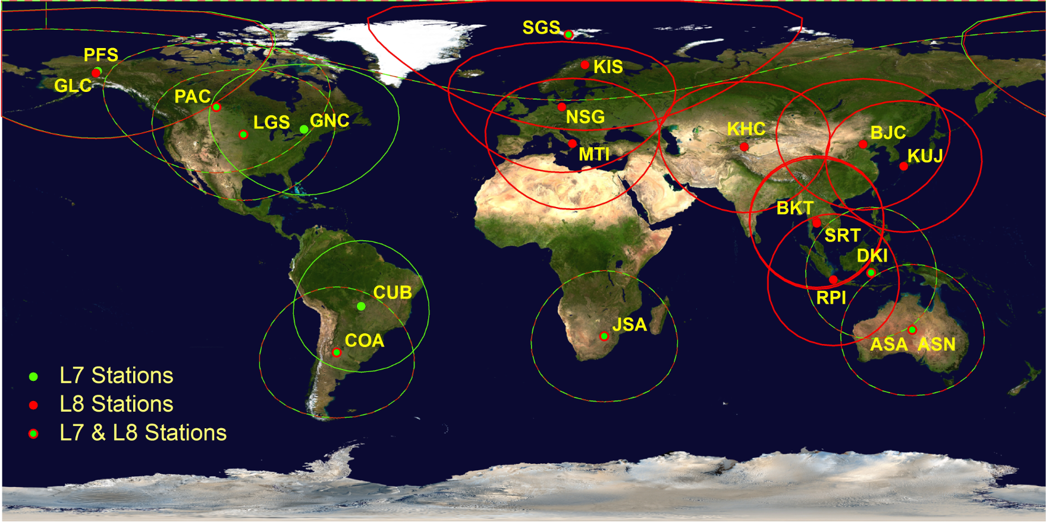
Active Landsat International Ground Stations
10 Active L7 Stations 17 Active L8 Stations
L7 pLGN

Slide 6
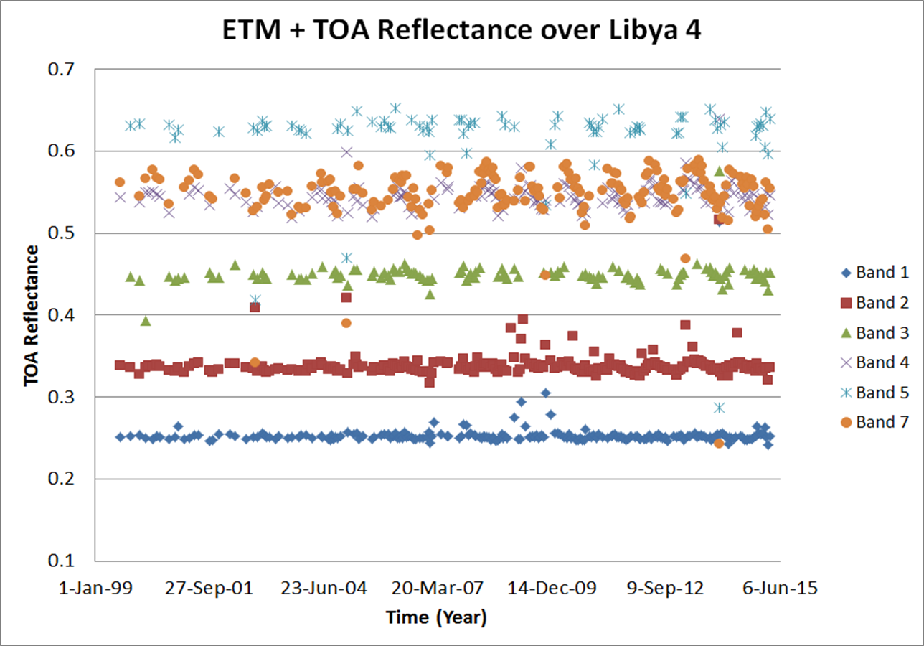
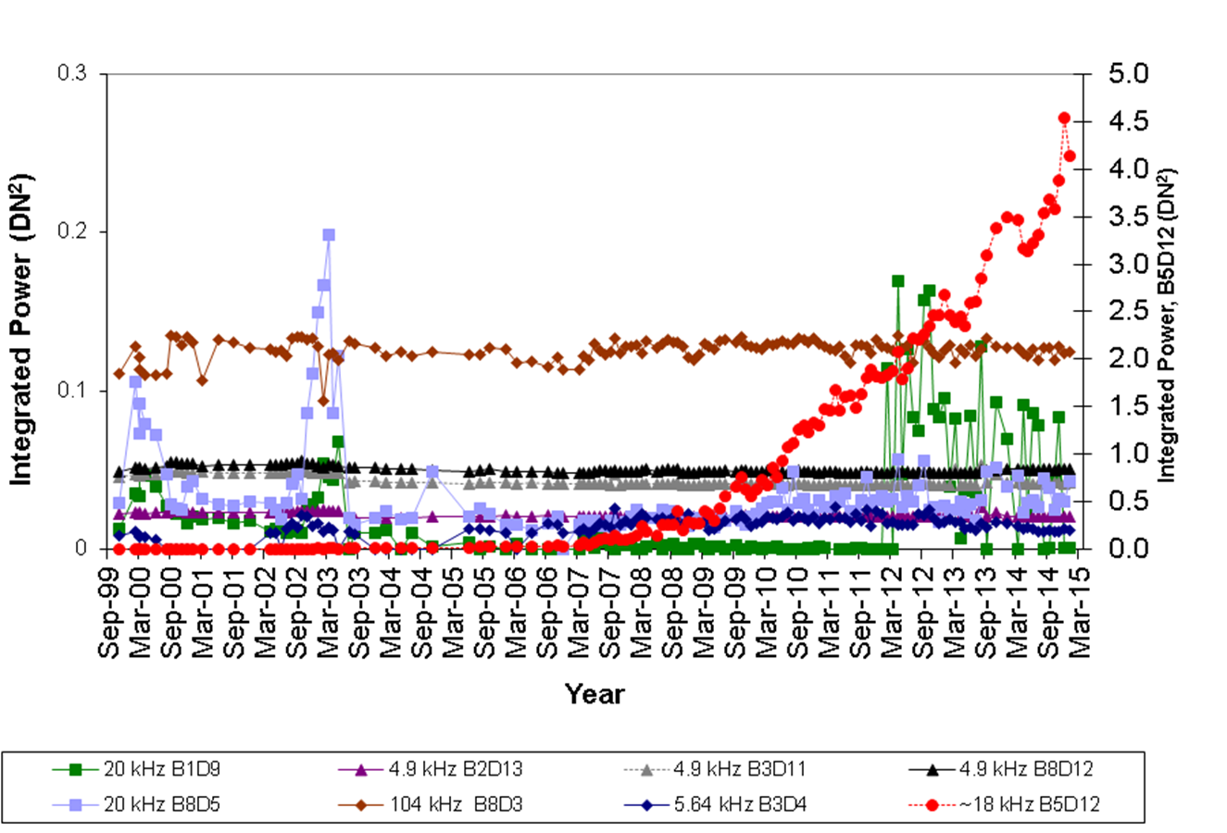
Landsat-7 Radiometric Performance
Lifetime TOA reflectance based on PICS stable with seasonal variations
Coherent noise component continues to increase
Continuing quarterly ETM+ absolute gain updates
Planning to propagate L8 OLI reflectance based calibration to L1-7

Slide 7
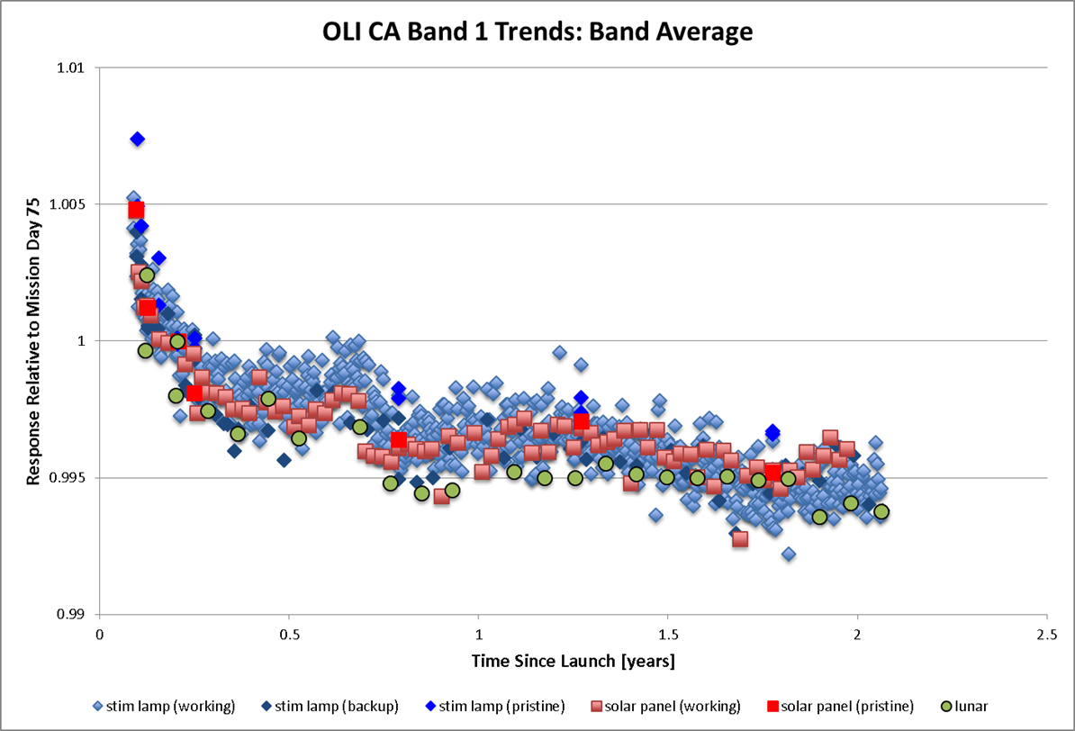
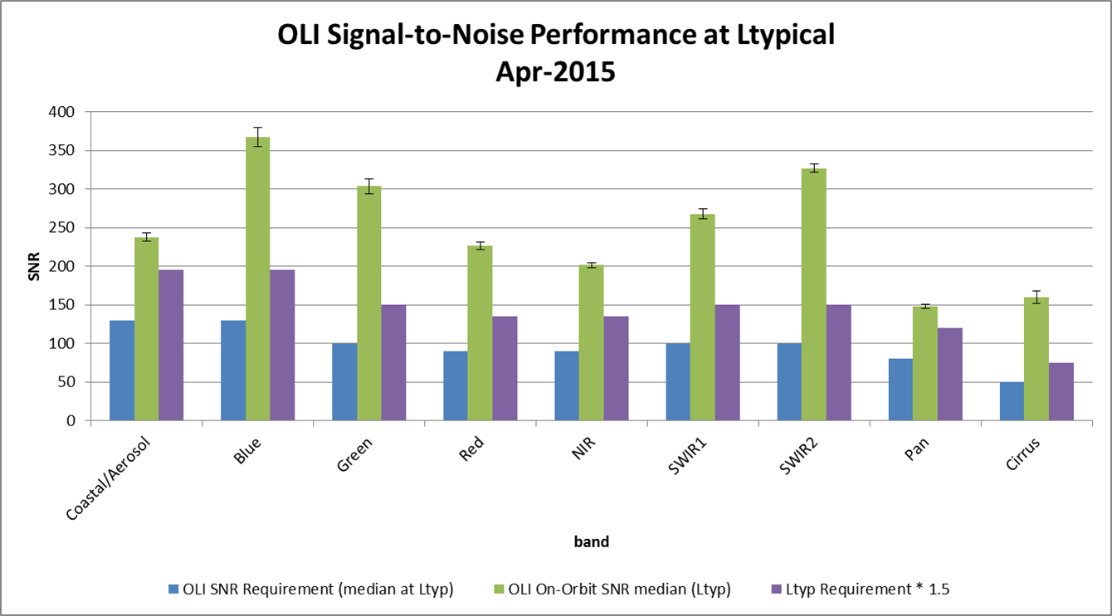
Landsat-8 Radiometric Performance
OLI radiometric stability, worst case band, about 1% over 2 years; most bands ~0.3%
SNR continues to exceed requirements
Continuing quarterly relative gain updates

Slide 8
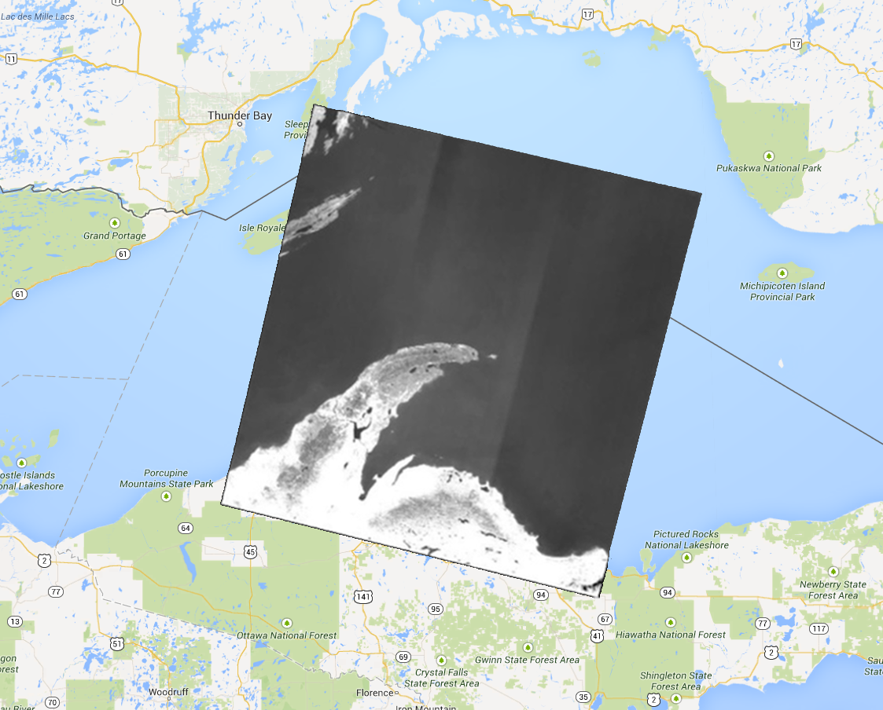
L8 TIRS Out-of-field Stray Light

Slide 9
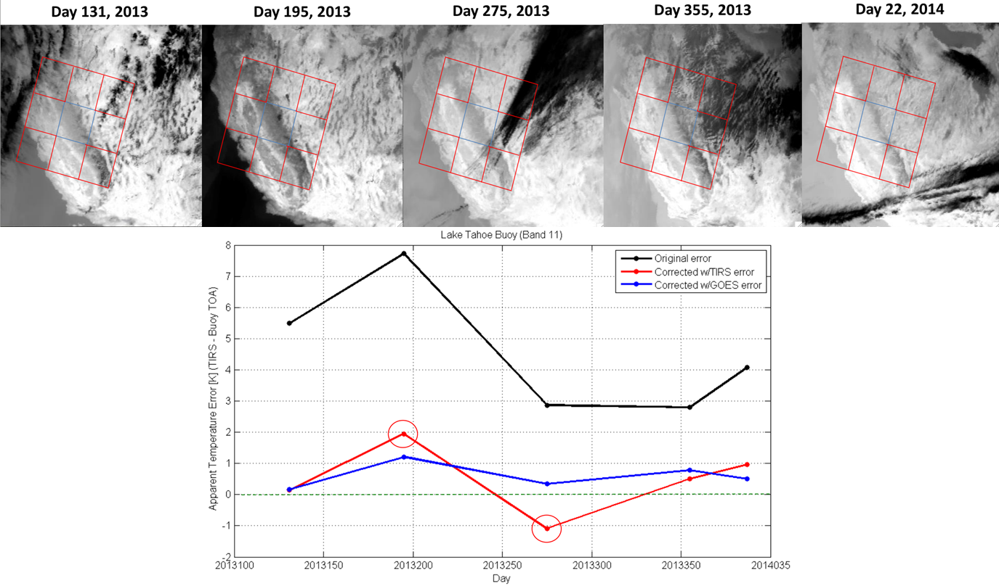
TIRS Stray Light Correction Results (Preliminary)
Model of stray light determined by optical model
Effectively a point spread function for each detector
Verified by comparing PSF to special lunar scans
Original
GOES Correction
TIRS Correction
Method 1:
Convolves PSF with GOES imagery to estimate stray light per pixel in TIRS image
Subtract stray light estimate from TIRS image
Method 2:
Convolves PSF with TIRS imagery, scene before and after
Where no TIRS imagery, use nearest TIRS pixels
Subtract stray light estimate from TIRS image

Slide 10
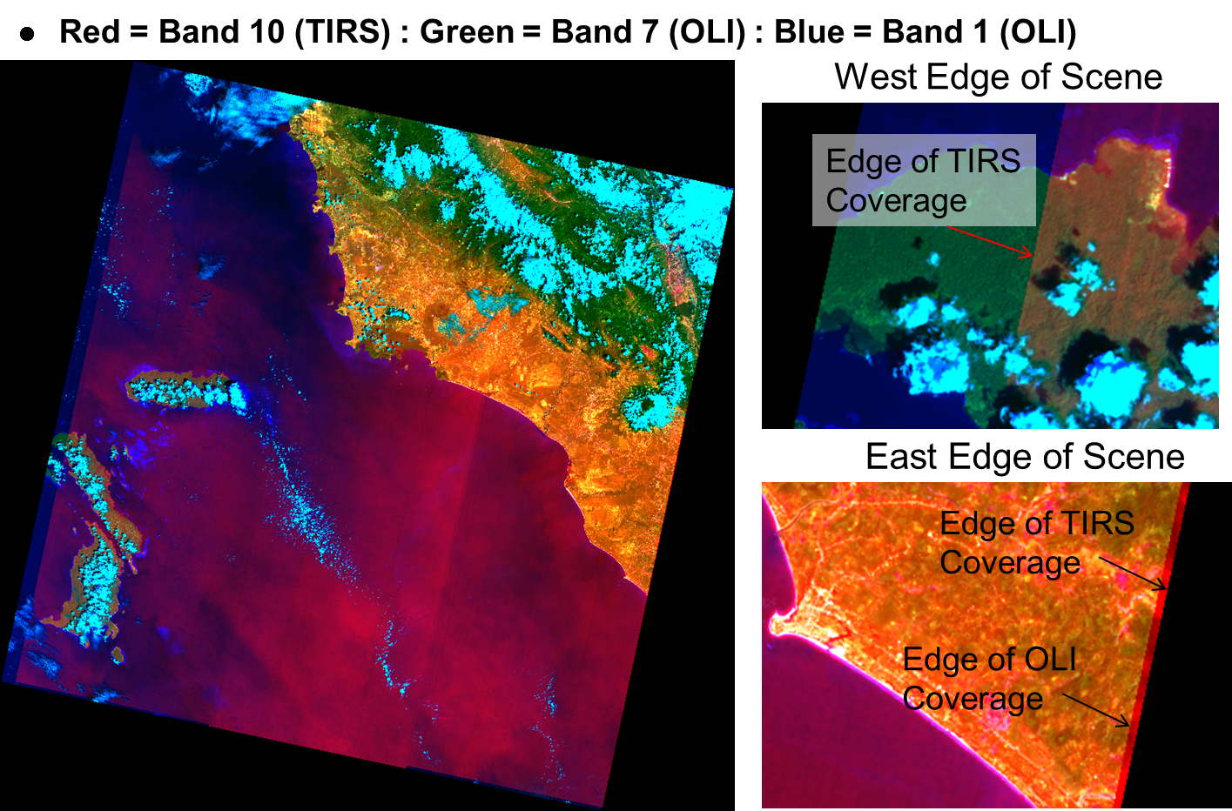
TIRS Scene Select Mirror Anomaly
SSM encoder current began increasing last Summer/Fall
Reached yellow limit December 19, 2014
Encoder powered down
Product generation system couldn’t handle no encoder
TIRS imagery zeroed through early March
Software updated April 23, 2015
TIRS electronics switched to side-B March 4, 2015
Radiometric and Geometric quality attained once more
Typical OLI-TIRS alignment
OLI-TIRS alignment without encoder

Slide 11
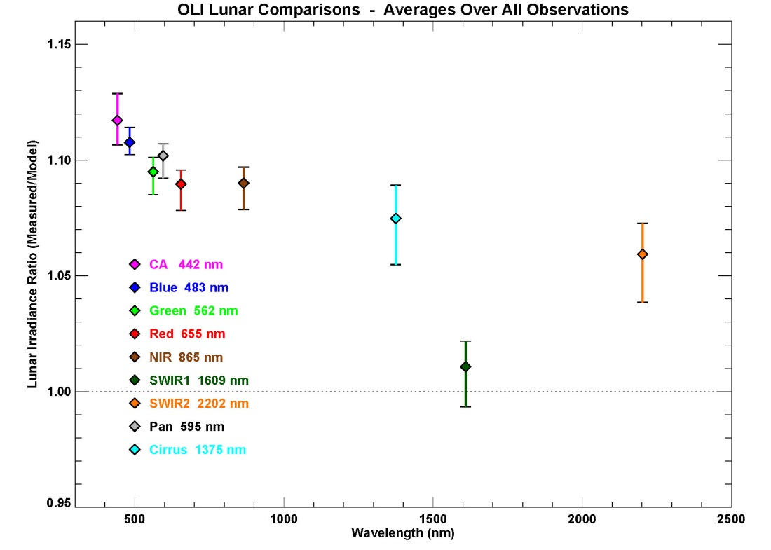
L8 OLI Lunar Calibration
Lunar trending follows other cal methods
lunar
Absolute offsets are relatively large — cause is being studied
Notes:
Landsat 8 is the first Landsat to look at the Moon

Slide 12
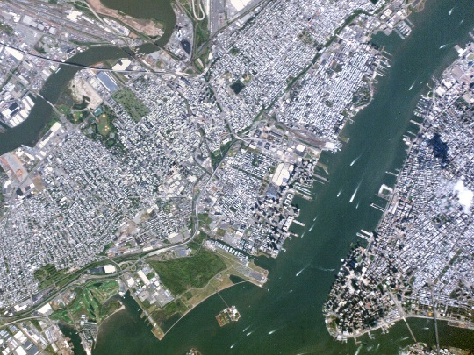
USGS Imagery Assessments 2013-2015
Assessments:
ResourceSat-2 AWiFS-2, VNREDSat-1, KOMPSAT-3, WorldDEM™, PROBA-V, Planet Labs (Doves-3 & 4, Flock-1a, Flock 1-c), SkyBox-1 & 2, SPOT-7
Future assessments:
More Planet Labs satellites, CBERS-4, KompSat-3A, DMC-3 constellation
Higher-Level Product Quality Monitoring
Snapshot of results:
Spatial resolution is not just GSD
More Pixels do not always mean More Resolution
Aperture makes all the difference!
Small aperture systems: more noise, resolution issues
Compression Artifacts – varying degrees
More and more systems using compression
Minor impact to detection, more impact to science
Pictures vs. Measurements
Follow-on satellites, or pairs, are very similar
AWiFS-1/AWiFS-2, Pleiades-1a/-1b, SPOT-6 & 7, etc.
Planet Labs Image over NYC 07 Sep 2014

Slide 14
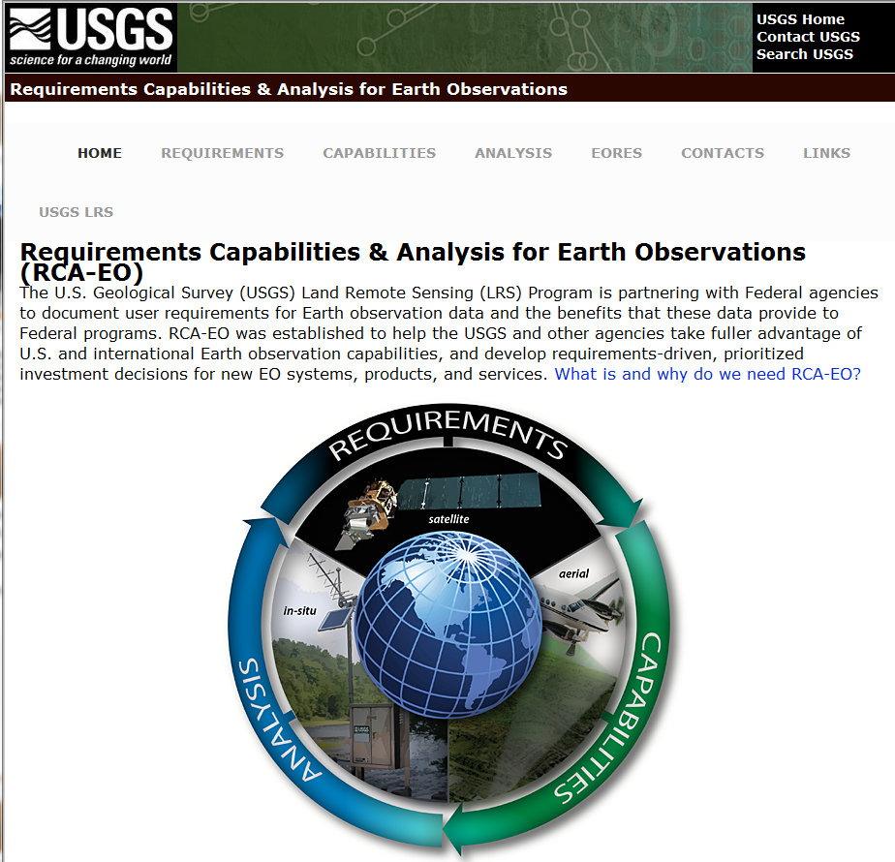
Requirements Capabilities and Analysis for Earth Observations (RCA-EO)
Strong partnership between USGS and NOAA for infrastructure development, data sharing, and assessment of civil Earth Observation user requirements and capabilities
Supporting and benefitting from the OSTP National Earth Observation Assessments (EOA)
Collaborating with DOI and other civil agencies in assessing their needs
http://remotesensing.usgs.gov/rca-eo/
Purpose:
Support program planning and budget justifications – informed by user needs
Improve the impact of USGS science and operational products and services
Quantitative analyses to guide decisions for research investments and technology innovations
Identify new Earth Observation solutions or capability gaps to better meet user needs

Slide 15
RCA-EO Components
RCA-EO Components
EORES
User Requirements
Database of system-independent user needs
Observing Systems Capabilities
Database of current and future Earth observing systems
Requirements
Capabilities
Analysis
Value Tree Information (VTI)
Organizational program Earth observing input and capabilities mapped to the organization’s goals and objectives
Value
Tree
Earth Observation Requirements Evaluation System (EORES) and Analysis
Using EOA VTI to elicit User Requirements
Across all Civil Federal Agencies
RCA-EO is driving toward a user needs driven business management process to address mission priorities, and incorporate evolving Earth observing technology
15

Slide 16
National Earth Observation Assessment
National Earth Observation Assessment (EOA 2012)
http://www.whitehouse.gov/sites/default/files/microsites/ostp/NSTC/national_plan_for_civil_earth_observations_-_july_2014.pdf
Conducted to inform the National Plan for Civil Earth Observations
Identified a portfolio of observing systems relied upon by the Federal agencies
Provided a cross-cutting and integrated look at observing capabilities (satellite and non-satellite systems)
Quantified the impact of those observing systems in delivering societal benefit
Second National Earth Observation Assessment (EOA 2016) underway
Refined process to capture details related to impacts and allow analysis of value information
Tri-annual National Federal Government assessment
Both use an organizing framework for the assessment of 13 Societal Benefit Areas (SBAs) plus Reference Measurements
Reference Measurements include geodesy, bathymetry, topography, geolocation, etc.
Agriculture & Forestry, Biodiversity, Climate, Disasters, Ecosystems (Terrestrial & Freshwater), Energy & Mineral Resources, Human Health, Ocean & Coastal Resources & Ecosystems, Space Weather, Transportation, Water Resources, Weather
SBA Teams each produced an assessment for their SBA

Slide 17
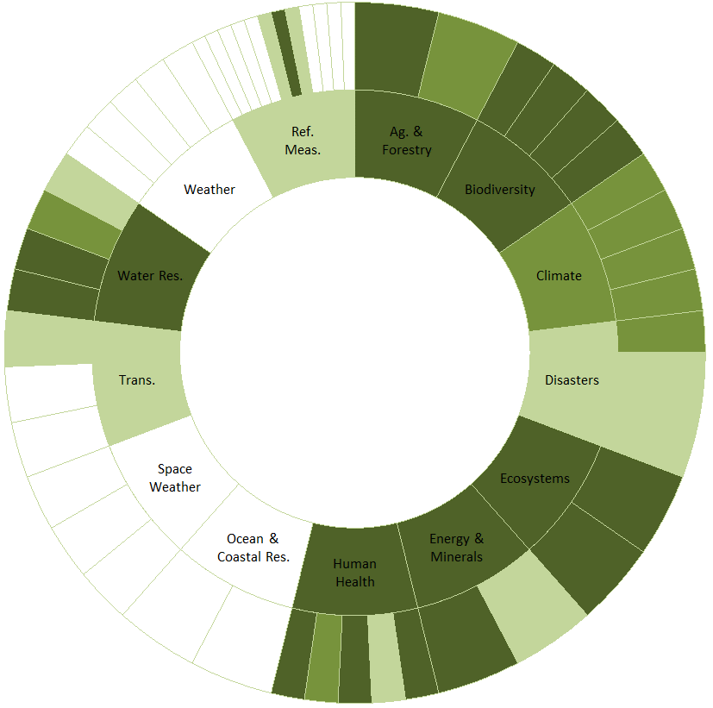
Landsat – EOA 2012 Results
Assessment of 362 US Earth Obs. Systems (EOS) (space, air, land, and sea platforms) contributions to 13 Societal Benefit Areas (SBAs)
Landsat was 3rd out of total, and Landsat 2nd “most critical SBA impact” of 132 satellite systems (GPS=1)
10 of 13 (77%) SBAs use Landsat data
Landsat has a Significant Impact on 6 SBAs;
Ranked #1 for contributions in Biodiversity, Ecosystems, and Energy
Ranked #2 for contributions in Agriculture/Forestry, Climate, Human Health, and Water
31 of 52 (60%) Sub-SBA Areas utilize Landsat
Landsat had a Significant Impact on 15 Sub-SBAs and a Moderate Impact on 6 Sub-SBAs
Societal Benefit Areas (inner ring)
Sub-Societal Benefit Areas (outer ring)
LANDSAT

Slide 18
Additional Activities
Joint Agency Commercial Imagery Evaluation (JACIE) Workshop collocated with ASPRS; 40-plus JACIE papers
April 12-14, 2016, Ft Worth, TX, http://conferences.asprs.org/Fort-Worth-2016/blog
http://calval.cr.usgs.gov/satellite-sensor-characterization/rst-presentations-publications/
Extensive support to the RCA-EO Project
Building “Capabilities” database
Developing analysis methods and processes
ESA Sentinel-2a
Archive Level 1c products available via USGS Earth Explorer; http://earthexplorer.usgs.gov/
ISRO ResourceSat-2
Starting agreement to archive ResourceSat-2 products over the U.S.
Land Change Monitoring, Assessments and Projections (LCMAP)
Architecture being built and tested, and Analysis Ready Data definition being published, and LCMAP Algorithms being developed
Preparing for Landsat-9 launch (Dec 2020) with NASA GSFC
Landsat 10 planning beginning
Studies: Sensor type, resolution, platform type or types, swath width, coverage, ….,
Notes:
- Planet Labs has improved optics and detectors since our earlier investigations
- CBERS-4 is of very high interest
- DMC-3 is to launch with in the coming weeks (we think) and has 75cm pan band, 3m VNIR. Interestingly, 100% of imaging capacity leased by Beijing company

Slide 19
Near-term GSICS Activities
Recommended solar spectrum for calibration purposes
Total and spectral solar irradiance — referenced to which instrument(s) and measurement(s) ?
Spectral resolution — accommodation of hyperspectral sensors
Coordination with CEOS-WGCV
Lunar inter-calibration
Evaluating uncertainties in the ROLO lunar irradiance model (to be discussed in GRWG VIS/NIR Lunar session, talk 4d)
Coordination with CLARREO (Tom is on the Science Definition Team)

Slide 20
Future Collaboration
Jointly support CEOS efforts
Interoperability
QA4EO
Calibration test sites and processes
Continue to work cross-calibration and validation
RadCalNet
PICS
Lunar
LPCS
Potential Joint Agency efforts
Become more involved in GRWG efforts, as needed
Cross calibration/comparison discussions welcomed
Notes:
LPCS: Land Product Characterization System

Slide 21
Thank You!
り
が
う
あ
と
Notes:
LPCS: Land Product Characterization System

