Slide 1
The GSICS Procedure for Product Acceptance ( GPPA )- New Challenges
Manik Bali and Lawrence E Flynn
March 1 , 2016

Slide 2
Outline
Introduction
Challenges
EUMETSAT Product becomes Operational
New Challenges [Proposed Solutions, Discussions]
GPPA for GSICS Model/Data Resources and other entities
GPPA Tool
Summary and Discussion

Slide 3
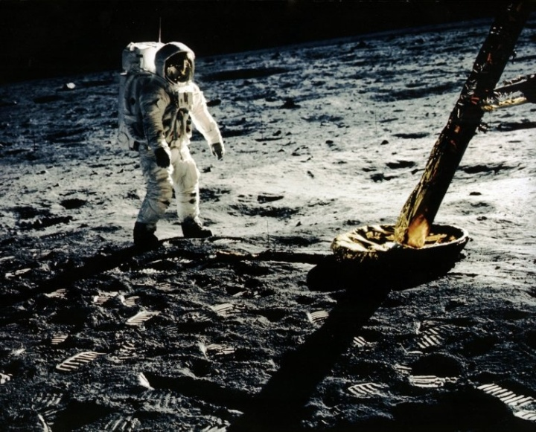
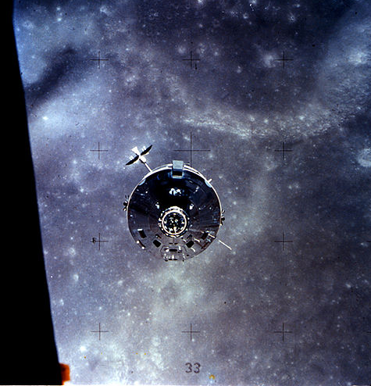
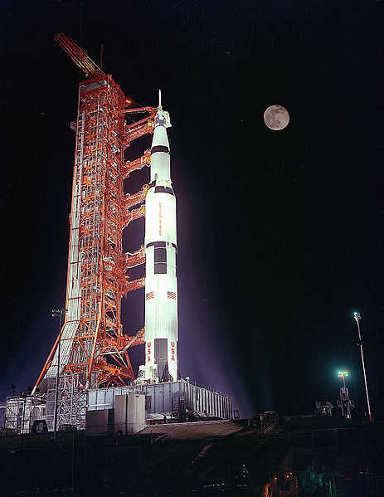
GPPA Introduction
The GPPA is the GSICS:
Product developers pathway to obtain a “Stamp of Approval” for a potential product
Data users window to GSICS product quality and “fitness for purpose”
Governing body reference for judging GSICS product fitness
Challenges
Time taking review process ~ years
No GPPA progress Monitoring
Un acknowledged work
Scant User Feedback
No GPPA for Resources/Deliverables
Operational
Phase
Product is fully accepted by GSICS Executive Panel (EP) and maintained within GSICS and
distributed to the public.
Product Logs, Data Usage
Preoperational
Phase
Product version Control Data released with disclaimer
C Operations and distribution plan Data user’s guide T=180 days
Demonstration Phase
Founding concepts Supporting models Data Archived and Free Access
ATBD Peer-Publications Product quality indicator description
Traceability document T=365 days
Submission Phase
Fill out GSICS Product Acceptance Form ( GPAF )

Slide 4
GPPA Introduction
Actions taken to meet challenges
Past Action: GCC to take a lead in discussing the GPPA with GSICS members to reduce the amount of time needed to move through the phases.
Actions from EP-16
Action: a) GCC to finalize the high-level categorization of GSICS holdings and deliverables, ensuring that actual or planned products can be mapped to these categories, indicating a target audience, delivery or access mode;
Action: b) GCC to propose appropriate review/acceptance mechanisms for each category of GSICS products (with a distinction between acceptance of the algorithms, and acceptance of the production of calibration coefficients or calibrated radiances).

Slide 5
EUMETSAT MSG 2/3 – SEVIRI product becomes Operational
Worked with EP and WMO to get appreciation certificates for the GPAT members.
Reviewed GPPA -> Identified time consuming segments , suggested product specific tuning.
EP decision-GCC can suggest GPPA specific for product based on situation at hand, resources and GSICS goals.
Resulted in a GPPA that enabled transition to Operational status with minimal overhead to the producer.
Progress depiction on Wiki-> Reconstructed progress of GPPA over the years and setup a wiki page ( See here ). EUMETSAT provided updated
Product User Guide,
ATBD ( updated uncetainities)
Impact Assessment report ( Added value through not required by GPPA at the time).
Applied the tuned GPPA on MSG 2/3 – IASI product.
Product was reviewed by GPAT and in 6 Months product declared Operational

Slide 6
New Challenges-Challenge-1
EP approved -> Exempt Clause can be applied at any stage of the GPPA.
EP Approved -> Delegate Clause. GPAT members can delegate their review and get review done under their supervision by a designate.
Situation at hand-> Reduced number of GPAT reviewers can be assigned if product fully backed by any one of these
Internal impact/assessment reports such as those presented by EUMETSAT.
Publications
Direct usage (plan) of the product by the agency is demonstrated.
KMA, ISRO, EUMETST response from GPAT members was overwhelming however
For new products some members have expressed worries about not many GPAT reviewers responding to review requests
olution
Suggestions for Producers
Presentation of the product-> Product instills confidence among users and reviewers.
Product need to be strongly backed by a user requirement and also by the agency.
Easy to use*.
Use cases show marked benefit by using product.
Backed by Published work.
*Agree for a exchange review i.e commitment to review each other’s product.
*Example of Ease of use ( Ref: User Feedback+: Randhir Huda)
We give -> L(LEO)=-offset/slope+(1/slope)*(L(GEO))
Easy ->Corrected radiances = slope*L(GEO) + offset
Start producing a product with user as part of the process.

Slide 7
New Challenges-Challenge-2
Producers face additional overhead to submit or mature product
Overhead on producers when a transition of maturity occurs for eg. Maturity indicator in filename
Do we reprocess the entire product to bring it to the maximum maturity Or have slots of fixes maturity in time ?
GDWG-> creating or moving data adds to work.
To avoid these overheads
We need to design a processing chain that requires minimal changes to during maturity transition.
Suggestions ?

Slide 8
New Challenges-Challenge-3
Products which have stopped being produced
Do we maintain their maturity?
Should we assign new/higher/lower maturity to them ?
For eg. Kalpana, IASI-A
Upcoming Classical Products
Agencies that have experience with producing classical products -> Can they directly submit to Pre-Op stage. ?

Slide 9
Proposed Classification of Entities(Talk 2.s)
Core products
For e.g. Classical products, sequence of bias adjustments
Models and Data Sets
Tools
Documents
Resources and Documents( external)

Slide 10
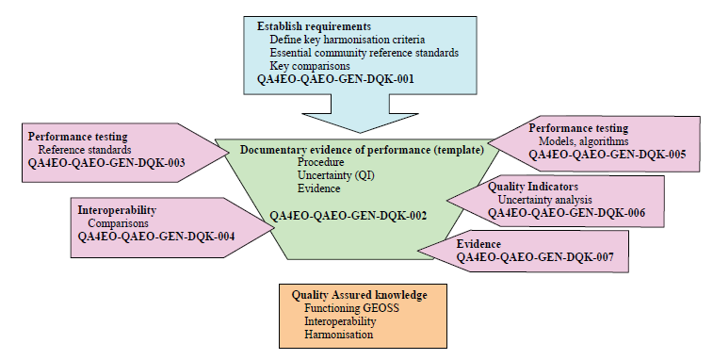
QA4EO - Guidelines
The GSICS Procedure for Product Acceptance (GPPA)
“
The Quality Assurance Framework for Earth Observation consist of ten distinct guidelines linked in the Guidelines Framework
“
Data Producer
(GPAF)
Data
Reviewer
(GPERF)
Data User
( GPERF)
GSICS Executive Panel
Acceptance is through meeting GSICS Goals.
Maturity is Acceptance+ satisfying user
Guidelines address
Quality Indicators
Traceability
Reference (measurement)Standard
Uncertainty
Ref: QA4EO The Guide

Slide 11
Action: b)
Acceptance and maturity for
Proposed Classification of Entities(Talk 2.s)
Core Products
Classical Products/ Products connected with ECV/FCDR ->Directly meet Follow GISCS/CF Conventions.
GSICS Resources and Documents
GPRC/ICVS/Corrections not following GSICS convections but meeting GSICS goals.
Models and Data Sets etc
For eg. GIRO/SBAF/Solar/Lunar
Intermediate Datasets used to create core products/Pre-Launch
Tools
For eg SNO Matchup/Bias Monitoring, Readers/SBAF
Acceptance and Maturity of GPPA Can be applied
Acceptance and Maturity of the GPPA Can be applied Partly
Accepted in the subgroup.
One or all conditions to be fulfilled
Models/Data sets published and peer reviewed and internationally accepted.
Have users within the group.
Accepted in the subgroup.
One or all conditions to be fulfilled
Models/Data sets published and peer reviewed and internationally accepted.
Have users within the group.

Slide 12
GPPA - Tools
Submission
Developed tools to make submission easy
Create a wiki Page
Submission can be made directly to the wiki
Discussions can be done on the wiki.
Metadata data and filenaming
GCC developed tool that can covert agency specific meta data to GSICS specific metadata and filename.

Slide 13
GPPA Tool Converts Agency2 GSICS Format
Monitored Instrument
Reference Instrument
Inter-comparison bias and offset available on THREDDS/Coll/FTP Serv. in Agency Format
Inter-comparison bias and offset in
GSICS Format
GPPA Scripts
Downstream services
For eg SST / CH suite
Contact GCC for details

Slide 14
Summary
GPPA has been tuned according to needs and situation at hand.
The MSG 2/3- IASI product transitioned to operations short time.
Acceptance and Maturity for Proposed New Categorization has been presented. This has allowed a range of entities to be created and accepted in GSICS.
GPPA tool has been developed that can facilitate submission of products in GSICS Format.

Slide 15
THANK YOU

Slide 16
Discussion on GPPA for EUMETSAT
Review Pages
Review of Meteosat-2/3 Seviri - IASI product
Review SEVIRI MODI (DCC) Product
Review GSICS Prime Reference Product

Slide 17
SEVIRI – Aqua Modis DCC Product
http://gsics.eumetsat.int/thredds/catalog/msg3-seviri-aqua-modis-demo-nrtc/catalog.html)

Slide 18
Fill out Sections I, II, III.1.A.1, and III.1.A.2 of the GSICS Product Acceptance Form (GPAF). Also, fill out Section III.1.B (ATBD) of the GPAF, but during the Submission Phase the ATBD needs only to be a preliminary version. The ATBD could be a journal article, technical memorandum or other documentation of the method used to make the product.
Who: Product provider
Done
Submit the GPAF and preliminary ATBD for review to the GSICS Product Acceptance Team (GPAT) via the GSICS Coordination Center (GCC) Deputy.
Who: Product provider
Done
Determine if the GPAF is filled out correctly and decide if the product theoretical basis is adequate and the product scope is within the GSICS domain.
Who: GPAT
Due: 6 weeks after the GPAF submission
Pending
GPAT feedback given to the Product provider.
Who: GCC Director
Due: 7 weeks from GPAF submission
Pending
Upload a sample file to a GSICS data server if GPAT feedback is affirmative.
Who: Product provider, GDWG Chairman
Due: One week after GPAT feedback regarding GPAF form submission
Done | Month to month file names differ but can be fixed.
Determine if the sample file follows the GSICS netCDF and file naming conventions.
Who: GDWG Chairman
Due: 2 weeks after successful product sample file upload
Pending
Remediate any GPAF issues according to the GPAT feedback.
Who: Product provider, GCC Director
Due: Within 20 days after sending GPAT feedback to the Product provider
Pending
Once all issues are resolved, the product enters the Demonstration Phase.
Who: GCC Director in consultation with the GPAT
Due: Within 90 days of the GPAF submission
Pending

