Slide 1
WMO GSICS Web-Site Discussion
2016 GSICS Joint Meeting on Research and Data Working Groups
Tsukuba, Japan
29 February to 4 March 2016

Slide 2
GSICS web site requirements
To provide web content pages to easily guide the user to the GSICS calibration product and associated documentation for implementation
To provide the user information of ongoing GSICS calibration activities in the various sub-groups and to provide users of anticipated sensor calibrations and methodologies
The user can then check on the web site for progress or have contacts for additional information

Slide 3
Lessons from NASA CERES project
Archiving and Distribution have different goals, both of which are very important
Archiving is about processing integrity, input datasets and methodologies, and version control
The archived datasets survive into perpetuity at datacenters long after the project ceases.
In case the dataset is deleted, it can be regenerated using the archived production software to replicate the deleted dataset
Distributing is about informing the user, which dataset best for the users application
The user wants very succinct information to make the selection, wants to avoid reading vast quantities of information. Expects the dataset project to provide the best dataset, with all outliers removed

Slide 4
Product Filenames
In the past both archiving and distribution were filename driven
If the user only sees the filename it is very difficult to select based on a filename that was customized for archiving
GSICS has the data product catalogue, which masks the GSICS filename
The GSICS product name than gives the filename oriented for the users

Slide 5
Current Product Catalogue Page
Calibrated or Monitored Instrument | Product type | Product Maturity level | Version | Dataset start | Dataset end | Calibration reference | Docs URL | Data URL | Bias monitoring link
GOES-13 imager | Near-Real Time correction | Preoperational | 1 | 2013-01-16 | present | Aqua-MODIS Collection 6 band 1
Excellent job of the GDWG to provide a product catalogue
I believe the users top priority is to find if the instrument has been calibrated by GSICS
Some sensors have various names, SEVIRI, MSG, Meteosat-8/11
Can the various product levels and product maturity be briefly explained, can users publish with preoperational?
The calibration reference must be more detailed with reference instrument versions and band information
Would be nice to have the bias monitoring links also on this page

Slide 6
Current Product Catalogue Page
Algorithm Type
SNO
Ray-matching
Rayleigh
Lunar
DCC
Algorithm Type
GEO-LEO VIS or IR
LEO-LEO VIS or IR
GEO-GEO
Precess-LEO
Is this not the relationship of the reference and monitored sensor?
Data producer, Data provider, Instrument operator
Will there be competing GSICS calibrations for a given sensor, is the GSICS calibration endorsed by the sensor calibration team
Taken from Manik taxonomy presentation

Slide 7
GSICS WMO web site

Slide 8
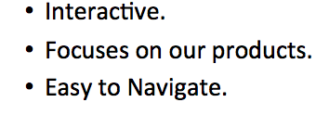
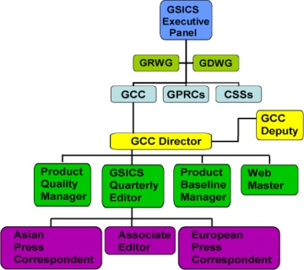
About GSICS
Appointed by WMO
Guide & develop GSICS
Conducts progress review
Chair: Mitch Goldberg
GSICS EP
GRWG
GPRC
GCC Dir.
CSS
GDWG
Product Quality Manager
GSICS Quarterly Editor
GCC
Product Baseline Manager
Web Master
US/European/
Asian Correspondent
GCC Deputy
IR
UV
VIS
VIS
Hover the mouse and get a popup of relevant info( or leads to a static page of info
Courtesy of Manik Bali

Slide 9
Information about each subgroup
Sub-group products currently available, short descriptive statement about the product
Provide references for publications, which use the GSICS calibration coefficients
The user likes to see short descriptions with links or interactive hovering to obtain more information about certain components of the short description
Starting with a long document, makes it difficult for a user to figure out what is important.
Anticipated products and methodologies being developed
Anything in being planed for 2016
Contact information

