Slide 1
Closing the GEO-ring Tim Hewison
Special Issue of the IEEE TGRS on “Inter-Calibration of Satellite Instruments”:
Special Issue of the IEEE TGRS on “Inter-Calibration of Satellite Instruments”:

Slide 2
GSICS Corrections for GEO-LEO IR
In 2016, 6 GPRCs are preparing for their GEO-LEO IR GSICS products to enter new modes:
EUMETSAT and NOAA -> Operational mode
JMA -> pre-operational mode
ISRO, CMA, KMA -> demonstration mode
GEO-LEO VIS GSICS DCC products coming soon!
For the first time we will be able to inter-calibrate the geostationary ring to the same reference!

Slide 3
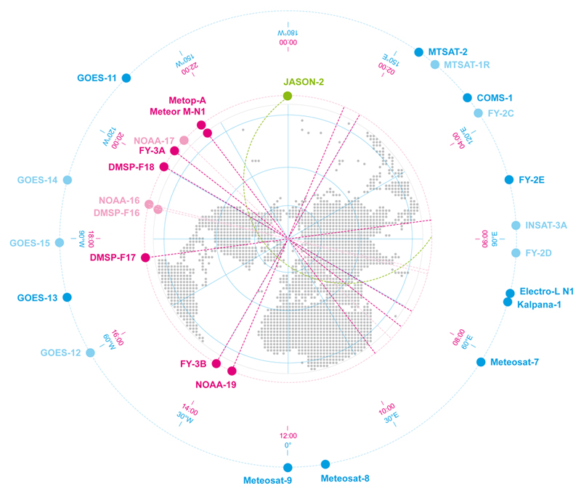
Linking the GEO ring
Schematic Example of GEO and LEO Earth Observing Satellite
Showing GEO sub-satellite longitude and equator crossing time for sun-synchronous LEO satellites

Slide 4
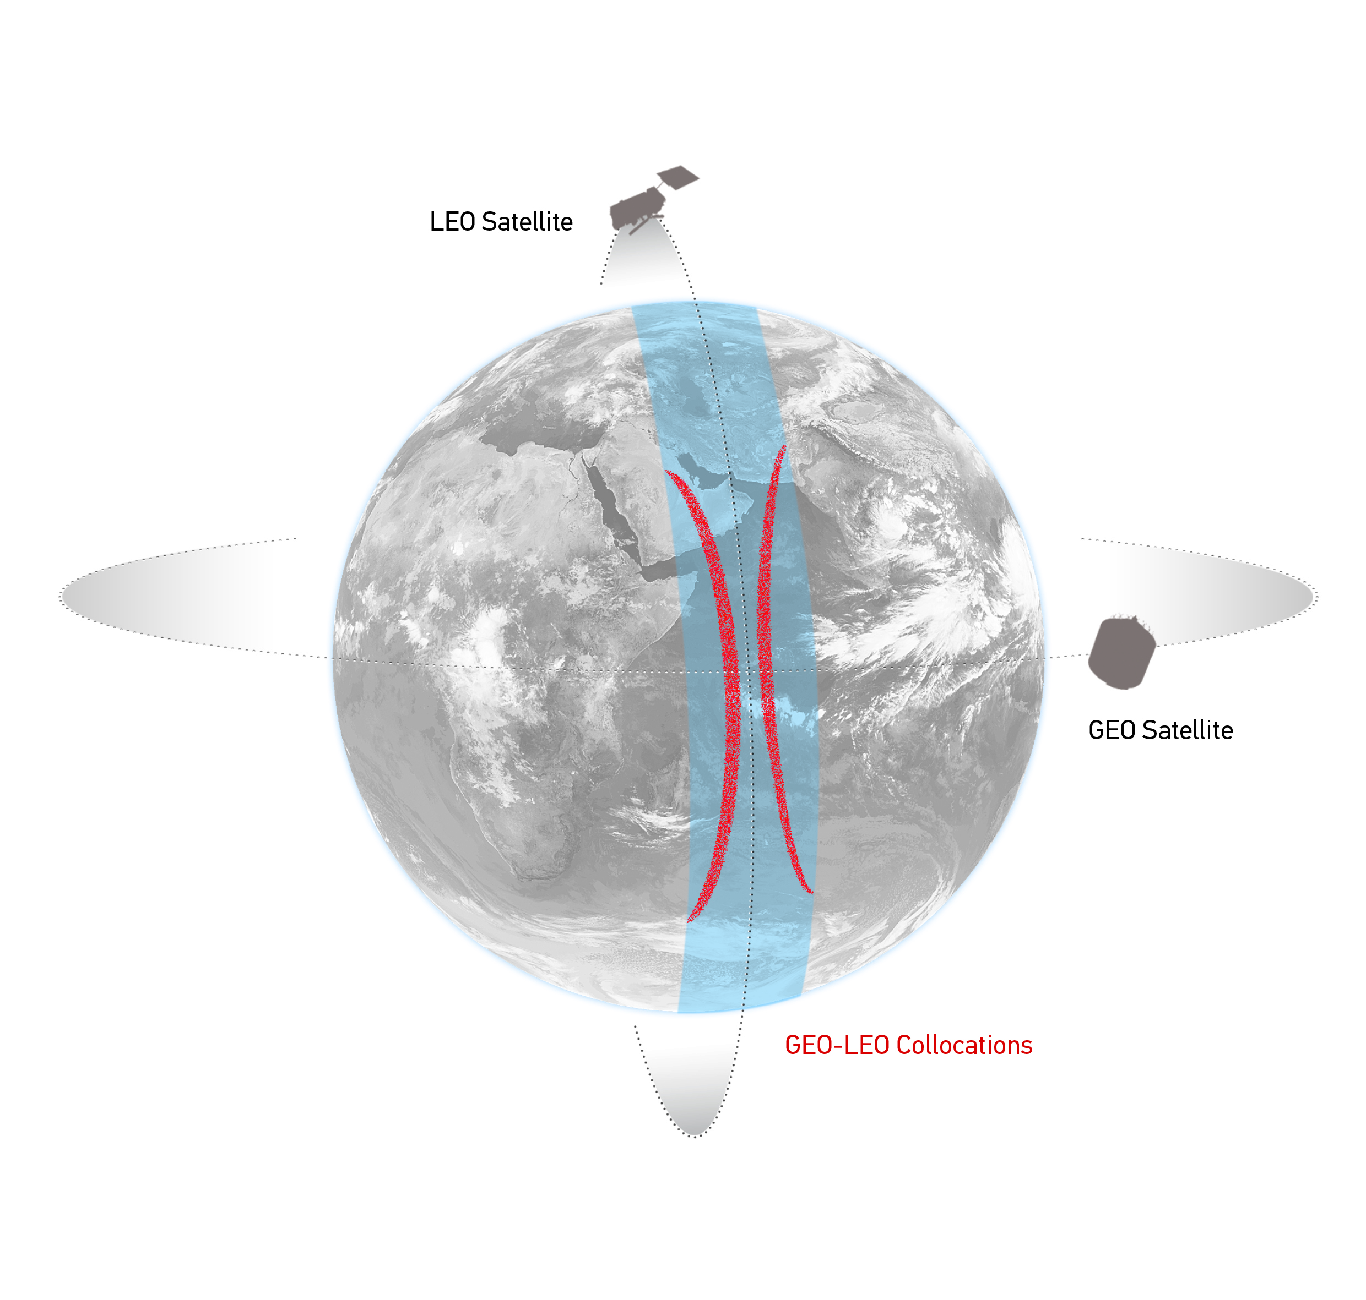
GEO-LEO IR - Hyperspectral SNO
Simultaneous near-Nadir Overpasses
of GEO imager and LEO sounder
Select Collocations
Spatial, temporal and geometric thresholds
Schematic illustration of the geostationary orbit (GEO) and polar low Earth orbit (LEO) satellites and distribution of their collocated observations.

Slide 5
Linking the GEO ring
GSICS Corrections for GEO-LEO IR
All using Metop/IASI as hyperspectral references
Solid lines = Pre-Operational
Dashed lines = Demonstration
Dotted lines = Prototype

Slide 6
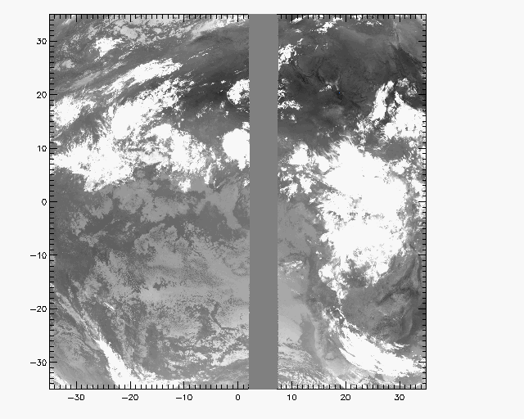
GEO-GEO IR – Broadband SNO
Simultaneous near-Nadir Overpasses
of GEO imager pairs
Select Collocations
Spatial, temporal and geometric thresholds
Narrow longitudinal strip of collocations
Allows continuous comparisons 24/7
Investigate midnight calibration problems
Non-identical Spectral Responses
Need Spectral Band Adjustment Factor
Based on IASI observations
Or reference profiles + RTMs
Example Image of Meteosat-9 10.8μm Channel Grey area shows collocated MSG2-MSG1 pixels

Slide 7
Linking the GEO ring
GEO-GEO Comparisons
Based on collocated observations
GEO imager pairs
Need SBAFs

Slide 8
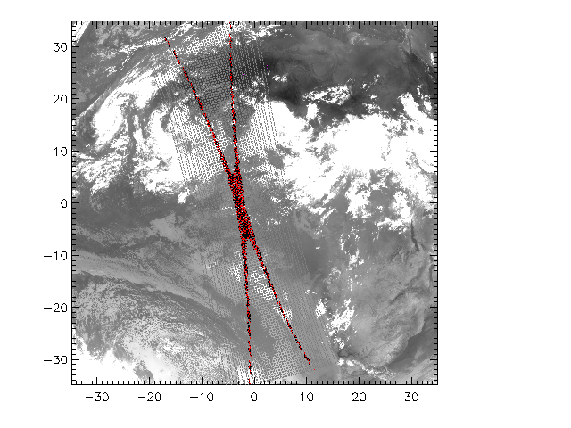
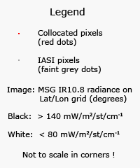
Collocation Criteria
Simultaneous near-Nadir Overpasses
Only night-time data ΔLat<35° ΔLon<35° Δt< 5 min Δsecθ < 0.01
GEO-LEO
GEO-GEO
Restricted to ~tropics
~1000 collocations/orbit/night
Restricted to narrow strip
Can extend to cover 24hr
Example Image of Meteosat-9 10.8μm Channel Red points show collocated MSG-IASI pixels
Example Image of Meteosat-9 10.8μm Channel Grey area shows collocated MSG2-MSG1 pixels

Slide 9
Linking the GEO ring
Comparing GEO-LEO and GEO-GEO Differences
To Validate Uncertainty estimates
Ensure consistency
Generate global L2 products
Ensure consistency

Slide 10
Strategy for closing the GEO Ring - Delhi
First step: Identify one date which is common to all GEOs
(without stray light or midnight effect)
Second step: to investigate the GEO-GEO comparison across the GEO ring. WHO?
Rob mentioned that the climate community would test the result of this work. IOGEO
Action: Tim to ask ECMWF for double differencing of geostationary ring. Done!
Action: IMD/ISRO to contact the IMD NWP and NCMRWF about the same topic.
Action: Tim to conduct a survey to identify a date among GPRC so that they produce the GSICS corrections for that date and provide them to Dave. Done!
Dave suggests taking 0/3/ 6/9 GMT for that date.
Action: Dave to report on the analysis of these data.
Action: Tim to provide SBAF tool to support this analysis
CMA are interested to compare the FY-2 observations to other instruments.

Slide 11
Case Studies
Chose a common date:
1 March 2014 (not too eclipsey?), + 20 March 2014 – Equinox
Chose time slots:
00z, 03z, 06z, 09z, 12z, 15z, 18z, 21z, 24z
Chose channels:
4μm, 7μm, 11μm, 13μm
Conditions:
All sky? Clear sky? How to select?
Products:
Full disc radiance images after GSICS Correction?
Statistics in overlap area
How to define?
Calculate SBAFs …(next slides)
Comparison with ECMWF? … (next slide)

Slide 12
Data Availability
 |  | 2014-03-01 |  |  |  |  |  |  |  |  | 2014-03-20
 |  | 00z | 03z | 06z | 09z | 12z | 15z | 18z | 21z | 24z | 00z | 03z | 06z | 09z | 12z | 15z | 18z | 21 | 24z
GOES-15 | 135°W | ☑ | ☑ | ☑ | ☑ | ☑ | ☑ | ☑ | ☑ | ☑ | ☑ | ☑ | ☑ | ☑ | ☑ | ☑ | ☑ | ☒ | ☑
GOES-13 | 75°W | ☑ | ☑ | ☑ | ☑ | ☑ | ☑ | ☑ | ☑ | ☑ | ☑ | ☑ | ☑ | ☑ | ☑ | ☑ | ☑ | ☑ | ☑
Met-10 | 0°E | ☑ | ☑ | ☑ | ☑ | ☑ | ☑ | ☑ | ☑ | ☑ | ☑ | ☑ | ☑ | ☑ | ☑ | ☑ | ☑ | ☑ | ☑
Met-7 | 57°E | ☑ | ☑ | ☑ | ☑ | ☑ | ☑ | ☑ | ☒ | ☑ | ☑ | ☑ | ☑ | ☑ | ☑ | ☑ | ☑ | ☒ | ☑
INSAT-3D | 82°E | ☑ | ☑ | ☑ | ☑ | ☑ | ☑ | ☒ | ☑ | ☑ | ☑ | ☑ | ☑ | ☑ | ☑ | ☑ | ☒ | ☑ | ☑
FY-2D | 86°E
FY-2E | 105°E
FY-2F | 112°E
COMS-1 | 128°E
MTSAT-2 | 145°E | ☑ | ☑ | ☑ | ☑ | ☑ | ☑ | ☑ | ☑ | ☑ | ☑ | ☑ | ☑ | ☑ | ☑ | ☑ | ☑ | ☒ | ☑

Slide 14
ECMWF (Tony McNally)
Do ECMWF simulate global radiances from real geostationary satellite instruments?
i.e. accounting for the different sensors spectral response functions, sub-satellite position, etc.
Yes - but only for the (spatially averaged BTs) CSR/ASR data we assimilate.
2. Could you extract O-B statistics from different GEO imagers in their overlap areas?
We don't routinely, but it would be easy to do.

Slide 15
ECMWF (Tony McNally) … cont
a) Which GEO imagers you currently assimilate/monitor?
GOES-13/15, MET-10/7, HIM-8, MTSAT-2
b) Which you did you in 2014?
GOES-13/15, MET-10/7, MTSAT-2
c) What spatial/temporal sampling/averaging you use?
Input observations are the spatially averaged BTs produced by EUMETSAT and other agencies (typically 50Km)
d) Any limitations - e.g. viewing zenith angle, clear sky only,
Just clear sky (matching the observed product we receive) are done routinely, but we can do cloudy simulations and produce statistics for a dedicated period of your choice. This is quite expensive though ...

Slide 16
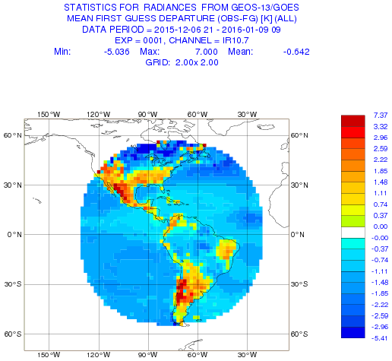
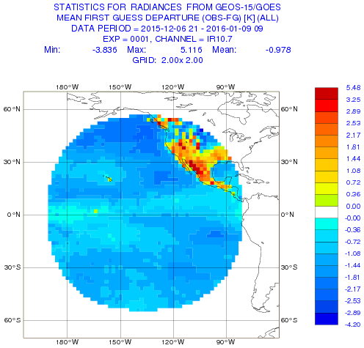
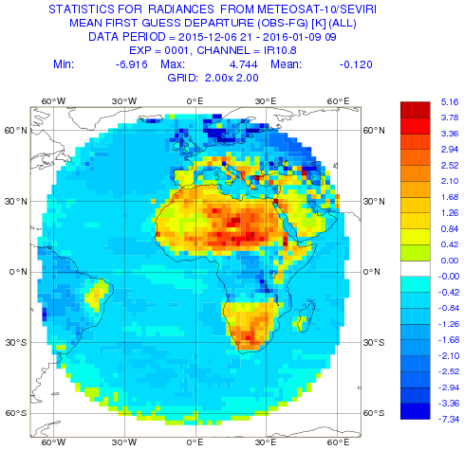
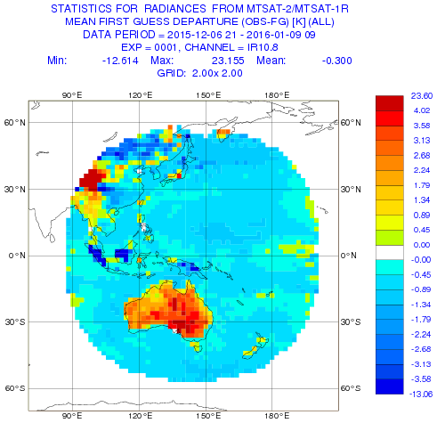
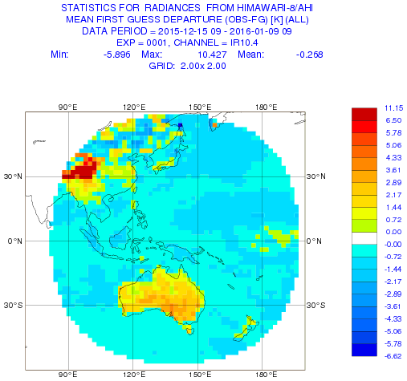
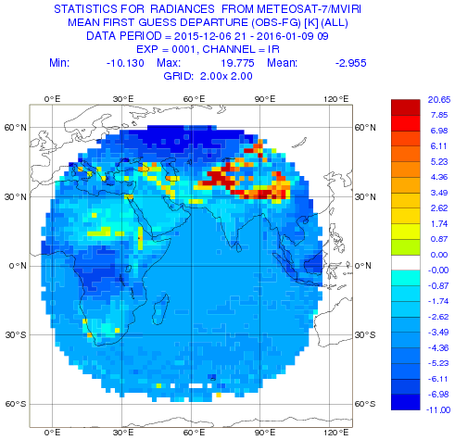
ECMWF Radiance Monitoring
http://www.ecmwf.int/en/forecasts/charts/obstat/?facets=Data%20type,Geostationary%20radiances

Slide 17
ECMWF Radiance Monitoring
http://www.ecmwf.int/en/forecasts/charts/obstat/?facets=Data%20type,Geostationary%20radiances

Slide 18
Defining Overlap Area
Could apply geometric alignment criteria: For GEO-LEO IR we use:|secθ₁|/|secθ₁|<0.01
Rule of Thumb:
maxsec=0.01
lonmin=(a.sslon+b.sslon)/2-maxsec*4500./abs(a.sslon-b.sslon)/2
lonmax=(a.sslon+b.sslon)/2+maxsec*4500./abs(a.sslon-b.sslon)/2
e.g. a.sslon=0°E, b.sslon=45°E, lonmax-lonmin=1°
Maximum latitude=30°? 45°? 60°?
VIS – Only at Local Noon?

Slide 19
Sat | Lon | Lon/deg | dlon/deg | overlap/deg | overlap/km
 |  |  |  | 45.00 | 111
GOES-15 | 135°W | -135
 |  |  | 60 | 0.75 | 83
GOES-13 | 75°W | -75
 |  |  | 75 | 0.60 | 67
Met-10 | 0°E | 0
 |  |  | 57 | 0.79 | 88
Met-7 | 57°E | 57
 |  |  | 25 | 1.80 | 200
INSAT-3D | 82°E | 82
 |  |  | 4 | 11.25 | 1250
FY-2D | 86°E | 86
 |  |  | 19 | 2.37 | 263
FY-2E | 105°E | 105
 |  |  | 7 | 6.43 | 714
FY-2F | 112°E | 112
 |  |  | 16 | 2.81 | 312
COMS-1 | 128°E | 128
 |  |  | 17 | 2.65 | 294
MTSAT-2 | 145°E | 145
 |  |  | 80 | 0.56 | 62
GOES-15 | 135°W | -135
 |  |  | Minimum | 0.56 | 62

Slide 20
Discussion
CMA, KMA data availability?
Who will provide corrected GEO IR data?
Who will provide corrected GEO VIS data?
Who will analyse corrected GEO IR data?
Who will analyse corrected GEO VIS data?
Who interested in analysing GEO-GEO comparisons?
Anyone else want to generate SBAFs?
Who interested in analysing ECMWF data?

Slide 21
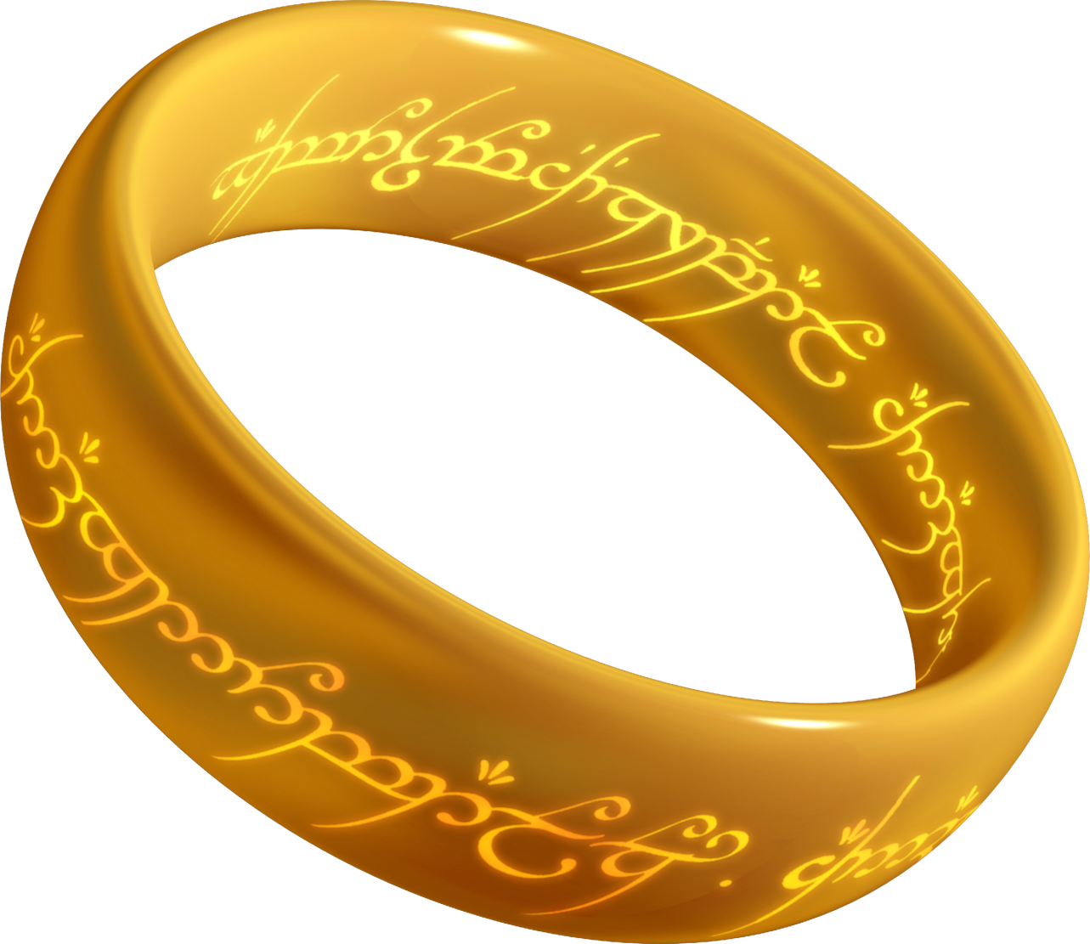
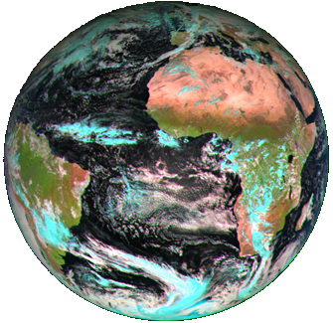
Thank You!

