Slide 1
Spectral Band Adjustment Factor (SBAF) Tool
David Doelling, Benjamin Scarino, Arun Gopalan, Rajendra Bhatt, Conor Haney
NASA-Langley
2016 GSICS Joint Meeting on Research and Data Working Groups
Tsukuba, Japan
29 February to 4 March 2016

Slide 2
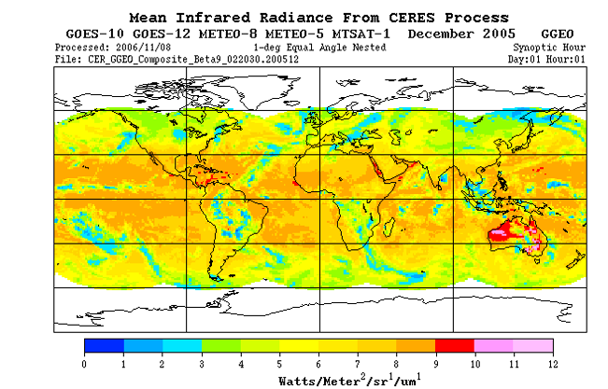
Geostationary IR composite, Dec 1,2005
GOES-10
GOES-8
MET-8
MET-5
MTSAT

Slide 3
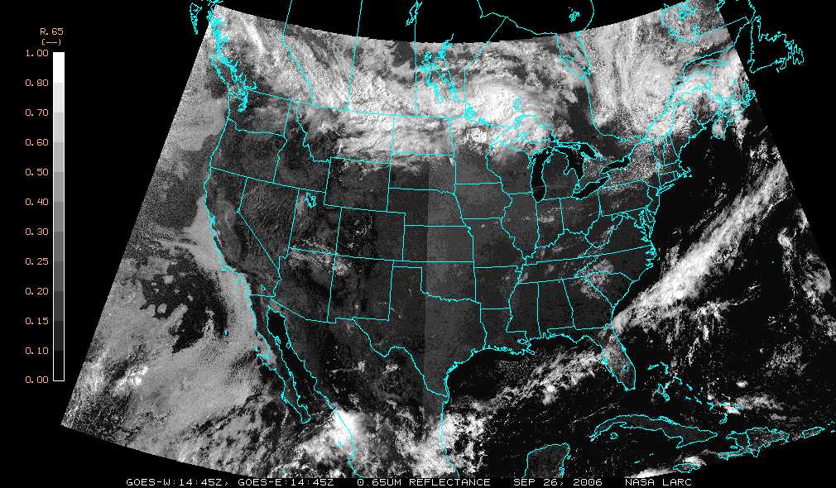
GOES-11/GOES-12 Visible, Sep. 26, 2006

Slide 4
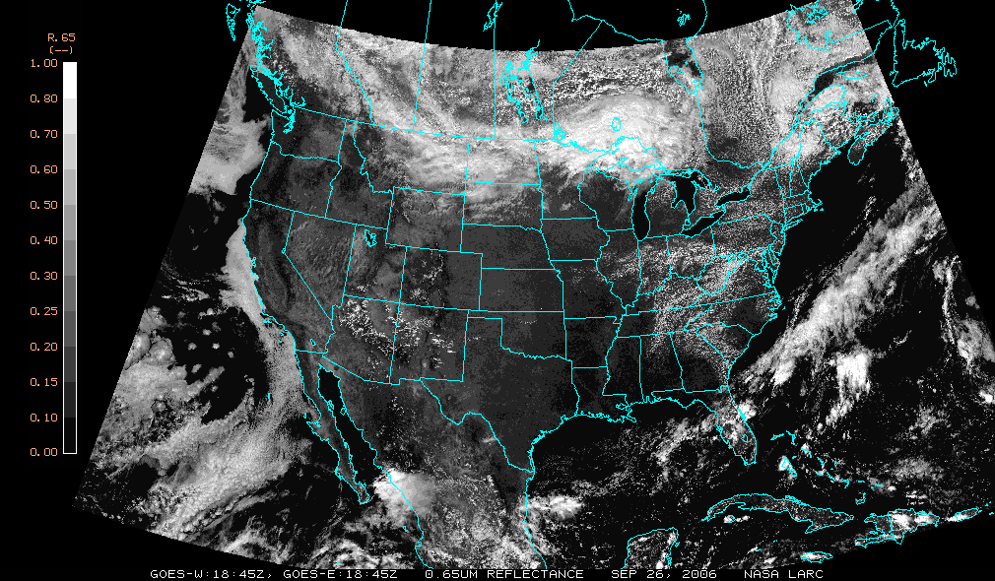
GOES-11/GOES-12 Visible, 18:45Z, Sep. 26, 2006
sat2
Sun
noon
sat1

Slide 5
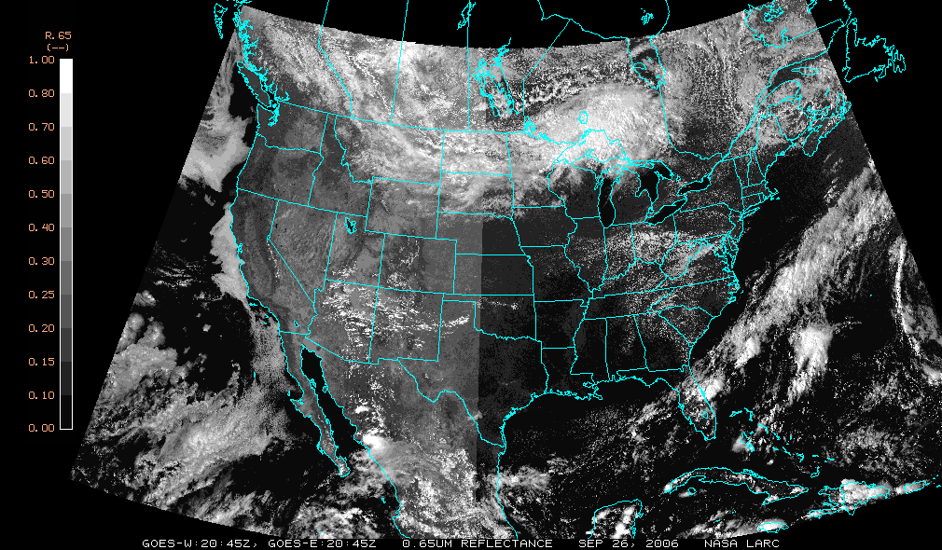
GOES-11/GOES-12 Visible, 20:45Z, Sep. 26, 2006

Slide 6
Current SBAF tool
SCIAMACHY (2002-2010)
30x240km footprints, collocated MODIS cloud properties
For invariant desert and ice targets, clear-sky ocean, and DCC the most pristine 1000 footprints are saved over the entire record
For all-sky large domain (Equatorial GEO domains, Polar SNO domains), take 100th footprint over the entire record.
IASI (2008 4 seasonal months)
4x12km footprints
Only all-sky large domains available
Web Site
http://cloudsgate2.larc.nasa.gov/SBAF

Slide 7
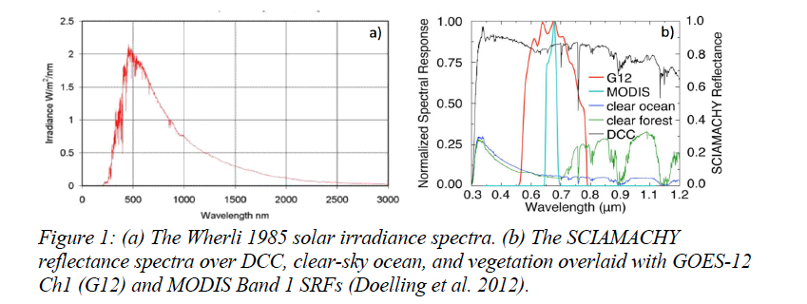
Need for SBAF
• Can not assume constant reflectance across both spectral bands
• Need to take into account the incoming solar irradiance

Slide 8
SBAF Procedure
• Compute the pseudo radiance (L) for both the reference (ref) and target (tar) instrument for all the SCIAMACHY footprints identified for the domain or invariant target
• Then regress the footprint target and reference pseudo radiances
• Find the optimal fitting function to describe the variability
• Coincident collocated SCIAMACHY footprints not needed
• Assume that the SCIAMACHY footprint spectra represent the average conditions over the target during inter-calibration. Must have sufficient inter-calibration sampling to observe the average conditions

Slide 9
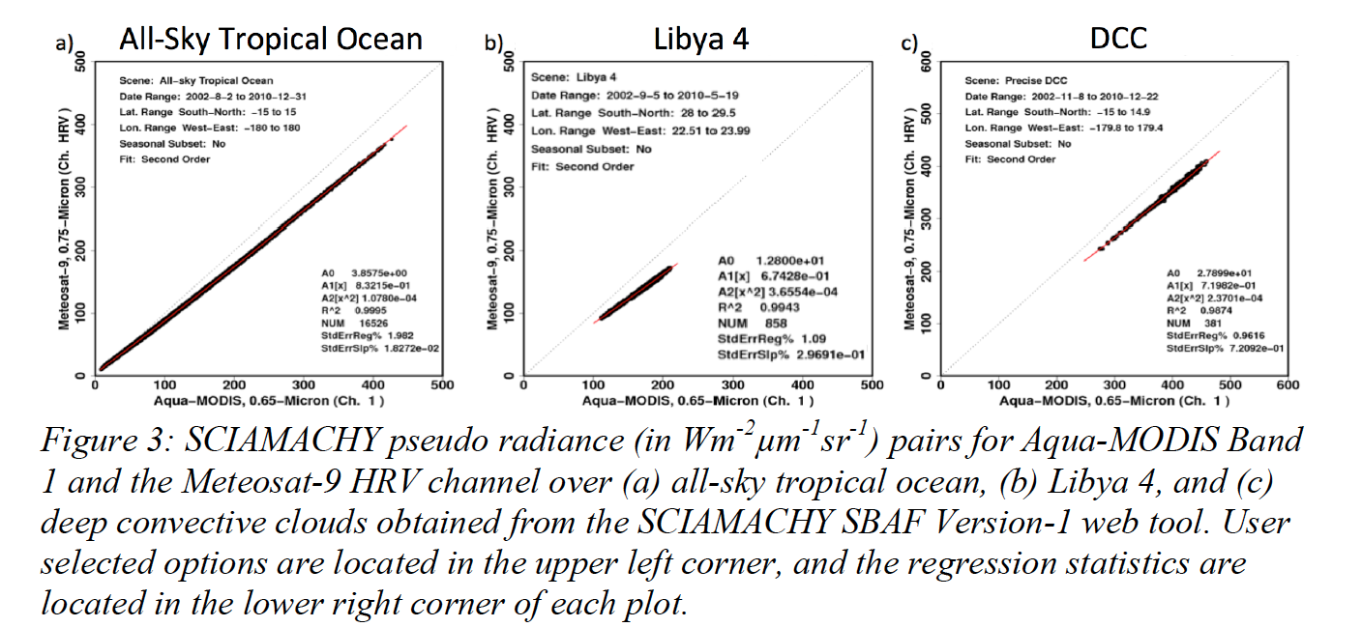
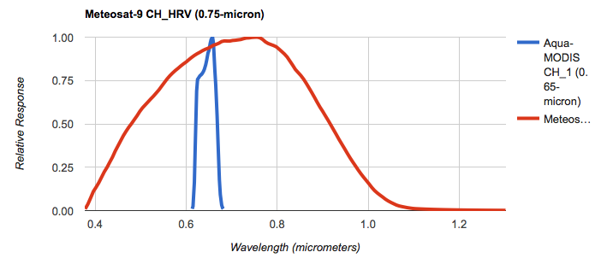
SCIAMACHY SBAF Examples

Slide 10
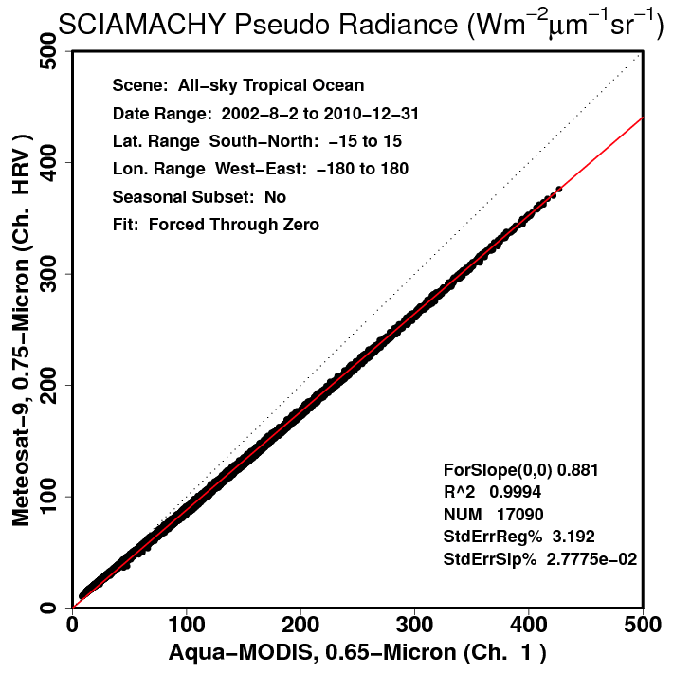
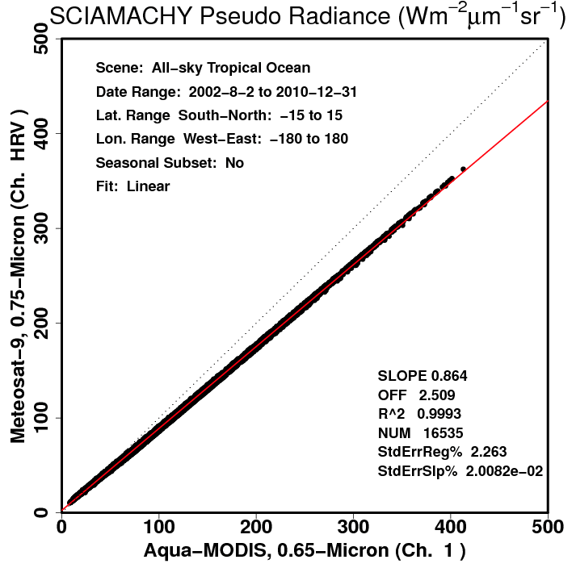
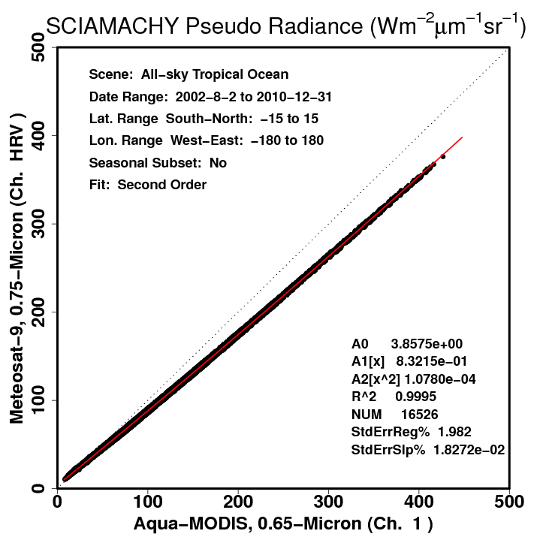
All-sky Tropical Ocean Aqua-MODIS Band1/Met-9 HRV SBAF
Linear through 0
Linear, slope and offset
Second Order
σ=3.2%
σ=2.3%
σ=2.0%
• Pick best fit to reduce the standard error

Slide 11
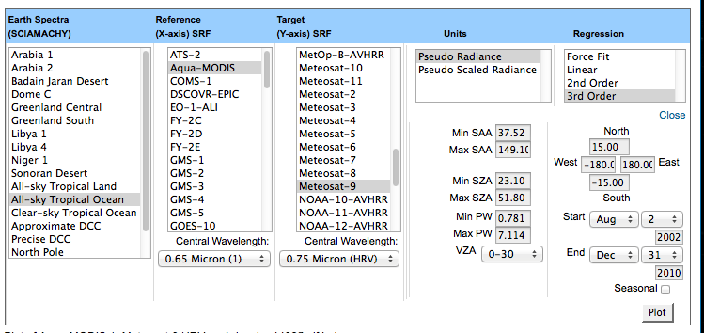
SCIAMACHY SBAF Tool
• Able to stratify by PW, season, VZA and SZA in order to reduce the standard error of the regression

Slide 12
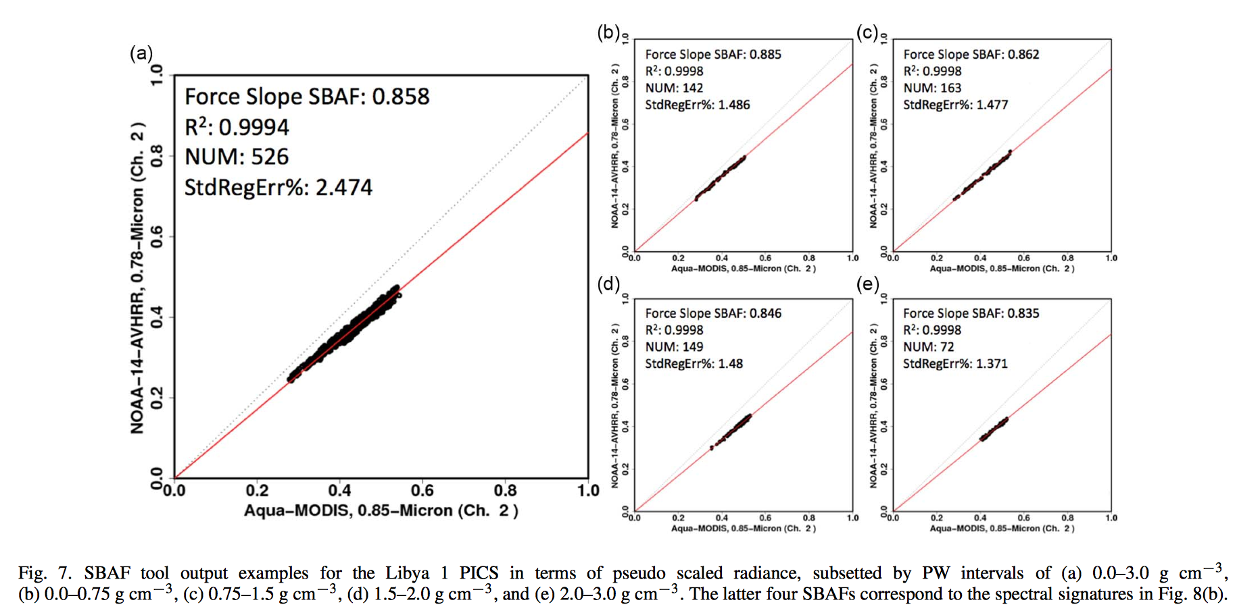
SCIAMACHY Tool PW stratification
PW=0-0.75
Slope=0.885
PW=0.75-1.5
Slope=0.862
PW=0.0-3.0
Slope=0.858
PW=1.5-2.0
Slope=0.846
PW=2.0-3.0
Slope=0.835

Slide 13
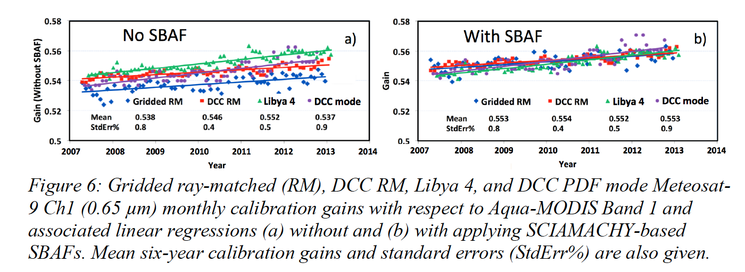
SCIAMACHY SBAF validation
Gridded RM = All-sky Tropical Ocean Ray-matching
DCC RM = Deep convective cloud ray-matching
• The 6-year mean calibration gain methodology difference without SBAF is 2.7%
With SBAF is < 0.4%

Slide 14
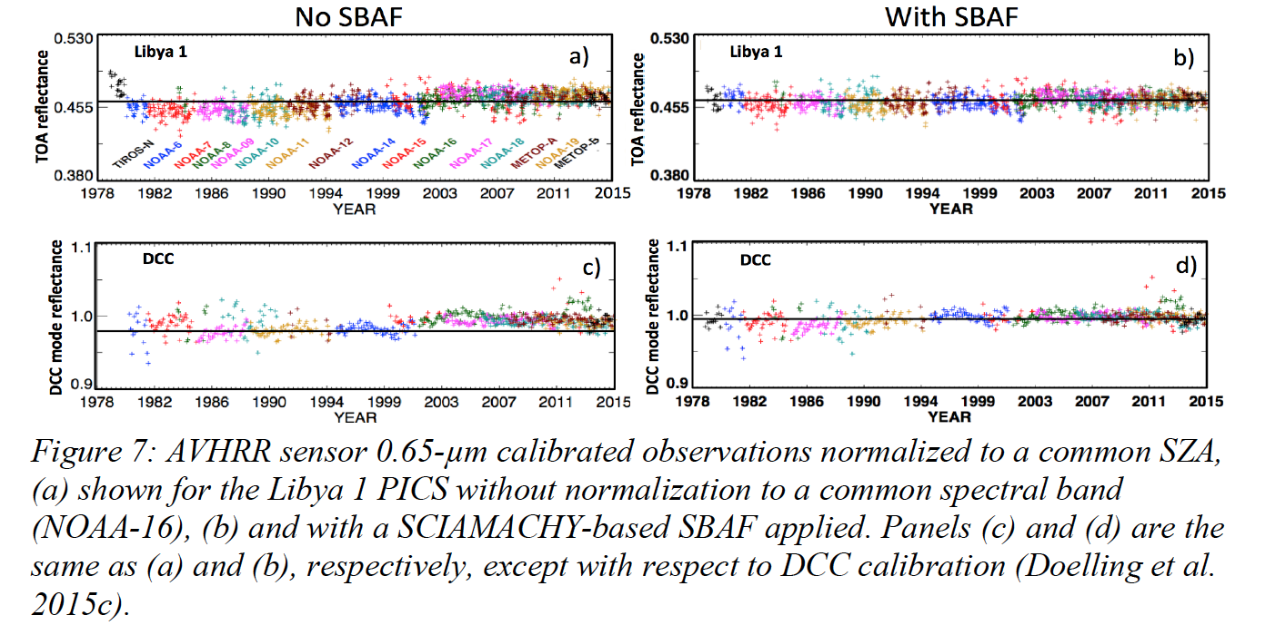
SCIAMACHY SBAF Validation

Slide 15
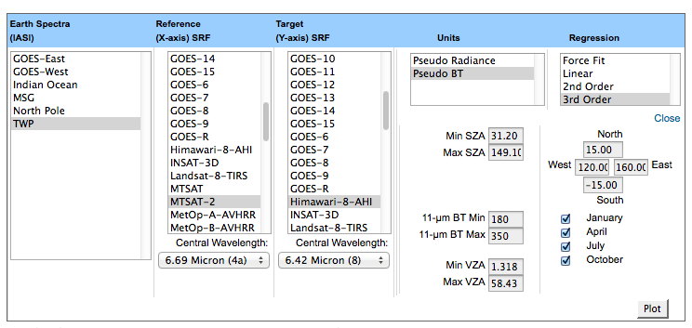
IASI SBAF Tool

Slide 16
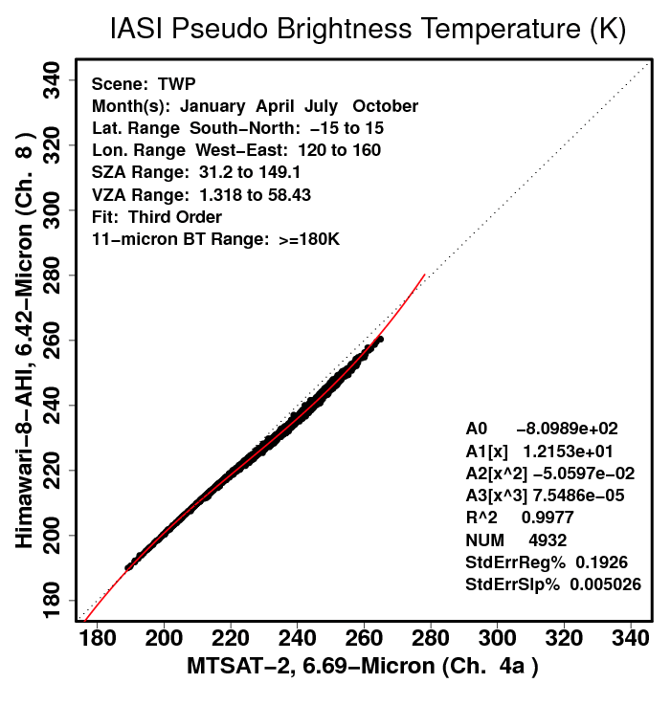
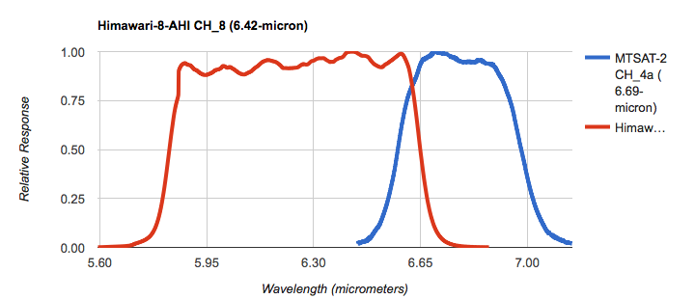
IASI SBAF Example

Slide 17
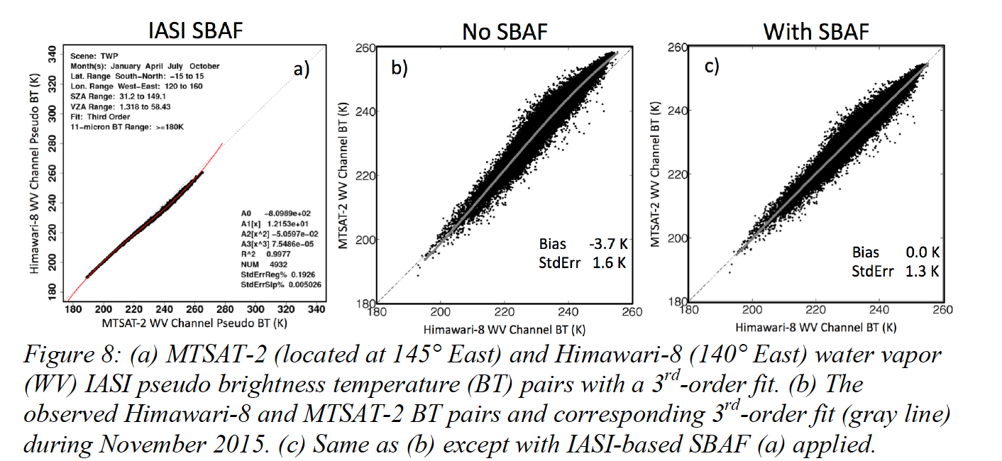
IASI SBAF Validation
• Coincident MTSAT-2 and Himawari-8 radiance pairs over the GEO domain, matched within 5° VZA
• The SBAFs can rescale the IR temperatures to a common channel for consistent GEO ring analysis

Slide 18
SBAF Proposal Submitted
NASA-Langley submitted a visible calibration NASA ROSES proposal
A.34 Satellite Calibration Interconsistency Studies
Submitted in December 8, 2015
Title: Open Access Spectral Band Adjustment Factors for Consistent Inter-Satellite Calibration and Retrievals
If anyone knows of any other proposal opportunities for SBAF please let me know

Slide 19
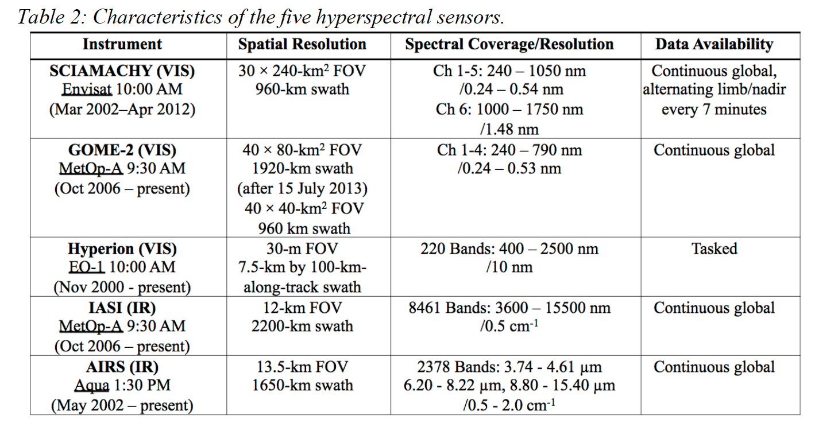
Future SBAF Hyper-spectral Datasets

Slide 20
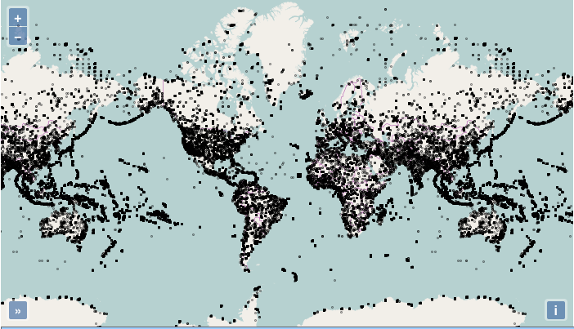
Hyperion Sampling
• We have downloaded the entire Hyperion dataset
• You are able to zoom in to collect only the footprints needed
• Hyperion footprints aggregated to ~7.5 km footprints both spatially and by reflectance

Slide 21
SBAF comparison over Libya-4 during August 2007
MODIS/NOAA-14 | SCIAMACHY | GOME-2 | Hyperion
Band 1 (0.65 µm) | 0.9811 | 0.9783 | 0.9789
Band 2 (0.86 µm ) | 0.8487 | N/A | 0.8474
• Spectral band adjustment factors from SCIAMACHY, GOME-2, and Hyperion calculated over the Libya 4 PICS, August 2007.
• The limited GOME-2 spectral range does not allow for SBAF derivation for Band 2.
• The SBAFs are determined from Aqua-MODIS and NOAA-14-AVHRR mean pseudo radiance ratios, which are derived from the SRF convolutions with mean instrument-measured hyper-spectral radiance values
• The SBAF factors are within 0.3% for band 1 and within 0.2% for band 2.
• The Hyper-spectral datasets have various footprint size, spectral resolution, spectral calibration accuracy

Slide 22
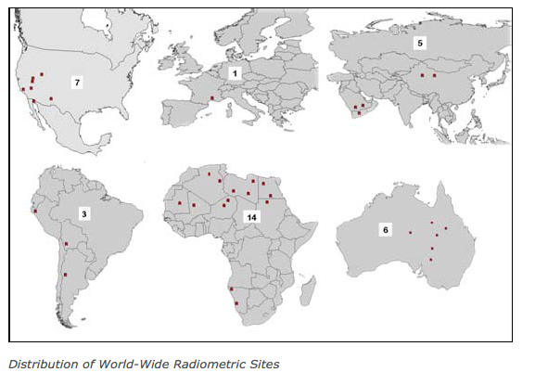
CEOS invariant targets

Slide 23
Other Hyper-Spectral Datasets
Each Hyper-spectral dataset has its advantages and disadvantages with respect to footprint size, sampling, spectral resolution, spectral calibration accuracy etc.
Hyper-spectral absolute calibration not necessary, however, spectral calibration accuracy is required.

Slide 24
SBAF Improvement Conclusions
SCIAMACHY, GOME-2, Hyperion, IASI, and AIRS hyper-spectral datasets
All CEOS invariant desert and polar ice target clear-sky datasets
Collocate coincident cloud, aerosol, and WV datasets for more parameter subsetting
Further suggestions, subsetting parameters and new hyperspectral datasets for improving SBAFs are welcome

