Slide 1
Selecting a GSICS reference instrument IR , VIS and Microwave
Manik Bali, Fuzhong Weng, Dave Doelling, Ralph Ferraro, Cheng-Zhi Zou, Lawrence E Flynn and Mitch Goldberg

Slide 2
Outline
Introduction
Big Question
Actions
GSICS Reference
Expectation from a Reference Instrument- User Feedback
Proposed Process of Selecting Reference instrument
What are we looking for in a Reference instruments.
Summary and Discussion

Slide 3
Introduction
Big Questions
Can GSICS come up with a procedure to select an in-orbit reference
Can/Should we score instruments and give winners and runners up reference instrument trophies.
Can this information empower the OSCAR by giving it the ability to suggest references similar to the instrument grading OSCAR has.
Reference:
Discussions from 2015 GSICS Annual Meeting , Delhi India

Slide 4
Introduction- Action and meetings in the past year
Action: Manik to interact with Jérôme to push forward the development of the expert system as a tool to select inter-calibration reference instruments ( Reference is made to OSCAR).
Action: Tim to provide to Manik a list of parameters from his scoring proposal to include them into the expert system.
….. and related discussions that….
Resulted from feedbacks that were received on scoring scheme and feedbacks from GUW on expectations on Ref Instrument.
Resulted from a need for stable in-orbit reference in Microwave.
https://gsics.nesdis.noaa.gov/wiki/Development/20150709
Action: Manik to review Tim's scoring for CrIS?
Action: Fangfang to attempt to evaluate Tim's proposed scoring scheme for geostationary sounders
Action: Dave to consider the applicability of the scoring scheme to select a reference for the VIS band

Slide 5
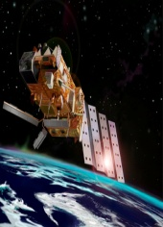
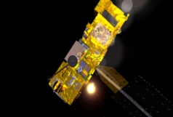
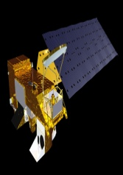
Introduction-GSICS References
GSICS Aims [Ref: wmo website ]
Monitoring instrument performances,
Operational inter-calibration of satellite instruments- GSICS Products
Tying the measurements to absolute references and standards, and recalibration of archived data
GSICS Reference Instruments
IR Products
Vis Products
MW
UV
GSICS Reference Instruments are at the Center of instrument Monitoring and Classical GSICS Product Generation.
Stability and accuracy (over time) of reference instrument are vital parameters for ensuring good quality of GSICS inter-calibration monitoring.
IASI
AIRS
MODIS

Slide 6
Expectation from a reference instrument

Slide 7
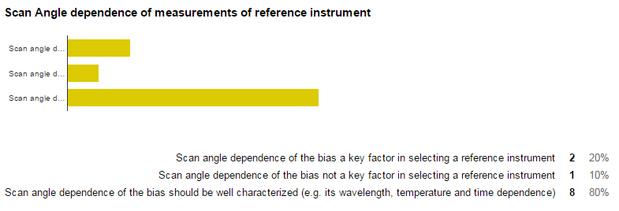
Expectation from a reference instrument
-> Split verdict

Slide 8
Proposed- Process to identify GSICS reference Instrument
GSICS Subgroups are the center of GSICS Cross Calibration Research and product generation.
The instrument and Channels agency wishes to monitor.
The method/s they would employ to monitor( eg. single or blended references, use transfer target , stability criterion).
May consider scoring proposed by Hewison and Reference Expectations gathered by GSICS Survey ( stated next slidse)
Demonstrated use of the instrument by member agencies and users for instrument monitoring.
Comparison of Instrument design specification ( Pre-launch testing) with In-orbit behavior.
May consider if in-orbit status of key parameters of Candidate Ref instrument are monitored and available to users ( such as . ICVS).
7. Take Info ( global coverage, eq. cross time etc) related to instrument available ( eg OSCAR) Phone: +1 301-683-3550
Process of Selection to be carried out within sub group.

Slide 9
Application of Process- Example-1
Selection Process Reference for MW
Identify a instrument and channels one wishes to monitor.
Pre-launch characterization Vs Post launch behaviour reports
Identify the method to monitor
If in-orbit status of key parameters of Candidate Ref instrument are monitored , are within specs and available to users ( via websites such as ICVS)
Consider usage of instruments for similar applications by agencies
OSCAR provides limited but critical information on instruments. (spectral, temporal and geographical coverage)
Detailed information is obtained via ATBD
Consider demonstrated use of the instrument by other agencies

Slide 10
Scoring Scheme
Scoring scheme comprehensive.
Can be fine tuned according to spectrum and need.
Cannot score winners or losers -> User Requirements differ, instruments change during life time
Curtsey Hewison@EUMETSAT

Slide 11
What are we looking for in a Reference Instruments
IR sounder 1. Sensor performance stability 2. Spectral coverage/Spectral resolution 3. Error budgets (prelaunch characterization and post-launch verification) 4. Geo-location accuracy 5. Data availability
References: CrIS, AIRS IASI A/B/C can be GSICS References ( No Primary or Secondary)
References: CrIS, AIRS IASI A/B/C can be GSICS References ( No Primary or Secondary)
MW sounder 1. Sensor performance stability 2. Field of view (FOV) consistency (ATMS has oversampling FOV and can be B-G to AMSU-A and MSU) 3. Error budgets (prelaunch characterization and postlaunch verification) 4. Geolocation accuracy 5. Data availability
References: ATMS SDR/TDR, FCDR

Slide 12
What are we looking for in a Reference Instruments
VIS/NIR
The reference instrument must have an active instrument calibration team funded by the project over the lifetime of the satellite
Must have onboard calibration that is well characterized, preferably with SD and lunar monitoring
The pre-launch and on orbit calibration must be well documented in journals
The data must be publicly available and easy to order and download and be released in near real-time
The instrument must have many users to verify the calibration and discover any calibration anomalies
References : Pre 2012 Aqua-MODIS Post 2012 use VIIRS, VIIRS onboard calibration superior and better characterized than MODIS

Slide 13
Discussion
GSICS Requirements have grown.
Diverse needs of member agencies. Several instruments fulfil minimum requirements and can complement each other and reveal bias of monitored instrument in several dimensions.
Reference Instruments cannot be treated as Primary or secondary, all are equal
‘GSICS references’

Slide 14
Summary and Conclusion
A process of selecting reference instrument has been proposed that takes into account subgroup needs, User expectation and Scoring.
Search could begin with first identifying the instrument and the channels one wishes to monitor and then go on to identify the reference candidate/s
In a multiple reference instruments scenario , instruments complement each other and not compete with each other-> Propose to use ‘GSICS Reference’ and not ‘Primary/Secondary GSICS Reference’.
EUMETSAT proposed scoring scheme comprehensive and can be simplified and applied to specific situations and needs.
Stability of Reference instrument bias and health, Scan Angle bias characterization, Overlap of Spectrum with Target instrument etc can be simple criterion for selection
Proposed Reference instruments
For IR- IASI-A/B/C/CrIS/AIRS
For VIS - Aqua-MODIS ( Pre- 2012) and VIIRS( Post- 2012)
For MW- ATMS-SDR/TDR , FCDR.

Slide 15
THANK YOU

Slide 16
Example of applying process in MW
Search began with the target, Monitored Instrument i.e ATMS
First identified channels of ATMS that we wished to monitor.
Aim was to know how well does ATMS –SDR ( L1B BT with Antenna Corrected) perform.
Long run to establish– a Classical GSICS style monitoring of ATMS.
In-orbit instruments such as AMSU and MSU that have exactly same channels as ATMS but would score poorly ( may have known trends scan angle biases nonlinearities ).
Zeroed in on AMSU/MSU FCDR
Trends and biases have been removed
Have highly positive user feedback but not in any known calibration activity ( closest IMICA Vs GPSRO )
Never scored an FCDR

Slide 17
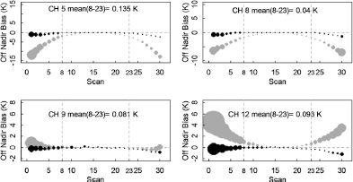
Search for a MW Reference
AMSU-A/MSU FCDR continuously monitored in Real time
Scan Angle Dependence has been corrected
Validated with GPSRO and instruments monitored at ICVS

Slide 18
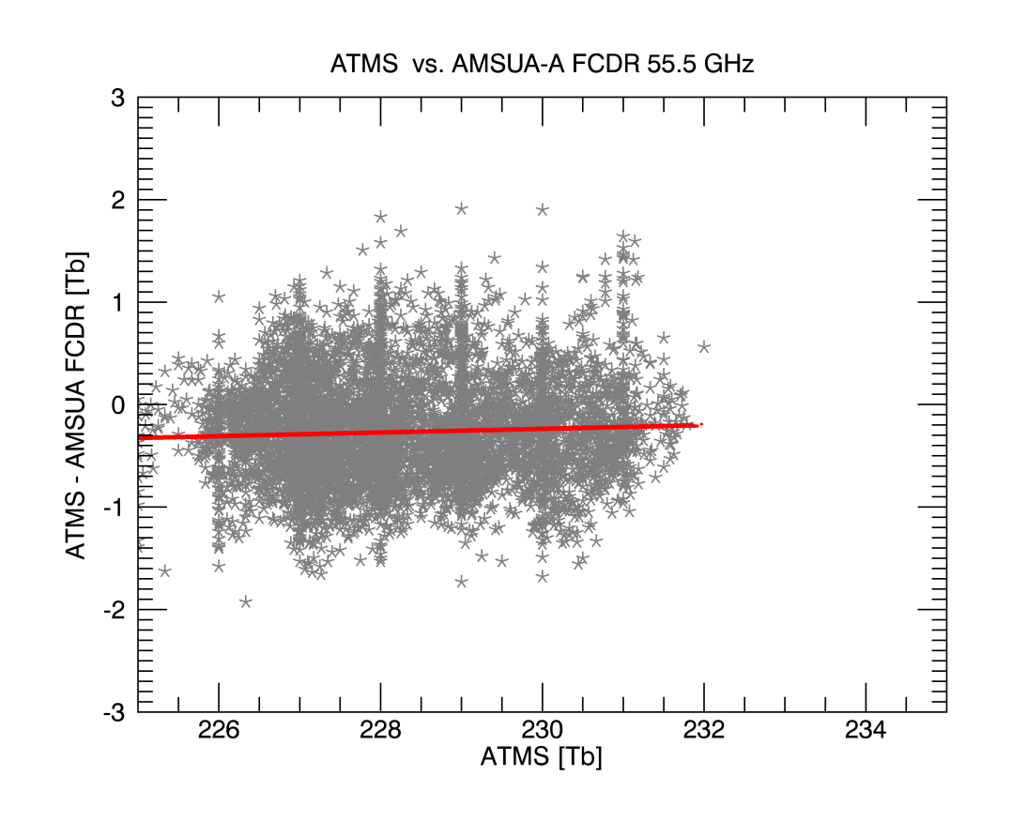
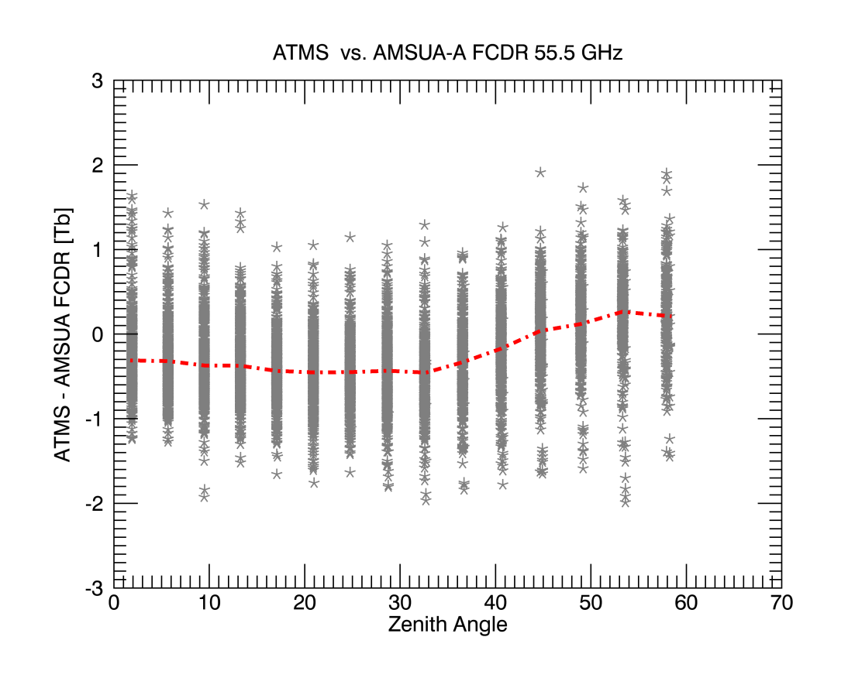
ATMS –FCDR AMSU-A 55.5 GhZ bias [NOAA-18]
Search for a MW Reference
Offset = -0.29 K
Oct 15- 31, 2015 data
Stable temperature dependent bias
Zenith angle dependence similar to model calculations
ATMS bias within the error bar of Pre and post launch determined ATMS measurements.
Reference Plot Curtsey
https://cimss.ssec.wisc.edu/itwg/itsc/itsc19/program/posters/1p_11_delrio_faulwetter.pdf

Slide 19
Proposed VIS/NIR Instrument References
The reference sensor weighting scheme is then the overall uncertainty to transfer the SI traceable calibration reference to the target reference
Pre 2012 Aqua-MODIS
Post 2012 use VIIRS, VIIRS onboard calibration superior and better characterized than MODIS
Evaluate the 3rd generation GEO and Metop-SG calibration stability and reconsider VIS/NIR reference instrument
Also worth to have several reference records established
To monitor the primary reference
In case of instrument failure and lack of overlap

Slide 20
Thank You

Slide 21
Introduction
Introduction- Instrument resources
OSCAR [ Observing System Capability Anaysis and Review Tool]
OSCAR is a resource developed by WMO in support of Earth Observation applications, studies
and global coordination. (IASI , CrIS )
Web pages are static. ( can act as a starting point but not complete input for selecting Ref Instrument)
National Calibration Center (NCC)
Info on NCC instrument that is more relevant to Cal/Val community
ICVS [ Integrated Calibration Validation System ] ( other similar systems can be explored)
On-orbit and prelaunch instrument characterization and long-term monitoring of instrument performance
Web pages give dynamic info on key cal/val parameters of the instrument

Slide 22
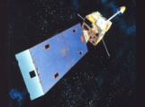
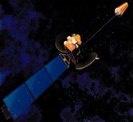
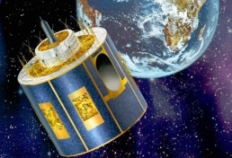
Introduction-Selection of GSICS References for Classical Monitoring
Initial years of GSICS ….handled problems of lower complexity ….
Monitored broad band GEO /LEO sensors by inter comparing with hyper spectral LEO in morning evening and afternoon.
Needed a reference instrument that is stable enough be able to monitor GEO/LEO instruments and reveal expected measurements biases ( and variations in them) .
AVHRR
MODIS
The MODIS instrument has high calibration accuracy and can track its own radiometric changes due to the inclusion of an onboard calibration system for the VIS/NIR spectral region [MCST].
For In-orbit Inter-calibration we broadly needed
An algorithm that can perform the inter- comparison [ eg. DCC, SNO baseline algorithm]
Well calibrated in-orbit References [ stability, accuracy ]
MTSAT
Stated Accuracy better than 1 K.
AIRS ( Afternoon orbit) and IASI ( Morning orbit ) Hyper-spectral Instruments
Radiances span main IR channels of broad band instruments i.e 11 12 13 Micron
AIRS and IASI routinely monitored and long term monitoring of three way comparisons exist ( CrIS IASI and AIRS).
Added confidence Comparisons of IASI and AIRS with Climate Instruments (ATSR2 and AATSR) reveal better than 0.1 K accuracy and pre-launch like behavior of AIRS and IASI.
In-orbit reference Instrument noise not fully known
AIRS
SEVIRI
IASI
GOES
Used a simple selection criterion for selecting reference instrument
Focused on monitoring IR and VIS bands using a limited number of reference instruments

Slide 23
Current State of In-Orbit Monitoring
GRWG
IR
MW
UV
VIS
AIRS
IASI A/B/C
Primary Ref*
CrIS*
GP-X *
ATMS*
MSU AMSU
SSMI*
OMI*
Aqua Modi+ DCC
Complexity of in-orbit Inter - comparision enhanced as by surface reflectance Solar Zenith Angle. viewing geometry impact A-B .
Stability of Transfer targets such as DCC, Desert kicks in instrument monitoring algo.
Monitored instrument overlaps with spectrum of hyper-spectral instruments
MW spectrum is large and not spanned by a single reference instrument.
Multiple broad band instruments can be candidates.
Diverse requirements across subgroups ( even within subgroups )
Notes:
tore

Slide 24
Opportunities and Challenges
Multiple candidate reference instruments ( CrIS IASI and AIRS) provide opportunity to monitor GEO instruments bias diurnally and give a complete picture of the bias variation.
Inter- comparison between the multiple instruments when considered along with their health monitoring can provide confidence about thrust worthiness of the instruments.
Gives an opportunity for inter-operability of computed bias among reference instruments, gives a challenge to develop advanced algorithms to achieve a trustworthy inter-operability.

Slide 25
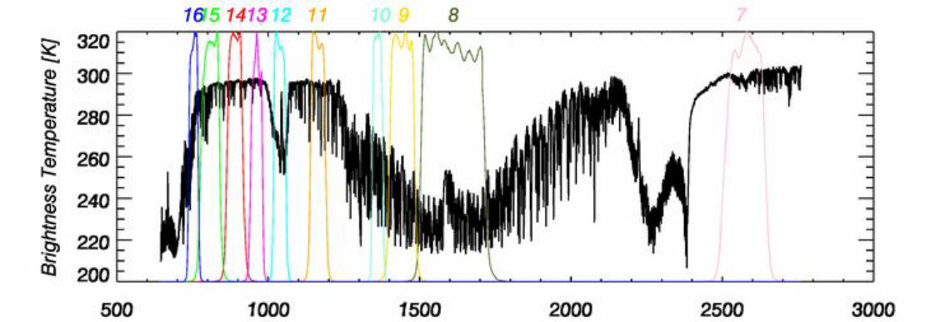
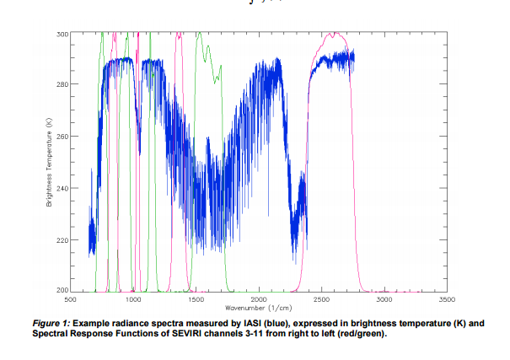

Slide 26
Tim Proposed Scoring Scheme-Overview
A very simple scheme
The proposed scoring scheme can be summarized by the definition of the following for each class of GSICS product:
Variables describing required performance of Reference.
Minimum thresholds for each variable required for inter-calibration to be useful.
Maximum thresholds (optimal values) for each variable above which no further improvement will be realized
Weighting for each variable (to align with contributions to overall uncertainty)
Curtsey Tim Hewison

Slide 27
Application of Process- Example-1
Selection Process Reference for MW
A sub-group meeting is organized to identify instrument to be monitored.
Instrument info on OSCAR and NRT monitoring on ICVS is considered
OSCAR provides limited but critical information on instruments. (spectral, temporal and geographical coverage)
Detailed information is obtained via ATBD
Group wishes to monitor GPM satellites spread over a range of roughly 25S to 25N ( for eg GMI)
Despite not presenting global observations SAPHIR also scores higher because the intended goal is to inter-calibrate low inclination instruments. In addition input from scoring is considered.
Group evaluates ATMS and SAPHIR.
Both SAPHIR and ATMS can score the same marks
On the other hand if goal would have been to monitor Polar instruments ATMS could have been a better choice.
Group considers that SAPHIR are the first radiometers in the 183 GhZ in low inclination orbit ( Wilheit)

Slide 28
Example-2
Application of Selection Process - Example-2
Reference for IR
A sub-group meeting is organized to identify instrument to be monitored.
Group considers that both the instruments span the Monitored instrument channels
Group wishes to monitor 11 and 12 and 13 Micron Channels of a GEO instrument.
OSCAR page reveals that noise levels in the 10- 13 Micron range are comparable.
Monitoring at ICVS reveals key calibration parameters within spec
.
Group evaluates IASI and CrIS
Both instruments can act as references .

Slide 29
Summary and Conclusions
Summary and Conclusions
Process by which reference instrument could be selected in GSICS has been proposed here.
It is proposed that the main decision to identify a reference instrument should rest with the subgroup.
Evaluation of OSCAR for the purpose of Ref selection reveals that while some information about candidate reference instruments could be obtained via the WMO OSCAR however OSCAR pages are static and a complete info about instrument should be obtained from the agency maintaining the instrument. Special caution to be applied when considering noise levels ( NeDT) stated at OSCAR.
More useful input could be provided by instrument monitoring done by the agency ( such as ICVS, NCC).
Scoring scheme for reference instrument can be a vital input in deciding which instrument to use as a reference.

Slide 30
Spectral Characteristics of CrIS
Spectral Characteristics of IASI
OSCAR page reveals that noise levels in the 10- 13 Micron range are comparable.
Both instruments can act as references

Slide 31
Outline
Introduction
Big Questions
Actions on Reference Instrument selection in the past year
GSICS Ref Instrument
Selection of GSICS References for Classical GSICS IR Monitoring
Opportunities and Challenges
Process to identify GSICS reference Instrument.
NOAA (Bali and Flynn) proposed process
EUMETSAT ( Hewison) Scoring Scheme
User expectation from Reference Instrument
Reference identification exercise
Infrared
Microwave
Visible
Summary and Conclusion.

Slide 32
Application of Process- Example-1
Selection Process Reference for MW
A sub-group meeting is organized to identify instrument to be monitored.
Instrument info on OSCAR and NRT monitoring on ICVS is considered
OSCAR provides limited but critical information on instruments. (spectral, temporal and geographical coverage)
Detailed information is obtained via ATBD
Group wishes to monitor GPM satellites spread over a range of roughly 25S to 25N ( for eg GMI)
Despite not presenting global observations SAPHIR also scores higher because the intended goal is to inter-calibrate low inclination instruments. In addition input from scoring is considered.
Group evaluates ATMS and SAPHIR.
Both SAPHIR and ATMS can score the same marks
On the other hand if goal would have been to monitor Polar instruments ATMS could have been a better choice.
Group considers that SAPHIR are the first radiometers in the 183 GhZ in low inclination orbit ( Wilheit)

Slide 33
Example-2
Application of Selection Process - Example-2
Reference for IR
A sub-group meeting is organized to identify instrument to be monitored.
Group considers that both the instruments span the Monitored instrument channels
Group wishes to monitor 11 and 12 and 13 Micron Channels of a GEO instrument.
OSCAR page reveals that noise levels in the 10- 13 Micron range are comparable.
Monitoring at ICVS reveals key calibration parameters within spec.
.
Group evaluates IASI and CrIS
Both instruments can act as references .

Slide 34
https://gsics.nesdis.noaa.gov/wiki/Development/20150709
It was agreed that other important criteria include:
The ability to transfer the calibration to other Reference sensors
Fully published supporting documentation
A system to routinely monitor the calibration to the Primary Reference against other Reference sensors
Belonging to a committed series of sensors, providing service over many years

Slide 35
As a user, I think that the road to selecting a reference instrument can vary from simple to not so simple ( depends on the exact nature of requirement for example a user needs to decide which channels does he want to inter-calibrate and for which time). This quest is getting more and more interesting and perhaps needs a further iterations

