Slide 1
Key Comparisons and the MRA Emma Woolliams
Welcome to the National Physical Laboratory

Slide 2
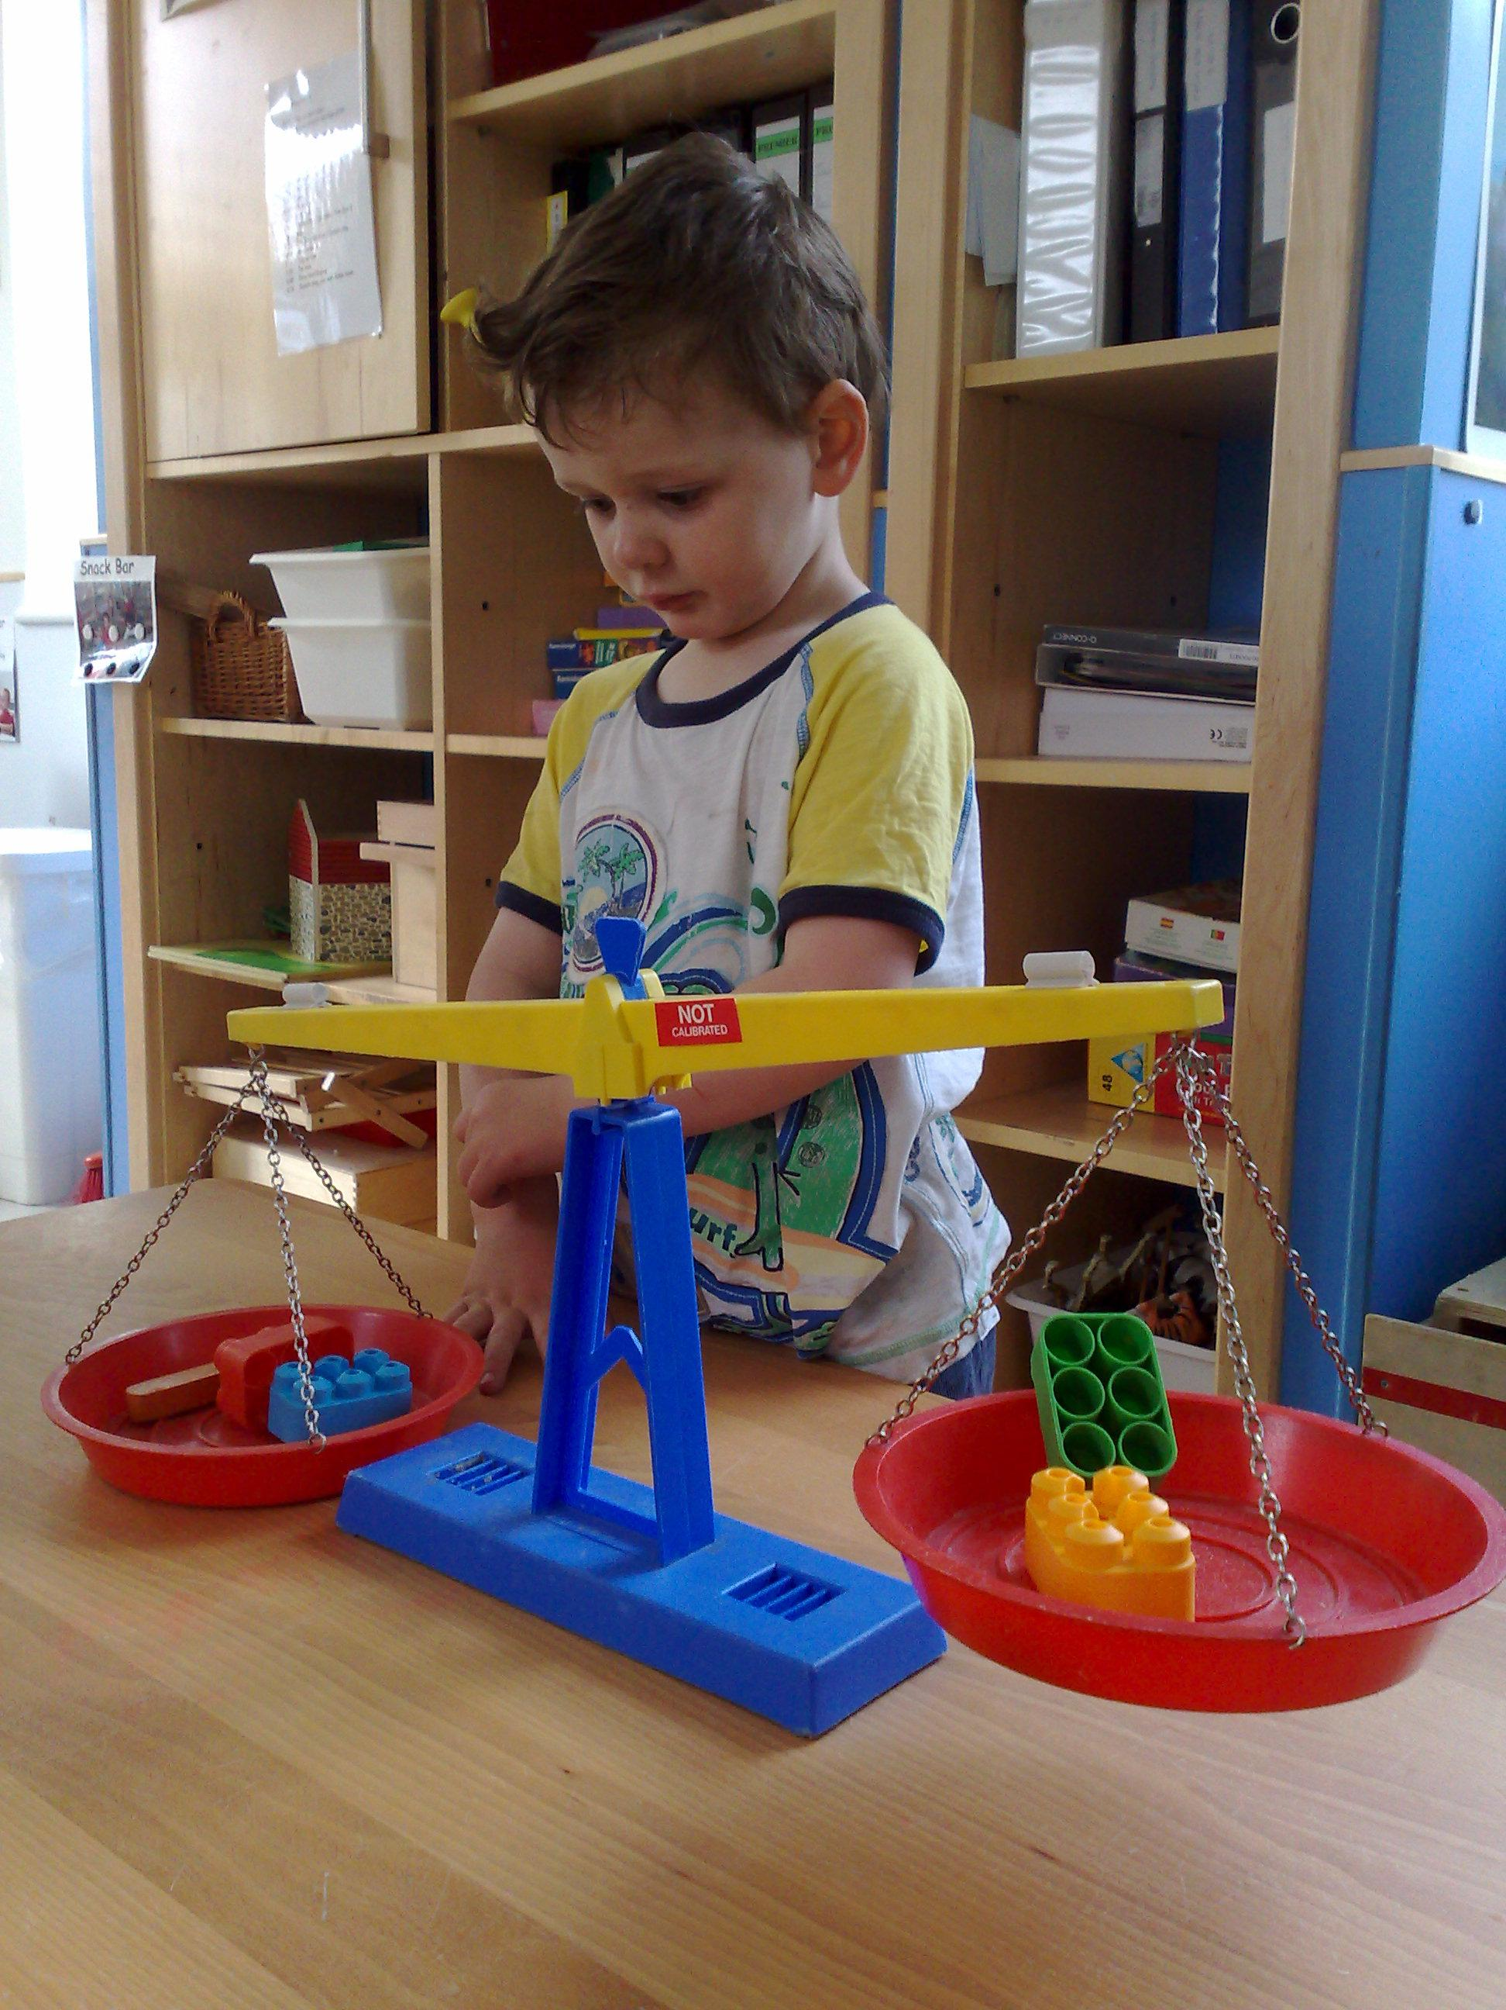
Why do we do comparisons?

Slide 3
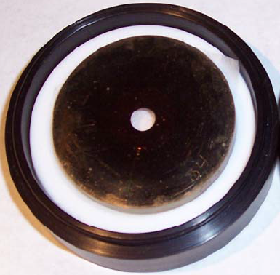
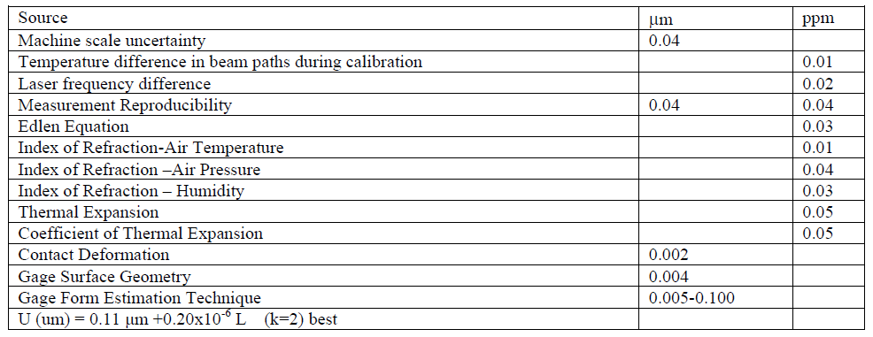
To test and validate an uncertainty budget
Optical method – scan laser beam over surface
Contact method – CMM: mechanically scan ball-ended stylus over surface
Notes:
This is a really simple measurement – the measurement of the area of a circular aperture. There are two methods that can be used – an optical method and a contact method. Both have been developed and have detailed uncertainty analyses. These are the uncertainty budgets for NPL methods – and what we might be interested in is the scientific question – can we trust our uncertainties?

Slide 4
Do methods agree?
For some apertures …
Notes:
And when we do this we sometimes find that yes, they do agree, but sometimes they really, don’t – in this case we got good agreement with small apertures and bad agreement with bigger apertures (vertical scale is aperture area)

Slide 5
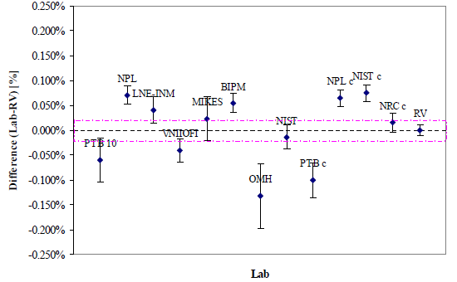
Lab-to-lab (results of a scientific comparison)
Interesting! What can I learn?
Notes:
At this stage of early scientific maturity we do comparisons for scientific reasons. And here is the result of the aperture area comparison where lab names have a “c” afterwards it is a contact method, without a “c” it’s an optical method.

Slide 6
For trade
The CIPM MRA responds to the need for an open, transparent and comprehensive scheme to give users reliable quantitative information on the comparability of national metrology services and to provide the technical basis for wider agreements negotiated for international trade, commerce and regulatory affairs.
Notes:
The second reason we do comparisons is to support the Mutual Recognition Arrangement (1999)

Slide 7
SI traceability Mutual Recognition Arrangement
CONVENTION OF THE METRE Key comparison of primary unit
SIM
APMP
National Metrology Institutes
EURAMET Regional comparisons
transfer standards
auditing
procedures
Accredited Calibration
Laboratories
calibration
INDUSTRY
Notes:
The MRA requires regular “key comparisons” amongst the “inner ring” of NMIs – the top ones for that quantity usually, but also usually evenly distributed around the world. These are then followed up by regional comparisons (e.g. within Europe). This system ensures the NMIs understand the degree to which they are equivalent. And this is then passed down to accredited calibration laboratories and then industry.

Slide 8
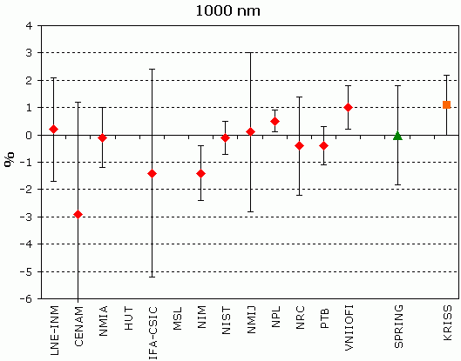
Do we need to review CMCs?
Notes:
Now comparisons are all about checking the quality. Here’s a spectral irradiance comparison result (where NPL was a slight outlier – consciously chosen for that reason for this presentation). If we get results like this it makes us wonder if we’re doing something wrong, or perhaps have to increase our “Calibration and Measurement Capability” statements – the statements that are on the key comparison database and say what the smallest uncertainties we can claim are

Slide 9
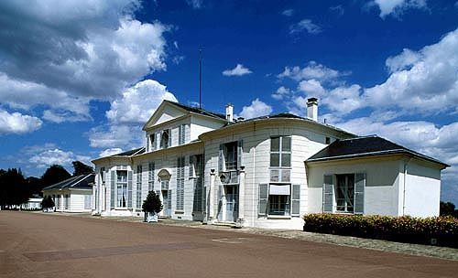
BIPM
Established by the Metre Convention (Paris, 1875)
The mission of the BIPM is to ensure and promote the global comparability of measurements, including providing a coherent international system of units
Three main roles of the BIPM are:
Coordinate the improvement of the worldwide measurement system
Provide scientific and technical work to Member States
Promote the importance of metrology
Notes:
Obviously don’t want all of this text - atm it’s just a direct cut and paste from the BIPM document found here: http://www.bipm.org/utils/en/pdf/BIPM_MRO.pdf
BIPM logo from Google images; is there an image of the Metre Convention document?
Begin here:
The BIPM is an intergovernmental organization established by the Metre Convention, through which Member States act together on matters related to measurement science and measurement standards.
The Metre convention is an international treaty signed by representatives from 17 countries to set up an institute for coordinating international metrology
Coherent international system of units for:
Scientific discovery and innovation,
Industrial manufacturing and international trade,
Sustaining the quality of life and the global environment
Three main roles of the BIPM:
To coordinate the realization and improvement of the world-wide measurement system to ensure it delivers accurate and comparable measurement results.
To undertake selected scientific and technical activities that are more efficiently carried out in its own laboratories on behalf of Member States.
To promote the importance of metrology to science, industry and society, in particular through collaboration with other intergovernmental organizations and international bodies and in international forums

Slide 10
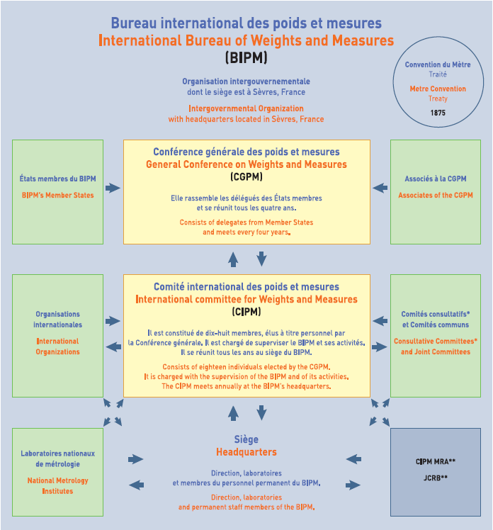
Political
Scientific
Technical / Scientific
Notes:
This is the layout of the BIPM with member states liaising through the political ‘layer’ shown on the top line.
The second line of boxes refers to an advisory group of high standing metrologists who advise the politicians.
The NMIs (of which NPL is one) sit in the box on the bottom left which send and receive guidance from BIPM on scientific/technical issues. The formulation of the GUM sits in the lower right box.
The main point to make with this slide is the influence that the GUM and BIPM have on political, legal and technical levels, with the full weight of international backing given to it/them.
This is all as support for the metre convention.

Slide 11
SI traceability Mutual Recognition Arrangement
CONVENTION OF THE METRE Key comparison of primary unit
SIM
APMP
National Metrology Institutes
EURAMET Regional comparisons
transfer standards
auditing
procedures
Accredited Calibration
Laboratories
calibration
INDUSTRY
Notes:
Mutual Recognition Arrangement of 1999 makes a measurement by one NMI “equivalent” to that of another NMI within the understood “degrees of equivalence”.
The “degrees of equivalence” are tested formally through formal international comparisons – both key comparisons (a few labs globally) and regional comparisons (all the labs in a continent).
The Key Comparison Data Base lists the results of the comparisons publically.
After comparisons, the BIPM-led committees review the capabilities of the laboratories and update the “calibration and measurement capability (CMC) data base”.
Which lists how well each laboratory can be seen to measure a given parameter – i.e. the uncertainties for which they have been peer reviewed.
BIPM in some fields does its own calibrations and would partake in such comparisons.
It no longer does photometry and radiometry research.
But it has an overseeing responsibility and hosts the international Consultative Committees (one or two representatives from each of the major NMIs). We partake in CCPR (Consultative Committee for Photometry and Radiometry)
SIM – Systema Interamericano de Metrologia

Slide 12
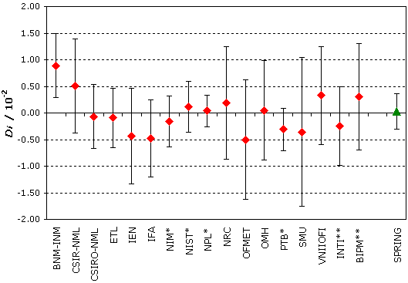
KC: Luminous intensity
Source: BIPM Key Comparison database (http://kcdb.bipm.org/)
Notes:
The Key Comparison Database (KCDB) provides the results of the 4-yearly (average) Key Comparisons of each NMI for every quantity they claim to be able to measure.
This gives an example of the most recent luminous intensity comparison.
With the exception of one, all the NMIs agree with the reference value (which is a weighted average of all NMIs).
The GUM allows this procedure since all NMIs follow a standard for evaluating their uncertainties.
Therefore the value of the uncertainty can be scrutinised and not the procedure for ascertaining it.

