Slide 1
GSICS UV sub-group:
GOME-2 hyper-spectral radiances for calibration of AVHRR imager data
Rűdiger Lang, Rose Munro, Gabriele Poli, Antoine Lacan, Christian Retscher, Michael Grzegorski, Alexander Kokhanovsky, Rasmus Lindstrot, Richard Dyer and Ed Trollope

Slide 2
GOME-2 Hyper-Spectral Radiances for calibration
of AVHRR imager data - Outline
GOME-2 calibration of AVHRR channel 1 radiances
GOME-2 calibration of Seviri channel 1 radiances (as additional material)
PMAp – Polar Multi-sensor Aerosol product: Towards continuous calibration of AVHRR Visible (and IR) channels

Slide 3
Metop-A/B GOME-2 Radiometric accuracy and calibration
Earthshine measurement co-location FM2 to FM3 / Co-location criteria
GOME-2 FM3 Metop-A
GOME-2 FM2 Metop-B
Metop-A (M02): FM3
Metop-B (M01): FM2
Co-location criteria:
Area overlap > 80%
Geo. AMF diff < 2%
Relative O₂ A-Band residual (ROR) smaller than empirical threshold
Time difference:
49 min (half an orbit)

Slide 4
Metop-B / FM2 Radiometric accuracy and calibration
Earthshine measurement co-location to Metop-A / FM3 / Radiances
GOME-2 FM3 Metop-A
GOME-2 FM2 Metop-B
Radiance residuals are dominated by FM3 degradation signature

Slide 5
Metop-A/B GOME-2 Radiometric accuracy and calibration
Earthshine co-located Metop-A/B residuals
Background predominantly from Metop-A degradation
GOME-2 FM3 Metop-A
Example for an average over multiple FM2/FM3 residuals in reflectance.
GOME-2 FM2 Metop-B
Prelim. Approach:
A linear background is subtracted per channel to account for the difference in reflectance-degradation and for broad-band differences in the different observed atmospheric paths per instrument.
Looking for the small scale structures per channel

Slide 6
Metop-A/B GOME-2 Radiometric accuracy and calibration
Earthshine co-located Metop-A/B reflectances and residuals
GOME-2 FM3 Metop-A
GOME-2 FM2 Metop-B
Residual in reflectance
+ Lin. background subtracted per channel
+ 20 pix. moving average smoothing
+ Relative Oxygen-A band Residual (ROR) selection criterium

Slide 7
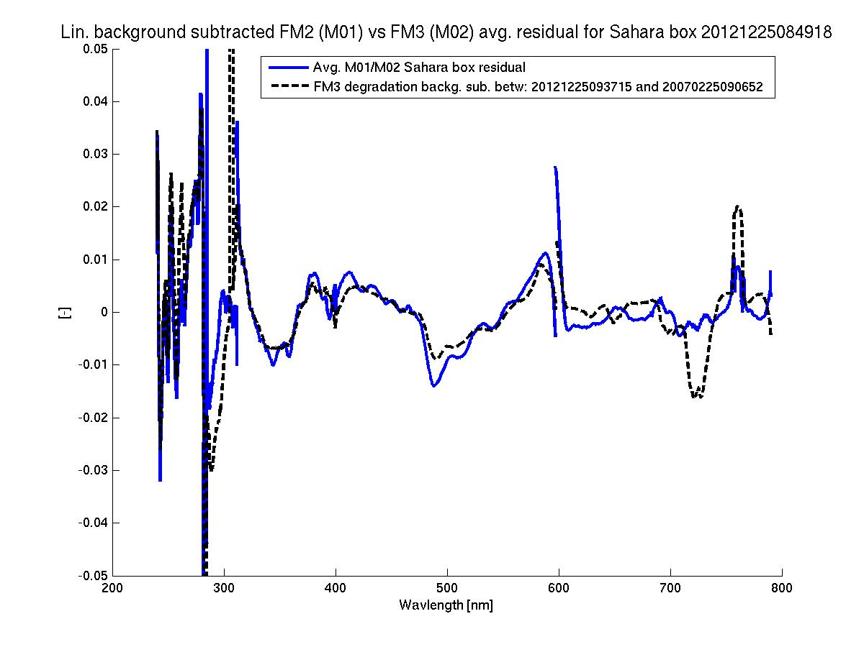
Metop-A/B GOME-2 Radiometric accuracy and calibration
Earthshine co-located Metop-A/B residuals / Background-subtracted
plus degradation residual from Metop-A
GOME-2 FM3 Metop-A
GOME-2 FM2 Metop-B
Background subtracted co-located Metop-A/B residual
Background subtracted temporal degradation residual Metop-A

Slide 8
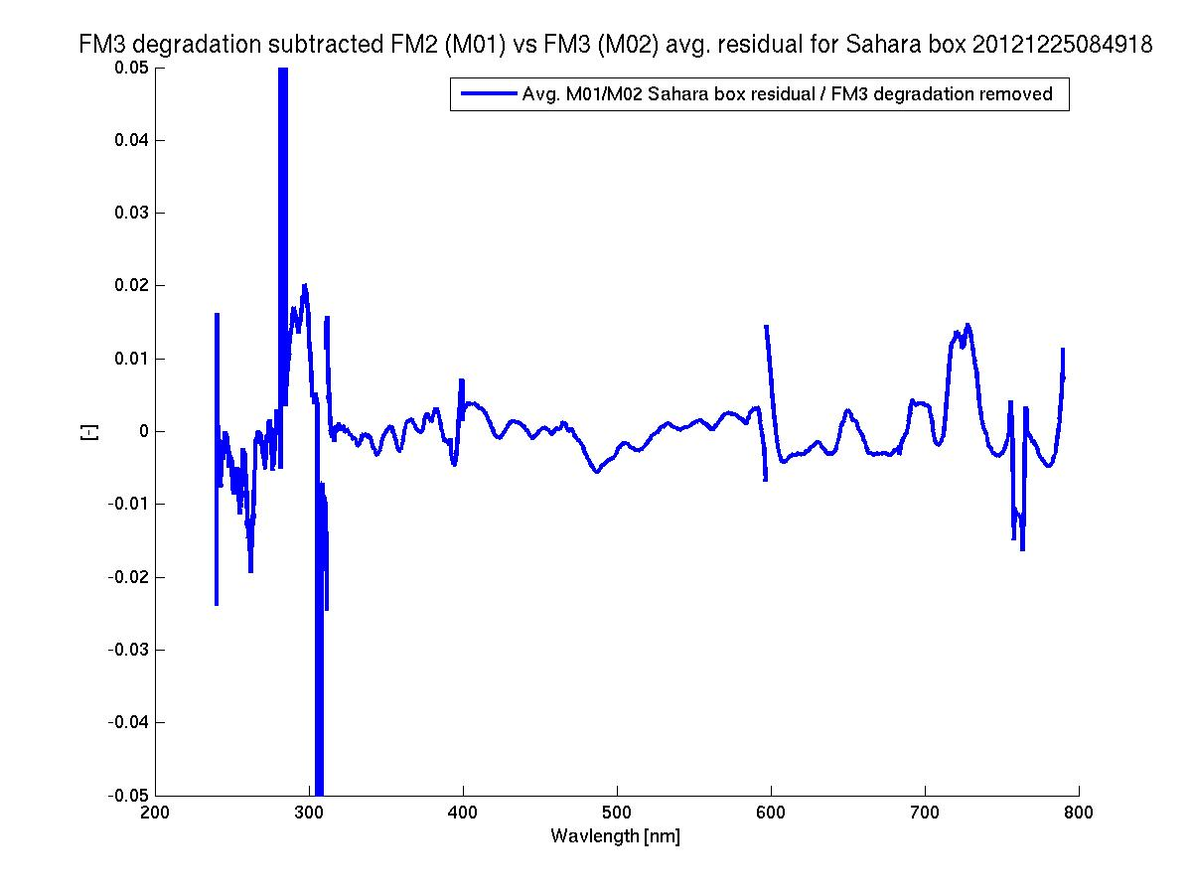
Metop-A/B GOME-2 Radiometric accuracy and calibration
Earthshine co-located Metop-A/B residuals / Background-subtracted
plus degradation residual from Metop-A subtracted
GOME-2 FM3 Metop-A
GOME-2 FM2 Metop-B
Background subtracted co-located Metop-A/B residual
without the temporal degradation contribution of Metop-A

Slide 9
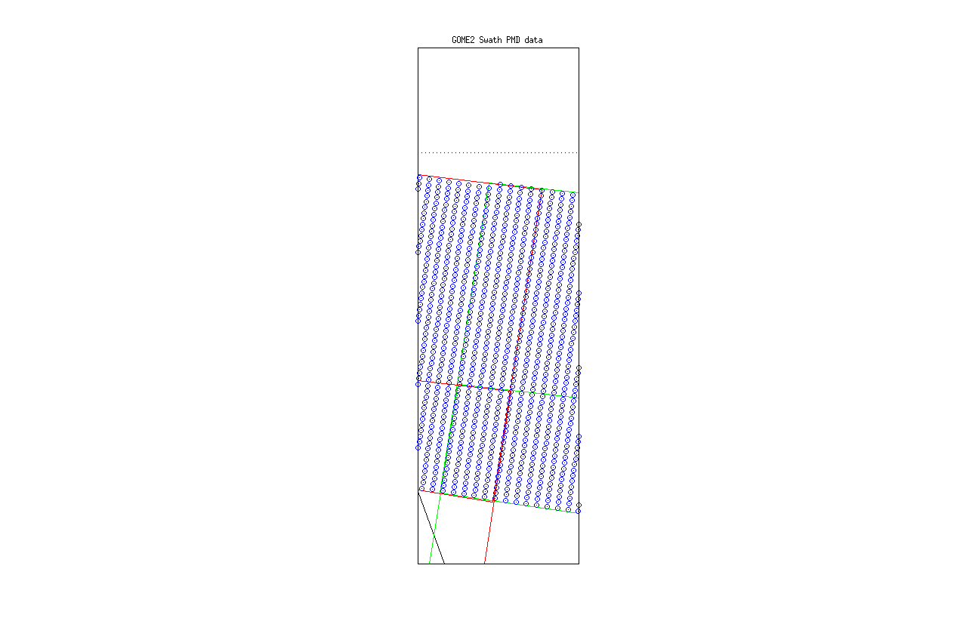
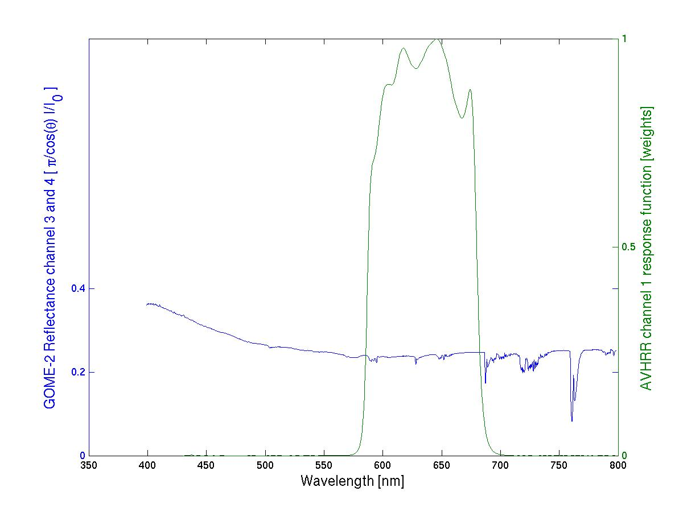
GOME-2/AVHRR reflectance inter-calibration
AVHRR ch 1/ Metop-A
GOME-2 FM3 Metop-A
AVHRR ch1
response function
GOME-2 Ch:4 (Band 6)
1024 measurements
GOME-2 Ch:3 (Band 5)
1024 measurements

Slide 10
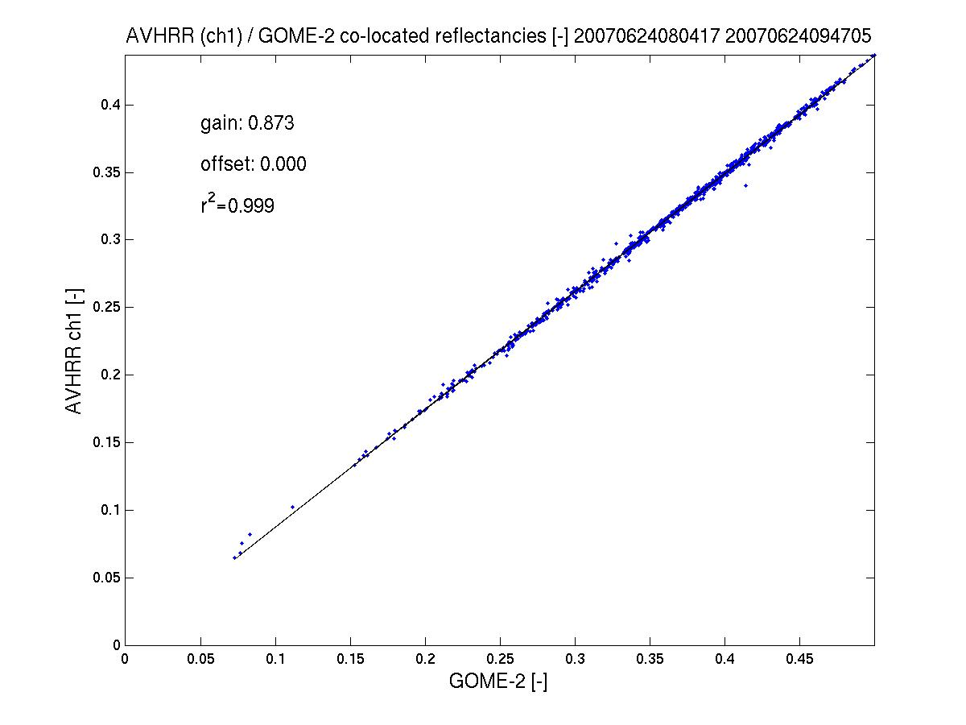
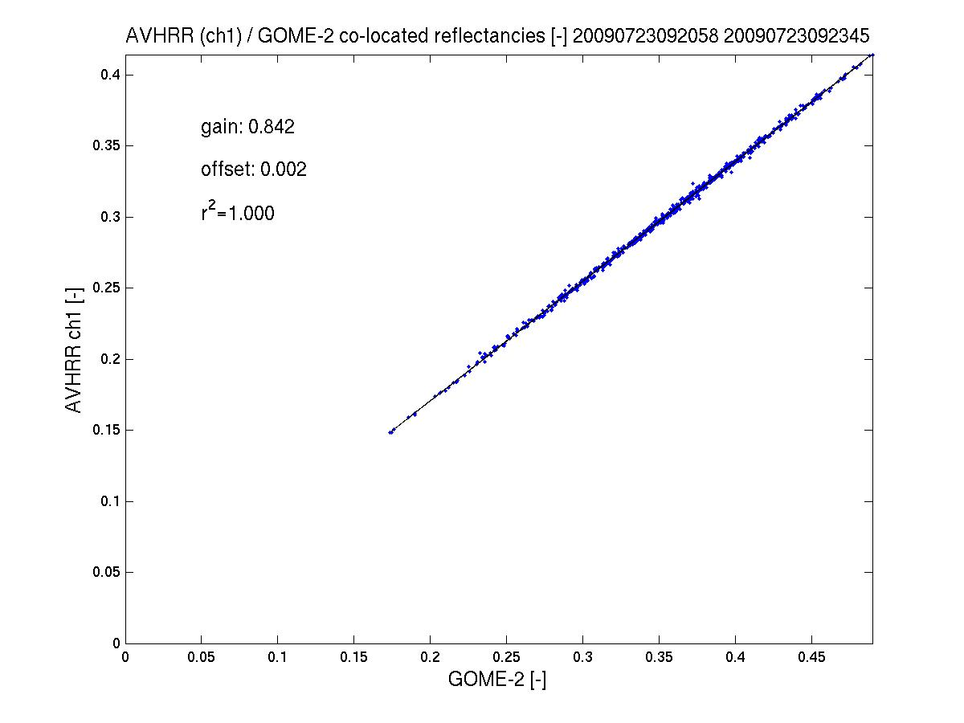
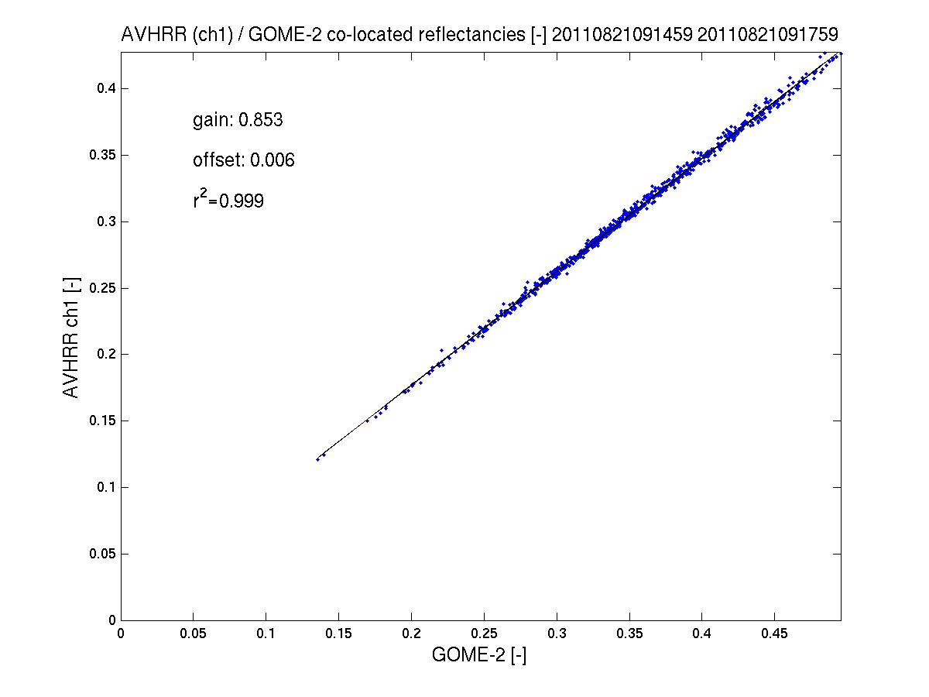
GOME-2 / AVHRR reflectance inter-calibration
AVHRR ch 1/ Metop-A
GOME-2 FM3 Metop-A
AVHRR channel 1 to GOME-2/Metop-A gain in reflectance >10%
(AVHRR < GOME-2)
Results indicate that the gain has been quite stable from 2007 to 2011.
see GSICS Quarterly Newsletters, vol 5, number 3, Latter et al.
2011
2007
2009
spatial aliasing accounted for

Slide 11
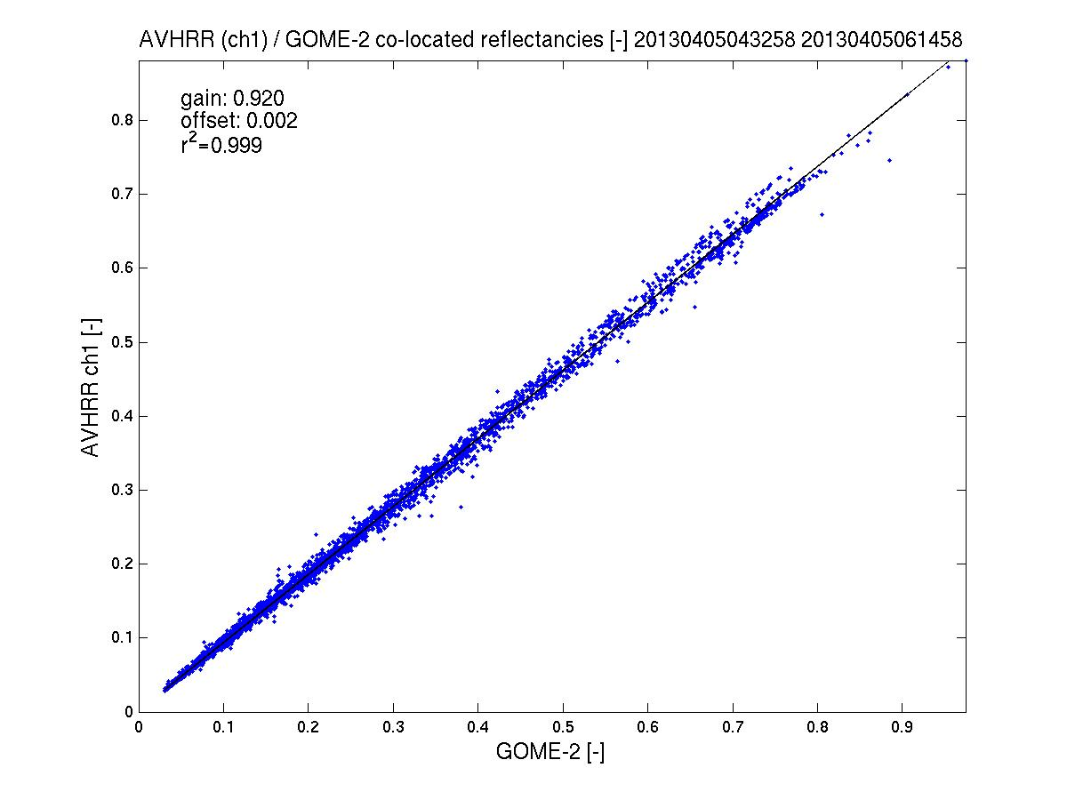
GOME-2 / AVHRR reflectance inter-calibration
AVHRR ch 1/ Metop-A
GOME-2 FM3 Metop-A
AVHRR channel 1 to GOME-2/Metop-A gain in reflectance <8%
(AVHRR < GOME-2)
2011 - 2013
see GSICS Quarterly Newsletters, vol 5, number 3, Latter et al.
2013
spatial aliasing accounted for

Slide 12
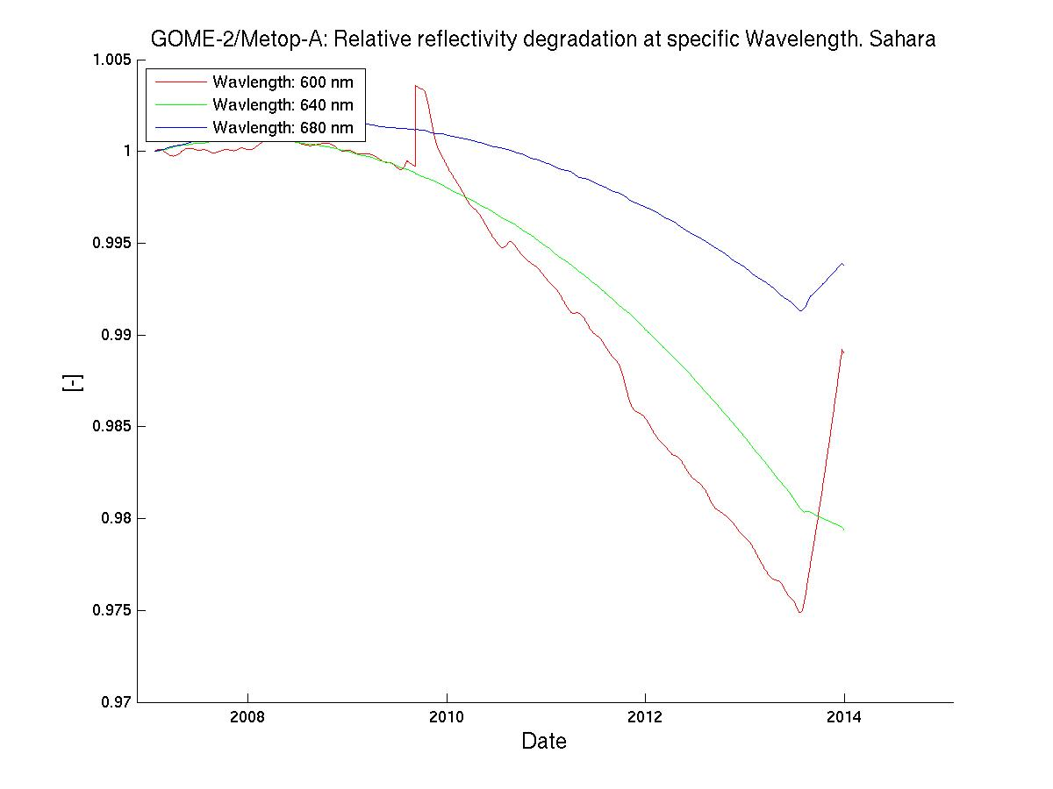
GOME-2 Metop-A degradation component modelling
Sahara – Reflectance Degradation / AVHRR ch1-domain
GOME-2 FM3 Metop-A
R2 campaign
Jan 2007– Jan 2012
OPS phase (same PPF 5.3)
Jan 2012 – Oct 2013
Reflectance
Degradation
600 nm
640 nm
680 nm
Average over all
GOME-2 viewing angles

Slide 13
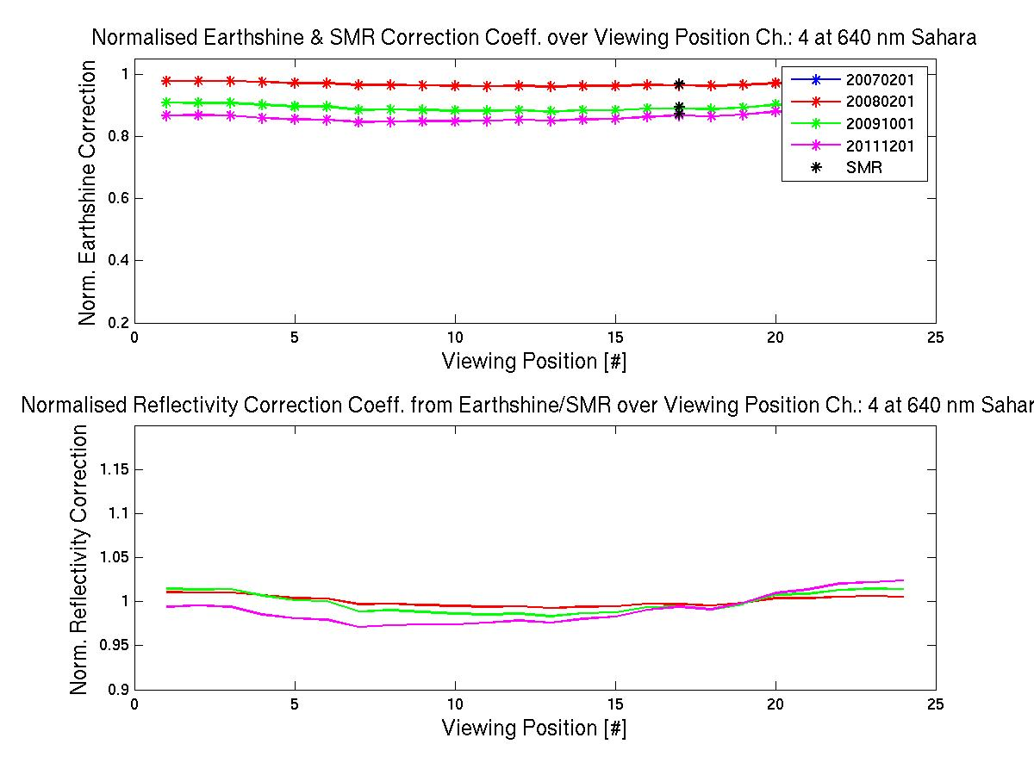
GOME-2 Metop-A degradation component modelling
Sahara – Reflectance Degradation / AVHRR ch1-domain
GOME-2 FM3 Metop-A
R2 campaign
Jan 2007– Jan 2012
OPS phase (same PPF 5.3)
Jan 2012 – Oct 2013
Reflectance
Degradation
640 nm
Over all
GOME-2 viewing angles
at
2008/02/01
2009/10/01
2011/12/01

Slide 14
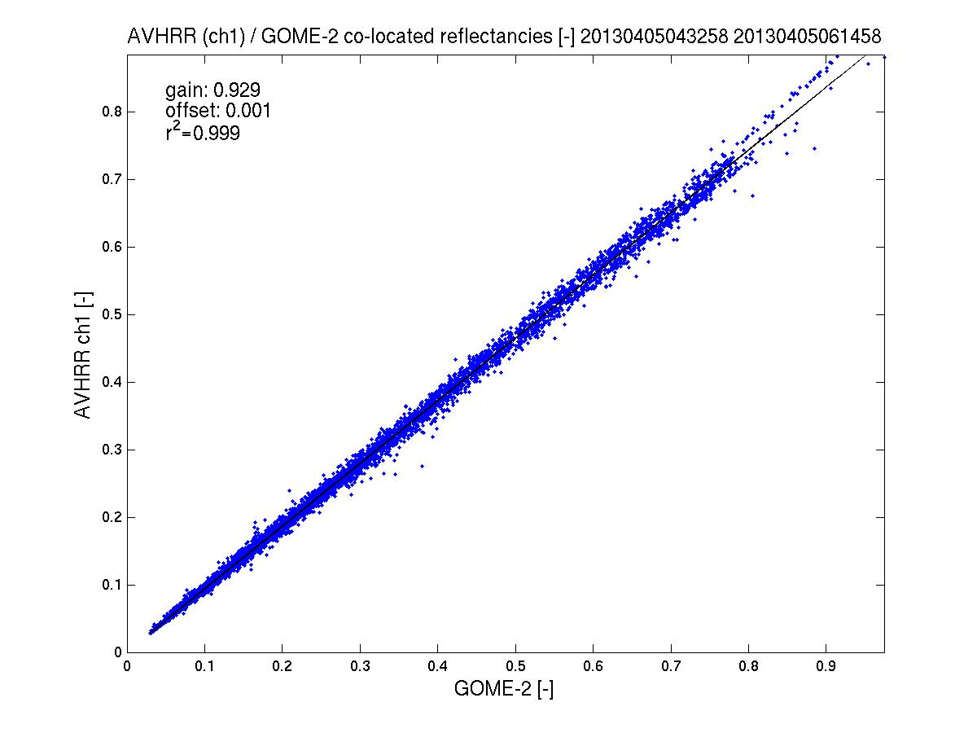
GOME-2/AVHRR reflectance inter-calibration
AVHRR ch 1/ Metop-A
GOME-2 FM3 Metop-A
AVHRR channel 1 to GOME-2/Metop-A gain in reflectance <8%
(AVHRR < GOME-2)
2013
Corrected /
Un-corrected
see GSICS Quarterly Newsletters, vol 5, number 3, Latter et al.
2013
spatial aliasing accounted for

Slide 15
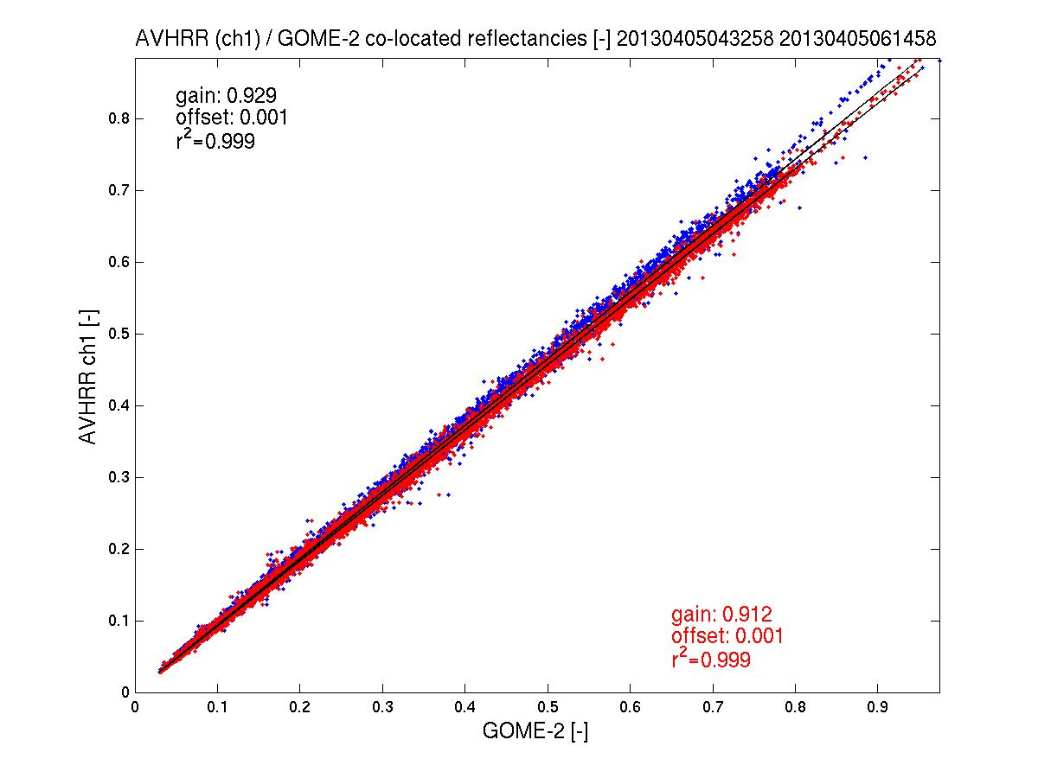
GOME-2/AVHRR reflectance inter-calibration
AVHRR ch 1/ Metop-A
GOME-2 FM3 Metop-A
AVHRR channel 1 to GOME-2/Metop-A gain in reflectance <8%
(AVHRR < GOME-2)
2013
Corrected /
Un-corrected
see GSICS Quarterly Newsletters, vol 5, number 3, Latter et al.
2013
spatial aliasing accounted for

Slide 16
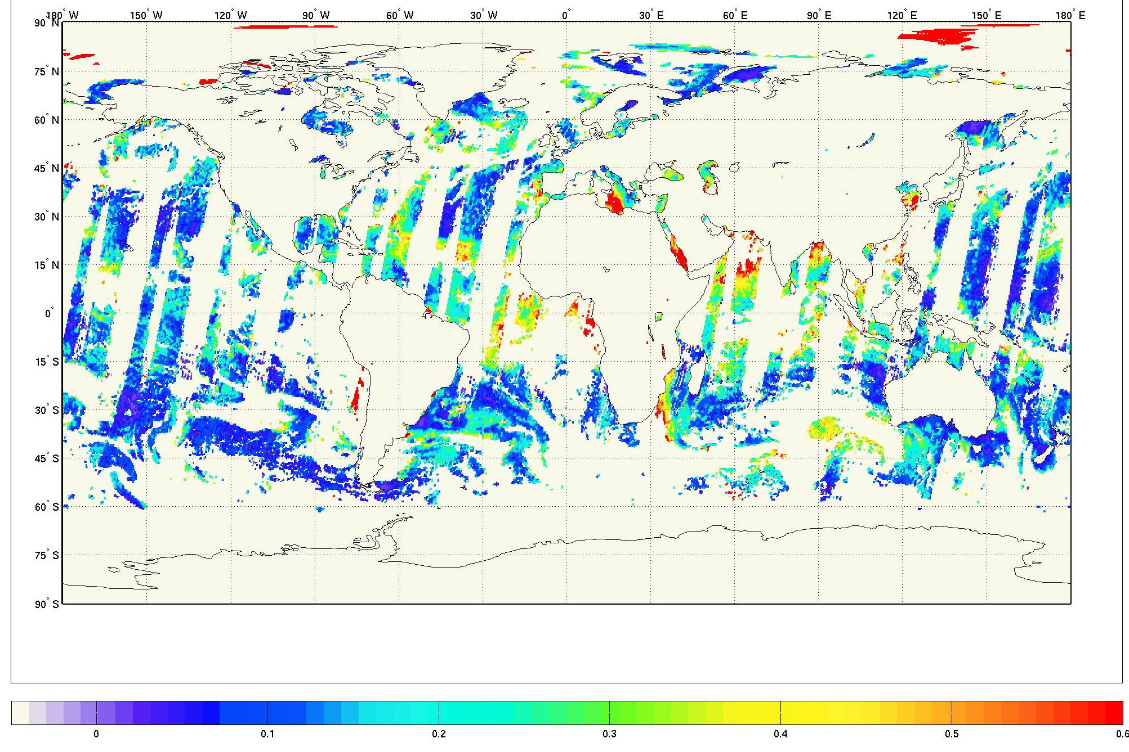
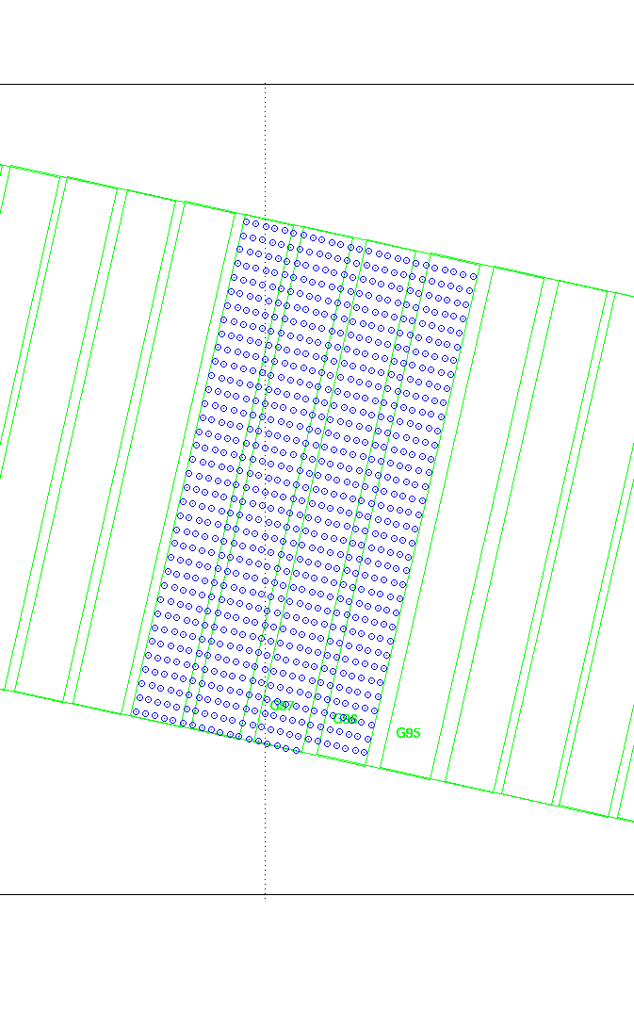
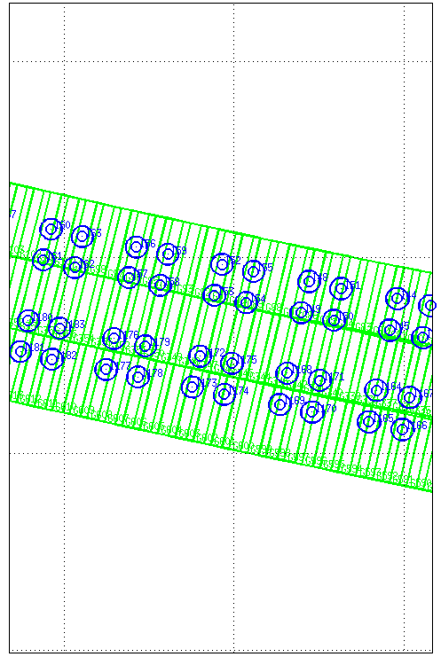
PMAp: Aerosol Optical Depth and volcanic ash from GOME-2 (Polarisation Measurements) / IASI and AVHRR
AOD / volcanic ash retrieval from two Metops – PMAp
Multi-sensor aerosol properties retrieval using GOME-2 stokes fractions from PMDs
GOME-2 FM3 Metop-A
GOME-2 FM2 Metop-B
GOME-2 PMD -
ground pixel sizes
Metop-B: 10 by 40 km
Metop-A: 5 by 40 km
GOME-2 PMD
AVHRR
GOME-2 PMD
IASI

Slide 17
PMAp – Multi-sensor co-location for aerosol optical depth retrievals
GOME-2 FM3 Metop-A
Instrument |  | Spatial resolution | Spectral range | comments
GOME | Main science channel | 80 x 40 km | 240nm -800nm, res. 0.25-0.5nm | AAI, low spatial resolution, not used
 | Polarization Monitoring Device | 10 x 40 km Metop-B 5 x 40 km Metop-A | 311nm-803nm, 15 bands | AOD, aerosol type, AAI
AVHRR | - | 1.08 x 1.08 km | 580nm-12500nm, 5 bands | Clouds, scene heterogeneity, dust/ash
IASI | - | 12km (circular) | 3700–15500nm, resolution 0.5 cm⁻¹ | desert dust, volcanic ash aerosol heights
Auxiliary data | ECMWF wind speed (forecasting) | Temporal interpolation necessary | - | Required for retrievals over ocean
 | surface albedo, Surface elevation | - | - | Required for retrievals over land
GOME-2 FM2 Metop-B
Target spatial resolution

Slide 18
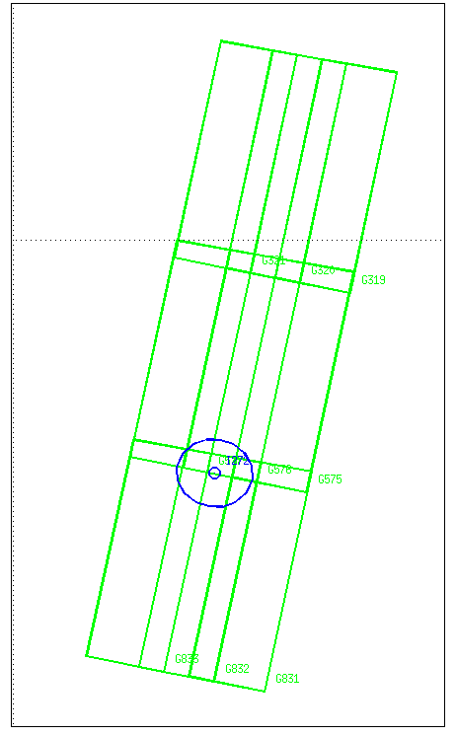
PMAp – Multi-sensor co-location for aerosol optical depth retrievals
The GOME-2 PMD / AVHRR / IASI co-location
GOME-2 FM3 Metop-A
GOME-2 FM2 Metop-B
AVHRR collocation:
an AVHRR pixel is collocated to a GOME-2 PMD pixel if it is inside the GOME-2 pixel
Spatial aliasing due to read-out timing of detectors is taken into account!
IASI collocation:
a IASI pixel may span up to 6 GOME-2 PMD pixels. Which GOME-2 pixel should it be collocated to?

Slide 19
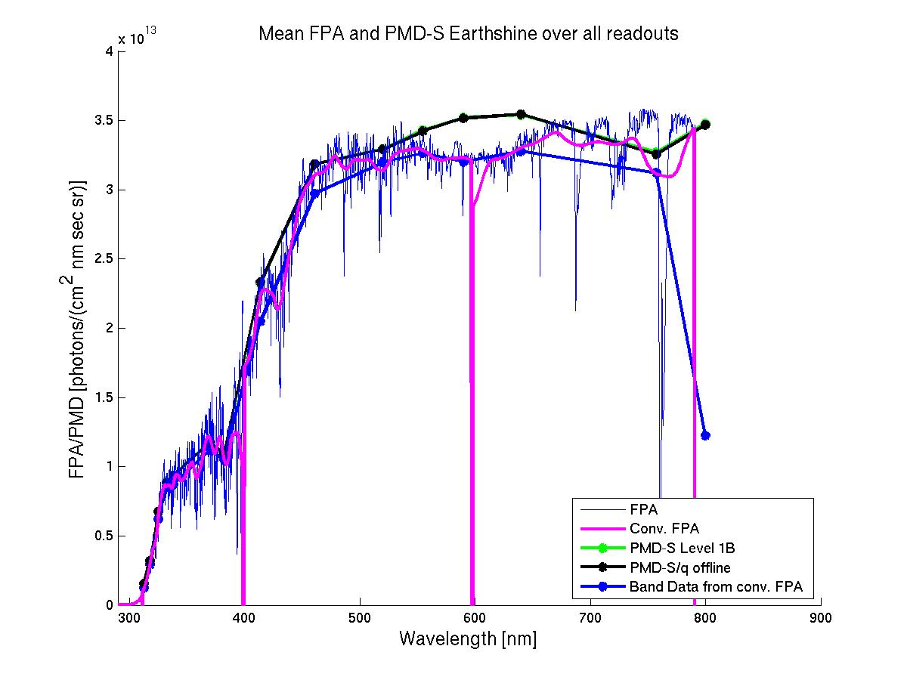
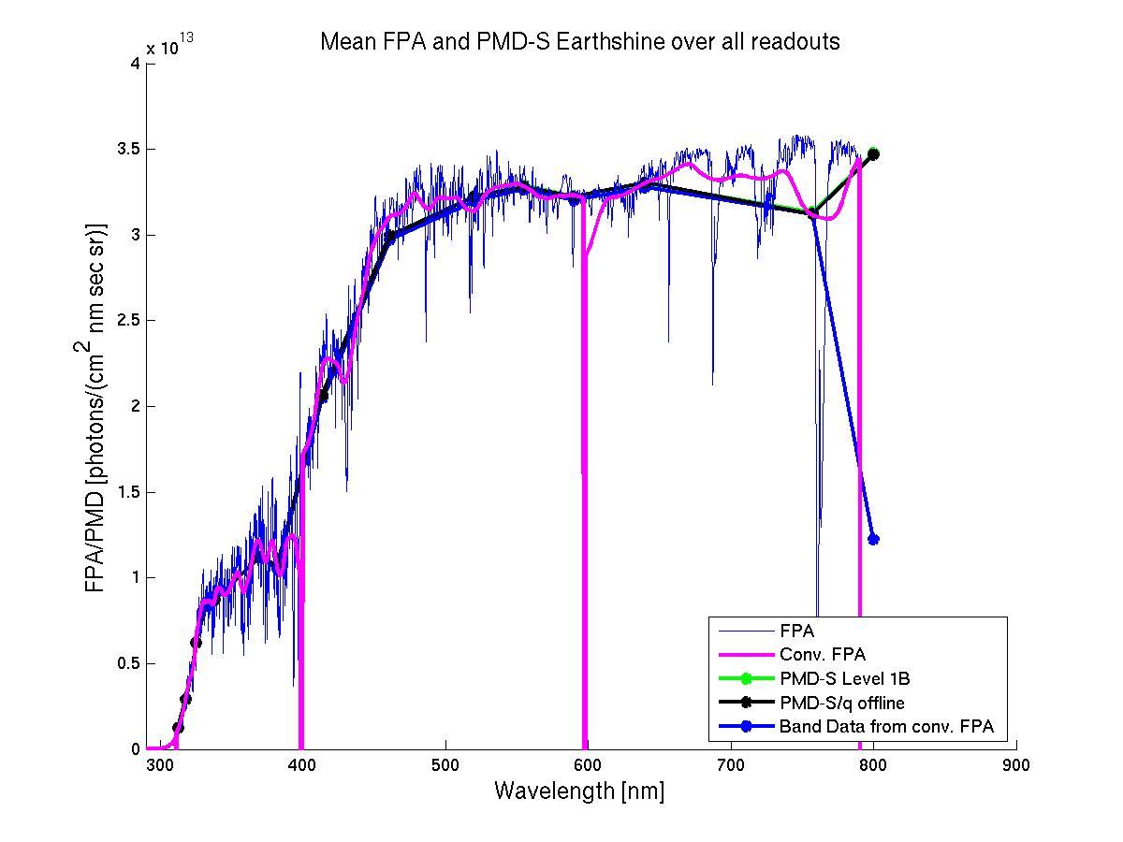
PMAp – Multi-sensor co-location for aerosol optical depth retrievals
Towards continuous calibration of AVHRR channels
GOME-2 FM3 Metop-A
For PMAp a consistent and continuous AVHRR – GOME-2/IASI radiometric
inter-calibration is needed!
GOME-2 FM2 Metop-B
1)
AVHRR vs GOME-2:
Use GOME-2
Main channels to calibrate AVHRR
ch 1 and 2 (?)
AVHRR channels
Channel | Central wave-length[μm] | Wavelength range [μm]
1 | 0.630 | 0.580 - 0.680
2 | 0.865 | 0.725 - 1.000
3A | 1.610 | 1.580 - 1.640
3B | 3.740 | 3.550 - 3.930
4 | 10.800 | 10.300- 11.300
5 | 12.000 | 11.500- 12.500
2)
Correct PMDs using MSC
GOME-2
PMD vs Main channels (MSC):
Make PMDs consistent
with main science
channel radiances
3)
AVHRR vs IASI:
Use IASI to calibrate AVHRR ch 3 to 5

Slide 20
Summary
GOME-2 inter-calibration (AVHRR/Seviri/PMAp)
GOME-2 / Metop-A channel 3/4 vs AVHRR / Metop-A channel 1
Scale factor of 0.89
(2007 to 2011, 2011 to 2013 after correction of GOME-2 data, spatial aliasing accounted for by empirical correlation optimisation)
GOME-2 / Metop-B channel 3/4 vs Seviri / MSG-3 channel 1
Scale factor of ~0.92 (see additional material)
(2013, no correction of GOME-2 data, no spatial aliasing)
  PMAp: GOME-2/(IASI) AVHRR inter-calibration
Towards continuous (operational) calibration for consistency with GOME-2 main science channels

Slide 21
Additional Material

Slide 22
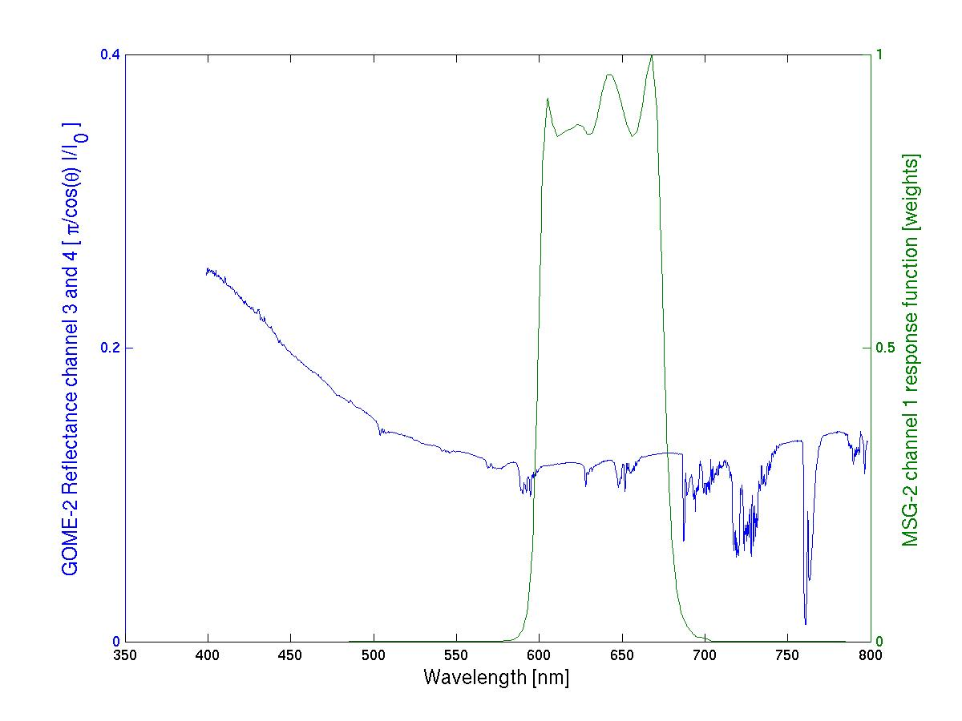
GOME-2 / Seviri reflectance inter-calibration
SEVIRI ch1/ MSG-2 – preliminary results
GOME-2 FM3 Metop-A
Seviri ch1
response function
GOME-2 Ch:4 (Band 6)
1024 measurements
GOME-2 Ch:3 (Band 5)
1024 measurements

Slide 23
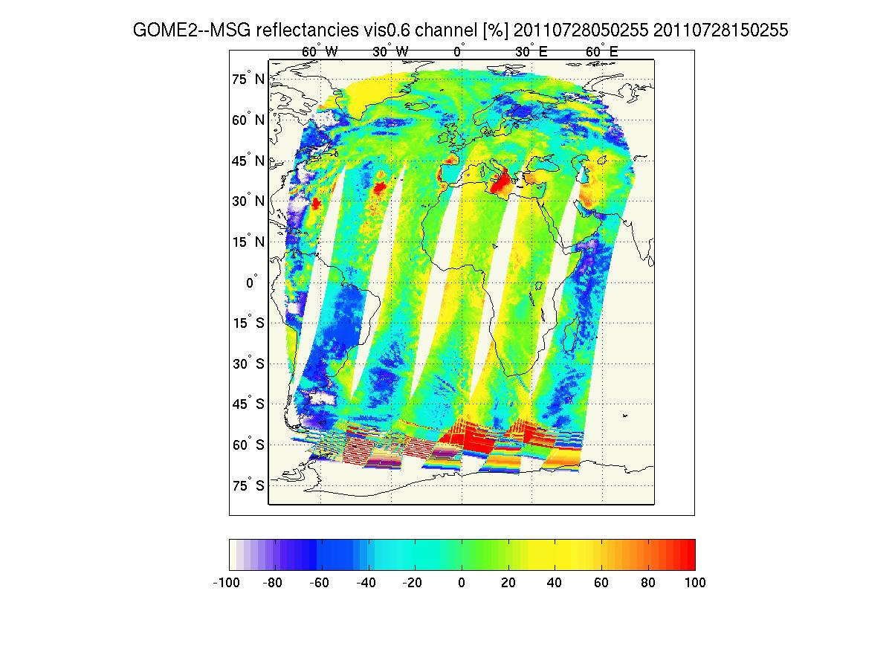
GOME-2 / Seviri reflectance inter-calibration
SEVIRI ch1/ MSG-2 – preliminary results
GOME-2 FM3 Metop-A
Co-location of GOME-2 Metop-A with Seviri / MSG data.
Spatial collocation: Average of all Seviri measurements (~4km) in one GOME-2 ground pixel (40 by 80 km)
Temporal collocation: Within +- 15 min of sensing time.
No spatial aliasing correction

Slide 24
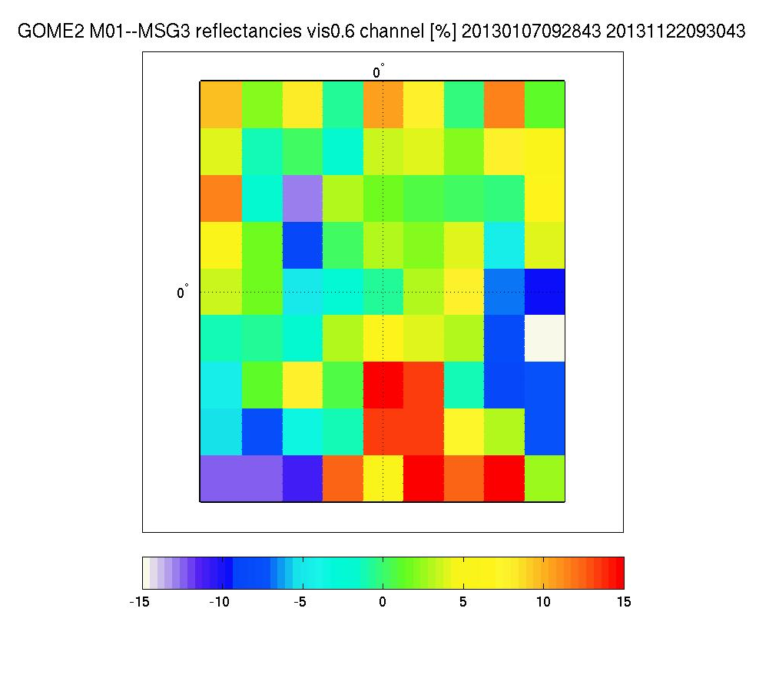
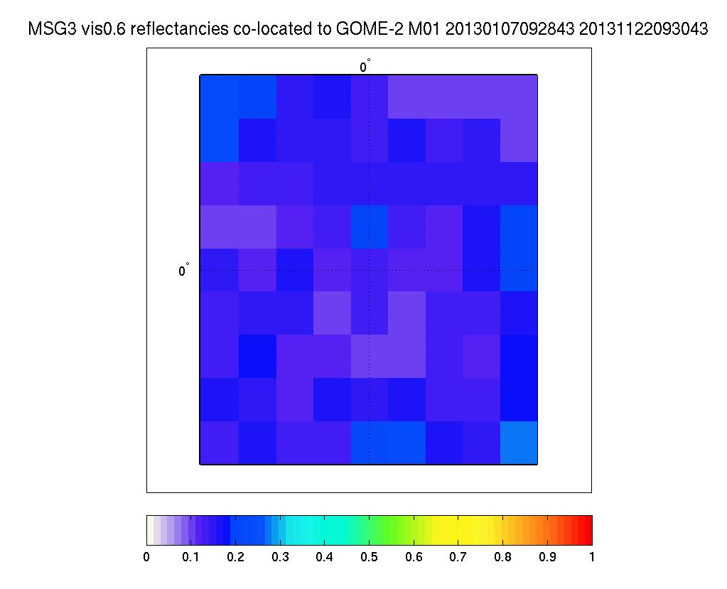
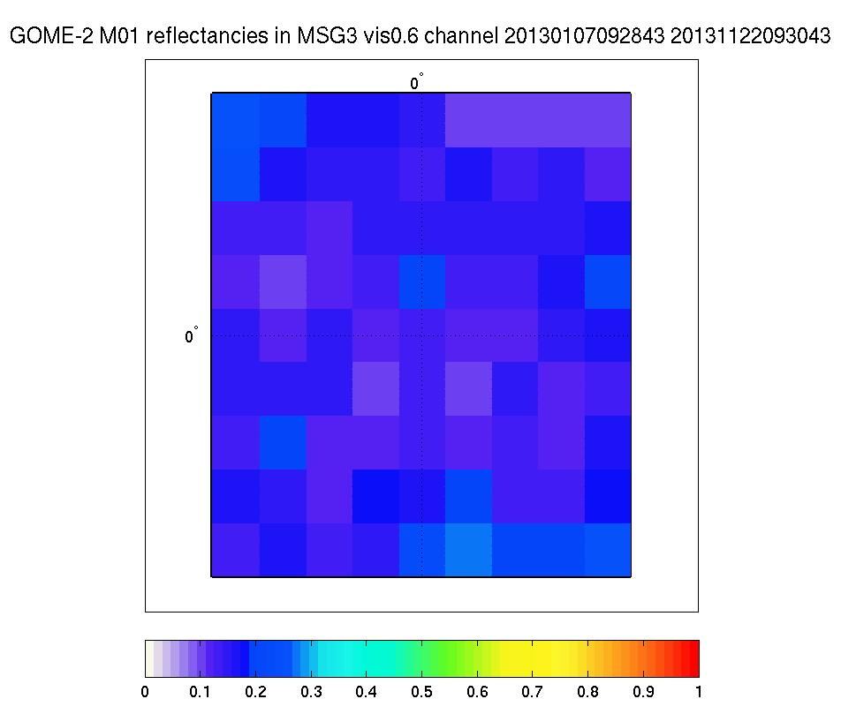
GOME-2/Metop-B reflectance inter-calibration
SEVIRI ch1/ MSG-3 – preliminary results
GOME-2 FM2 Metop-B
Reflectance MSG3 / Seviri Ch 1
1.5/1.5 degrees box at 0/0º
Reflectance GOME-2 / Metop-B
1.5/1.5 degrees box at 0/0º
Residual MSG-3 /Seviri vs GOME-2 / Metop-B [%]
1.5/1.5 degrees box at 0/0º

Slide 25
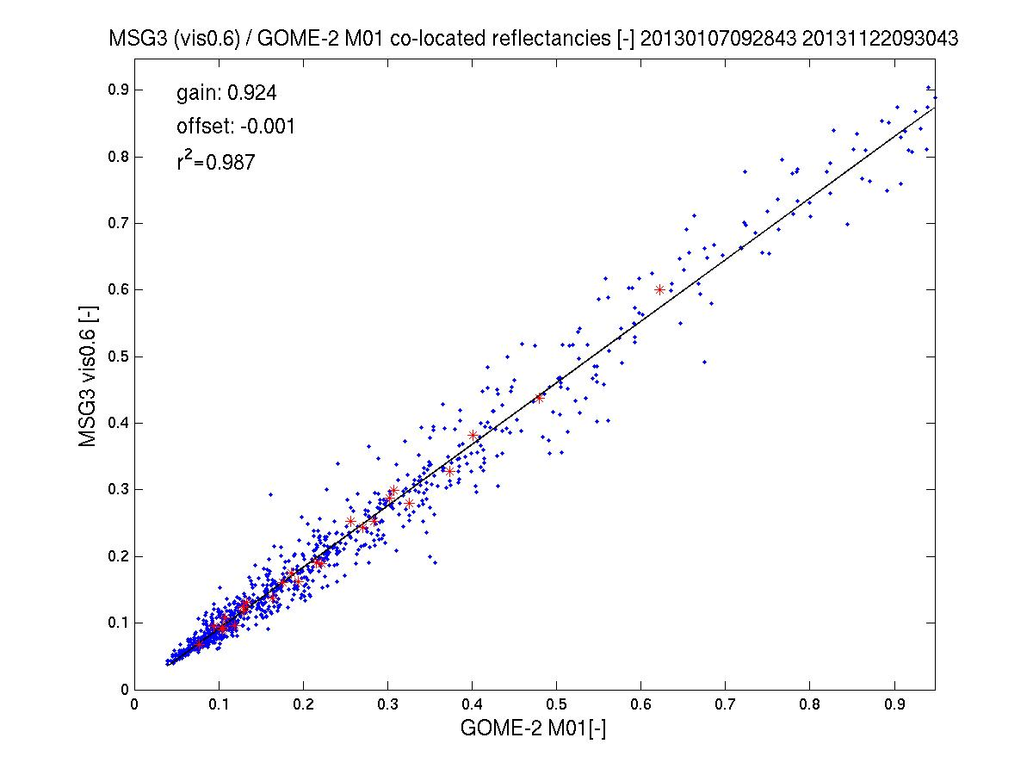
GOME-2/Seviri reflectance inter-calibration
SEVIRI ch1/ MSG-3 vs GOME-2/Metop-B – preliminary results
GOME-2 FM2 Metop-B
MSG-3 / Seviri ch 1 to GOME-2/Metop-B gain in reflectance ~8%
(Seviri < GOME-2)
1st Jan to 22nd Nov 2013
* bi-weekly average

Slide 26
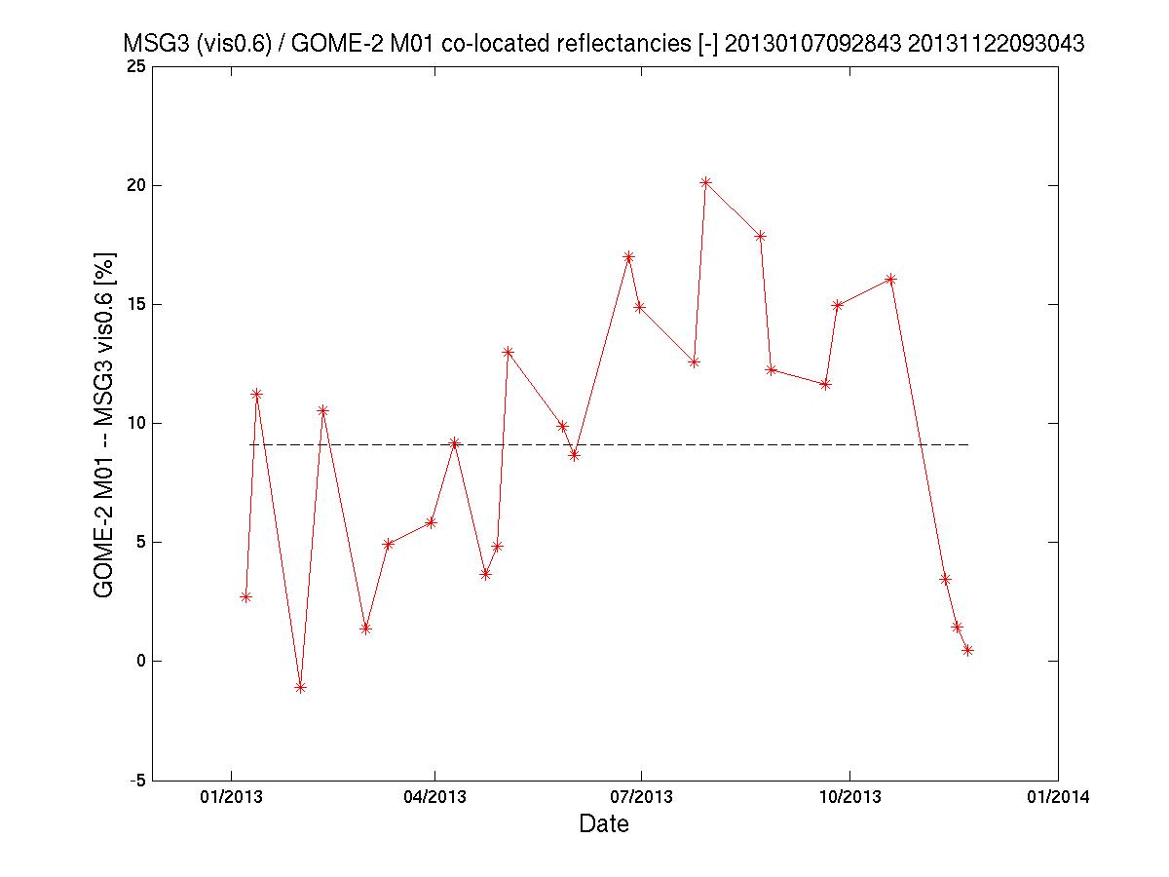
GOME-2/Metop-B reflectance inter-calibration
SEVIRI ch1/ MSG-3 – preliminary results
GOME-2 FM2 Metop-B
MSG-3 / Seviri ch 1 to GOME-2/Metop-B gain in reflectance ~8.5%
(Seviri < GOME-2)
1st Jan to 22nd Nov 2013
No spatial aliasing correction yet
No correlation with SZA found

