Slide 1
GEO-LEO IR Progress at JMA

Slide 2
Achievement in 2015
AHI started operation on 7 July, 2015.
GSICS approach was helpful for AHI commissioning phase data analysis.
AHI IR calibration performance has been evaluated by the GSICS approach.
Tb biases are less than 0.2K at standard radiance in all IR bands. The biases in low Tb region are larger.
Diurnal variation is not significant.
Trend is stable.
AHI calibration monitoring web page opened.
An application to SST was presented at the Mini conference [1l].

Slide 3
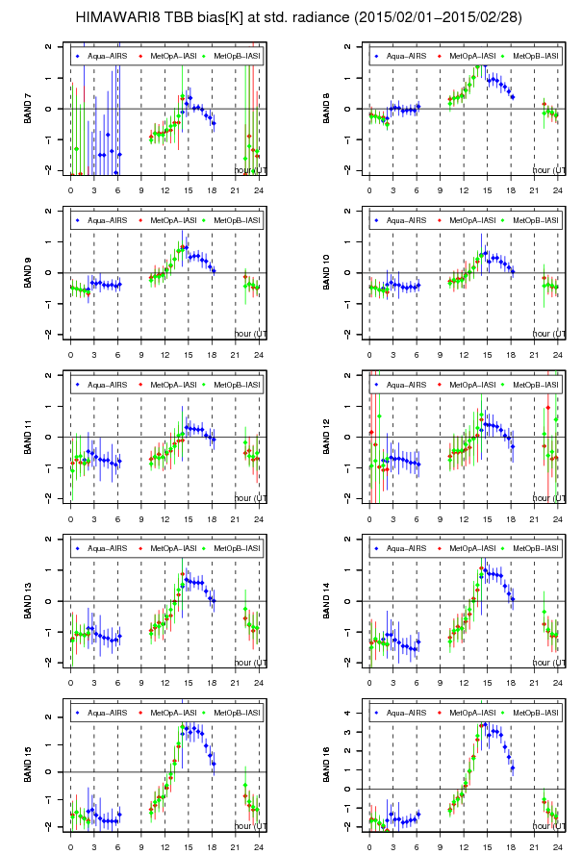
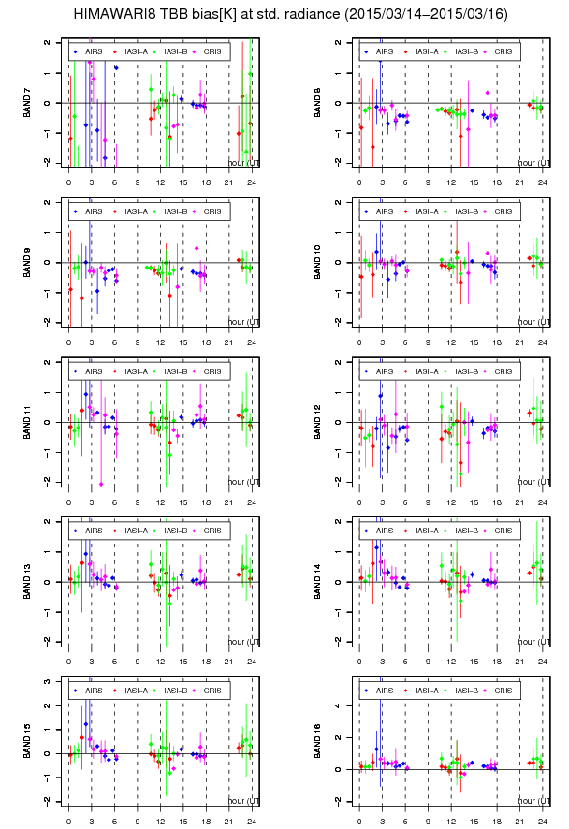
GSICS approach helped AHI commissioning phase
Application of the GSICS approach revealed diurnal variation of IR calibration performance caused by a software bug.
After a bug fix update, the variation resolved.
Diurnal variation in commissioning phase data at the earliest stage

Slide 4
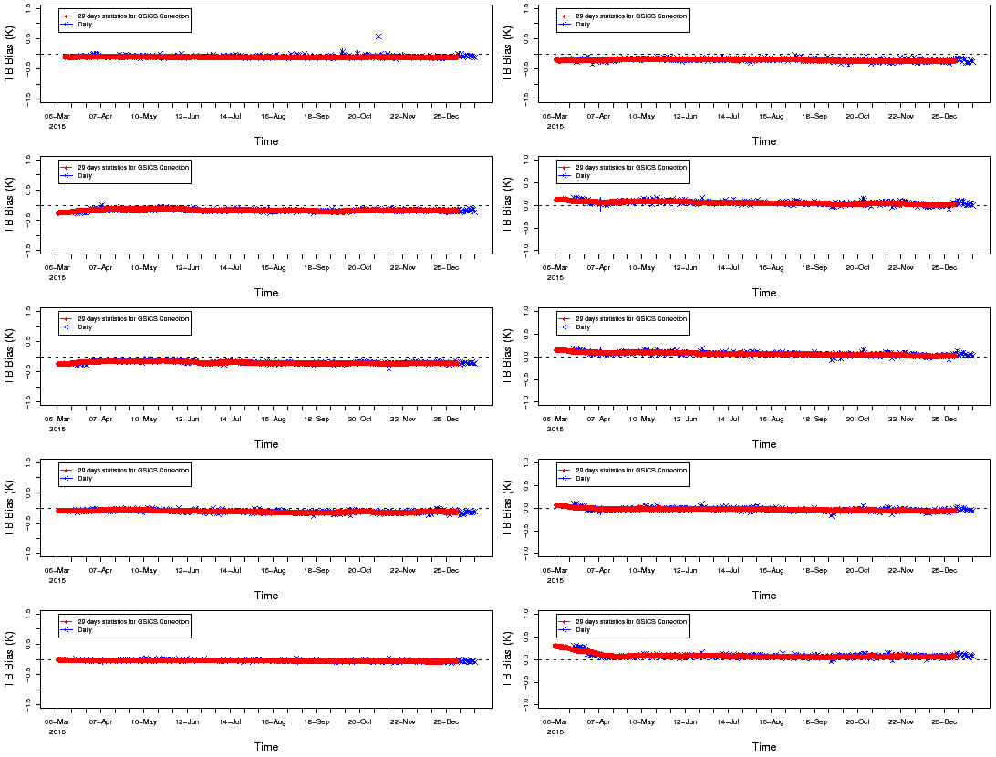
AHI data quality
Tb biases at standard radiance are less than 0.2K.
Reference:
IASI-A
Band 7 (3.9)
Band 12 (9.6)
x: Daily
o: 30 days
Band 8 (6.2)
Band 13 (10.4)
Band 9 (6.9)
Band 14 (11.2)
Band 10 (7.3)
Band 15 (12.4)
Band 11 (8.6)
Band 16 (13.3)
Mar. 2015
Dec.
2015
Mar. 2015
Dec.
2015

Slide 5
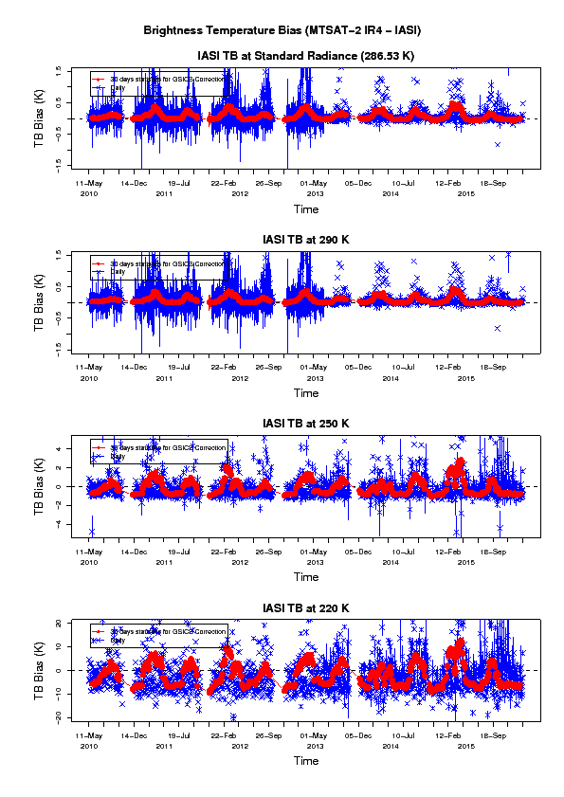
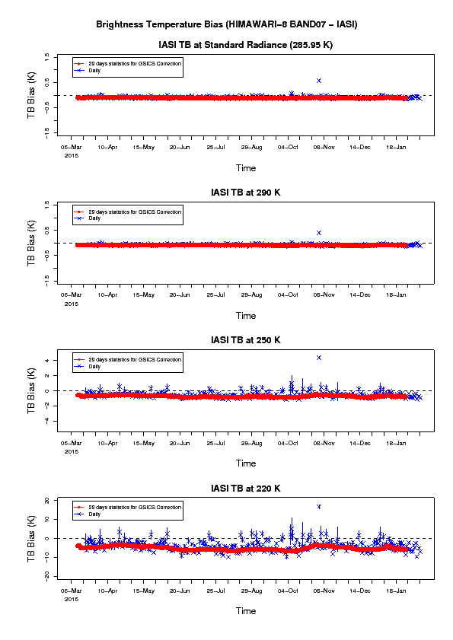
AHI data quality
Tb biases look stable comparing with MTSAT-2.
less long/short-term variation
MTSAT-2 IR4 (3.7um) vs IASI-A
AHI Band 7 (3.7um) vs IASI-A
at std. radiance
at 290 K
at 250 K
at 220 K

Slide 6
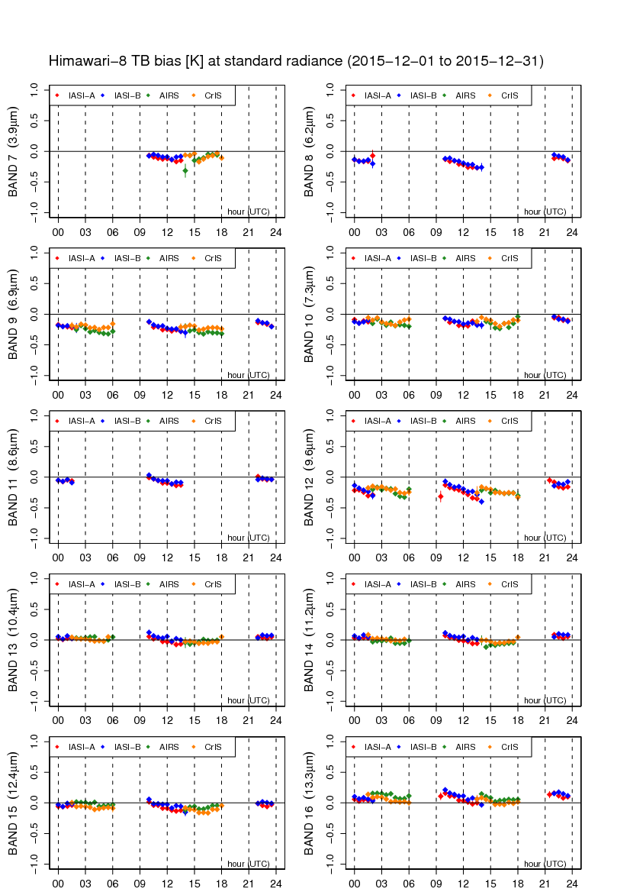
AHI data quality (Diurnal variation in IR)
Himawari-8/AHI
There is no significant diurnal variation seen in MTSAT-2
The biases at the standard radiance are shown.
Data periods are Dec. 2015 (AHI) and Dec. 2014 (MTSAT-2).
Reference sensors are:
Metop-A/IASI
Metop-B/IASI
Aqua/AIRS
S-NPP/CrIS
MTSAT-2/Imager

Slide 7
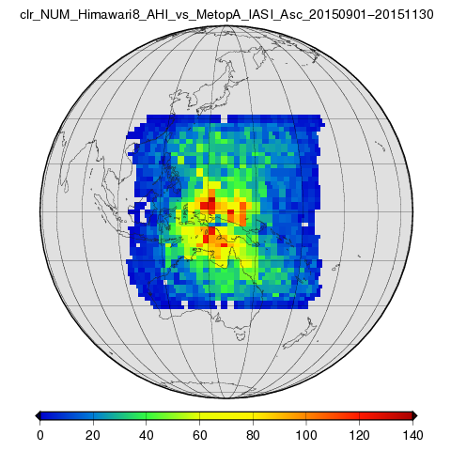
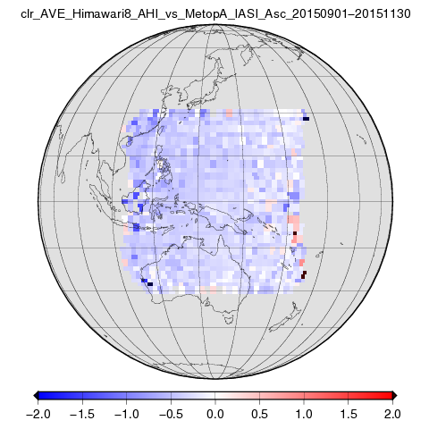
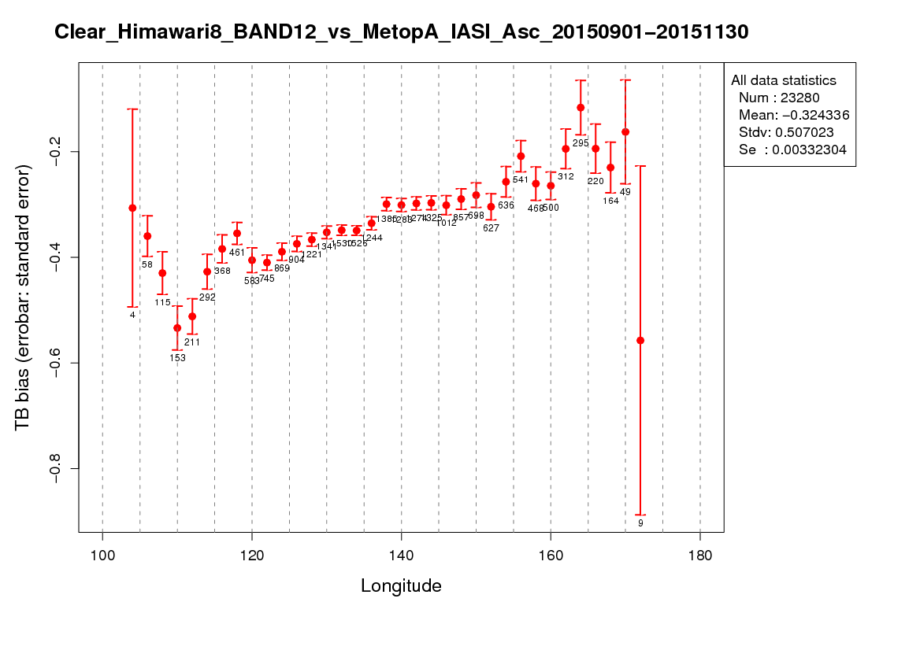
AHI data quality (Tb bias vs location)
What is an uneven plot in the diurnal variation?
Collocation data location depends on time of day and equatorial crossing time of LEO satellite.
Assuming that GEO Tb bias depends on observed location, the uneven plot might be appeared at the timing of reference sensor change.
Further investigation is required.
AHI Band 12 (9.6um) vs. IASI-A
# of collocation data Mean TB bias TB bias in each longitudinal bin
~clear scene
2 x 2 degrees grid statistics for 2015 (Sep. - Nov.)

Slide 8
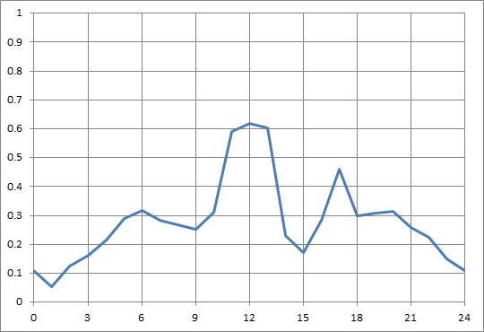
Application of GEO-GEO Potential to figure out the diurnal variation
GEO – LEO
Himawari8(12.4um) -LEO
GEO - LEO
MTSAT2(12.0um) - LEO
MTSAT-2 imager had a diurnal variation, especially in 12.0um band.
Himawari-8 has no significant bias.
The pattern of the [H8 – MT2] looks roughly consistent with [MT2 – LEO].
GEO-GEO information could be useful for filling the gap of LEO orbits.
As a food of thought for now...
GEO - GEO
H8-MT2 (SBAF applied)
17 Dec. 2015 – 14 Jan. 2016

Slide 9
Contents of the GSICS Correction
will be discussed in [3o]
Current contents
Offset and slope to convert GEO radiance to LEO radiance in [mW m⁻² sr⁻¹(cm⁻¹)⁻¹] => [WN]
Tb bias at std. scene
Coefficients to convert Tb to radiance
Coefficients to convert radiance to Tb
JMA optional for MTSAT-2:
Offset and slope to convert GEO DN to LEO radiance in [mW m-2 sr-1(cm-1)-1] => [WN]
LUT from DN to LEO Tb [K]
For WL-believers to obtain LEO radiance
Situation in AHI
Himawari Standard Data contains WL-based radiance [mW m⁻² sr⁻¹ um⁻¹ ]
LUT approach (JMA optional B) is not reasonable for AHI any more.
3.9 um band has 14 bits.
Do we need the option (c) to support “wavelength-based” radiance users?
GEO DN
C)
GEO rad. [WL]
LEO rad. [WL]
B)
GEO Tb [K]
LEO Tb [K]
A)
GEO rad. [WN]
LEO rad. [WN]
GSICS Correction

Slide 10
Work plan and issues
New imager’s GSICS Correction with current algorithm
GSICS Correction for MTSAT-2 IR is now in demonstration phase.
The algorithm for AHI is same as the one for MTSAT-2.
GSICS Correction of AHI IR will be submitted to Pre-operational phase after uncertainty analysis and external users’ review.
Should we continue update retired imager’s GSICS Correction?
MTSAT-2 operation was over. Do we need to promote the MT2 GSICS Correction to operational phase?
We will revisit this question in future, if we establish an approach to correct diurnal variation, because some of MTSAT-2 IR bands had a diurnal variation.
Is it in a scope of SCOPE-CM IOGEO?

