Slide 1
2016 GSICS Annual Meeting (29 Feb ~ 4 Mar 2016 )@ Tsukuba, Japan
GEO-LEO IR Progress at KMA (Diurnal Variation)
NMSC/KMA

Slide 2
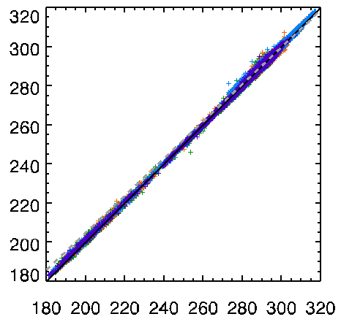
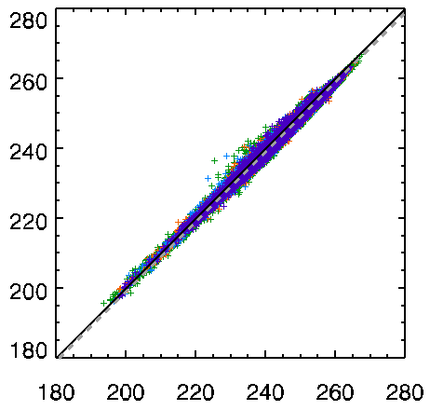
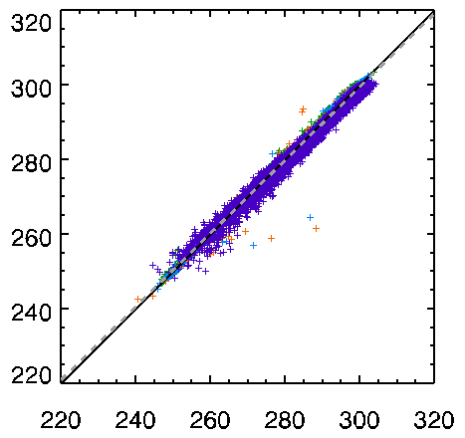
GEO-LEO TB bias
check the TB bias for each IR channels
period: AIRS IASI-A (April 2011 - Dec. 2015) IASI-B (Aug. 2013 - Dec. 2015) CrIS(Jan. 2014 - Dec. 2015)
COMS TB (K)
IR1(10.8μm)
IR2(12.0 μm)
In SWIR of CrIS, large bias due to much shorter spectral coverage of MI broadband
COMS TB (K)
WV(6.8μm)
SWIR(3.8μm)
LEO TB (K)
LEO TB (K)

Slide 3
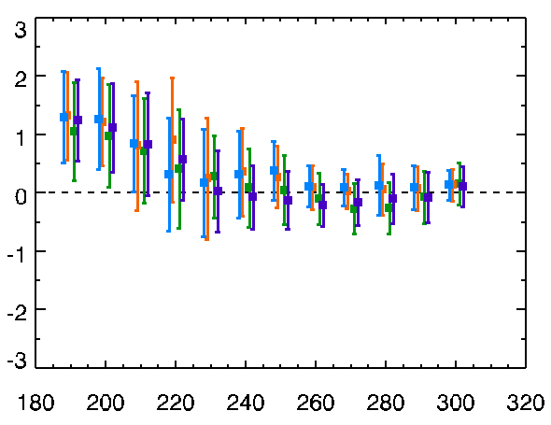
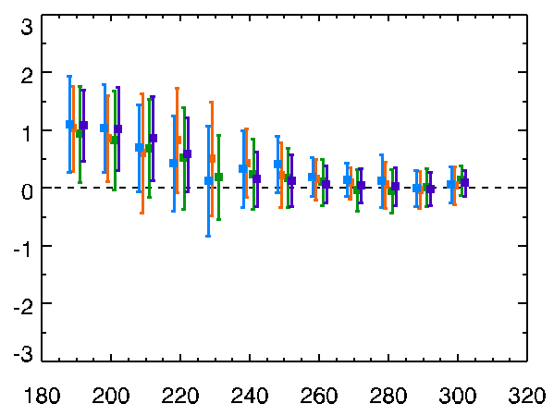
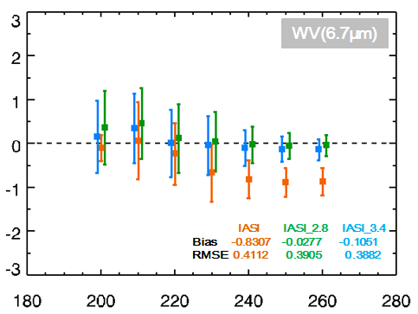
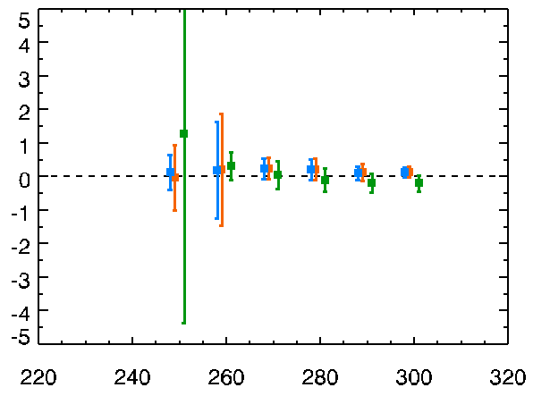
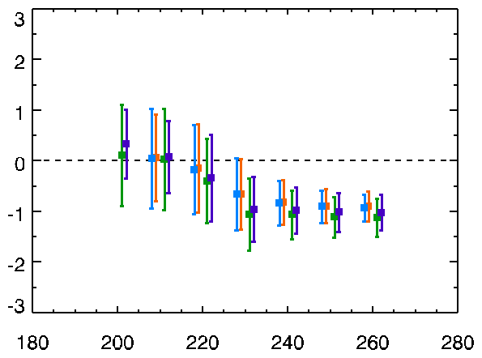
$∆$TB(COMS/MI –LEO)
trend of TB bias for COMS IR TBs
period: AIRS IASI-A (April 2011 - Dec. 2015) IASI-B (Aug. 2013 - Dec. 2015) CrIS(Jan. 2014 - Dec. 2015)
IR1
IR2
TB Bias(COMS –LEO)(K)
WV
SWIR
TB Bias(COMS –LEO)(K)
TB(COMS)
TB(COMS)

Slide 4
Monthly variation of TB Bias & RMSE
monthly variation of TB bias and RMSE
period: AIRS IASI-A (April 2011 - Dec. 2015) IASI-B (Aug. 2013 - Dec. 2015) CrIS(Jan. 2014 - Dec. 2015)
AIRS IASI-A IASI-B CrIS
TB Bias (COMS-LEO)
TB RMSE
Double Diff.(IASI/A TB bias- IASI/B TB bias)
Mean bias -0.0208
IR1
IR1
IR1
Mean bias -0.0283
IR2
IR2
IR2
WV
WV
Mean bias 0.0142
WV
SWIR
Mean bias 0.0088
SWIR
SWIR

Slide 5
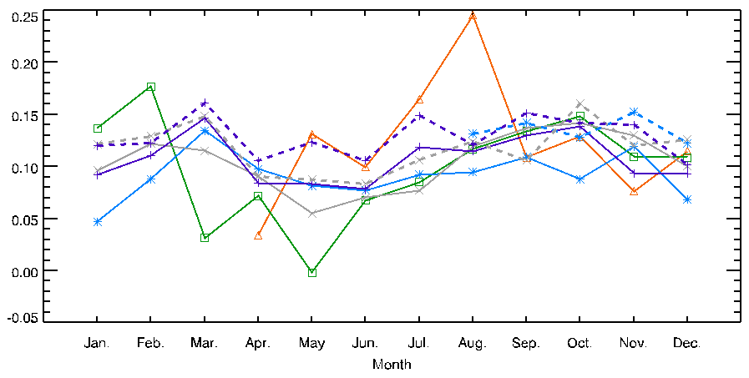
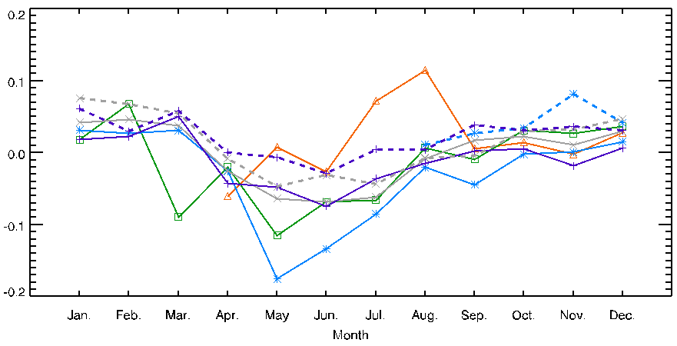
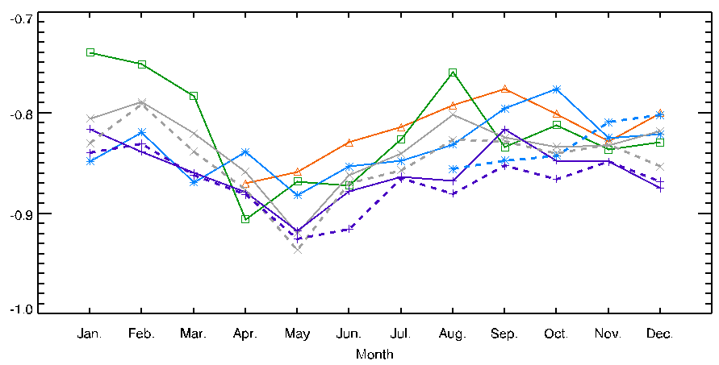
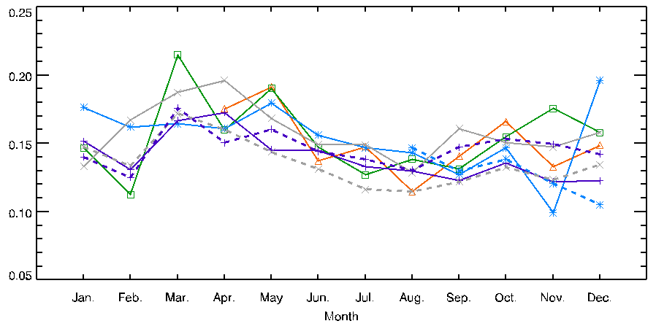
Seasonal variation of MI-IASIA/B
Seasonal variation of TB bias
period: IASI-A (April 2011 - Dec. 2015), IASI-B (Aug. 2013 - Dec. 2015)
2011 2012 2013 2014 2015
IASI-A: solid line IASI-B: dash line
IR1
TB Bias(COMS –LEO)(K)
IR2
WV
SWIR
TB Bias(COMS –LEO)(K)

Slide 6
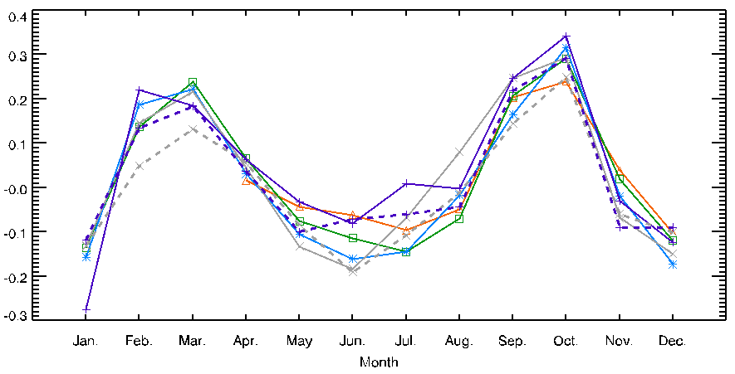
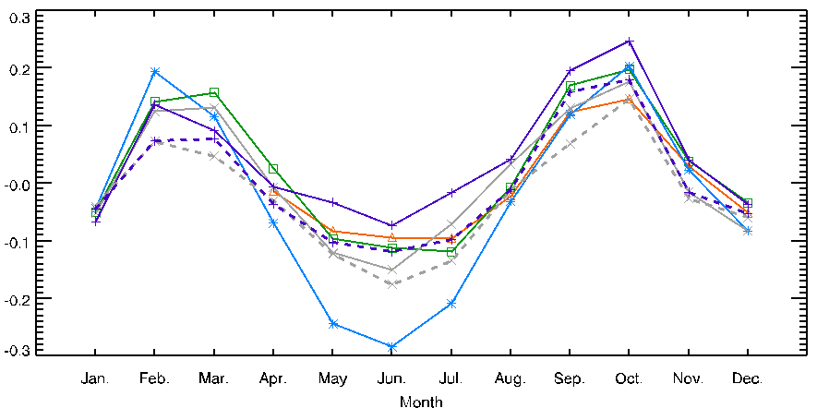
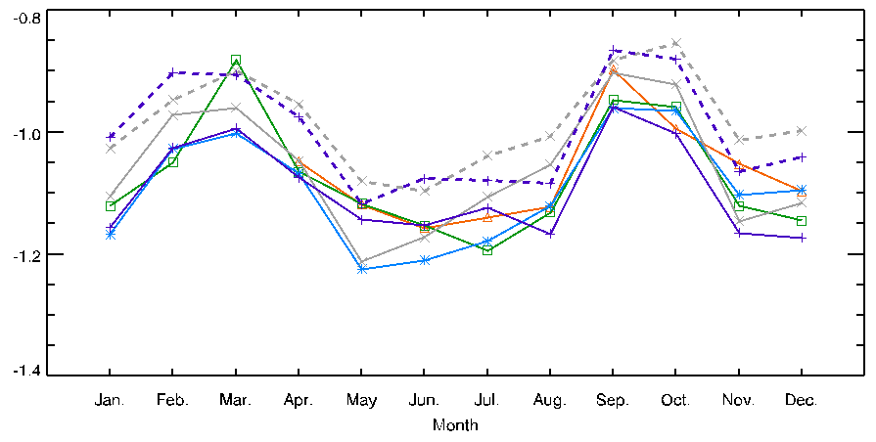
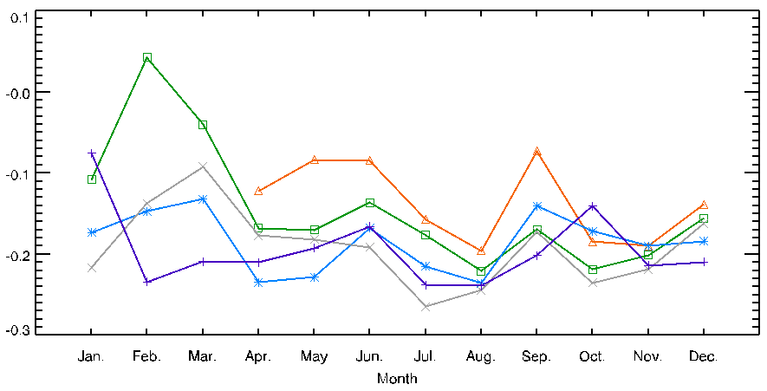
Seasonal variation of MI-AIRS/CrIS
Seasonal variation of TB bias
period: AIRS (April 2011 - Dec. 2015), CrIS (Jan. 2014 - Dec. 2015)
2011 2012 2013 2014 2015
AIRS: solid line CrIS: dash line
IR1
TB Bias(COMS –LEO)(K)
IR2
WV
SWIR
TB Bias(COMS –LEO)(K)

Slide 7
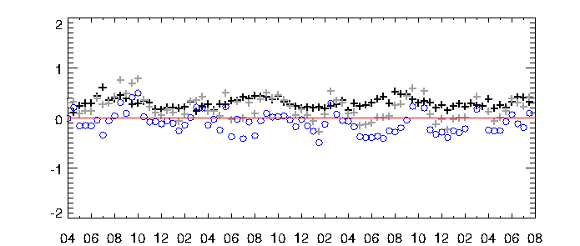
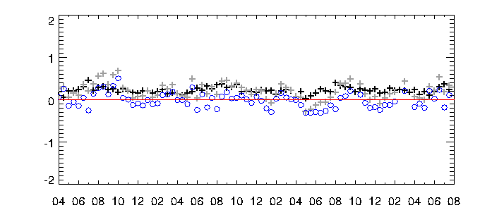
Double differences(AIRS-IASI)
[COMS/MI-Aqua/AIRS] – [COMS/MI-MetOp-A/IASI]
time series of mean bias for 15days
IR1
Mean: -0.095
Std. dev.: 0.208
TB difference (K)
+ mean bias with MetOp-A/IASI
+ mean bias with Aqua/AIRS
○ difference of mean biases
2011
2012
2013
2014
2011
2012
2013
2014
IR2
TB difference (K)
Mean: -0.015
Std. dev.: 0.175
2011
2012
2013
2014
Notes:
95% confidence level / trend(regression) and 1-sigma value ???

Slide 8
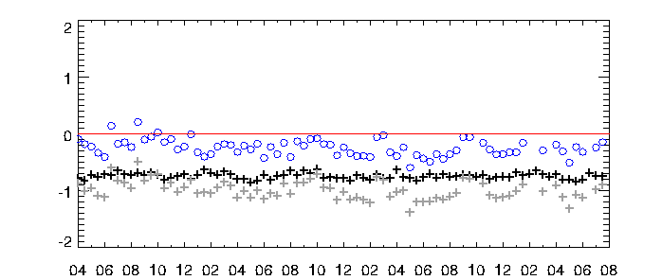
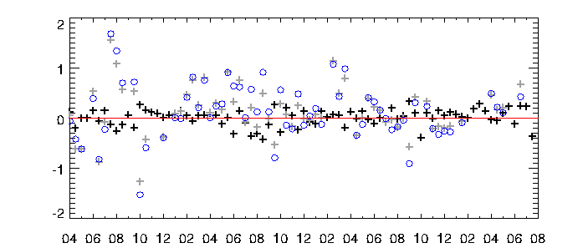
Double differences(AIRS-IASI)
WV
Mean: -0.243
Std. dev.: 0.146
TB difference (K)
+ mean bias with MetOp-A/IASI
+ mean bias with Aqua/AIRS
○ difference of mean biases
2011
2012
2013
2014
SWIR
Mean: -0.141
Std. dev.: 0.553
TB difference (K)
2011
2012
2013
2014
Notes:
WV difference of mean bias – significant ??? 무시하기 어려운 정도의 수치 ??

Slide 9
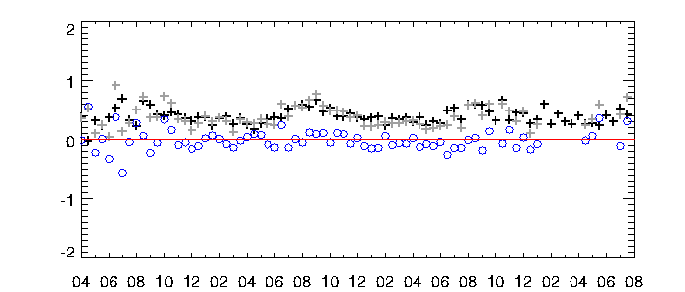
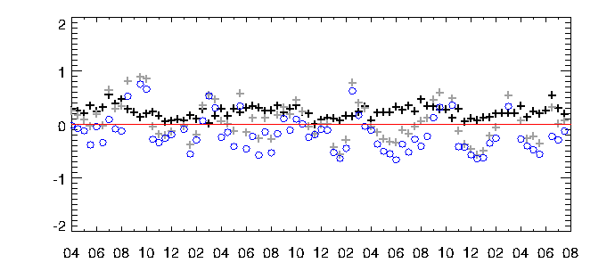
DD (day/night-time data)
IR1 - day
+ mean bias with MetOp-A/IASI
+ mean bias with Aqua/AIRS
○ difference of mean biases
TB difference (K)
Mean: -0.012
Std. dev.: 0.170
2011
2012
2013
2014
IR1 - night
Mean: -0.172
Std. dev.: 0.331
TB difference (K)
2011
2012
2013
2014

Slide 10
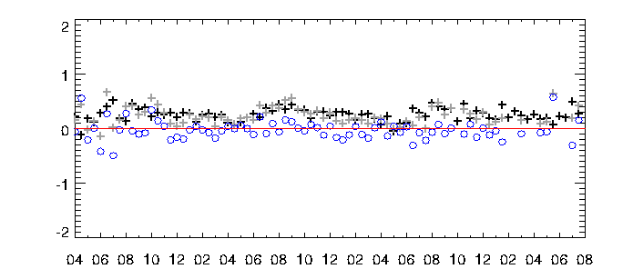
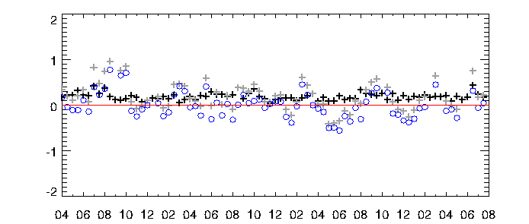
DD (day/night-time data)
IR2 - day
+ mean bias with MetOp-A/IASI
+ mean bias with Aqua/AIRS
○ difference of mean biases
TB difference (K)
Mean: -0.027
Std. dev.: 0.176
2011
2012
2013
2014
IR2 - night
Mean: -0.000
Std. dev.: 0.282
TB difference (K)
2011
2012
2013
2014

Slide 11
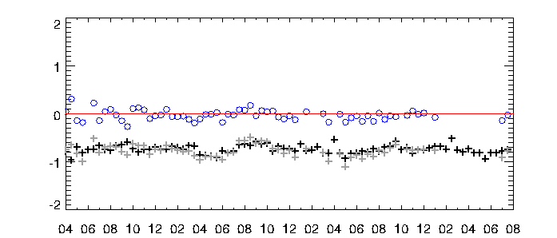
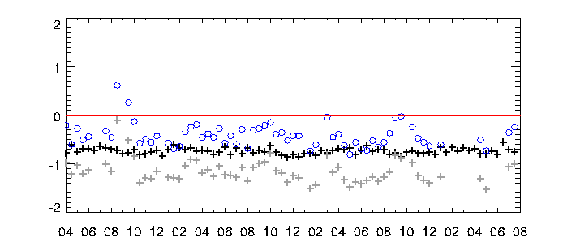
DD (day/night-time data)
IR3 - day
+ mean bias with MetOp-A/IASI
+ mean bias with Aqua/AIRS
○ difference of mean biases
TB difference (K)
Mean: -0.029
Std. dev.: 0.107
2011
2012
2013
2014
IR3 - night
Mean: -0.416
Std. dev.: 0.243
TB difference (K)
2011
2012
2013
2014

Slide 12
Double Difference(Summary)
Type | Channel | Mean of Bias Differences | Std. dev. of Bias Differences
All-time data | IR1 (10.8μm) | -0.0951 | 0.2086
 | IR2 (12.0μm) | -0.0153 | 0.1757
 | WV (6.8μm) | -0.2440 | 0.1460
 | SWIR (3.8μm) (night only) | -0.1410 | 0.5530
Day-time data | IR1 | -0.0117 | 0.1707
 | IR2 | -0.0275 | 0.1764
 | WV | -0.0294 | 0.1068
Night-time data | IR1 | -0.1718 | 0.3314
 | IR2 | -0.0004 | 0.2823
 | WV | -0.4158 | 0.2431

Slide 13
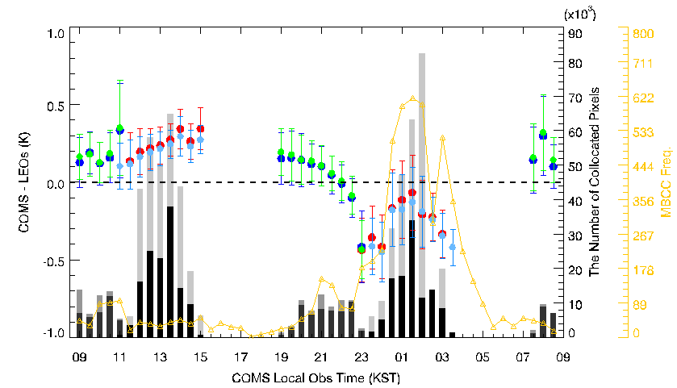
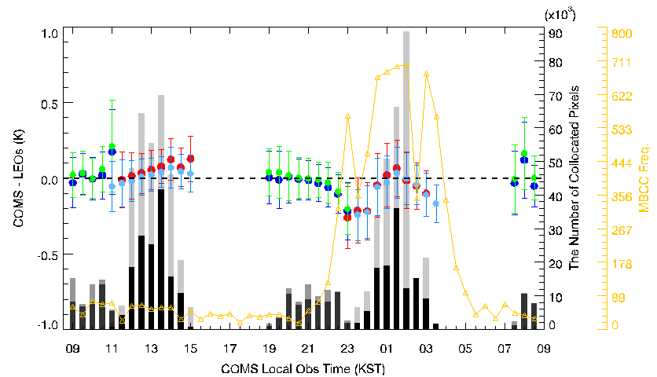
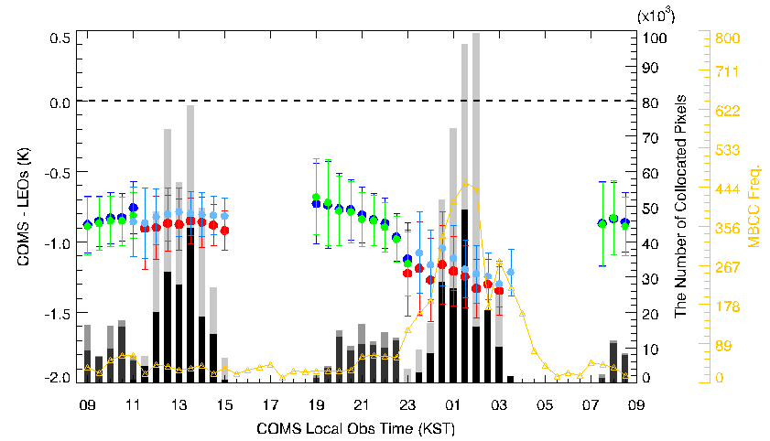
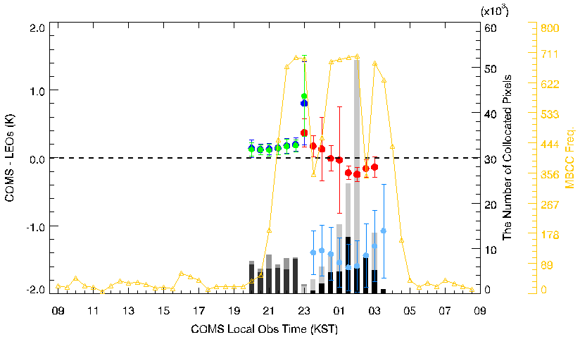
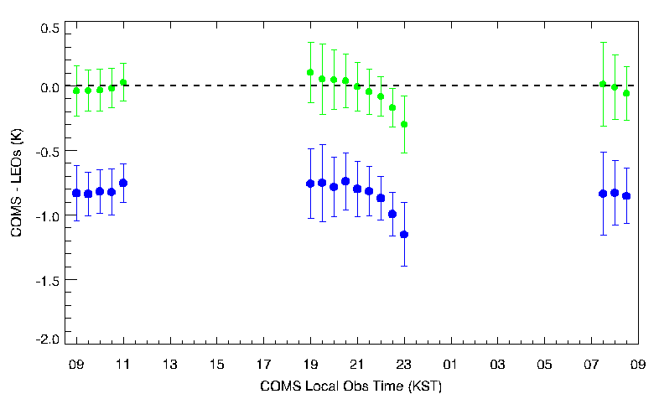
Diurnal variation of COMS-LEO(Bias)
Diurnal variation for COMS IR TBs
period: AIRS IASI-A (April 2011 - Dec. 2015) IASI-B (Aug. 2013 - Dec. 2015) CrIS(Jan. 2014 - Dec. 2015)
IR1
IR2
IASI WV SRF shift
WV
SWIR
IASI IASI_2.8
period: Jan. 01.2014 - Dec.12.2014
WV(6.7μm)
AIRS IASI-A IASI-B CrIS

Slide 14
Diurnal Tb variation & MBCC performance
period: AIRS(April 2011 - Dec. 2015)
$Diurnal Tb variation=\max\left(∆{Tb}_{GEO−AIRS,i}\right)−\min\left(∆{Tb}_{GEO−AIRS,j}\right)$
$MBCC performance=\operatorname{mean}\left(∆{Tb}_{GEO−AIRS,i}\right)−\operatorname{mean}\left(∆{Tb}_{GEO−AIRS,j}\right)$
$i=daytime$, $j=nighttime$ (KST)
Diurnal Tb variation
 | Winter | Spring | Summer | Autumn | Total
IR1 | +0.7034 | +0.8256 | +0.8107 | +1.0421 | +0.7803
IR2 | +0.2706 | +0.3911 | +0.5523 | +0.4875 | +0.3882
WV | +0.5503 | +0.4635 | +0.5788 | +0.5791 | +0.4960
Ref. Yu et al., 2013
MBCC performance
 | Winter | Spring | Summer | Autumn | Total
IR1 | +0.5545 | +0.4385 | +0.6173 | +0.4669 | +0.5087
IR2 | +0.1434 | +0.1265 | +0.2787 | +0.0938 | +0.1523
WV | +0.4530 | +0.3155 | +0.3734 | +0.3726 | +0.3706

Slide 15
Thank you…

Slide 16
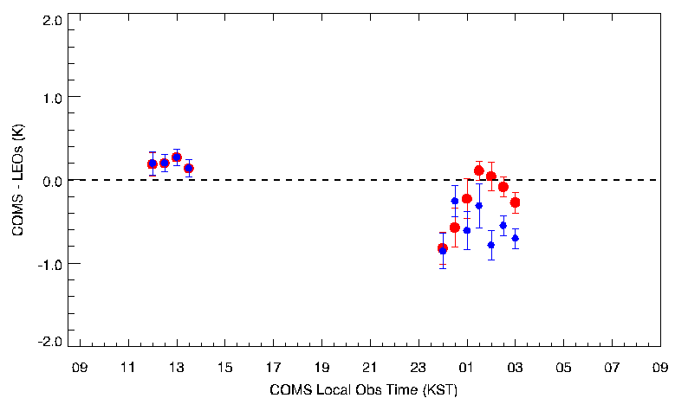
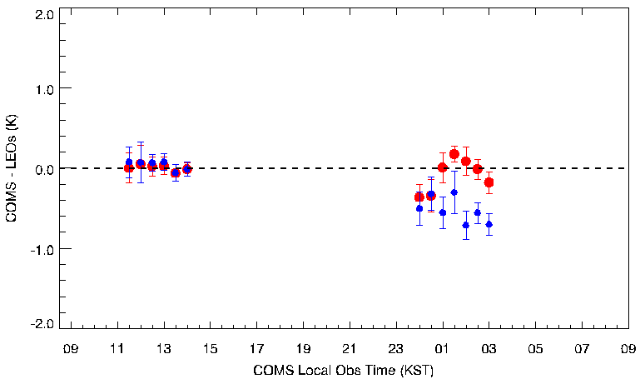
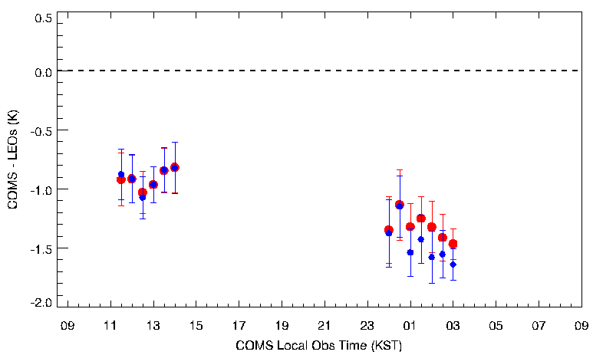
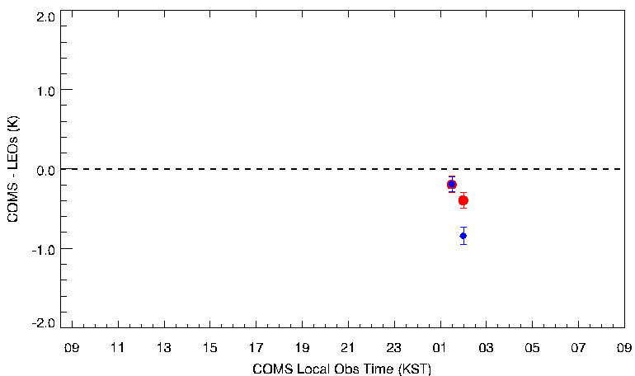
Diurnal variation of COMS-LEO(Bias)
Before MI MBCC application vs. After MI MBCC application for COMS IR TBs
period: AIRS (April.8.2015 – April.17.2015)
After MI MBCC Before MI MBCC
IR1
IR2
WV
SWIR

