Slide 1



Hyperspectral Infrared Sounder
Traceability and Uncertainty
Likun Wang^{1*} and Tim Hewison²
1. CICS/ESSIC/UMD
2. EUMETSAT
*Email: wlikun@umd.edu
Contributions from CNES, UW, UMBC, NOAA/STAR, JPL/AIRS team, EUMETSAT …
2016 GSICS Annual Meeting, Tsukuba, Japan

Slide 2
Outline
Hyperspectral IR Instruments
Calibration uncertainties and traceability
  Using CrIS as an example
Inter-Comparison results
Discussion

Slide 3
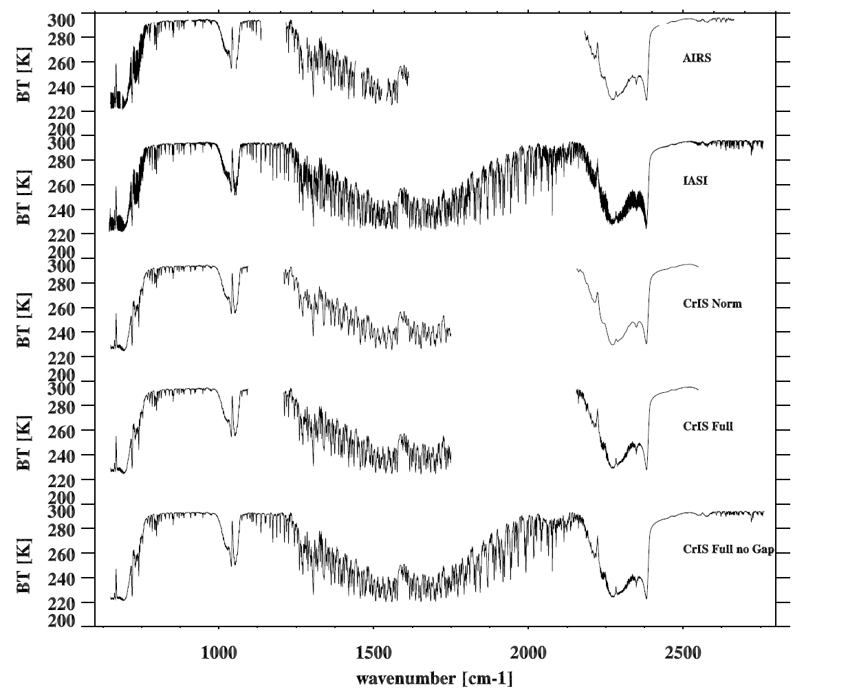
Spectral Coverage of AIRS, IASI, and CrIS
AIRS (2378 channels)
Aqua (2002-now)
IASI (8461 channels)
MetOp-A(2006-now)
MetOp-B (2013-now)
CrIS Normal Resolution
(1305 channels)
NPP (2011-now)
CrIS Full Resolution
(2211 channels)
NPP (2014-now)
Proposed for Future
CrIS on JPSS/2

Slide 4
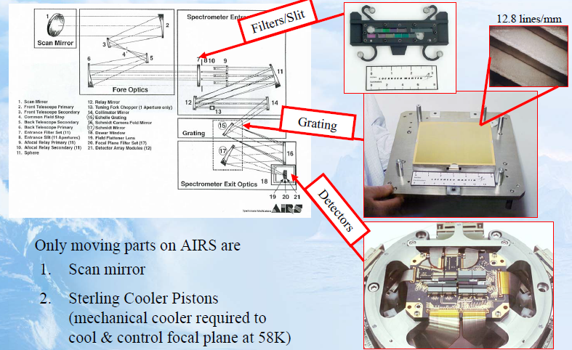
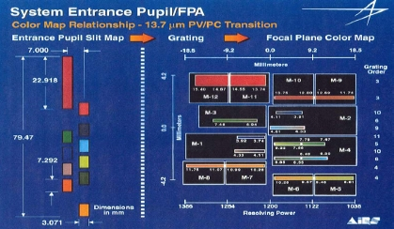
AIRS: Grating Spectrometer
AIRS detector Array
Launched on 2002 on NASA Aqua
From Christ Barnet

Slide 5
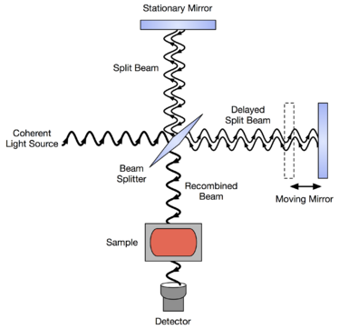
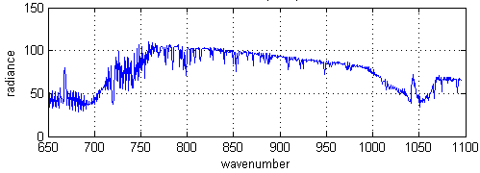
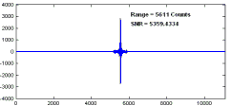
IASI and CrIS: Interferometer
CrIS optical system
From Yong Han, NOAA/STAR
Fourier
Transform
IR spectrum
Interferogram

Slide 6
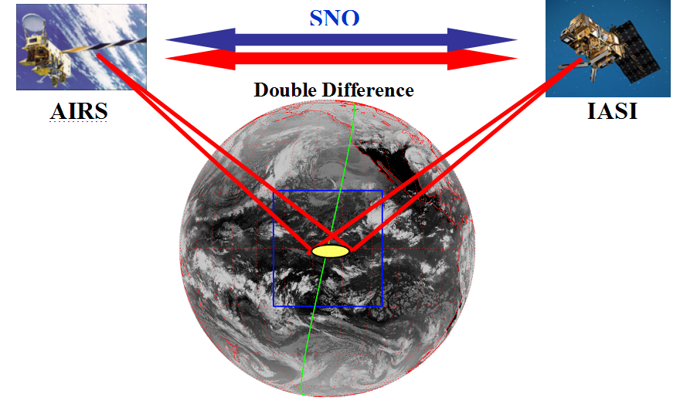
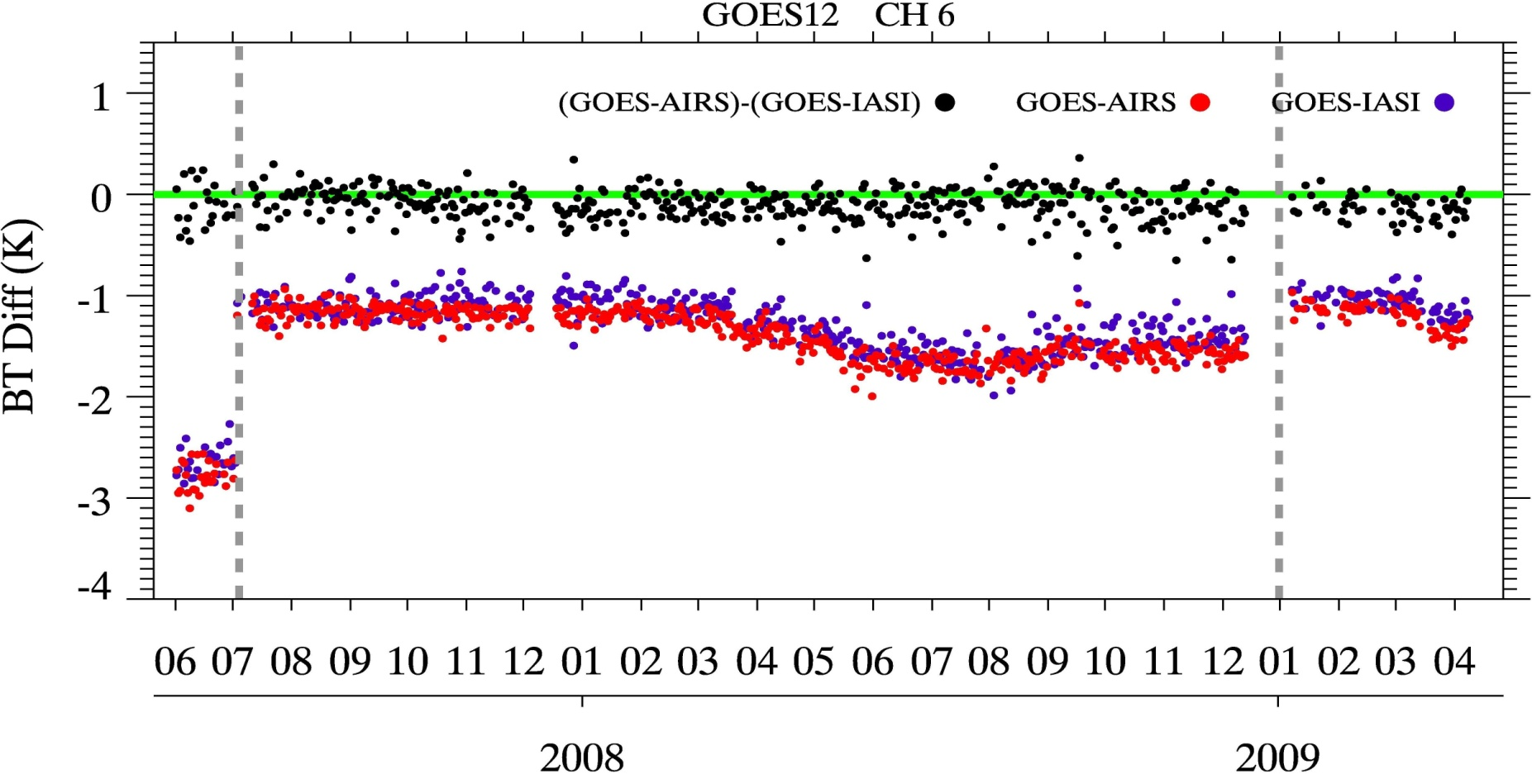
Radiances consistency of CrIS, IASI, and AIRS
Inter-calibration for other instrument
GSICS Framework:
Independent Calibration Assessment
  Each Agency routinely uses AIRS/IASI to assess calibration accuracy of its own geostationary instruments
GEOS Decontamination
Spectral and radiometric consistency among CrIS, AIRS and IASI is significant for GSICS community.

Slide 7
Hyperspectral Sounder Calibration
Radiometric calibration
  Calibration accuracy
  Noise
Spectral calibration
  How does frequency shift?
Geometric calibration
  Geolocation accuracy
Must be well documented and monitored during the mission
Radiometric
Spectral
Spatial

Slide 8
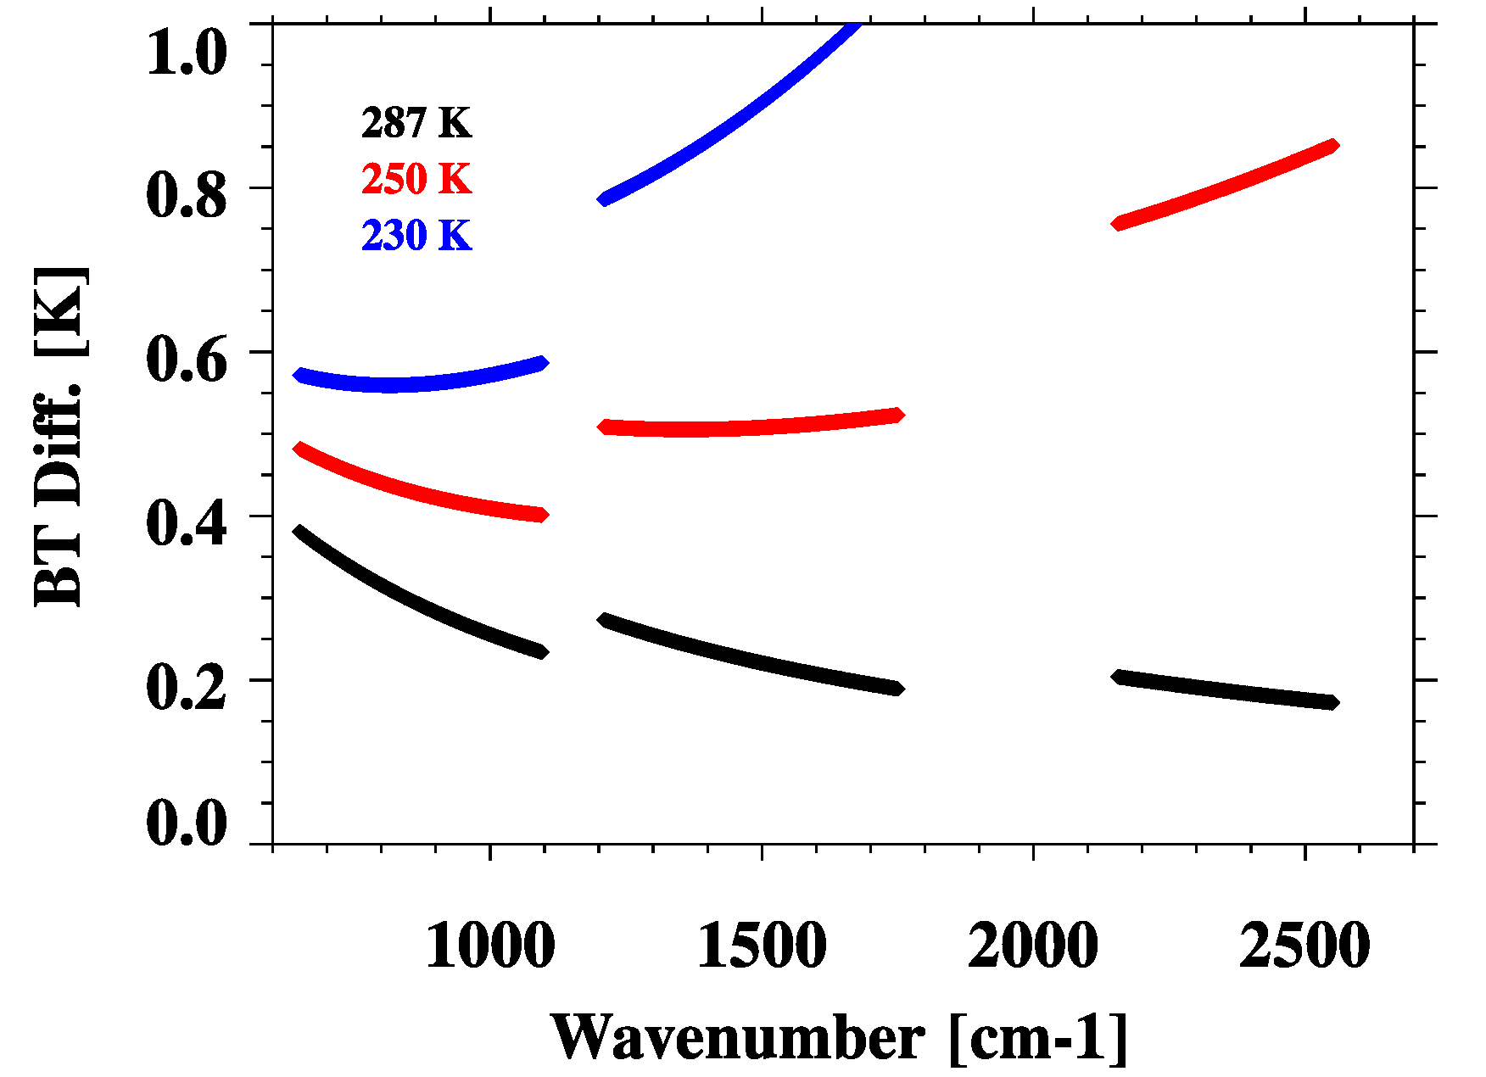
NPP CrIS Sensor Data Record
Calibration Uncertainty Specifications
SDR Calibration Uncertainty
Band | Spectral range (cm⁻¹) | N. of chan. | Resolution (cm⁻¹) | FORs per Scan | FOVs per FOR | NEdN @287K BB mW/m²/sr/ cm⁻¹ | Radiometric Uncertainty @287K BB (%) | Spectral (chan center) uncertainty ppm | Geolocation uncertainty km
LW | 650-1095 | 713 | 0.625 | 30 | 9 | 0.14 | 0.45 | 10 | 1.5
MW | 1210-1750 | 433 | 1.25 | 30 | 9 | 0.06 | 0.58 | 10 | 1.5
SW | 2155-2550 | 159 | 2.5 | 30 | 9 | 0.007 | 0.77 | 10 | 1.5
Radiometric uncertainty specification converted to that expressed in brightness temperature
NEdT, ⁰K
From Vladimir Zavyalov of SDL

Slide 9
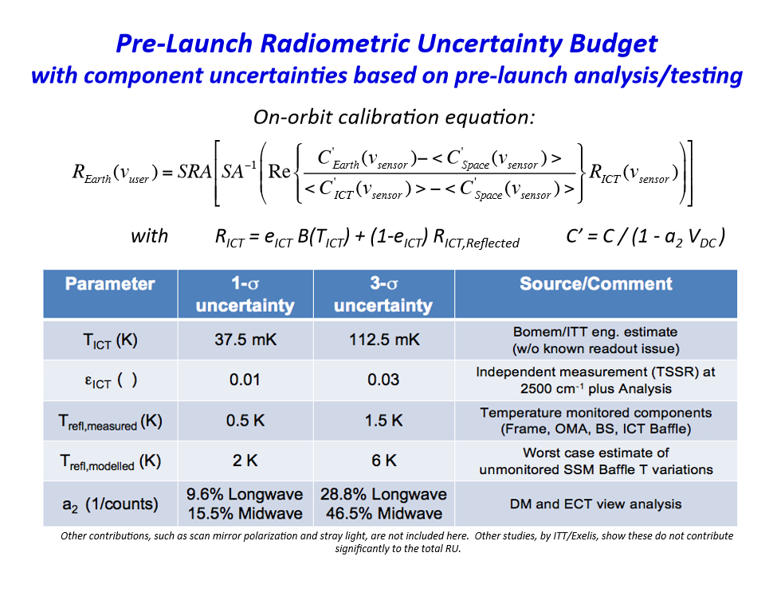
Radiometric calibration Uncertainties
From Dave Tobin at Univ. of Wisconsin

Slide 10
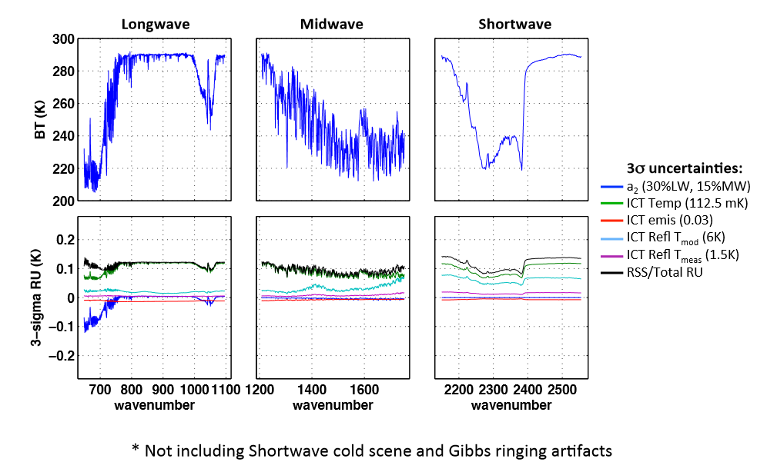
On-orbit Radiometric Uncertainty (RU) for a typical clear sky scene
From Dave Tobin at Univ. of Wisconsin

Slide 11
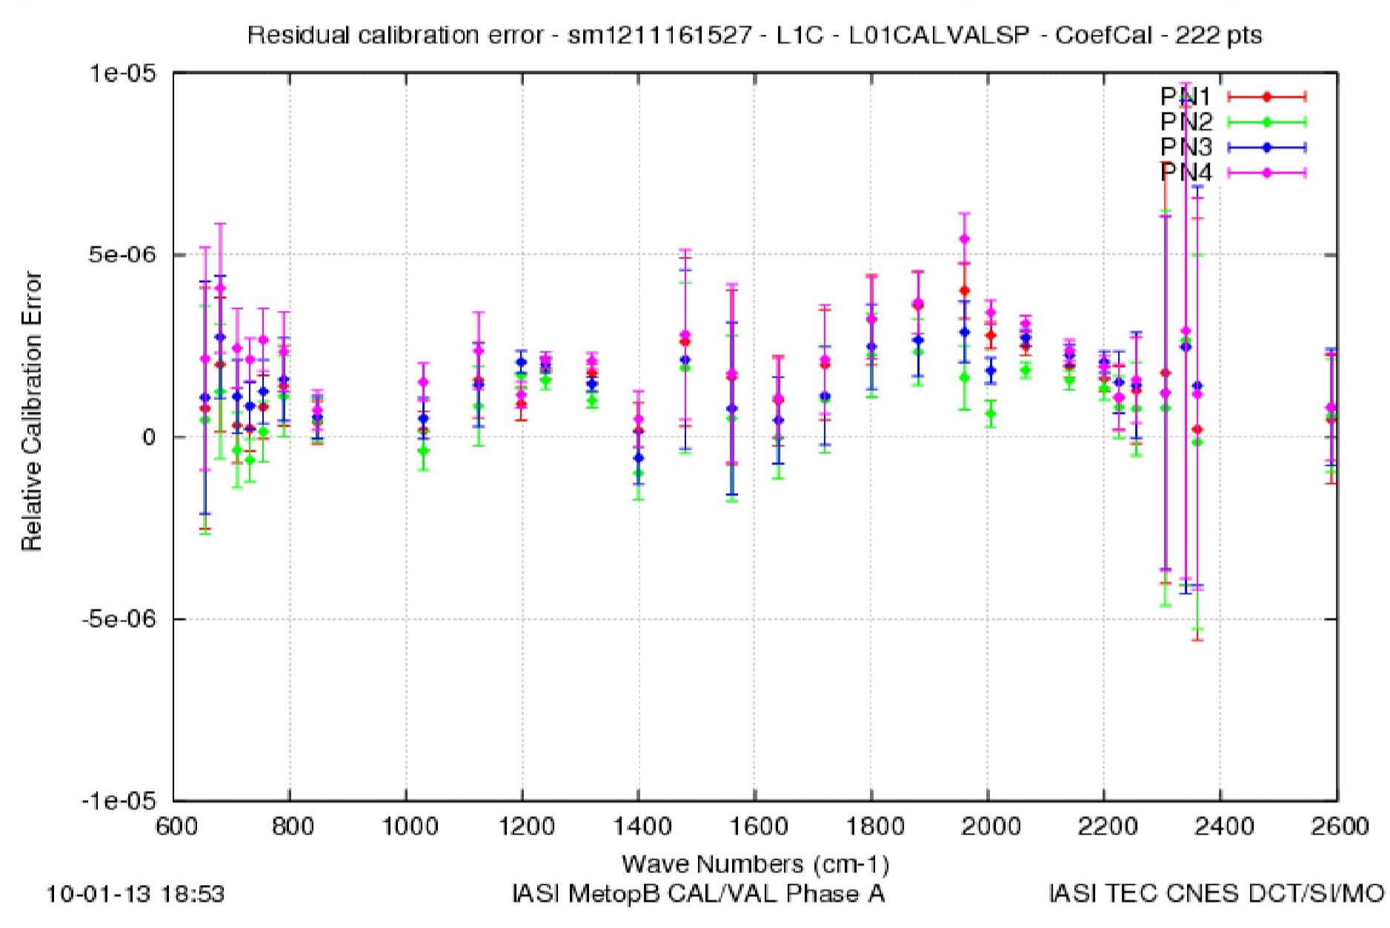
Spectral Calibration
CrIS respect to CRTM
IASI respect to 4A/OP
LWIR
From Yong Chen of UMD
From Elsa Jacquette of CNES
Inter FOV: ~ 1 ppm
Spectral calibration with respect to CRTM is less than 4 ppm for LWIR, MWIR, and SWIR
Inter FOV: ~2.5 ppm.
Overall region ~2ppm but some regions have larger undercities
Cross-correlation method under Clear Sky between Observation and RTM calculation

Slide 12
Part II
Inter-comparison Results
SNO direct comparison
  CNES , UW, NOAA/STAR, JPL, UMBC
Double Differences: relative to common reference
  RTM Simulations
  Other instruments
Aircraft Instruments

Slide 13
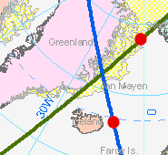
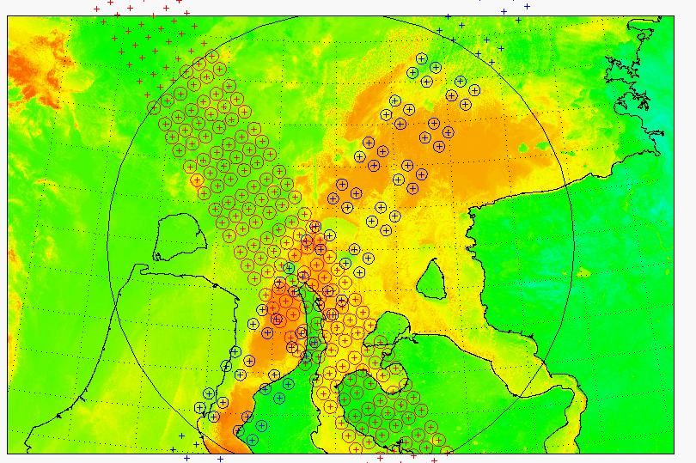
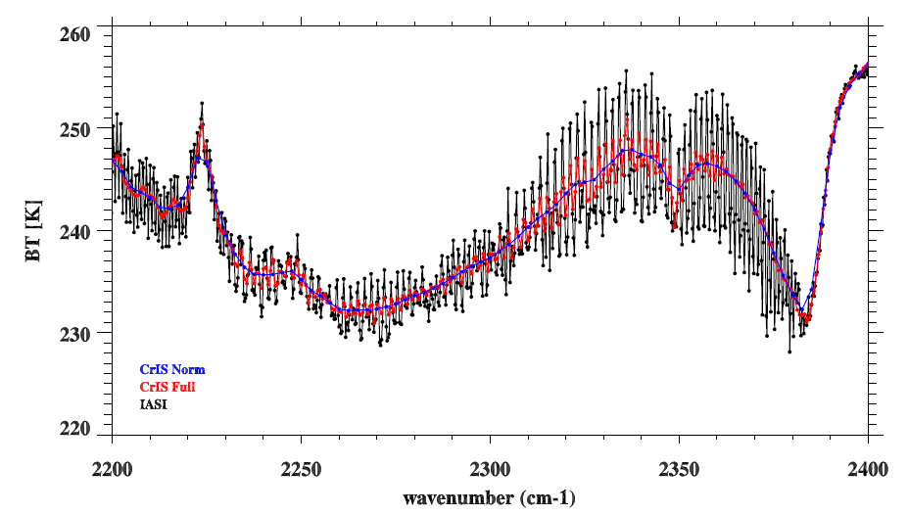
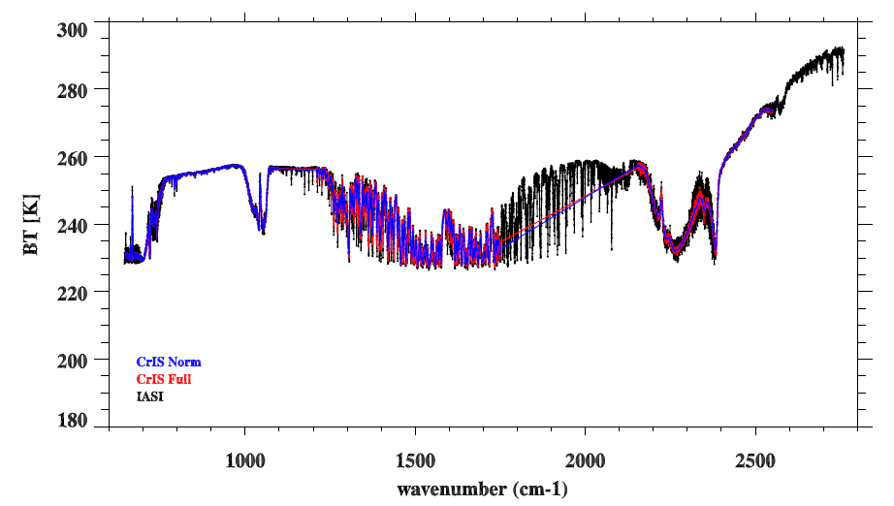
Simultaneous Nadir Overpass (SNO)
Between CrIS and IASI
CrIS
Time Difference: <= 120 Sec
FOV distance difference: <=(12+14)/4.0 km = 6.5 km
Angle Difference: ABS(cos(a1)/cos(a2)-1) <= 0.01
IASI
From Changyong Cao
CrIS: Afternoon orbit
IASI : Morning orbit
SNO Spectra during full resolution test
On August 27 2013

Slide 14
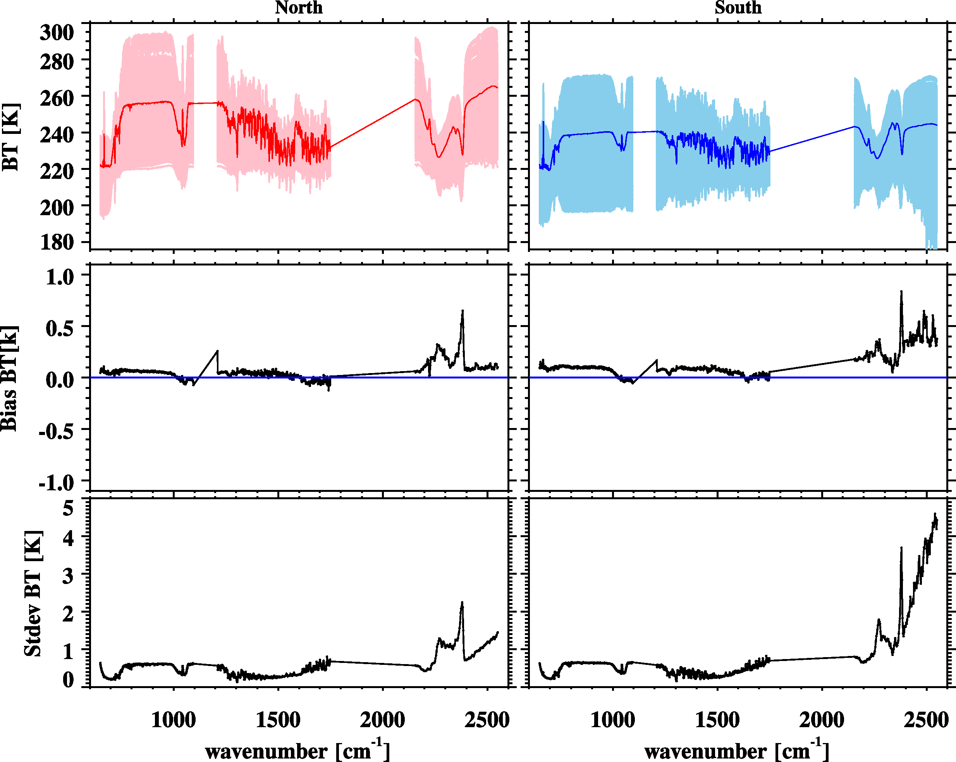
CrIS vs. IASI-A SNO Results
NOAA/STAR
North Pole (2168)
South Pole (2475)
Bias: CrIS-IASI
Bias: CrIS-IASI
STDEV: CrIS-IASI
STDEV: CrIS-IASI

Slide 15
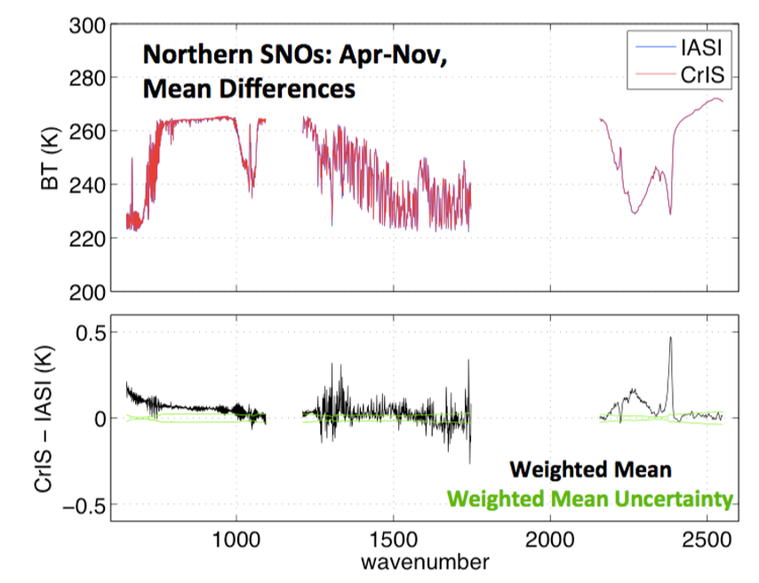
CrIS vs. IASI-A results from UW
From Dave Tobin at Univ. of Wisconsin

Slide 16
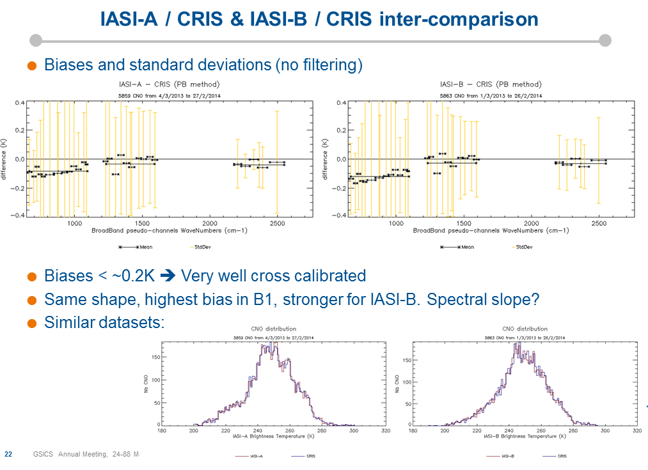
IASI vs. CrIS from CNES

Slide 17
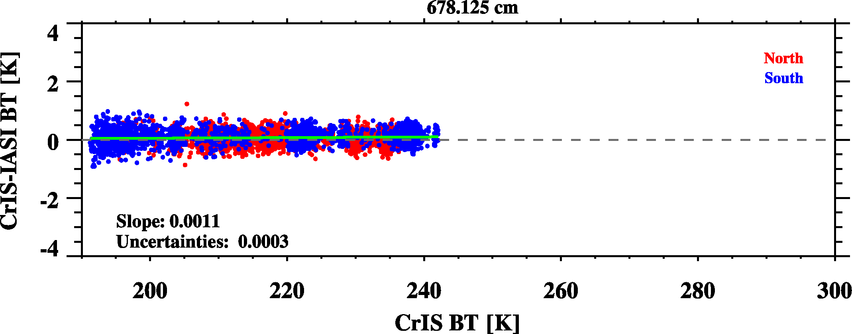
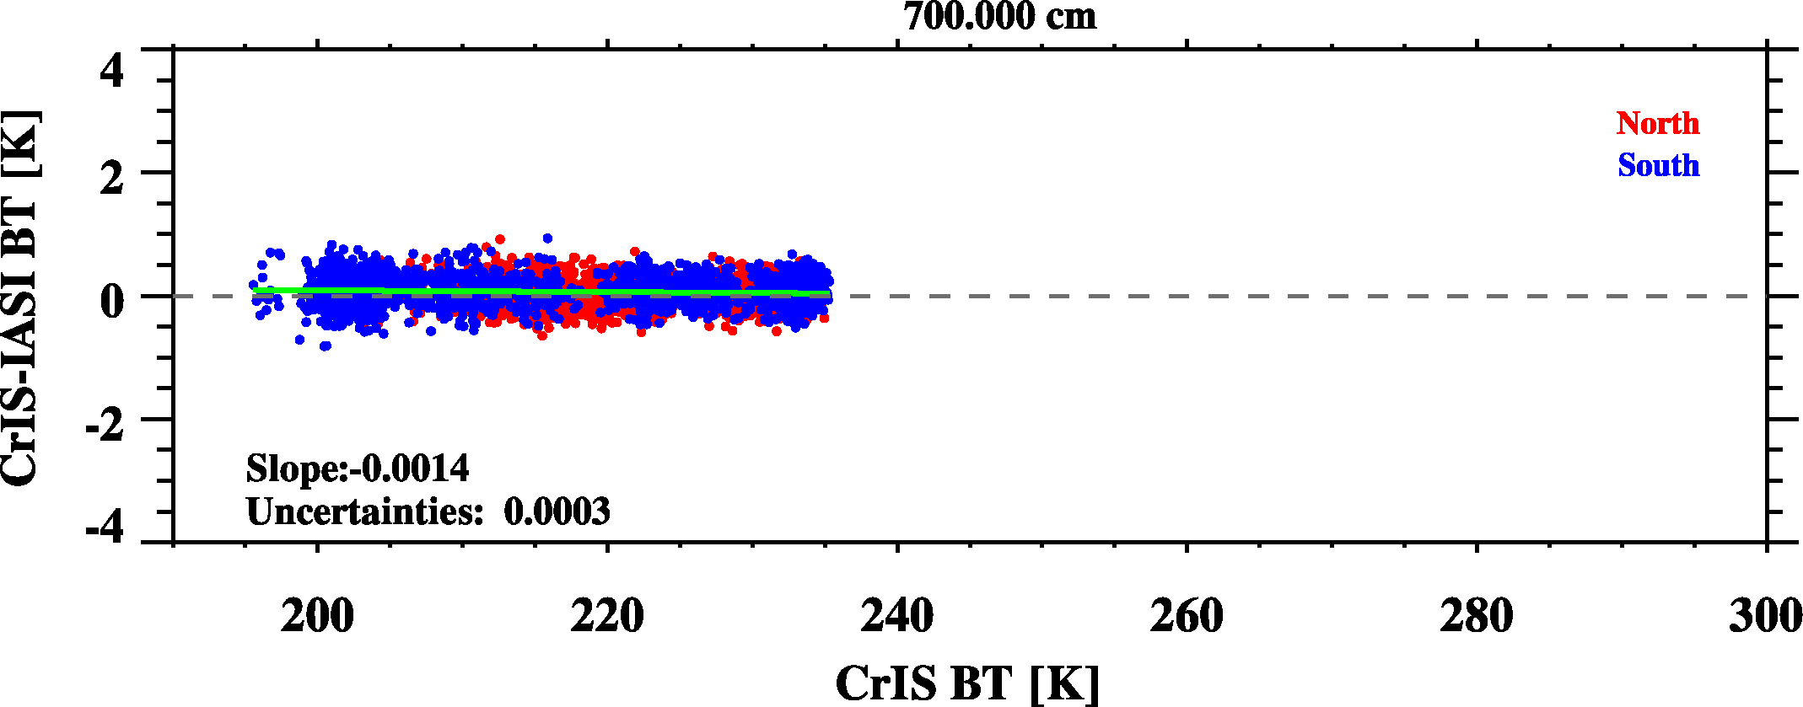
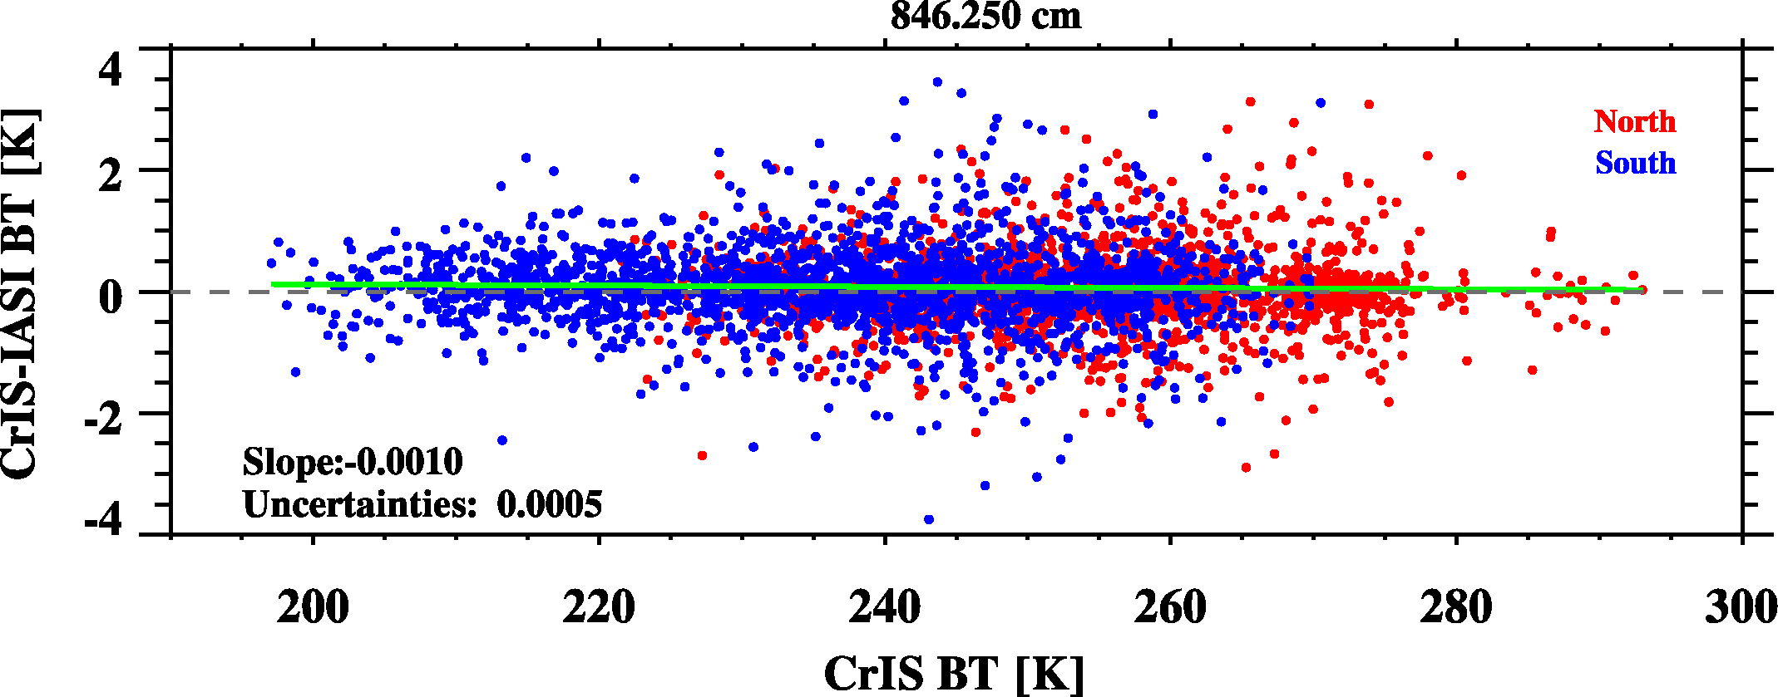
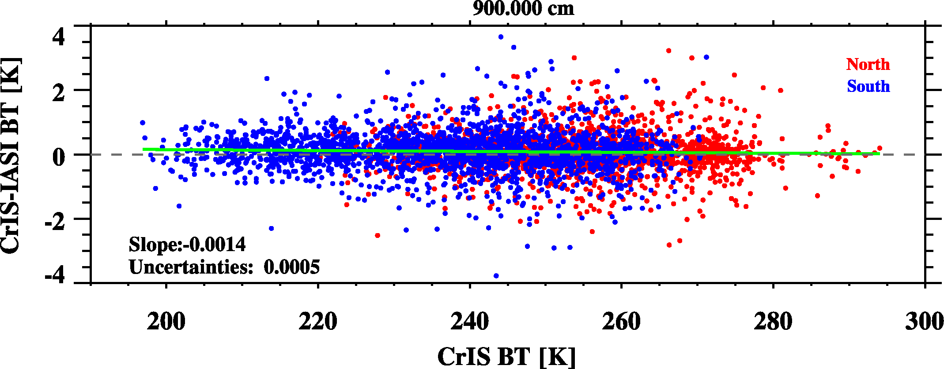
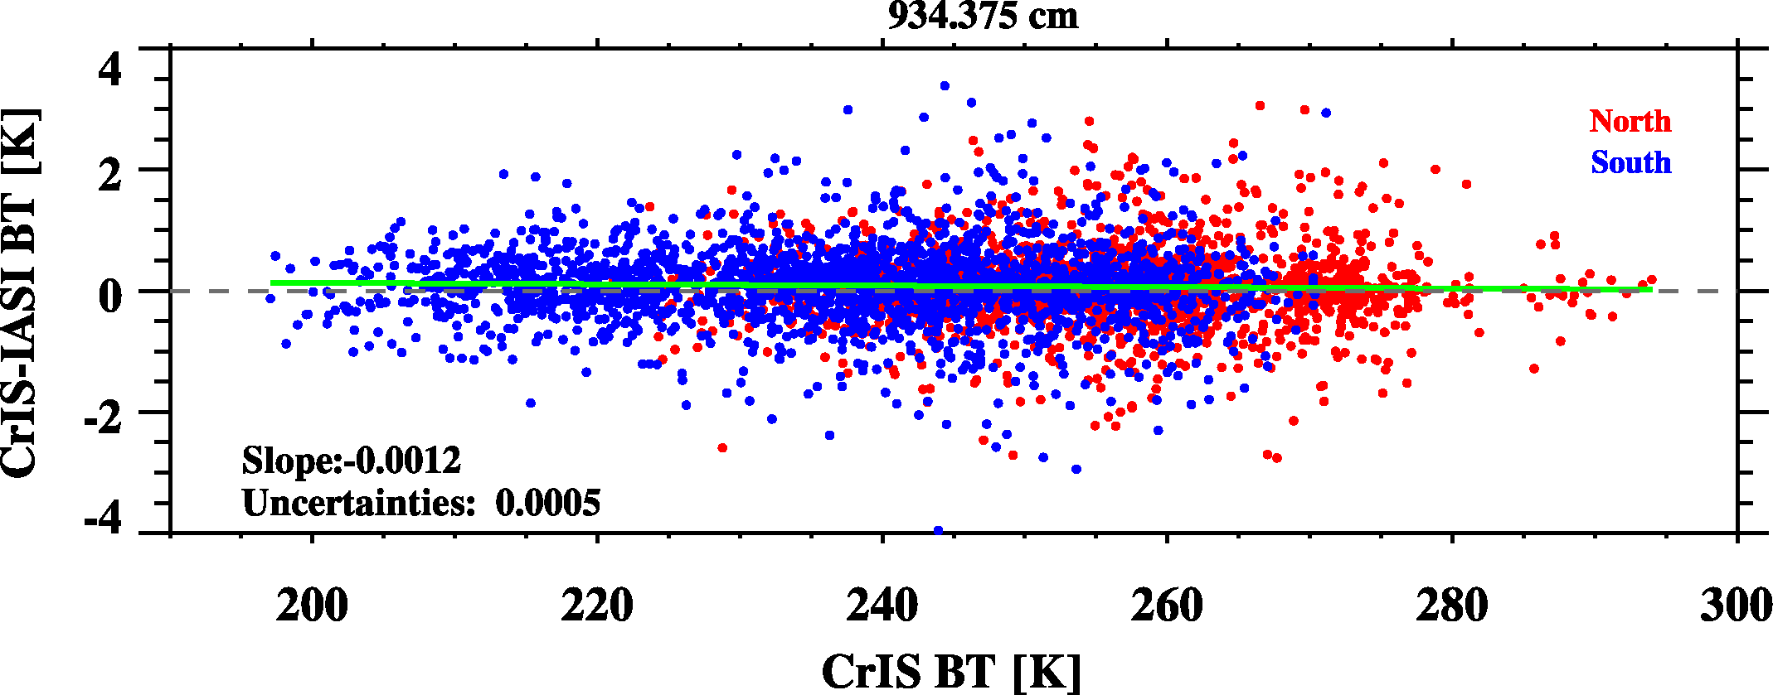
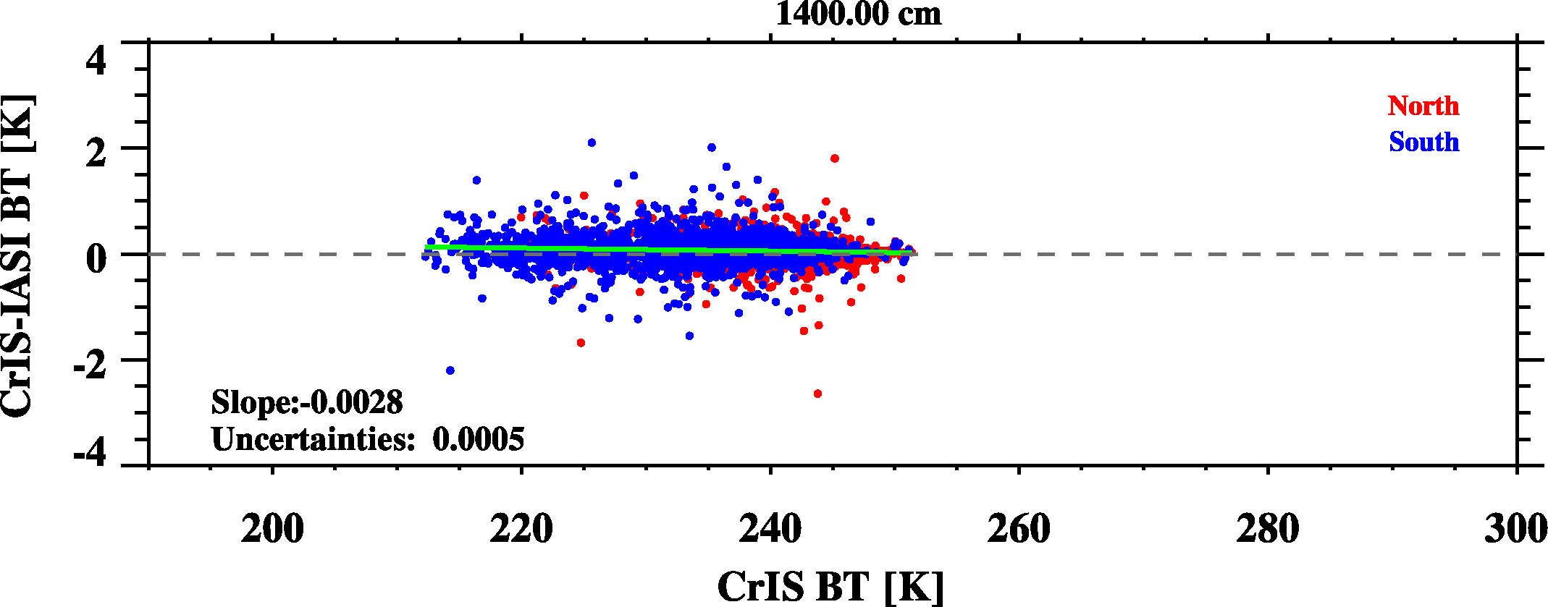
Scene-Dependent Bias
CrIS-IASI/A
CO₂ sounding channel
CO₂ sounding channel
Atmospheric window channel
Atmospheric window channels
Atmospheric window channels
water vapor absorption channels

Slide 18
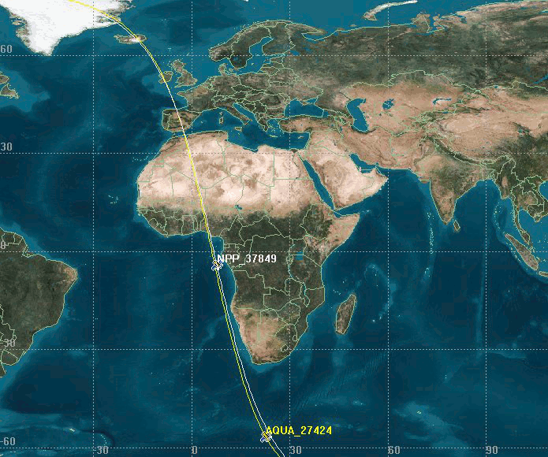
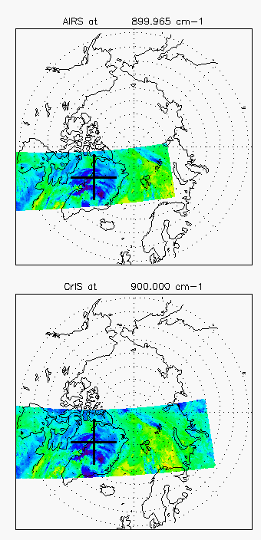
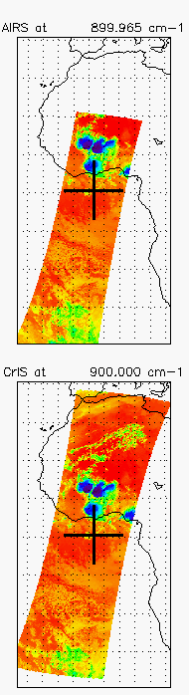
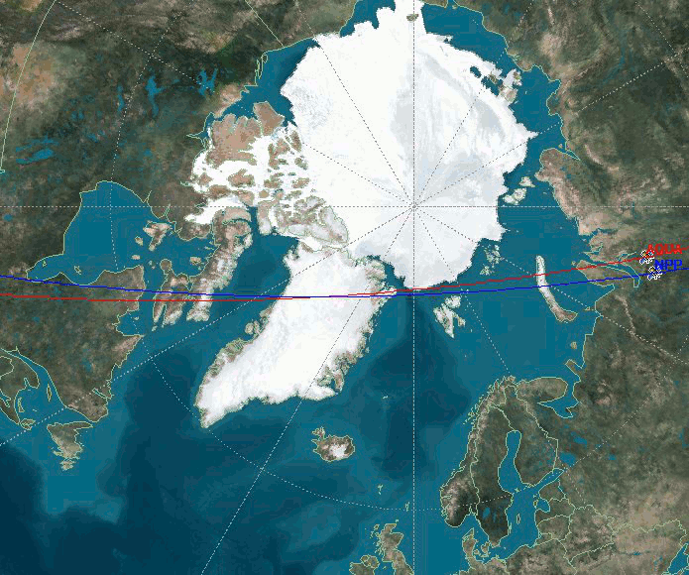
Simultaneous Nadir Overpass (SNO)
Between CrIS and AIRS
CrIS and AIRS: afternoon orbit
From Changyong Cao
SNOs at Polar regions
AIRS
SNOs at the
Tropics
AIRS
From Changyong Cao
CrIS
CrIS

Slide 19
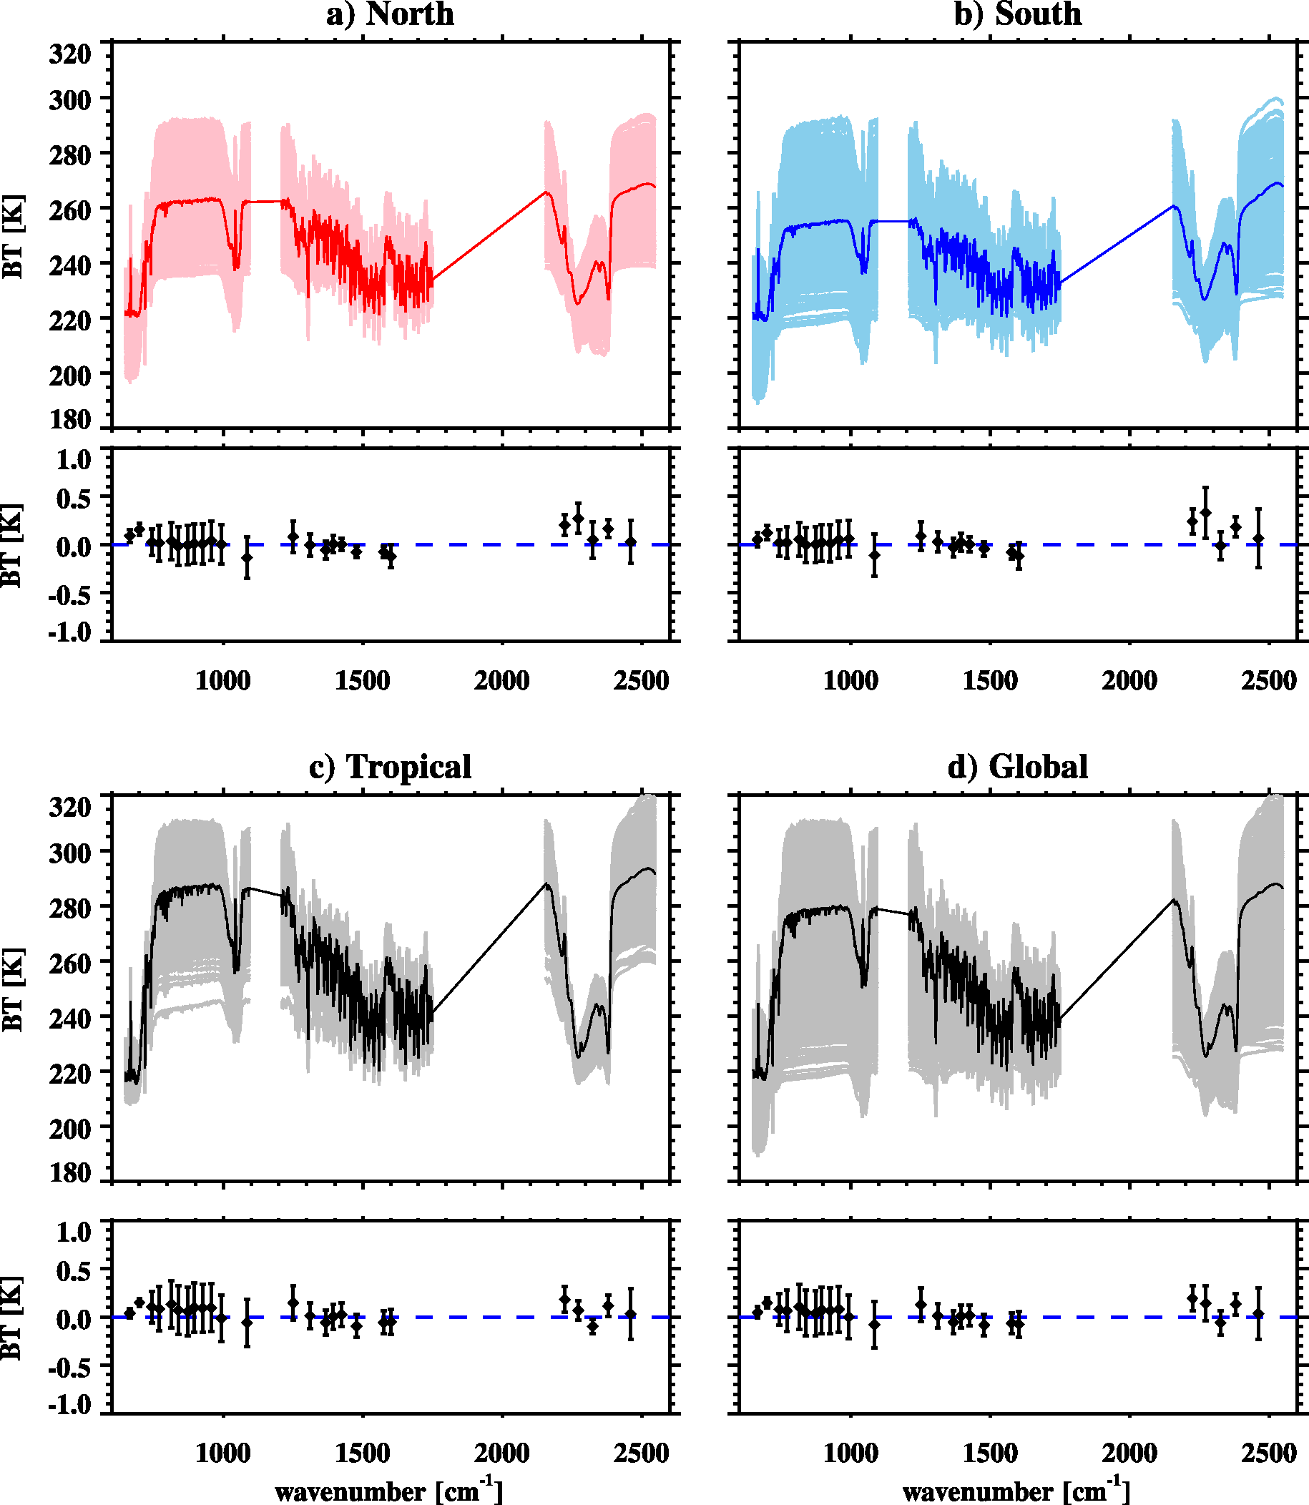
CrIS vs. AIRS from STAR
SNO spectra at North Pole
SNO spectra at South Pole
CrIS-AIRS
CrIS-AIRS
SNO spectra at the Tropics
SNO spectra in Global
CrIS-AIRS
CrIS-AIRS

Slide 20
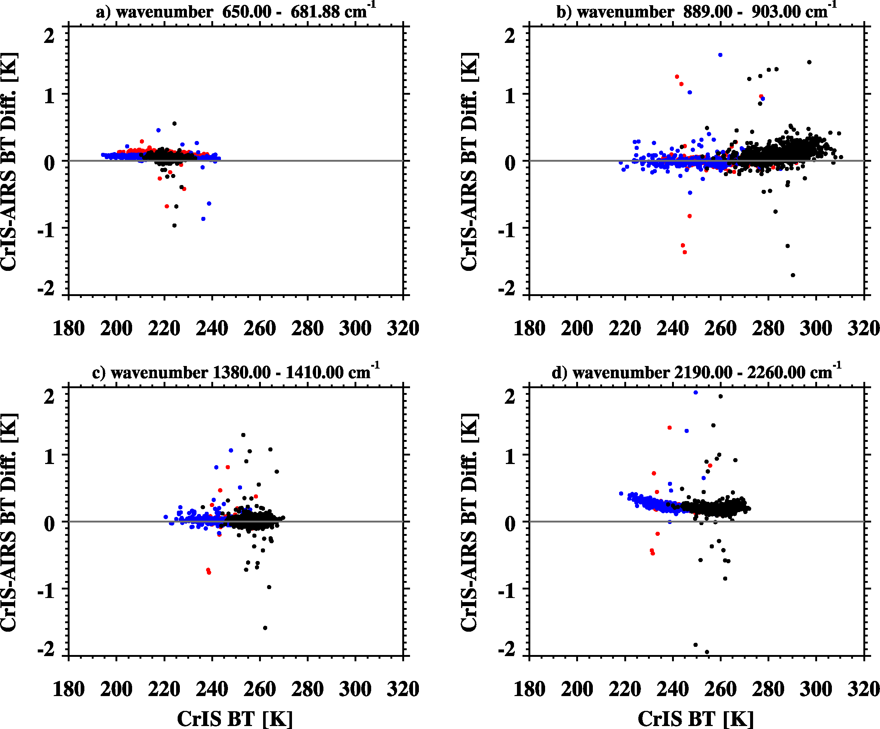
Scene-Dependent Bias
North Pole
Tropics
South Pole
Atmospheric window channels
CO₂ sounding channels
water vapor absorption channels
shortwave channels

Slide 21
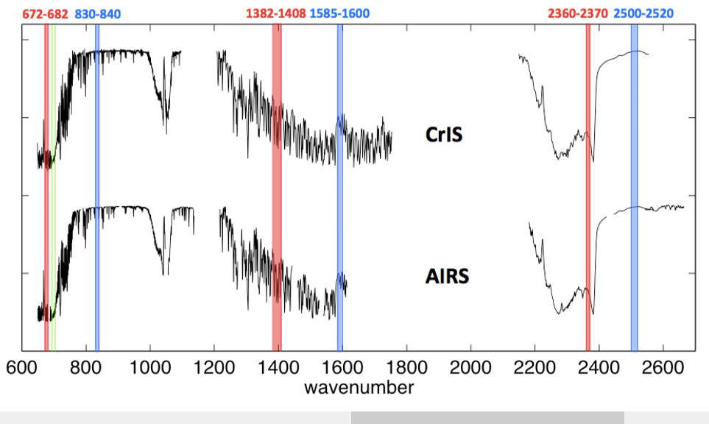
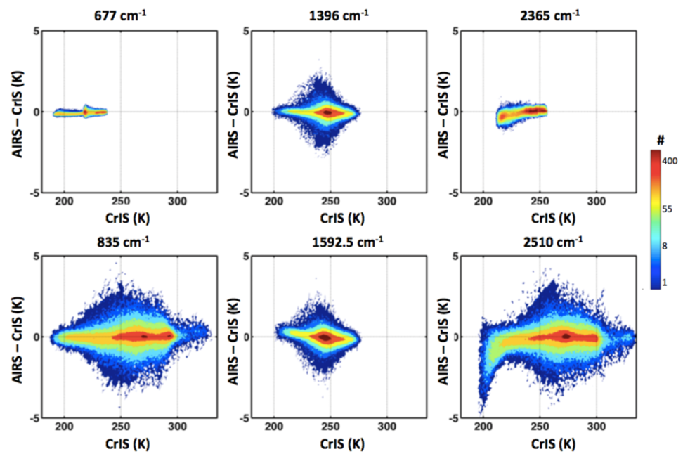
AIRS vs. CrIS from UW
From Dave Tobin at Univ. of Wisconsin

Slide 22
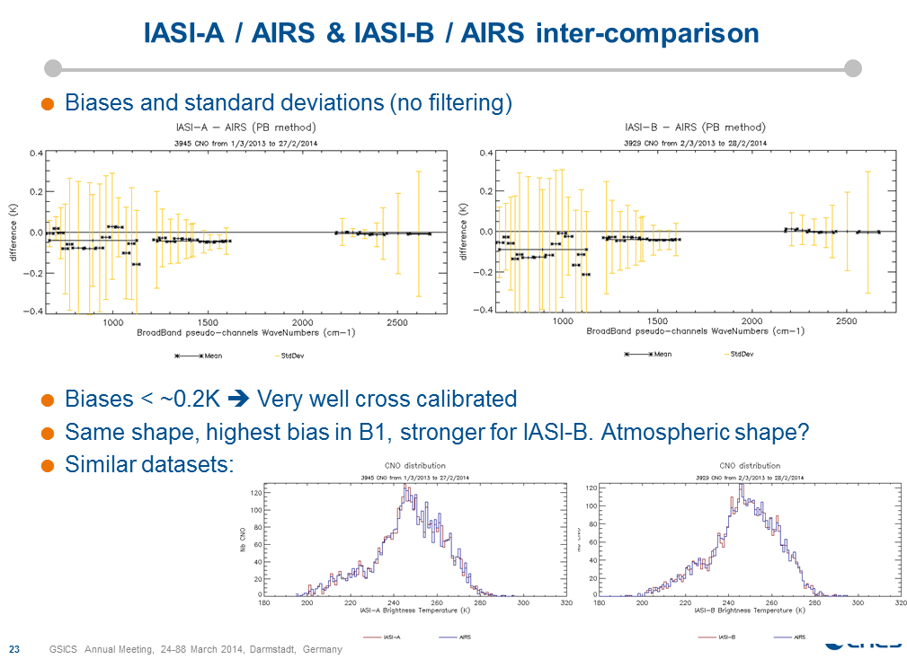
IASI vs. AIRS
From CNES

Slide 23
Double Difference between CrIS and IASI2CrIS
From Yong Chen of UMD

Slide 24
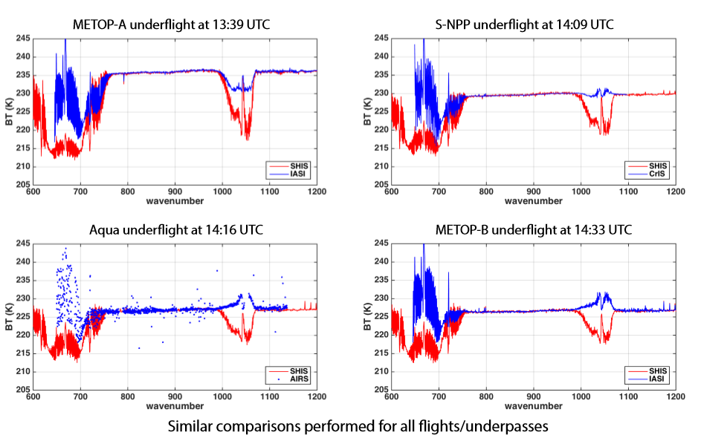
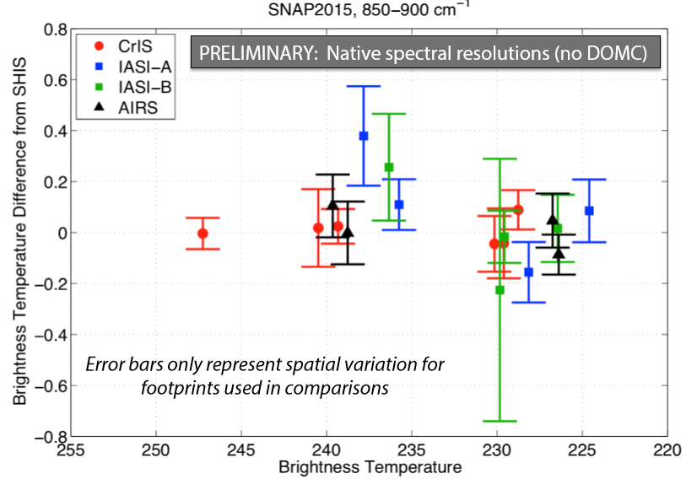
Inter-comparison with SHIS from UW
From Joe Taylor of UW

Slide 25
Conclusion
CrIS, AIRS, and IASI radiometric and spectral calibration uncertainties should be monitored and reported to GSICS.
CrIS vs. IASI-A/IASI-B
  IASI spectra can be converted into CrIS spectral grid and the comparison can be done along CrIS spectral grid.
  CrIS and IASI well agree each other at LWIR and MWIR bands with 0.1-0.2K differences, but MWIR band is more consistent. CrIS is warmer than IASI at LWIR band.
  No apparent or strong scene dependent bias.
  At SWIR band, a sharp increases can be clearly seen at spectral transition region.
  The results from different groups generally agree.
IASI/CrIS vs. AIRS
  IASI/CrIS and AIRS are hard to compare at the finest spectral grid. Different groups choose the different spectral regions using box-car average methods. The results are hard to compare to each other,
  IASI/CrIS and AIRS agree each other at LWIR and MWIR bands with the differences of 0.1-0.2 K .
Given the fact that the radiometric differences do exist between hyperspectral instruments, the inter-calibration community should be cautious to use only one hyperspectral sounder as a prime reference. A best practice should compare the broad- or narrow-band instruments against all four hyperspectral sounders to avoid biasing the results.

Slide 26
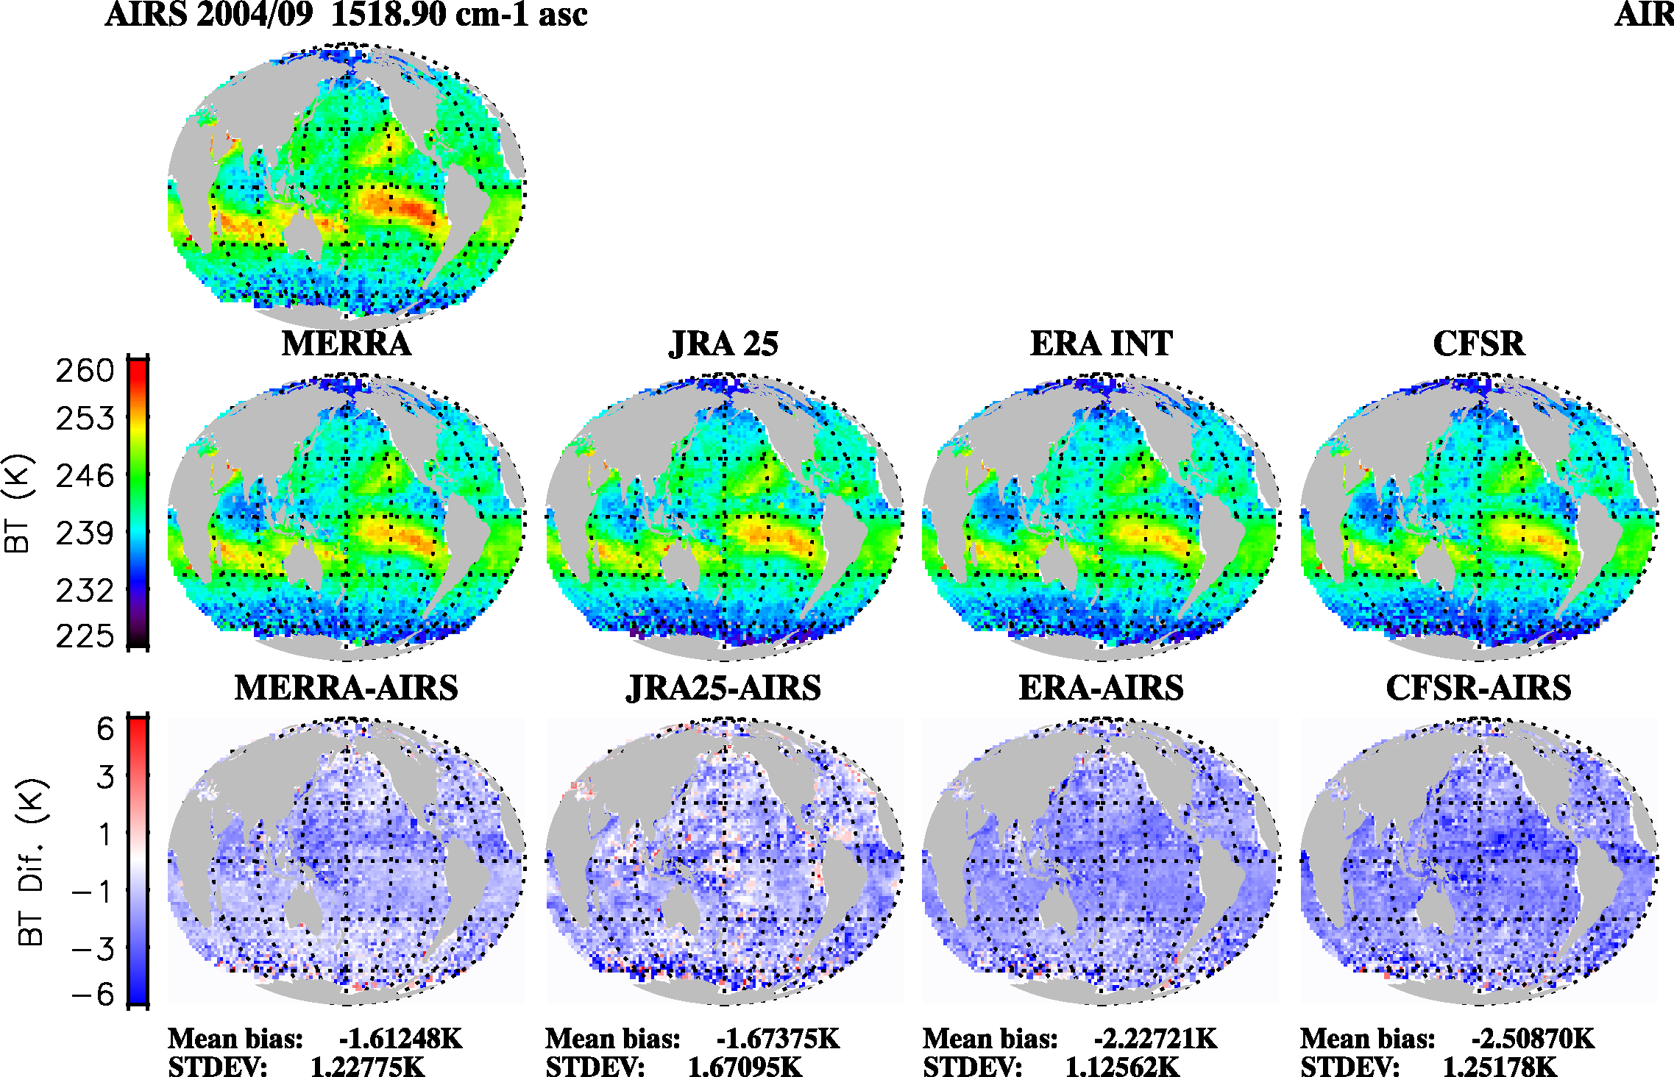
Radiances consistency of CrIS, IASI, and AIRS (2)
Climate Data Records
AIRS – Simulations (Reanalysis)
Hyperspectral radiance measurements can serve as a benchmark for model assessment, but the consistency is the key.

Slide 27
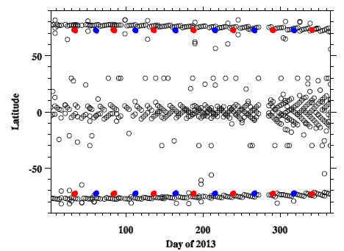
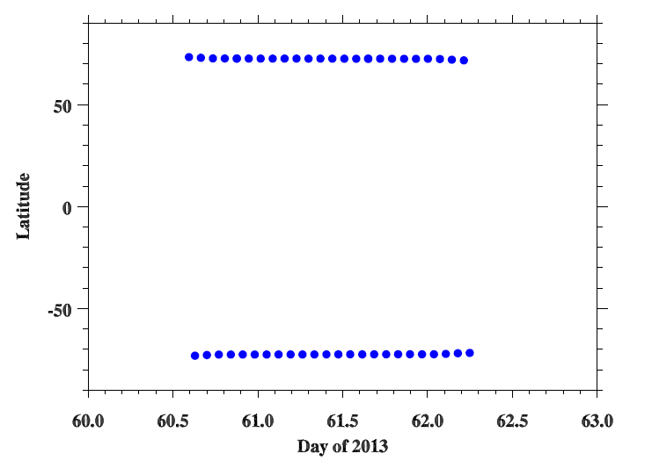
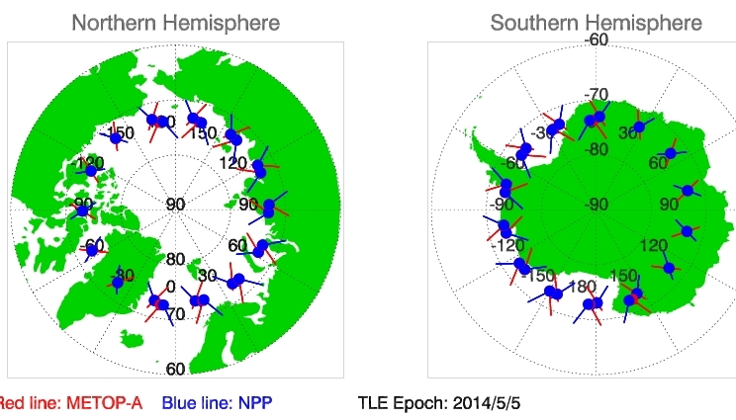

SNOs Latitude Distribution Time Series
The SNOs between SNPP and Aqua occurred every days.
The SNOs between MetOp and SNPP occurred every 50 days.
Fortunately, once an SNO event occurs, their orbits will continuously cross each
other every orbit.

Slide 28
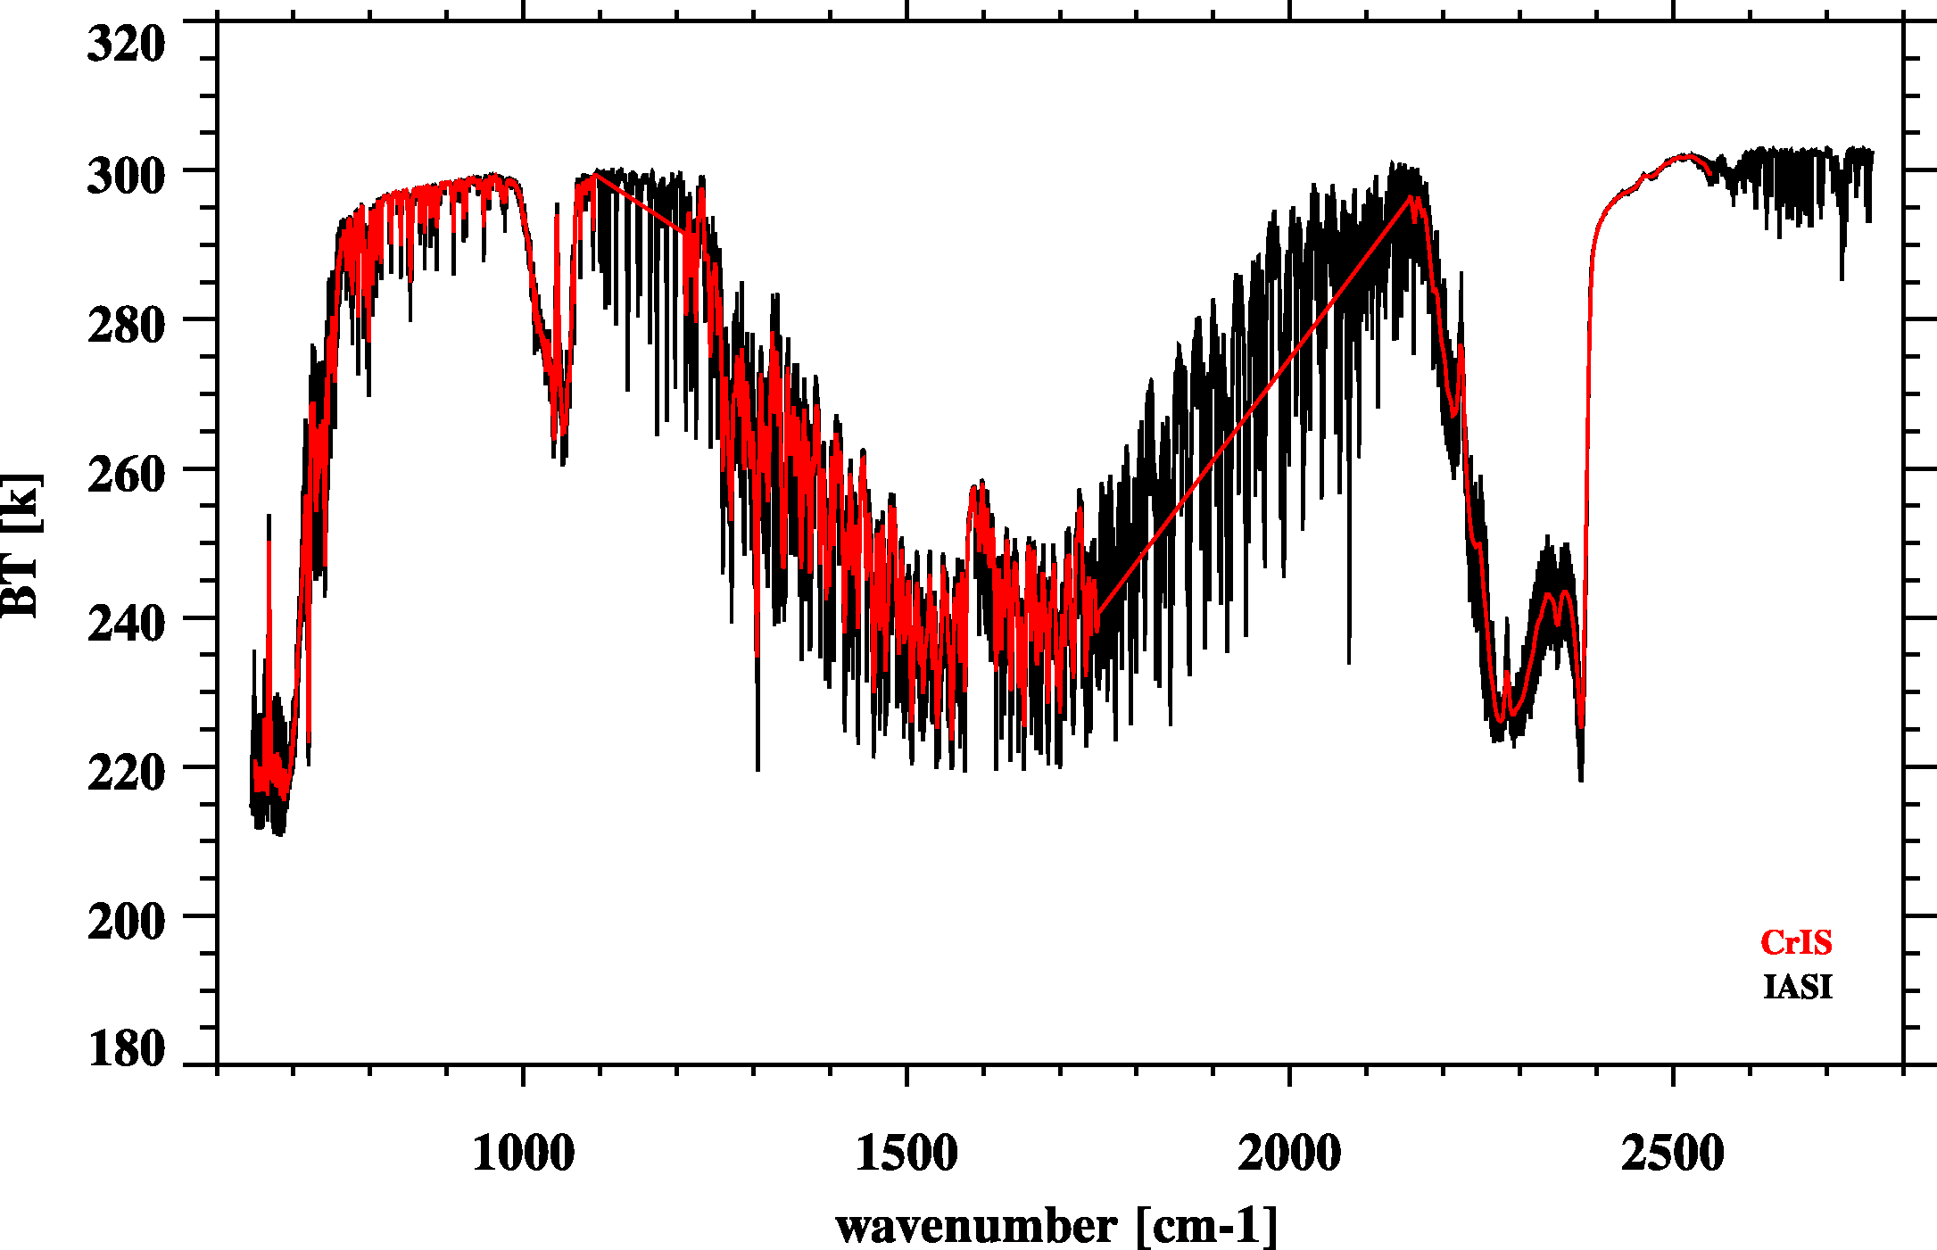
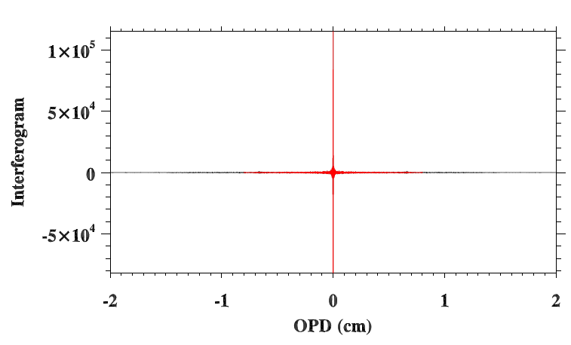
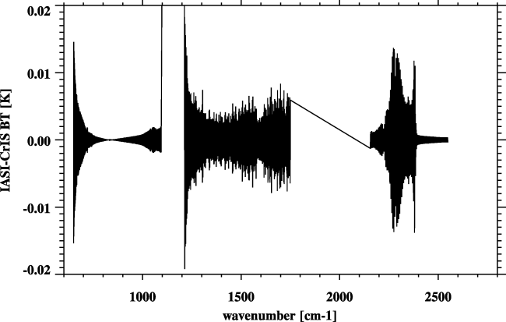
Resample IASI to CrIS
Fourier Transform
CrIS – IASI
1) De-Apodization of IASI spectra
2) Truncation of IASI spectra
3) Apodization using CrIS Hamming Apodization function
Re-sampling error very small
Inverse Fourier Transform

Slide 29
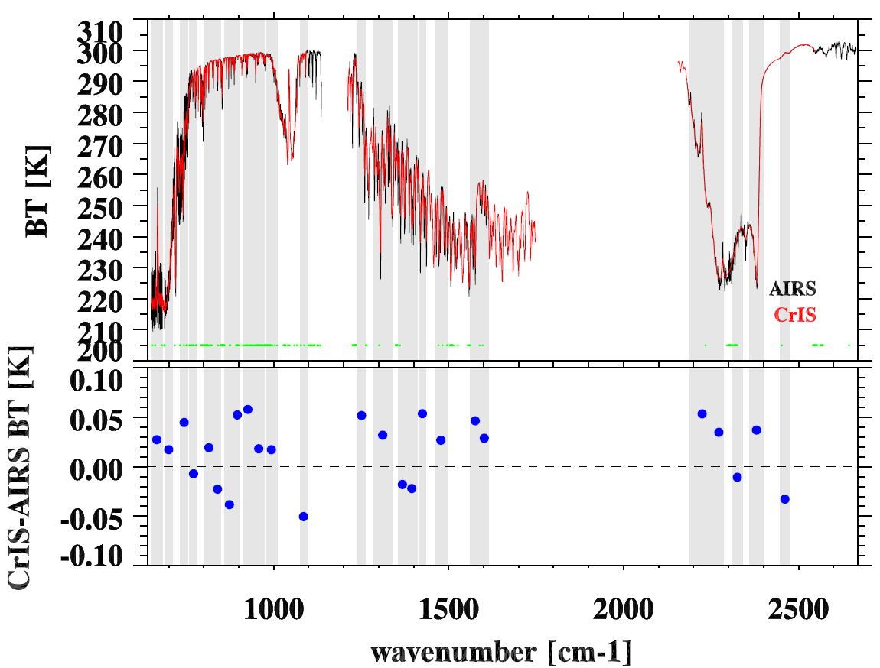
Match CrIS with AIRS:
Focus on 25 spectral regions
Ideal case
CrIS-AIRS match error is less than 0.06K with consideration of
AIRS degraded channels.

Slide 30
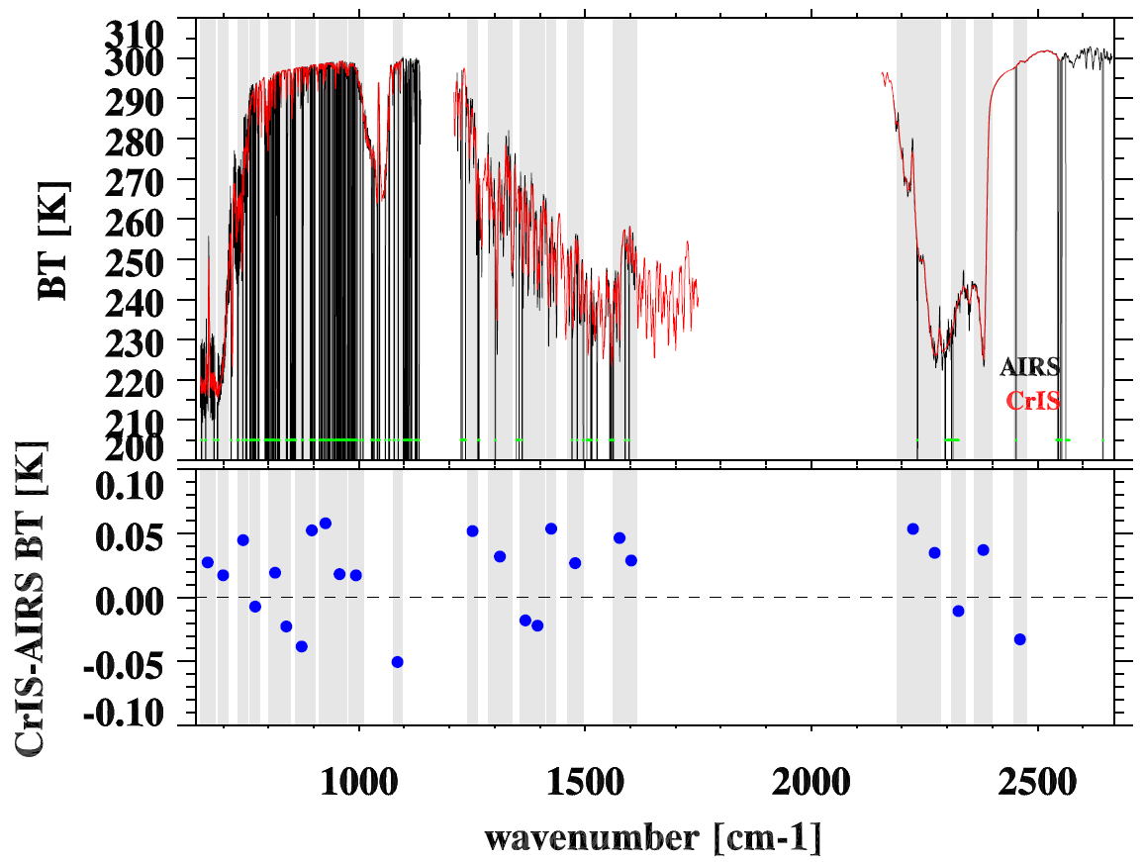
Match CrIS with AIRS:
Focus on 25 spectral regions
In reality
CrIS-AIRS match error is less than 0.06K with consideration of
AIRS degraded channels.

Slide 31
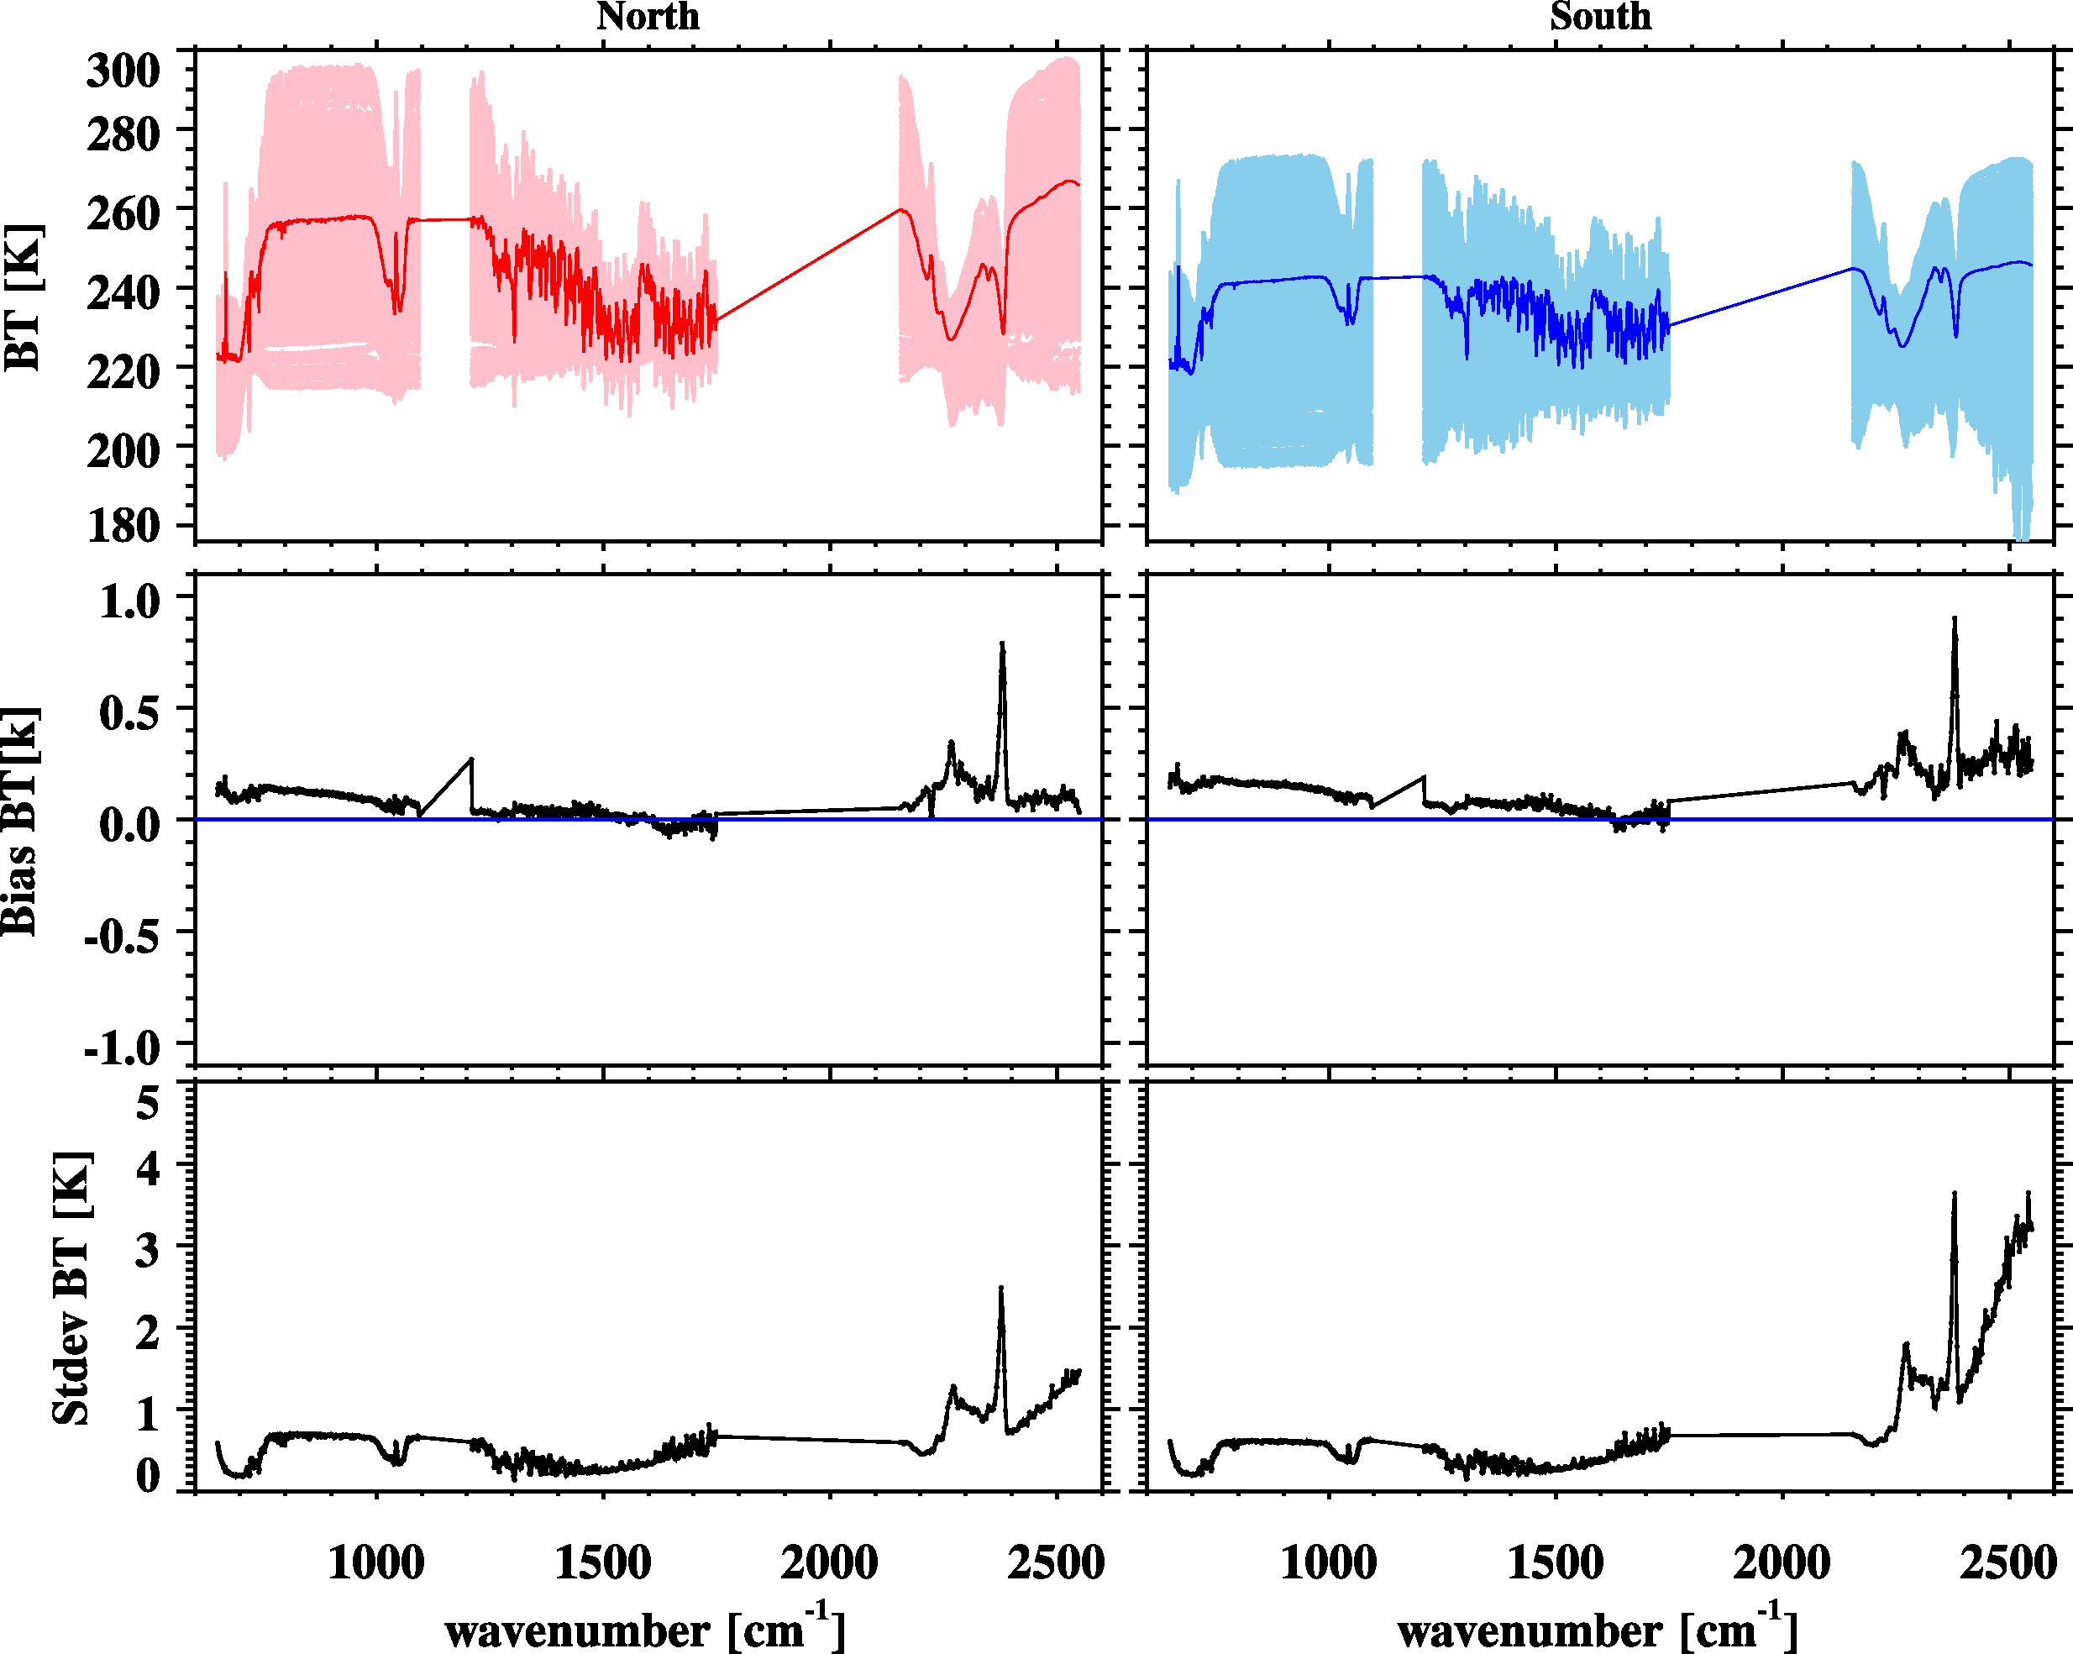
CrIS vs. IASI/MetOp-B
North Pole (2020)
South Pole (2284)
applied retrospectively
Bias: CrIS-IASI
Bias: CrIS-IASI
STDEV: CrIS-IASI
STDEV: CrIS-IASI

