Slide 1
SRF Retrieval Using VIIRS/AIRS/IASI radiances
MaNIK BALI
NOAA/NESDIS/STAR

Slide 2
Contents
Introduction
Pre Vs Post Launch
Method
Steps
Simulations
Conclusions.

Slide 3
Introduction
Measurement accuracy of a detector critically depends on the accuracy of the detector’s Spectral Response Function (SRF).
Any shift or leaks in the SRF can dramatically influence the measured values and induce trends and biases in its measurements. ( eg AVHRR AATSR GOES-13)
It is important to monitor the status of SRF while the instrument is in-orbit

Slide 4
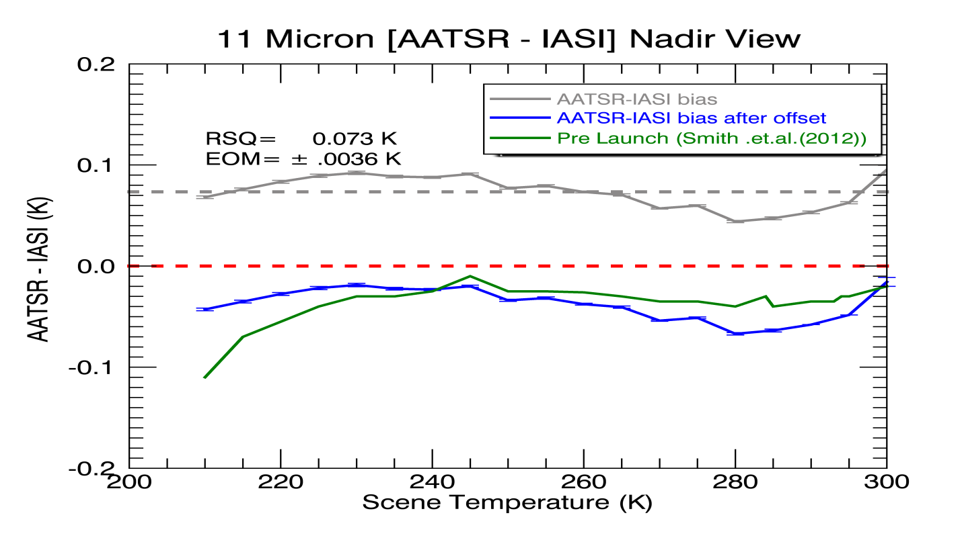
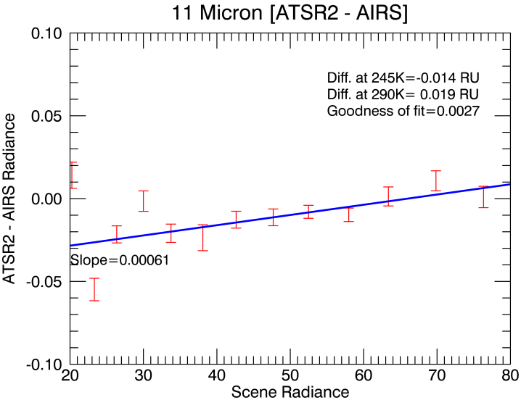
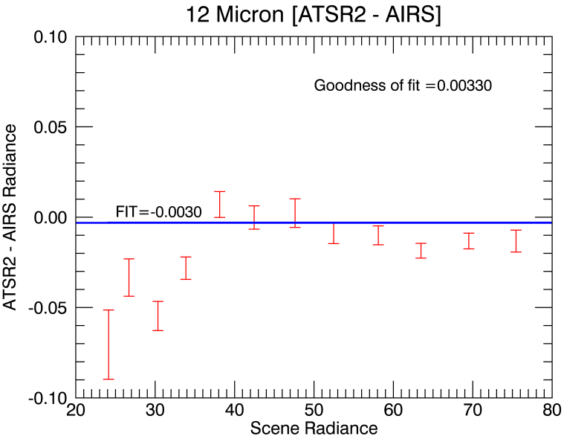
Pre Vs Post launch
Offset= -0.11K
< 0.03K
< 0.068K
Three years (2009-2011) of AATSR/IASI collocation….
AIRS and IASI displays Pre-Launch like behavior in Space to a few 100th of a degree.
ATSR2 and AATSR have SI traceable blackbodies.
Since SRF was determined pre-launch so we can in principal determine SRF in space

Slide 5
Method
Rep Rad =
---Convolution
Hyperspectral Radiances
SRF
Rep Radiances
AX=B
SRF = A⁻¹ B

Slide 6
Challenges
Bias has seasonal effects-does not always closely match with pre-launch.
In space, IASI itself has a offset, Question is how to bring target radiances to corrected radiances.

Slide 7
Steps
Collect SNO collocations between target and reference ( Hyper-spectral Instrument).
Apply GSICS recommended thresholds zenith, time, spatial homogeneity.
Convolute to find the Hyperspectral (IASI/AIRS/CrIS) Rep radiances.
Find a fit using a suitable polynomial
Find the fit to the pre-launch curve.
Apply the offset to get the ( so called) SI traceable radiances.
Perform the inversion using a suitable method like SVD.

Slide 8
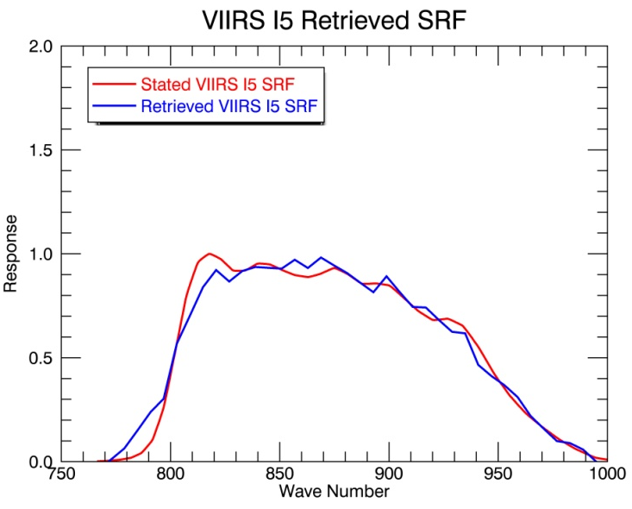
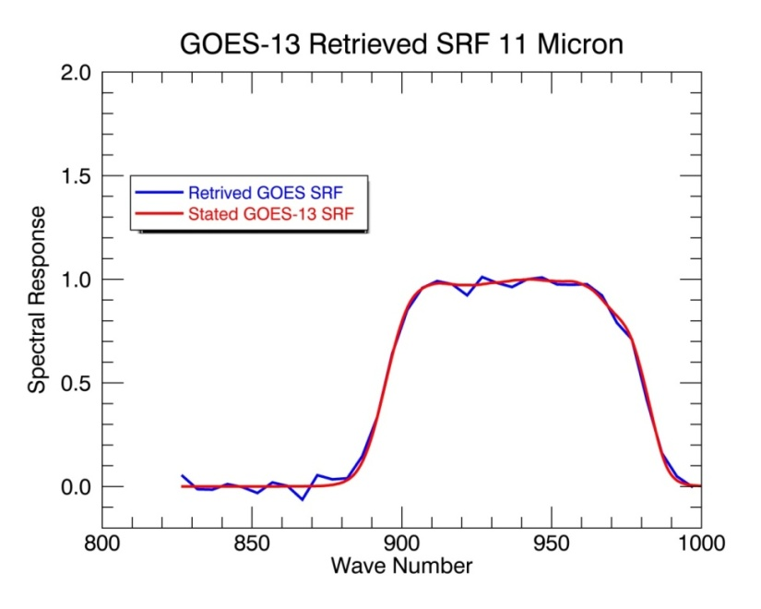
Results LEO Instruments ATSR2 and AATSR
VIIRs I5 SRF retrieved from collocations
By Likun Wang SNO algorithm

Slide 9
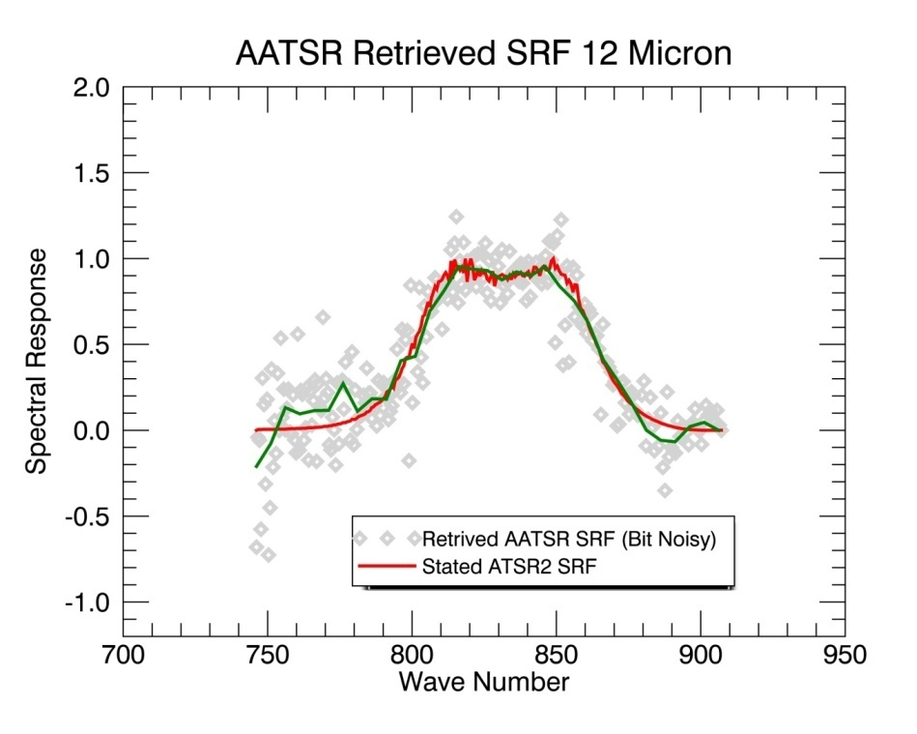
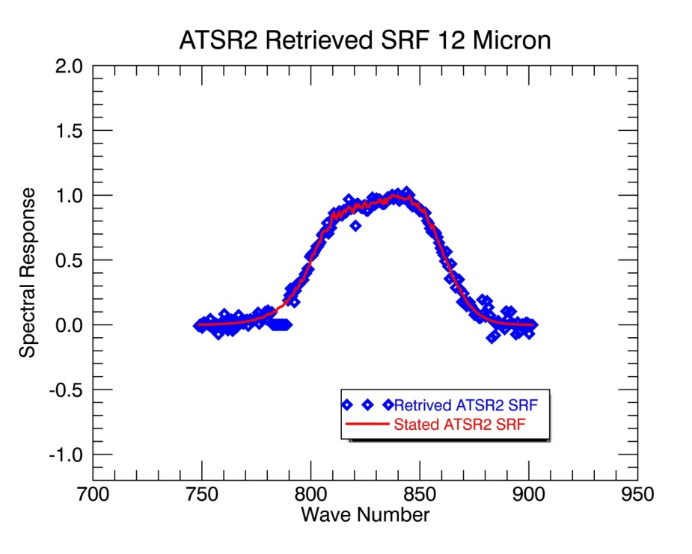
Results LEO Instruments ATSR2 and AATSR
The retrieved SRF closely match the stated SRf
Retrieved SRF from ATSR2 appears less noisy.

Slide 10
Sensitivity of method to shifts and leaks

Slide 11
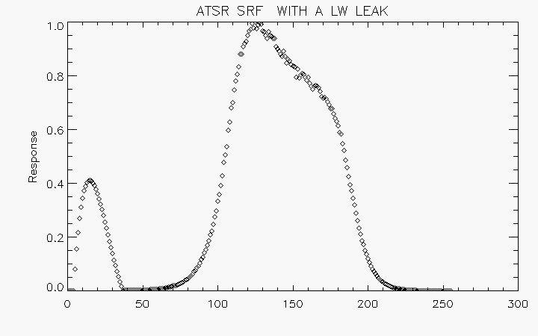
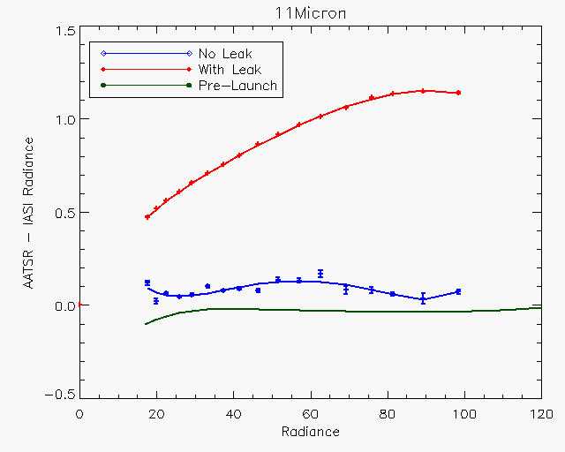
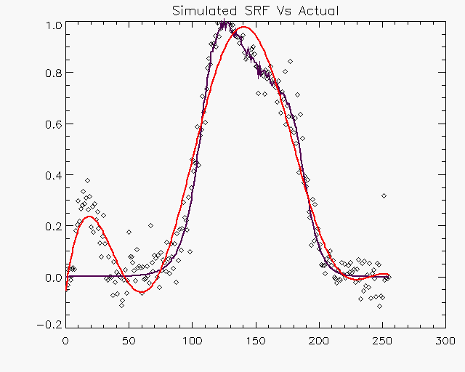
This leak gives the Red Curve
Imagine there is a leak in the ATSR SRF and it looks like above
Retrieved SRF using our method.
Leak is clearly simulated.

Slide 12
Added a Shift of +4 WN

Slide 13
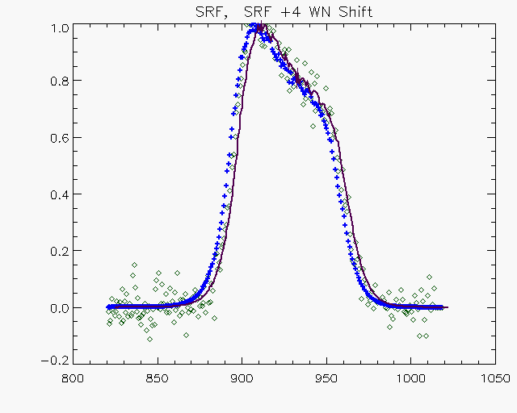
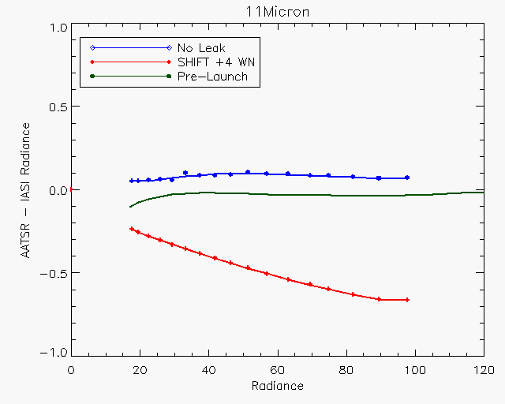
Blue is original SRF
Black is SRF shifted by +4 WN
The dots are the simulated SRF( analyzed in next slide)
Impact on Radiances

Slide 14
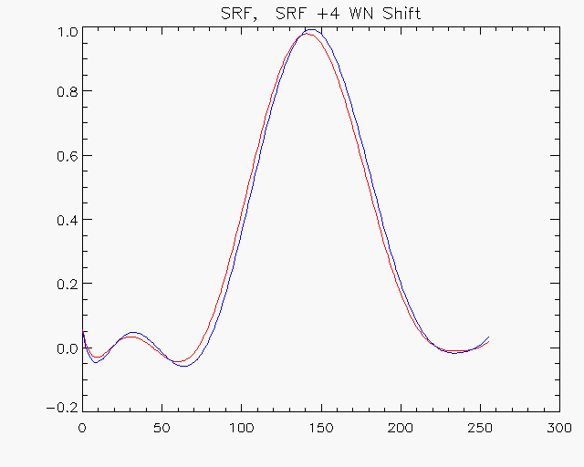
Simulated SRF
Original SRF
Another way of measuring the Shift is to fit a known function to SRF at pre-launch and the SRF retrieved from our method
Fit to the simulated SRF is blue. The fit to original SRF is red is the The shift is clearly visible in the fits to the SRF. The shift of the maxima is exactly of 4 WN.

Slide 15
Inputs
The main input to this technique is a spectrum
of radiances that are used as reference.
Idea could be extended to non hyperspectrum
Outputs
The Spectral Response function.

Slide 16
Conclusions
De-Convolution is a promising technique that can be used to retrieve SRF status while the instrument is in orbit.
Hyperspectrum of CrIS, AIRS and IASI can be used to retrieve SRF.
The method is sensitive to WN shifts as small as ±4 WN.
The method can be applied to address SRF problems in VIIRS and GOES-13.
Work in progress…GOES Imager SRF for 13 Micron channel, use CrIS Spectrum and add uncertainty analysis.

Slide 17
Thank You

Slide 18
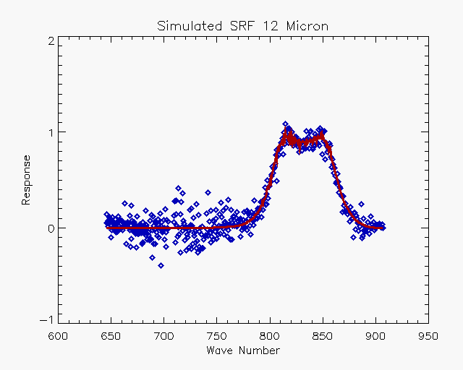
 | IASI – AIRS 210K-230 K (using SNO) | IASI – AIRS 295K ( using GOES-11 Transfer)
11 Micron | -0.0790 (± 0.06 ) RU | -0.0433(± 0.016 ) RU
12 Micron | -0.1471 (± 0.062) RU | -0.0460 (± 0.018 ) RU
Wang et al 2012

Slide 19
