Slide 1


Aqua MODIS RSB
Calibration and Performance
Aisheng Wu and
MODIS Characterization Support Team (MCST)
2016 GSICS GRWG/GDWG Annual Meeting, Tsukuba, Japan, Feb 27 - Mar 4.
Page 1
Notes:
1

Slide 2
Outline
Introduction
RSB calibration using SD/SDSM
  SD degradation
  RSB gain performance
Lunar calibration
  RSB gain from lunar measurements
EV response trending
Current Algorithm and Updates
Summary and future work

Slide 3
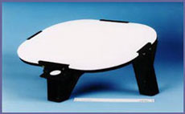
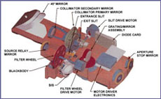
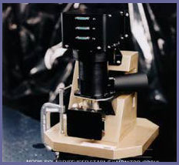
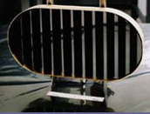

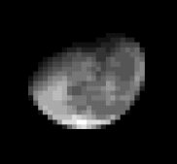
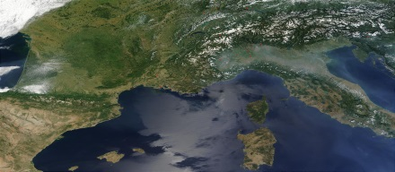
On-orbit Calibration Activities
SRCA:
Radiometric: monthly
Spatial: quarterly
Spectral: tri-annual
SD/SDSM:
Weekly to tri-weekly
Solar Diffuser
SRCA
SDSM
Blackbody
Scan Mirror
Space View
BB: quarterly
Spacecraft maneuvers:
Yaw (SD BRF, VF)
Roll (Moon)
Moon: monthly (nighttime orbits)
0-20° spacecraft roll maneuvers
55° phase angle
Notes:
Summary of the MODIS on-orbit calibration activities
MODIS scan-mirror is constantly rotating at 20.3 rpm to provide complete global coverage in less than 2 days
As the scan mirror rotates it is also able to sample the on-board calibrators
The primary calibrators for Reflective Solar Bands are the Solar diffuser and SD Stability Monitor
And space view port where the MODIS detectors can image the moon after a spacecraft roll maneuver

Slide 4
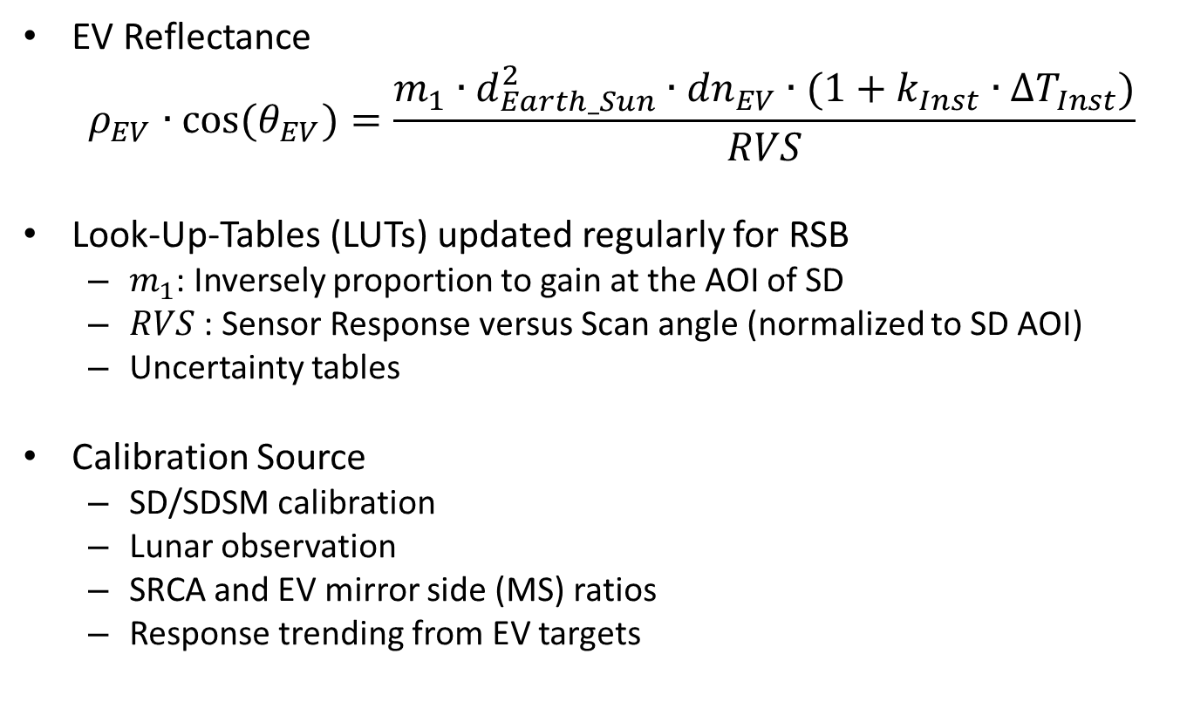
RSB Calibration
EV Reflectance
  $$ρ_{EV}∙\cos{{(θ}_{EV})}=\frac{m_{1}∙d_{Earth_Sun}^{2}∙{dn}_{EV}∙(1+k_{Inst}∙{∆T}_{Inst})}{RVS}$$
Look-Up-Tables (LUTs) updated regularly for RSB
  $m_{1}$: Inversely proportion to gain at the AOI of SD
  $RVS$: Sensor Response versus Scan angle (normalized to SD AOI)
  Uncertainty tables
Calibration Source
  SD/SDSM calibration
  Lunar observation
  SRCA and EV mirror side (MS) ratios
  Response trending from EV targets
SV Port 11.2
EV Start 10.5
BB 26.3
SRCA 38.2
Nadir 38
SD 50.25
EV Stop 65.5
Angle of Incidence (AOI)

Slide 5
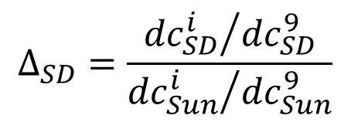
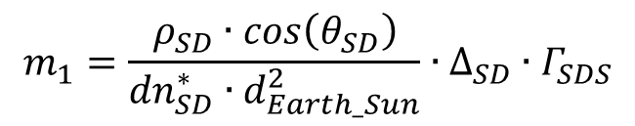
RSB SD Calibration
Sun
1.44 % screen
Optional 7.8 % screen (SD)
Terra: SD screen in permanent down position since July 2, 2003
SDSM
SD degradation
$$Δ_{SD}=\frac{{{dc}_{SD}^{i}}/{{dc}_{SD}^{9}}}{{{dc}_{Sun}^{i}}/{{dc}_{Sun}^{9}}}$$
Scan mirror
$$m_{1}=\frac{ρ_{SD}∙\cos\left(θ_{SD}\right)}{{dn}_{SD}^{∗}∙d_{Earth_Sun}^{2}}∙∆_{SD}∙Γ_{SDS}$$
SD
$ρ_{SD}∙\cos\left(θ_{SD}\right)=BRF, {dn}_{SD}^{∗}$ = Signal from SD (temperature and background corrected), $∆_{SD}=SD degradation, Γ_{SDS}=screen attenuation$

Slide 6
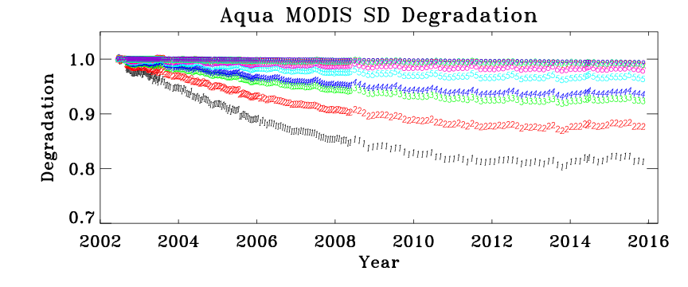
MODIS SD Degradation
Increased degradation after SD door anomaly on July 2, 2003
D1(0.41) D2(0.46) D3(0.55) D4(0.55) D5(0.64) D6(0.74) D8(0.90) D9(0.94)
Larger SD degradation at shorter wavelengths for both instruments
Aqua

Slide 7
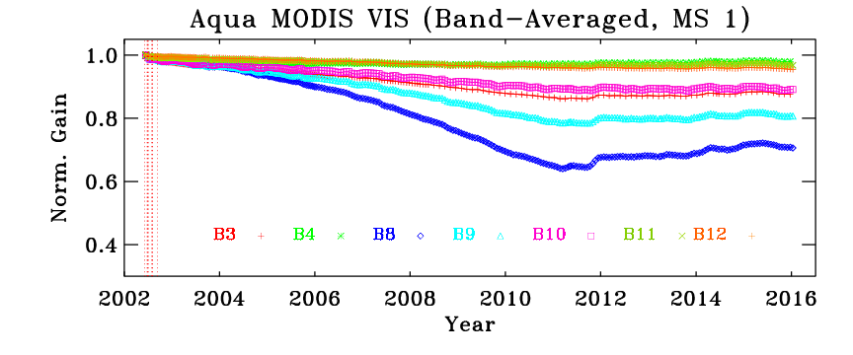
SD Gain Trending: Aqua
Most change observed for short-wavelength bands
Band 8 (.412 µm) maximum change is ~40%
Aqua VIS bands have a maximum mirror-side difference of about 3% at the SD AOI (Band 8)
Mirror Side 2

Slide 8
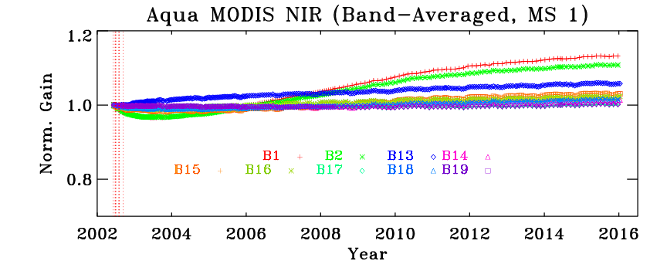
SD Gain Trending: Aqua
Changes for most NIR bands are within 6%
Mirror-side differences are <1%

Slide 9
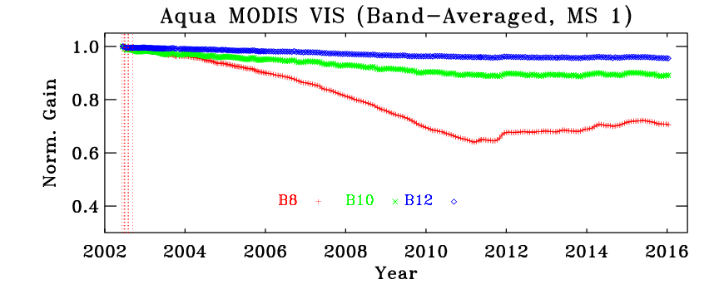
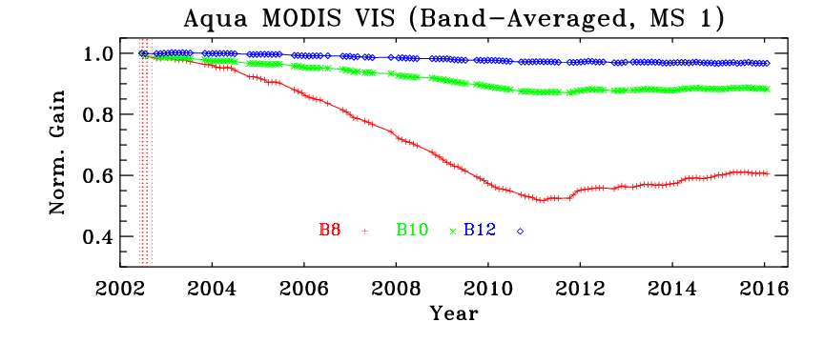
SD & Lunar Gain Trending
SD
Lunar
SD & Lunar measurements used to derive the on‐orbit RVS change
SD AOI = 50.25° Lunar (SV Port) AOI = 11.2°

Slide 10
EV-based RVS algorithm for Aqua bands 1-4
Aqua C6 RVS currently uses on-board calibrators (SD & lunar) in addition to EV mirror side ratios for bands 1-4
  Bands 8 and 9 include EV-response from desert sites to derive the LUT
  MCST regularly evaluates the long-term desert/Dome C/DCC trends to monitor the calibration stability for these bands
  Recent trends for bands 1 and 4 (especially) at nadir indicate a need to extend the current approach used for bands 8 and 9 to bands 1-4
Recent trends show a deviation between the on-board lunar and EV gain (at lunar AOI) for bands 1 and 2
  Similar phenomenon already observed in Terra MODIS
  Algorithm similar to Terra bands 1 and 2 extended to Aqua MODIS

Slide 11
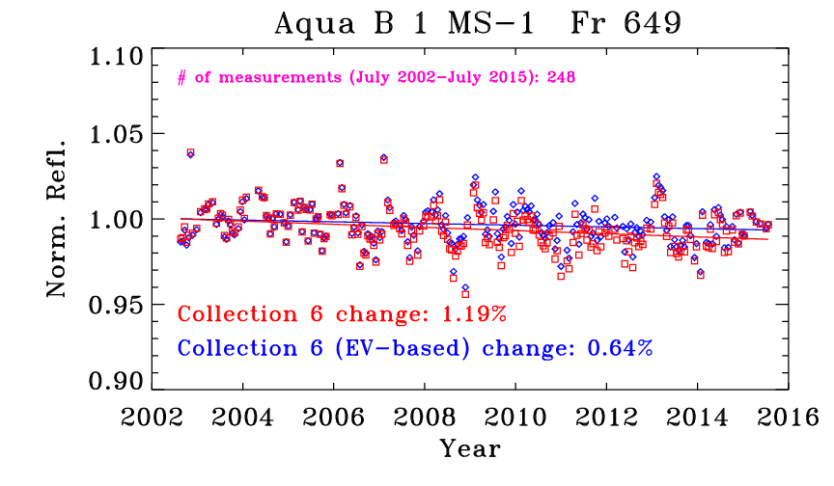
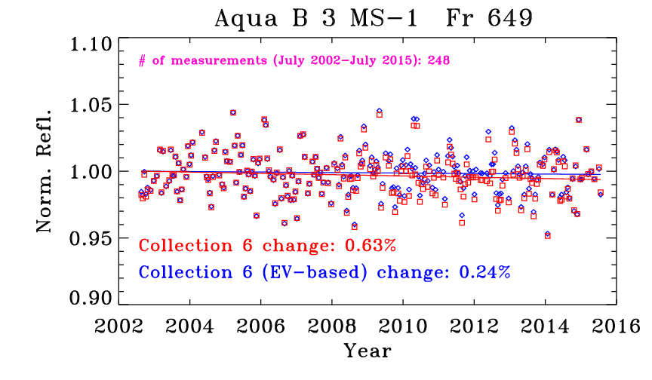
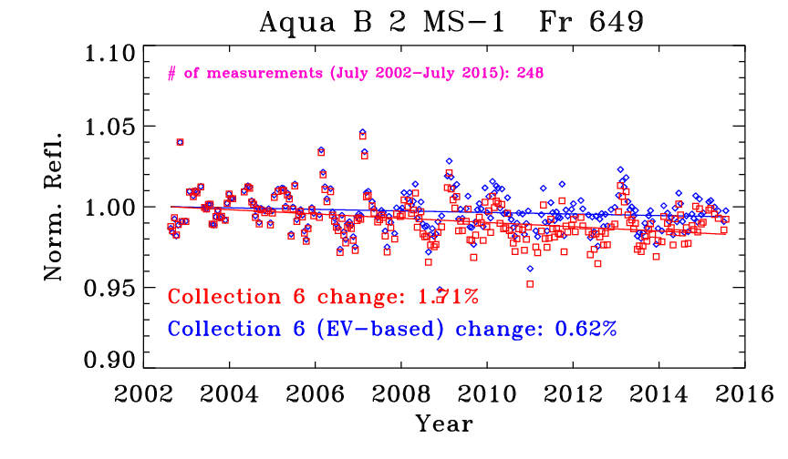
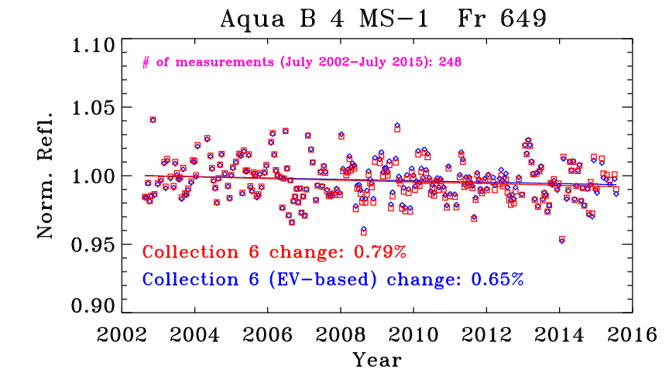
Aqua Bands 1-4 desert reflectance trending
Band 1: 646 nm
Band 3 465 nm
Band 2: 856 nm
Band 4: 553 nm

Slide 12
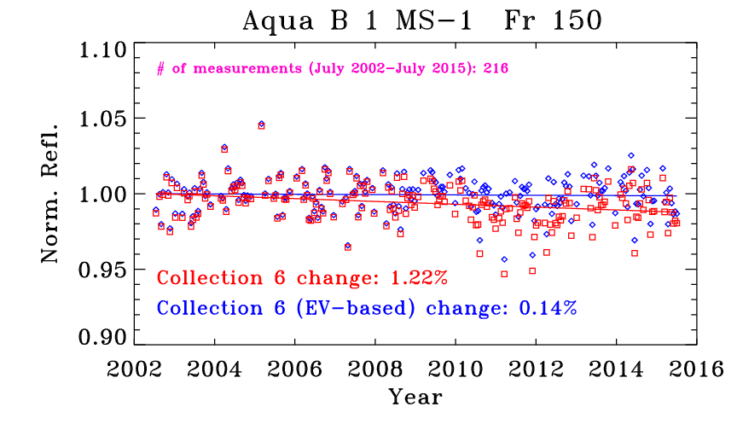
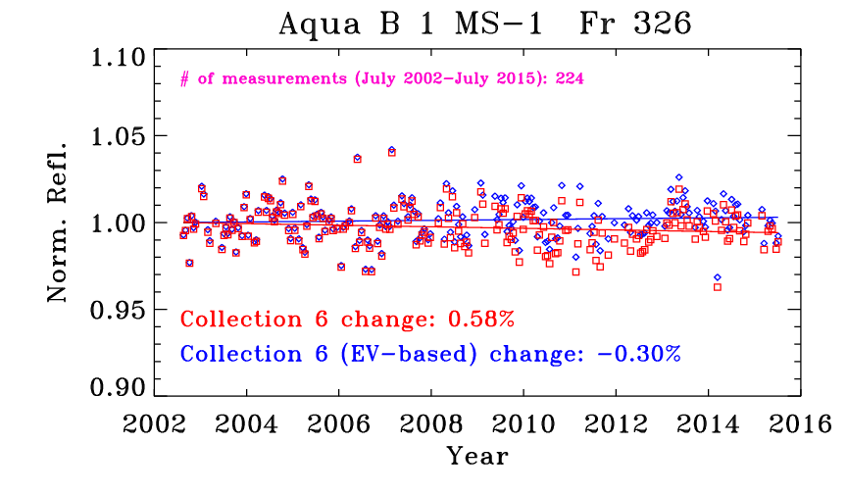
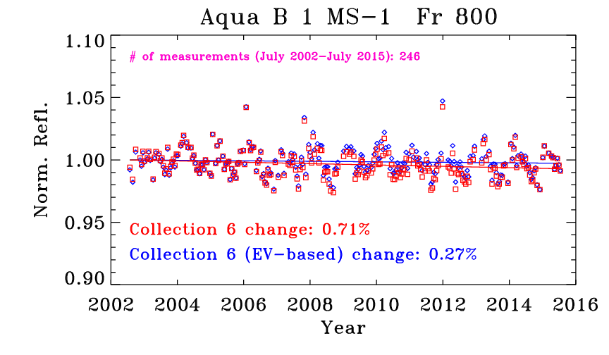
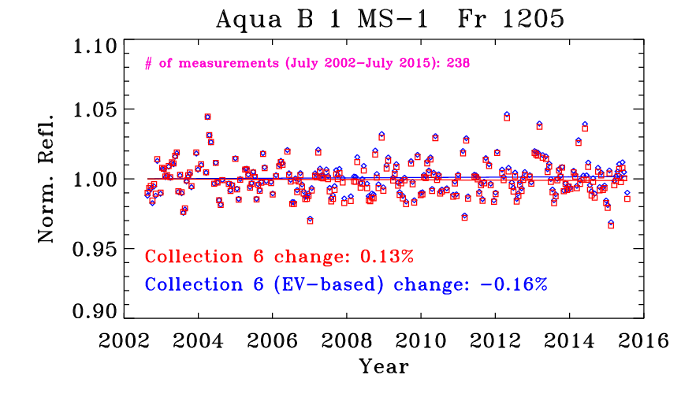
Aqua Bands 1 desert reflectance trending at different AOI

Slide 13
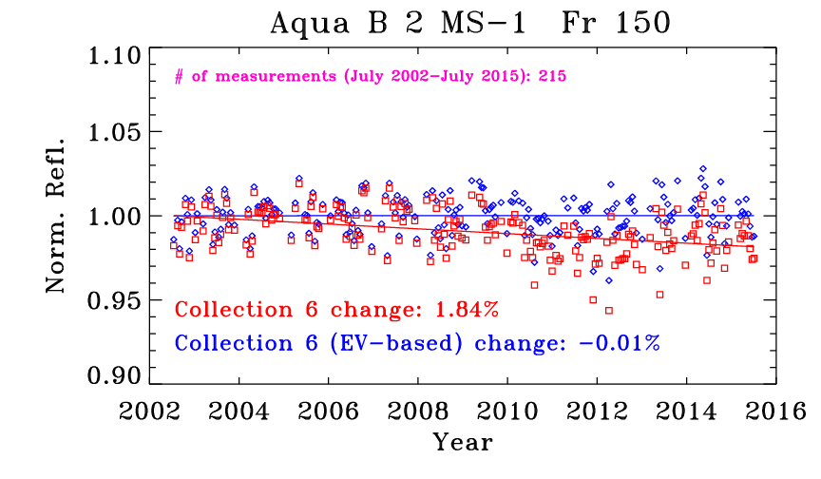
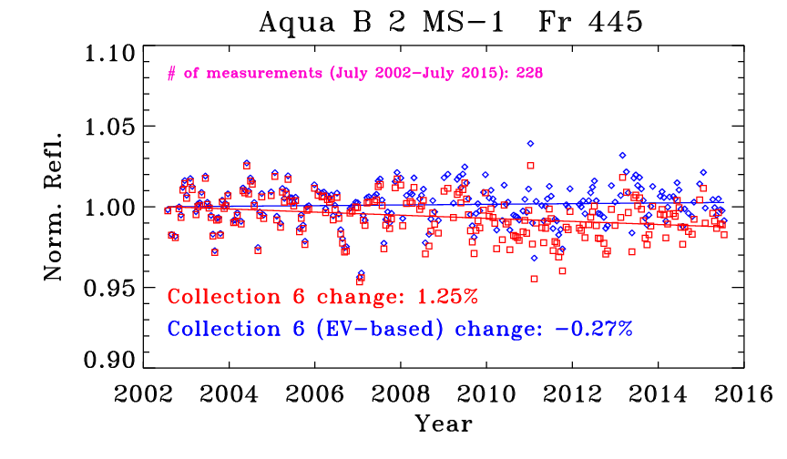
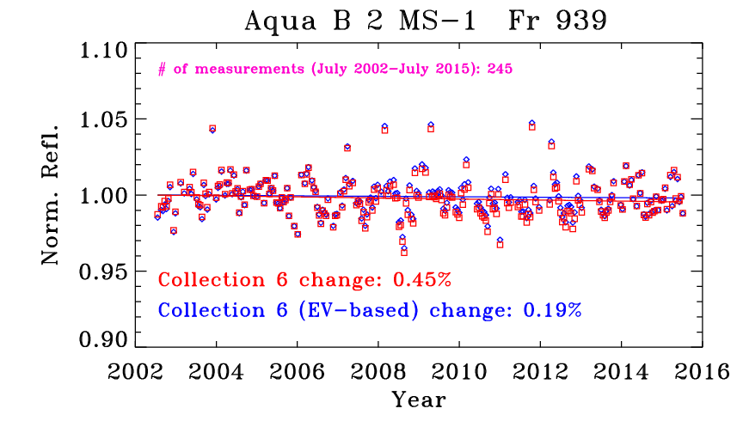
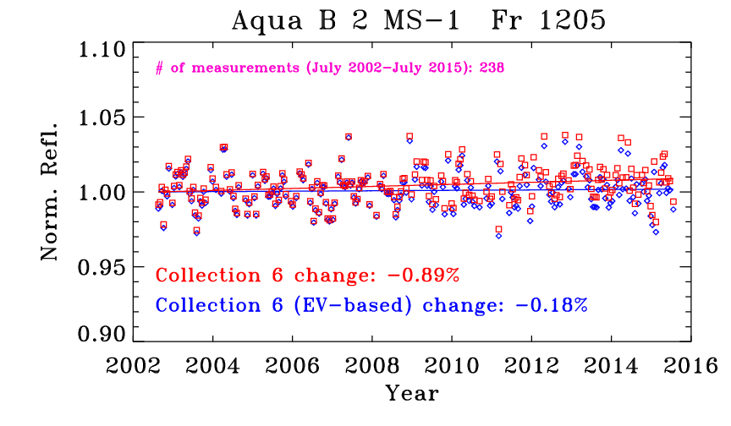
Aqua Bands 2 desert reflectance trending at different AOI

Slide 14
Aqua Bands 1 & 2 reflectance trending over Dome C

Slide 15
Aqua Bands 1 & 4 reflectance trending over DCC

Slide 16
Summary and future work
SD/SDSM and lunar observations are used to track RSB gain change
  Additional information from EV response (desert) are used for select RSB (Terra 1-4, 8-10 and Aqua 8-9)
    The EV-based RVS approach has been extended to bands 1-4 of Aqua MODIS
    The discrepancy between EV and lunar trends, previously observed for Terra MODIS bands 1 and 2 is now evident in Aqua bands 1 and 2
Shorter wavelength VIS Bands show larger degradation (strong wavelength, mirror-side, and scan-angle dependence)
  Gain change over 20% seen in Aqua Band 8 (.412 µm) at the AOI of SD (50.25°)
NIR bands gain change generally within 10%
SWIR bands gain change within 10%
Challenges:
  Degradation of the solar diffusers
  Changes in the RVS

