Slide 1
Update on Advancing Development of the ROLO Lunar Calibration System
Thomas C. Stone
U.S. Geological Survey, Flagstaff, Arizona USA
GSICS Joint Working Group Meeting
Tsukuba, Japan
29 February ‒ 04 March 2016

Slide 2
Introduction
Task: Improvement of the reference standard for lunar calibration
to improve absolute accuracy
to reduce residual geometry dependencies (phase, librations)
The reference irradiance is generated for each observation of the Moon taken by an instrument by computing the lunar model (ROLO, GIRO)
Improving the reference means refining and/ or re-developing the lunar irradiance model

Slide 3
Refinement and/or Re-development
Refining ROLO
reprocessing the ROLO telescope dataset using new algorithms
incorporating reliable new observational data
e.g. PLEIADES: several lunations with Moon observations as frequent as once per orbit = dense phase angle coverage
support (limited) from USGS, includes USGS‒CNES collaboration
Re-developing the lunar model reference
collecting new radiometric measurements of the Moon
requirements:
high-accuracy, with traceability to SI
full spectral coverage at moderate spectral resolution
photometric geometry coverage (phase and librations) sufficient for high-precision modeling

Slide 4
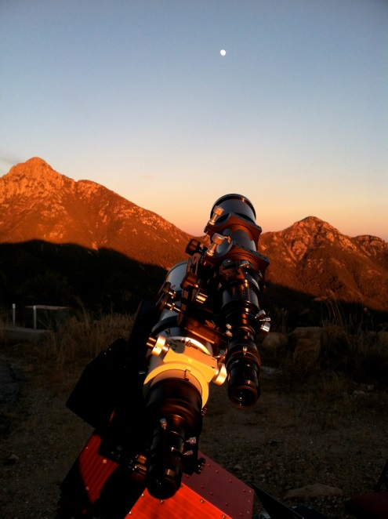
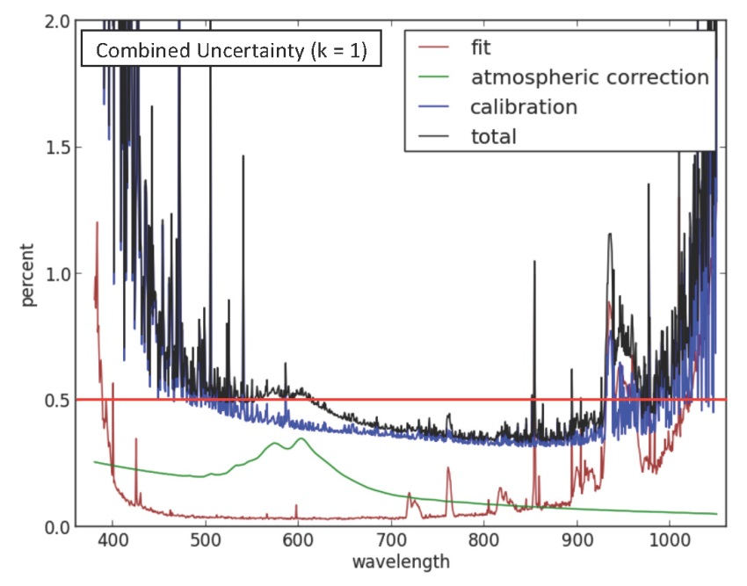
New Measurements of the Moon — Recent Progress
NIST absolute lunar spectral irradiance measurements¹
observations from Mt. Hopkins, Arizona, 2367m altitude
two nights in November 2012 with favorable observing conditions
atmospheric correction by Langley analysis of the lunar measurements
combined total uncertainty under 1% (k=1) from 400 nm to 1000 nm
data analysis ongoing, including absolute comparison against ROLO
¹C. Cramer et al. J. Res. NIST 118, 396 (2013)

Slide 5
New Measurements of the Moon — Recent Progress
ARCSTONE — absolute lunar irradiance measurements from a small satellite
presented at 2015 GSICS joint working groups meeting in Delhi
mission development based at NASA Langley Research Center
collaborations with NIST, USGS, Resonon Inc.
significant developments since last year…

Slide 6
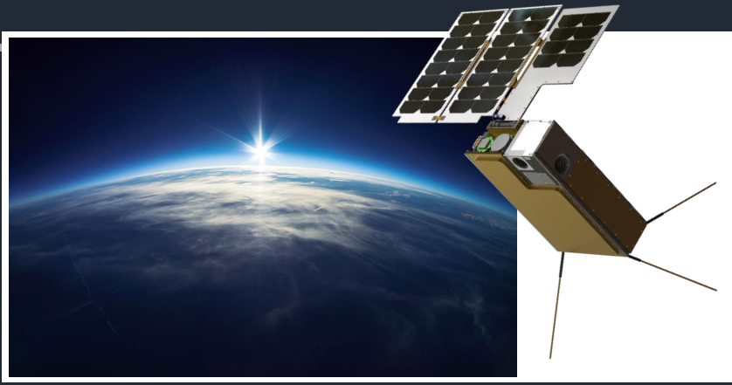
ARCSTONE
Calibration of Lunar Spectral Reflectance from Space
PI: Constantine Lukashin
Team: NASA LaRC, NASA GSFC, USGS, NIST, Resonon Inc.
ARCSTONE:
A spectrometer flying in LEO on a 6U CubeSat
Image courtesy of Blue Canyon Technologies

Slide 7
ARCSTONE: Key Mission Performance Parameters
Key Performance Parameters (KPP) | Threshold Value | Goal Value
Accuracy (reflectance) | 1.0% (k=1) | 0.5% (k=1)
Stability | < 0.15% (k=1) per decade | < 0.1% (k=1) per decade
Orbit | Sun-synch orbit | Sun-synch orbit
Time on-orbit | 1 year | 3 years
Frequency of sampling | 24 hours | 12 hours
Instrument pointing | < 0.2º combined | < 0.1º combined
Spectral range | 380 nm – 900 nm | 350 nm – 2300 nm
Spectral sampling | 8 nm | 4 nm
Lunar phase angle | 0º – 75º | 0º – 135º
Reference for radiometric requirements (ROLO, T. Stone):
Lunar Phase Angle = 75º
Nominal Irradiance = 0.6 (μW / m² nm)
Wavelength = 500 nm

Slide 8
ARCSTONE: Current Status
ARCSTONE development is funded internally at NASA LaRC (for FY16)
1st ARCSTONE Team Meeting: September 2015, Hampton, VA
Kick off ARCSTONE Engineering team: November 2015, NASA LaRC
Level-1 and major Level-2 Requirements are drafted, work in progress
Instrument concept by the Resonon, Inc: January, 2016
Instrument Breadboard design by the Resonon, Inc: January 2016
Instrument EDU/Flight design (Resonon & LaRC team): February 2016
ARCSTONE mission development in parallel with instrument
Near term objective: submit a NASA ESTO IIP proposal (Summer 2016)
The ARCSTONE team will need a support letter from GSICS/WMO
Comments and questions from the GSICS RWG are welcome !

Slide 9
Challenges and Limiting Factors
Space-based measurements:
lunar reflectance measurement requires observing both the Moon and the Sun
factor 4×10⁵ brightness difference, for Full Moon
requires fast sampling of the Moon, from LEO
lunar view geometry changes rapidly as satellite moves along its orbit
lunar irradiance changes ~0.1% in 20 seconds (Sun-sync orbit)
Ground-based measurements:
requires >3 years for sufficient coverage of geometry space
constrained by the orbit of the Moon, and by observing only at night
requires correction for the atmosphere (high-altitude site preferred)
NIST measurements represent a potential absolute scale for ROLO
2 nights fully processed to date, for phase angles 6.6° and 9.5°

Slide 10
Challenges and Limiting Factors
Major limiting factor: funding
ROLO is 100% funded by external sponsored projects
NASA-LaRC: support for ARCSTONE and CLARREO lunar calibration
USGS Land Remote Sensing Program: support for OLI lunar calibration, includes lunar model refinement and GSICS
analysis of NIST lunar measurements is not supported
advancing development of lunar calibration does not fit well to Earth Science research solicitations, e.g. NASA requests for proposals
lunar calibration enables meeting Earth science research objectives, it does not directly address these objectives
Solar spectrum:
need higher spectral resolution than standard/accepted solar models
involves filtering, interpolation, convolution and scaling of high-res spect.

