Slide 1
Application of GIRO to NIR bands
Meteorological Satellite Center,
Japan Meteorological Agency

Slide 2
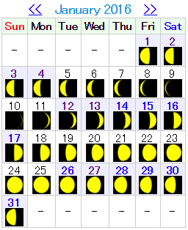
Lunar calibration for AHI
AHI VNIR bands
AHI observes the moon on routine basis. 60-70 lunar images can be obtained in a day on average.
More than 5000 images were archived in a half year.
AHI has 3 NIR bands. We are interested in a performance of GIRO for the NIR bands.
 | Wavelength [um]
Band 1 | 0.47
Band 2 | 0.51
Band 3 | 0.64
Band 4 | 0.86
Band 5 | 1.6
Band 6 | 2.3

Slide 3
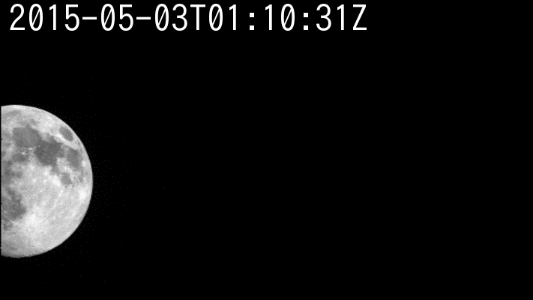
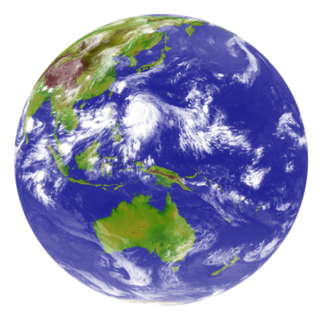
Full Disk / Regional Observation in 10 minutes Repeat Cycle
AHI FoR
Region 4, 5: mainly used for landmark observation, but region 5 is also used for lunar observation
Earth edge
Lunar observations
Band5 (1.6μm)
Preliminary fixed area
Flexible observation area
Full Disk Observation
every 10 min.
Region 1
2000 x 1000km
(NE Japan)
Every 2.5 min.
Region 2
2000 x 1000km
(SW Japan)
Every 2.5 min.
Region 3
1000 x 1000 km
(Target Area)
Every 2.5 min.
Region 4
1000 x 500 km
(Landmark Area)
Every 30 sec.
Region 5
1000 x 500 km
(Landmark Area)
Every 30 sec.

Slide 4
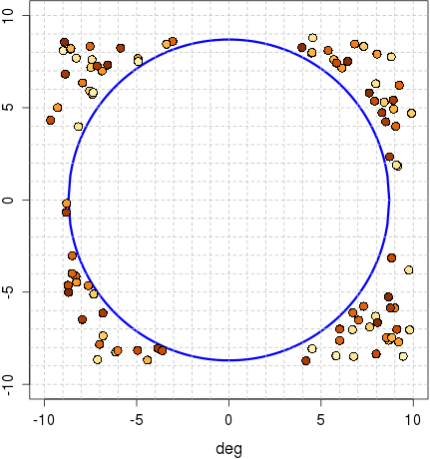
AHI Lunar Observation
Lunar phase angle [deg]
-180 -120 -60 0 60 120 180
Performed using Region 5 (1000x500km for the earth scene) flexible observation
Just one scan to observe the Moon
1 observation / 30 seconds
-> lots of observation
Full moon
Himawari-8/AHI
(30 Mar. – 12 Sep. 2015)
4956 Obs. / 5.5 months
Earth disk
MTSAT-2/Imager
(Jul.2010 – Dec.2013)
98 Obs. / 3.5 years
Earth disk
AHI FoR

Slide 5
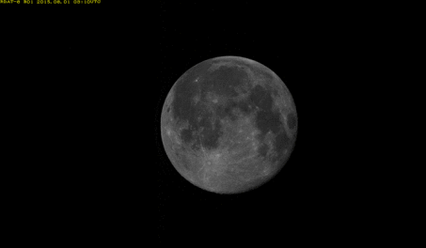
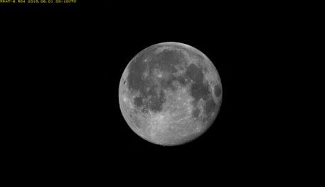
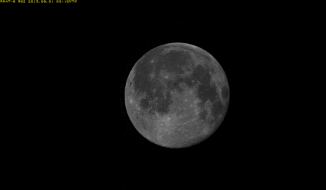
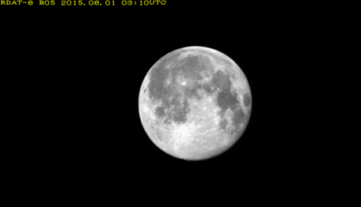
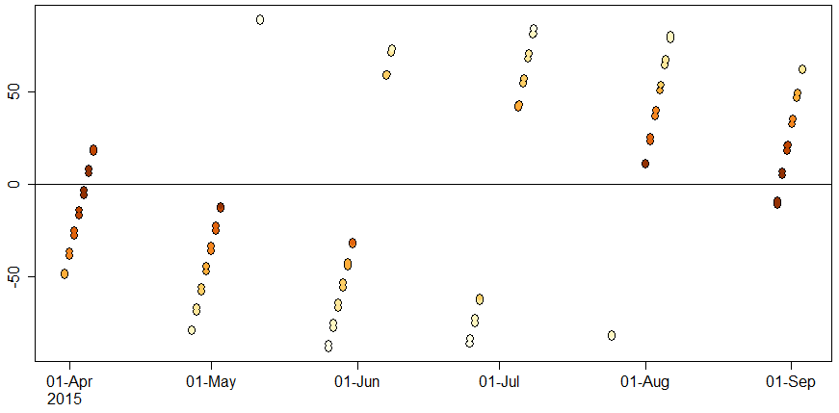
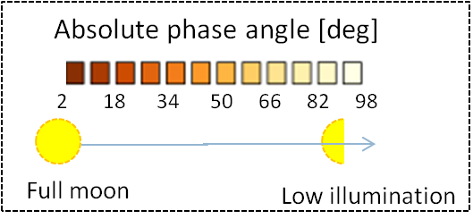
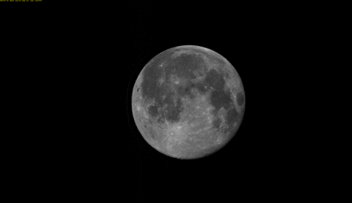
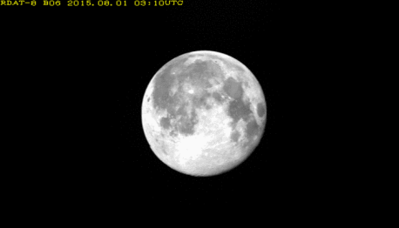
AHI Lunar Observation for GIRO
2979 useful lunar observations for the GIRO within the applicable phase angle:
2 deg <= |phase angle| <= 92 deg
47 days data
-> 60-70 lunar observation / day on average
2015-08-01T03:03:26Z (phase angle: 10.5deg)
B01 (0.47μm)
B04 (0.86μm)
Time series of AHI lunar phase angle [deg]
B02 (0.51μm)
B05 (1.6μm)
[deg]
B03 (0.64μm)
B06 (2.3μm)

Slide 6
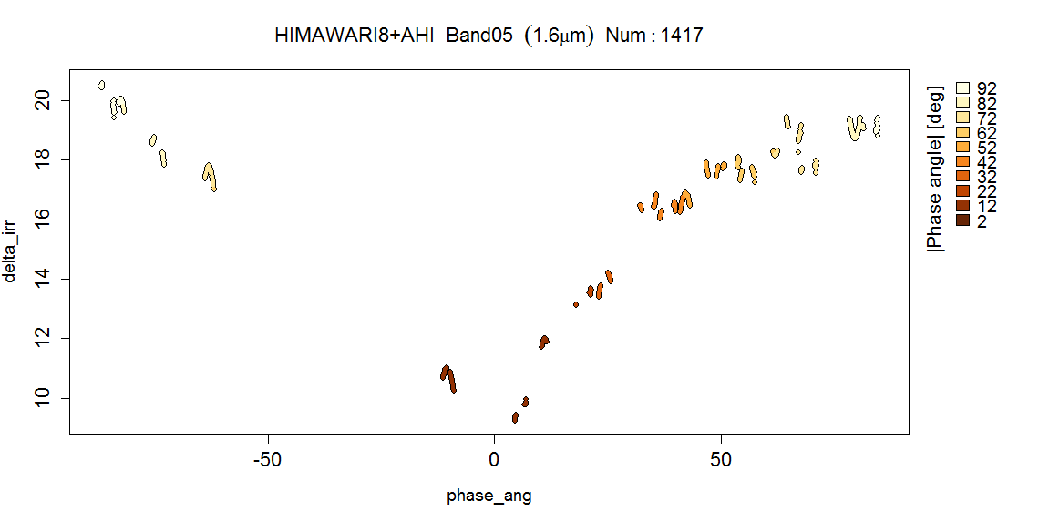
AHI Lunar Calibration – Preliminary Results
Phase angle dependence
Similar results with other instruments (e.g. MSG/SEVIRI NIR1.6)
Need to be investigated further
Himawari-8/AHI Band05 (1.6μm)
8 June to 3 September 2015
MSG1/SEVIRI NIR1.6 result
by B. Viticchie at the Lunar calibration Workshop in Dec. 2014
ΔIrr (%)
25 May to 8 June 2015
Operated under different calibration coefficients
Difference of lunar irradiance between the observation and GIRO [%]
Phase angle (deg)

Slide 7
Phase angle vs ΔIrr
Phase angle dependency depends on band.
It looks significant in longer wavelength.
The variation might be caused by coherent noise on images.
Need to be investigated further
~ 3%
~ 4%
~ 4%
~ 3%
~ 10%
~ 15%

Slide 8
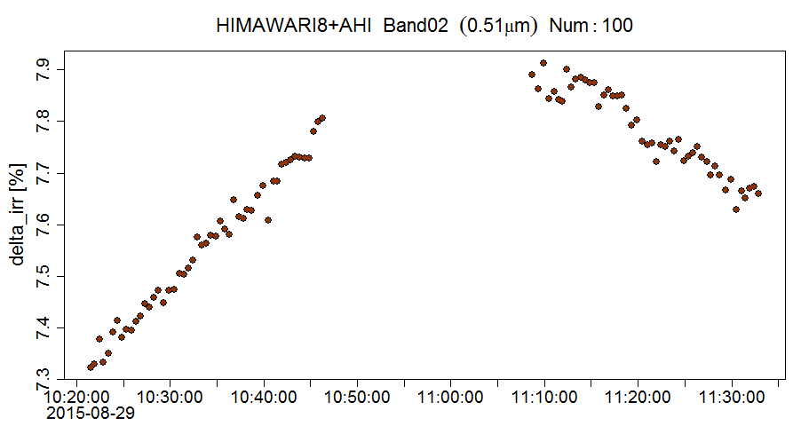
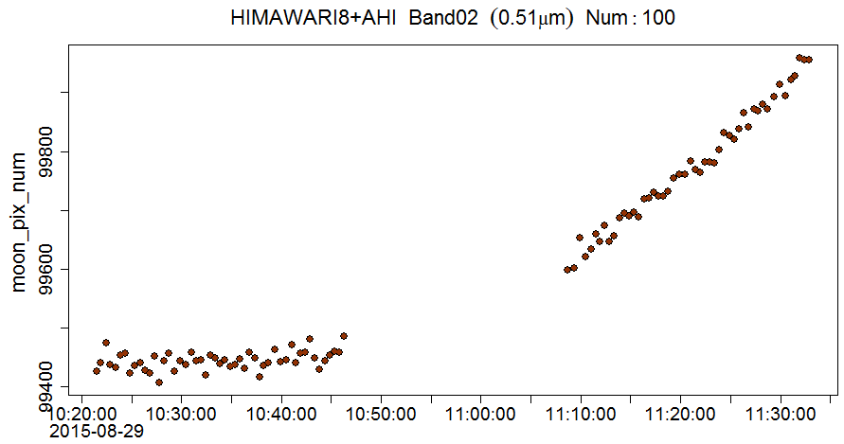
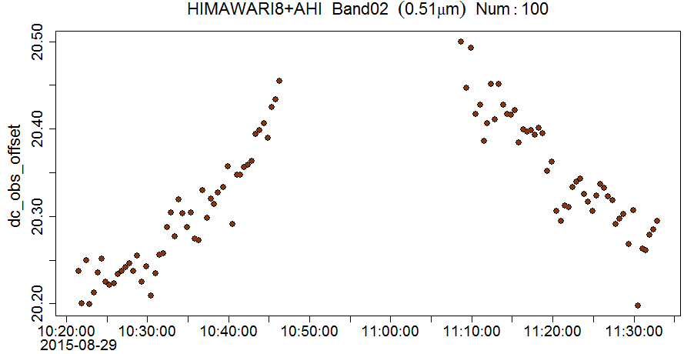
AHI Lunar Calibration Preliminary Results – Case Study
Difference of lunar irradiance between the observation and GIRO [%]
~0.6%
29 August 2015
Phase angle: from -11.5 to -9.0 [deg]
100 observation / ~90 minutes
AHI FoR
Earth edge
Lunar observations
ΔIrr (%)
~0.3 count
Number of the Moon pixels
Averaged deep space counts
Deep space count depends on a distance from the Earth.

Slide 9
Summary and Future Plan
Lunar observation by AHI
AHI observed more than 5000 images in a half year.
The AHI’s frequent observation function helps to investigate characteristics of GIRO output.
Findings
AHI NIR bands, 1.6 um and 2.3 um, shows the angular dependency similar to MSG1/SEVIRI 1.6 um.
Deep space count in AHI potentially depends on distance from the earth.
Future plan
Processing AHI lunar data after September
Improvement of deep space data handling
Inter-comparison of results with the ones by other calibration approaches such as DCC and SD observation.
Further investigation, especially the case such as 29 August

