Slide 1
Status of GIRO and GLOD policy, infrastructure and study on inter-calibration
S. Wagner, T. Hewison, B. Viticchiè

Slide 2
Overview
Status of the GIRO
GIRO and GLOD policy, licensing, copyrights
Infrastructure
Some preliminary results on the study on SBAF validation
Towards inter-calibration
Conclusions

Slide 3
Overview
Status of the GIRO
GIRO and GLOD policy, licensing, copyrights
Infrastructure
Some preliminary results on the study on SBAF validation
Towards inter-calibration
Conclusions

Slide 4
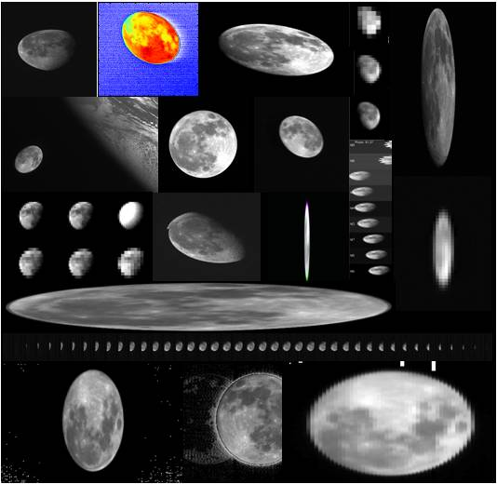
Context
Since the First Lunar Calibration Workshop in December 2014:
GIRO Version 1.0.0 released
GIRO usage and GSICS Lunar Observation Dataset policy terms agreed within Lunar Calibration Community and presented at the GSICS Executive Panel
Tighten links and interactions with CEOS WGCV IVOS, who support GSICS initiative on lunar calibration
Examples of Moon observations from instruments represented in Lunar Calibration Workshop

Slide 5
Lunar Calibration: Definition of a collaborative framework
External datasets to improve the irradiance reference model
(e.g. CNES with Pleiades)
EUMETSAT
Instrument Monitoring
US Geological Survey
ROLO lunar irradiance reference model
EUMETSAT
GIRO lunar irradiance reference model (GSICS Implementation of the ROLO model)
Publication of the enhancements to the ROLO = public domain
GSICS / CEOS-IVOS
Cross-comparisons
Instruments from other space and meteorological agencies
NASA
MODIS Aqua
= Current GSICS reference for VNIR channels
GSICS
Inter-calibration products
Monitored instruments from GSICS partners

Slide 6
Using the GIRO…
1/ The operational implementation of the GIRO at EUMETSAT allowed correcting for some small issues:
File naming convention: name of calibration file ends with 01.nc instead 00.nc ➔ Compliance with GIRO version v1.0.0
Modified global attributes:
Version number now included (in the field “processing level”).
ROLO version corrected (now = 3.11g).
Variable attributes: correction of some unit names ➔ date, central wavelength, effective wavelength, observed Moon irradiance, ROLO irradiance, ROLO wavelength, Apollo wavelength.
Following advice from SPICE team, replaced one SPICE Kernel (earth_000101_130520_130227.bpc, which stops on 20 May 2013) by a high precision one (earth_latest_high_prec.bpc , which currently stops in Jan 2016).
2/ Update of the GIRO version after green light for distribution

Slide 7
Overview
Status of the GIRO
GIRO and GLOD policy, licensing, copyrights
Infrastructure
Some preliminary results on the study on SBAF validation
Towards inter-calibration
Conclusions

Slide 8
GIRO + GLOD policy
GIRO + GLOD policy agreed among the Lunar Calibration Community
GIRO + GLOD policy was presented to the GSICS Executive Panel (June 2015)
Process to commit to the policy:
EUMETSAT Legal Affair Division to provide support in re-shaping the current policy to a more standard format (similar to a license)
Process to commit to the policy still to be defined (but likely to be good old paper!)
Provided to all of us as soon as we have the green light for code distribution

Slide 9
GIRO + GLOD: licensing and copyrights
We agreed GLOD to be available to all Lunar Calibration Community
EUMETSAT Legal Affairs division investigating Copyright situation
Distribution of the GLOD:
a letter to be prepared by EUMETSAT (to ensure homogeneity in the terms)
to be signed by the agencies or PIs of each instrument team participating in the project
Problem with licensing:
Numerical Recipes
Solar Irradiance Spectrum (Wehrli)
Apollo spectrum
➔ Blocking point for redistribution

Slide 10
GIRO + GLOD: licensing and copyrights
Numerical Recipes: if no agreement, then need to recode independently what is used. Acceptable but add more time.
Spectra (Wehrli + Apollo): we will contact the organisations providing the information
Time line: seek for feedback from the data/code owner by end of March / beginning of April (due to necessary internal iterations at EUMETSAT)
WARNING: in general, licensing might be an issue if we talk about exchanging code between agencies within GSICS ➔ discussion at GDWG

Slide 11
Overview
Status of the GIRO
GIRO and GLOD policy, licensing, copyrights
Infrastructure
Some preliminary results on the study on SBAF validation
Towards inter-calibration
Conclusions

Slide 12
Infrastructure
GIRO under Configuration Management system at EUMETSAT:
SVN repository (only internally accessible)
Tags for releases ➔ consistent with GIRO release version to external partners
Internal documentation to support operational use ➔ directly usable by GSICS
In order to distribute GIRO + GLOD ➔ set-up of a infrastructure required
See presentation 4f

Slide 13
Concept for a dedicated service (presented to GDWG, see 5f)
Link to GIRO + GLOD webpage:
WMO GSICS portal
GSICS wiki (in the dedicated Lunar Cal page)
GCC web page
IVOS Cal/Val portal
Visibility on the web?
➔ Keywords for search tools
(Implementing agency) GPRC web site
GSICS data server (any server?)
Front end : web page on GPRC web page for the implementing agency + external requests through Helpdesk
Restricted access (password? login?)
GIRO + GLOD policy
GIRO source code ➔ last version only
1. Documentation:
ATBD
User manual
Input/Ouput format description
Link toward the GSICS dedicated meeting (GSICS wiki)
Results of the GIRO validation + traceability
EUMETSAT Reports + scientific papers (references)
Others docs produced by partner on the GSICS wiki
2. Tools (or on the GSICS wiki)
1. GLOD:
1 dataset / instrument
More instruments / agency
Last valid version visible
Older versions “archived”
2. Benchmark for the validation of GIRO updates + traceability to ROLO

Slide 14
Overview
Status of the GIRO
GIRO and GLOD policy, licensing, copyrights
Infrastructure
Some preliminary results on the study on SBAF validation
Towards inter-calibration
Conclusions

Slide 15
Lunar inter-calibration study
Title : Study on validation of spectral band adjustment factors using lunar hyperspectral measurements
Contractors = M. Krijger (Earth Space Solution), R. Snel (Armamentarium), P. van der Meer (Tasty Chips Electronics)
3 activities:
Accounting for spectral differences between instruments: derive SBAFs with the GIRO and validate them with lunar hyperspectral measurements (using SCIAMACHY).
Supporting the establishment of an absolute scale for lunar calibration: adjustment of the GIRO on an absolute using the GLOD and SCIAMACHY
Define the list of parameters to make use of GOME-2 lunar observations + methodology to derive those parameters.
Kicked off in December 2015 ➔ Completion by end of 2016
All preliminary results presented in the following slides have been prepared by M. Krijger, R. Snel and P. van der Meer.

Slide 16
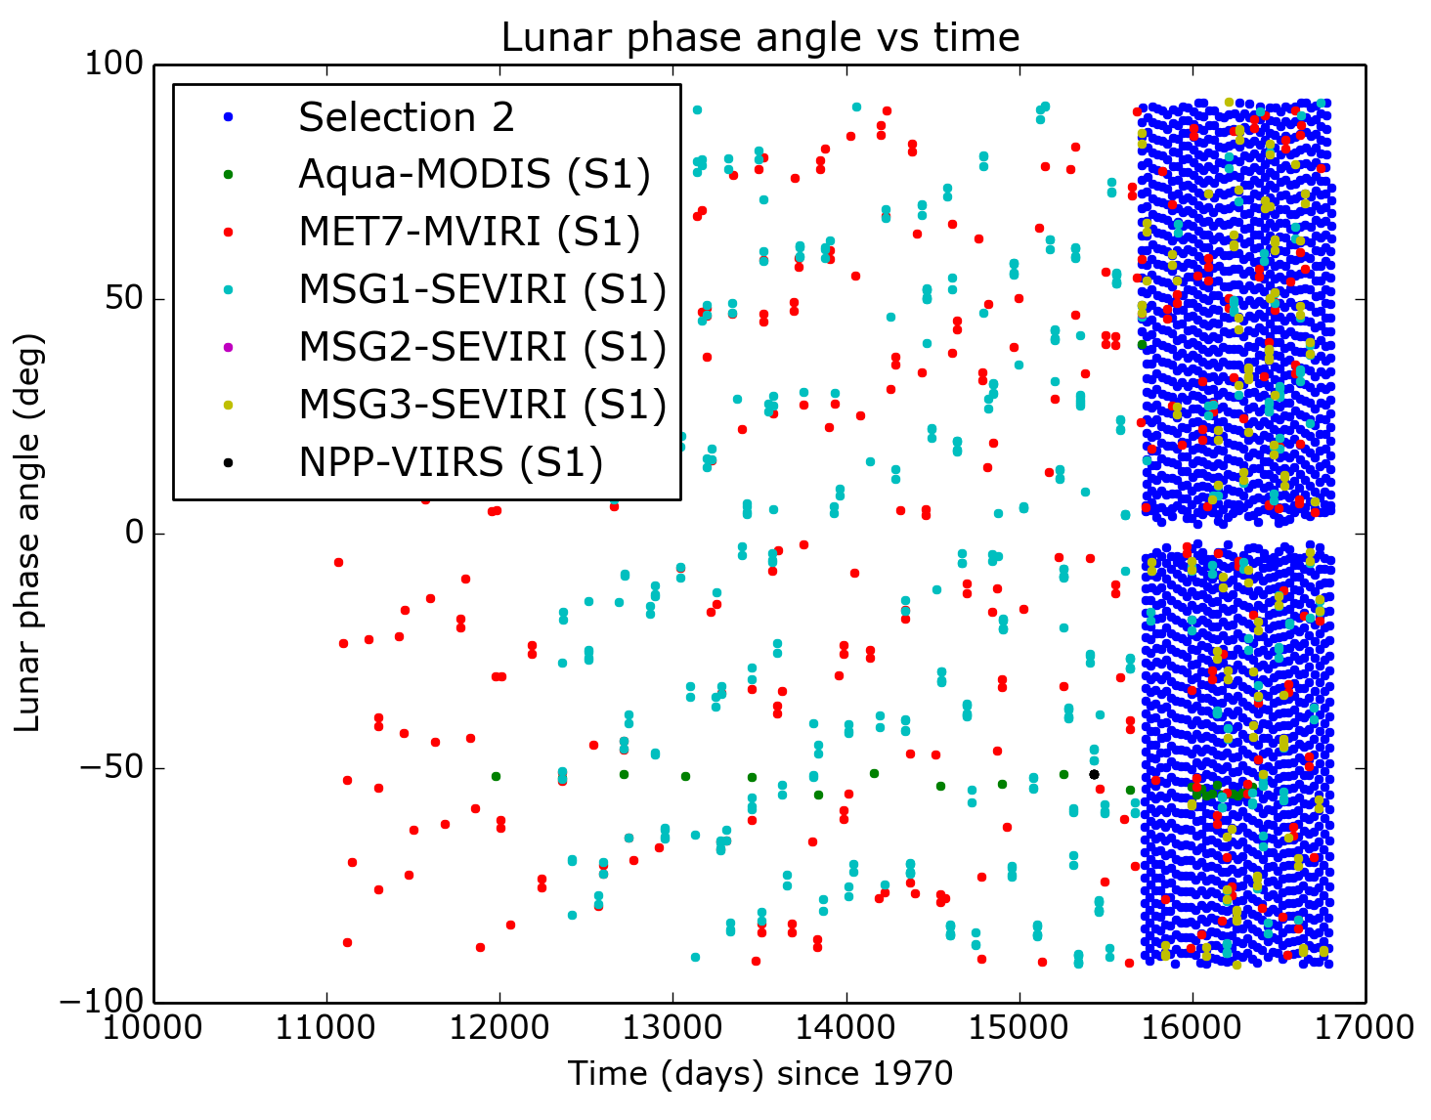
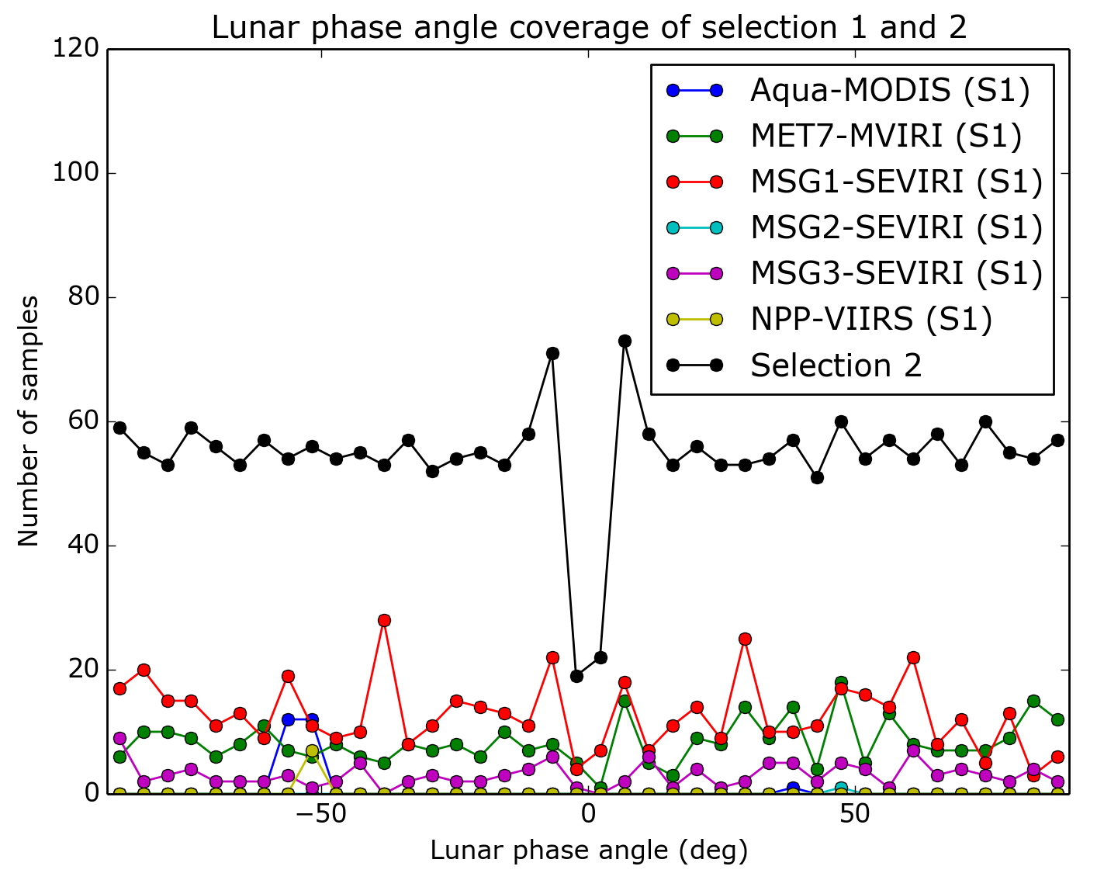
SBAFs derived with the GIRO
Two approaches:
Use the actual time and satellite positions as provides by the GLOD (Selection 1)
Use simulated data sets (3-year period at 6-hour resolution, Selection 2)

Slide 17
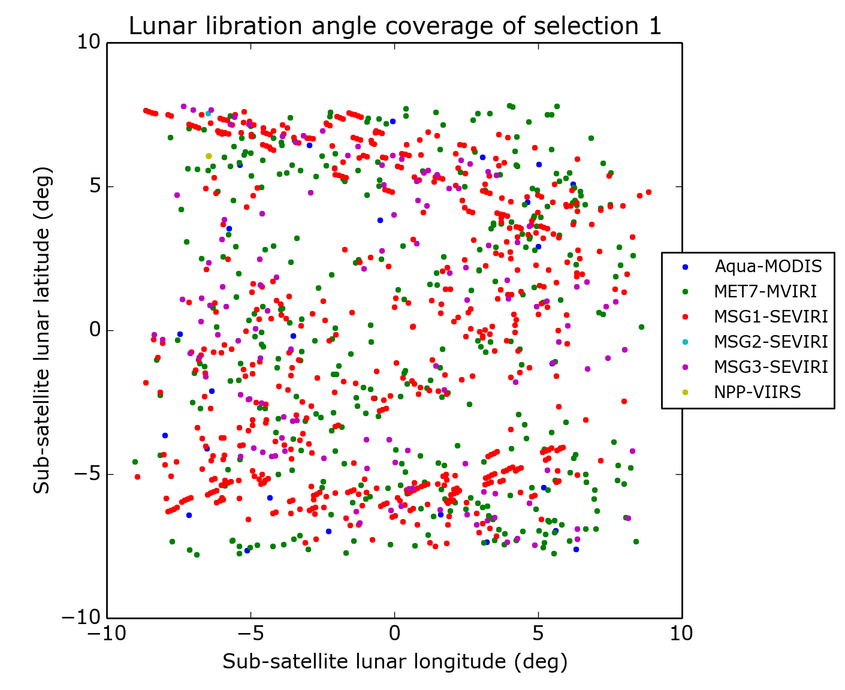
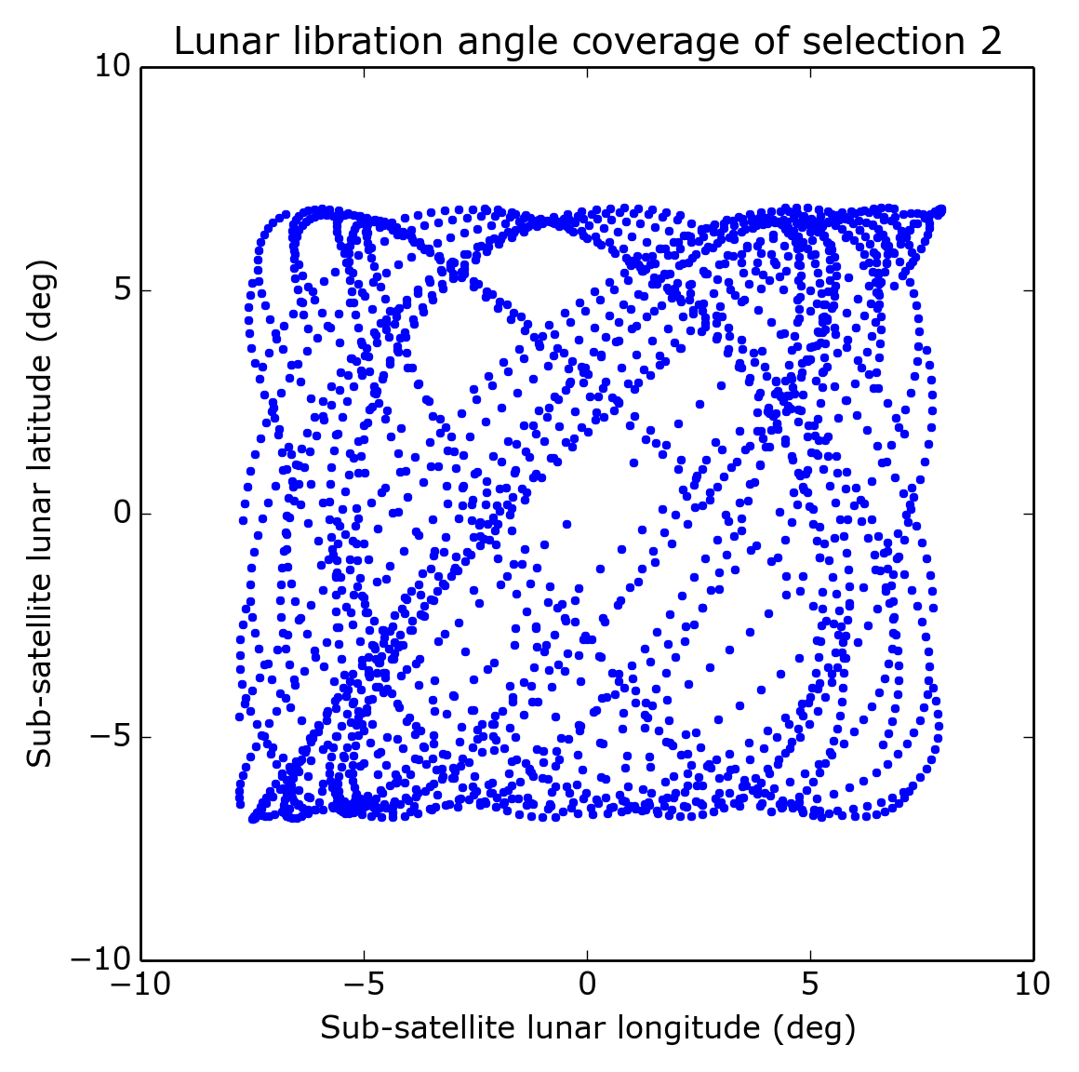
SBAFs derived with the GIRO

Slide 18
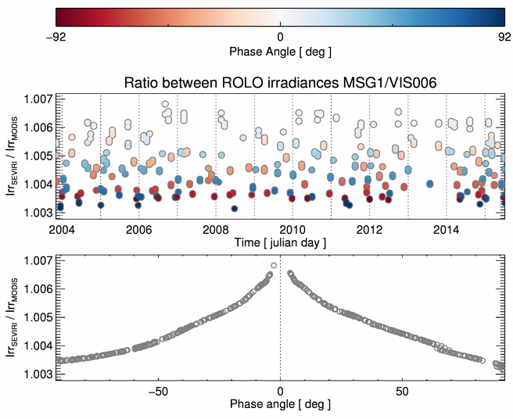
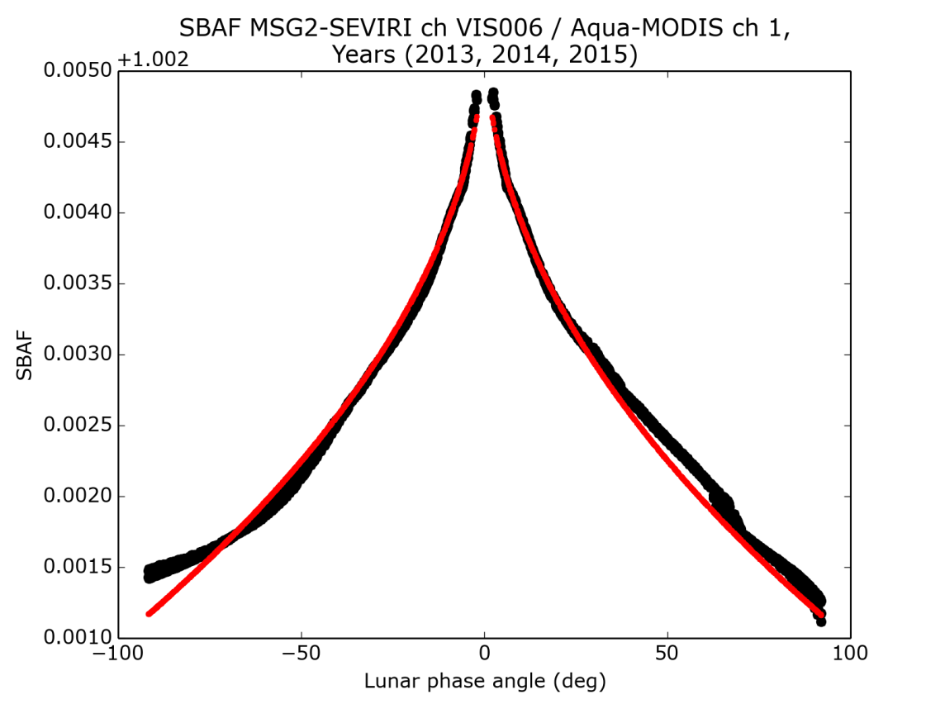
SBAFs derived with the GIRO
EUMETSAT’s results – web meeting 2015-09-08
For DCCs MSG1 – MODIS Aqua Band 1: 1.015 using NASA tool, 1.017 using data from GSICS ATBD

Slide 19
Overview
Status of the GIRO
GIRO and GLOD policy, licensing, copyrights
Infrastructure
Some preliminary results on the study on SBAF validation
Towards inter-calibration
Conclusions

Slide 20
A possible scheme for inter-calibration
Reference instrument = Aqua MODIS
Phase angle range = [-56,54]
λ, ϕ = Reference wavelength, Phase
ϕ = “50” = MODIS range
λ’, ϕ’ = Monitored wavelength, Phase
By definition:
MODIS is the truth ➔ we re-projected in the irradiance space of the monitored instrument:
From GLOD/NASA data, we derive the mean
If MODIS is perfectly calibrated and there is no phase dependence:
Consequently:

Slide 21
A possible scheme for inter-calibration
Issue: the phase dependence must be removed from the relative bias: 2 solutions
Remove the dependence from the GIRO ➔ Investigations in the ROLO
Correct the dependence using possible information from other satellites in a similar band (central wavelength + band width) ➔ first order approach
Need to evaluate uncertainty, including SBAF and Phase-Angle-dependence
This uncertainty used as weight of the lunar method in the blend with DCC, etc.
This assume that all required parameters to estimate the observed irradiance are accurately calculated (i.e. the over-sampling factor).
Advantage of normalising with the GIRO instead of the reference instrument irradiance = no impact of the instrument noise at low irradiance levels.
Not worked out yet the exact correction formulae (to move from a correction to a gain)
Feedback and suggestions from GRWG-VIS/NIR + IVOS are very welcomed ☺

Slide 22
Overview
Status of the GIRO
GIRO and GLOD policy, licensing, copyrights
Infrastructure
Some preliminary results on the study on SBAF validation
Towards inter-calibration
Conclusions

Slide 23
Conclusions
Top priority = unlock the situation on the license issues
Set-up the infra-structure to make the GIRO and GLOD available to the Lunar Calibration Community
Get the Lunar Calibration Community members to sign the policy
Follow-up the on-going study
Put in place an algorithm for inter-calibration using the Moon as a transfer target ➔ next candidate to add to the GSICS VIS/NIR product.
Follow the various activities led by our partners and foster interactions/collaborations to keep the momentum!

