Slide 1
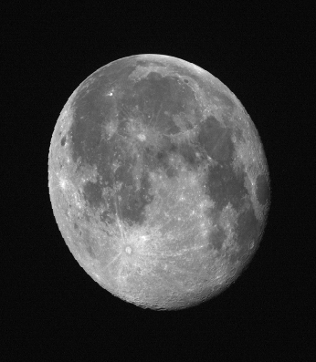
Lunar Radiance Calibration ABI/AHI Solar Reflective Bands
F. Yu, X. Shao, X. Wu
NOAA /NESDIS/STAR
2016 GSICS Annual Meeting
29 Feb. – 4 March 2016
Tsukuba, Japan

Slide 2
Acknowledgements
JMA for the AHI lunar images
AIST for the SELENE/SP L2C data
JAXA for SELENE/LALT and SELENE/SP L2B data

Slide 3
Outline
Select Targets
Compute Angles
Determine BRDF
Applications

Slide 4
ABI/AHI Solar Reflective Bands
GOES-R ABI | Central Wavelength (µm) | Nominal IGFOV (km) | Himawari-8 AHI
B1 | 0.47 | 1.0 | B1
 | 0.51 | 1.0 | B2
B2 | 0.64 | 0.5 | B3
B3 | 0.865 | 1.0 | B4
B4 | 1.378 | 2.0
B5 | 1.61 | 2.0 | B5
 |  | 1.0
B6 | 2.25 | 2.0 | B6

Slide 5
1. Select Sites
Favorable Conditions
Spatially Uniform – for flat moon surface. No impacts of vegetation and atmosphere
SELENE/Laser Altimeter (LALT) for lunar global topography
Spectrally Uniform
SELENE/SP for spectral variation
Sufficiently Large – tolerant to INR uncertainty
Different spatial resolutions at different bands
Closer to the center to minimize BRDF effect – viewing/illumination variations
More data opportunity for model development
If not, across the disk
Both dark (low elevation) and bright (high elevation) sites – bright sites to increase SNR
Apollo 16 site for absolute calibration
Weighting for these favorable conditions

Slide 6
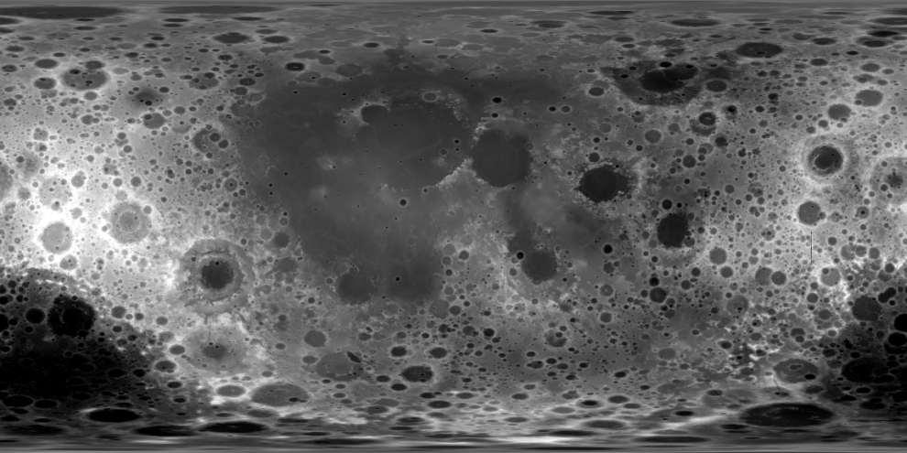
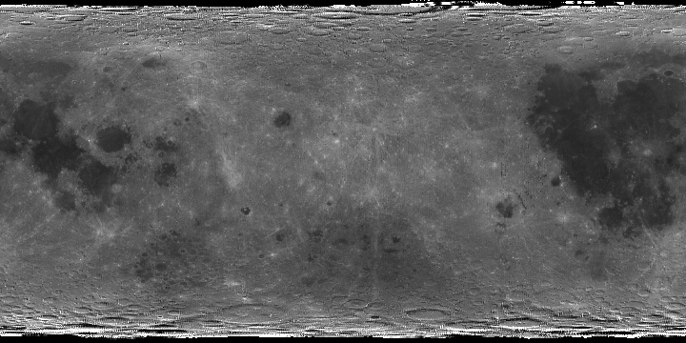
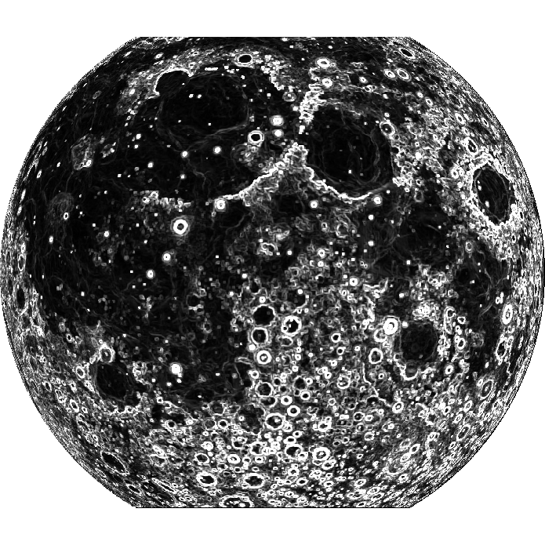
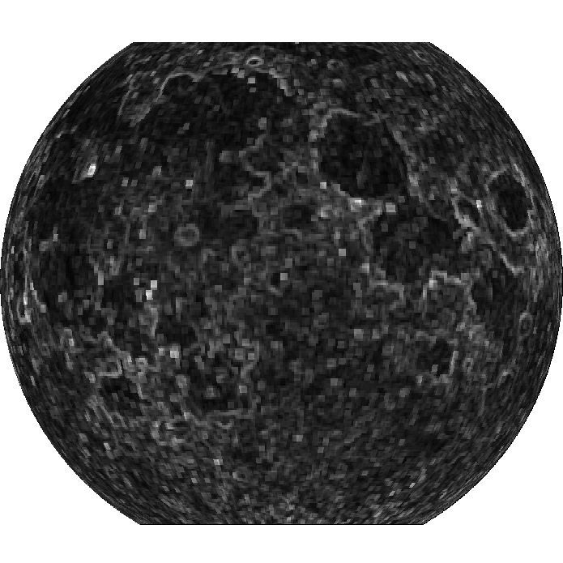
SELENE (Kaguya) Data to Select the Target Areas
SELENE/LALT
SELENE/SP
(-180, 90) (180, 90)
(-180,-90) (180, -90)
Re-project the near side of lunar surface products from cylindrical onto plane projection with selenographic coordinate at 5km/grid spatial resolution at Equator
Generate the Coefficient of Variation (CoV) of the topographic and radiometric products
Combine the CoV maps
Spectral convolution with ABI B2 SRF
60º
60º
60º
60º
-90º
90º
90º
-90º
Identify the Topographically and Spectrally Uniform Targets
-60º
-60º
-60º
-60º

Slide 7
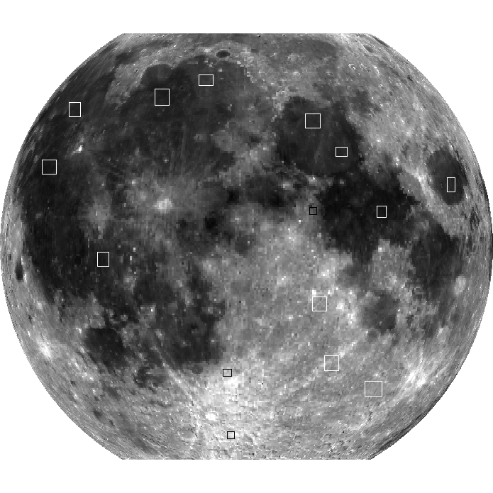
Lunar Surface Targets
10
9
13
3
1
14
4
Apollo Site #16
12
2
15
5
6
7
11
8
Selected Lunar Target Sites

Slide 8
Initial Set of Lunar Surface Targets
No | Central lat/lon | Size (in pixel) | Elevation (CoV) | Ch2 (stddev) | Ch3 (stddev) | Ch4 (stddev) | Ch5 (stddev)
1 | 22.6º, 24.7º | 15x14 | -2.76 (0.59) | 4.47 (±0.18) | 5.74 (±0.20) | 10.18 (±0.31) | 11.72 (±0.34)
2 | 8.1º, 33.7º | 14x17 | -0.80 (0.17) | 3.85 (±0.139) | 4.93 (±0.17) | 8.16 (±0.33) | 9.30 (±0.38)
3 | 30.7º, 18.3º | 22x21 | -2.60 (0.29) | 4.69 (±0.17) | 6.07 (±0.19) | 10.72 (±0.28) | 12.37 (±0.31)
4 | 14.5º, 59.3º | 12x21 | -3.67 (0.51) | 4.59 (±0.20) | 5.87 (±0.22) | 10.10 (±0.34) | 11.69 (±0.39)
5 | -13.5º, 17.8º | 21x21 | 1.52 (1.83) | 8.80 (±0.60) | 11.49 (±0.71) | 18.28 (±1.04) | 20.47 (±1.14)
6 | -30.9º, -5.2º | 13x11 | -1.25 (0.96) | 10.44 (±0.46) | 13.09 (±0.53 | 20.74 (±0.72) | 22.93 (±0.78)
7 | -28.3º, 23.2º | 21x22 | 1.75 (2.43) | 9.12 (±0.70) | 11.85 (±0.80) | 18.98 (±1.10) | 21.19 (±1.18)
8 | -50.1º, -5.6º | 11x11 | -2.80 (2.65) | 11.29 (±0.77) | 14.28 (±0.82) | 22.32 (±1.15) | 24.66 (±1.21)
9 | 42.5º, -12.9º | 21x16 | -2.69 (0.35) | 5.21 (±0.22) | 6.67 (±0.22) | 11.85 (±0.39) | 13.55 (±0.42)
10 | -37.3º, -25.5º | 21x24 | -2.34 (0.13) | 4.22 (±0.18) | 5.38 (±0.21) | 8.98 (±0.36) | 10.39 (±0.40)
11 | -35.3º, 39.3º | 25x22 | 0.30 (1.48) | 8.72 (±0.38) | 11.41 (±0.47) | 18.39 (±0.70) | 20.52 (±0.76)
12 | 8.3º, 15.9º | 11x11 | -0.41 (1.70) | 6.17 (±0.49) | 8.02 (±0.61) | 13.10 (±0.95) | 14.73 (±1.04)
13 | 33.8º, -57.1º | 17x21 | -2.21(0.55) | 4.49(±0.23) | 5.75(±0.29) | 9.47(±0.65) | 10.98(0.72)
14 | 18.8º, -57.8º | 21x21 | -2.11(0.45) | 3.96(±0.20) | 5.00(±0.23) | 8.13(±0.39) | 9.40(±0.43)
15 | -2.9º, -35.6º | 17x21 | -1.75(0.30) | 4.17(±0.21) | 5.29(±0.26) | 8.7(±0.40) | 1.01(±0.45)

Slide 9
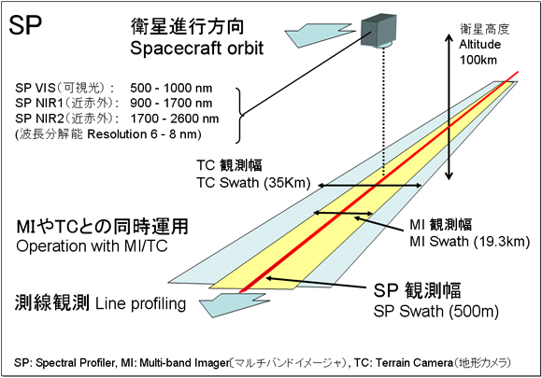
SELENE(KAGUYA) and SP
SP: Spectral Profiler
Spectral range:
500-2600 nm
Spectral resolution:
6 nm (VNIR 520-960 nm)
8 nm (NIR-SWIR > 900 nm)
Observation swath
500 m
Courtesy of JAXA

Slide 10
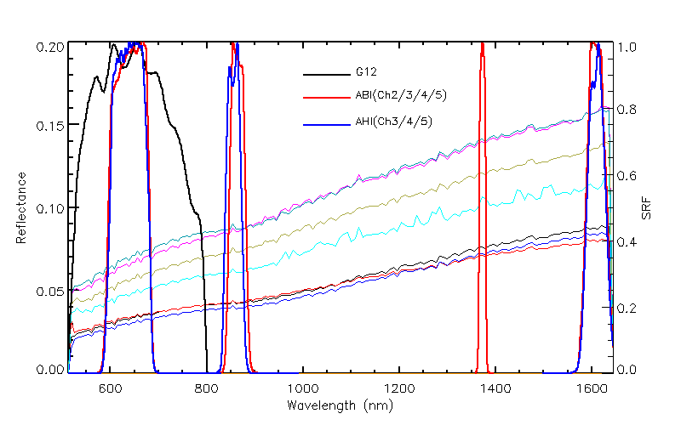
ABI/AHI SRFs and the mean SP Spectra at the Targets

Slide 11
Characterization of Lunar Surface Targets with SELENE/SP

Slide 12
Characterization of Lunar Surface Targets with SELENE/SP

Slide 13
2: Compute the Angles
Step 1: Recover the Lunar Image
Correct progressive shift in east-west scan of lunar image
Correct oversampling factor/distortion.
Scaling back to a disk.
Boundary detection of lunar disk
Use smoothness of boundary to find the disk boundary
Fit with ellipse
Scaling back to a disk.

Slide 14
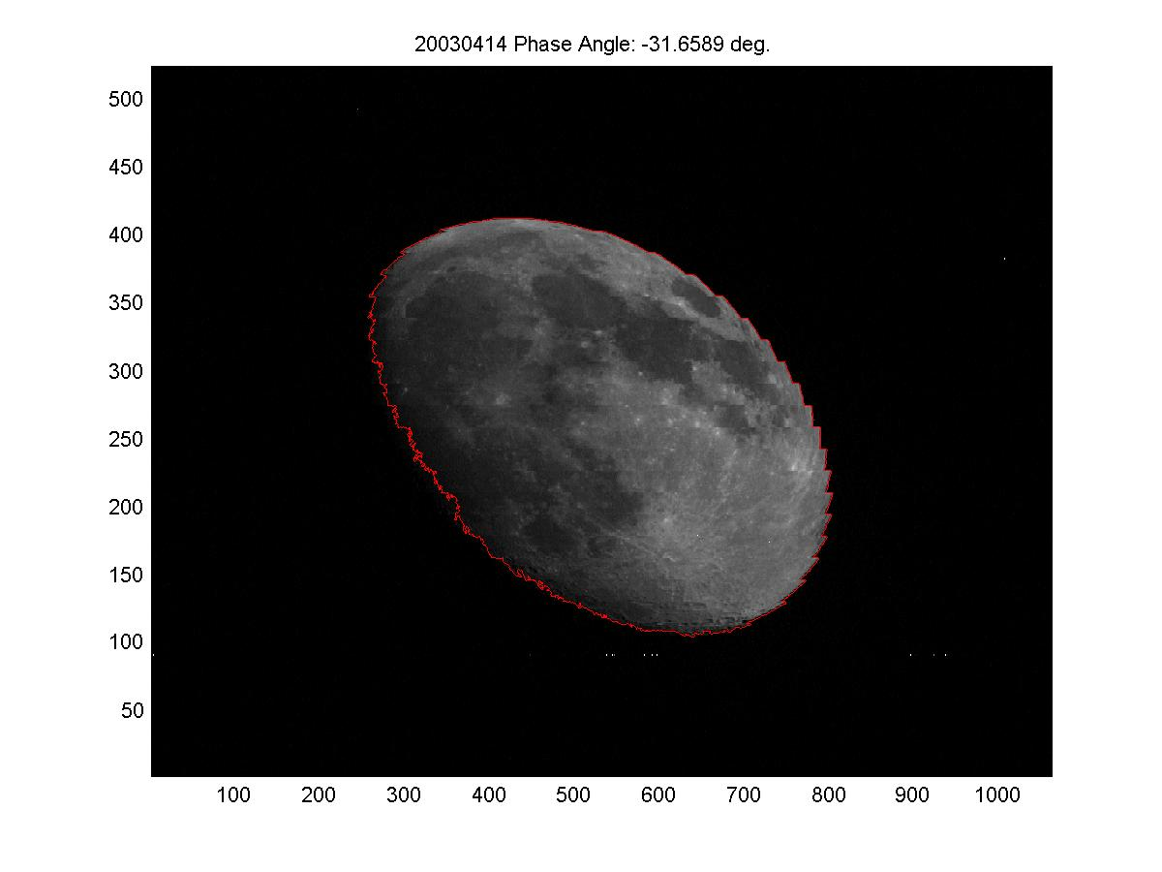
Original lunar image

Slide 15
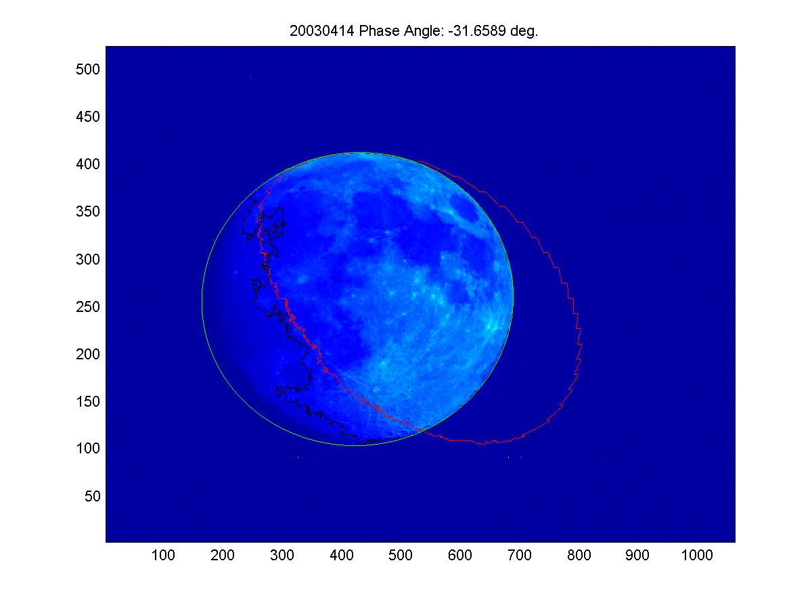
After Correcting for “saw tooth”

Slide 16
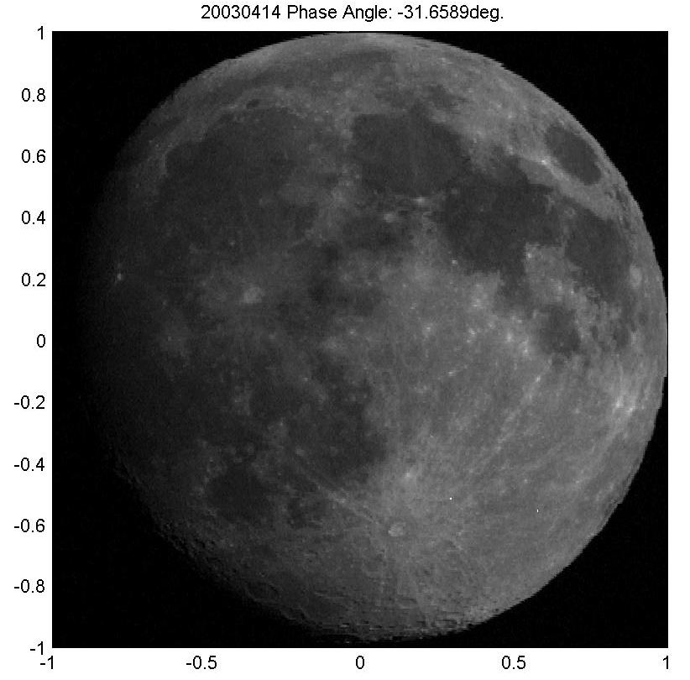
After correcting for over-sampling 20030414

Slide 17
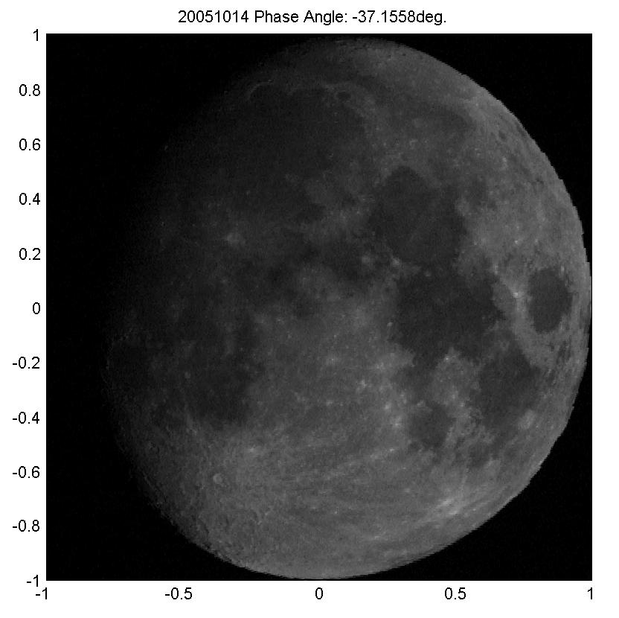
After correcting for over-sampling 20041014

Slide 18
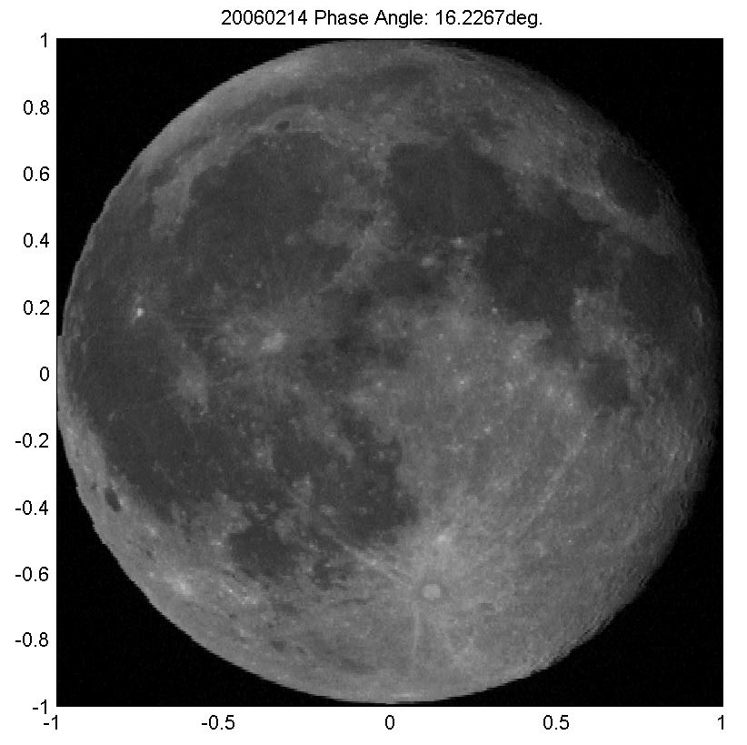
After correcting for over-sampling 20060214

Slide 19
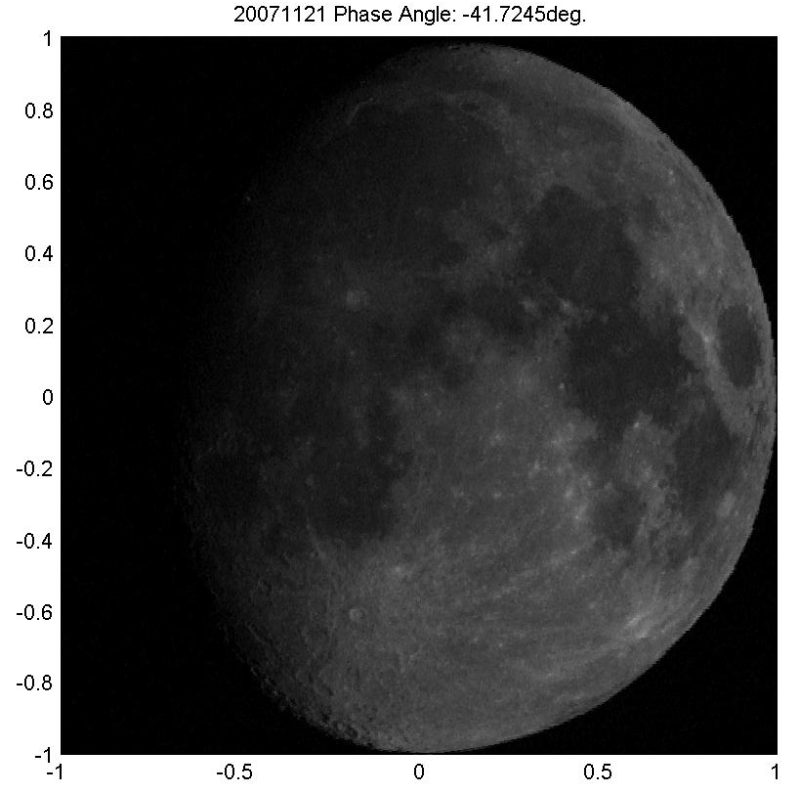
After correcting for over-sampling 20071121

Slide 20
2: Compute the Angles
Step 2: Rotate the Lunar Image
Match landmark in Longitude-r space
Determine selenographic coordinates of landmark on lunar image through cross-correlation between a template image and the observed lunar image.
Map the projected lunar image back to spherical coordinate through three consecutive rotations into selenographic coordinates.

Slide 21
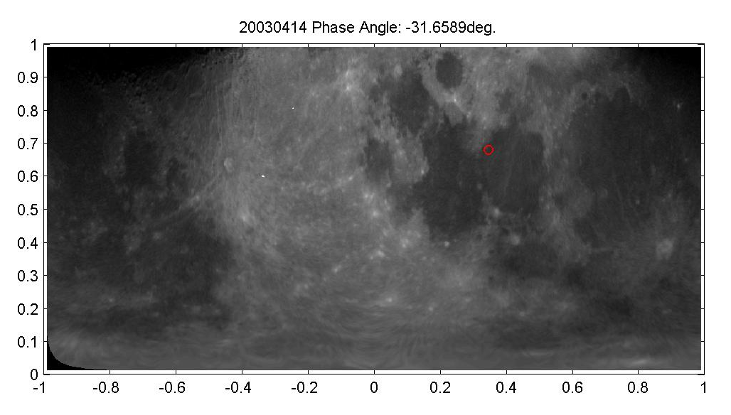
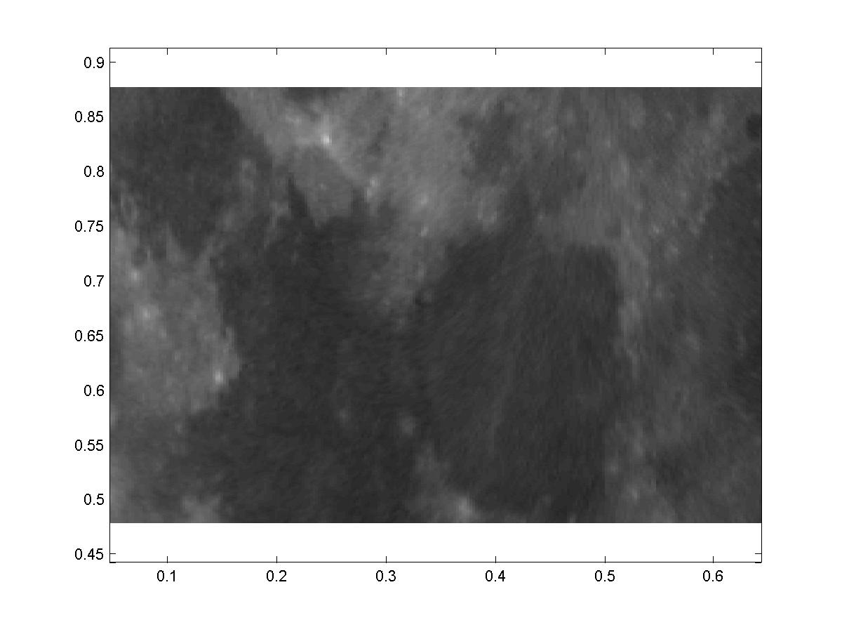
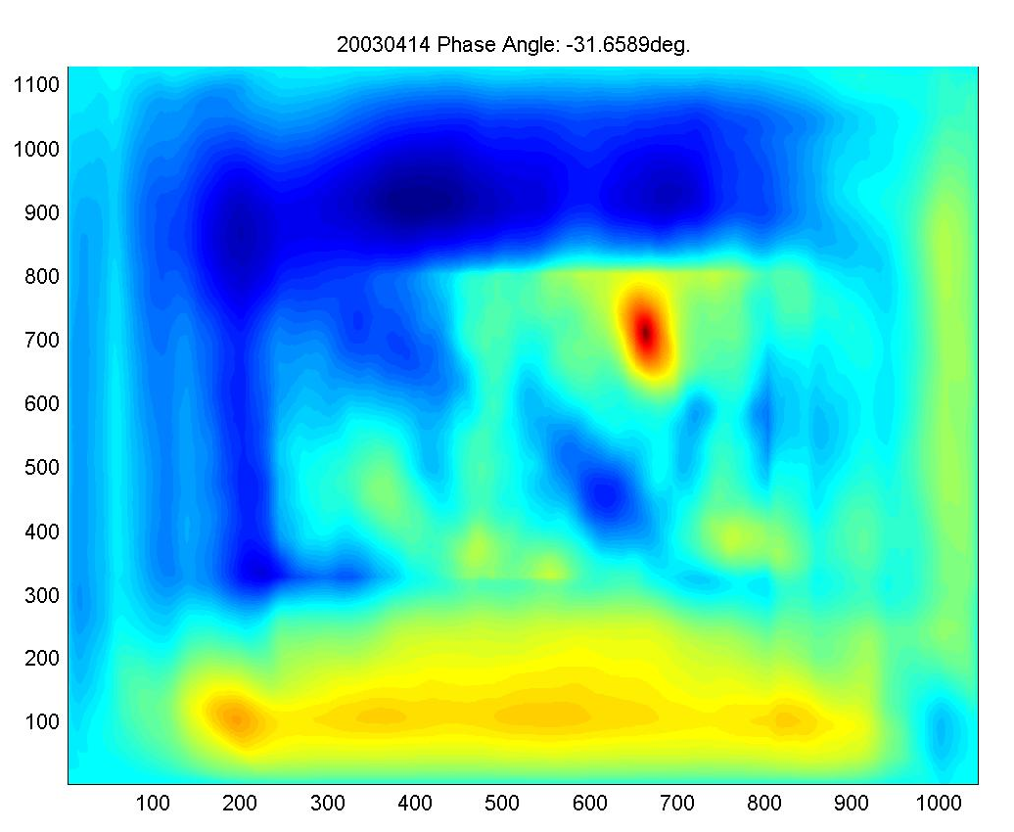
Controlling Point Mapping-20030414
r
Longitude/180
Cross-correlation map

Slide 22
Coordinate Transformation
Use controlling point mapping to determine relative rotation angle shift δ$φ$ in the projected disk.
Given Satellite direction in Selenographic Coordinate (φ_{s},α_{s})
Given point on projected lunar disk (r, φ)
Map to (X, Y, Z) in Cartesian Selenographic Coordinate
$$\left[\begin{matrix}cos⁡(φ_{s}) & −sin⁡(φ_{s}) & 0 \\ sin⁡(φ_{s}) & cos⁡(φ_{s}) & 0 \\ 0 & 0 & 1\end{matrix}\right]\left[\begin{matrix}cos⁡(α_{s}) & 0 & sin⁡(α_{s}) \\ 0 & 1 & 0 \\ −sin⁡(α_{s}) & 0 & cos⁡(α_{s})\end{matrix}\right]\left[\begin{matrix}0 \\ rcos(φ+\text{δ}φ) \\ rsin(φ+\text{δ}φ)\end{matrix}\right]$$
=$\left[\begin{matrix}X \\ Y \\ Z\end{matrix}\right]$
Then convert (X, Y, Z) to selenographic longitude and latitude.

Slide 23
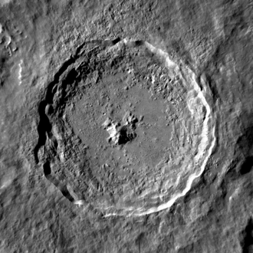
Validation Point: Tycho Crater
Tycho seen by Lunar Reconnaissance Orbiter. NASA
Coordinates | 43.31°S 11.36°WCoordinates: 43.31°S 11.36°W
Diameter | 86 km
Depth | 4.8 km
Colongitude | 12° at sunrise
Eponym | Tycho Brahe
After the mapping, Tycho Crator is used as the landmark to validate the lunar-location or perform fine tuning

Slide 24
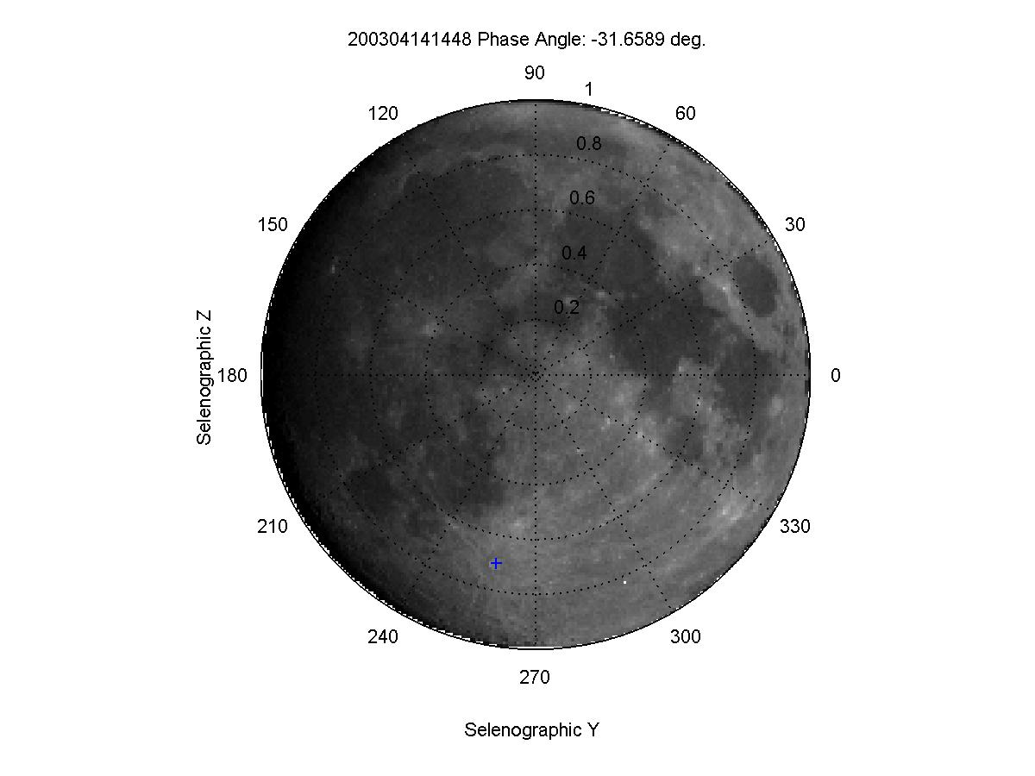
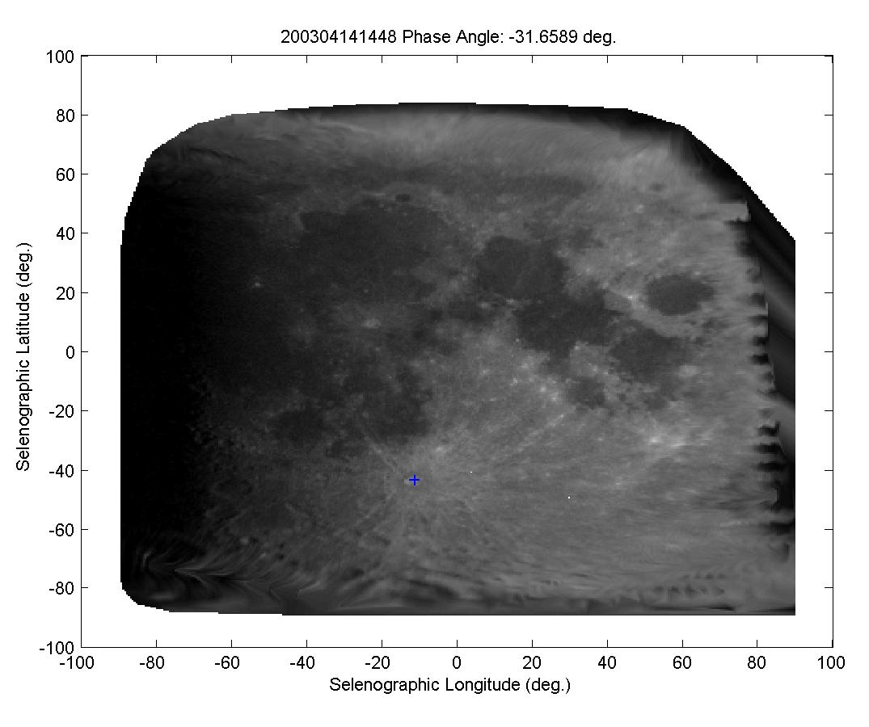
Mapped in Selenographic Coordinates: 20030414

Slide 25
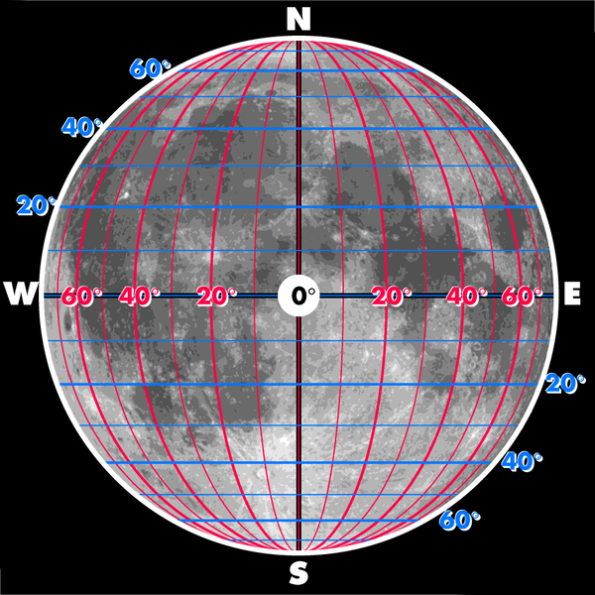
Example:20030414

Slide 26
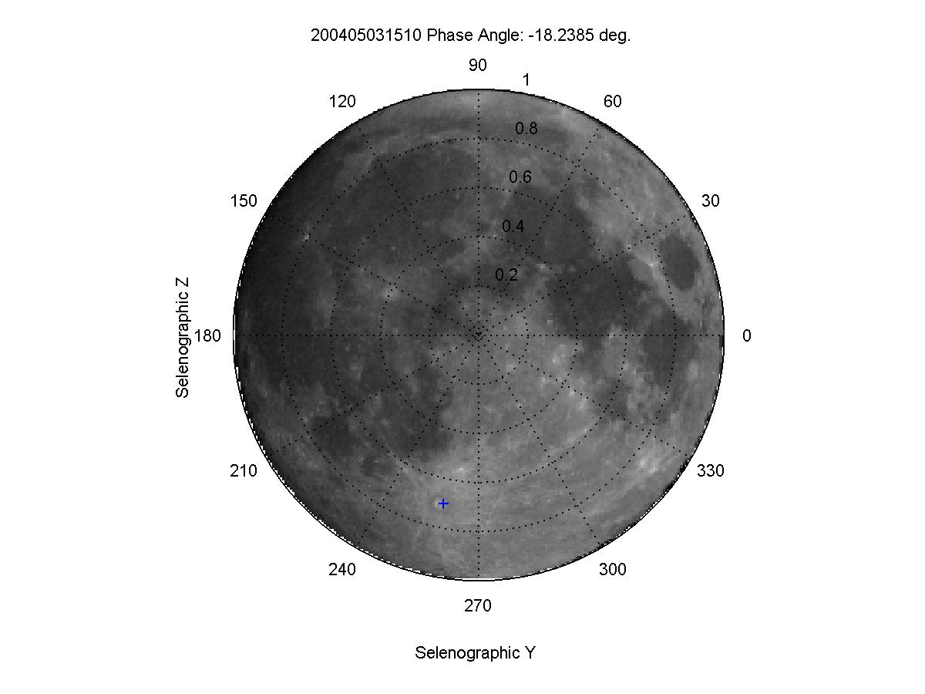
Example:20040503

Slide 27
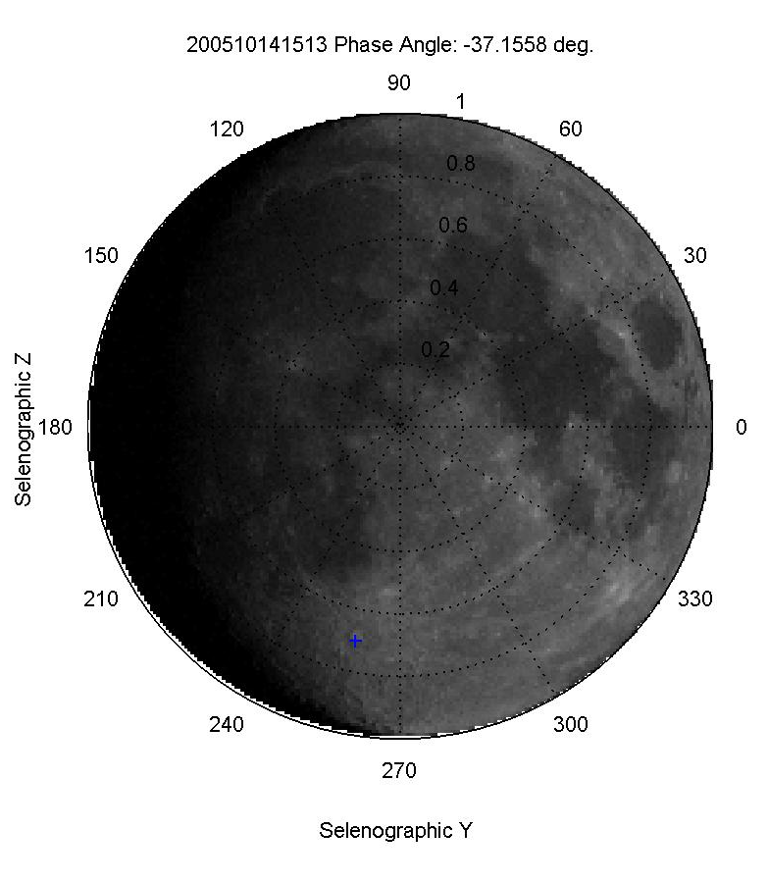
Example:20051014

Slide 28
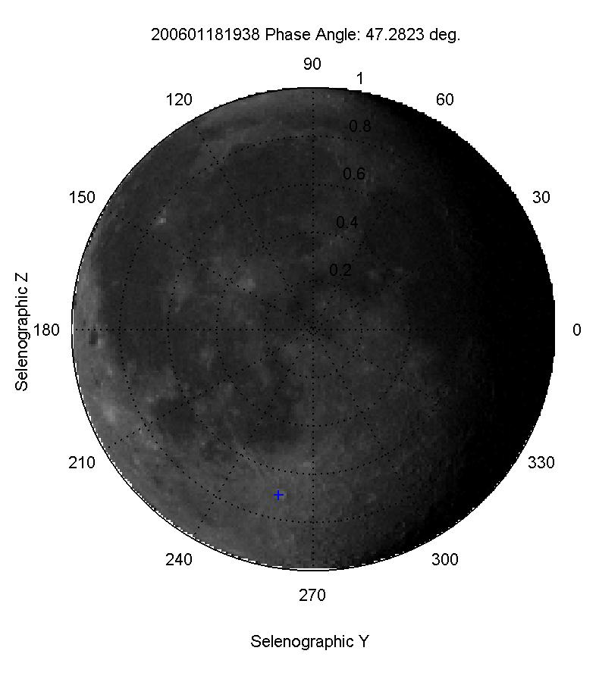
Example:20060108

Slide 29
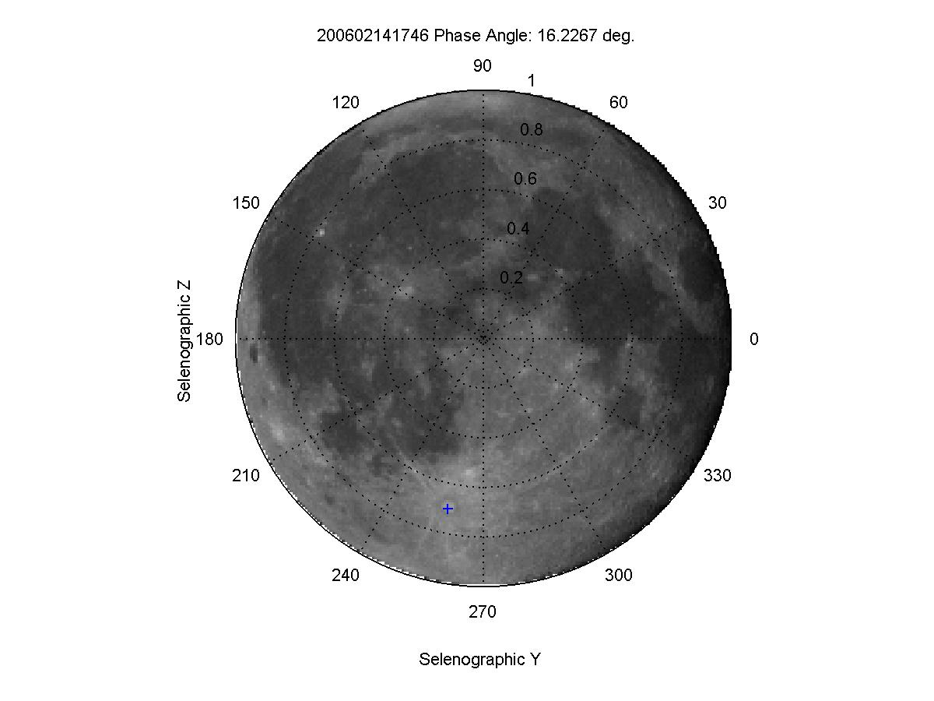
Example:20060214

Slide 30
3. Determine BRDF
To be derived empirically from large amount of lunar images at variety of illumination and viewing geometry
SELENE/SP
Pro: hyper spectral, very high spatial resolution
Cons: nadir view only, cover ABI B2-4 and AHI2-3 SRFs
Plaides
Pro: stable radiometric calibration , high spatial resolution
Cons: Different SRFs from ABI/AHI
H8 AHI
Pro: good calibration accuracy, similar SRFs and spatial resolution
Cons: missing Ch1.38um for ABI, might experience some sensor degradation

Slide 31
4. Applications
Experimental study
lunar radiance vs. irradiance for AHI RVS validation

Slide 32
AHI Lunar Calibration Preliminary Results – Case Study
29 August 2015
Phase angle: from -11.5 to -9.0 [deg]
100 observation / ~90 minutes
AHI FoR
Earth edge
Lunar observations
Courtesy of JMA

Slide 33
Uncertainty in Irradiance Calibration
E_{Lunar}: Model uncertainty
f_{i}: Is over-sampling constant or known?
Ground processing
Instrument performance
C^{i}_{M}: Which pixel is/isn’t the Moon?
Edge detection
PSF
C_{S}: Space count
Out of field radiance
1/f noise

Slide 34
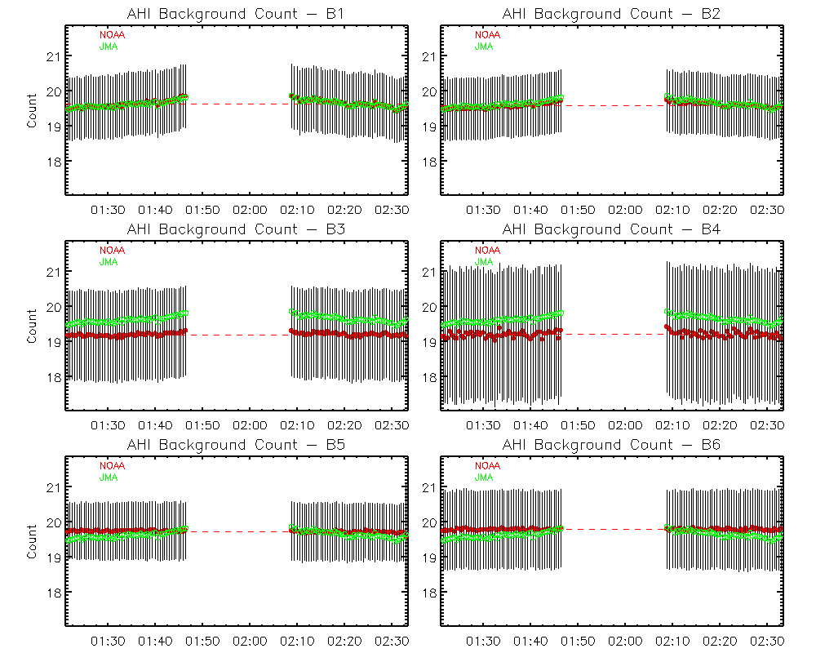
Time-Series of Mean Space Count

Slide 35
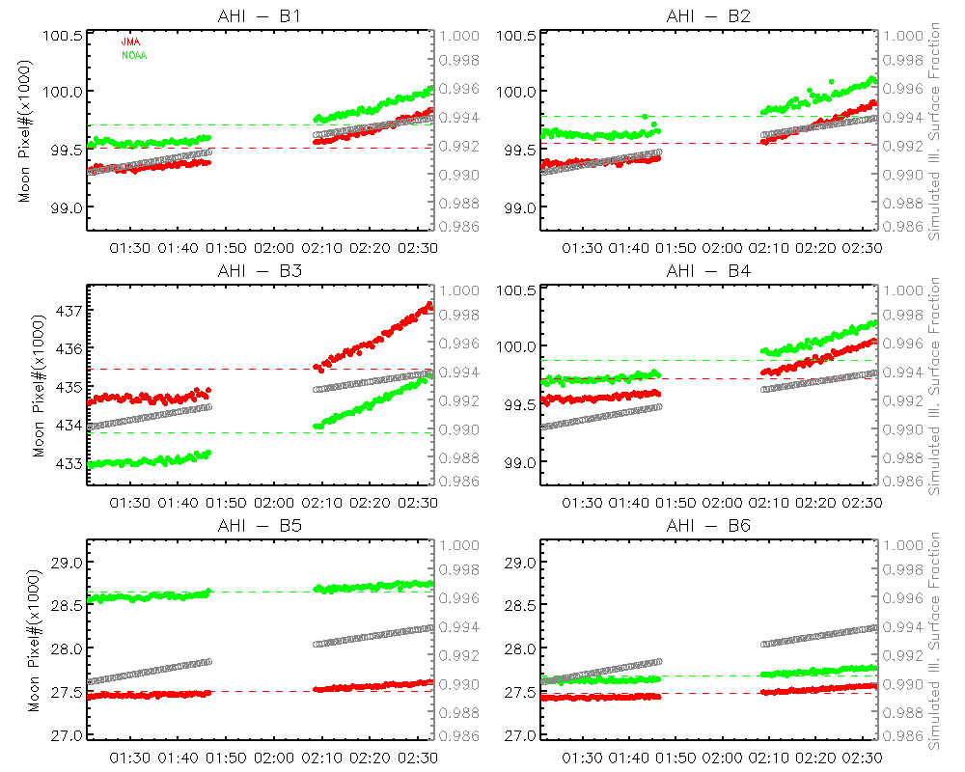
Time-Series of # Illuminated Lunar Pixels

Slide 36
Oversampling Factor

Slide 37
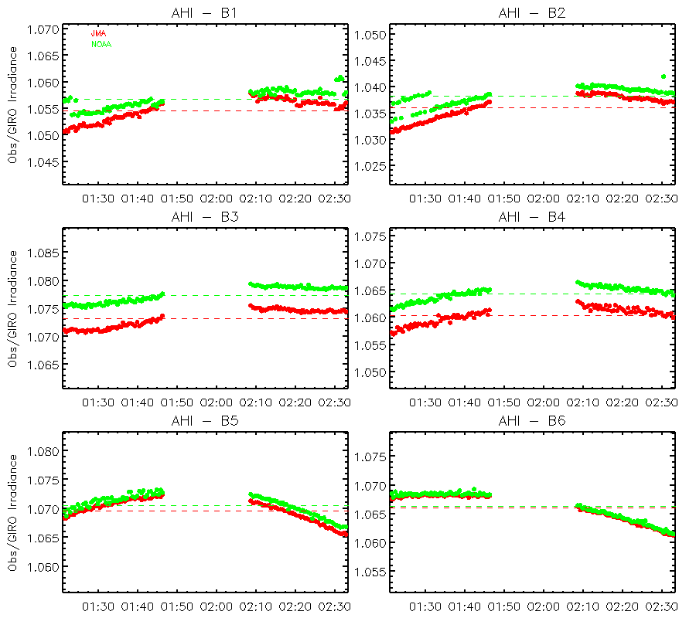
Irradiance Measurement to GIRO Simulation Ratios
Most likely caused by out-of-field radiance impact
Trending resulted from two independent methods generally follows each other very well at each band
Band dependent trending pattern
Ratio variations <1% for all VNIR bands
B3 ratio trending is most consistent. Variation is within 0.4%

Slide 38
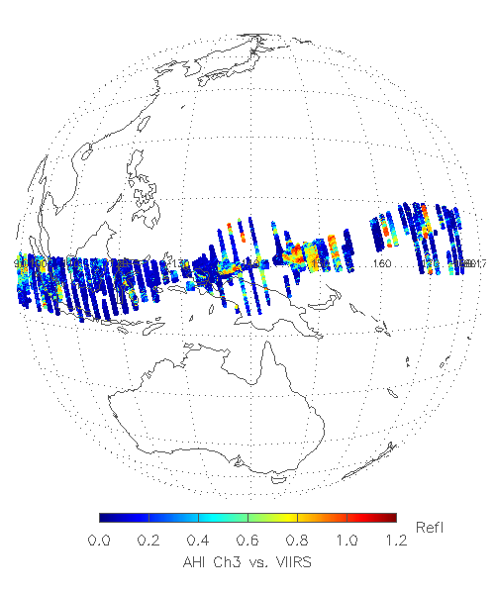
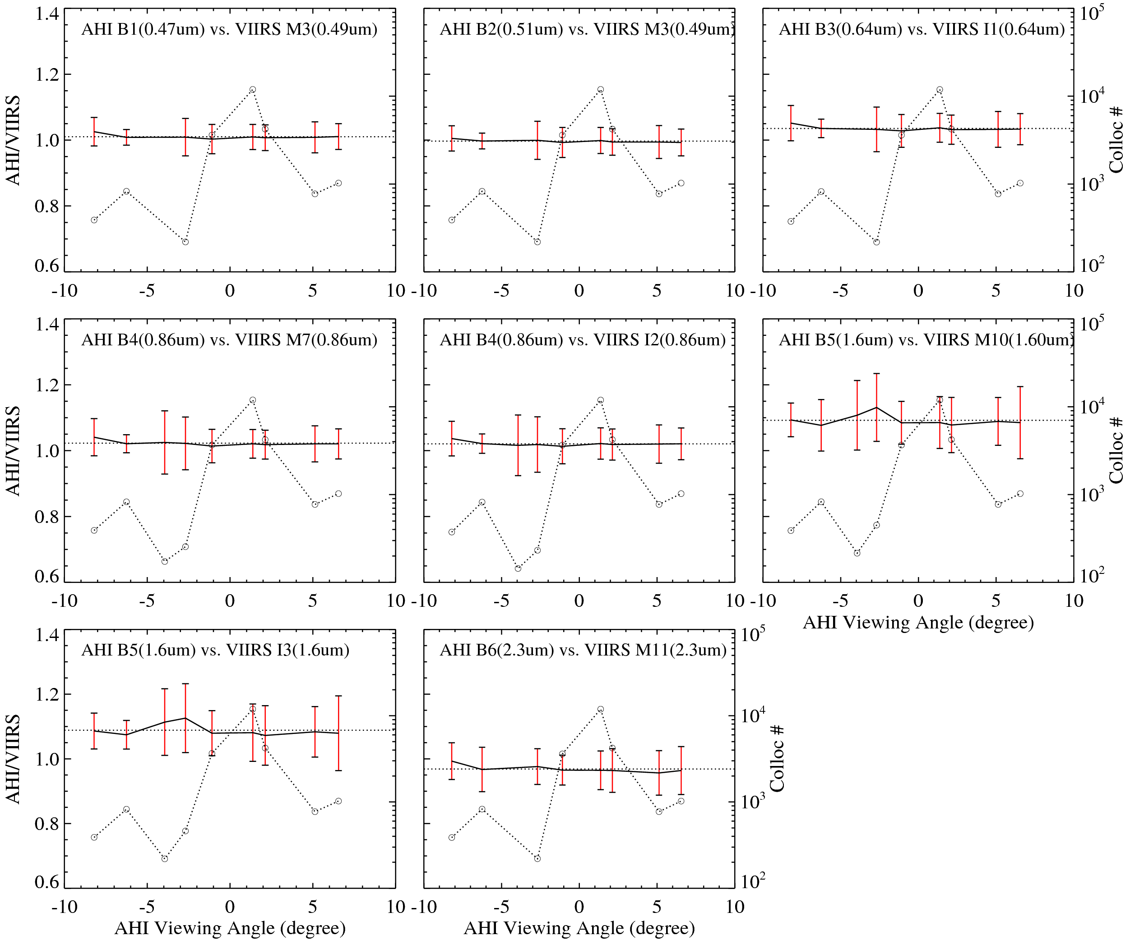
E-W Spectral Uniformity Validation with Earth Data
Yu, F. and X. Wu, 2016, Remote Sensing, in press

Slide 39
Lunar Radiance Model
Manual data extraction: mean radiance for a 3x3 array within the pre-defined areas
4 sites, one bright and three dark, across the disk
The spatial uniformity images are used for this manual data extraction
The purpose of this study is to test the radiance model in RVS study
21 images, selected from every 5 consecutive time-series ones.

Slide 40
Site 10
Site 20
Site IDs may be different from the ID order used at Slide#8
Site 1
Site 11
Spatial uniformity map – standard deviation of radiance from 3x3 window array

Slide 41
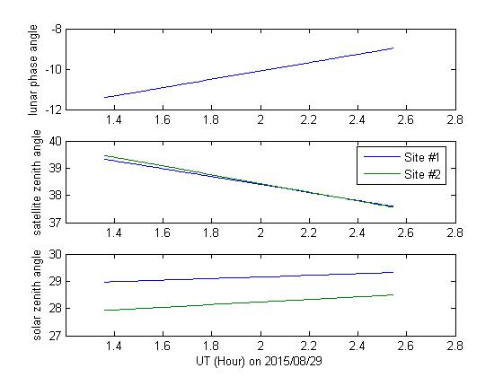
Viewing Geometry

Slide 42
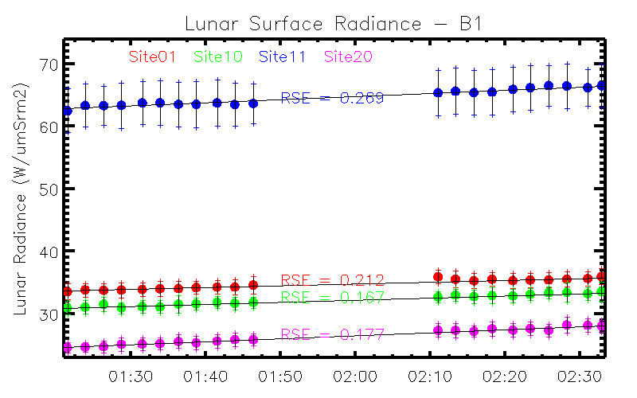
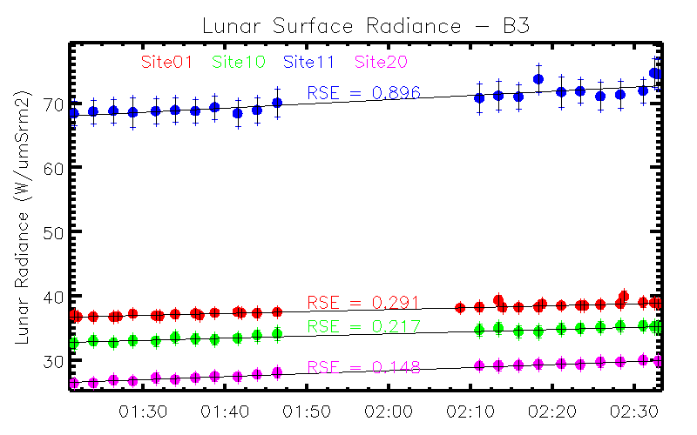
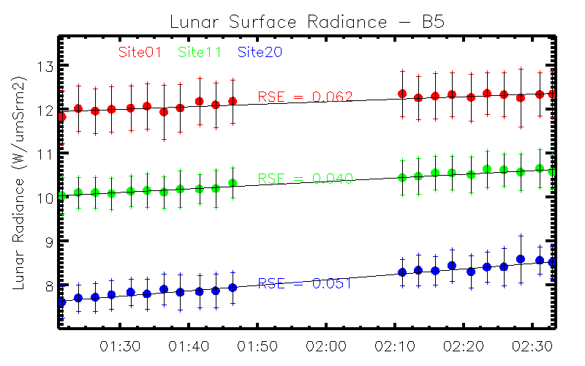
Time-series of Site Radiance

Slide 43
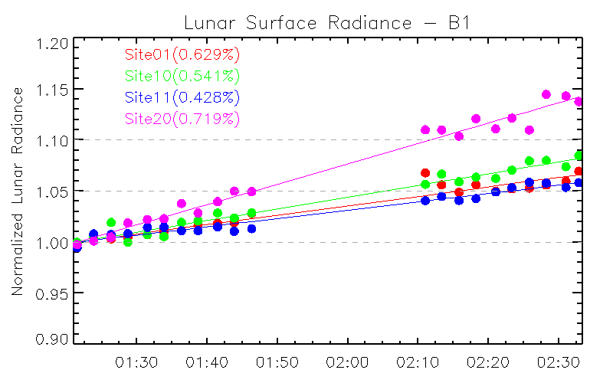
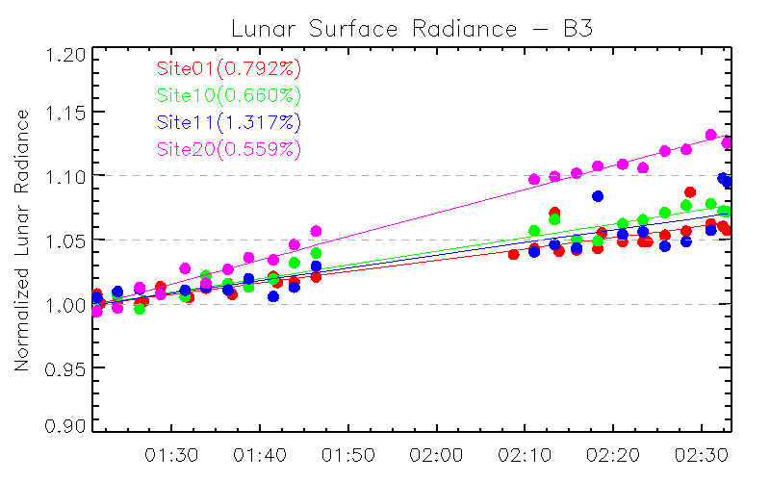
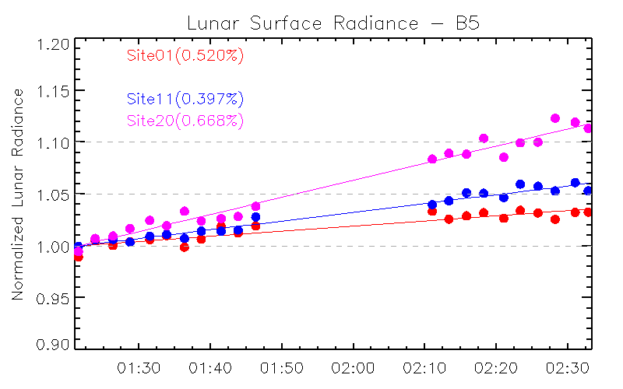
Time-series of Normalized Site Radiance

Slide 44
Summary
Lunar Radiance measurement
Irrelevant to oversampling factor
Irrelevant to the impact of out-of-field radiance
No need to determine the lunar boundary
Can be applied to image before BDS shift adjustment
Reduce the impact of the uncertainty in background space count
The experimental study indicates that the lunar radiance calibration model can be applicable to all the ABI/AHI bands
Will re-visit the target site selection
BRDF model is critical
Accurate data extraction technique is also important

Slide 45
Discussion
Select Targets
Suggestions?
Compute Angles
Feasible to compute from orbit parameters?
Determine BRDF
Suggestions?
Interested in collaboration?

