Slide 1
Progress toward DCC Demo product
S. Wagner

Slide 2
Status of the GSICS VIS/NIR product
Current under deployment on the EUMETSAT operational system for instrument monitoring
Concept = modular approach so that new products can be plugged by adjusting the blending method only.
GSICS VIS/NIR products for Meteosat-10 SEVIRI VIS0.6:
Both NRT and RA are produced following the IR approach (one correction per day over a sliding window)
Accessible via Server: http://gsics.eumetsat.int
Products automatically transferred to the EUMETSAT GSICS data server
Submitted GSICS Procedure for Product Acceptance in September 2015 to enter the demonstration phase ➔ still on hold (one reviewer still missing)
Deseasonalisation: for the moment the seasonal factors from the Meteosat-9 dataset are given as seasonal factors for Meteosat-10.
In the present version, seasonal factors are not updated in time
Algorithm applies to images between 11:00 and 13:00 UTC

Slide 3
General concept for the GSICS VIS/NIR products
Data input – Ground segment
Data extraction
DCC
…
Data extraction Lunar Cal
DCC
Moon
Intermediate data
Data processing
DCC
…
Data processing
Lunar Cal
Planned for 2016 (see 4f)
GSICS DCC product
GSICS Lunar product
Intermediate products
Data reader + blend processor
GSICS VIS/NIR product
EUMETSAT GSICS data server

Slide 4
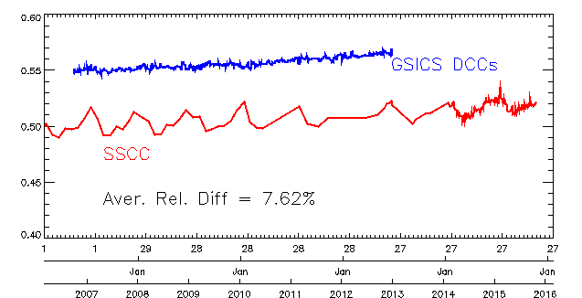
Results – Meteosat-9 VIS0.6
After deployment in the OPE monitoring system
Need for reprocessing
Correction of the VIS0.6 w.r.t. Aqua MODIS in agreement with the feedback from cloud community

Slide 5
Future activities / developments
Collecting user requirements ➔ beta tester = marine application group: study on deriving water turbidity using SEVIRI data. GSICS VIS/NIR RA product provided for Meteosat-9. However only the bias w.r.t. Aqua MODIS + drift estimate were considered (i.e. the time series is noise-free).
Continuation study (-ies) = opportunities to include an assessment of the GSICS corrections + sensitivity analysis on the correction noise.
Validation of the approach in place for the seasonal factor: are the corrections from Meteosat-9 applicable to Meteosat-10?
If Yes: can we think of using a geographical blend for instruments of a same series?
If No: need to include a corrective algorithm till the time series for the monitored instruments are long enough to derive robust seasonal factors.
What about changes in the geographical coverage (for instance when moving MSG1 over the Indian Ocean)?
Uncertainty analysis still to be done.
Re-processing of SEVIRI data with SSCC is on-going ➔ revisit the uncertainty on the drift estimates for the DCC, Moon and Desert Target methods.

Slide 6
Conclusions
Top priority = finalise the implementation and monitor the current version of the GSICS VIS/NIR product (based on DCC only)
Continue through the various steps of the GPPA. One review still missing.
Reprocess the data for the various SEVIRI instruments
Use VIIRS as a new reference in order to process all reflective solar bands available on SEVIRI
(Add HRVIS to the list of monitored bands)
Support EUMETSAT activities on climate to apply DCC algorithm to support re-calibration of Meteosat First Generation archive
Put in place an algorithm for inter-calibration using the Moon as a transfer target ➔ next candidate to add to the GSICS VIS/NIR product.

