Slide 1
Progress toward DCC Demo product
Meteorological Satellite Center,
Japan Meteorological Agency

Slide 2
Achievement on MTSAT-2 and Himawari-8
MTSAT-2
Calibration coefficients are obtained for entire operation period, 2010-2015, based on “standard” DCC approach.
The result shows good consistency with the result by lunar calibration approach.
Himwari-8
Feasibility study has been performed based on AHI data based on “ray-matching” and “standard” DCC approached.
The result shows good consistency with the result by other approaches.

Slide 3
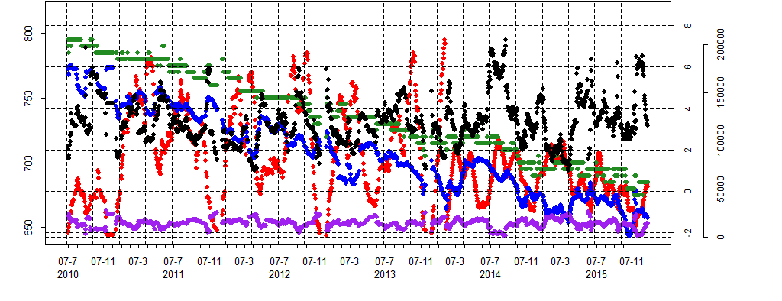
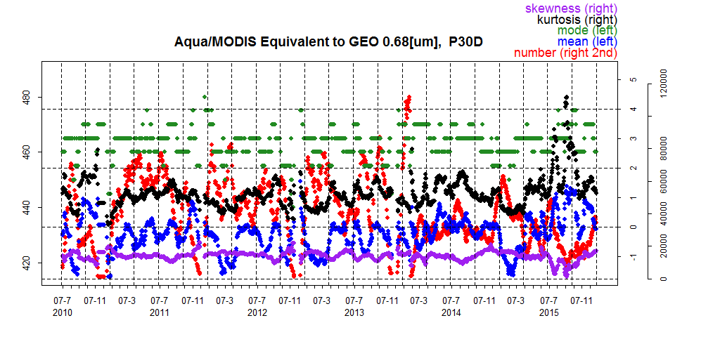
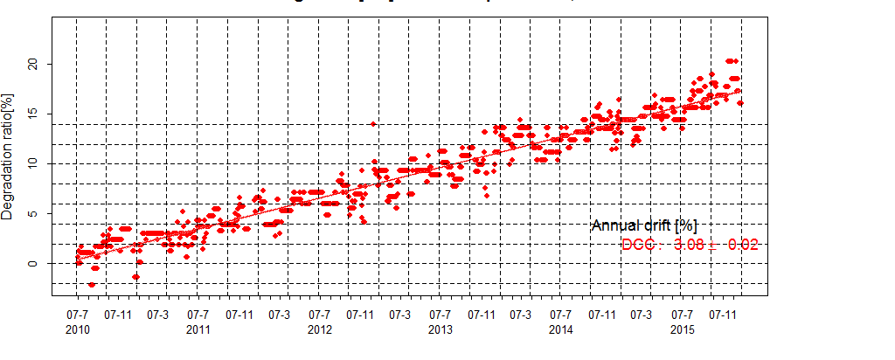
Standard DCC approach on MTSAT-2
MTSAT-2 (0.68)
o: mode
Mode and mean radiance of DCC pixels are picked up from MTSAT2/IMAGER and AQUA/MODIS data.
The result shows that MODIS data is well-calibrated and stable.
MTSAT-2 had not changed VIS calibration coefficients. Degradation trend is shown.
AQUA/MODIS (0.68)
$$∆Gain= \frac{Gain_{t}}{Gain_{t0}} −1$$

Slide 4
DCC data used in AHI study (Mar.-Dec. 2015)
1) DCC selected using GSICS standard algorithm (“standard DCC”)
Based on Doelling et al. (2011)
SSP +/- 20 deg. (20S-20N, 120.7E-160.7E), IR (Band13: 10.4μm) < 205K, solar/satellite viewing angle < 40 deg., Smoothed pixels based on 3x3 pixels stdv
Hu BRDF
S-NPP/VIIRS: not implemented yet
2) DCC from Himawari-8/AHI vs. S-NPP/VIIRS ray-matched data (“ray-matched DCC”)
Based on Doelling et al. (2011)
Δt < 5 minutes, difference of solar/satellite zenith angle, azimuth angle < 10 deg., etc.
Spatial averaging (e.g. 0.5 deg. bin) is NOT applied
SBAF for DCC (derived from NASA Langley SBAF website)
Channels used for inter-comparison
Himawari-8/AHI | Band1 (0.47) | Band2 (0.51) | Band3 (0.64) | Band4 (0.86) | Band5 (1.6) | Band6 (2.3)
S-NPP/VIIRS | M3 (0.488) | M3 (0.488) | I1 (0.640) | M7 (0.865) | M10 (1.61) | M11 (2.25)

Slide 5
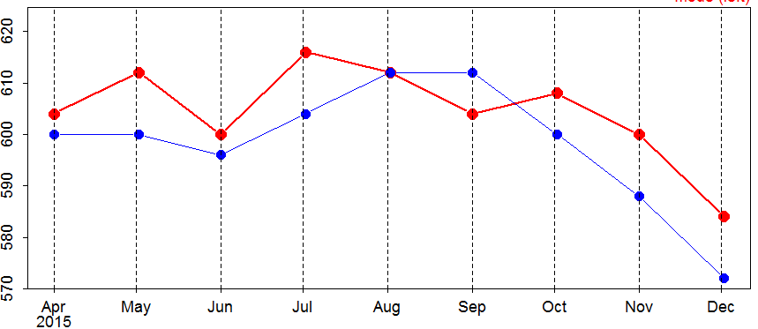
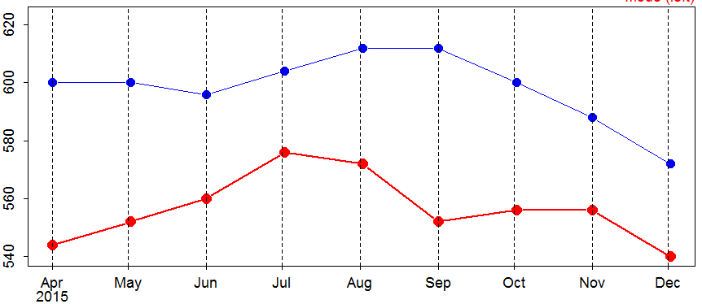
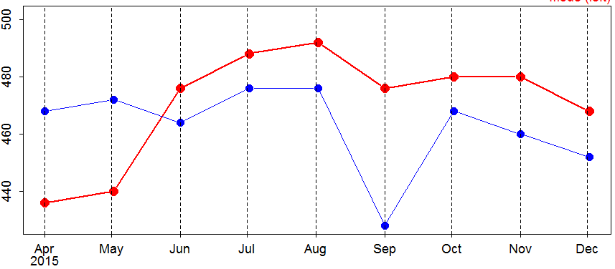
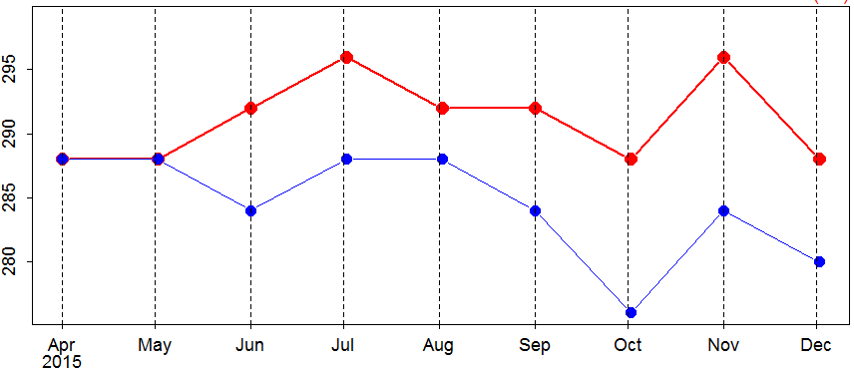
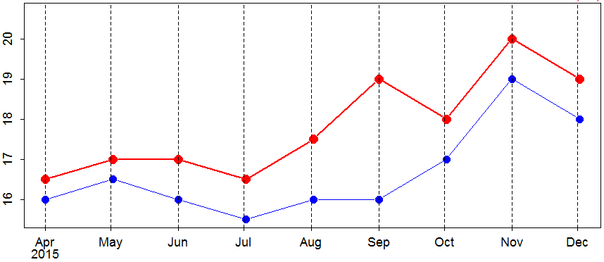
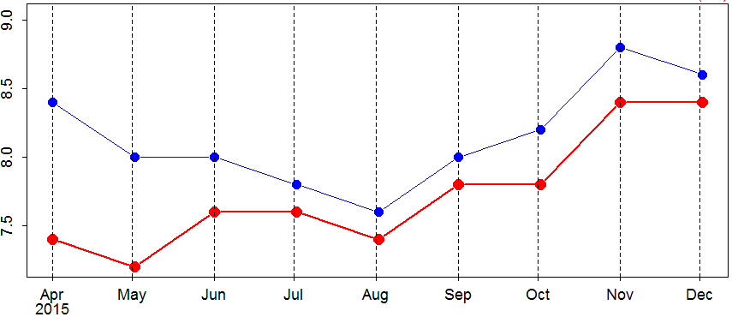
AHI/VIIRS “Ray-matched DCC”
In general, both DCC modes show similar trend/variation
Most collocations are over the ocean
Discrepancy (e.g. VIIRS I1 in Sep 2015) could be caused by less sample data
The trend of VIIRS looks consistent with a monitoring on NOAA’s web page.
Time series of AHI/VIIRS radiance mode
AHI Band1 (0.47μm), VIIRS M3 (0.488 μm) AHI Band2 (0.51μm), VIIRS M3 (0.488 μm) AHI Band3 (0.64μm), VIIRS I1 (0.640 μm)
Radiance [W/m²/sr/μm]
AHI Band4 (0.86μm), VIIRS M7 (0.865 μm) AHI Band5 (1.6μm), VIIRS M10 (1.61 μm) AHI Band6 (2.3μm), VIIRS M11 (2.25 μm)
Radiance [W/m²/sr/μm]

Slide 6
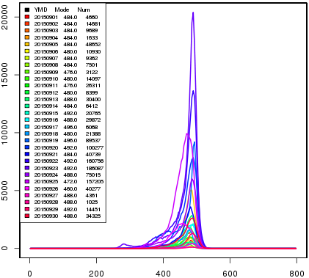
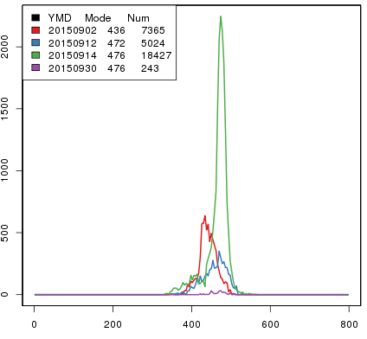
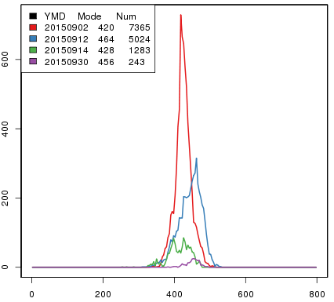
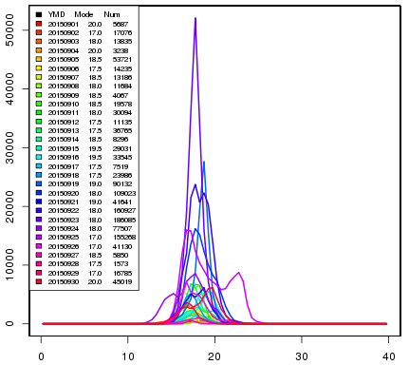
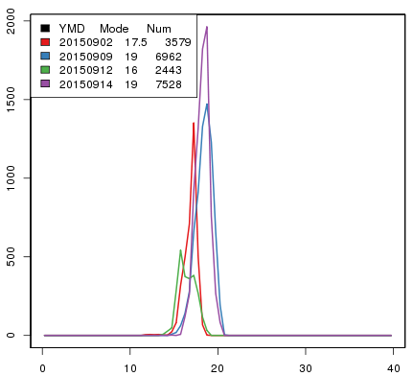
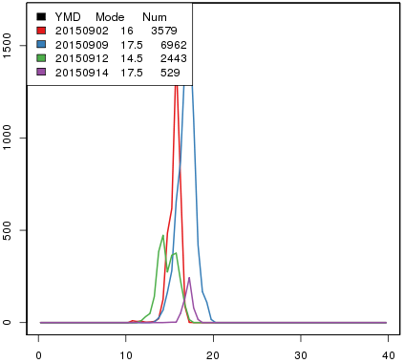
Day-to-day variation of DCC PDF statistics (Sep 2015)
PDF shape differs day to day
Standard AHI DCC Ray-matched AHI DCC Ray-matched VIIRS DCC
Band3
(0.64 μm)
Band3
(0.64 μm)
M3
(0.640 μm)
# of DCC data
# of data:
~7000
# of data:
~5000
1.6 μm 0.64 μm
Band5
(1.6 μm)
Band5
(1.6 μm)
M10
(1.61 μm)
# of data:
~4000
# of DCC data
# of data:
~7000
Radiance [W/m²/sr/um] Radiance [W/m²/sr/um] Radiance [W/m²/sr/um]
Data quality check needs to be improved.

Slide 7
Comparison of multiple calibration methods
Time series of Ray-matching DCC shows consistent trend with other approaches.
Need to revisit sample data quality check to derive stable results
Time series of ray-matching DCC, Ray-matching and RT simulation results
Band 1 (0.47μm) Band 2 (0.51μm) Band 3 (0.64μm)
Band 4 (0.86μm) Band 5 (1.6μm) Band 6 (2.3μm)
Ray-matched AHI/VIIRS DCC: data on 2 September are removed

Slide 8
AHI solar diffuser calibration
SD Observation : ~once every 2 weeks
Data before the end of Feb 2015: not reliable
Degradation: ~1% / year in Bands 1-4, not clear in Bands 5 and 6
Generally consistent results with other calibration methods
Degradation of SD will be evaluated in the near future
Time series of inverse of calibration slope w.r.t. day 1 SD observation
Band 1 (0.47μm) Band 2 (0.51μm) Band 3 (0.64μm)
1%
Band 4 (0.86μm) Band 5 (1.6μm) Band 6 (2.3μm)

Slide 9
Vicarious calibration on DCC
Vicarious calibration over DCC is not implemented yet, but in preparation.
Water cloud and clear sky ocean targets are applied in current AHI calibration monitoring.
What type of scattering particle can be suitable?
JMA/MRI is developing a kernel based on Voronoi particle.
The kernel does not have characteristic scattering angle, which is more reasonable for actual thin ice cloud comparing with simple shape particle such as column.
Ice habit mixture models are also discussed in an article and show good characteristics.
Phase function and
spherical albedo difference (SAD)
phase function
SAD
phase function
SAD
scattering angle
scattering angle
scattering angle
scattering angle
“Investigation of ice particle habits to be used for ice cloud remote sensing for the GCOM-C satellite mission”, H. Letu, et. al., Atmos. Chem. Phys. Discuss., 15, 31665–31703, 2015

Slide 10
Summary and future work
Calibration coefficients are obtained for MTSAT-2 entire operation period, 2010-2015. The result shows good consistency with the result by lunar calibration approach.
Two DCC approaches are under investigation for Himawari-8.
“Standard” DCC approach
MODIS, VIIRS will also be implemented
Difference of DCC statistics over land/ocean will be investigated
“Ray-matched” DCC approach
The result shows similar trends by other calibration methods
Implementation will be revisited to derive stable results
DCC method seems to be applicable to all AHI VNIR bands
Vicarious calibration approach over DCC target is in preparation with MRI.
Masaya and Sebastien have drafted requirements for application of plotting tool to DCC products. The requirement will be discussed in [4j].
Future plans for all VNIR calibration methods
To continue inter-comparison of multiple calibration methods
To integrate calibration methods
Uncertainty analysis.

