Slide 1
Verifying the DCC methodology calibration transfer
2016 GSICS Joint Meeting on Research and Data Working Groups
Tsukuba, Japan
29 February to 4 March 2016

Slide 2
Outline
GEO DCC calibration methodology
DCC pixel identification
Angular transformation (Hu model)
Monthly PDF transformation
Long-term radiometric trending
Monthly DCC file description
Monthly PDF and temporal trending results
Absolute calibration using DCC referenced to Aqua-MODIS
Data availability

Slide 3
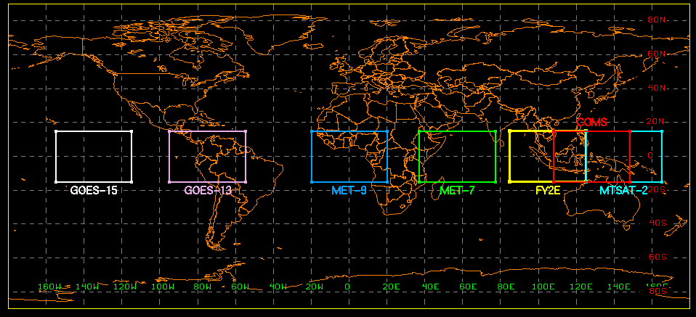
GEO DCC domain
A fixed DCC domain confined to ±15° latitude and ±20°E-W longitude, and centered at the GEO sub-satellite point is defined for each GEOSat.
 | GOES-15 | GOES-13 | MET-9 | MET-7 | FY2E | COMS | MTSAT-2
Orbit | 135°W | 75°W | 0W | 57°E | 105°E | 128°E | 145°E

Slide 4
DCC pixel identification
DCC pixels are identified within the DCC domain using the following criteria [Doelling et al, 2013]:
GEO parameter | DCC threshold
Window brightness temperature | BT11μm < 205°K
Brightness temperature homogeneity | Standard deviation of 3x3 pixels BT11μm < 1°K
Visible radiance homogeneity | Standard deviation of 3x3 pixels visible radiance < 3%
Solar zenith angle | SZA < 40°
View zenith angle | VZA < 40°
Local time range at GEOSat longitude | 12:00 PM < image time < 3:00 PM

Slide 5
Angular transformation
DCC response is dependent upon viewing and solar geometry
GEO DCC counts are normalized using Hu model [Hu et al 2004]
Before applying the Hu model,
Subtract the space-count from each DCC pixel count
Apply Earth-Sun distance and COS(SZA) factors
Corrected count = Measured Count/(d²*COS(SZA))
Normalized count = Hu(SZA, VZA, RAZ, Corrected count)
Note: A Hu-model subroutine package (written in Fortran) will be provided with the dataset.

Slide 6
Monthly DCC binary files
Sequence of parameters
Sigma VIS (0.65 um)
Sigma IR BT (11 um)
SZA
VZA
RAZ
Channel data (Count or BT)
Latitude
Longitude
GMT time
Day of Year
All DCC pixels within a month are compiled into a binary file (big-endian format).
Examples: MET9_cold_2012_07, COMS_cold_2012_07, etc.
Number of parameters included into the binary files are GEO specific
Each parameter is written as a 4-byte floating-point number

Slide 7
Monthly PDF
A probability distribution function (PDF) of all DCC pixels within a month is generated after the angular corrections.
The Mode of the monthly PDF shifts towards left as the sensor response degrades over time
Count PDF bin resolutions used are given in the table below
GEO Satellite | PDF count increment
GOES-15 | 5
GOES-13 | 4
MET-9 | 4
MET-7 | 3
COMS | 4
FY2E | 1500*
MTSAT-2 | 5
* Squared count

Slide 8
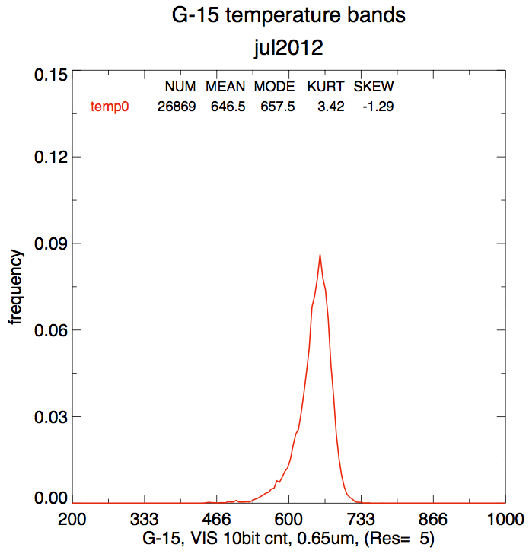
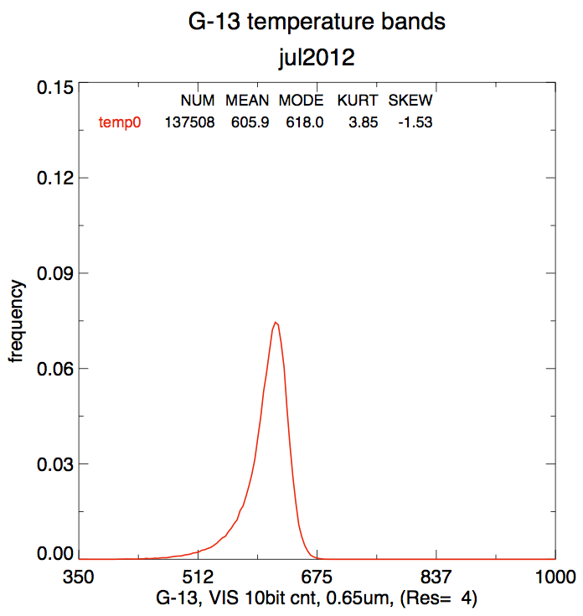
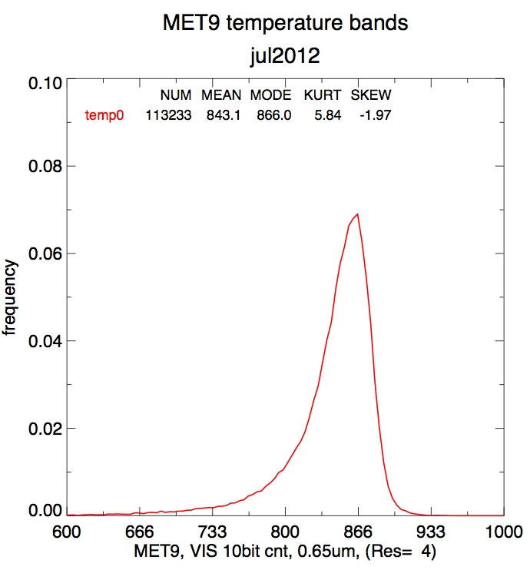
Monthly PDF examples (July 2012)

Slide 9
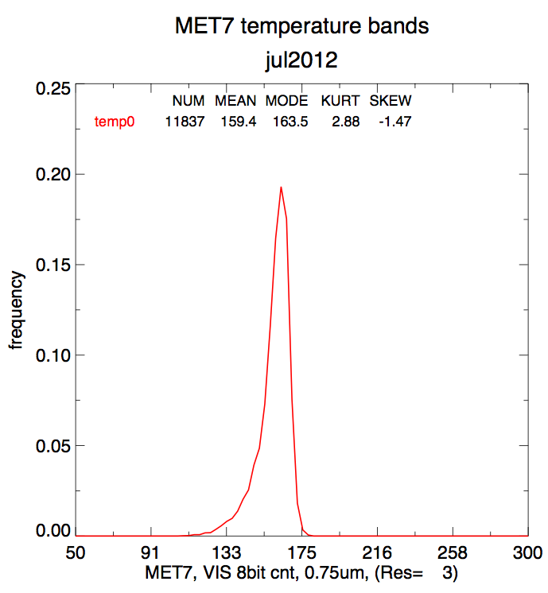
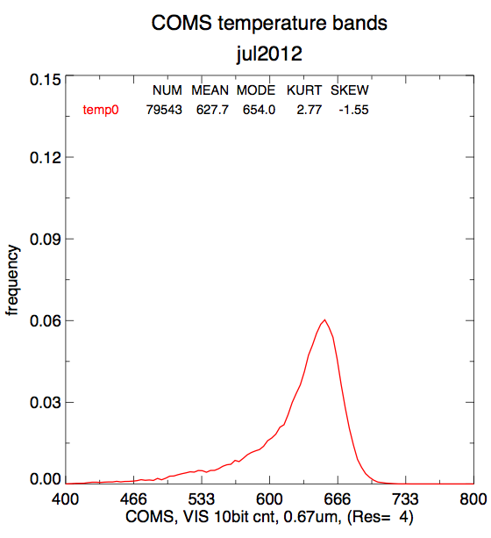
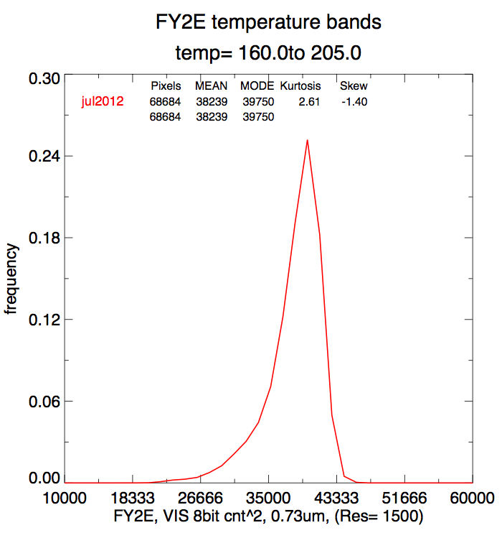
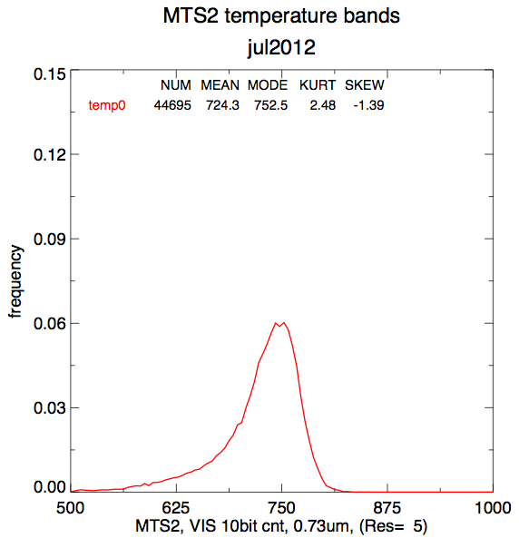

Slide 10
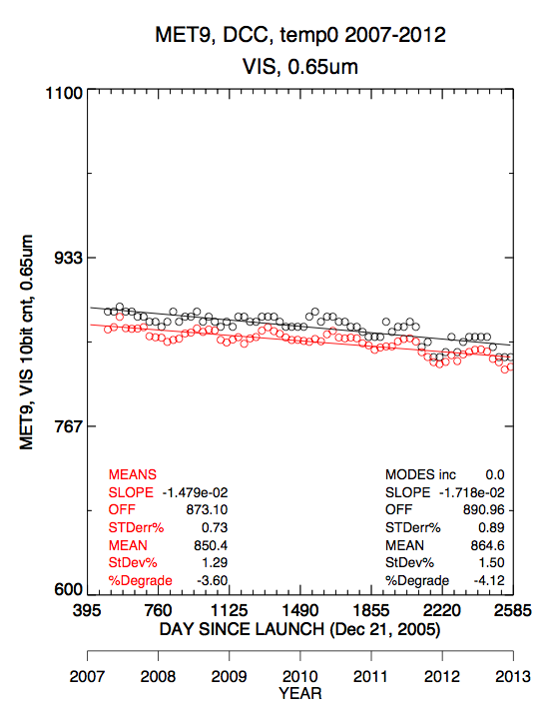
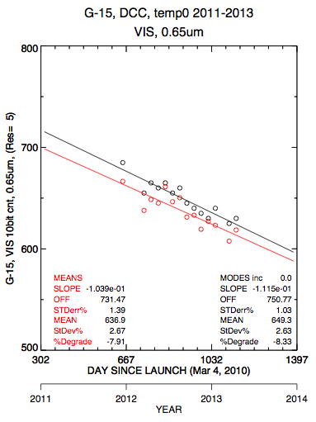
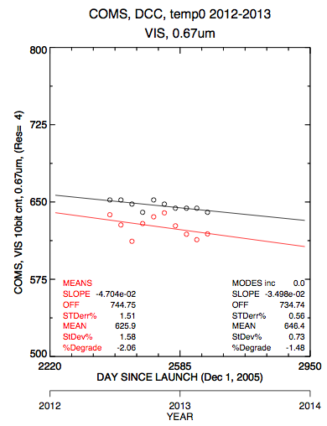
Relative trending
The mode of the monthly PDF is tracked over time to obtain the temporal stability of the GEO visible sensor

Slide 11
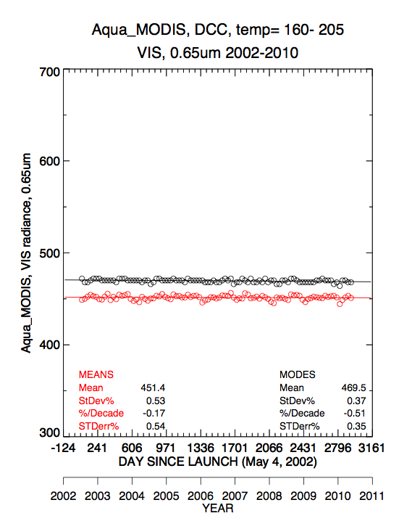
Absolute calibration transformation
The average mode for all 10-years of the Aqua-MODIS (reference sensor) monthly PDFs over the GEO domain is assumed to be the true viewing radiance, and is used to calibrate the GEO counts
Spectral corrections between the MODIS and GEO visible channels are made using SCIAMACHY hyperspectral data [Doelling et al, 2012].

Slide 12
DCC calibration targets to transfer calibration
We have mainly focused on the DCC methodology to determine the satellite calibration drift
The DCC methodology assumes that the reference and monitored sensor DCC mode radiance is equal if the observations were taken during the same temporal window and spatial domain
Does not need to be coincident or ray-matched
Must validate this assumption

Slide 13
Validation procedure
Validate the DCC methodology gain with DCC ray-match calibration techniques using the same reference instrument
DCC ray-matching either with 10-km or 30-km cores
Compare the calibration gains between these methods and the DCC methodology

Slide 14
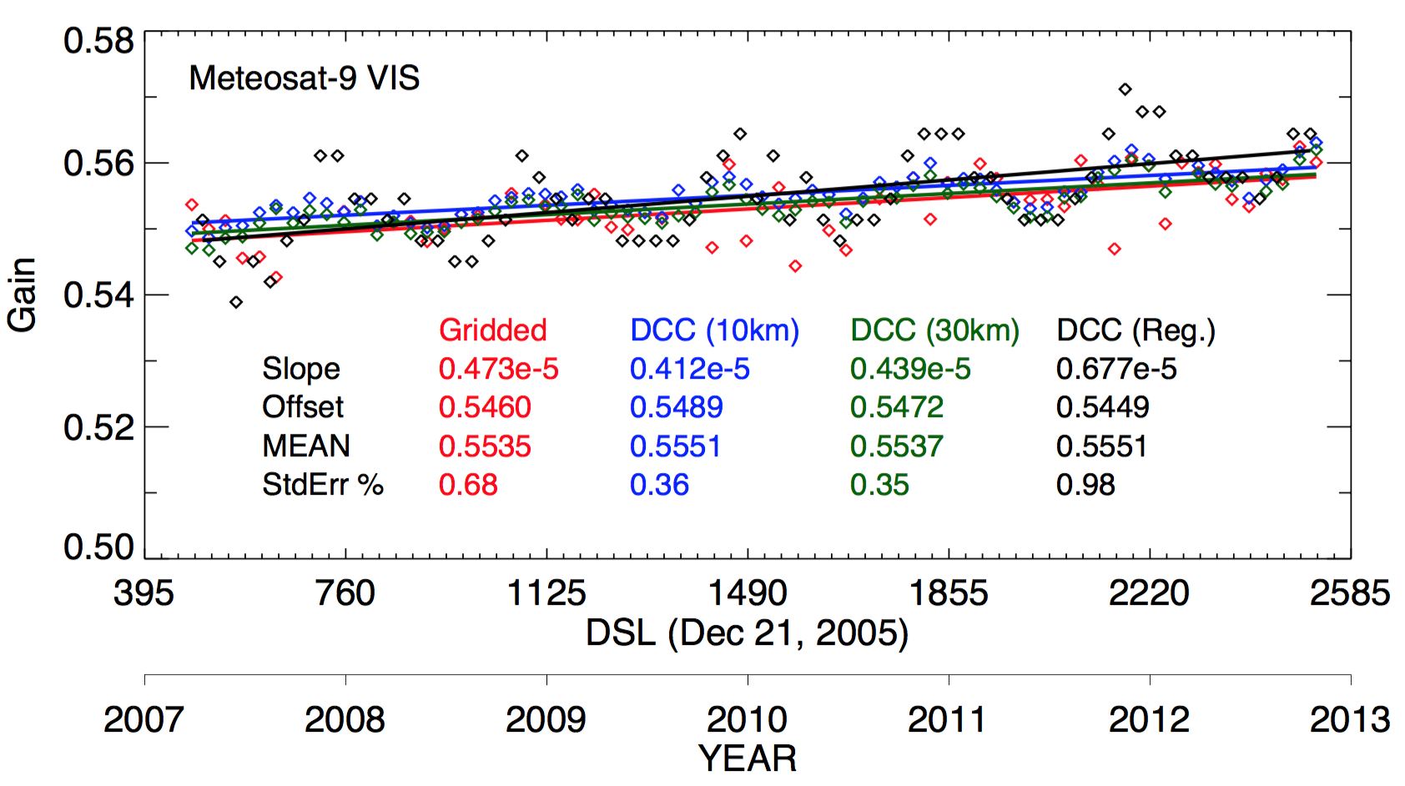
Met-9 within 0.25%

Slide 15
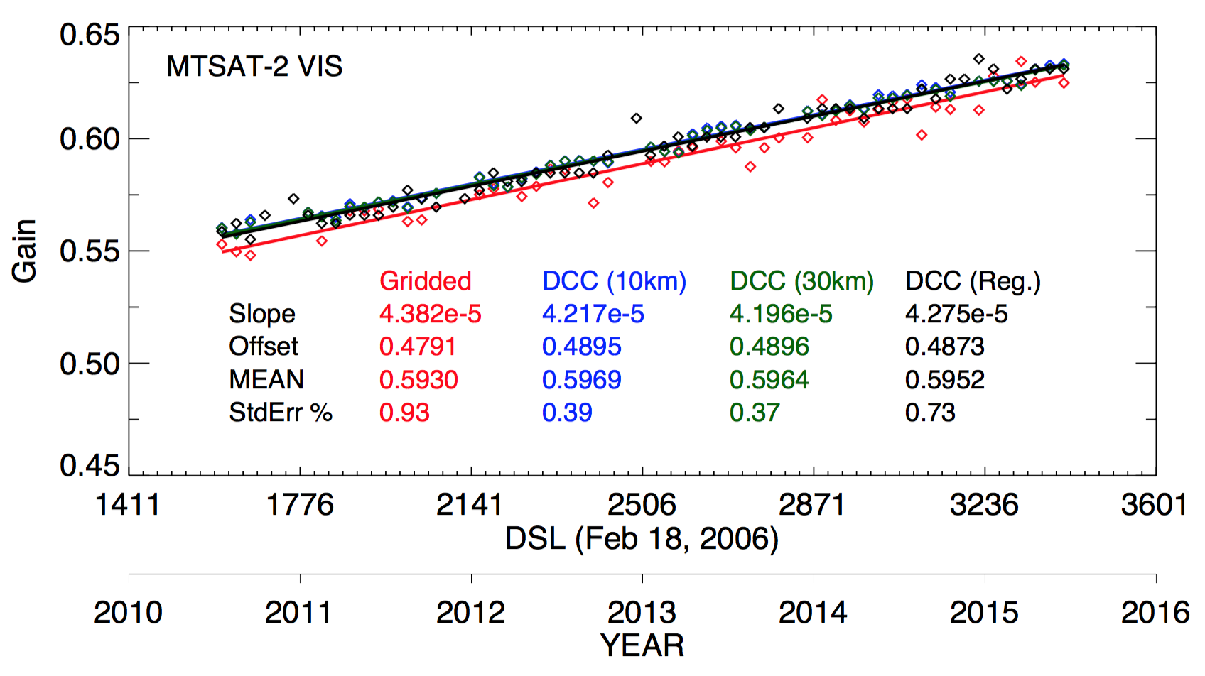
MTSAT-2 within 0.29%

Slide 16
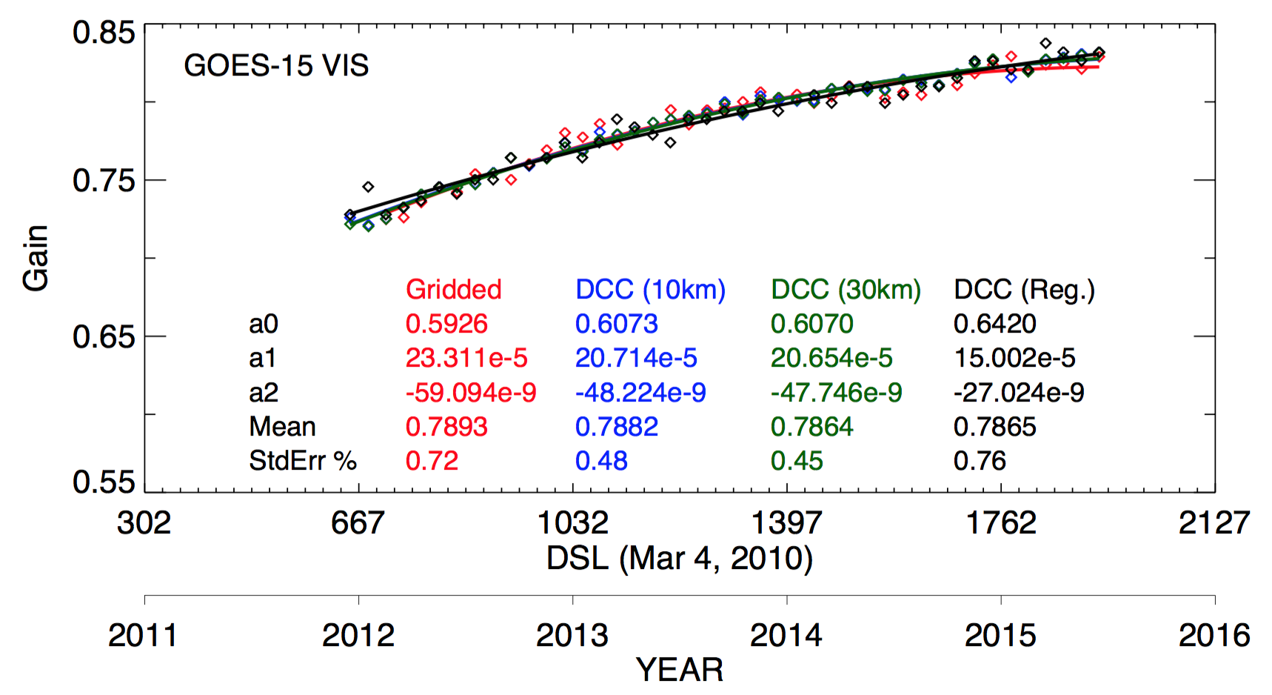
GOES-15 within 0.21%

