Slide 1
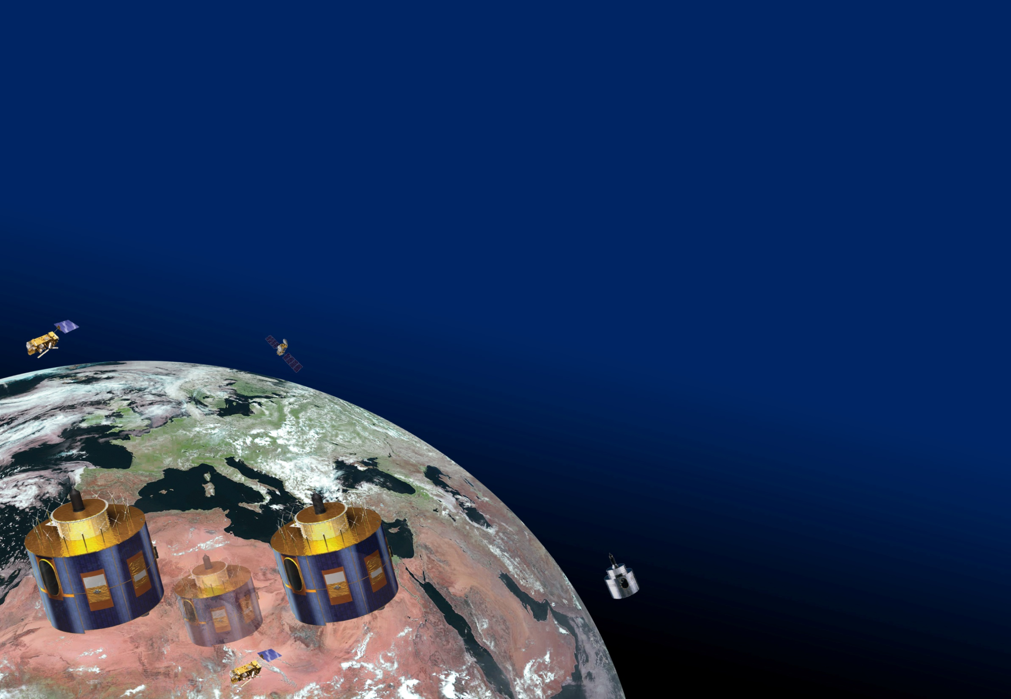
Towards a blended GSICS VIS/NIR product
S. Wagner

Slide 2
Product update frequency
  Update frequency: the initial idea was to follow the IR approach = One value per day using a sliding window
  Frequency depends on the degradation rate ➔ instrument dependent
  ➔ Suppose that the time series has been cleaned (no seasonal cycle for instance)
  What if the available data are not clean enough, i.e. the variability of the signal is too large?
  Question: too large with respect to what? ➔ We need user requirements on the stability of the time series for the GSICS products

Slide 3
General concept for the GSICS VIS/NIR products
Data input – Ground segment
Data extraction
DCC
…
Data extraction Lunar Cal
DCC
No coincident times
Moon
Data processing
DCC
…
Data processing
Lunar Cal
GSICS DCC product
GSICS Lunar product
How to do the blend?
Data reader + blend processor
GSICS VIS/NIR product
EUMETSAT GSICS data server

Slide 4
How to handle time differences between single methods?
  Problem: how to include method with different data availability?
  Typical case: DCC + Moon
  Should we have an approach similar to the GSICS prime corrections?
  Should we adjust the weight with the time span since last Moon acquisition to have a weight adjustment similar to the change of reference in the IR?

