Slide 1
4t. Solar Ultraviolet Spectra Project
L. Flynn (NOAA), M. Deland (SSAI – NASA), J. Niu (SRG NOAA), C. Pan (ESSIC UMD)

Slide 2
Outline
Project Summary / Objectives
Review of reference spectra resources
Representing variations with solar activity
Examples

Slide 3
GSICS UV Solar Spectra Project
The purpose of the is project is to compare solar measurements from BUV (Backscatter Ultraviolet) instruments.
The first step is to catalog high spectral resolution solar reference spectra and agree on a common one to use for the project.
For each instrument, participants should provide the following datasets:
Solar measurement for some date (wavelength scale, irradiance) adjusted to 1 AU
Wavelength scale and bandpass (Δλ, # of points, bandpass centers, normalized bandpass weights)
Synthetic spectrum from common reference (wavelength scale, irradiance)
Synthetic for wavelength scale perturbations (±0.01 nm) from common reference (wavelength scale, irradiance)
Synthetic from alternative reference spectra (wavelength scale, irradiance)
Solar activity pattern (wavelength, relative change)
Mg II index (if 280 nm is covered) Mg II 279.6 Mg I 285.2 (date, index)
Ca H/K index (if 391 nm to 399 nm is covered) CA II 393.4 and 396.8.
Goals:
Agreement at 1% on solar spectra relative to bandpass-convolved high resolution spectra as a transfer after identifying wavelength shifts and accounting for solar activity
Long-term solar spectral measurement drift and instrument degradation by using OMI solar activity pattern (with internal confirmation from Mg II Indices and scale factors)

Slide 4
Reference Spectra - Comments
No single instrument measures all spectral regions of interest (X-ray, UV, visible, IR) simultaneously. Thus, any “reference” spectrum is likely to be a composite of measurements from multiple instruments, using different bandpasses, probably taken at different times.
Some reference spectra are constructed using measurements from one data set, but adjusted radiometrically through comparisons with another data set.
Differences in spectral resolution are particularly important in the UV, where many Fraunhofer lines occur. The definition of “high” resolution can depend on the requirements of the user.
Frequent sampling present in the data set may not indicate high spectral resolution. Check the background story before using the data.
Notes:
Matthew DeLand
Science Systems and Applications, Inc. (SSAI) Lanham, Maryland USA
GRWG Meeting – UV Subgroup Darmstadt, GERMANY 27 March 2014

Slide 5
Four Reference Spectra
KNMI [Dobber et al., 2008].
Covers 250-550 nm.
Hall and Anderson [1991] for 200-310 nm, Kurucz et al. [1984] for 310-550 nm.
Original data have very high resolution (Δλ = 0.025, 0.005 nm).
Convolve with 0.025 nm bandpass, sample at 0.01 nm.
Adjust radiometric calibration to match lower resolution reference spectrum (average of UARS SUSIM data).
SAO [Chance and Kurucz, 2010].
– Covers 200-1001 nm.
Hall and Anderson [1991] for 200-310 nm, Kurucz et al. [1984] for 310-1001 nm.
Convolve with 0.04 nm bandpass, sample at 0.01 nm.
Adjust radiometric calibration to match lower resolution reference spectrum (Thuillier et al.).
Notes:
Matthew DeLand
Science Systems and Applications, Inc. (SSAI) Lanham, Maryland USA
GRWG Meeting – UV Subgroup Darmstadt, GERMANY 27 March 2014

Slide 6
Four Reference Spectra
ATLAS-1, ATLAS-3 [Thuillier et al., 2004].
– Covers 0.5-2400 nm.
Rocket data (1994) for 0.5-120 nm; UARS SUSIM and SOLSTICE for 120-200 nm; UARS SUSIM and SOLSTICE, ATLAS SUSIM, SSBUV, SOLSPEC for 200-400 nm; SOLSPEC for 400-870 nm; SOSP for
870-2400 nm.
UV: Smooth to 0.25 nm resolution, sample at 0.05 nm; Visible: resolution = 0.5 nm, sampling = 0.2-0.6 nm.
Average individual data sets together where available.
Each reference spectrum represents single date.
WHI (Whole Heliospheric Interval) 2008 [Woods et al., 2009].
– Covers 0.1-2400 nm.
Rocket EVE + TIMED SEE for 0.1-120 nm; SORCE SOLSTICE for 120-310 nm; SORCE SIM for 310-2400 nm.
Resolution = 0.1 nm in UV, ~1.5-30 nm from near-UV to near-IR. Sampling = 0.1 nm throughout.
Each reference spectrum represents narrow range of dates (~1 week).
Reference spectra scaled to TIM TSI values.
Notes:
Matthew DeLand
Science Systems and Applications, Inc. (SSAI) Lanham, Maryland USA
GRWG Meeting – UV Subgroup Darmstadt, GERMANY 27 March 2014

Slide 7
Resolution and Sampling
Same spectral region (300-320 nm) and absolute scale used for all panels in this figure.
Effect of bandpass change between KNMI and SAO is apparent, even with same input data set.
Satellite measurements (bottom two panels) have lower resolution.
WHI spectrum shows change in original instrument resolution when SIM data begin at 310 nm.
Notes:
Matthew DeLand
Science Systems and Applications, Inc. (SSAI) Lanham, Maryland USA
GRWG Meeting – UV Subgroup Darmstadt, GERMANY 27 March 2014

Slide 8
Absolute Difference
Comparisons at higher resolution are very sensitive to convolution method, intensity at peaks of spectral features, accuracy of wavelength scales.
Smoothing to lower resolution necessary to evaluate radiometric differences.
Comparisons at higher resolution are very sensitive to convolution method, intensity at peaks of spectral features, accuracy of wavelength scales.
Smoothing to lower resolution necessary to evaluate radiometric differences.
Irradiance data
Ratio: Δλ = 0.5 nm
Ratio: Δλ = 20 nm
Top panel: Thuillier et al. 2004 and Kurucz 2010 solar irradiance spectra (1014 photons s1 cm2 nm1 ) at 0.5 nm FWHM triangular band pass. Middle panel: relative differences (Thuillier–Kurucz)/Thuillier. Lower panel: differences after 20 nm FWHM triangular band pass.
Notes:
Matthew DeLand
Science Systems and Applications, Inc. (SSAI) Lanham, Maryland USA
GRWG Meeting – UV Subgroup Darmstadt, GERMANY 27 March 2014

Slide 9
Solar Activity
Solar irradiance shortward of 300 nm varies on short-term (~27-day) and long-term (~11-year) time scales.
Longward of 300 nm, only Fraunhofer lines show variations exceeding ~0.5% (the magnitude of this variability is resolution- dependent).
The spectral dependence of solar variations appears to be very consistent for both short and long time scales.
Therefore, we can use solar UV activity proxy (e.g. Mg II index) and wavelength-dependent “scaling factors” to estimate irradiance changes over time.
Notes:
Matthew DeLand
Science Systems and Applications, Inc. (SSAI) Lanham, Maryland USA
GRWG Meeting – UV Subgroup Darmstadt, GERMANY 27 March 2014

Slide 10
Solar Cycle Variations
Spectral dependence shows distinct features due to atomic species in Sun.
Variations generally less than 1% beyond
~300 nm.
Good agreement between data sets from two solar cycles with semi-empirical model.
DeLand and Cebula [2012]
Notes:
Matthew DeLand
Science Systems and Applications, Inc. (SSAI) Lanham, Maryland USA
GRWG Meeting – UV Subgroup Darmstadt, GERMANY 27 March 2014

Slide 11
Solar Variations – UV, Visible
OMI instrument resolution (0.4 nm) shows small features at Fraunhofer lines.
Generally very good agreement between long- term changes (red) and short-term changes (black).
Marchenko, S. V., and M. T. DeLand [2014], Solar spectral irradiance changes during Cycle 24, Astrophys. J., 789:117, doi:10.1088/0004-637X/789/2/117.
Notes:
Matthew DeLand
Science Systems and Applications, Inc. (SSAI) Lanham, Maryland USA
GRWG Meeting – UV Subgroup Darmstadt, GERMANY 27 March 2014

Slide 12
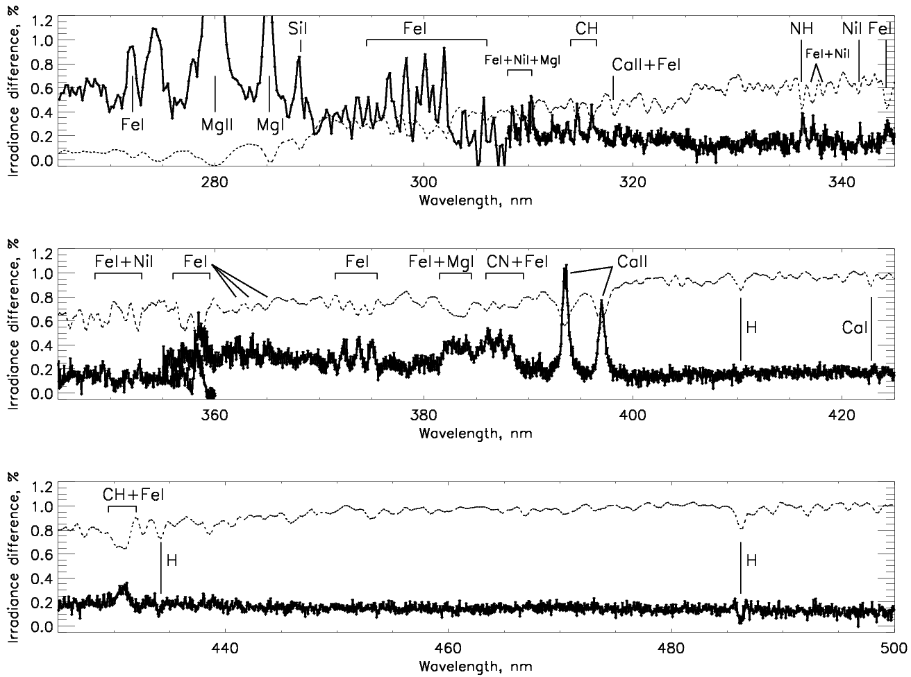
Time-averaged irradiance differences: (mid-y2012+y2013) vs.
(mid-y2007+y2008+mid-y2009)
Sun as a star Aura OMI: spectral irradiance changes in Cycle 24, S. Marchenko, M. DeLand
Dotted line: scaled Solar spectrum
Notes:
12

Slide 13
Solar Variations – Resolution
Short-term variations during Cycle 24 calculated using same dates for both instruments.
Larger variations observed at major lines for GOME-2 (blue, Δλ = 0.2 nm) than for OMI (black, Δλ
= 0.4 nm).
Notes:
Matthew DeLand
Science Systems and Applications, Inc. (SSAI) Lanham, Maryland USA
GRWG Meeting – UV Subgroup Darmstadt, GERMANY 27 March 2014

Slide 14
Solar UV Activity Proxy
Numerous data sets are available, with similar overall behavior.
Mg II index has best physical connection to UV irradiance.
Be aware of resolution (see next slide).
Notes:
Matthew DeLand
Science Systems and Applications, Inc. (SSAI) Lanham, Maryland USA
GRWG Meeting – UV Subgroup Darmstadt, GERMANY 27 March 2014

Slide 15
MG II Index Scaling Factors
Calculate max/min ratio for irradiance over solar rotation to minimize instrument change effects.
Calculate the ratio for the same dates with Mg II index.
The slope from linear regression fit gives a “scaling factor”. Good dynamic range is preferred.
The value of the scaling factor at any wavelength depends on instrument resolution for both irradiance and proxy.
Slope = 1.07(±0.04)
Notes:
Matthew DeLand
Science Systems and Applications, Inc. (SSAI) Lanham, Maryland USA
GRWG Meeting – UV Subgroup Darmstadt, GERMANY 27 March 2014

Slide 16
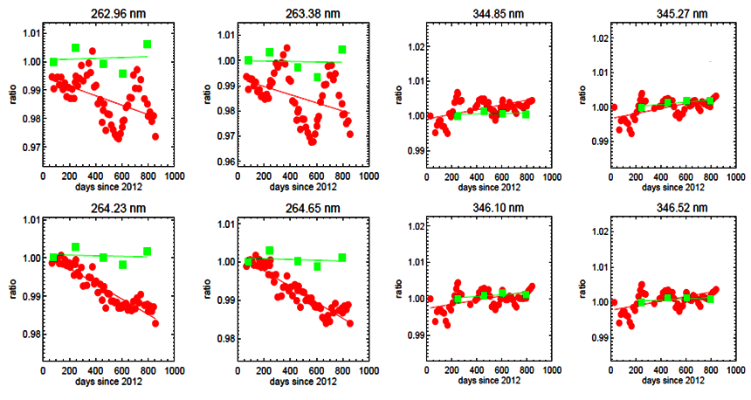
Trending of OMPS measured solar data
Reference Diffuser
Every six months
Working Diffuser
Every two weeks
Nadir Mapper
Nadir Profiler

Slide 17
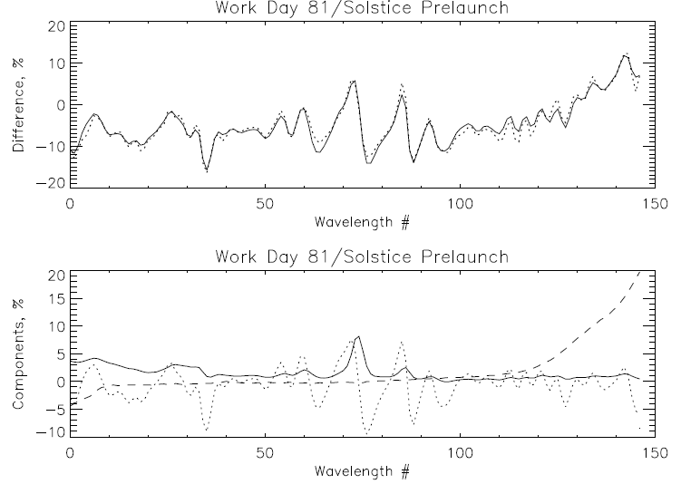
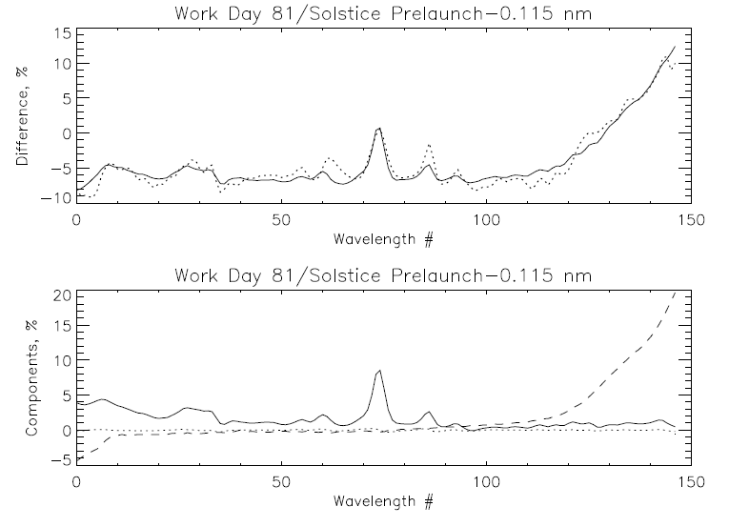
Comparison of OMPS NP Solar spectrum to synthetic from Solstice and prelaunch data. Fits of the differences with a model using three patterns of the form:
Meas/Synth = a0 + a1*WavelengthShift + a2*SolarActivity + a3*DihroicShift
Model
Measurement
Model
Measurement
250 nm 310 nm
250 nm 310 nm
Solar Activity
Dichroic Shift
Wavelength Shift
Solar Activity
Dichroic Shift
Wavelength Shift
250 nm 310 nm
250 nm 310 nm
Working Day 81 vs Solstice Synthetic (1.1% rmsr)
%offset %Mg II Shift nm Dich nm
-7.3 7.3 -0.127 -0.349
Working Day 81 vs Solstice Synthetic (1.1% rmsr)
%offset %Mg II Shift nm Dich nm
-7.5 7.7 -0.004 -0.347

Slide 18
OMPS Nadir Profiler Solar Measurements
Newest
Degradation Component
The working diffuser’s exposure is
13 times the reference exposure.
Two years of measurements
Compared to their average.
250 nm 310 nm
250 nm 310 nm
Wavelength Shift Component
Solar Activity Component
Patterns are Mg II scale factors
and track Solar activity.
Wavelength shifts track optical
bench annual thermal variations.
Oldest
250 nm 310 nm
250 nm 310 nm
Notes:
The working diffuser for the OMPS has 13 times the exposure of the reference diffuser.

Slide 19
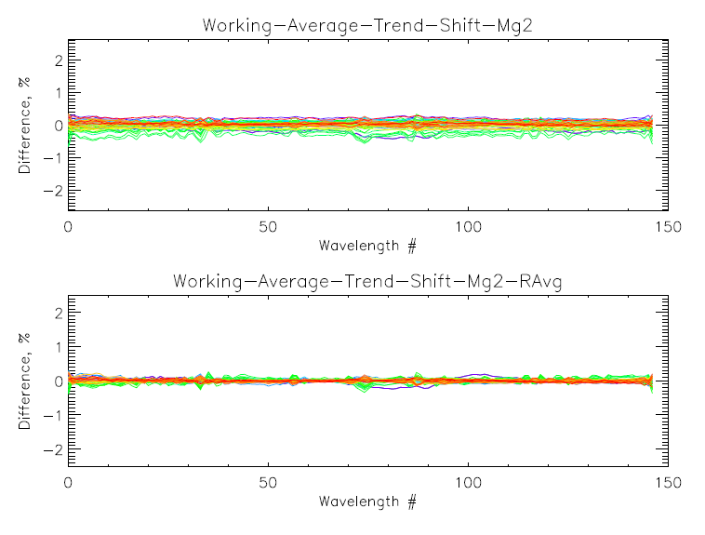
OMPS NP Working Solar residuals after fits

Slide 20
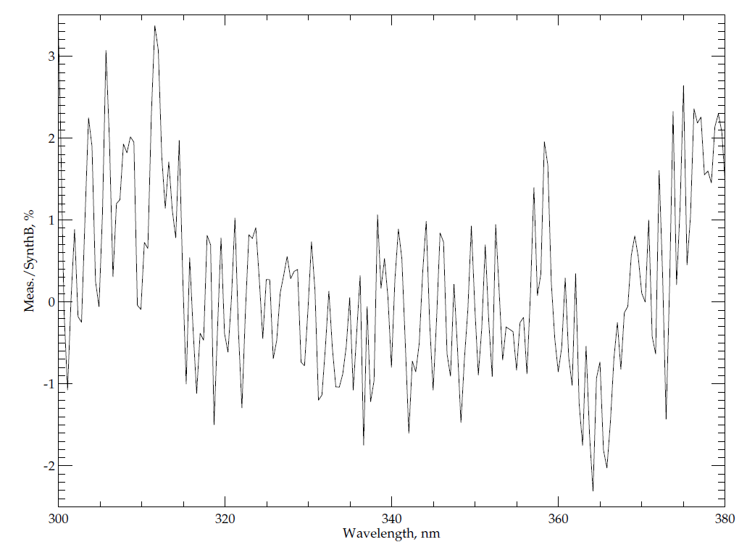
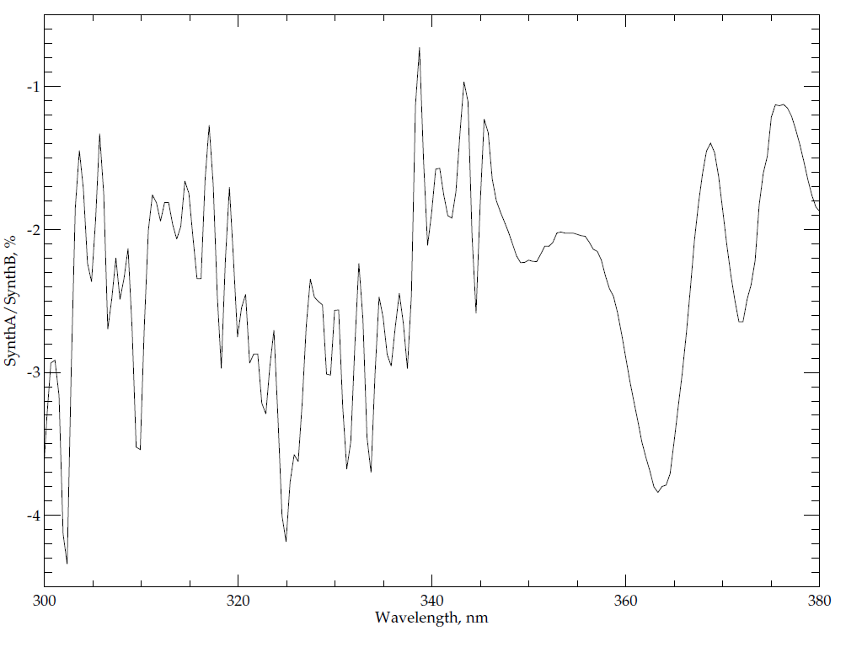
Using Reference Solar to create Proxy Spectra
Comparisons of OMPS Nadir Mapper measured and proxy (from references) solar spectra for 300 nm to 380 nm.
(Proxy AK / Proxy BK – 1)*100 (Measured/Proxy BK – 1)*100
1%
1%
Notes:
Proxy B uses the reference Colin Seftor, NASA SSAI provided and Proxy A uses the reference Ruediger Lang EIMETSAT provided.

Slide 21
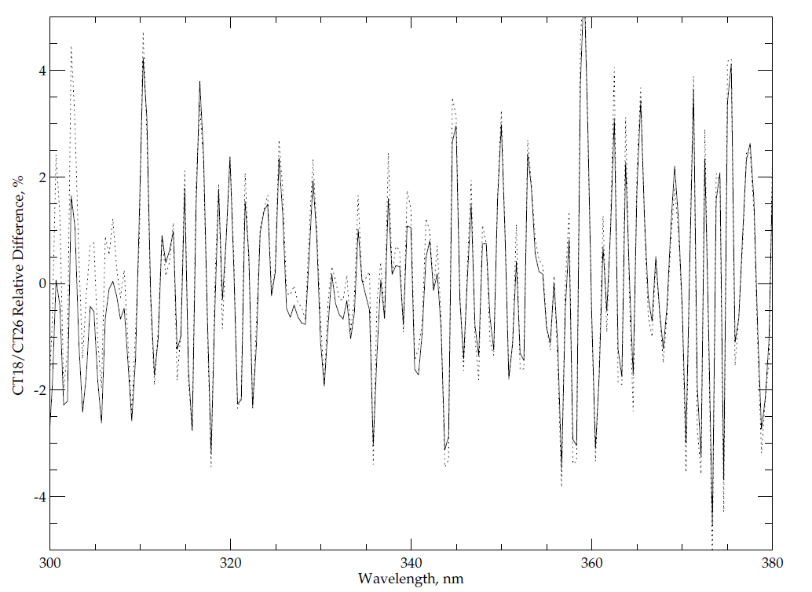
OMPS Nadir Mapper predicted Cross-Track (CT) differences from Proxy and Measured spectra
Solid Line – (Proxy AK CT18 / Proxy AK CT26 – 1)*100
Dotted Line – (Measured CT18 / Measured CT26 – 1)*100 – 2.0

Slide 22
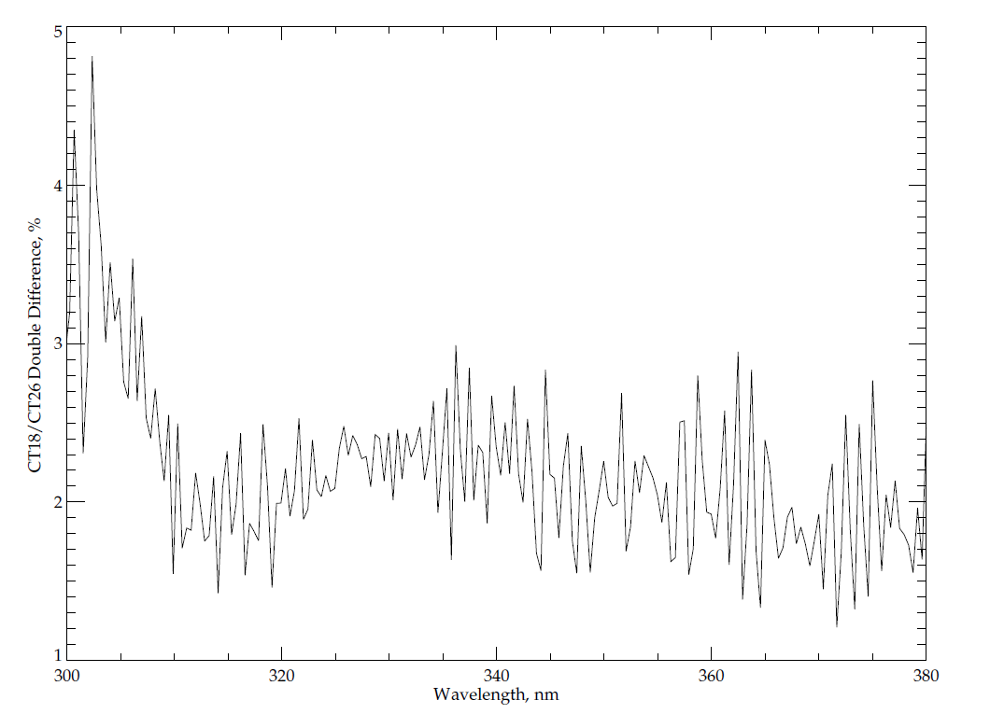
OMPS Nadir Mapper Double Difference of CT18/CT26, Measured minus Proxy
(Measured CT18 / Measured CT26 – Proxy A CT18 / Proxy A CT26 )*100
1%

Slide 23
Conclusions
High resolution reference solar spectra have been constructed for different purposes.
Understanding how a reference spectrum was created helps to make it more useful.
At wavelengths shorter than 300 nm, natural solar variations must also be considered for best results.
Mg II proxy index can be used with (instrument-dependent) scaling factors to determine adjustments for solar activity as a function of wavelength and time.
Solar features can be used to estimate wavelength shifts.
Reference spectra have calibration offsets but can be used as transfer standards (Double Differences).
Note: Most users take the radiance/irradiance ratios as the important measurement and want the two to have good relative calibration not individual absolute calibration. (e.g., requirements Rad 7%, Irr 7%, Rad/Irr 1%)
The calibration teams work to determine and remove the diffuser degradation from the ratios.

Slide 24
References
• Dobber, M., et al. [2008], Solar Phys. 249, 281-291.
Hall, L. A., and Anderson, G. P. [1991], J. Geophys. Res. 96, 12,927-12,931.
Kurucz, R. L., et al. [1984], Solar Flux Atlas from 296 to 1300 nm, National Solar Observatory.
Chance, K. and Kurucz, R. L. [2010], J. Quant. Spec. Rad. Trans. 111, 1289-1295.
Thuillier, G., et al. [2004], Solar Variability and its Effects on Climate, American Geophysical Union, p. 171-194.
Woods, T., et al. [2009], Geophys. Res. Lett. 36, L01101, doi:10.1029/2008GL036373.
DeLand, M. T., and Cebula, R. P. [2012], J. Atmos. Solar-Terr. Phys. 77, 225-234.

Slide 25
Background slides

Slide 26
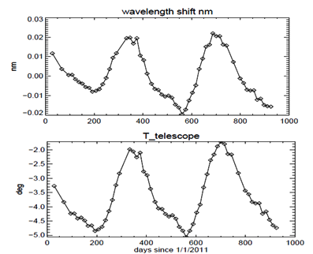
Annual Cycle in Wavelength Scale Changes and Temperatures
f(x) = a1*sin(b1*x+c1) + a2*sin(b2*x+c2) + a3*sin(b3*x+c3) +
a4*sin(b4*x+c4)

Slide 27
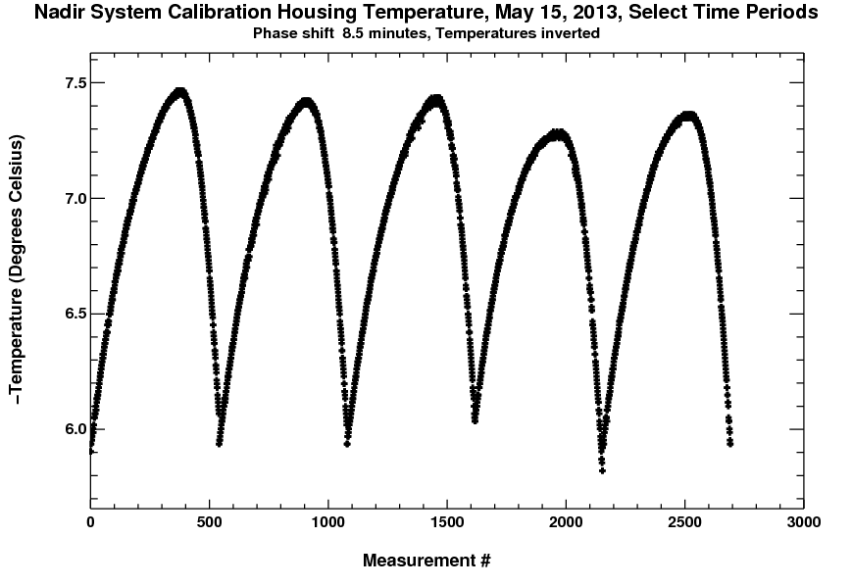
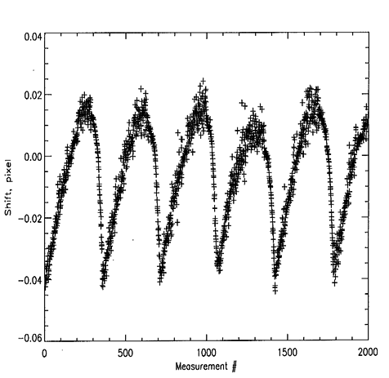
NM wavelength change vs. thermal loading
NM housing temperature (ºC)
Intro-orbital wavelength shift in pixel

Slide 28
Proxy Results

Slide 29
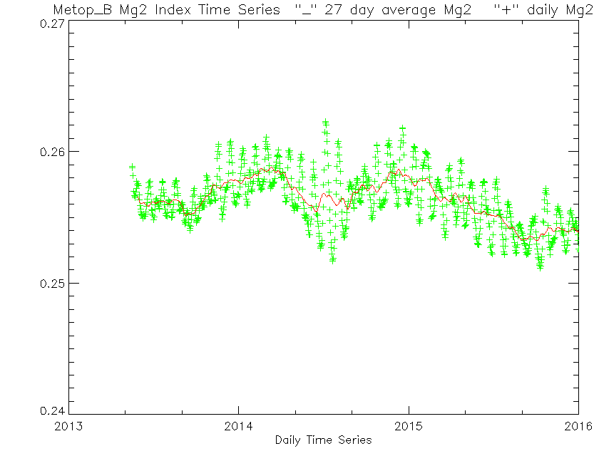
2%

Slide 30
OMI Irradiance Time Series
Solar cycle variations derived from OMI irradiance measurements.
Analysis benefited from location of data set in solar cycle, well- behaved instrument, hyperspectral data.
Still required monthly averages to get useful results at longer wavelengths.
Marchenko and DeLand [2014]

Slide 31
Absolute Difference - 2
Smoothing irradiance data to lower resolution necessary to evaluate radiometric differences.
Some comparisons still show differences that exceed quoted uncertainties.
SORCE SOLSTICE vs. UARS SUSIM, SOLSTICE
Woods et al. [2009]
Notes:
Matthew DeLand
Science Systems and Applications, Inc. (SSAI) Lanham, Maryland USA
GRWG Meeting – UV Subgroup Darmstadt, GERMANY 27 March 2014

Slide 32
Time-averaged irradiance differences: (mid-y2012+y2013) vs.
(mid-y2007+y2008+mid-y2009)
Sun as a star Aura OMI: spectral irradiance changes in Cycle 24, S. Marchenko, M. DeLand
Dotted line: scaled Solar spectrum
Notes:
32

Slide 33
Mg II Index - Resolution
Figure courtesy of Marty Snow, 2014 SORCE Meeting
Notes:
Matthew DeLand
Science Systems and Applications, Inc. (SSAI) Lanham, Maryland USA
GRWG Meeting – UV Subgroup Darmstadt, GERMANY 27 March 2014

Slide 34
Introduction
Solar irradiance is primary energy source for terrestrial system.
Important to know absolute value and relative variations, for both integrated measurement and spectral dependence.
Sun represents a valuable calibration source for satellite instruments:
Easy access
High intensity
Relatively stable compared to on-board sources
Many spectral features for wavelength calibration
Some “features” also represent challenges for operational use:
Exposure-dependent degradation (particularly in UV)
Large dynamic range needed to co-exist with Earth view data
Natural variability in UV region
Complex spectral structure
This presentation will briefly discuss some issues associated with using reference solar spectra.

Slide 35
Project to Compare Solar Measurements
High resolution solar reference spectra
Reference high resolution solar Spectra (SOLSTICE, SIM, Kitt Peak, etc. – Everybody has a favorite. How do they compare?)
Mg II Index time series, Scale factors at high resolution
Instrument data bases
Bandpasses, wavelength scales (Shift & Squeeze codes)
Day 1 solar, time series with error bars (new OMI product) (Formats, Doppler shifts, 1 AU adjustments)
Mg II Indices and scale factors at instrument resolution
Reference calibration and validation papers
Using the information from above we can compare spectra from different instruments and times
Notes:
Composite Mg II solar activity index for solar cycles 21 and 22
Matthew T. DeLand, Richard P. Cebula
DOI: 10.1029/93JD00421
Creation of a composite solar ultraviolet irradiance data set
Matthew T. DeLand, Richard P. Cebula
DOI: 10.1029/2008JA013401

Slide 36
Actions
Colin, Dave, Ruediger: provide reference solar spectrum to establish common reference
All: provide other options for reference solar spectra
All: For your instrument (Optional)
Solar measurement (wavelength scale, irradiance)
Wavelength scale and bandpass (Δλ, Normalized bandpass weight)
Synthetic from common reference (wavelength scale, irradiance)
Synthetic for wavelength scale perturbations (±0.01 nm) from common reference (wavelenth scale, irradiance)
Synthetic from alternative reference spectra (wavelength scale, irradiance)
Solar activity pattern (wavelength, relative change)
Mg II index (if 280 nm is covered) Mg II 279.6 Mg I 285.2
Ca H/K index (if 391 nm to 399 nm is covered) CA II 393.4 396.8.
A measured solar for their instrument
A synthetic solar produced from the high resolution reference
The wavelengths and bandpasses used to create 1 from 2.
A set of two spectra for ±0.01 nm shifts, that is, synthetic spectra as earlier but with the spectral scale shifted uniformly by +0.01 nm and -0.01 nm.
A set of solar activity scale factors
If the instrument covers the 277 nm to 283 nm wavelength, then each team should provide Mg II index values. These should be computed as follows:
Fit three quadratic functions to the core and wing measurements using all measurements in the following three intervals: [276,278], [279,281],[282,284]. Then compute the core to wing ratios using the vertices of the three fit quadratics, Mg II Index = VCore*2/(VWingL+VWingR). Also, report the wavelength coordinate of the core vertex.
Composite Time series of Mg II Indices to convert from one date to another.

