Slide 1
Technical aspects of the GIRO work: inputs from GRWG
S. Wagner

Slide 2
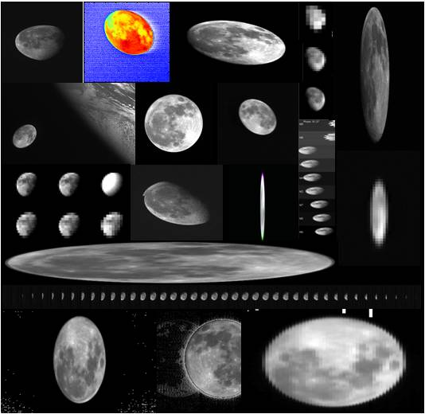
Lunar calibration from the research side…
GSICS Implementation of the ROLO model = agreed international reference for lunar calibration
Since the First Lunar Calibration Workshop in December 2014:
GIRO Version 1.0.0 released (executable)
GIRO usage and GSICS Lunar Observation Dataset policy terms agreed within Lunar Calibration Community and presented at the GSICS Executive Panel
Tighten links and interactions with CEOS WGCV IVOS, who support GSICS initiative on lunar calibration
Examples of Moon observations from instruments represented in Lunar Calibration Workshop
See presentation 4f

Slide 3
Lunar Calibration: Definition of a collaborative framework
External datasets to improve the irradiance reference model
(e.g. CNES with Pleiades)
EUMETSAT
Instrument Monitoring
US Geological Survey
ROLO lunar irradiance reference model
EUMETSAT
GIRO lunar irradiance reference model (GSICS Implementation of the ROLO model)
Publication of the enhancements to the ROLO = public domain
GSICS / CEOS-IVOS
Cross-comparisons
Instruments from other space and meteorological agencies
NASA
MODIS Aqua
= Current GSICS reference for VNIR channels
GSICS
Inter-calibration products
Monitored instruments from GSICS partners

Slide 4
GIRO and GLOD: decisions
GIRO source code available to Lunar Calibration Community upon formal agreement with the GIRO policy
Access to GLOD upon formal agreement with the GLOD policy
Restricted access to GIRO + GLOD
EUMETSAT remains the implementing agency for the time being
➔ EUMETSAT to set-up the service to provide GIRO + GLOD

Slide 5
GIRO and GLOD: current situation and plans for 2016
GIRO under Configuration Management system at EUMETSAT:
SVN repository (only internally accessible)
Tags for releases ➔ consistent with GIRO release version to external partners
Internal documentation to support operational use ➔ directly usable by GSICS
Licensing arrangement to release software
Set-up of the infrastructure to distribute GIRO (sources) + GLOD
Developing inter-calibration using the Moon as a transfer target (part of EUMETSAT’s organisational objectives for 2016) and add the method to the GSICS blend (no impact on the GSICS servers as data flow remains as for DCCs)
See presentation 4f

Slide 6
Concept for a dedicated service
Link to GIRO + GLOD webpage:
WMO GSICS portal
GSICS wiki (in the dedicated Lunar Cal page)
GCC web page
IVOS Cal/Val portal
Visibility on the web?
➔ Keywords for search tools
(Implementing agency) GPRC web site
GSICS data server (any server?)
Front end : web page on GPRC web page for the implementing agency + external requests through Helpdesk
Restricted access (password? login?)
GIRO + GLOD policy
GIRO source code ➔ last version only
1. Documentation:
ATBD
User manual
Input/Ouput format description
Link toward the GSICS dedicated meeting (GSICS wiki)
Results of the GIRO validation + traceability
EUMETSAT Reports + scientific papers (references)
Others docs produced by partner on the GSICS wiki
2. Tools (or on the GSICS wiki)
1. GLOD:
1 dataset / instrument
More instruments / agency
Last valid version visible
Older versions “archived”
2. Benchmark for the validation of GIRO updates + traceability to ROLO

Slide 7
Actions
EUMETSAT to address licensing ➔ blocking point
Support from GDWG for setting up:
Web front-end
Set-up of the GSICS data server repositories
Securing the access to the GIRO + GLOD
Liaising with WMO GSICS, GCC and IVOS Cal/Val to create link on their website to the front-end

