Slide 1
Introduction to JAXA Data Distribution Service - G-Portal/DPSS
JAXA Satellite Applications and Operations Center(SAOC)
Yousuke Ikehata, Masumi Matsunaga
3/2/2016
Notes:
Thank you for attending this presentation.
I‘m Yousuke Ikehata from Jaxa JAXA Satellite Applications and Operations Center(SAOC)
and I am responsible for G-portal which is JAXA’s data distribution service.
Today, I would like to talk to you about JAXA satellite data dissemination Systems.

Slide 2
Agenda
Overview of JAXA ground and data dissemination systems
ALOS-2/ALOS User Interface Gateway (AUIG2)
GCOM-W Data Providing Service
G-Portal
Notes:
Here is the outline of my presentation.
This presentation has four parts.
First, I will introduce Overview of JAXA ground and data dissemination systems
Then, I’lll show summary of each systems.
Lastly, I will speak about G-Portal
Main topic of this presentation is G-Portal.

Slide 3
“Introducing to
JAXA Data Dissemination Systems”
a. Overview of JAXA ground and data dissemination systems
b. ALOS-2/ALOS User Interface Gateway (AUIG2)
c. GCOM-W Data Providing Service
d. G-Portal
Notes:
I’d like to start by looking at Overview of JAXA ground and data dissemination systems

Slide 4





a. Overview of JAXA ground and data dissemination systems(1/3)
JAXA’s Ground System Overview for Earth Observation Satellites
JMA : Japan Meteorological Agency
NIES : National Institute for Environmental Studies
JAFIC : Japan Fisheries Information Service Center
PF : PLATFORM
PI :Principal Investigator
Earth Observation Satellite
Users
PI, Institute, etc
Operation Plan
Observed Data
Search/Order
Commercial
Products
Ground Station
(S-band)
Ground Station
(X-band)
Private Distributers PASCO
PF(ALOS/ALOS-2)
Products
Search
/Order
Users
NASA
Operation Plan
Observed Data
Observation Request Reception
Observation
Request
Operation Planning system
Data Dissemination System
Data Transmission System
GCOM-W Data Providing Service
Observation
Request
Products
AUIG2(ALOS/ALOS-2)
Observed
Data
Products
Catalogue
Core Users
JMA, NIES, JAFIC, etc
Users
PI, Institute, etc
Products/
Catalogue
CATS-I
G-Portal
Products
Data Processing System
Archive
JAXA Mission Operations System
Notes:
This is Overview of JAXA ground and data dissemination systems.
There are 3 functions, observation request reception from users, operation planning system, and mission operation system.
Mission opearation system includes 4 parts.
Data transmittion system, data processing system, archive system and data dissemination system.
JAXA has 3 Data dissemination system.
-GCOM-W Data Providing Service(DPSS)
-AUIG2(ALOS/ALOS-2)
-G-Portal

Slide 5
a. Overview of JAXA ground and data dissemination systems(2/3)
JAXA satellite data dissemination Systems
JAXA has 3 data dissemination systems.
Satellite | Data dissemination System
ALOS-2/ALOS | ALOS-2/ALOS User Interface Gateway (AUIG2)
GCOM-W(AMSR/AMSR-E/AMSR2) | GCOM-W Data Providing Service
GPM/TRMM/GOSAT/Aqua/ ADEOS-II/ADEOS/MOS-1/ MOS-1b/JERS-1/ERS-1 (Future)GCOM-C/EarthCARE | G-Portal
Common function of those data dissemination System
- Search Products
- download and order by internet using 10Gbps line.
Notes:
As I said, JAXA has 3 data dissemination systems.
ALOS-2/ALOS User Interface Gateway (AUIG2) provides ALOS/ALOS-2 products.
GCOM-W Data Providing Service provides GCOM-W(AMSR/AMSR-E/AMSR2) products.
G-Portal provides low resolution and free products like them.
In the future, G-Portal provides GCOM-C and EarthCARE products.
Users can search and download by All Data dissemination systems.
And All systems using 10Gbps lines.

Slide 6
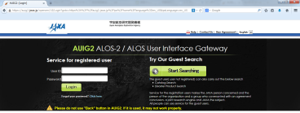
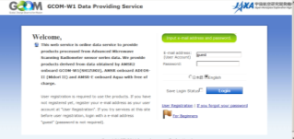
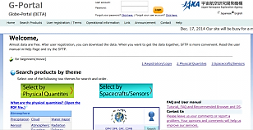
a. Overview of JAXA ground and data dissemination systems(3/3)
JAXA satellite data dissemination Systems(URL, Mail, Top page)
AUIG2
https://auig2.jaxa.jp/ips/home/
Z-ALOS-2_ORDERDESK@jaxa.jp
GCOM-W Data Providing Service
https://gcom-w1.jaxa.jp/
z-gw1help@jaxa.jp
G-Portal
https://www.gportal.jaxa.jp/
z-gportal-support@jaxa.jp
Notes:
This is URL and mail address and system top page.

Slide 7
“Introducing of
JAXA Data Dissemination Systems”
a. Overview of JAXA ground and data dissemination systems
b. ALOS-2/ALOS User Interface Gateway (AUIG2)
c. GCOM-W Data Providing Service
d. G-Portal
Notes:
Next three sections, I’d like to talk about I will introduce each data dissemination systems
First, I’ll introduce ALOS/ALOS-2 User Interface Gateway (AUIG2)

Slide 8
b. ALOS-2/ALOS User Interface Gateway (AUIG2)(1/4)
Summary
Providing data
  ALOS-2/PALSAR-2
  ALOS/ AVNIR-2
  ALOS/ PRISM
  ALOS/PALSAR
Function
  Search Archived Data
  Order Products
  View Observation Plan(ALOS-2)
  for High resolution products
Notes:
AUIG2 provides ALOS products; AVNIR-2, PRISM, PALSAR
And ALOS-2 products; PALSAR-2
AUIG2 has 3 functions; search archived data, order products, provides observation plan(but this is only ALOS-2).
AUIG2 treats high resolution products.
Next, I explain about each functions.

Slide 9
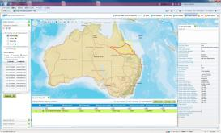
b. ALOS-2/ALOS User Interface Gateway (AUIG2)(2/4)
Search ALOS/ALOS-2 products
Search ALOS-2/ALOS data by specifying area, conditions and period
Area | Conditions | Period
point Path/Argument of latitude polygon kml file shape file | Observation mode Off-nadir angle or pointing angle Orbit derection Observation direction (right or left) Cloud Coverage (Optical only) Existence of browse image Interferometry pair search | Observation start date and end date
Notes:
Here is Search function at AUIG2
User can serach ALOS-2/ALOS data by specifying area, conditions and period.
Area can be selected as below;
-point,
-Path/Frame,
-polygon,
-kml file,
-shape file
And user can specify conditions;
Observation mode
Off-nadir angle or pointing angle
Orbit derection
Observation direction (right or left)
Cloud Coverage (Optical only)
Existence of browse image
Interferometry pair search

Slide 10
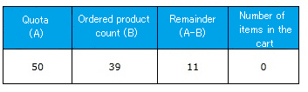
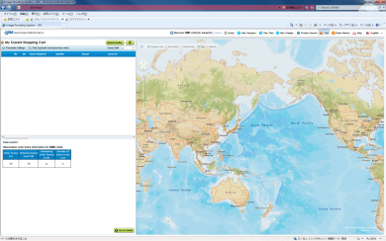
b. ALOS-2/ALOS User Interface Gateway (AUIG2)(3/4)
Order ALOS/ALOS-2 products
Product level
  L1.1
  L1.5
  L2.1
  L3.1
Product format
  CEOS
  Geotiff
  Zipped file
  Delivery method is “AUIG2 download” (by internet)
  User can check Order status and Quota status
Notes:
Next is order function.
AUIG2 treats these product level.
ポインタ等で示す。
And product format is 4.
Ceos format, geotiff, jpeg, geopdf.
Delivery method is AUIG2 download by internet.
Off course, user can check order status and quota status.

Slide 11
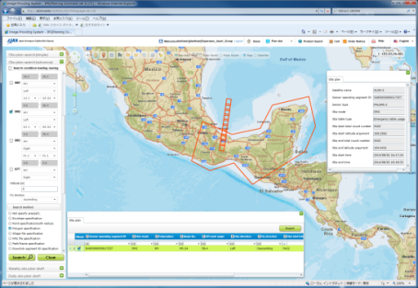
b. ALOS-2/ALOS User Interface Gateway (AUIG2)(4/4)
View ALOS-2 Observation Plan
ALOS-2 observation plan is fixed one day before.
(So, it can be changed until then.)
Detailed information on ALOS-2 observation
Notes:
Last is observation plan function.
ALOS-2 observation plan is fixed one day before.
(So, it can be changed until then.)
Detailed information on ALOS-2 observation in this url.

Slide 12
“Introducing of
JAXA Data Dissemination Systems”
a. Overview of JAXA ground and data dissemination systems
b. ALOS-2/ALOS User Interface Gateway (AUIG2)
c. GCOM-W Data Providing Service
d. G-Portal
Notes:
Second, I’ll introduce GCOM-W Data Providing Service.
And here in after called as DPSS.

Slide 13
c. GCOM-W Data Providing Service(1/4)
Summary
Providing data
  AMSR
  AMSR-E
  AMSR2
  including Standard and Near Real-time Product
Function
  Search Archived Data
  Order Products
  Convert products
Also G-Portal provides AMSR/AMSR-E products.
Notes:
DPSS provides AMSR, AMSR-E and AMSR2
DPSS has 3 functions; search archived data, order products, convert products.
Also G-Portal provides AMSR/AMSR-E products.
Next, I explain about each functions.

Slide 14
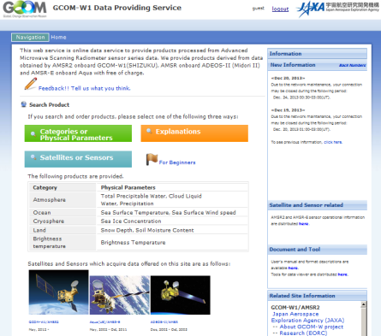
c. GCOM-W Data Providing Service(2/4)
Product’s Download interface
Web (HTTP)
  Users will be able to
  Search and order from our web page.
  convert dormat as listed below
    HDF5 to netCDF, GeoTiff（AMSR2）
    HDF4 to HDF5, netCDF, GeoTiff
    （AMSR/AMSR-E)
SFTP
  Users will be able to log in to our SFTP server and download products.
  Users cannot convert format
DPSS Web page
https://gcom-w1.jaxa.jp
Notes:
DPSS provides 2 ways. Web and SFTP for download.
By Web, http,
Users will be able to Search and order from DPSS web page.
And Users can convert dormat as listed below.
HDF5 to netCDF, GeoTiff for AMSR2 products.
HDF4 to HDF5, netCDF, GeoTiff for AMSR/AMSR-E products
By SFTP,
Users will be able to log in to our SFTP server and download products.
But users cannot convert format by SFTP.

Slide 15
c. GCOM-W Data Providing Service(3/4)
Overview of products(The definitions of processing level)
Processing Level |  | Description | Data provide
 |  |  | Standards Products | NRT Products
Level 1A | Count Value | A product that adds radiometric correction processing and geometric correction processing to the Level 0 data set, calculates antenna temperature conversion coefficients, antenna temperature count values, etc. and divides the data set by scene. | ○ (Special User) | －
Level 1B | Brightness Temperature | A product that converts antenna temperatures output in Level 1A to brightness temperatures using the conversion coefficients. | ○ | ○ (Special User)
Level 1R | Brightness Temperature (Resampled) | A product that resamples the Level 1B product using precalculated resampling coefficients to adjust data for lower frequency resolutions. | ○ | －
Level 2 | Geophysical Parameters (Scene) | A product that calculates geophysical parameters primarily related to water from the Level 1B product. | ○ | ○ (Special User)
Level 3 | Geophysical Parameters (Global Data) | A product that averages the Level 1B product and the Level 2 product spatially and over time with respect to predefined lattice grid points on the Earth surface and maps the averages on a global scale. | ○ | －
Notes:
This is overview of products which provides from DPSS.
This sheet is described by processing level.

Slide 16
c. GCOM-W Data Providing Service(4/4)
Products Overview(Level2 Geophysical Parameters)
Product |  | Description
Atmosphere | Total Precipitable Water (TPW) | Total volume of water vapor in the atmosphere integrated in the vertical Direction
 | Cloud Liquid Water (CLW) | Total volume of cloud liquid water in the atmosphere integrated in the vertical direction
 | Precipitation (PRC) | Hourly rainfall depth of liquid precipitation (rain) at the ground surface
Ocean | Sea Surface Temperature (SST) | Water temperature several millimeters below the sea surface penetrated by microwaves (near-skin sea temperature)
 | Sea Surface Wind speed (SSW) | Wind speeds 10 meters above the sea surface
Cryosphere | Sea Ice Concentration (SIC) | Ratio of the area occupied by sea ice when sea water and sea ice exist in the 18 GHz band’s observed field of View
Land Area | Snow Depth (SND) | Depth of accumulated snow
 | Soil Moisture Content (SMC) | Volumetric water content in surface soil
Notes:
This table describes level2 geophysical parameters.

Slide 17
“Introducing of
JAXA Data Dissemination Systems”
a. Overview of JAXA ground and data dissemination systems
b. ALOS-2/ALOS User Interface Gateway (AUIG2)
c. GCOM-W Data Providing Service
d. G-Portal
Notes:
Last, I’ll introduce G-Portal

Slide 18
G-Portal(1/10)
Summary
Providing data
  GPM/TRMM/GOSAT/Aqua/
  ADEOS-Ⅱ/ADEOS/MOS-1/MOS-1b/JERS-1/ERS-1
  (Future) GCOM-C/EarthCARE/GOSAT-2
  including Standard and Near Real-time Product
Function
  Search Archived Data
  Order Products
  for Low/Middle resolution products
Notes:
G-Portal provides JAXA’s low/ middle resolution products for free.
Satellites and sensors listed as below.
G-Portal has 2 functions; search archived data, order products

Slide 19

d. G-Portal(2/10)
Feature of G-Portal
Cross-search from JAXA's various satelites
provides data with free of charge.
HTTPS service and SFTP service are available.
Product format
  Binary, HDF4/5, GeoTiff, zipped file, netCDF, text
https://www.gportal.jaxa.jp
Notes:
This slide summarize features of g-portal again.
G-portal provides Cross-search from JAXA's various satelites
And provides data with free of charge.
HTTPS service and SFTP service are available.
Product format is Binary, HDF4/5, GeoTiff, zipped file, netCDF, text.

Slide 20





d. G-Portal(3/10)
Product’s Download interface
search by
physical quantity
or
spacecraft/sensors
select
physical quantity
or
spacecraft/sensors
select
period and
region
check
search result
order
download
Web
or
SFTP
HTTPS
SFTP
products download
without Web browser
Direct Download
├── AQUA
│ └── AQUA.AMSR-E
│ ├── L1A
│ ├── L1B
│ ├── L2.AP
│ ├── L2.CLW
│ ├── L2.IC
│ ├── L2.SM
│ ├── L2.SST
│ ├── L2.SSW
Notes:
Next I explain order function.
G-Portal provides 2 ways. HTTPS and SFTP
By http,
Users will be able to Search by physical quantity or satellite/sensors.
And specify time period and region.
Finally user can order and download.
By SFTP,
Users will be able to log in to our SFTP server and download products directly.

Slide 21
d. G-Portal(5/10)
Physical quantities provided by G-Portal
 | Physical quantities | Physical quantity | Satelite
Terrestrial | Soil Moisture | ・ Soil Moisture | AQUA/ADEOS-Ⅱ/MOS-1/ MOS-1b
 | Snowpack | ・ Snow Coverage Distribution ・ Surface Temperature ・ Snow Grain Size ・ Snow Depth
 | Radiance/Reflectance | ・ Radiance/Reflectance | ADEOS-Ⅱ/ADEOS
 | Vegetation | ・ Vegetation Parameters
Ocean | Sea Surface Temperature | ・ Sea Surface Temperature | GPM/TRMM/AQUA/ADEOS/ ADEOS-Ⅱ/MOS-1/MOS-1b
 | Sea Surface Wind | ・ Sea Surface Wind Speed | TRMM/AQUA/ADEOS-Ⅱ/ MOS-1/MOS-1b
 | Ocean Color | ・ Normalized Water-Leaving Radiance ・ Chlorophyll-a Concentration ・ Suspended Solid Concentration ・ Colored Dissolved Organic Matter | ADEOS/ADEOS-Ⅱ
Others | Radiance/Brightness temperature | ・ Brightness Temperature ・ Radiance ・ Radiance/Reflectance | GPM/TRMM/AQUA/ADEOS/ ADEOS-Ⅱ/MOS-1/MOS-1b
 | Radar | ・ Calibrated Received Power ・ Radar Reflectivity ・ Backscattering cross section | GPM/TRMM
 | Geometric Information | ・ Geometric Information | ADEOS-Ⅱ
 | Environment Auxiliary | ・ Environment Auxiliary | GPM
Blue color letters show products provided only for specific user.
Notes:
This is physical quantities provided by g-portal.

Slide 22
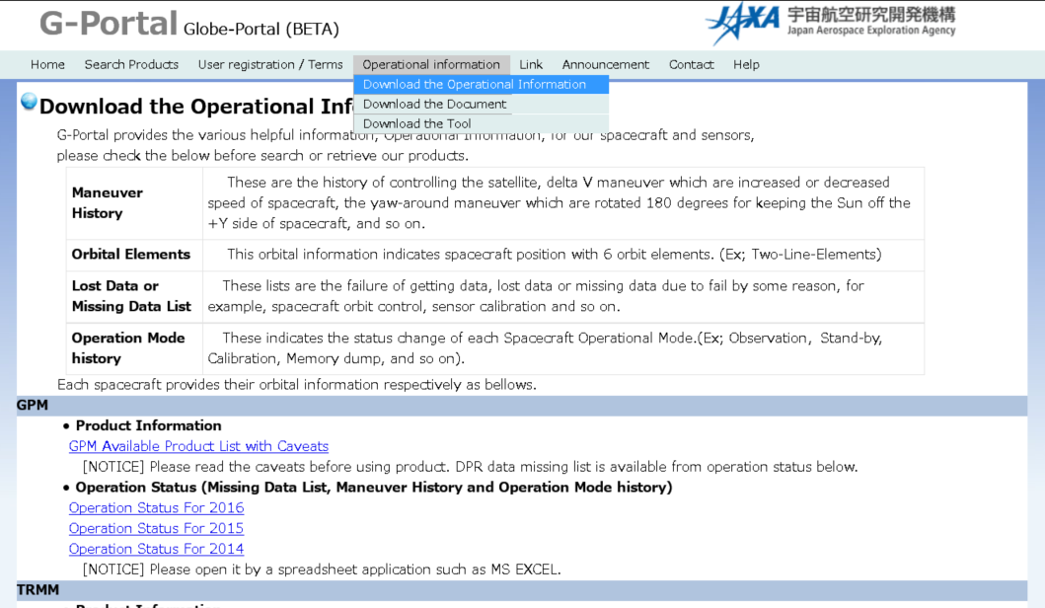
G-Portal(6 /10)
Providing Operational Information
Notes:
Also G-Portal provides additional information.
Operational information
Document
Tools.
This slide shows sample of operational information.
User can download operational information from each satellites categoly.
For example user click gpm operational information….
スライドを変更する

Slide 23
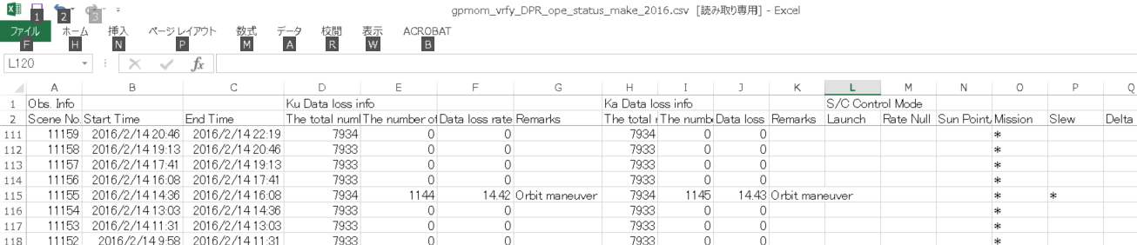
d. G-Portal(7/10)
Operational Information(Excel)
1144 (The number of data loss scannings)
*
(Slew)
Orbit maneuver
(remarks)
Notes:
User can download csv file.
And csv ffile includes various operational information.
For example the number of data loss scannings, orbit maneuver, slew and so on.

Slide 24
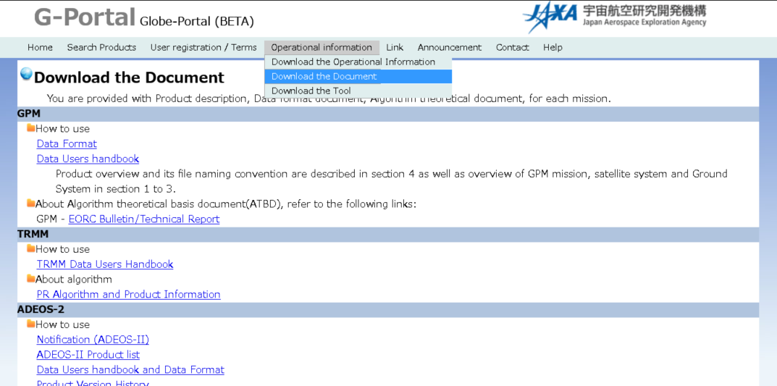
d. G-Portal(8/10)
Providing Document
Data Format
Data Users handbook
Algorithm Theoretical Basis Document(ATBD)
Notes:
Next is document.
G-portal provides
Data format, data users handbook and algorithm theoretical basis document(ATBD)

Slide 25
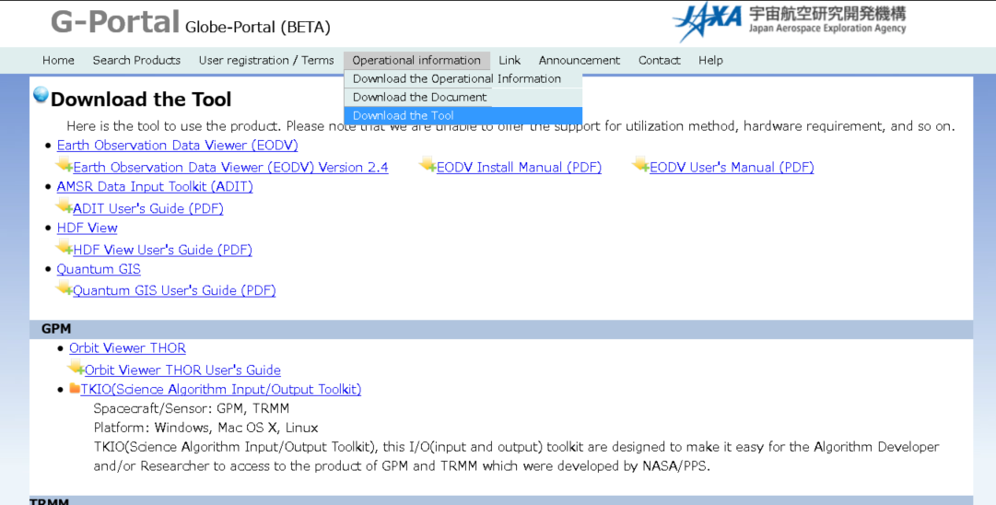
d. G-Portal(9/10)
Providing Tools
Notes:
Last is tools.

Slide 26
d. G-Portal(10/10)
Future Plan
G-Portal will integrate GCOM-W Data Providing Service in FY2016.
GCOM-C, EarthCARE will also be provided after products released.
G-Portal will be renewal in 2017.
Notes:
And lastly, I will explain future plan of g-portal.
G-Portal will integrate GCOM-W Data Providing Service in FY2016.
GCOM-C, EarthCARE will also be provided after products released.
G-Portal will be renewal in 2018.
Thank you.
Are there any questions?

