Slide 1
Sno Unit testing tool
MaNIK BALI
NOAA/NESDIS/STAR

Slide 2
Contents
Introduction
SNO Code Input and Output
Unit Testing Method
Conclusions.

Slide 3
Introduction
Simultaneous Nadir overpass algorithm produces collocation between two instruments.
This algorithm lies at the heart of the Classical GSICS product generation.
Accuracy and precision of this code is critical to instrument monitoring, anomaly detection and correction.
There is a need to have a unit testing suite for the SNO algorithm.
Aim is to detect and remove logical and programmatically errors

Slide 4
SNO Code Input and Outputs
Input -Level -1B, Sat-1 Sat-2
Output- Collocation data

Slide 5
Unit Testing is a series of tests at times using test data sets
TEST 1
Sat 1 Vs Sat 1 inter-comparision
Should produce 1 collocation for each pixel.

Slide 6
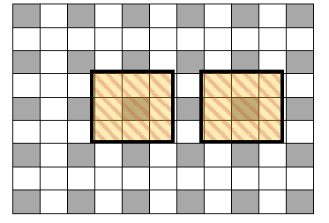
TEST 2
te Data
Should produce 1 collocation for each pixel.
Simulate data which is similar to real life scenario and number of collocated
pixels are predetermined
Sat-1: Is the gridded AATSR L1B
Sat-2: Is produced by ignoring every alternate pixel of Sat-1
Resulting data set has pixels that are large enough to collocate with exactly 3x3 AATSR L1B pixels.
Helps in detecting logical errors in SNO algorithm

Slide 7
Conclusion
A Unit Testing suite for GSICS SNO –baseline algorithm has been presented here.
This suite uses a two step process to test the SNO code for logical accuracy.
Suite has been used at NOAA for SNO code of GEO-LEO and LEO-LEO algorithm and helped to detect and remove key errors.

Slide 8
THANK YOU

Slide 9
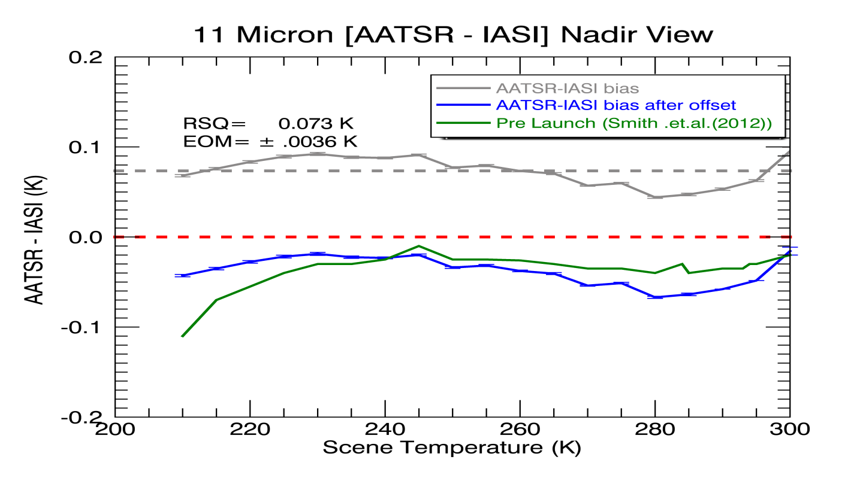
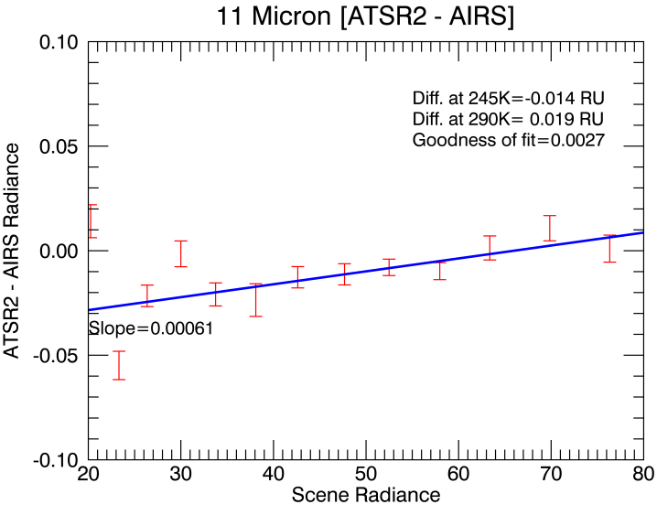
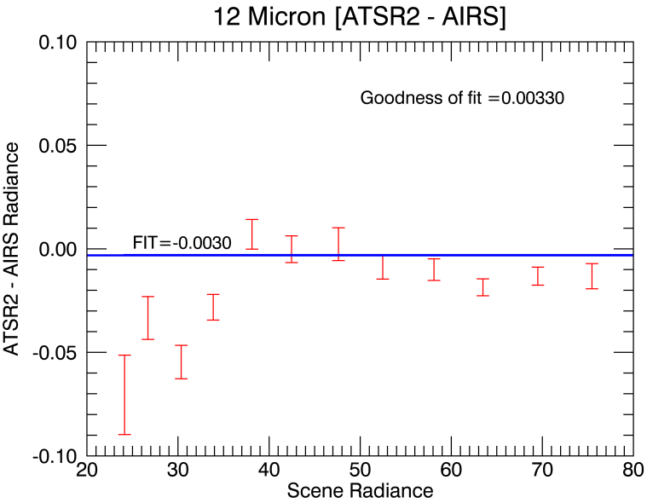
Pre Vs Post launch
Offset= -0.11K
< 0.03K
< 0.068K
Three years (2009-2011) of AATSR/IASI collocation….
AIRS and IASI displays Pre-Launch like behavior in Space to a few 100th of a degree.
ATSR2 and AATSR have SI traceable blackbodies.
Since SRF was determined pre-launch so we can in principal determine SRF in space

