Slide 1
GSICS Quarterly Special Issues and Editors
Manik Bali and Larry Flynn
GSICS Coordination Center, NOAA
GSICS Annual Meeting 2016, New Delhi

Slide 2
Outline
Introduction
New features GSICS Newsletter
Newsletter readers across the world
Article Review Process
Newsletter Phases
Acceptable research articles in the GSICS Newsletter.
Editorial Board
Future Needs
Conclusion

Slide 3
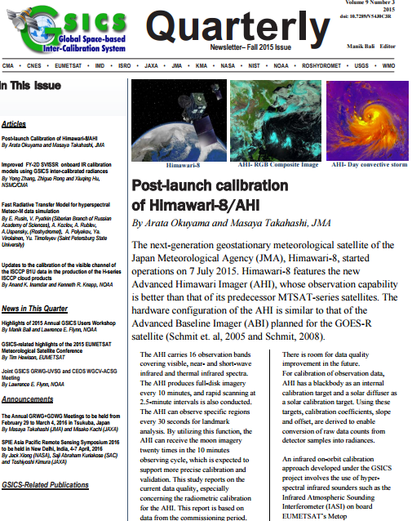
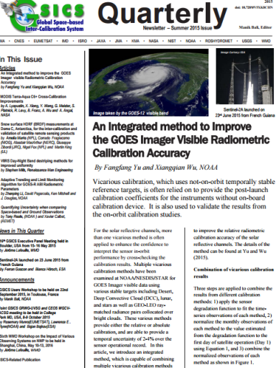
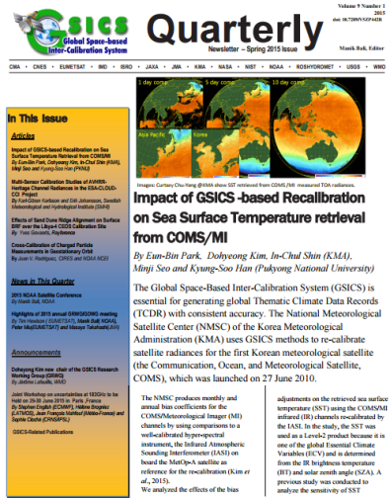
New Features
Since Fall 2013, brand new format .
A robust review process.
Since Winter 2014, the Newsletter has a doi.
Accepts articles on topics related to calibration (Pre and Post launch).
New Landing page on the GCC website.
Rate and Comment section: readers and authors can interact.
Articles are reviewed by subject experts
Help available to non native English speaking contributors.
Since Fall 2014, new navigation features added to the Cover Letter.
Info Trending articles
Would you like to have a citation index?

Slide 4
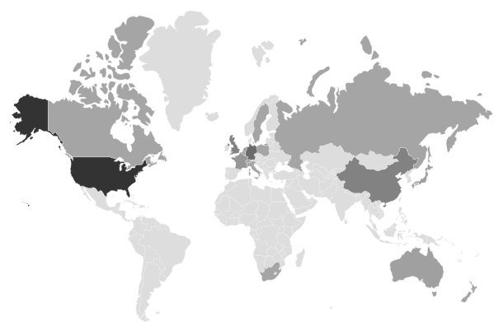
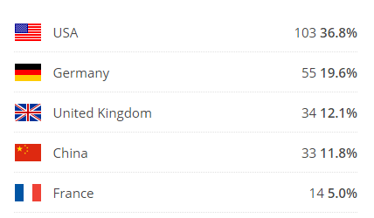
Newsletter Readers across the world
Newsletter getting noticed
Journal of Physics and Chemistry of Earth invited Authors of GSICS Microwave issue to submit articles based on their submission to GSICS Newsletter .

Slide 5
Newsletter Article Review process
Author
Reviewer
Editor
Editor has a preliminary look at the article and checks.
If the article falls within the scope of GSICS/WMO/CGMS /GPM-X or scope of its partners including the 3G
Article falls within the 700-800 word limit with 2 Figures and 1 table.
If the article is a lead article it fulfils lead article criterion
Articles are solicited round the year however call is sent out every quarter via the GSICS Dev.
Articles are sent to the Newsletter Editor directly or via GSICS Correspondents or Chairs of GSICS Groups/Subgroups.
Newsletter review
Guiding Principal
If the editor decides to publish the article, the article is sent to a proof reader or/and a subject expert reviewer.
Editor may decide to send the article directly to a reviewer or via a proof reader.
Editor procures doi number from NOAA library and pastes it into the Newsletter and gives the final copy of the newsletter to the technical expert for release via mailcimp. The technical expert releases I and also makes a web version of the lead article.
Editor forwards the Comments from the reviewer to the author who makes changes and re-submits the article to the editor who forwards them back to the reviewer for his final go ahead.
Editor facilities communication between Author and Reviewer to get GSICS/peer reviewed article.

Slide 6
Types of articles acceptable in the Newsletter
Experimented with several types of articles.
Article on brand new work , not peer reviewed earlier (GCC does not have the resources to review such work accurately)
Articles based on already published work (replication of text and key result figures need to be avoided)
Easy to accept articles that are review of published work , do not replicate results but give ideas about the way forward.

Slide 7
Editorial Board
Manik Bali, Editor
Lawrence E. Flynn, Reviewer
Lori K. Brown, Proofreader and Tech Support
FangFang Yu, Americas Correspondent.
Tim Hewison, European Correspondent
Yuan Li, Asian Correspondent
Do you wish to nominate anyone for editorial board.
Nominate Guest editor.

Slide 8
ACTION
GSICS Quarterly Special Issues/Editors
People are concerned about the formalism currently adopted by the newsletter, where it could prevent researchers to publish their work. It prevents possible contributors to send papers.
Action: GCC takes this feedback on-board and will propose an approach more like conference proceedings
GCC: GCC took the following steps
Looked at Copyright clauses of major journal publication.
Took views from NOAA library.
Neal Kaske - NOAA Federal <neal.kaske@noaa.gov>
Apr 20 (1 day ago)
to me, Stanley, Anna
Manik, Yes, this can be seen as infringing on the journal's copyright. Most journals will permit you to use a figure - all you need to do is ask the publisher for permission. As for text from an article - as always use quotation marks and provide a full reference to the source.
Neal

Slide 9
ACTION
Articles written by NOAA Federal Employees are exempt from Copyright restrictions. Their research is public.
Journals that are Open Access : Allow publication provided credit is given ( Sensor, EGU-Atmos-Chem-Phys, AMS -JTECH).
Articles published by the EGU come under Creative Commons Attribution 3.0 ( for example www.atmos-chem-phys.net )
Mausam, IMD Journal gave permission to copy content if credit is given.
GCC would advice authors to give due credit to journals and if required seek permission from journals wherever necessary, while submitting articles for the GSICS Newsletter.
Do we need a Copyright verse for the Newsletter ?

Slide 10
Conclusions
The GSICS Newsletter has evolved into an effective tool for sharing GSICS research with global scientific community.
Past year doi, navigation features, new format has been added.
Editorial board has been formed. ( recommendations invited for member)
Propose to have guest editor for special issues.
New features to be added in the coming time.

Slide 11
THANK YOU

