Slide 1
7h: User Interaction & 2016 Users’ Workshop
L. Flynn, GCC

Slide 2
Where the Work is
User Survey
User Requirements
Should these be compiled internally for each agency?
Will agencies develop NRT products to meet external users requirements?
User Product Reviews
Product developers are the best place for GCC to obtain identification of users.
GPPA Flexibility
We need to evolve to handle new products, model endorsement, tool distribution and document and key data libraries.
Agencies could identify a contact for each instrument (Instrument Manager or Principle Investigator) for GSICS interactions.

Slide 3
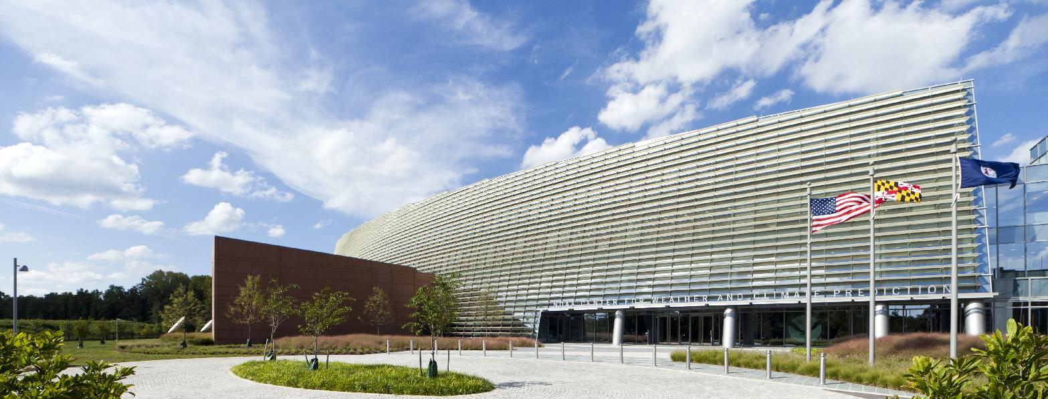
2016 Users’ Workshop
Welcome to the GSICS Users’ WORKSHOP 2016 at
NOAA NCWCP, College Park, MD USA
as part of the JPSS Annual Science Team Meeting 8-12 Aug 2016
환영합니다
Bienvenue
Willkommen
Web site for last year’s meeting including the agenda and presentations
http://www.star.nesdis.noaa.gov/star/meeting_2015JPSSAnnual.php

Slide 4
Users’ Workshop Agenda Open to Suggestions
Some of the usual ideas
User experiences
Identify/review user requirements (NRT, Climate, IR, MW, Vis, UV)
Update of survey results
Current products
Planned products
New types of products
Possible unusual ideas
Developers as users
Level 2 product requirements

