Slide 1
Outcomes of 2016 GRWG Meeting JAXA, Tsukuba, Japan Tim Hewison on behalf of Dohyeong Kim
Special Issue of the IEEE TGRS on “Inter-Calibration of Satellite Instruments”:
Special Issue of the IEEE TGRS on “Inter-Calibration of Satellite Instruments”:

Slide 2
Overview
GRWG Chairing
Deliverables
Update Strategy
IR
GEO-LEO IR products
“Prime” Corrections
Hyperspectral comparisons
GEO-ring demonstration dataset
VIS/NIR
Deep Convective Cloud inter-calibration for GEO VIS }
Lunar inter-calibration for all VIS/NIR channnels } ^{}- Merge!}
Lunar irradiance/radiance modelling
Challenges

Slide 3
GRWG Chairing
GSICS Research Working Group
Chair: Dohyeong Kim
Vice-Chair: Tim Hewison
Vice-Chair: Scott Hu
UV Sub-Group
Chair: Rose Munro
IR Sub-Group
Chair: Tim Hewison
VIS/NIR Sub-Group
Chair: Dave Doelling
Microwave Sub-Group
Chair: Ralph Ferraro

Slide 4
Definition of GSICS Deliverables
GSICS Products for users of satellite data, including calibration corrections/coefficients
GSICS Algorithms, which describe inter-calibration processes, (described by ATBD)
GSICS Monitoring Reports, assessments
GSICS Reference datasets, including Solar spectrum, …
GSICS Tools for use by inter-calibration developers, (GIRO, SBAF, …)
GSICS recommended standards, conventions and guidelines,
GSICS User Services, information
Pro- ducts corrections
Intercalib. Algorithms
Monitoring assessmentreports
Calibration datasets
Software and hardware tools
Standards, conventions,
Calibration references

Slide 5
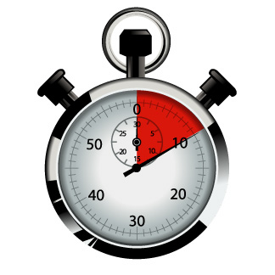
Routine Generation of GSICS Products
Decision: GSICS should aim to provide users with the most recent available calibration data
at the highest available update frequency,
allow users to decide how to apply it for their applications.
For example:
Considering calibration changes driven by long-term drift:
Users interested in long-term trends may want to apply frequent updates to the calibration corrections (expected to be smaller) to avoid large, artificial jumps in the calibration time series,
Users interested in near real-time applications may want to apply the updates less frequently (e.g. only when it exceeds a certain threshold) to avoid additional calibration noise.

Slide 6
Challenges - References
Multiple References
Merging or Single
Handling Transitions
Traceability
CLARREO/TRUTHS
The Moon
The Sun
10:35 | Manik Bali | NOAA | Selecting GSICS References: IR and MW | 3e
11:05 | Tim Hewison | GRWG | Primary GSICS or Key Comparison References? | 3f
17:05 | Denis Jouglet (Remote) | CNES | Hyperspectral IR comparisons - including TANSO-FTS/2 | 3p
17:25 | Likun Wang | NOAA | IR Reference Sensor Traceability and Uncertainty | 3q
16:30 | Discussion | All (+XX?) | Discussion: Migration of reference instrument | 4s
18:05 | Tim Hewison/Tobin | EUMETSAT | CLARREO preparations | 3s
9:00 | Aisheng Wu | NASA | MODIS calibration summary presentation | 4a
9:20 | Jack Xiong | NASA | VIIRS calibration summary presentation | 4b
10:30 | Tom Stone | USGS | ROLO developments & schedule | 4d
10:50 | Arata Okuyama | JMA | Application of GIRO to NIR bands | 4e
11:10 | Sebastien Wagner | EUMETSAT | Status of GIRO policy, infrastructure & inter-cal study | 4f
11:30 | Discussion | All | Way forward on lunar inter-calibration | 4g
11:50 | Fred Wu/Fangfang Yu | NOAA | Lunar surface target selections & auto-mapping | 4h
11:50 | Fred Wu/Fangfang Yu | NOAA | Lunar surface target selections & auto-mapping | 4h
16:50 | Larry Flynn | UVSG | Reference Solar Irradiance Spectra | 4t

Slide 7
Challenges - Expansion
New Instruments
New Channels (GEO NIR)
Sounders
Hyperspectral
High-Resolution
New Sub-Groups
Coordinate with CEOS
10:50 | Arata Okuyama | JMA | Application of GIRO to NIR bands | 4e
17:05 | Denis Jouglet (Remote) | CNES | Hyperspectral IR comparisons - including TANSO-FTS/2 | 3p
13:20 | Seongick Cho | KIOST | Operation and Calibration of GOCI | 1j
13:40 | Hiroshi Murakami | JAXA | Himawari-8 Ocean Color and Aerosol | 1k
14:00 | Yukio Kurihara | JAXA | Himawari-8 SST | 1l
14:20 | Hiroshi Murakami | JAXA | Calibration activities of GCOM-C/SGLI | 1m
14:40 | Kei Shiomi | JAXA | Calibration activities of GOSAT & GOSAT-2 | 1n
15:30 | Takeo Tadono | JAXA | Calibration activities of ALOS/AVNIR2 PRISM | 1o
15:50 | Takeshi Motooka | JAXA | Calibration activities of ALOS-2/PALSAR | 1p
16:10 | Takeshi Masaki | JAXA | Calibration activities of TRMM & GPM Radars | 1q
16:30 | Marehito Kasahara | JAXA | Calibration activities of GCOM-W/AMSR2 | 1r
16:50 | Ralph Ferraro | NOAA | Intercalibration on ATMS and SAPHIR | 1s
17:10 | Shengli Wu (Remote) | CMA | Intercalibration on the FY3/MWRI | 1t
17:30 | Takashi Maeda | JAXA | Intercalibration of AMSR2 and PMWs | 1u

Slide 8
GRWG Coordination
GSICS Exec Panel
GSICS Coordination Center
GSICS Research Working Group
GSICS Data Working Group
UV Sub-Group
IR Sub-Group
WGCV IVOS
WGCV MWSG
GPM X-CAL
CEOS ACC
WGCV ACSG
VIS/NIR Sub-Group
Microwave Sub-Group

Slide 9
Challenges - Consistency
Between Algorithms
Merging Results
DCC/lunar
Spectral
Formats
Focus on Users
15:50 | Bertrand Fougnie | CNES | Combining Methods | 4q
17:10 | Discussion | All (+BF+FY) | Discussion: Next method - Rayleigh v Ray-matching | 4u

Slide 10
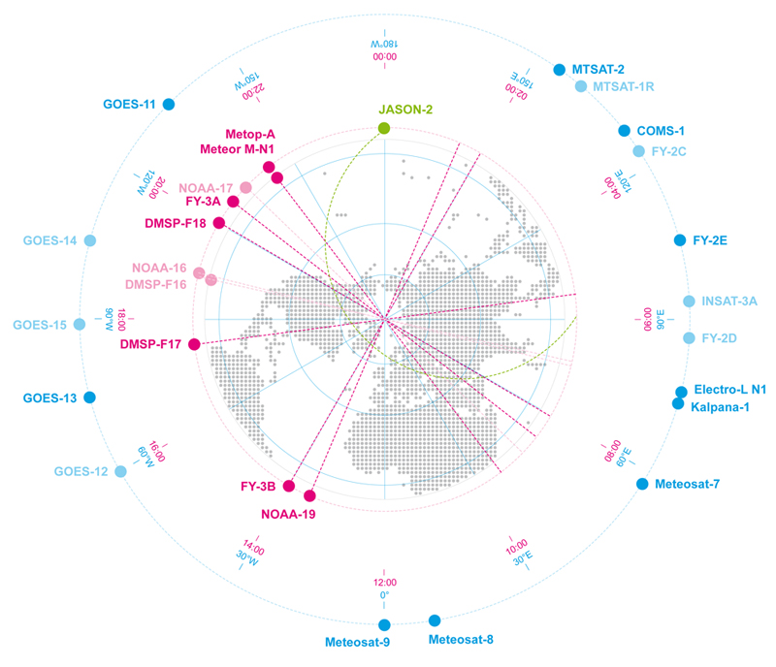
Linking the GEO ring
Comparing GEO-LEO and GEO-GEO Differences
To Validate Uncertainty estimates
Ensure consistency
Generate global L2 products
Ensure consistency

Slide 11
GSICS GEO-LEO IR Product Status 2016-02
GPRC | Monitored Instrument | Reference Instrument | GSICS NRT Correction | GSICS Re-Analysis Correction | GSICS Bias Monitoring
EUMETSAT | Meteosat-8 – 11 } Meteosat-7 | Metop-A/IASI | Operational Demo | Operational Demo | Plots RAC*
JMA | MTSAT-1R } MTSAT-2 } | IASI (+ AIRS) | Demo | Demo | Plots RAC
NOAA | GOES-13 & -15 Imager GOES-11 & -12 Imager | IASI (+ AIRS) | Pre-op | Pre-op Demo | Prototype
 | GOES Sounder | IASI (+ AIRS) | Development | Development | In development
CMA | FY2C – E | IASI (+ AIRS) | Development | Development | Prototype
KMA | COMS-1 | IASI | Prototype | Prototype
ISRO | INSAT-3D | IASI | Prototype | Prototype
Full GSICS Product Catalog available at http://www.star.nesdis.noaa.gov/smcd/GCC/ProductCatalog.php

Slide 12
IR Product Development within GSICS
GEO-LEO IR hyperspectral
Progress existing products to Operational Status
Promote new products to Demonstration Status
Application of Prime GSICS Correction concept
To merge multiple reference instruments
To allow corrections to cover diurnal cycle
Other Agencies’ plans for Prime GSICS Corrections?
Wednesday afternoon
13:05 | Xu Na (Remote) | CMA | GEO-LEO IR Progress at CMA | 3i
13:20 | Munn V. Shukla (Remote) | ISRO | GEO-LEO IR Progress at ISRO | 3j
13:35 | Arata Okuyama | JMA | GEO-LEO IR Progress at JMA | 3k
13:50 | Dohyeong Kim? | KMA | GEO-LEO IR Progress at KMA | 3l
14:05 | Yuanzheng "Jordan" Yao | NOAA | GEO-LEO IR Progress at NOAA | 3m
11:25 | Tim Hewison | GRWG | Do we need to generate Prime GSICS NRTCs? | 3g
16:20 | Fangfang Yu? | NOAA | Handling Diurnal Cycle in GEO-LEO IR | 3n

Slide 13
New IR Product Development within GSICS
Scope potential new GSICS products/deliverables
Alternative inter-calibration algorithms
Retrieved SRFs
GEO-GEO inter-calibration (part of GEO-ring)
LEO-LEO inter-calibration
Traceability of Reference Instruments
Plans for TANSO-FTS/2 & CLARREO
Wednesday morning & afternoon
16:35 | Arata Okuyama | JMA | v2 of GEO-LEO IR - alternative ATBDs | 3o
17:45 | Manik Bali | NOAA | SRF Retrievals | 3r
9:00 | Tim Hewison | GRWG | GEO-Ring Test Dataset | 3a
9:15 | Rob Roebeling | EUMETSAT | Discussion: GEO-Ring dataset preparation | 3b
9:30 | Discussion | All | Discussion: GEO-Ring dataset analysis | 3c
18:25 | Aisheng Wu | NASA | Development of LEO-LEO IR Products | 3t
11:45 | Rose Munro | EUMETSAT | Plans for AVHRR inter-calibration | 3h
17:05 | Denis Jouglet (Remote) | CNES | Hyperspectral IR comparisons - including TANSO-FTS/2 | 3p
17:25 | Likun Wang | NOAA | IR Reference Sensor Traceability and Uncertainty | 3q
18:05 | Tim Hewison/Tobin | EUMETSAT | CLARREO preparations | 3s

Slide 14
Outcomes
Sub-Group | Topic | #Actions | #Recommendations | #Decisions
GRWG | Handover Chair | 1
 | GEO-ring Demo | 2 |  | 2
GRWG+GDWG | User Requirements | 6
IR | GEO-LEO IR | 4 | 6
 | “Prime” Corrections | 1
 | LEO-LEO IR (broadband) |  | 4 | 1
 | LEO-LEO IR Hyperspectral | 6 |  | 1
 | SRF Retrievals | 1 | 3
VIS/NIR | DCC | 5
 | Lunar inter-cal | 3 | 1
 | Lunar irradiance | 3 | 1
 | Lunar radiance | 1 | 2

Slide 15
Presentations and Minutes
Presentations are all on Wiki:
https://gsics.nesdis.noaa.gov/wiki/Development/20160229
Draft minutes are available on Wiki
Currently under final review – so check them now!
In Google Drive
And exported to MS Word 2016-04-06

Slide 16
Thank You!

