Slide 1
How good is IASI-A as an in-orbit reference in GSICS in LWIR and IR
Manik Bali and Larry Flynn
GSICS Coordination Center, NOAA
8 Sept 2016

Slide 2
Outline
Introduction
Trustworthiness Matrix ( Ref Selection Matrix) ->Accepted by FIDUCEO
Inter- Comparison Results
Recommendations
Conclusion
Citation: Bali, M., Mittaz, J. P., Maturi, E., and Goldberg, M. D.: Comparisons of IASI-A and AATSR measurements of top-of-atmosphere radiance over an extended period, Atmos. Meas. Tech., 9, 3325-3336, doi:10.5194/amt-9-3325-2016, 2016.
Part of the paper were cited by the FIDUCEO report
http://www.fiduceo.eu/sites/default/files/deliverables/D6.4_v1.pdf

Slide 3
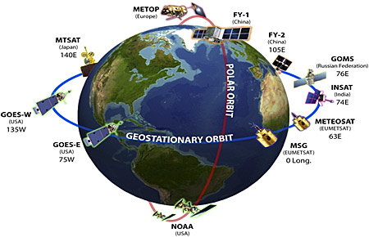
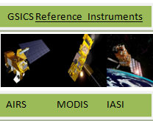
GSICS Introduction
Global Space Based Inter-calibration System (GSICS) is an international collaborative effort initiated in 2005 by WMO and the CGMS to monitor, improve and harmonize the quality of observations from operational weather and environmental satellites of the Global Observing System (GOS)
Big Questions the paper addresses
How trustworthy are they ( IASI-A AIRS) ?
How do we pick a reference ?
Inter- comparisons with reference instrument should aid in re-calibrating monitored instrument -> reveal trends, temporal and temperature dependent biases.
Notes:
To meet accuracy and stability requirements of satellite measurements
There is a critical need to perform in-orbit satellite inter-comparison to monitor instrument

Slide 4
Trustworthiness Matrix ( Ref. Selection Matrix)
Inter-compare IASI-A/AIRS with instruments of better stated accuracy and evaluate .
Scan Angle Bias
Temperature Dependent Bias
Long term trends
Arrive at a set of recommendations when the instruments are most trustworthy as a reference.
IASI-A *
AIRS**
ATSR -2
AATSR
Radiometric Accuracy
*~better than 0.5 K ( Illingworth et al 2009, ACP)
**~ better than 0.2 K (Chahine et al 2011, BAMS)
Designed for Climate applications
Expected ~better than 0.1K and stability better than 0.01K
Matrix accepted and used by FIDUCEO

Slide 5
Method- GSICS Style SNO Method
GSICS Style SNO Collocations were generated
THRESHOLDS
Standard Deviation of Collocated Pixels | < 0.5 K
Standard Deviation of Perimeter pixels | < 1 K
Time Difference | < 15 Mins
Time Span | 2008/01-2011/03
Percentage of area of IASI pixel collocated with AATSR pixels | 70%
Sat Zenith Angle difference | 1º
5 Pixels
Collocation | Period of collocation | Number of Collocations | Number of qualifying Collocations used in this study
AATSR Vs IASI –A | 1Jan2008- 31 Mar2011 | 10,047,594 | 1,447,030
ATSR-2 Vs AIRS | 1Sep2002 – 30Nov2002 | 767, 354 | 23, 305

Slide 6
Inter- Comparison Results
Scan Angle
Scan angle dependence of the AATSR–IASI bias for cold (200–220 K) and SST (265– 300 K) temperature ranges. Neither AATSR nor IASI show any scan angle dependence in the −20 to +20◦ scan angle range.
Inter - comparisons with IASI-A can reveal scan angle dependence of monitored instruments in the IR

Slide 7
Inter- Comparison Results
Temperature
Temperature dependence of AATSR–IASI-A (in grey) bias over the period of 39 months.
Blue curve is also the same temperature dependence with an offset of 0.11 K (i.e. post launch) subtracted from it. This blue curve is similar to pre-launch (Smith et al., 2012) characteristics of AATSR to within hundredth of Kelvin.
IASI-A is nearly as good a pre-launch reference with an offset of 0.11K. Radiometric performance better
than specs and previously thought.

Slide 8
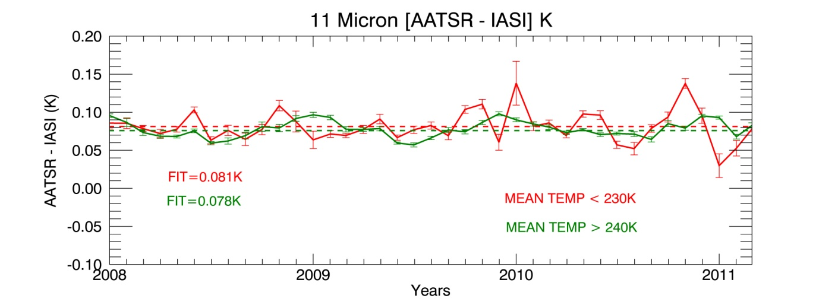
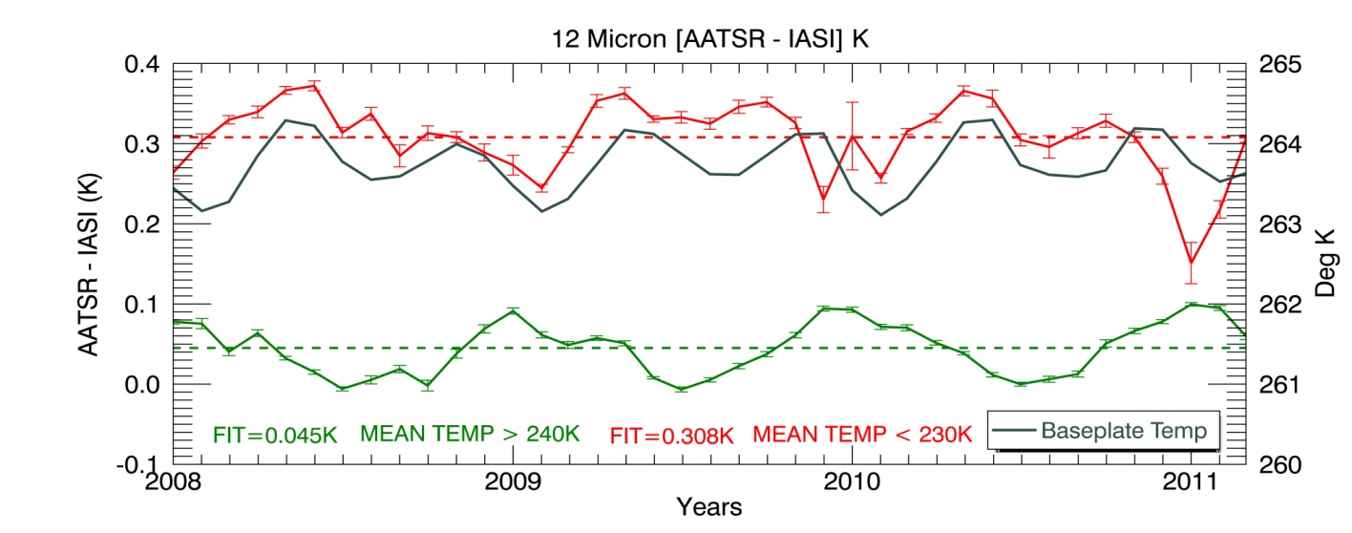
Inter- Comparison Results
Long Term Monitoring
Time series of variation of AATSR IASI bias for 11 and 12 µm channels in the cold (red) and warm (green) temperature ranges. The bias at cold temperature in 12 µm is correlated (ρ=0.78) with the instrument baseplate temperature (grey curve in the lower plot).
Impact pf ENVISAT Orbital Changes
IASI-A measurements maintain stability w.r.t AATSR over 3 yrs of study

Slide 9
Inter- Comparison Results
Spectral Dependence
IASI- A Vs AIRS of -0.042 K (± 0.05 K) and - 0.093K (± 0.05K) for 11 and 12 µm for cold .
IASI- A Vs AIRS . For warm (more than 260 K) temperature bias is -0.029K (± 0.01K)
and -0.043K (± 0.01K) for 11 and 12 µm channels.
3. AIRS Vs ATSR-2 -0.015 K (±0.001K) in 11 µm and -0.011 (±0.004K) 12 µm channel
IASI-A has a small spectral dependence of bias

Slide 10
Recommendations
GSICS goals go beyond to routine daily monitoring-> Root Cause analysis -> Recalibration
Instruments that ensure highly stable and accurate measurements can be considered as a reference. For IR, Climate purpose measurements ( stability better than 0.01/Dec and accuracy better than 0.1K ) could be treated as a reference.
Pre-launch behavior of the instrument can act as a key reference. It can be used to validate in-orbit inter- comparisons between monitored and reference instrument. Close similarity can demonstrate robustness of the inter-comparing instruments.
Quality of measurements of reference instruments can vary in space and time. Hence instruments need to be evaluated for
Scan Angle
Temporal
Temperature
Spectral Biases
Instrument health needs to be monitored

Slide 11
Conclusions
Stability and accuracy of IASI-A has been evaluated using GSICS style inter- comparisons of IASI-A and AATSR spanning 39 Months of data.
Results indicate that IASI-A has performed robust stable measurements during the period of study and provided pre-launch level of accuracy with an +0.11K offset.
IASI-A has very small scan angle dependence
IASI-A nearly pre-launch level of reference radiances ( +.07K)
IASI-A has a very small spectral dependence.
Overall IASI-A has been an in-orbit excellent reference for GSICS monitoring and can compliment

Slide 12
THANK YOU

