Slide 1
NOAA VIIRS Team GIRO Implementation
8/30/2016
Taeyoung (Jason) Choi, Xi Shao, Changyong Cao, Fuzhong Weng
For Lunar Calibration Web Meeting

Slide 2
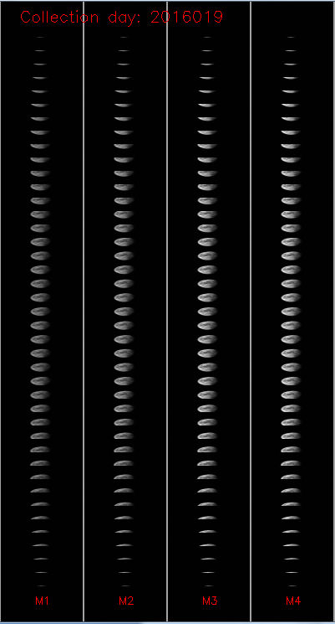
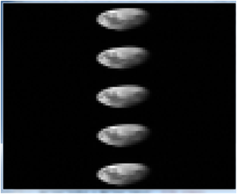
Scheduled Lunar Collections
Moon observation made through the Space View (SV) as shown in Figure 1.
During the sector rotation, the VIIRS observations are set to be fixed High Gain (HG) mode.
Spacecraft roll maneuvers are required.
To avoid the complex oversampling factor calculation,
Center 5 scans with full moon in the entire scan are used.
Figure 1. Scheduled lunar collection example image on Jan. 19th, 2016.

Slide 3
Scheduled Lunar Collections
Table 1. Lunar phase angles are very consistent.
Date | Phase Angle | Date | Phase Angle
4/2/2012 | -51.24 | 4/10/2014 | -50.6
5/2/2012 | -50.92 | 5/10/2014 | -50.91
10/25/2012 | -51.01 | 6/9/2014 | -51.04
11/23/2012 | -50.73 | 10/4/2014 | -50.8
12/23/2012 | -50.9 | 11/3/2014 | -50.52
2/21/2013 | -50.71 | 12/31/2014 | -50.73
3/23/2013 | -51.15 | 1/30/2015 | -51.16
4/21/2013 | -50.82 | 3/30/2015 | -51.29
10/14/2013 | -50.94 | 4/29/2015 | -50.43
11/13/2013 | -50.66 | 5/29/2015 | -51.07
12/12/2013 | -50.39 | 6/27/2015 | -54.42
1/11/2014 | -51.3 | 11/22/2015 | -50.76
2/10/2014 | -51.03 | 12/21/2015 | -50.3
3/12/2014 | -51.05

Slide 4
VIIRS Lunar Calibration
Lunar F-factor is calculated as a secondary calibration coefficient.
Primary source of calibration is the Solar Diffuser (SD).
The lunar F-factor is calculated as a ratio between the GIRO lunar irradiance and observed lunar irradiance.
I_{GIRO} : band dependent lunar irradiance value from the the Global Space-based Inter-Calibration System (GSICS) Implementation of RObotic lunar observatory (GIRO v1.0.0) model (at https://gsics.nesdis.noaa.gov/wiki/Development/LunarWorkArea ), φ: moon phase angle, L_{Avg}: averaged radiance of the effective lunar pixels, R_{moon}: moon radius, Dist_{Sat_Moon}: distance between satellite and moon

Slide 5
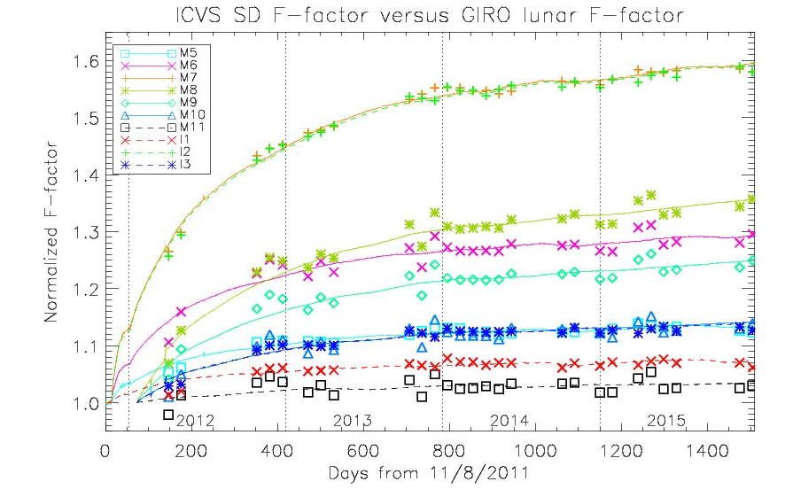
SD and Lunar F-factor comparisons
The two F-factors need to be normalized (or scaled) properly because of the different solar irradiance models.
The SD F-factors (solid lines) are normalized
The best fitting scaling factors are calculated and applied for lunar F-factors (symbols).

Slide 6
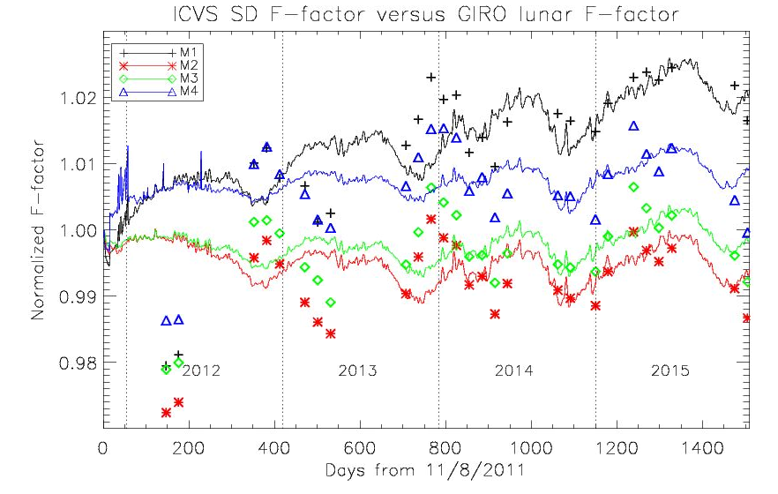
SD and Lunar F-factor comparisons
The oscillation patterns in M1~M4 were out of synchronization in 2012 to mid 2014.
Lunar and SD F-factors are showing similar annual trends in starting from mid 2014.

Slide 7
SD and Lunar F-factor comparisons
The one-sigma standard deviation (STD) values between SD and lunar F-factors are also shown in Table 2.
The SD F-factors are interpolated at the lunar collection time.
The short wavelength bands (M1~M4) are well within one percent level.
Other bands show excellent agreements less than 2 percent level.
Table 2. One-sigma STD of the differences between the SD and lunar F-factors.
Band | STD | Band | STD
M1 | 0.91 | M8 | 1.71
M2 | 0.84 | M9 | 1.60
M3 | 0.72 | M10 | 1.47
M4 | 0.74 | M11 | 1.34
M5 | 0.71 | I1 | 0.76
M6 | 1.67 | I2 | 0.91
M7 | 0.88 | M3 | 0.74

Slide 8
Summary
NOAA VIIRS team successfully implemented GIRO to monitor primary SD calibration.
The two independent calibration coefficients from SD and moon are calculated and compared for S-NPP VIIRS RSB.
The SD and lunar F-factors show possible long-term differences especially in the short wavelength bands from M1 to M4.
However, the 1-σ STD of the SD and lunar F-factors < 2% in all bands.
The SD F-factor correction using lunar trending needs more evidences.
Such as DCC, pseudo invariant Cal. site trending, SNO x-calibration, etc.
The moon is a very important source of independent radiometric calibration for any on-orbit imaging sensor in the visible and near inferred bands.

