Slide 1
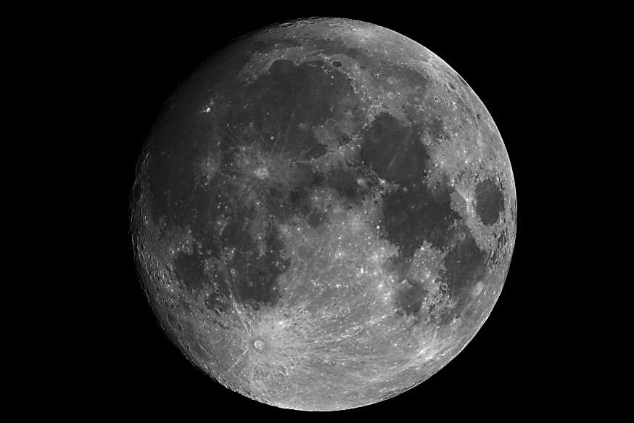
Revising the ROLO Lunar Model — A Status Update
Thomas C. Stone
U.S. Geological Survey, Flagstaff, AZ USA
GSICS webmeeting
30 August 2016

Slide 2
To produce a new lunar irradiance model using data existing today requires the following steps, in sequence:
Reprocessing the ROLO lunar image dataset (model basis data)
ROLO is still the most extensive collection of lunar measurements
involves revising the telescope data reduction routines for image processing to irradiance measurements
routines for evaluating background and edge spread effects
data quality checks: comparison against the current lunar model
Reformulating the lunar disk reflectance model
e.g. implement band-dependent libration terms
Fitting the irradiance dataset — obtaining model coefficients
develop and implement fit constraints derived from external data, e.g. PLEIADES, SNPP-VIIRS
iterate with (2) above
Testing the new model
reprocess existing lunar measurement datasets and compare results
do we still see a phase angle dependence for e.g. MSG series?

Slide 3
Next efforts at USGS:
revising the ROLO data reduction system
i.e. Step 1 of the sequence
assessing uncertainties in the existing ROLO model
essential for ground-based aerosol measurements at night using moonphotometers
geometric specification — irradiance changes with phase and libration
spectral specification of the lunar reflectance (and solar irradiance)
Future efforts: redeveloping the lunar calibration reference
requires new, high-accuracy basis dataset(s)
NIST ground-based lunar irradiance measurement project
Stephen Maxwell has taken over from Claire Cramer
NASA-Langley cubesat mission — ARCSTONE
prototype instrument designed and built by Resonon, tested at NIST
instrument EDU is under development
proposal submitted to NASA Instrument Incubator Program → TRL 5

