Slide 1
The SCIAMACHY Solar Spectrum
GSICS/CEOS: Reference Solar Spectrum
01 Dec 2016
Klaus Bramstedt, Tina Hilbig, Mark Weber, Matthijs Krijger², Ralph Snel²
Institute of Environmental Physics, University of Bremen
² SRON Netherlands Instit. for Space Research, Utrecht, the Netherlands

Slide 2
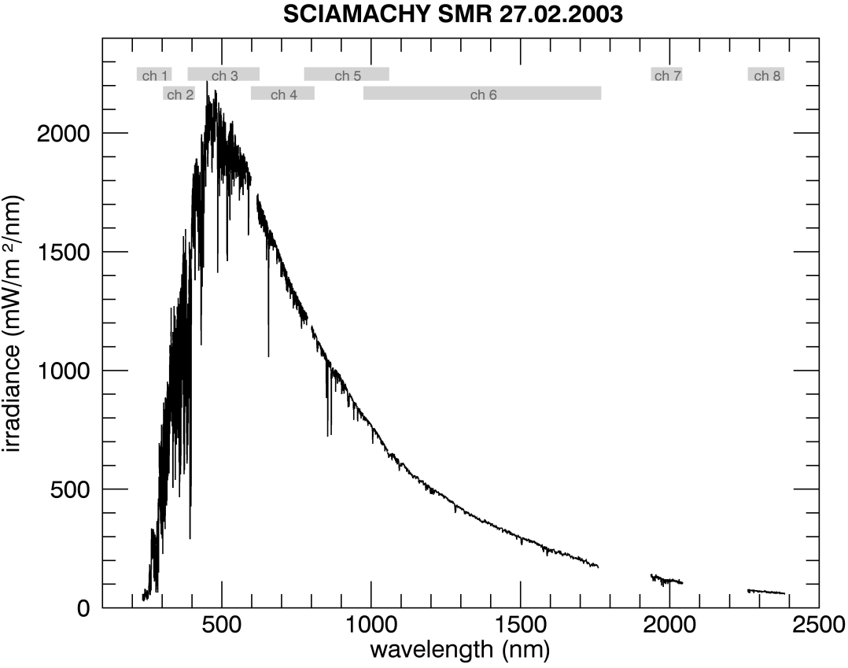
SCIAMACHY
SCIAMACHY - Scanning Imaging Absorption spectroMeter for Atmospheric CHartographY - aboard ESA’s ENVISAT satellite platform
daily sun observations
2002 - 2012
wavelength range 212 nm to 2380 nm
spectral resolution of 0,2 to 1,5 nm
Challenges:
changes from pre-launch to in-orbit (Pagaran et al., 2011)
UV radiation damage (deposits of comtaminants on optical surfaces)/Icing
instrument and platform anomalies
Notes:
SCIAMACHY - Scanning Imaging Absorption spectroMeter for Atmospheric CHartographY
aboard ESA’s ENVISAT satellite platform
2002 – 2012
designed to measure the radiance backscattered from the Earth and hence determine total columns and vertical profiles of atmospheric trace gas species
daily sun observations
wavelength range 212 nm to 2380 nm
spectral resolution of 0,2 to 1,5 nm

Slide 3
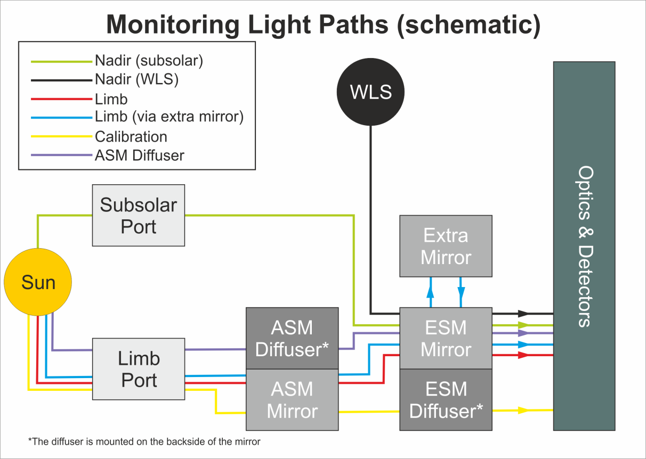
SCIAMACHY solar measurements
SCIAMACHY solar spectra:
ESM diffuser (radiom. calibrated)
ASM diffuser
Sub-solar / Solar occulation
Extra-mirror measurement
ESM diffuser is the only radiometrically calibrated solar spectrum
Degradation of optical components needs to be determined over lifetime
Solar measurements for each light path monitor end-to-end degradation.
ESM diffuser

Slide 4
New degradation correction scheme (V8 and later)
Scanner unit (mirrors and diffusers) are described by a physical model (Fresnel equations). (Krijger et al 2014, AMT)
Scan angle dependent radiometric calibration!
Degradation:
(growing) contamination layers on mirrors/diffuser
Degradation of Optical Bench Modul (OBM, including detectors)
L1b Version 9 (exp. 2017):
Bug fixes.
New fitting scheme for contamination thicknesses and OBM degradation.
On-ground to Inflight correction (WLS).

Slide 5
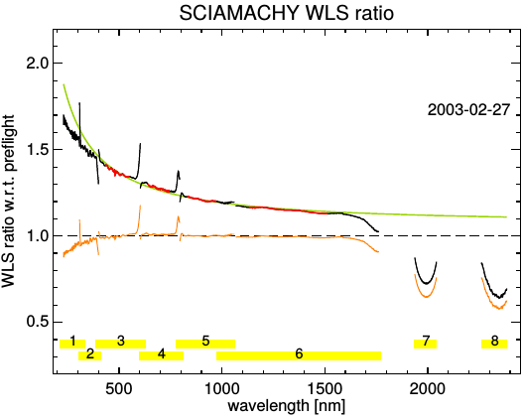
On-ground to In-flight Correction
Idea: Track on-ground to in-flight change with internal WLS!
Ratio of WLS in-flight and WLS on-ground is composed of:
WLS zero-gravity change
T change
Change of Planck-curve, fit from WLS-ratio
Instrumental change
Plot:
WLS ration on-ground/inflight
fit range
ratio fitted Planck curves
ratio measured (black) to modeled (green) WLS ratio → Instrumental change!

Slide 6
On-ground to In-flight Correction
Improvements due to new on-ground to in-flight correction:
channel boundaries
icing effect in channel 7 and 8
IR channels 7/8 are cooled
varying ice layer rapidly changed throughput
influence of temperature changes (e.g. channel 6+)
radiometric calibration in channel (1), 2 and 3

Slide 7
SCIAMACHY solar reference spectrum
New solar reference spectrum
Date: 27. Feb. 2003
Early in mission: no (severe) degradation
Instrument in final flight state!
In Feb. 2003, detector temperatures were adjusted to state during calibration campaign
Reference date for degradation correction:
Monitoring measurements failed in 2002
2002 interrupted by commissioning phase tasks.

Slide 8
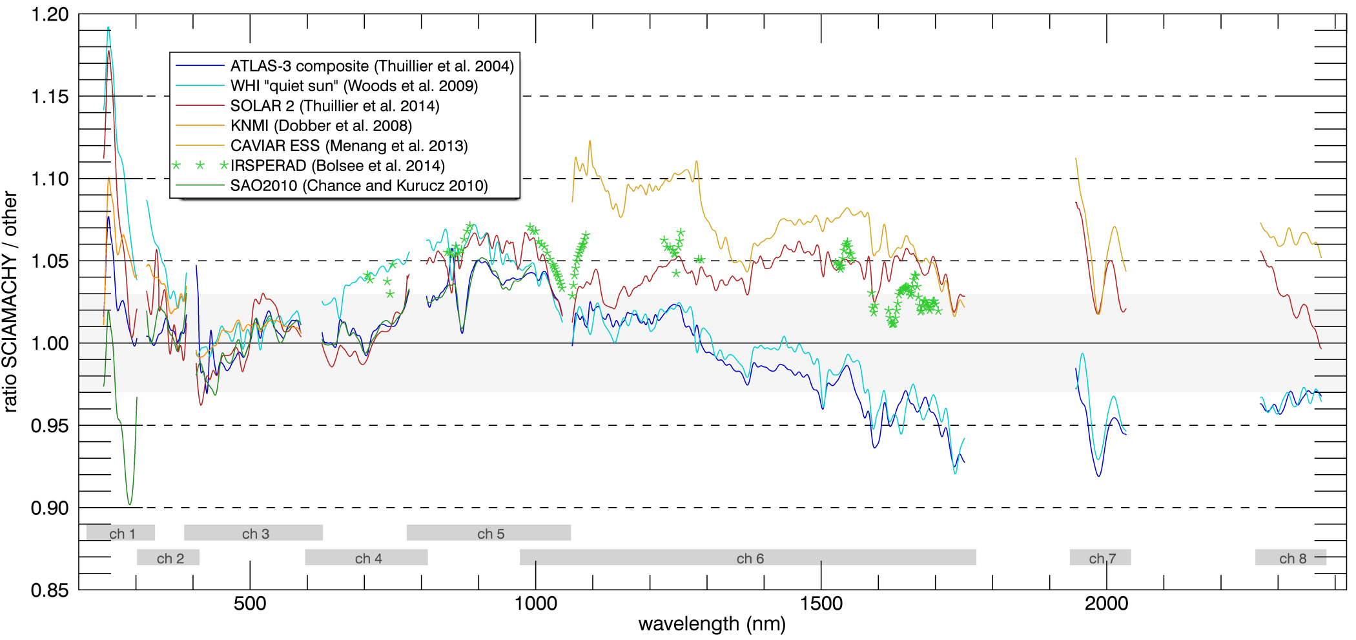
Comparison with Solar Reference Spectra
<300 nm : larger variations
300 – 800 nm : mostly within 3%
800 – 1000nm : SCIA 4-5% higher
NIR : up to 5% lower than ATLAS/SIM
first time reasonable results ch. 7 / ch. 8

Slide 9
Summary and Outlook
SCIAMACHY provides 10 years of daily SSI
(UV-vis-NIR-SWIR)
Revised radiometric calibration (physical model of scanner unit)
Reference spectrum (27. Feb 2003) compared with other SSI
Further work:
Consolidate new calibration
Time series of SCIAMACHY SSI
Extend to GOME / GOME-2
Acknowledgement: Funded by BMBF (SCIASOL-ROMIC), ESA (SQWG, SCILOV 10), State and University of Bremen

