Slide 1
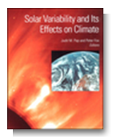
Reference Solar Irradiance Spectrum
- Previous CEOS WGCV IVOS
Discussions
Nigel Fox – representing IVOS team
AGU monograph 2003/4
WGCV IVOS

Slide 2
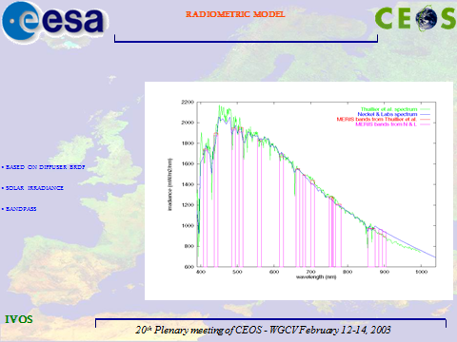
Background
From an IVOS perspective - Exo-atmospheric
Solar spectral irradiance key parameter to link
Earth Viewed radiances and reflectances
(TOA and BOA)
- Band averaging, RT codes etc
- Spectral range (largely) ~400 – 2400 nm
- linkage and comparison of products from
different sensors will depend on choice &
method of use of solar irradiance spectrum
- 2003 CEOS plenary adopted a resolution
from WGCV to encourage agencies to use
a common spectrum (based on a composite from Thuillier et al paper) or as a
minimum to make clear what has, and how it has, been used.
- However, whilst significant agency uptake – not universal & is it still appropriate??
E.G. Impact on Sentinel 2

Slide 3
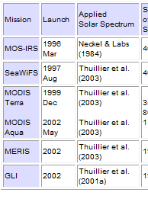
Discussion webex and conclusions (Oct 2013)
1 hr fixed time webex
18+ attendees (inc commercial) No US Gov due to shut down.
From inputs: Pre- & during meeting
~ 75% used CEOS recommended Thuillier
IOCCG formally recommend/encourage use of
CEOS spectrum
Kurucz used were high resolution is reqd e.g. FT spectrom
also when integrated into other software packages (Modtran
Neckels and Labs also used (in 6S)
ISRO provides products utilising both Neck/Lab & Thuillier
Eumetsat keen for spectrum to ~5 um most content 2.5 um
380 nm enough for most IVOS but not Atmos Chem??
Agreed there is value in a common spectrum but difficult to
achieve for all applications particularly non Land/Ocean
but should aim for:
a few well defined spectra with accessible data via cal/val portal
a ‘best practise for use/convolution with sensor/application characteristics
Note that for Atmos Chem there is significant solar irradiance variability in UV
Not as big an issue for Vis/SWIR
Thuillier also created a high resolution spectrum
e.g. from IOCCG

Slide 4
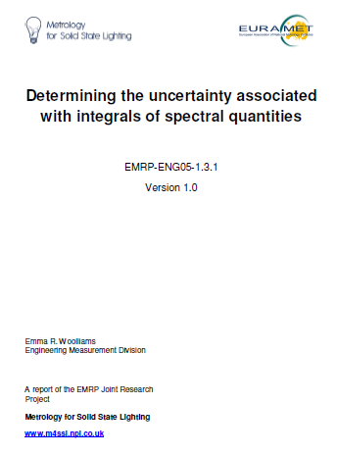
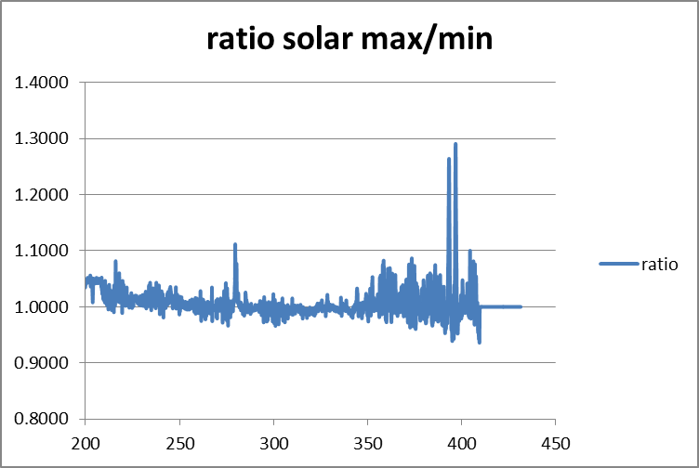
Solar spectra
Burlov & Vailjev
Ratio to Thuillier (2004)
Neckels & Labs
http://Tinyurl.com/NPLIntegrals
For UV solar
max and solar min spectra?

Slide 5
Next Steps:
Increase scope/community dialogue and range of potential applications if CEOS/GSICS recommended spectra
Is there merit and desire for a single continuous ref SSI for all applications?
What spectral resolution is needed? Real spectrum in observation space or fixed spectral intervals?
Should there be one for UV at all?
Do we need to also agree on method for convolving SSI with instrument and potentially reflectance from other surfaces?
Access to spectra

