Slide 1
Solar Ultraviolet Spectra Project Summary for 2016/12/01 Meeting
L. Flynn (NOAA), M. Deland (SSAI – NASA), R. Lang (EUMETSAT), J. Niu (SRG NOAA), C. Pan, C. Seftor (SSAI – NASA) and M. Bali (ESSIC UMD)
and many others

Slide 2
Outline
Project Summary / Objectives
Review of reference spectra resources
Representing variations with solar activity
Examples

Slide 3
GSICS UV Projects
I. Comparisons of Solar Spectra
II. Comparisons of Initial Measurement Residuals for Ozone Profile Channels
III. Comparisons of Effective Reflectivity and Aerosol Indices
IV. Match-up comparisons
V. Laboratory best practices and key data sets

Slide 4
I. Solar Spectra Project
The purpose of the is project is to compare solar measurements from BUV (Backscatter Ultraviolet) instruments.
The first step is to catalog high spectral resolution solar reference spectra and agree on a common one to use for the project.
For each instrument, participants should provide the following datasets:
Solar measurement for some date (wavelength scale, irradiance)
Wavelength scale and bandpass (Δλ, # of points, bandpass centers, normalized bandpass weights)
Synthetic spectrum from common reference (wavelength scale, irradiance)
Synthetic for wavelength scale perturbations (±0.01 nm) from common reference (wavelength scale, irradiance)
Synthetic from alternative reference spectra (wavelength scale, irradiance)
Solar activity pattern (wavelength, relative change)
Mg II index (if 280 nm is covered) Mg II 279.6 Mg I 285.2 (date, index)
Ca H/K index (if 391 nm to 399 nm is covered) CA II 393.4 and 396.8.
Goals:
Agreement at 1% on solar spectra relative to bandpass-convolved high resolution spectra as a transfer after identifying wavelength shifts and accounting for solar activity
Long-term solar spectra drift and instrument degradation by using OMI solar activity pattern (with internal confirmation from Mg II Indices and scale factors)

Slide 5
Reference Spectra - Comments
No single instrument measures all spectral regions of interest (X-ray, UV, visible, IR) simultaneously. Thus, any “reference” spectrum is likely to be a composite of measurements from multiple instruments, using different bandpasses, probably taken at different times.
Some reference spectra are constructed using measurements from one data set, but adjusted radiometrically through comparisons with another data set.
Differences in spectral resolution are particularly important in the UV, where many Fraunhofer lines occur. The definition of “high” resolution can depend on the requirements of the user.
Frequent sampling present in the data set may not indicate high spectral resolution. Check the background story before using the data.
From a Talk by Matthew DeLand NASA/GSFC/SSAI
Notes:
From a Talk by Matthew DeLand NASA/GSFC/SSAI
Science Systems and Applications, Inc. (SSAI) Lanham, Maryland USA
GRWG Meeting – UV Subgroup Darmstadt, GERMANY 27 March 2014

Slide 6
Four Reference Spectra
KNMI [Dobber et al., 2008].
Covers 250-550 nm.
Hall and Anderson [1991] for 200-310 nm, Kurucz et al. [1984] for 310-550 nm.
Original data have very high resolution (Δλ = 0.025, 0.005 nm).
Convolve with 0.025 nm bandpass, sample at 0.01 nm.
Adjust radiometric calibration to match lower resolution reference spectrum (average of UARS SUSIM data).
SAO [Chance and Kurucz, 2010].
– Covers 200-1001 nm.
Hall and Anderson [1991] for 200-310 nm, Kurucz et al. [1984] for 310-1001 nm.
Convolve with 0.04 nm bandpass, sample at 0.01 nm.
Adjust radiometric calibration to match lower resolution reference spectrum (Thuillier et al.).
From a Talk by Matthew DeLand NASA/GSFC/SSAI
Notes:
Matthew DeLand
Science Systems and Applications, Inc. (SSAI) Lanham, Maryland USA
GRWG Meeting – UV Subgroup Darmstadt, GERMANY 27 March 2014

Slide 7
Four Reference Spectra
ATLAS-1, ATLAS-3 [Thuillier et al., 2004].
– Covers 0.5-2400 nm.
Rocket data (1994) for 0.5-120 nm; UARS SUSIM and SOLSTICE for 120-200 nm; UARS SUSIM and SOLSTICE, ATLAS SUSIM, SSBUV, SOLSPEC for 200-400 nm; SOLSPEC for 400-870 nm; SOSP for
870-2400 nm.
UV: Smooth to 0.25 nm resolution, sample at 0.05 nm; Visible: resolution = 0.5 nm, sampling = 0.2-0.6 nm.
Average individual data sets together where available.
Each reference spectrum represents single date.
WHI (Whole Heliospheric Interval) 2008 [Woods et al., 2009].
– Covers 0.1-2400 nm.
Rocket EVE + TIMED SEE for 0.1-120 nm; SORCE SOLSTICE for 120-310 nm; SORCE SIM for 310-2400 nm.
Resolution = 0.1 nm in UV, ~1.5-30 nm from near-UV to near-IR. Sampling = 0.1 nm throughout.
Each reference spectrum represents narrow range of dates (~1 week).
Reference spectra scaled to TIM TSI values.
From a Talk by Matthew DeLand NASA/GSFC/SSAI
Notes:
Matthew DeLand
Science Systems and Applications, Inc. (SSAI) Lanham, Maryland USA
GRWG Meeting – UV Subgroup Darmstadt, GERMANY 27 March 2014

Slide 8
Resolution and Sampling
Same spectral region (300-320 nm) and absolute scale used for all panels in this figure.
Effect of bandpass change between KNMI and SAO is apparent, even with same input data set.
Satellite measurements (bottom two panels) have lower resolution.
WHI spectrum shows change in original instrument resolution when SIM data begin at 310 nm.
From a Talk by Matthew DeLand NASA/GSFC/SSAI
Notes:
Matthew DeLand
Science Systems and Applications, Inc. (SSAI) Lanham, Maryland USA
GRWG Meeting – UV Subgroup Darmstadt, GERMANY 27 March 2014

Slide 9
Absolute Difference
Comparisons at higher resolution are very sensitive to convolution method, intensity at peaks of spectral features, accuracy of wavelength scales.
Smoothing to lower resolution necessary to evaluate radiometric differences.
Comparisons at higher resolution are very sensitive to convolution method, intensity at peaks of spectral features, accuracy of wavelength scales.
Smoothing to lower resolution necessary to evaluate radiometric differences.
Irradiance data
Ratio: Δλ = 0.5 nm
Ratio: Δλ = 20 nm
Top panel: Thuillier et al. 2004 and Kurucz 2010 solar irradiance spectra (1014 photons s1 cm2 nm1 ) at 0.5 nm FWHM triangular band pass. Middle panel: relative differences (Thuillier–Kurucz)/Thuillier. Lower panel: differences after 20 nm FWHM triangular band pass.
From a Talk by Matthew DeLand NASA/GSFC/SSAI
Notes:
Matthew DeLand
Science Systems and Applications, Inc. (SSAI) Lanham, Maryland USA
GRWG Meeting – UV Subgroup Darmstadt, GERMANY 27 March 2014

Slide 10
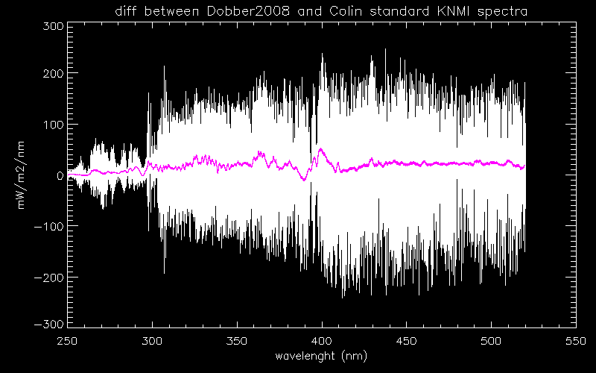
Comparison at NOAA of reference spectra provided by NASA C. Seftor, EUMETSAT R. Lang
Notes:
By Jianguo Niu, NOAA/NESDIS/SRG

Slide 11
The fundamental measurements used in BUV retrievals are ratios of Earth Radiance, R, to Solar Irradiance, F. Given {b_{k}}, the normalized bandpass weights for a channel centered at wavelength λ for K evenly spaced discrete locations, {λ_{k}}, about λ,
The forward models can compute, I_{λk}, estimates of the radiance out per unit radiance in for the discrete wavelengths. These must be combined with a high reference solar and the bandpasses to produce estimates of the measurements.
Notice that when we create a model
albedo, Rmod/Fmod, any shared bias
in the reference solar over the spectral
response interval will cancel.
The key time-dependent calibration
factor is the degradation of the
unshared element, the solar diffuser.
Entrance Aperture
Entrance Aperture
Earth
Mode
Solar
Mode
Diffuser

Slide 12
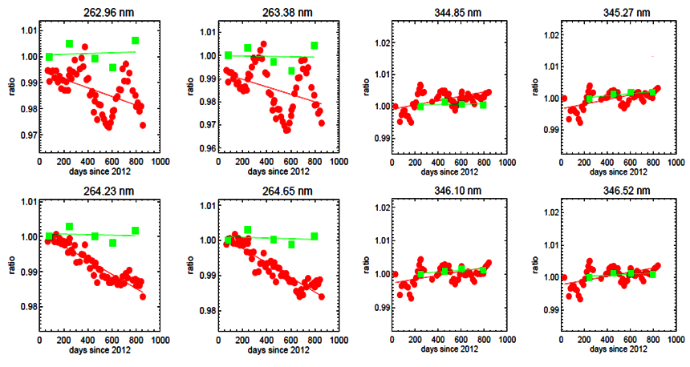
Trending of OMPS measured solar data
Reference Diffuser
Every six months
Working Diffuser
Every two weeks
Nadir Mapper
Nadir Profiler

Slide 13
Analysis of Time Series of Solar Spectra
The OMI, GOME-2 and OMPS teams have generated models of their time series of solar measurements by using
Solar activity scale factors
with proxies (e.g., Mg II Indices)
directly estimating pattern over solar rotations
Wavelength shift patterns
with proxies (e.g., optical bench temperatures)
directly from fits of solar features
Diffuser and instrument degradation estimated
with proxies (e.g., diffuser exposure times)
with on-board references
from working and reference diffuser measurements
from residual changes after identifying activity and wavelength changes
considering albedo changes over targets or compared to other sensors
The model results match the measurements at the tenths of percent level.
Notes:
Many UV solar spectra can be modeled well with three terms
Solar activity (Mg II Index with Scale factors)
Wavelength shifts (wavelength shift patterns)
Diffuser and instrument degradation
Linear Regression or EOF analysis can help to identify these patterns.

Slide 14
OMPS Nadir Profiler Solar Measurements
Newest
Degradation Component
The working diffuser’s exposure is
13 times the reference exposure.
Two years of measurements
Compared to their average.
250 nm 310 nm
250 nm 310 nm
Wavelength Shift Component
Solar Activity Component
Patterns are Mg II scale factors
and track Solar activity.
Wavelength shifts track optical
bench annual thermal variations.
Oldest
250 nm 310 nm
250 nm 310 nm
Notes:
The working diffuser for the OMPS has 13 times the exposure of the reference diffuser.

Slide 15
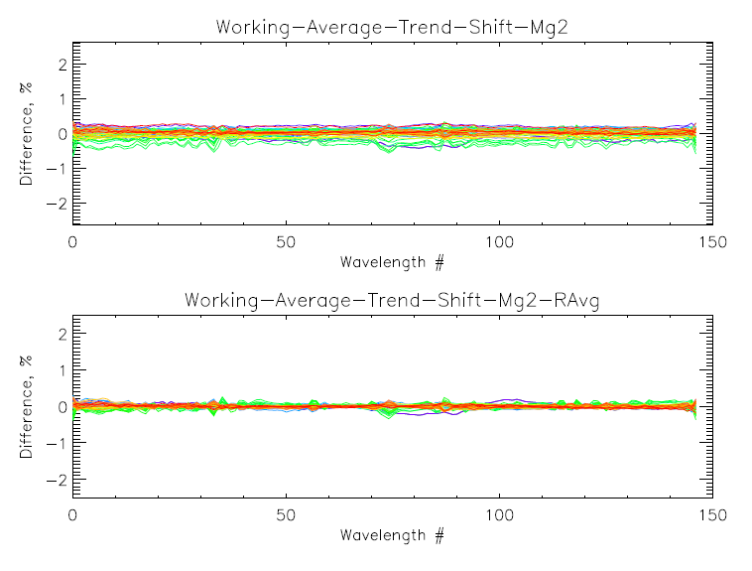
OMPS NP Working Solar residuals after fits

Slide 16
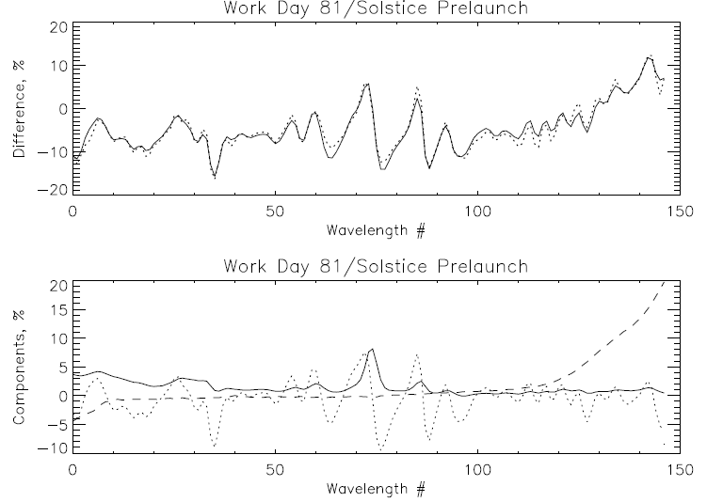
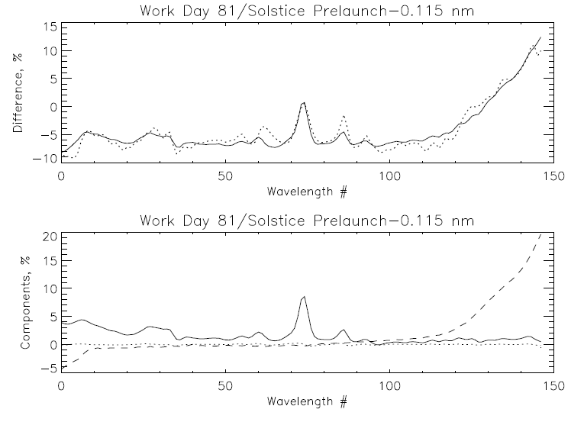
Comparison of OMPS NP Solar spectrum to synthetic from Solstice and prelaunch data. Fits of the differences with a model using three patterns of the form:
Meas/Synth = a0 + a1*WavelengthShift + a2*SolarActivity + a3*DihroicShift
Model
Measurement
Model
Measurement
250 nm 310 nm
250 nm 310 nm
Solar Activity
Dichroic Shift
Wavelength Shift
Solar Activity
Dichroic Shift
Wavelength Shift
250 nm 310 nm
250 nm 310 nm
Working Day 81 vs Solstice Synthetic (1.1% rmsr)
%offset %Mg II Shift nm Dich nm
-7.3 7.3 -0.127 -0.349
Working Day 81 vs Solstice Synthetic (1.1% rmsr)
%offset %Mg II Shift nm Dich nm
-7.5 7.7 -0.004 -0.347

Slide 17
Solar Activity
Solar irradiance shortward of 300 nm varies on short-term (~27-day) and long-term (~11-year) time scales.
Longward of 300 nm, only Fraunhofer lines show variations exceeding ~0.5% (the magnitude of this variability is resolution- dependent).
The spectral dependence of solar variations appears to be very consistent for both short and long time scales.
Therefore, we can use solar UV activity proxy (e.g. Mg II index) and wavelength-dependent “scaling factors” to estimate irradiance changes over time.
Notes:
Matthew DeLand
Science Systems and Applications, Inc. (SSAI) Lanham, Maryland USA
GRWG Meeting – UV Subgroup Darmstadt, GERMANY 27 March 2014

Slide 18
Solar Variations – UV, Visible
OMI instrument resolution (0.4 nm) shows small features at Fraunhofer lines.
Generally very good agreement between long- term changes (red) and short-term changes (black).
Marchenko, S. V., and M. T. DeLand [2014], Solar spectral irradiance changes during Cycle 24, Astrophys. J., 789:117, doi:10.1088/0004-637X/789/2/117.
Notes:
Matthew DeLand
Science Systems and Applications, Inc. (SSAI) Lanham, Maryland USA
GRWG Meeting – UV Subgroup Darmstadt, GERMANY 27 March 2014

Slide 19
Solar Cycle Variations
Spectral dependence shows distinct features due to atomic species in Sun.
Variations generally less than 1% beyond
~300 nm.
Good agreement between data sets from two solar cycles with semi-empirical model.
DeLand and Cebula [2012]
Notes:
Matthew DeLand
Science Systems and Applications, Inc. (SSAI) Lanham, Maryland USA
GRWG Meeting – UV Subgroup Darmstadt, GERMANY 27 March 2014

Slide 20
Solar UV Activity Proxy
Numerous data sets are available, with similar overall behavior.
Mg II index has best physical connection to UV irradiance.
Be aware of resolution (see next slide).
Notes:
Matthew DeLand
Science Systems and Applications, Inc. (SSAI) Lanham, Maryland USA
GRWG Meeting – UV Subgroup Darmstadt, GERMANY 27 March 2014

Slide 21
MG II Index Scaling Factors
Calculate max/min ratio for irradiance over solar rotation to minimize instrument change effects.
Calculate the ratio for the same dates with Mg II index.
The slope from linear regression fit gives a “scaling factor”. Good dynamic range is preferred.
The value of the scaling factor at any wavelength depends on instrument resolution for both irradiance and proxy.
Slope = 1.07(±0.04)
Notes:
Matthew DeLand
Science Systems and Applications, Inc. (SSAI) Lanham, Maryland USA
GRWG Meeting – UV Subgroup Darmstadt, GERMANY 27 March 2014

Slide 22
Conclusions
High resolution reference solar spectra have been constructed for different purposes.
Understanding how a reference spectrum was created helps to make it more useful.
At wavelengths shorter than 300 nm, natural solar variations must also be considered for best results.
Mg II proxy index can be used with (instrument-dependent) scaling factors to determine adjustments for solar activity as a function of wavelength and time.
Solar features can be used to estimate wavelength shifts.
Reference spectra have calibration offsets but can be used as transfer standards (Double Differences).
Note: Most users take the radiance/irradiance ratios as the important measurement and want the two to have good relative calibration not individual absolute calibration. (e.g., requirements Rad 7%, Irr 7%, Rad/Irr 1%)
The calibration teams work to determine and remove the diffuser degradation from the ratios.

Slide 23
Sensor specifications for OMPS nadir sensors
Parameter | Value
Both
Radiance - RMS uncertainty | 8%
Irradiance - RMS uncertainty | 7%
Radiance / irradiance ratio - RMS uncertainty Absolute Relative (between wavelengths) | 2% 0.5%
Wavelength calibration – RMS uncertainty | 0.015 nm
On-orbit wavelength shift sensitivity | 0.01 nm
Stray light (before correction) | 2%
Non-linearity knowledge (Zero input signal to full CCD well) | 0.2%
Pixel-to-pixel response knowledge | 0.2%
NM
Wavelength range Minimum SNR (all wavelengths) | 300 -380 nm 1000
NP
Wavelength range 252 nm 273 nm 283 nm 287 nm 292 nm 297 nm 302 nm 306 nm | 250 – 310 nm Minimum SNR 35 100 200 250 400 400 400 400

Slide 24
References
• Dobber, M., et al. [2008], Solar Phys. 249, 281-291.
Hall, L. A., and Anderson, G. P. [1991], J. Geophys. Res. 96, 12,927-12,931.
Kurucz, R. L., et al. [1984], Solar Flux Atlas from 296 to 1300 nm, National Solar Observatory.
Chance, K. and Kurucz, R. L. [2010], J. Quant. Spec. Rad. Trans. 111, 1289-1295.
Thuillier, G., et al. [2004], Solar Variability and its Effects on Climate, American Geophysical Union, p. 171-194.
Woods, T., et al. [2009], Geophys. Res. Lett. 36, L01101, doi:10.1029/2008GL036373.
DeLand, M. T., and Cebula, R. P. [2012], J. Atmos. Solar-Terr. Phys. 77, 225-234.

Slide 25
Backup Slides

Slide 26
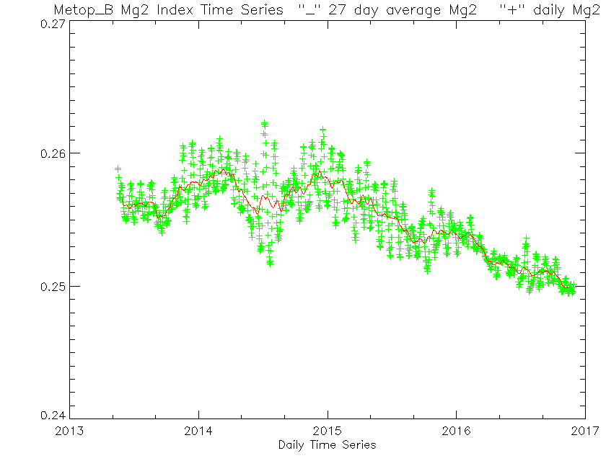
2%
Could we tell which spectra came from which time?

Slide 27
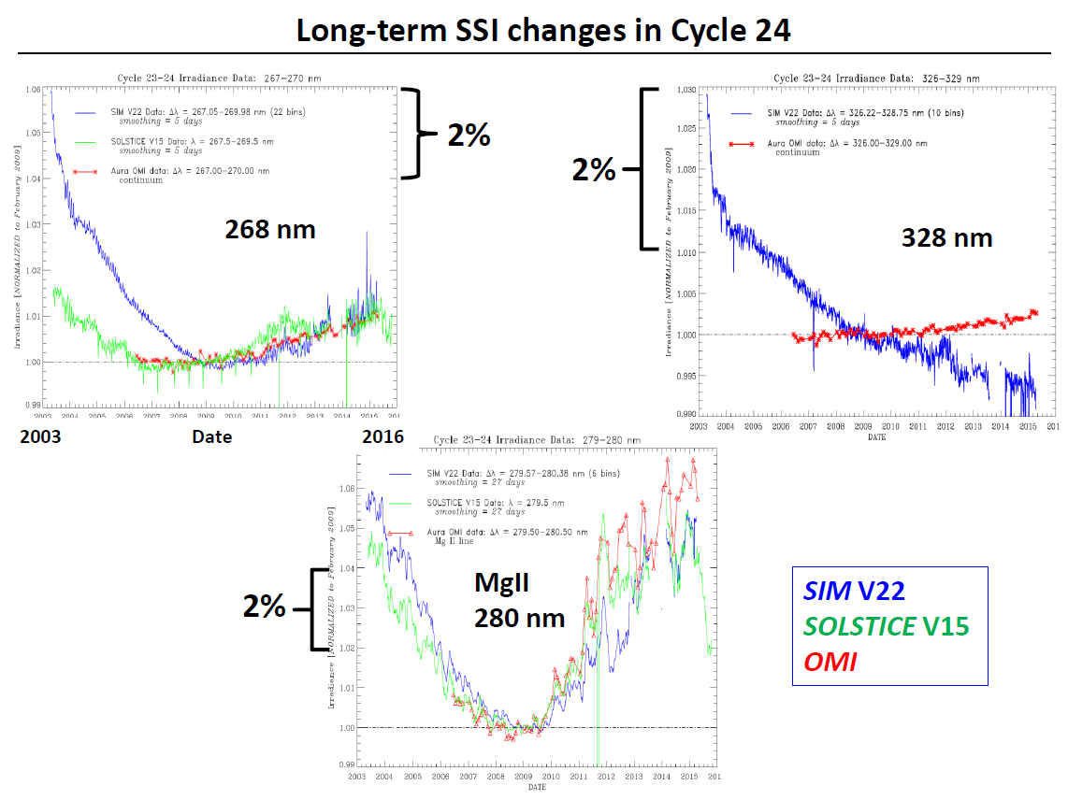

Slide 28
Change in solar flux from solar temperature change
0.20
0.15
Irradiance change, % / K
0.10
0.05
0.00
260
280
300
Wavelength, nm
320
340

Slide 29
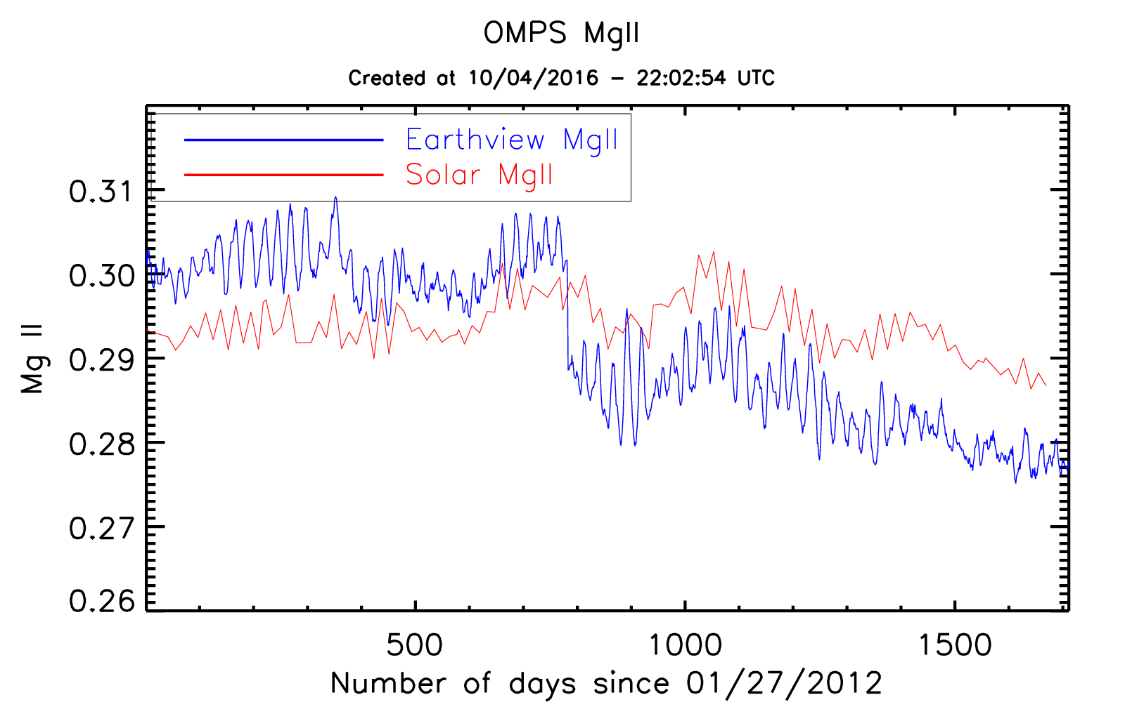
Creation of a daily OMPS Mg II Index from Earth-View Spectra
Biweekly
Stray Light Correction
Implemented
Daily
Notes:
http://www.star.nesdis.noaa.gov/icvs/status_NPP_OMPS_NP.php

Slide 30
Solar Variations – Resolution
Short-term variations during Cycle 24 calculated using same dates for both instruments.
Larger variations observed at major lines for GOME-2 (blue, Δλ = 0.2 nm) than for OMI (black, Δλ
= 0.4 nm).
Notes:
Matthew DeLand
Science Systems and Applications, Inc. (SSAI) Lanham, Maryland USA
GRWG Meeting – UV Subgroup Darmstadt, GERMANY 27 March 2014

Slide 31
Mg II Index - Resolution
Figure courtesy of Marty Snow, 2014 SORCE Meeting
Notes:
Matthew DeLand
Science Systems and Applications, Inc. (SSAI) Lanham, Maryland USA
GRWG Meeting – UV Subgroup Darmstadt, GERMANY 27 March 2014

Slide 32
Proxy Results

Slide 33
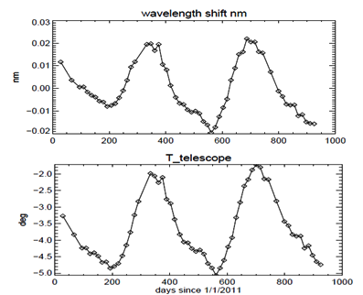
Annual Cycle in Wavelength Scale Changes and Temperatures
f(x) = a1*sin(b1*x+c1) + a2*sin(b2*x+c2) + a3*sin(b3*x+c3) +
a4*sin(b4*x+c4)

Slide 34
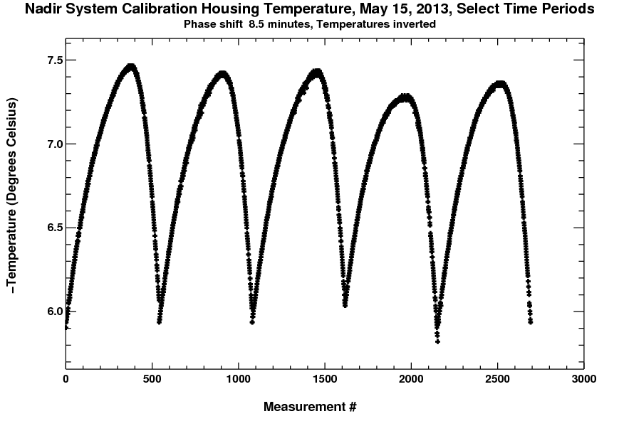
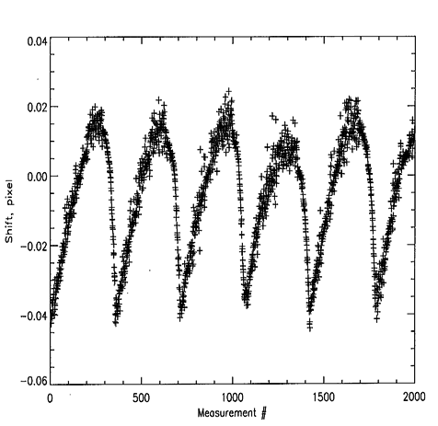
NM wavelength change vs. thermal loading
NM housing temperature (ºC)
Intro-orbital wavelength shift in pixel

Slide 35
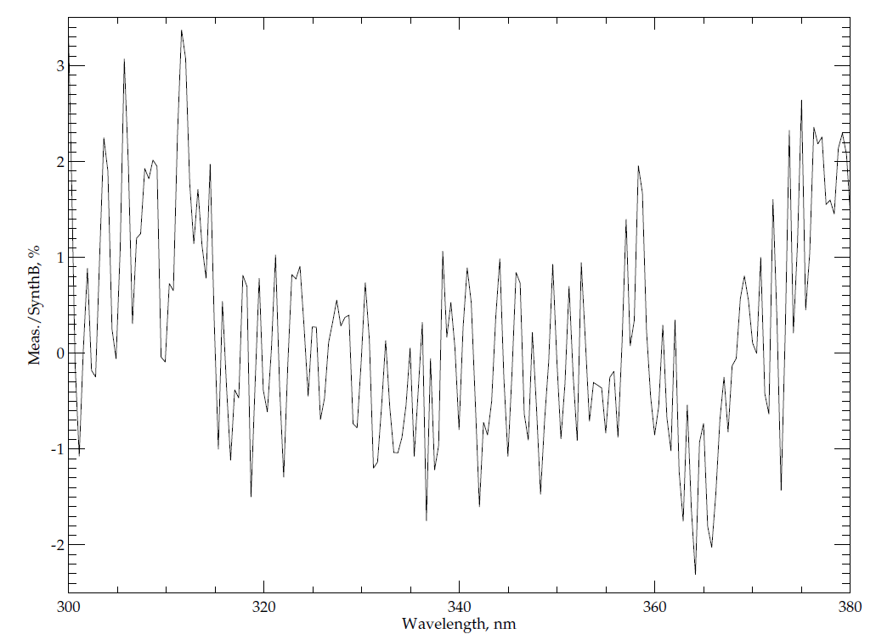
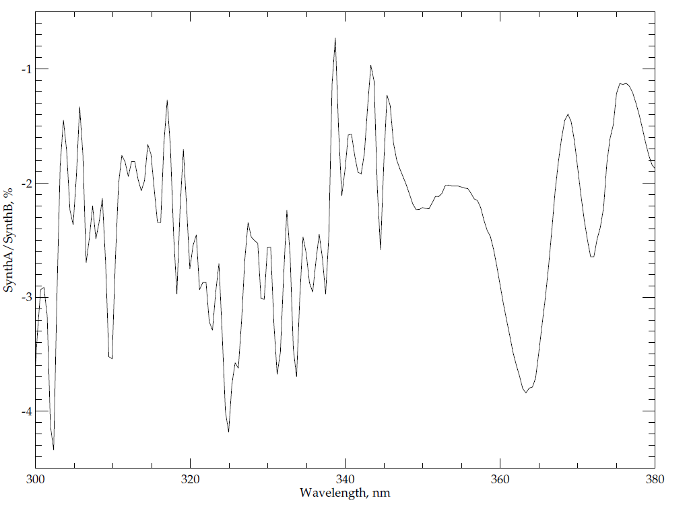
Using Reference Solar to create Proxy Spectra
Comparisons of OMPS Nadir Mapper measured and proxy (from references) solar spectra for 300 nm to 380 nm.
(Proxy AK / Proxy BK – 1)*100 (Measured/Proxy BK – 1)*100
1%
1%
Notes:
Proxy B uses the reference Colin Seftor, NASA SSAI provided and Proxy A uses the reference Ruediger Lang EUMETSAT provided.

Slide 36
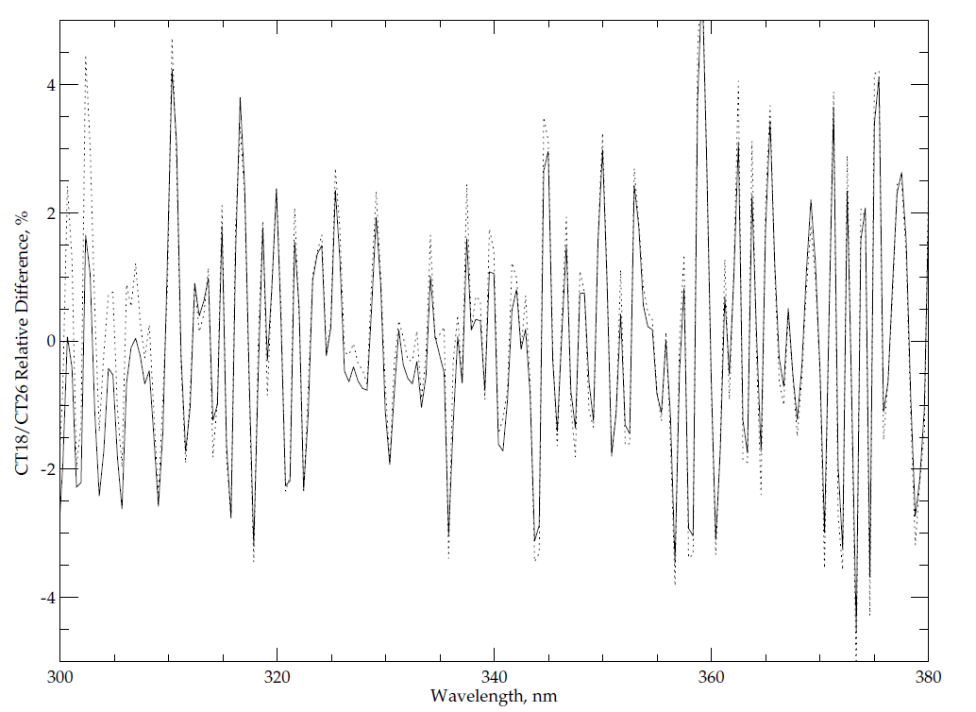
OMPS Nadir Mapper predicted Cross-Track (CT) differences from Proxy and Measured spectra
Solid Line – (Proxy AK CT18 / Proxy AK CT26 – 1)*100
Dotted Line – (Measured CT18 / Measured CT26 – 1)*100 – 2.0

Slide 37
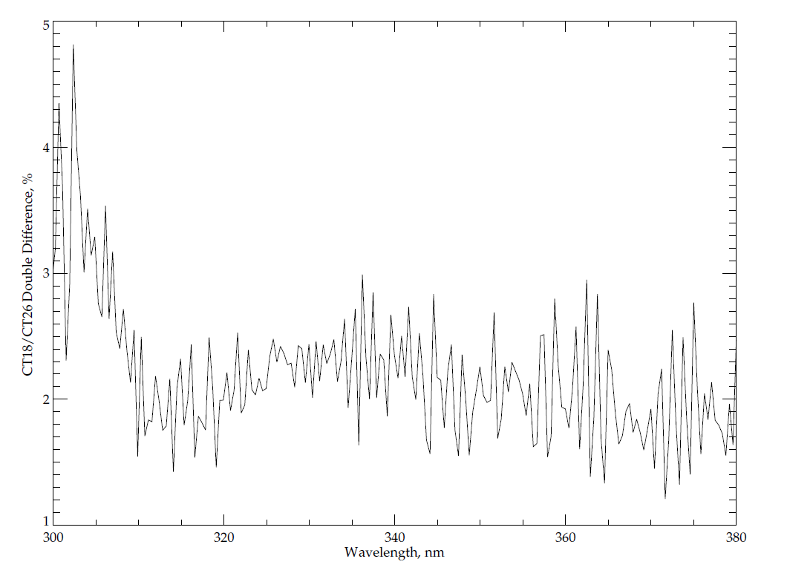
OMPS Nadir Mapper Double Difference of CT18/CT26, Measured minus Proxy
(Measured CT18 / Measured CT26 – Proxy A CT18 / Proxy A CT26 )*100
1%

Slide 38
Absolute Difference - 2
Smoothing irradiance data to lower resolution necessary to evaluate radiometric differences.
Some comparisons still show differences that exceed quoted uncertainties.
SORCE SOLSTICE vs. UARS SUSIM, SOLSTICE
Woods et al. [2009]
Notes:
Matthew DeLand
Science Systems and Applications, Inc. (SSAI) Lanham, Maryland USA
GRWG Meeting – UV Subgroup Darmstadt, GERMANY 27 March 2014

Slide 39
Introduction
Solar irradiance is primary energy source for terrestrial system.
Important to know absolute value and relative variations, for both integrated measurement and spectral dependence.
Sun represents a valuable calibration source for satellite instruments:
Easy access
High intensity
Relatively stable compared to on-board sources
Many spectral features for wavelength calibration
Some “features” also represent challenges for operational use:
Exposure-dependent degradation (particularly in UV)
Large dynamic range needed to co-exist with Earth view data
Natural variability in UV region
Complex spectral structure
This presentation will briefly discuss some issues associated with using reference solar spectra.

Slide 40
Project to Compare Solar Measurements
High resolution solar reference spectra
Reference high resolution solar Spectra (SOLSTICE, SIM, Kitt Peak, etc. – Everybody has a favorite. How do they compare?)
Mg II Index time series, Scale factors at high resolution
Instrument data bases
Bandpasses, wavelength scales (Shift & Squeeze codes)
Day 1 solar, time series with error bars (new OMI product) (Formats, Doppler shifts, 1 AU adjustments)
Mg II Indices and scale factors at instrument resolution
Reference calibration and validation papers
Using the information from above we can compare spectra from different instruments and times
Notes:
Composite Mg II solar activity index for solar cycles 21 and 22
Matthew T. DeLand, Richard P. Cebula
DOI: 10.1029/93JD00421
Creation of a composite solar ultraviolet irradiance data set
Matthew T. DeLand, Richard P. Cebula
DOI: 10.1029/2008JA013401

Slide 41
Actions
Colin, Dave, Ruediger: provide reference solar spectrum to establish common reference
All: provide other options for reference solar spectra
All: For your instrument (Optional)
Solar measurement (wavelength scale, irradiance)
Wavelength scale and bandpass (Δλ, Normalized bandpass weight)
Synthetic from common reference (wavelength scale, irradiance)
Synthetic for wavelength scale perturbations (±0.01 nm) from common reference (wavelenth scale, irradiance)
Synthetic from alternative reference spectra (wavelength scale, irradiance)
Solar activity pattern (wavelength, relative change)
Mg II index (if 280 nm is covered) Mg II 279.6 Mg I 285.2
Ca H/K index (if 391 nm to 399 nm is covered) CA II 393.4 396.8.
A measured solar for their instrument
A synthetic solar produced from the high resolution reference
The wavelengths and bandpasses used to create 1 from 2.
A set of two spectra for ±0.01 nm shifts, that is, synthetic spectra as earlier but with the spectral scale shifted uniformly by +0.01 nm and -0.01 nm.
A set of solar activity scale factors
If the instrument covers the 277 nm to 283 nm wavelength, then each team should provide Mg II index values. These should be computed as follows:
Fit three quadratic functions to the core and wing measurements using all measurements in the following three intervals: [276,278], [279,281],[282,284]. Then compute the core to wing ratios using the vertices of the three fit quadratics, Mg II Index = VCore*2/(VWingL+VWingR). Also, report the wavelength coordinate of the core vertex.
Composite Time series of Mg II Indices to convert from one date to another.

Slide 42
Possible Goals/Topics for the UV Subgroup
1. Exchanges and traceability of standards
NIST and SIRCUS
Integrating Spheres, diffusers, lamps, lasers, etc.
2. Establish a library of solar measurements
Reference high resolution solar (SOLSTICE, SIM, Kitt Peak, etc.)
Mg II Index time series, Scale factors at resolution (new OMI)
3. Establish a library of instrument data bases
Bandpasses, calibration constants, wavelength scales
Day 1 solar, time series with error bars
Mg II Indices and scale factors
FOVs, Polarization sensitivity,
Reference papers, ATBDs, validation, Shift & Squeeze,
4. Establish a library Absorption data bases
O3 in the UV with wavelength and temperature dependence
at instrument resolution – from DOAS?
UV compared to Visible and IR
other species -- SO2, NO2, etc.
5. Standard climatologies; vicarious calibration & residual studies
Ozone and temperature profiles, covariances
Neural net, with tropopause information
Averaging kernels or efficiency factors, measurement contribution functions, and Jacobians
6. Analysis of on-board systems
Diffusers, stable orbits
White lights, spectral lamps, LEDs
Moon views
Stray light, linearity, gains, offsets, mirrors, polarisation, λ-scale, bandpass
7. Considerations for comparisons
Complications from diurnal variations, SZA, SVA, RAA
Zonal means
Simultaneous nadir overpass (Rad/Irrad or products)
Formation flying / Chasing orbits
No-local-time differences
Ice, desert and open ocean targets
Pacific Box
LEO to GEO to L1
8. Internal consistency techniques
Ascending/descending -- Langley methods
Pair justification
DOAS (and EOF analysis) (Closure polynomials)
Stray light correlation
Wavelength scale, shift and squeeze, etc.
Measurement Residuals, reflectivity range/distribution
9. Forward model and measurements
Rayleigh
Absorption
Spherical geometry
Inelastic scattering (Ring Effect), Stray light, solar activity
Aerosols
Polarization
TOMRAD, VLIDORT, SCIATrans, CRTM, etc.
V8 SBUV/2 and A Priori as transfer for Viewing conditions…
10. Reflectivity
Surface (database and snow/ice forecasts), Variations in surface reflectivity with season, sza and sva.
Surface pressure
Clouds (Cloud top pressure)
Cloud-optical-centroids (Ring Effect, 02-02, O2 A band)
11. Aerosols
Climatology/Type, height
Wavelength or polarization dependence (Aerosol Indices)
12. Nadir Instruments LEO
TropOMI, GOME(-2), OMPS, TOU/SBUS, OMS,
SCIAMACHY, OMI, TOMS, SBUV(/2)
12. Nadir Instruments GEO or L1
TEMPO, GEMS, UVN and EPIC
13. Limb instruments
SAGE III, ACE/MAESTRO, OSIRIS, MLS,
GOMOS, SCIAMACHY, OMPS-LP
14. Ground-based
WOUDC, Dobson, Brewer, Lidar, MW and Ozonesondes
Notes:
http://www.nesdis.noaa.gov/news_archives/dscovr.html
http://science.nasa.gov/media/medialibrary/2012/03/01/Nguyen-DSCOVR-Mission-Briefing-HPS-v01b.pdf

Slide 43
II. Initial Measurement Residual Project
The purpose of this project is to use initial measurement residuals from the Version 8 ozone profile retrieval algorithm to compare channels from 240 nm to 290 nm. (Note, this will require modification of the first guess creation to use consistent total ozone starting values as inputs.)
Ascending/descending equivalent channel ideas will be used with hyperspectral measurements.
Zonal mean and other matchup criteria will be used both to establish offsets and track relative drifts.
Expand SBUV(/2) results to other sensors (OMPS, SBUS, OMI, GOME-2)
Monitor time dependence for multiple instruments.
http://www.star.nesdis.noaa.gov/smcd/spb/OMPSDemo/proSBUV2released-2.php
http://www.star.nesdis.noaa.gov/smcd/spb/OMPSDemo/proOMPSbeta.O3PRO_V8.php
Goals
Agreement at 2% for Profile channels by using the Version 8 A Priori Profiles with TOMRad Tables and single scattering.

Slide 44
Outline of an Approach for Comparisons of radiance/irradiance ratios from 240 nm to 300 nm
Double Difference using Climatology:
Compute the measurement residuals using a forward model with the effective scene reflectivity of the clouds and surface determined from longer channel measurements, and the ozone profile prescribed by the Version 8 a priori climatology. Use viewing geometries and bandpasses are as reported for each instrument.
Compare residuals for channels λ1 and λ2 where S1*α1 = S2* α2, where S values give the path lengths and α values give the ozone absorption cross sections. That is, works with pairs of wavelengths where the measurement contribution functions are similar.
Perform comparisons (statistical trade off in quantity of matchups vs. quality)
Simultaneous nadir overpass matchups
Zonal means (and No-local-time-difference zonal means)
Opportunistic formation flying / Chasing orbits
Benign geographic regions (e.g., Equatorial Pacific Box)
Ascending/descending zonal means (In the Summer hemisphere, the same latitude is observed twice so one can obtain a set of internal comparisons.)
Forward model and measurements
V8 SBUV/2 forward model and A Priori as transfer for Viewing conditions
Complications from real diurnal variations in the ozone profiles
Complications if best ozone product values differ and initial residuals are used
Measurement residuals’ correlation with scene reflectivity for longer wavelengths can disclose stray light contamination.
Notes:
I believe a similar method was used to check the GOME long-term calibration by assuming stable equatorial ozone profiles.

Slide 45
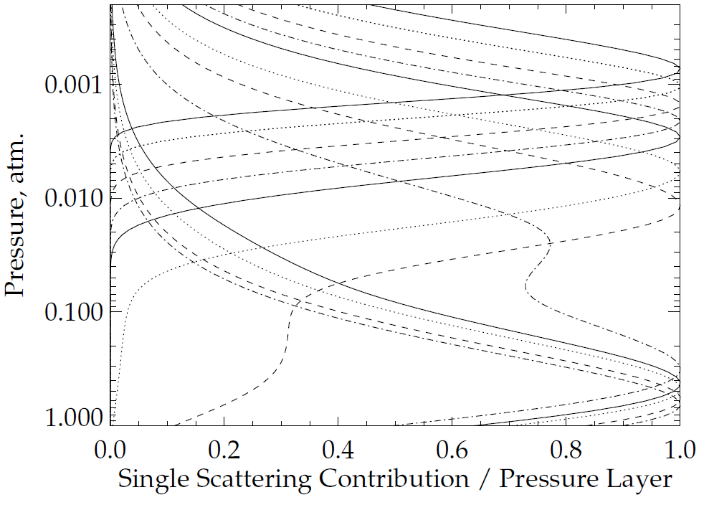
273 nm
253 nm
318 nm
340 nm
Figure 6.a. Normalized Single Scattering Contribution Functions for 12 wavelengths at [253,273,283,288,292,297,302,306,313,318,331,340] nm for a 325 DU total column ozone profile for Solar Zenith Angle θ₀ = 30°.

Slide 46
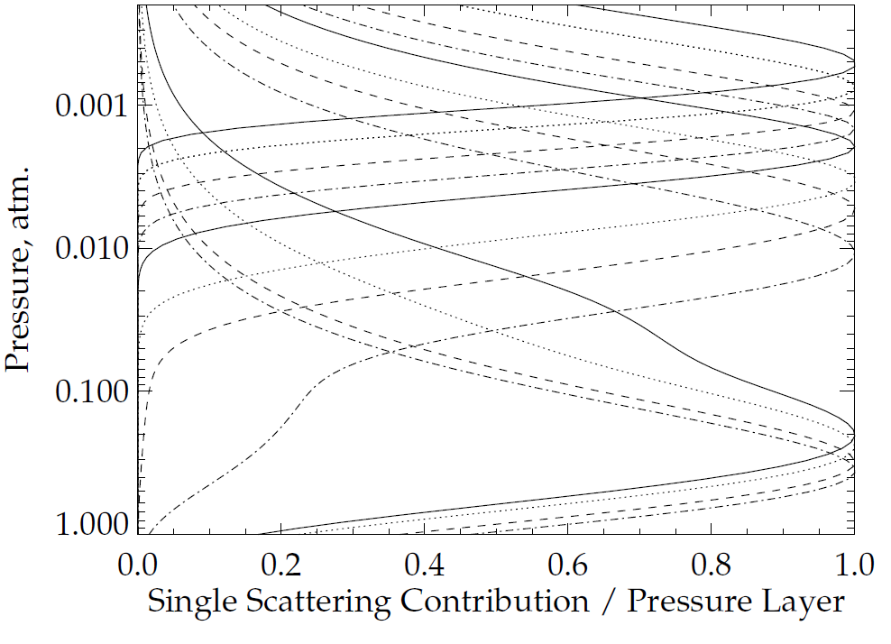
273 nm
318 nm
340 nm
Figure 6.b. Normalized Single Scattering Contribution Functions for 12 wavelengths at [253,273,283,288,292,297,302,306,313,318,331,340] nm for a 325 DU total column ozone profile for Solar Zenith Angle θ₀ = 70°.

Slide 47
Pseudo-Channels in the UV from 250 nm to 300 nm
As the SZA or SVA increases, the contribution functions shift up. One can find combinations of longer channels that can represent (capture the response to ozone changes) a measurement at a shorter channel at SZA=0 and SVA=0.
We can compare instruments measuring at different viewing geometries or times of day.
This can help to determine both internal and external biases.
Diurnal ozone variations will present an involved complication.

Slide 48
III. Effective Reflectivity Project
The aim is to produce over-pass comparisons of UV/Vis sensors for specific target sites or regions in use by the community. As a first step, summaries of methods and results for target sites currently in use will be collected. We will compare measurements at reflectivity channels from 330 nm to 500 nm.
Ice, desert and open ocean targets.
Absolute Radiance/Irradiance check; Track variations over time.
Reflectivity range/distribution, 1-percentile, Deep Convective Clouds (DCC)
Wavelength Dependence – Aerosol Indices, Clean atmospheres
Complications
Viewing and Solar angle considerations
Sun Glint
Surface pressure
Partially cloudy scenes
Polarisation
Inelastic Scattering
Turbidity, chlorophyll
Compare Global monthly surface reflectivity data bases
Goals
Agreement at 1% on cloud free scene reflectivity for 340 nm. Desert, Equatorial Pacific, Polar Ice.
Agreement at 1% on aerosol index – wavelength dependence of reflectivity.
Long-term reflectivity channels at 0.5% stability

Slide 49
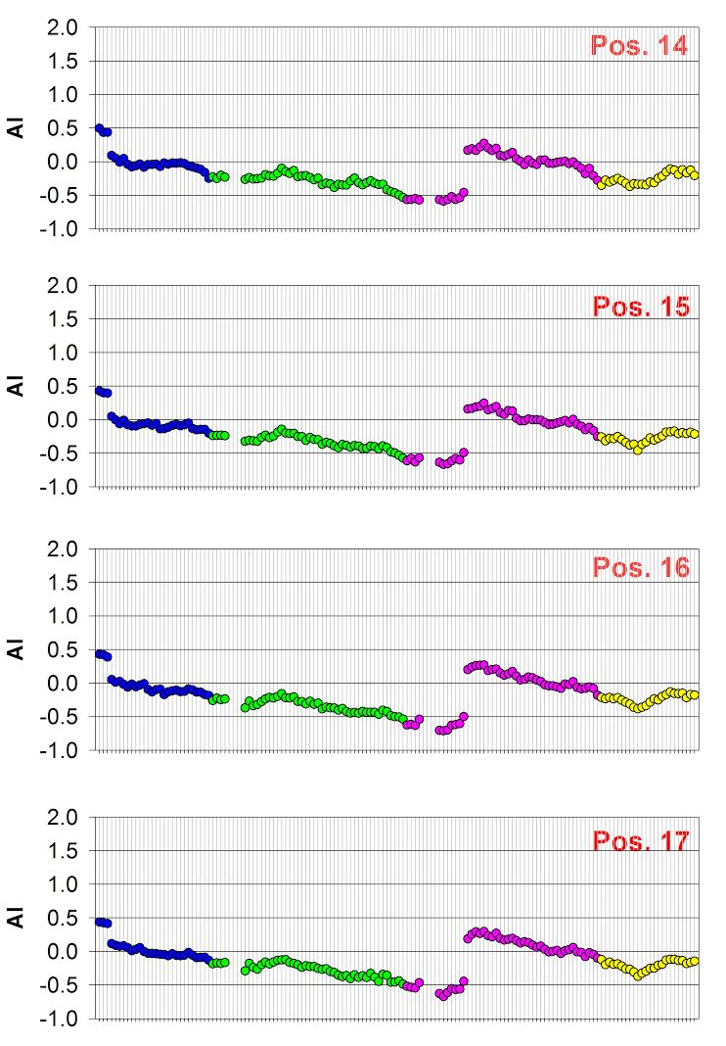
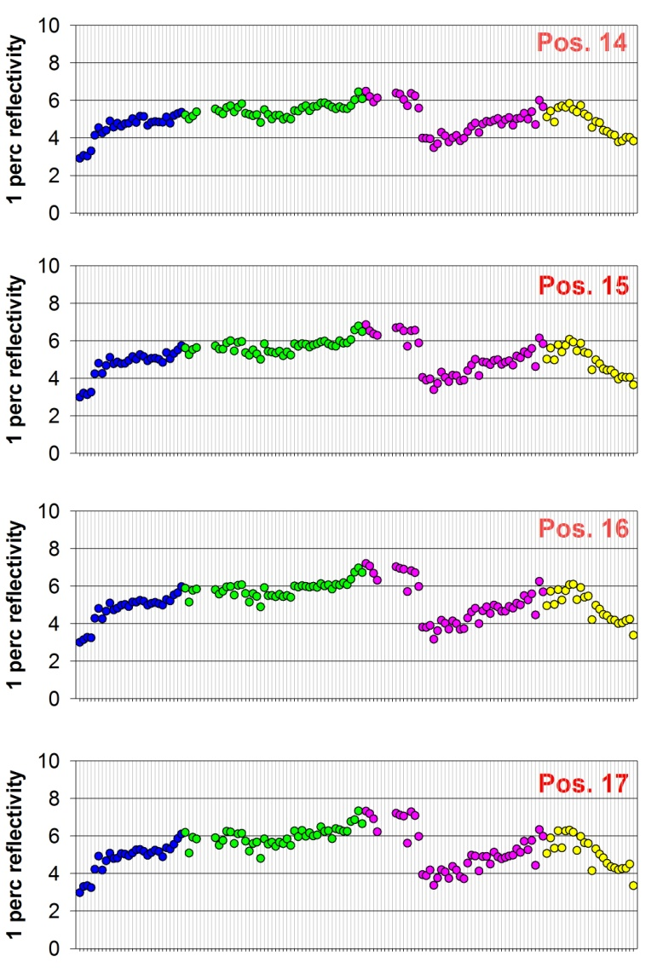
We are examining the V8 TOMS algorithm reflectivity and Aerosol Index Values for an Equatorial Pacific Region for OMPS, OMI and GOME-2
Time Series of GOME-2 Aerosol Index
(360 nm vs 331 nm)
Equatorial Pacific
Time Series of → GOME-2 1-percentile Reflectivity Equatorial Pacific
Jumps are from NOAA-applied soft calibration adjustments to the operational products.
GOMS_2 MetOP-B

Slide 50
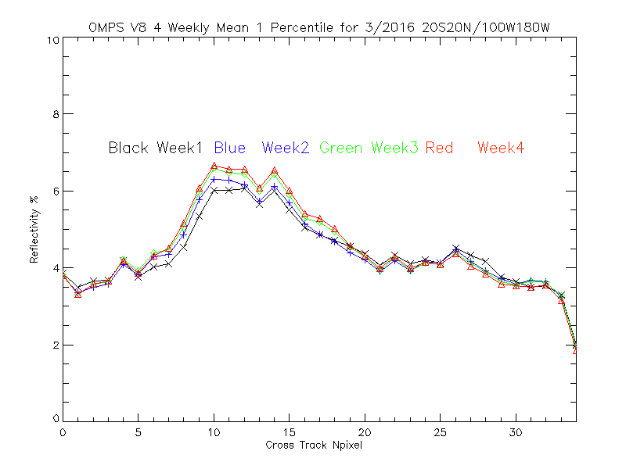
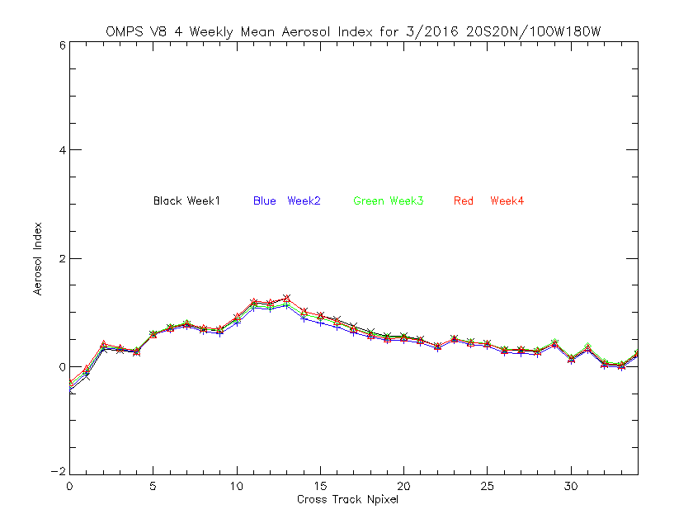
Cross-Track Internal Consistency for OMPS
← Weekly Effective Reflectivity values for the V8 algorithm for March2016 for all the data in a latitude/ longitude box in the Equatorial Pacific versus cross-track view position, 17 is nadir. We expect the values to be approximately 5% for this region of the globe. The cross-track variations for positions 8 to 15 are related to sun glint effects.
Weekly Aerosol Index values for the V8 → algorithm for March2016 for all the data in a latitude/ longitude box in the Equatorial Pacific versus cross-track view position, 17 is nadir. We expect the aerosol index values to be approximately zero N-values for this region of the globe. The cross-track variations for positions 8 to 15 are related to sun glint effects.

Slide 51
IV. Match-Up Comparisons
We would also like to expand the use of matchup comparisons for UV instruments. Current approaches include:
Chasing Orbits (Opportunistic Formation Flying)
S-NPP and EOS-Aura have 16-day repeat cycles but one makes 227 orbits and the other 233 so every 64 hours they are flying with orbital tracks within (360/14)*110*3/(14*8*2) ~ 40 km of each other, 15 minutes apart.
For NOAA-19 and S-NPP, the matchups are every 12 days – (360/14)*110/(14*12*2) ~ 9 km.
LEO vs LEO Simultaneous Nadir Overpass (and its non-simultaneous No-Local-Time-Difference zonal means)
LEO underflights of GEO and L-1 instruments – Coincident Line-of-Sight Observations. (GOME-2 vs. SEVIRI, OMPS vs. TEMPO)
Zonal Means (including ascending/descending repeat coverage – S1*α1 = S2* α2)

Slide 52
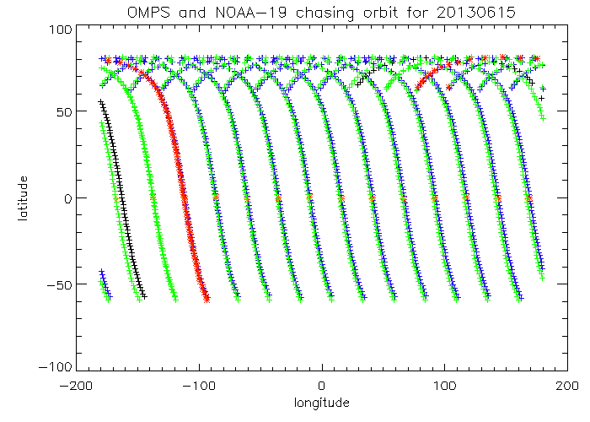
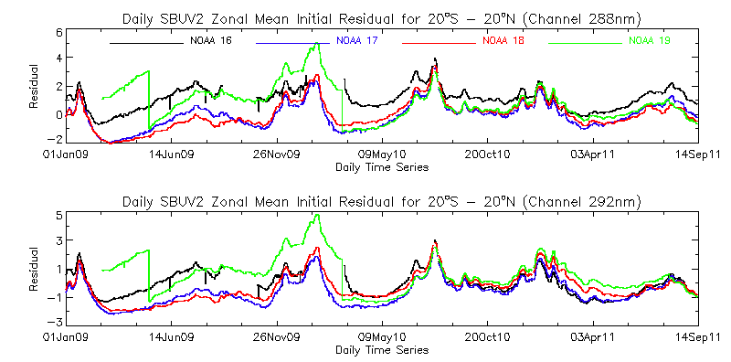
Well-matched Orbits for 6/15/2013
Comparison of Initial V6 Measurement Residuals for S-NPP OMPS NP and NOAA-19 SBUV/2
Latitude, Degrees North
Longitude, Degrees East
Operational Initial Residuals for SBUV/2
Daily Means
Equatorial Pacific Box
20S – 20N Latitude
100W to 180W Longitude

Slide 53
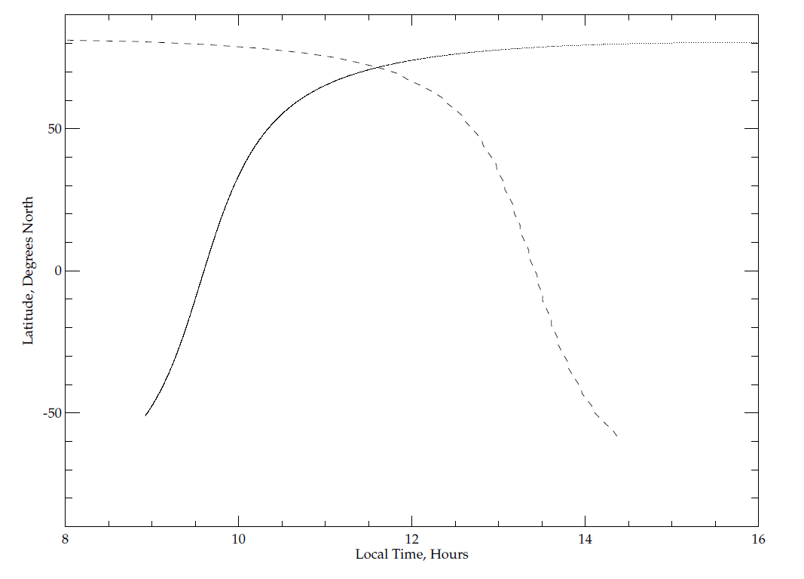
Simultaneous Nadir Overpass and No Local Time Difference Comparisons
Latitude range
for zonal mean
Latitude, Degrees North
---- GOME-2
- - - OMPS
Local Time, Hours

Slide 54
Match for viewing
geometry
Schematic for L-1 & LEO matched viewing conditions at Equinox. Matches shift north or south seasonally “following” the sun.
To L1
and
the
Sun
or
LEO Orbital
Track
Local
Solar
Noon
Equator
LEO Cross
Track FOV
Great Circle aligned
with Cross-track FOV
Sunlit side of
the Earth
Simultaneous View Path (SVP) match up between DSCOVR EPIC at 0º offset with the Earth/Sun line and S-NPP OMPS. Matches will be present for any BUV instrument on a GEO platform with one in a LEO orbit as the LEO orbital tracks pass near the GEO sub-satellite point.

Slide 55
Backup

Slide 56
252 nm
273 nm
302 nm
306 nm
S1*α1 = S2* α2, Si = 1 + sec(SZAi) for nadir viewing
Notes:
Figure 2. Normalized weighting functions for SBUV/2 measurements for a standard 325 DU (0.325 atm.-cm.) ozone profile for two SZAs (Eight wavelengths from 252, 273, 283, 288, 292, 298, 302 to 306 nm)
The normalized single-scattering weighting functions, which show how sensitive the measurements are to ozone changes as functions of pressure, are given for eight wavelengths (252, 273, 283, 288, 292, 298, 302, and 306 nm) in Figure 2. The two sets of curves from top to bottom are for the wavelengths from short to long. This shows, for example, that the measurement by a space-based instrument looking down on a sunlit atmosphere of the radiance at 252 nm is primarily affected by changes in the ozone above 2.0 mbar while the measurement at 306 nm is affected by changes in ozone throughout the stratosphere. Ozone profile retrieval algorithms make use of this physical difference in the spectral measurements to obtain estimates of vertical ozone profiles.
The information at wavelengths measured by a BUV instrument shifts upward as the Solar Zenith Angle (SZA) or the Satellite Viewing Angle (SVA) increases and the path length of photons through the atmosphere increases. For the example in Figure 2, at 70° SZA, the 273 nm measurements responds to changes in the ozone vertical profile in almost the same manner as the 252 nm measurements do at 30° SZA. Notice that the second highest dotted curve and the highest dashed curve almost coincide.
The eight wavelengths in Figure 2 are the standard profiling wavelengths for normal SBUV/2 observations. They provide good coverage of the stratosphere. The gradual decrease in the weighting function (the lack of sharp cutoffs) limits the resolution of the vertical profile information. Even these eight wavelengths have some redundancy in their information and it remains to be seen how much new information will be obtained by denser spectral coverage.
Hyperspectral algorithms for profile retrievals are under development. The duplication of measurement information both spectral and spatial, should help to provide internal consistency and calibration checks. It will also help with methods for radiance comparisons between measurements for Cal/Val work.
Limb viewing produces a geometric magnification of layer response compared to nadir viewing, but with at the cost of a large increase in the optical path.

Slide 57
Instrument and Project Leads
Instrument | Main Contact Web Site | Reflectivity/ Aerosols | Solar Spectra | Ozone Profiles | Calibration
ACE/MAESTRO
EPIC 2015
GEMS 2018
GOME
GOME-2 | R. Lange EuMetSat |  |  |  | R. Lange
GOMOS
MLS
OMI |  | O. Torres | M. DeLand
OMPS Nadir | L. Flynn NOAA |  |  | L. Flynn
OMPS Limb | G. Jaross NASA
OMS
OSIRIS
SAGE III | D. Flittner NASA
SBUS | F-X. Huang CMA |  |  | F-X. Huang
SBUV/2 | L. Flynn NOAA |  |  | L. Flynn
SCIAMACHY | M. Weber Bremen |  | M. Weber
TEMPO | K. Chance SAO
TOMS
TOU | W-H. Wang CMA | W-H. Wang
TropOMI
UVN |  |  |  |  | Berit/Marcel

Slide 58
2000
1500
Days since 2012
1000
500
0
0
20
40
60
80
100
120
140
Measurement Number

Slide 59
0.00
Ref2/Work2-Ref6/Work6
-0.01
-0.02
-0.03
250
260
270
280
Pixel, #
290
300
310

Slide 60
0.0006
0.0004
Data-Fit
0.0002
0.0000
-0.0002
-0.0004
250
260
270
280
Pixel, #
290
300
310

Slide 61
0.04
0.03
0.02
Mg2i/Mg20-1.
0.01
0.00
-0.01
-0.02
0
20
40
60
80
100
120
140
Measurement, #

Slide 62
0.06
0.04
0.02
SHift in pixels
0.00
-0.02
0
20
40
60
80
100
120
140
Measurement, #

Slide 63
0.030
0.025
0.020
Mg II Scale Factors
0.015
0.010
0.005
0.000
250
260
270
280
Wavelength, nm
290
300
310

Slide 64
0.000
Ref7/Ref3-1 Mg II Diff Adjusted
-0.002
-0.004
-0.006
250
260
270
280
Wavelength, nm
290
300
310

Slide 65
0.002
Ref7/Ref3-1 Mg II adjusted - diff adjusted - fit
0.001
0.000
-0.001
-0.002
250
260
270
280
Wavelength, nm
290
300
310

Slide 66
0.000
-0.005
Two years of degradation
-0.010
-0.015
-0.020
250
260
270
280
Wavelength, nm
290
300
310

Slide 67
0.04
0.03
Ref/working bias
0.02
0.01
0.00
250
260
270
280
Wavelength, nm
290
300
310

Slide 68
0.02
0.01
Remaining features
0.00
-0.01
-0.02
250
260
270
280
Wavelength, nm
290
300
310

Slide 69
Covariance Matrix
1×10⁻⁴
5×10⁻⁵
0
-5×10⁻⁵
-1×10
-4
150
100
150
pixel
50
100
50
pixel
0 ₀

Slide 70
₁₀-1
Ordered Eigenvalues
₁₀-2
₁₀-3
Eigenvalues
₁₀-4
₁₀-5
₁₀-6
₁₀-7
0
5
10
pixel
15
20

Slide 71
0.0015
EOF patterns
-2.5×10⁻⁵
EOF patterns
6×10⁻⁶
EOF patterns
0.0010
4×10⁻⁶
-3.0×10⁻⁵
0.0005
2×10⁻⁶
Normalized EOF
Normalized EOF
Normalized EOF
0.0000
-3.5×10⁻⁵
0
-0.0005
-2×10⁻⁶
-4.0×10⁻⁵
-0.0010
-4×10⁻⁶
-0.0015
250
260
270
280
Wavelength, nm
290
300
310
-4.5×10⁻⁵
250
260
270
280
Wavelength, nm
290
300
310
-6×10⁻⁶
250
260
270
280
Wavelength, nm
290
300
310
2×10⁻⁶
EOF patterns
1×10⁻⁶
EOF patterns
1×10⁻⁶
EOF patterns
1×10⁻⁶
5×10⁻⁷
5×10⁻⁷
Normalized EOF
Normalized EOF
Normalized EOF
0
0
0
-1×10⁻⁶
-5×10⁻⁷
-5×10⁻⁷
-2×10⁻⁶
250
260
270
280
Wavelength, nm
290
300
310
-1×10⁻⁶
250
260
270
280
Wavelength, nm
290
300
310
-1×10⁻⁶
250
260
270
280
Wavelength, nm
290
300
310

Slide 72
0.4
EOF coefficients
0.06
EOF coefficients
0.010
EOF coefficients
0.04
0.005
0.2
0.02
0.000
EOF coefficient
EOF coefficient
EOF coefficient
0.0
0.00
-0.005
-0.02
-0.010
-0.2
-0.04
-0.015
-0.4
0
20
40 60 80
Measurement along orbit
100
120
-0.06
0
20
40 60 80
Measurement along orbit
100
120
-0.020
0
20
40 60 80
Measurement along orbit
100
120
0.010
EOF coefficients
0.008
EOF coefficients
0.005
EOF coefficients
0.006
0.005
0.004
0.000
0.002
0.000
0.000
-0.005
-0.002
-0.005
-0.004
EOF coefficient
EOF coefficient
EOF coefficient
-0.010
0
20
40 60 80
Measurement along orbit
100
120
-0.006
0
20
40 60 80
Measurement along orbit
100
120
-0.010
0
20
40 60 80
Measurement along orbit
100
120

Slide 73
RMSR after removal of 2 EOFs
0.6
0.5
RMSR, 95AR, AbsMaxR in %
0.4
0.3
0.2
0.1
0.0
250
260
270
280
Wavelength, nm
290
300
310

Slide 74
0.010
0.005
Proportial change per 0.01 nm
0.000
-0.005
-0.010
250
260
270
280
Wavelength, nm
290
300
310

Slide 75
0.002
0.001
EOF1(waveshift)-Finite Diff, 1/(0.01 nm)
0.000
-0.001
-0.002
-0.003
-0.004
250
260
270
280
Wavelength, nm
290
300
310

Slide 76
0.298
0.296
Mg II Index
0.294
0.292
0.290
0
100
200
300
400
500
Time, Days since 2011

Slide 77
0.03
0.02
Wavelength Shift, nm
0.01
0.00
-0.01
-0.02
0
500
1000
Days since 2011
1500
2000

