Slide 1
Update on SSM/T-2 work
S. Kobayashi, P. Poli, E.-S. Chung, V. O. John
GSICS Microwave Sub Group Meeting
11-January-2017

Slide 2
Background
SSM/T-2 data are underutilised compared to other sounder measurements.
Milz et al., 2010 (EUMETSAT Conference poster) tried to use the data for deriving upper tropospheric humidity:
Data were obtained from NOAA/CLASS (1994 – 1995)
They found good agreement between AMSU-B and SSM/T-2 for binned monthly mean UTH, how ever they reported:
Data format is unclear and lacks documentation;
Scaling factors not available after 18-Sep-2001 and the data not usable;
Only Antenna Temperatures available and no information on Antenna Pattern;
We heard from NOAA CDR Program (Prof. Luo) that there is another version of SSM/T-2 data available from NOAA/NGDC:
Data are available from 12-Apr-1994 to 28-May-2008;
Obtained the data, converted to NetCDF and did some initial quality analysis (John and Chung, 2014, GSICS Quarterly News Letter)

Slide 3
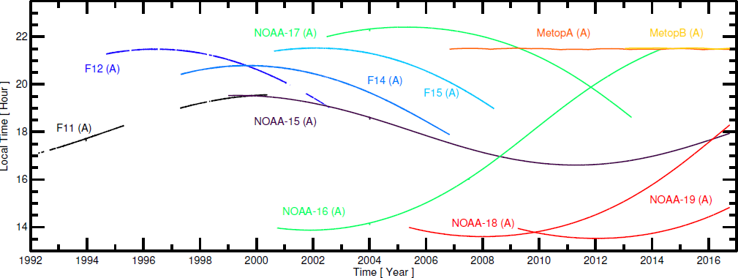
Results of the initial quality analysis
There are anomalies in the data, but there are sufficient stable periods to consider these data for extending the microwave humidity sounding data back in time before the start of AMSU-Bs;
(Right) Mean brightness temperatures corresponding to the warm counts during the warm target view of the instruments and (left) their standard deviations.
Equator crossing times of the ascending nodes of satellites carrying SSM/T-2, AMSU-B, and MHS.

Slide 4
Using re-analyses to assess the quality
After the initial quality analyses we provided the SSM/T-2 to ECMWF in netCDF format;
ECMWF used ERA-Interim profiles to to simulate SSM/T2 radiances;
Reanalysis fields are interpolated to observation location;
Temporal interpolation is not performed; instead, the reanalysis data that are closest in time are used;
RTTOV version 11.2 is used;
Surface emissivity is estimated with FASTEM-5 over sea, assumed to be 0.95 over land and 0.90 over sea ice;
About 10 days on ECMWF Linux cluster to compute the whole period.

Slide 5
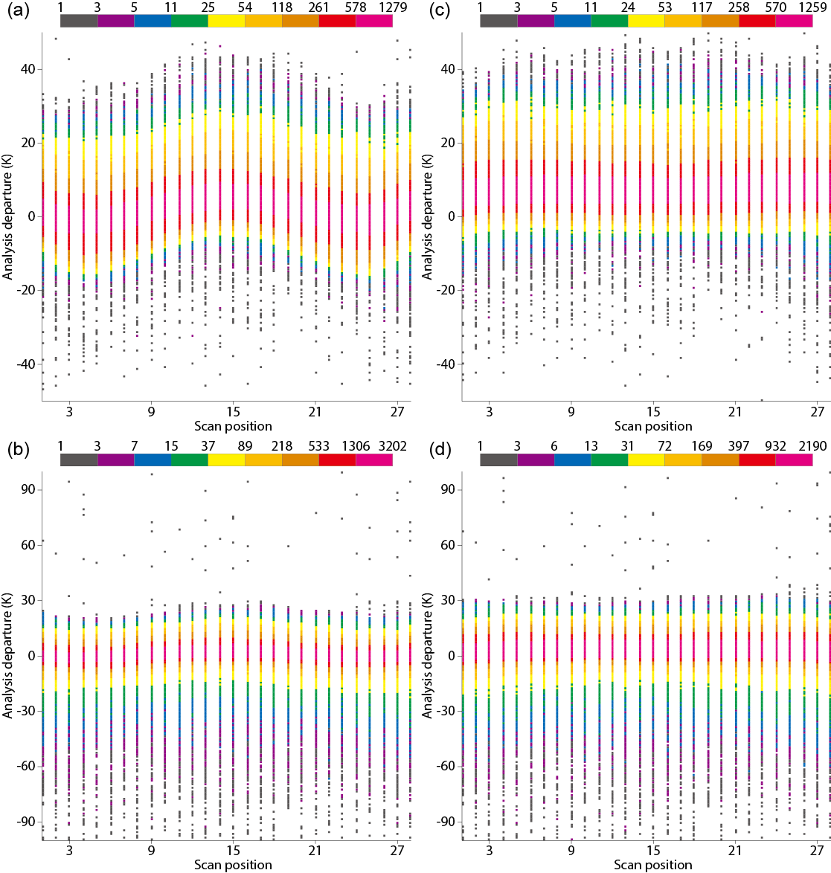
“Unspecified” polarisation Departures of window channels
Assuming
vertical at nadir
Assuming
horizontal at nadir
Channel 4
(91.655 GHz)
Channel 5
(150 GHz)
DMSP 12
20010101~
20010108
Over sea only

Slide 6
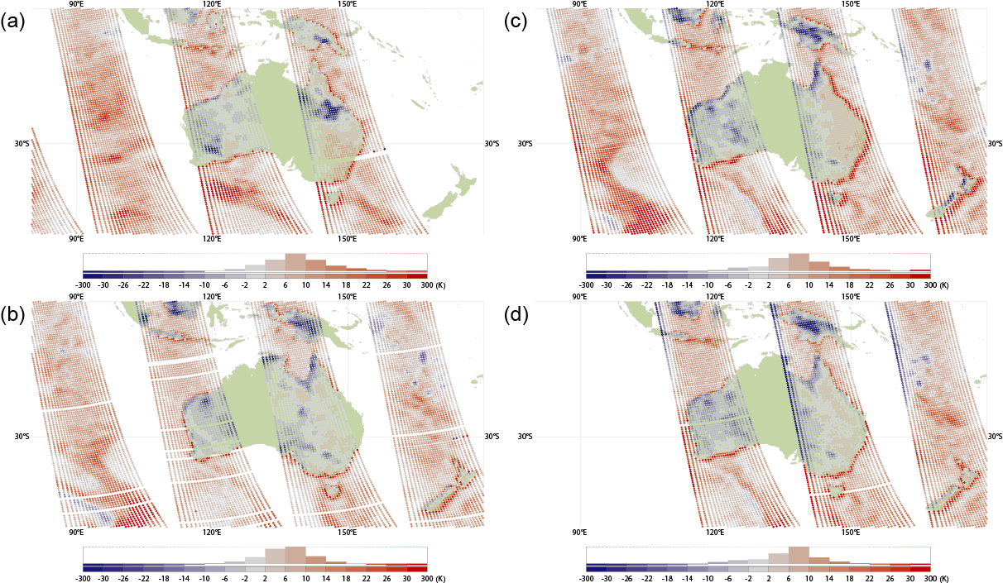
Geolocation error Departures of channel 4 (91.655 GHz)
DMSP 11, 19990103 12 UTC
DMSP 14, 20010103 12 UTC
DMSP 12, 20010103 12 UTC
DMSP 15, 20010103 12 UTC

Slide 7
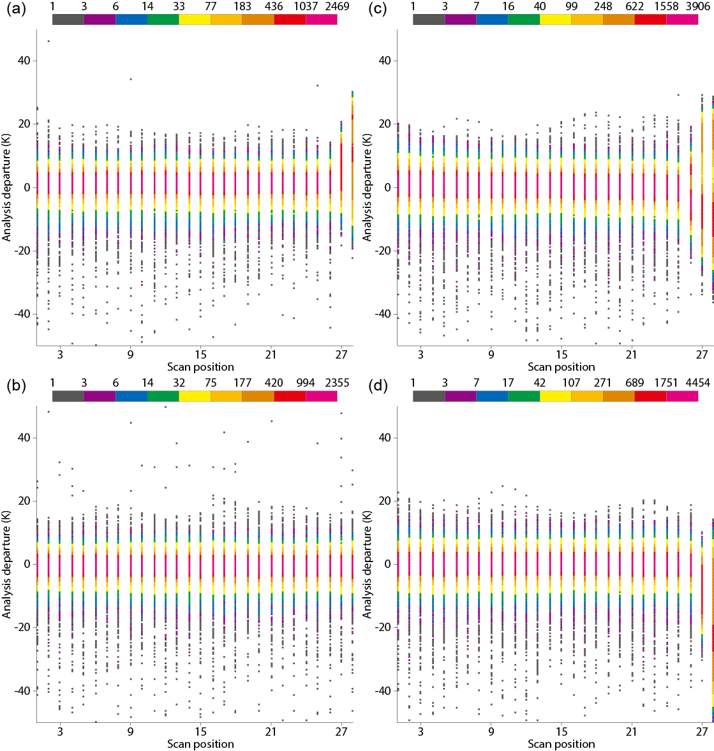
Scan angle dependent biases Departures of channel 2 (183.31±1 GHz)
DMSP 11
19990101~
19990108
Over sea only
DMSP 14
20010101~
20010108
Over sea only
#26-28 were contaminated by the glare obstruction bracket
DMSP 12
20010101~
20010108
Over sea only
DMSP 15
20010101~
20010108
Over sea only

Slide 8
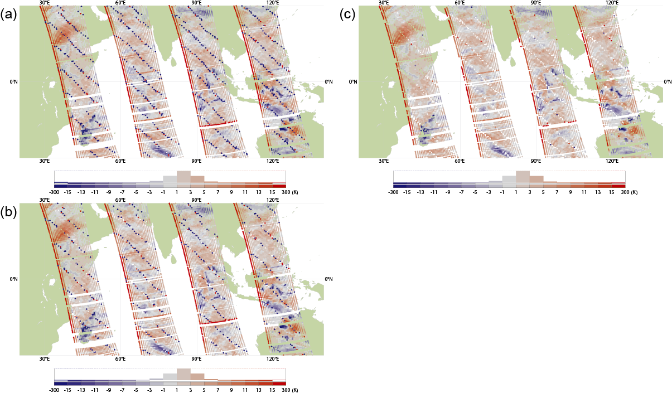
Poor quality data before 1994
All data
Quality flag and departure check (±20 K) applied
T_{b} (FOV, channel) array contains a cluster of several corrupted data approximately every 70 elements.
Additional QC such as departure check is essential to remove these poor quality data.
DMSP 11 channel 2, 19930105 12 UTC
Quality flag applied

Slide 9
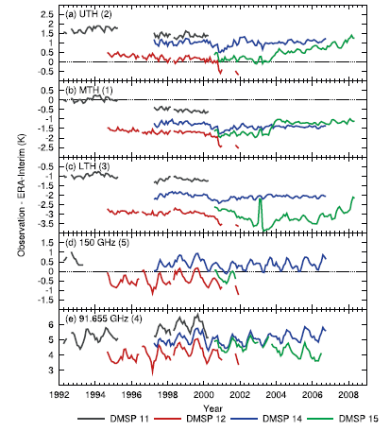
Recalibration of Meteosat Images
Fig: Monthly mean departures from the ERA-Interim analysis averaged over the tropical ocean clear-sky data.

Slide 10
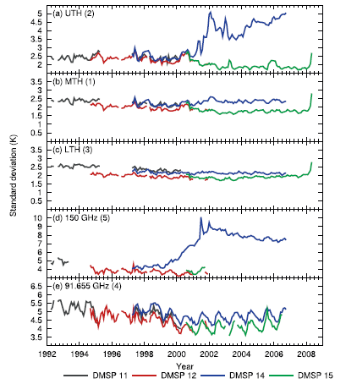
Recalibration of Meteosat Images
Fig: Monthly standard deviation of the departures from the ERA-Interim analysis (tropical ocean clear-sky data).

Slide 11
Summary
We have been working on assessing the quality of SSM/T-2 data using reanalysis products as a transfer;
Could identify issues with the data and inter-satellite biases;
The work of generating FCDR of microwave humidity sounders and deriving UTH from those is ongoing in the EUMETSAT’s CMSAF and EU Horizon2020 FIDUCEO projects
.

Slide 12
Thanks!

