Slide 1
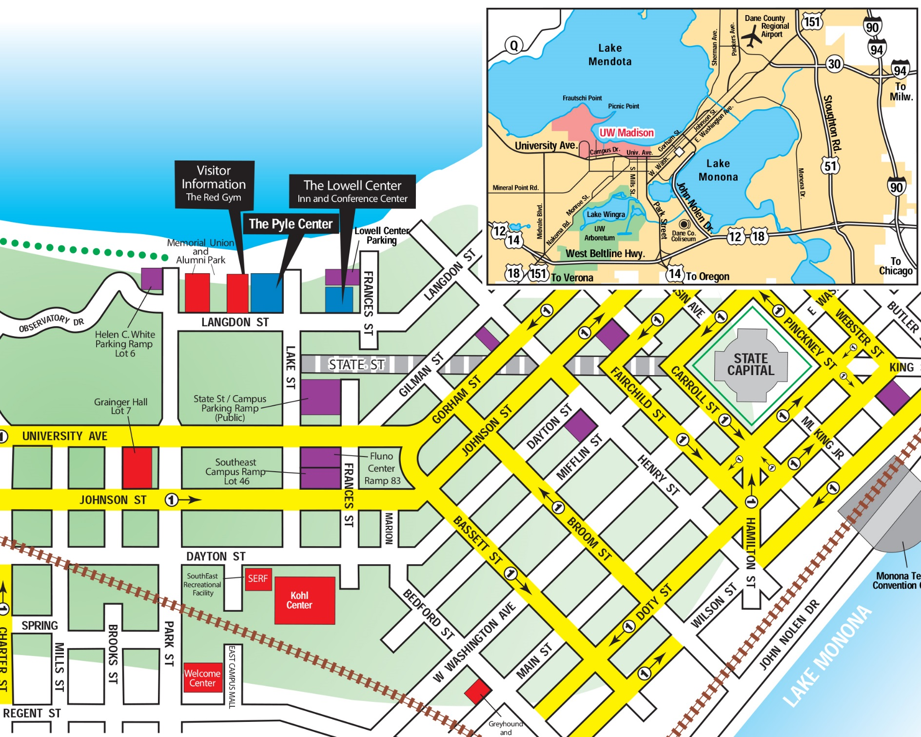
Orientation of Pyle Center
Concourse Hotel *
University Club *
Food carts
*Porta Bella

Slide 2
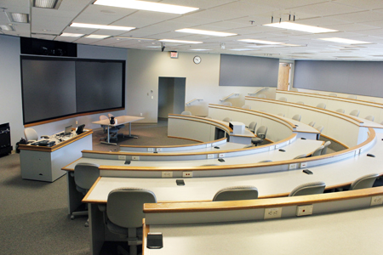
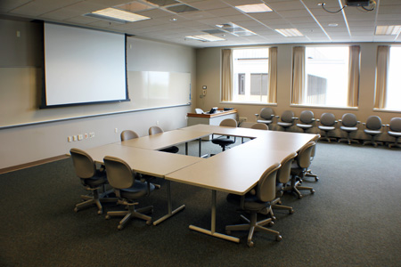
Meeting Facility: Pyle Center
3 rooms all week (+added breakouts for Wed & Thurs)
1) Tiered room (DE 335) 2) Breakout room (225) (225)
Rooms 225 & 325 set in a hollow square, maximum of 30 people.
Tiered room full AV support for $$ (audioconferencing, videoconferencing,
Webconferencing, webcasting and audio/visual streaming, digital media services (such as CD and DVD duplication, and editing and studio recording)

Slide 3
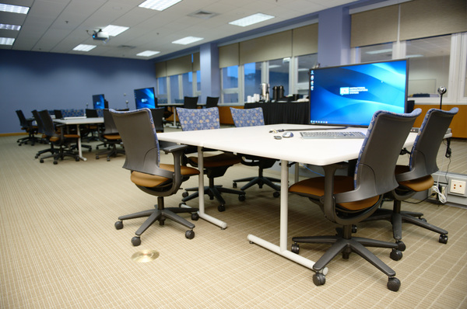
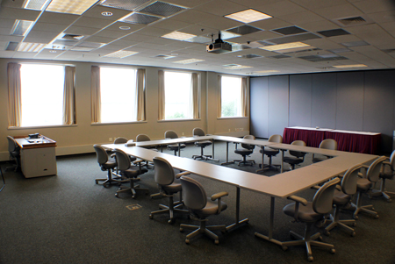
Meeting Facility: Pyle Center
3 rooms all week (+added breakouts for Wed & Thurs)
3) Poster room (209) 4) Breakout room (325)
Rooms 225 and 335 set in a hollow square, maximum of 30 people.
Tiered room full AV support for $$ (audioconferencing, videoconferencing,
Webconferencing, webcasting and audio/visual streaming, digital media services (such as CD and DVD duplication, and editing and studio recording)

Slide 4
Meal Logistics
Breakfast included with Lowell Center guest rooms
The Concourse Hotel has restaurants and a Starbucks (provides free shuttle for airport & campus)
Poster Reception Monday afternoon (5:30)
Cash bar
Coffee breaks (regular coffee and tea) – Cokes needed?
Lunches on own currently (see map)
Food Carts
Memorial Union
State Street Restaurants
Alternatively, can be arranged for $15/day@Pyle, if everyone pays: Buffet, box lunch, salads, sandwiches, or pizza
Working Group Dinner listed for Tuesday (see map)
Cash bar
University Club
Porta Bella

Slide 5
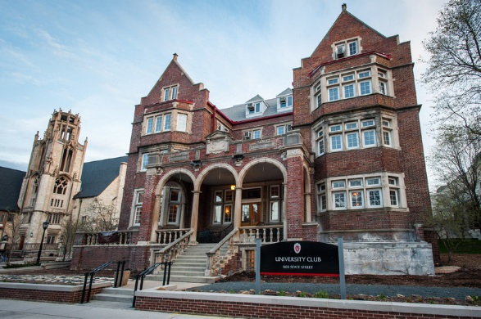
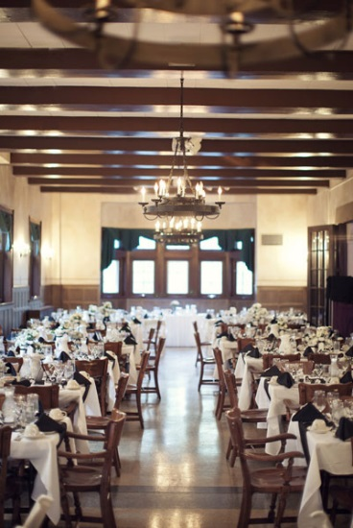
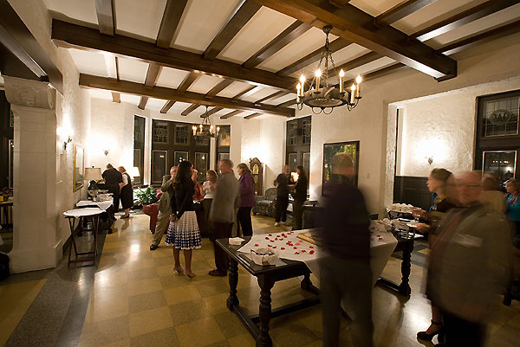
The University Club $38
6:00pm Cash Bar Opens
6:30pm Dinner Buffet Opens in Wayside Dining Room
Mixed Greens Garden Salad w/ Balsamic Vinaigrette
Standard Buffet
Chicken Florentine
Vegetarian Strudel
Chef's Choice Starch
Chef's Choice Vegetable
Bread Service
6:30 Dessert/Coffee Bar Opens in Foyer
Gallons of Coffee (Boom Brothers)
Hot Tea Station
Petit Dessert Buffet
Chef selection of finger sweets, includes bars, pastries, chocolate covered strawberries (prepped 2 pieces per person)

Slide 6
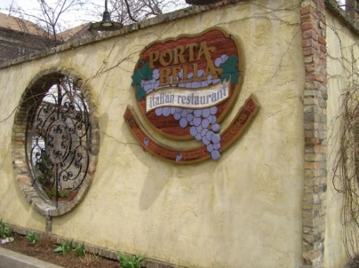
Porta Bella Restaurant ~$32
6:00pm Cash Bar Opens
6:30pm Dinner Buffet Opens in Mantova Room
Strawberry and almond salad
Standard Buffet (choose 1 of each)
Meat Filled Lasagna or Chicken Parmesan
Vegetarian Strudel or Manicotti
Bread Service
Beverage (coffee, tea, soda)
Tiramisu or Cannelloni

